Slide 1
The Large Intestine “The colon”
BY MBBSPPT.COM

Slide 2
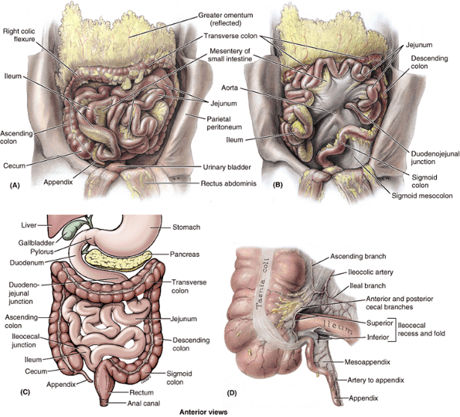

Slide 4
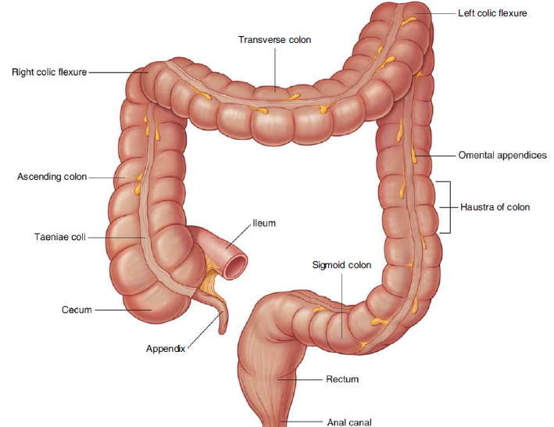

Slide 5
The colon
The colon (large intestine) is a distal part of the gastrointestinal tract, extending from the caecum to the anal canal.
Anatomically, the colon can be divided into four parts :–
Ascending:
Caecum,
Vermiform appendix,
Transverse,
Descending and
Sigmoid.
The colon averages 150cm in length.
The parts of the large intestine form a frame for the small intestine.

Slide 6
The large intestine
The large intestine can easily be distinguished from the small intestine by:
1. Taeniae coli, three thickened bands of longitudinal muscle.
2. The sacculation's of its walls between the taeniae, called haustra.
3. Appendices epiploic (omental appendages), the small pouches of omentum filled with fat.
4. Much greater caliber.

Slide 8
Three teniae coli
Thickened bands of smooth muscle representing most of the longitudinal coat.
These begin at the base of the appendix as the thick longitudinal layer of the appendix splits to form three bands.
The teniae run the length of the large intestine, merging again at the rectosigmoid junction into a continuous longitudinal layer around the rectum.
Because the teniae are shorter than the intestine, the colon becomes sacculated between the teniae, forming the haustra.
Dissector:
3 teniae one anterior two posteriomedial & posteriolateral.
In transeverse colon:
One anterior one posterior one superior

Slide 9
Appendix epiploica
Fat-filled pockets of peritoneum projecting from the visceral peritoneum on the surface of the large intestine
There are many appendices epiploic on the large intestine (except the rectum); also known as omental appendage.

Slide 10
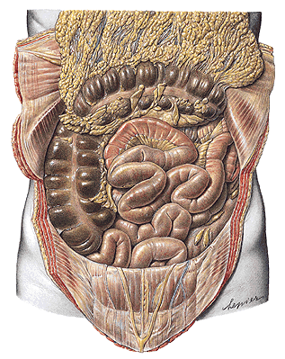

Slide 11
Haustra
Multiple pouches in the wall of the large intestine.
Haustra form where the longitudinal muscle layer of the wall of the large intestine is deficient; also known as: sacculations

Slide 12
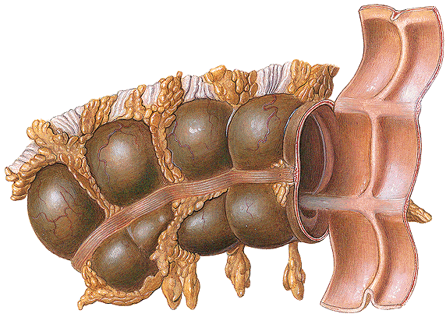

Slide 13
The Cecum
The sac-like caecum (L. caecus, blind) is the 1st part of the large intestine and is obviously continuous with the ascending colon.
The caecum is a broad blind pouch and is 5 to 7 cm in length.
It is located in the right lower quadrant, where it lies in the iliac fossa, inferior to the ascending colon.
The ileum opens into its superior part at the ileocaecal junction.
About 2.5 cm inferior to this, the vermiform appendix opens into its medial aspect.
Unlike the ascending colon above it, the cecum is intraperitoneal.
There is a cul-de-sac of the peritoneal cavity, called the retrocolic recess. This recess is often deep enough to admit a digit.
In 64% of people, the appendix lies in it.

Slide 14
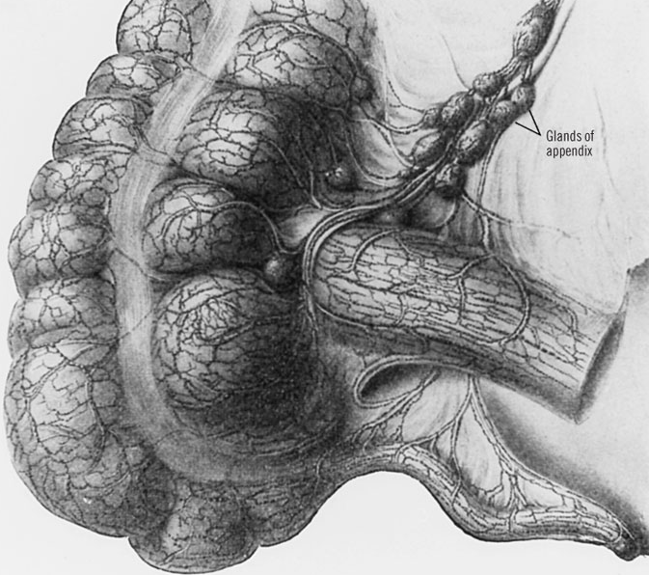

Slide 15
Ileocaecal orifice
The ileum enters the caecum obliquely, and partly invaginates into it, forming lips superior and inferior to the ileocaecal orifice.
These lips of the ileocaecal valve meet medially and laterally to form ridges, called the frenula of the ileocaecal valve.
However, the circular muscle is poorly developed in them and the ileocaecal valve has little sphincteric action.

Slide 16
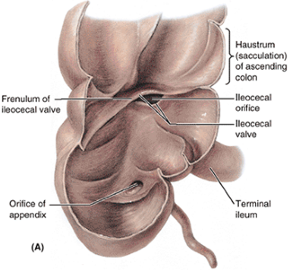

Slide 17
The Vermiform Appendix
This is a narrow, worm-shaped blind tube (L vermis, worm + forma, form).
It is variable in length, averaging 8 cm.
It joins the caecum about 2.5 cm inferior to the ileocaecal junction and is relatively longer in infants and children than in adults.
The appendix has its own short triangular mesentery, called the mesoappendix.This suspends it from the mesentery of the terminal ileum.
The position of the body of the appendix is variable: retrocaecal or retrocolic (65%), pelvic (31%), subcaecal (2.3%) and rarely anterior or posterior to the terminal ileum.
The base of the appendix is fairly constant and usually lies deep at the junction of the lateral and middle 1/3 of the line joining the ASIS and the umbilicus (McBurney's point).
The three taeniae coli of the caecum converge at the base of the appendix and form a complete outer longitudinal coat for it.

Slide 18
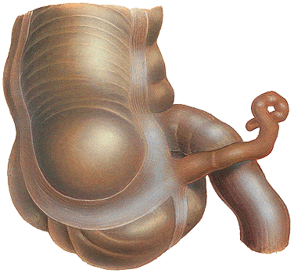

Slide 21
ASCENDING COLON
It is located in the right paracolic gutter and covered by the peritoneum on the front and sides, which binds it to the posterior abdominal wall.
Its posterior surface is located on 3 muscles:
Iliacus,
Quadratus lumborum,
Transversus abdominis.
During its course from the caecum to the undersurface of the liver, it crosses 3 nerves.
From below upward these are:
Lateral cutaneous nerve of thigh,
Ilioinguinal nerve, and
Iliohypogastric nerve.
Anteriorly it is related to the coils of the small bowel and right edge of the greater omentum.

Slide 22
Right colic flexure
Junction of the ascending colon and the transverse colon.
Right colic flexure lies anterior to the lower part of the right kidney and inferior to the right lobe of the liver; also known as: hepatic flexure.

Slide 23
TRANSVERSE COLON
It is the longest (20 inch/50 cm in length) and most mobile part of the large intestine.
It stretches from the right colic flexure (in right lumbar region) to the left colic flexure (in the left hypochondriac region).
Strictly speaking transverse colon isn’t transverse but creates a dependent loop in front of loops of small intestine between the left and right colic flexures.
The lowest point of loop generally goes up to the level of umbilicus but might occasionally extend into the pelvis. Therefore, the transverse colon is generally ‘U’ shaped

Slide 24
DIFFERENCES BETWEEN THE RIGHT TWO-THIRD AND LEFT ONE-THIRD OF THE TRANSVERSE COLON
Features | Right two-third of transverse colon | Left one-third of transverse colon
Development | From midgut | From hindgut
Arterial supply | Middle colic artery, a branch of superior mesenteric artery (artery of midgut) | Left colic artery, a branch of inferior mesenteric artery (artery of hindgut)
Nerve supply | By vagus nerves | By pelvic splanchnic nerves

Slide 25
Left colic flexure
Junction of the transverse colon and descending colon.
Left colic flexure lies anterior to the left kidney and inferior to the spleen; also known as: splenic flexure

Slide 26
DESCENDING COLON
The descending colon is longer (25 cm), narrower, and more deeply found than the ascending colon.
It goes from the left colic flexure to the very front of the left external iliac artery in the level of pelvic brim where it becomes continuous with the pelvic colon (sigmoid colon).
It’s covered by the peritoneum on the front and sides which fixes it in the left paracolic gutter and iliac fossa.

Slide 27
DESCENDING COLON
Its proximal part descends vertically downward from the left colic flexure to the left iliac fossa.
In this course it enters in front of 3 muscles and 3 nerves.
Quadratus lumborum,
Transversus abdominis, and
Iliacus.
The nerves are:
Iliohypogastric ,
Ilioinguinal , and
Lateral cutaneous nerve of the thigh.
Its distal part turns medially from the left iliac fossa to the very front of the left external iliac vessels.
In this course it enters in front of the femoral nerve, psoas major muscle, testicular vessels, genitofemoral nerve, and left external iliac vein.

Slide 28
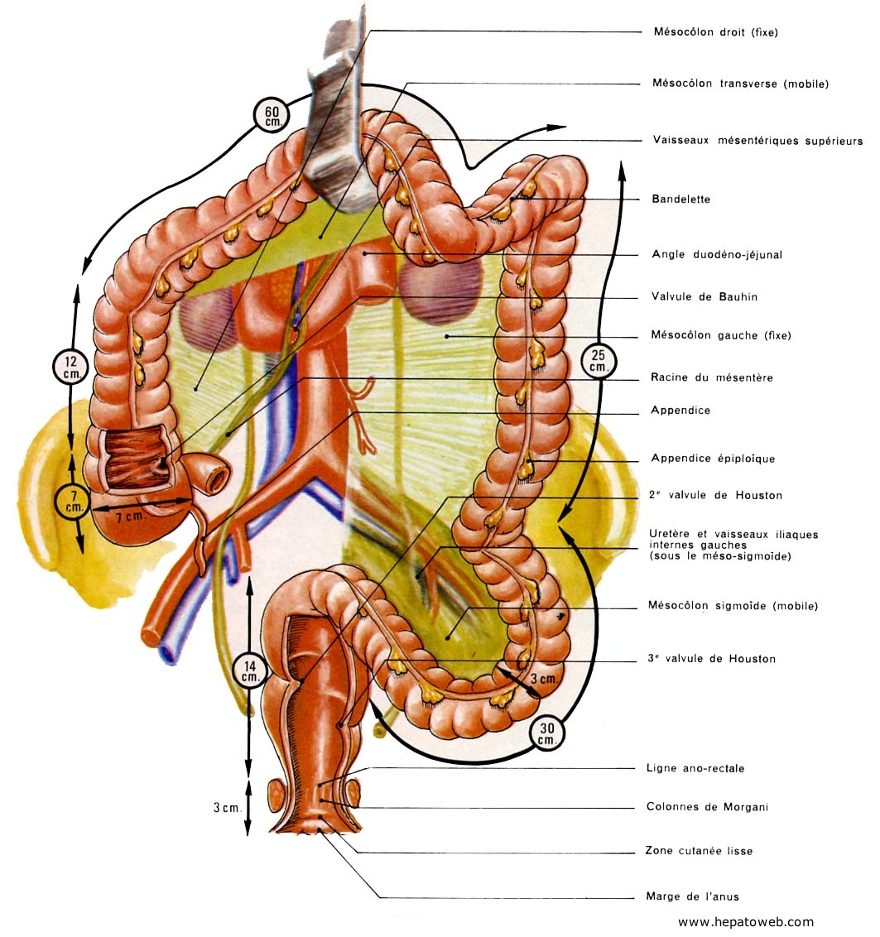

Slide 29
SIGMOID (PELVIC) MESOCOLON
The sigmoid colon is suspended from the pelvic wall by a large peritoneal fold termed sigmoid mesocolon. The sigmoid mesocolon has an inverted V shaped connection/ root.
The left limb: The left limb of the root is connected on the external iliac artery. It goes from the end of the descending colon to the middle of the common iliac artery. Here it turns sharply downward and to the right across the lesser pelvis to the 3rd section of the sacrum, creating the right limb.
The right limb is connected on the pelvic outermost layer of the sacrum. The meeting point of 2 limbs is termed apex. The people must remember these facts in connection to the apex of “A”.
Just lateral to the apex of the A, a pocket-like expansion of the peritoneal cavity enters upward posterior to the root of the mesocolon. It’s termed intersigmoid recess. The left ureter is located behind this recess.
The inferior mesenteric artery splits near the apex of A.
The superior rectal artery enters the right limb and sigmoidal arteries goes into the left limb

Slide 30
SIGMOID COLON (PELVIC COLON)
The sigmoid colon is around 15 inches (37.5 cm) long and attaches the descending colon with the rectum. It’s S shaped and therefore its name, sigmoid colon (G. Sigma = S-shaped alphabet).
It goes from the lower end of descending colon in the left pelvic inlet to the pelvic surface of the 3rd section of sacrum, where it becomes continuous with the rectum.
During its course it creates a sinuous loop which hangs free in the lesser pelvis. In the pelvis it is located in front of the bladder and uterus, below the loops of ileum.
The loop of sigmoid colon contains 3 parts:
first part runs downward in contact together with the left pelvic wall;
2nd part transverses the pelvic cavity horizontally between the bladder and the rectum in male (uterus and rectum in female); and
third part runs backward to get to the midline in front of third sacral vertebra.

Slide 31
Paracolic Gutters
The paracolic gutters are two spaces between the ascending/descending colon and the posterolateral abdominal wall.
These structures are clinically important, as they allow infective material that has been released from abdominal organs to accumulate elsewhere in the abdomen.

Slide 32
Anatomical Relations
 | Anterior | Posterior
Ascending colon | Small intestine Greater omentum Anterior abdominal wall | Iliacus and quadratus lumborum Right kidney Iliohypogastric and ilioinguinal nerves
Transverse colon | Greater omentum Anterior abdominal wall | Duodenum Head of the pancreas Jejunum and ileum
Descending colon | Small intestine Greater omentum Anterior abdominal wall | Iliacus and quadratus lumborum Left kidney Iliohypogastric and ilioinguinal nerves
Sigmoid colon | Urinary bladder Uterus (females only) upper vagina (females only) | Rectum Sacrum Ileum

Slide 33
Arterial Supply
As a general rule, midgut-derived structures are supplied by the superior mesenteric artery, and hindgut-derived structures by the inferior mesenteric artery.
The colon is supplied by the following arteries:
Ileocolic artery
Right colic artery
Middle colic artery
Left colic artery
Sigmoidal arteries.
Superior rectal artery

Slide 34
The supply of distinct parts of the colon
Ascending colon | The lower smaller part of the ascending colon is supplied by the ileocolic artery. its bigger upper part is supplied by the right colic artery.
Transverse colon | The right two-third of the transverse colon is supplied by the middle colic artery. The left one-third by the left colic artery.
Descending colon | The left colic artery.
Sigmoid colon | The sigmoidal branches of the inferior mesenteric artery and superior rectal artery

Slide 35
VENOUS DRAINAGE
The veins emptying the colon follow the arteries.
The veins accompanying the ileocolic, right colic, and middle colic arteries join the superior mesenteric vein, while the veins, accompanying the branches of inferior mesenteric artery, join the inferior mesenteric vein. The superior and inferior mesenteric veins ultimately drain into the portal vein flow.

Slide 36
The lymphatic drainage
The lymphatic drainage of the colon is medically very essential because carcinoma of the colon propagates via lymphatic route.
There are numerous colic lymph nodes, which drain the lymph from the colon. These nodes have common routine of distribution.
Epiploic nodes, are small nodules and are located on the wall of the colon.
Paracolic nodes, is located quite close to the marginal artery (of Drummond), i.e., along the medial edges of the ascending and descending colons and along the mesenteric edges of transverse and sigmoid colons.
Intermediate colic nodes, is located along the ileocolic, right colic, middle colic and left colic, arteries, and drain into terminal nodes.

Slide 37
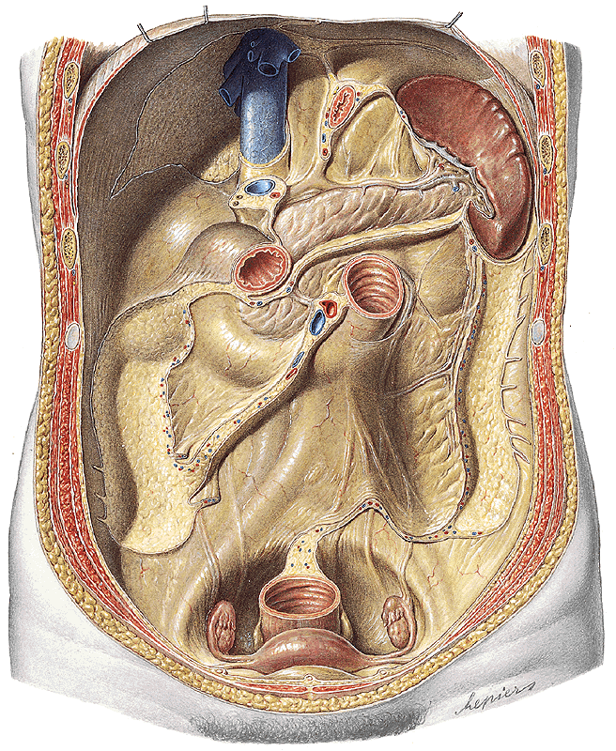

Slide 38
Congenital Megacolon/Hirschsprung Disease
It happens when neural crest cells don’t migrate and create the myenteric plexus (parasympathetic ganglia) in the sigmoid colon and rectum during embryonic development.
This state ends in absence of peristalsis. Consequently the normal proximal colon becomes grossly dilated because of the fecal retention causing abdominal distension.
The constricted section normally corresponds to rectosigmoid junction.

Slide 39
Cancer (Carcinoma) of Colon
Cancer of colon (really large intestine) is a top cause of death in the Western world.
Comparatively common in those who are above 50 years old and nonvegetarian.
Slow growing tumor and causes constriction of the colon.
In advanced cases, it spreads to the liver via portal vein circulation. If diagnosed early, hemicolectomy (partial resection of the colon) is carried out to heal the patient.

Slide 40
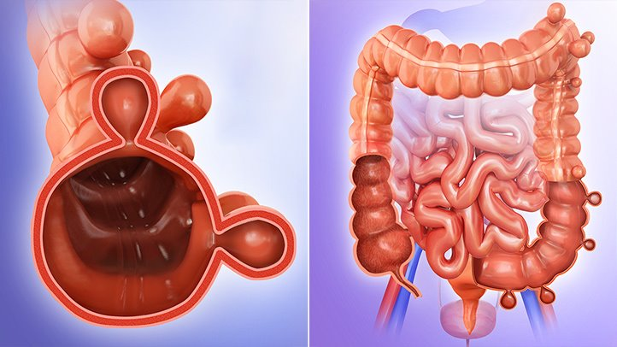
Diverticulosis
The diverticulosis includes the herniation of the lining mucosa via the circular muscle between the teniae coli.
The herniation takes place where the circular muscle coat is the feeblest, i.e., where it is pierced by the blood vessels.
The inflammation of diverticula is named diverticulitis

Slide 41
Volvulus
It’s a clinical illness, where a portion of gut rotates (clockwise/anticlockwise) on the axis of its mesentery. It typically happens because of adhesion of antimesenteric border of the gut to the parietes or some other viscera. It might correct itself spontaneously or the rotation may continue until the blood supply of the gut is cut off leading to ischemia. The sigmoid colon is susceptible to volvulus due to extreme freedom of its mesentery- the pelvic mesocolon.

Slide 42
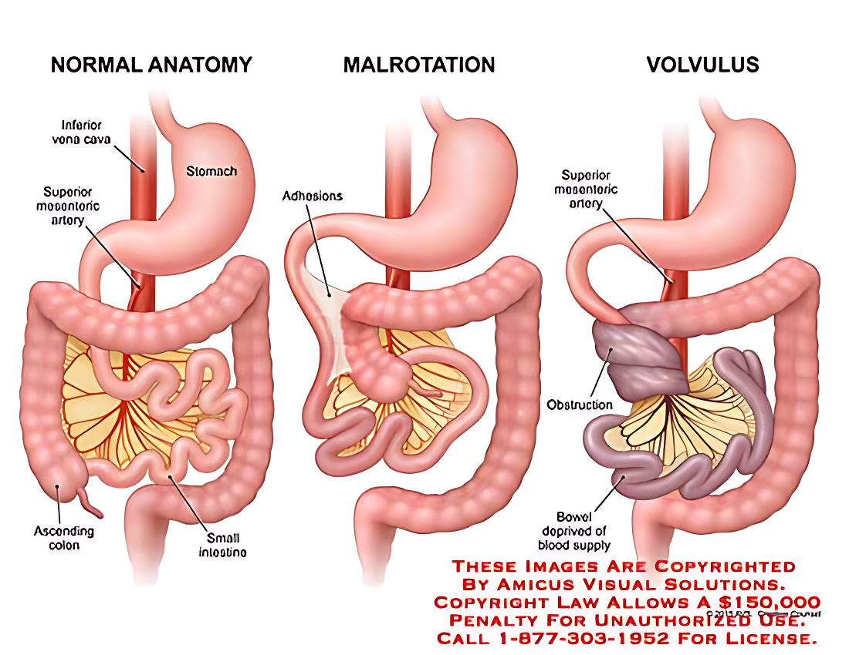

Slide 43
Intussusception:
It is a clinical condition where a proximal section of the bowel invaginates into the lumen of an adjoining distal section.
This might cut off the blood supply to the bowel and cause gangrene.
The different forms of intussusception are ileoileal, ileocaecal, and colocolic.
The ileocaecal intussusception is the most typical form.

Slide 44
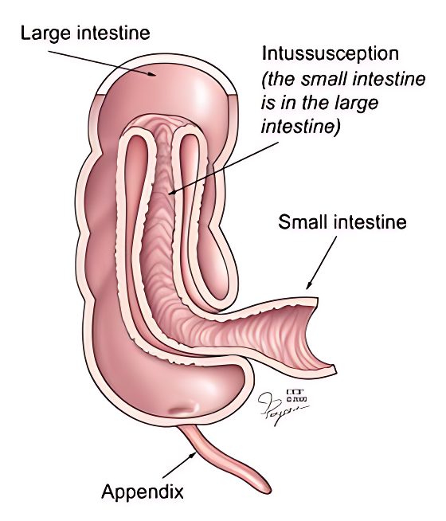

Slide 45
Appendicitis
Appendicitis is acute inflammation of the appendix, and is the most common cause for acute, severe abdominal pain. The abdomen is most tender at McBurney’s point – one third of the distance from the right anterior superior iliac spine to the umbilicus. This corresponds to the location of the base of the appendix.
Initially, the appendicitis causes a vague pain in the periumbilical region. As the appendix swells, it irritates the parietal peritoneum, and causes severe pain in the right lower quadrant.
If the appendix is not removed, it can become necrotic and rupture, resulting in peritonitis (inflammation of the peritoneum).

Slide 46
THANK YOU!

