Slide 1
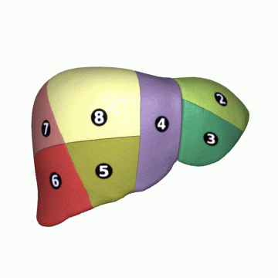
LIVER ANATOMY

Slide 2
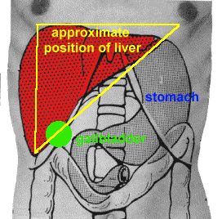
LEARNING OBJECTIVES
Introduction
Functions
Surface anatomy
External features
Internal features
Peritoneal relations
Blood supply
Innervation
Applied aspects

Slide 3
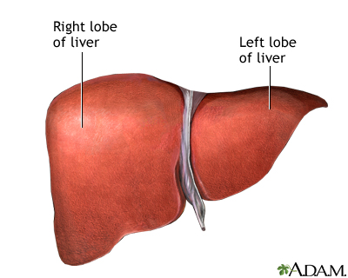
INTRODUCTION
Largest Gland
Foregut derivative
Location- Extends from right upper quadrant to left upper quadrant of abdomen
Shape- Wedge, four sided pyramid laid on one side
Weight- 1.6 kg in males & 1.3kg (females)
Colour- Red - Brown

Slide 4
CONTD…
Weight-
- At birth: 150 g.
- In males: 1.4 to 1.8 kg.
- In females: 1.2 to 1.4 kg.
Proportional weight-
- Newborn: 5% of body weight
- Adult: 2.5% of body wt
Attached to diaphragm by:
- Falciform & coronary ligaments
- Left & right triangular ligaments

Slide 5
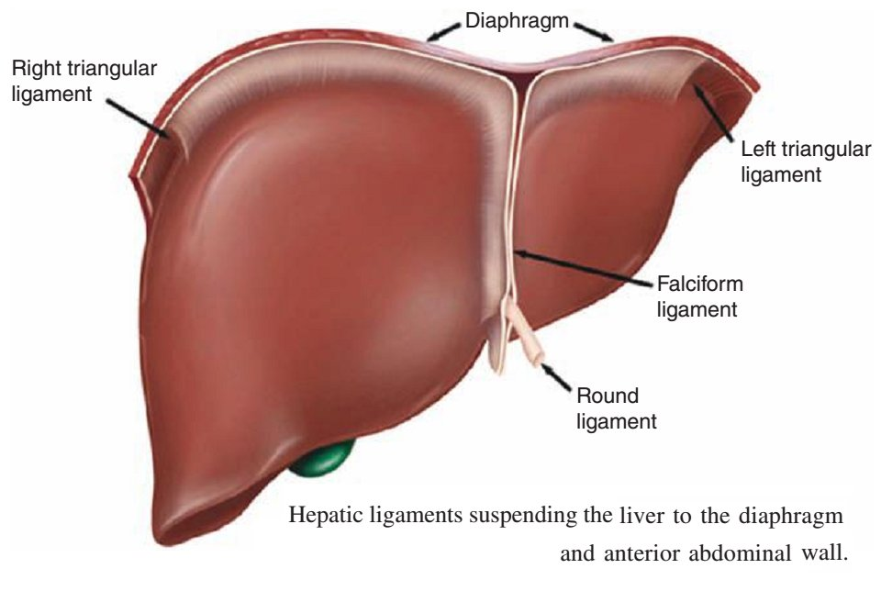
LIGAMENTS OF LIVER
1. False ligaments
Lesser omentum
Falciform ligament
Coronary ligaments
Triangular ligaments
2. True ligaments
Round ligament of the liver
Ligamentum venosum

Slide 6
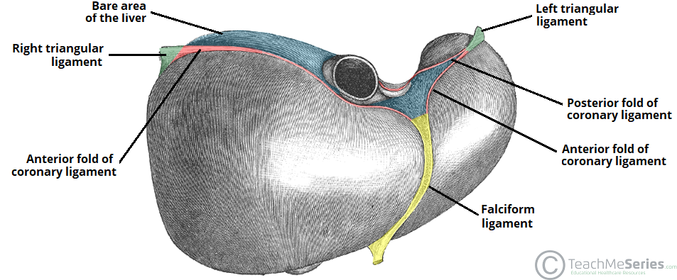

Slide 7
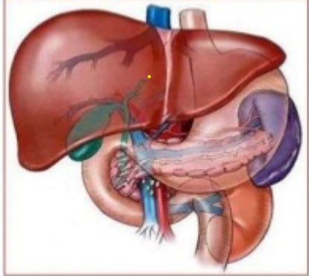
FUNCTIONS
Bile production & secretion
Detoxification
Storage of glycogen
Protein synthesis
Production of heparin & bile pigments
Erythropoiesis (in fetus)- occupies 2/5th of abdomen
Note: Liver is much larger in newborn & young children due to its Hemopoietic function in fetal life, & occupies 2/5th of the abdomen

Slide 8
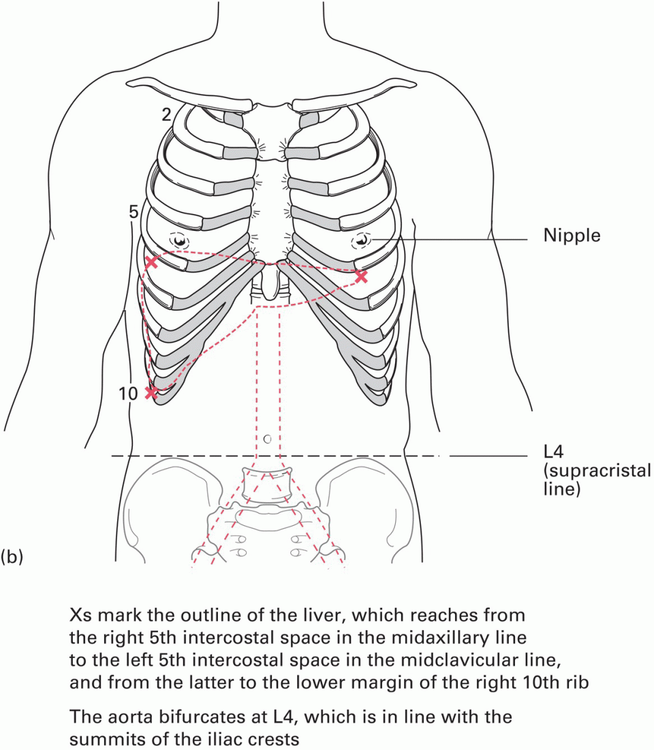
SURFACE ANATOMY

Slide 9
SURFACES
Diaphragmatic surface:
Smooth & dome-shaped surface
Superior surface
Anterior surface
Right lateral surface
Inferior to diaphragm
Posterior surface
Separated from diaphragm by subphrenic recess & from posterior organs {kidney & suprarenal glands} by hepatorenal recess

Slide 10
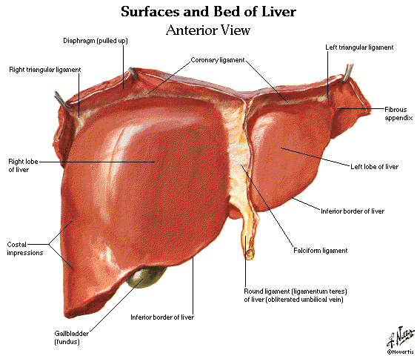
Ligaments:
Ligamentum teres hepatis -
obliterated umbilical vein
Falciform hepatic ligament
(attachment to peritoneum
of anterior abdominal wall)
- Coronary hepatic ligament
- Triangular hepatic ligament
10

Slide 11
VISCERAL SURFACE
Covered by visceral peritoneum except porta hepatis & gall bladder bed
Inferior surface
Visceral surface is related to:
Right side of stomach i.e. Gastric & pyloric areas
Superior part of duodenum
i.e. duodenal area
Lesser omentum
Gall bladder
Right colic flexor & right
transverse area- colic area
Right kidney & suprarenal
gland; Renal area

Slide 12
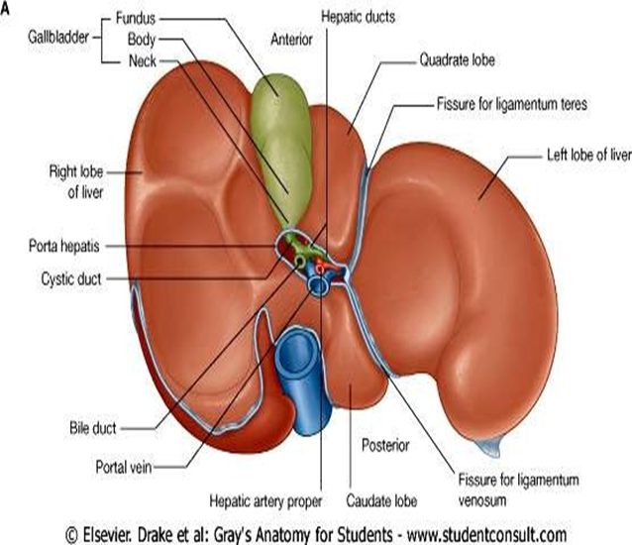
Visceral surface ‘H’
Cross-bar of H = Porta hepatis
- Hepatic artery, Portal vein, Bile ducts,
Nerves and Lymphatic vessels
Left inferior of H = Ligamentum teres hepatis or round ligament of liver
(Remnant of umbilical vein)
c. Left superior of H = Ligamentum
venosum (Remnant of ductus
venosus)
d. Rt. inferior of H = Gall bladder
e. Rt. superior of H = Inferior vena cava

Slide 13
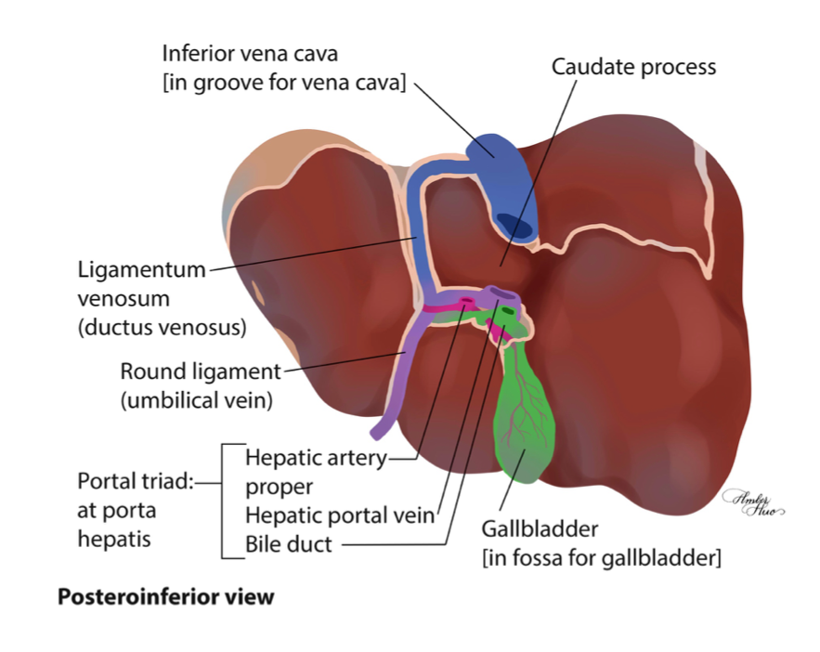

Slide 14
POSTERIOR VIEW

Slide 15
LIVER LOBES
Right and left lobe
Functionally independent
i.e. each with own blood
& nerve supply
Blood supply by:
Hepatic artery
Portal vein
Blood out through:
Veins &
Biliary drainage

Slide 16
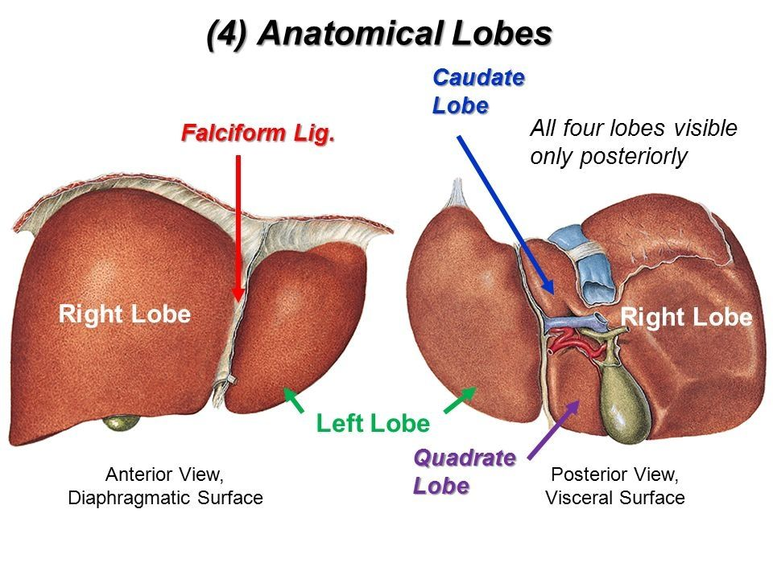

Slide 17
Liver lobes
Right lobe Demarcated by :
Gall bladder fossa
Inferior vena cava fossa
Imaginary line from fundus of gall bladder & inferior vena cava

Slide 18
Left lobe
Divided into:
Medial & lateral segments
Medial superior - Caudate lobe
Medial inferior - Quadrate lobe

Slide 19
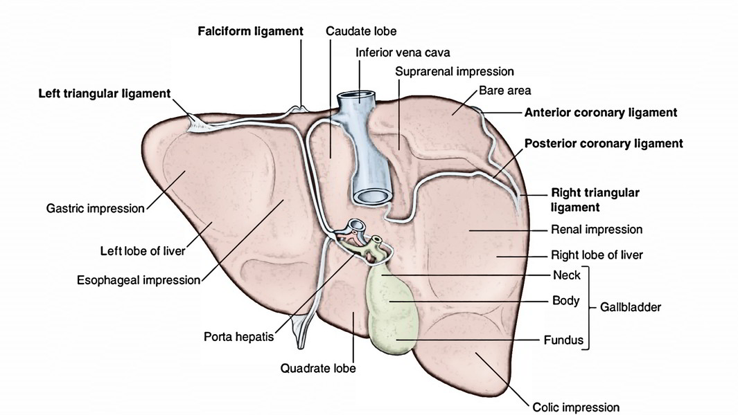
VISCERAL SURFACE
LOBES :
Lobus dexter – right lobe
l. sinister – left l.
l. caudatus – caudate l.
l. quadratus – quadrate l.

Slide 20
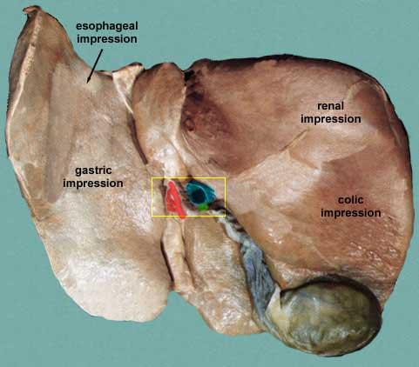
IMPRINTS OF SURROUNDING ORGANS
Right lobe-
duodenum, right kidney and suprarenal gland,
right colic flexure
Left lobe -
Stomach
oesophagus

Slide 21
Caudate Lobe: post. Surface
Rt. – Groove fr IVC
Lt.- Fissure fr Lig. Ven.
Inf.- Porta hepatis
Quadrate Lobe: Inf. Surface
Ant. – Inf. Border
Post.- Porta hepatis
Rt.-fossa fr G.B.
Lt.- Fissure fr Lig. Teres
PORTA
HEPATIS

Slide 22
Caudate Lobe: posterior Surface
Right - Groove for IVC
Left - Fissure for Lig. Ven.
Inferior - Porta hepatis
Quadrate Lobe: Inferior surface
Anterior - Inferior Border
Posterior - Porta hepatis
Right - fossa for Gall bladder
Left - fissure for Lig. teres

Slide 23
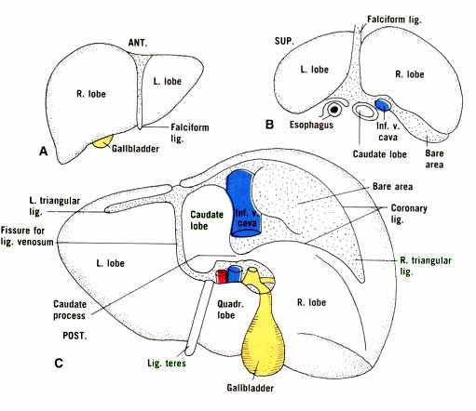

Slide 24
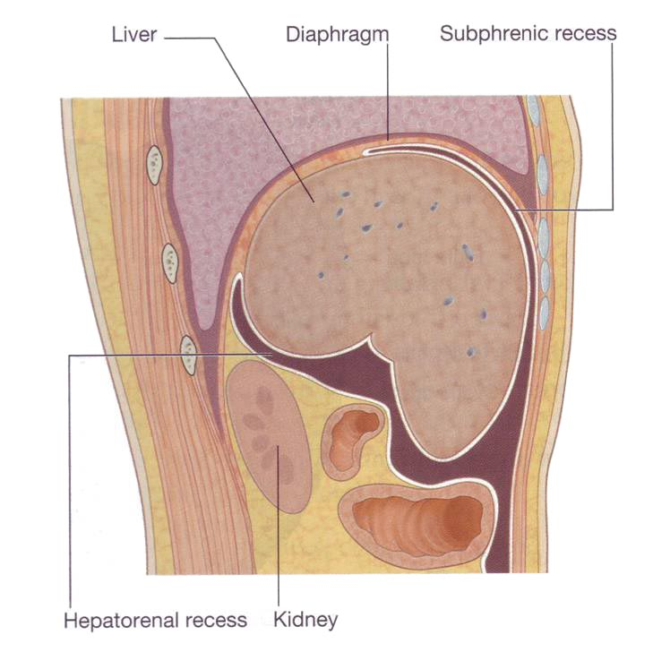
Parasagittal section through liver
Showing subphrenic recess and hepatorenal recess
(Rutherford-Morison pouch)

Slide 25
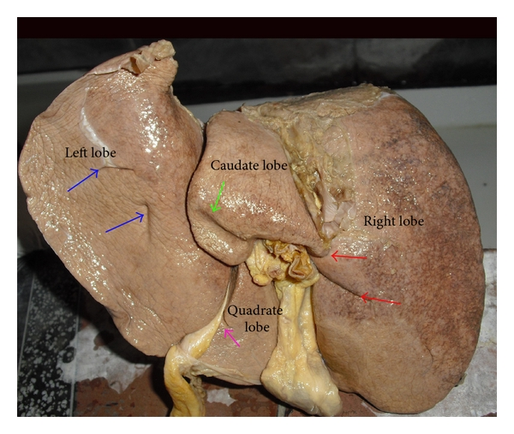
Left lobe cont…
Lateral segment is separated from the medial segments by:
On visceral surface:
fissure of ligamentum teres (round ligament)
fissure of ligamentum
venosum
On diaphragmatic surface:
attachment of falciform
ligament

Slide 26
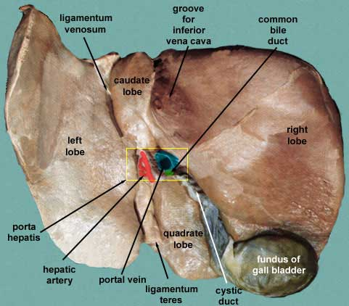
Visceral Surface
Round ligament(ligamentum teres) – obliterated umbilical vein
Ligamentum venosum – fibrous remnant of fetal ductus vein
Porta hepatis (hepatic potal: portal fissure) - transverse fissure on the visceral surface of liver.
It gives passage to the:
Portal vein
Hepatic artery
Hepatic nerve plexus
Hepatic ducts
Lymphatic vessels

Slide 27
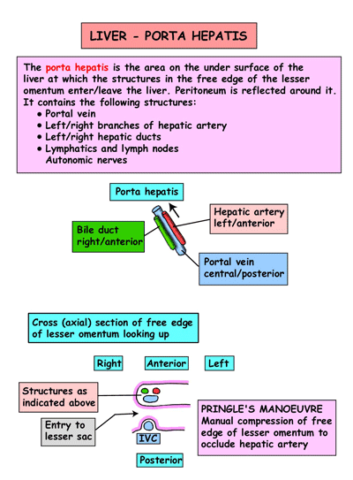

Slide 28
PORTA HEPATIS - hepatic triad
Inf. Surface
Deep ,Transverse fissure, 5 cm long.
Between Caudate l. & Quadrate l.
PORTAL VEIN
PROPER HEPATIC ARTERY (branch of common HA)
Hepatic plexus of nerves
RIGHT and LEFT HEPATIC DUCT
- lymphatics, - vegetative nerve

Slide 29
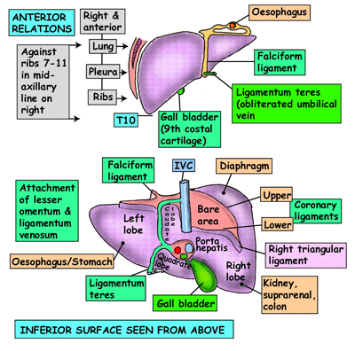

Slide 30
INTERNAL FEATURES
Liver is composed of hexagonal shaped units- lobules
Radiate from central vein to the periphery
Between the rows of hepatocytes are sinusoids which supply blood

Slide 32
PORTAL TRIAD
Branches of portal vein, hepatic artery and the biliary ducts bound together in the perivascular fibrous capsule

Slide 33
PERITONEAL RELATIONS
Lesser omentum
Encloses portal triad (bile duct, hepatic artery and portal vein)
Passes from liver to lesser curvature of stomach + 1st inch of first part of duodenum.
duodenum
Thick free edge -- hepatoduodenal ligament
Sheet like remainder – hepatogastric ligament

Slide 34
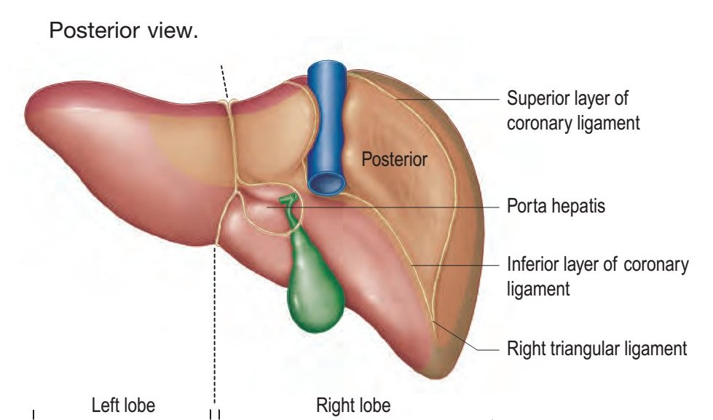
CONTD…
Posterior Surface-
Bare area- Diaphragm & Rt.
Suprarenal gland
Groove for IVC.
Caudate lobe- crura of
diaphragm, Inf. Phrenic art. &
Coeliac trunk
Fissure for lig. Venosum
Post. Surf of lt. lobe is maked
by oesophageal impression.

Slide 35
Bare areas of the liver
peritoneum
b/t Ant. & Post. Coronary ligaments
Fossa for gall bladder
Porta hepatis
Fissure for Lesser omentum
Fissure for ligamentum venosum
Fossa for IVC

Slide 37
Intraparenchymal branches of right division of portal vein (portal) -> retroperitoneal veins (systemic)

Slide 38
COUINAUD SEGMENTS
Segments I, II, III and IV make up the functional left lobe
Segments V, VI, VII and VIII make up the functional right lobe
Segment I corresponds to the gross anatomical caudate
lobe and segment IV to the quadrate lobe

Slide 39
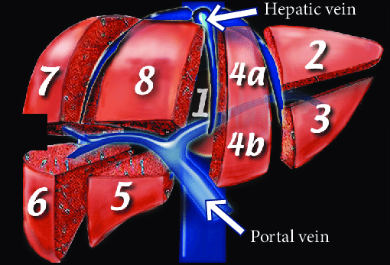

Slide 40
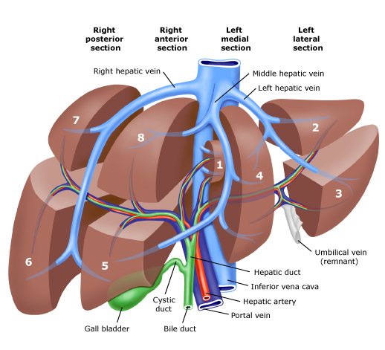

Slide 41
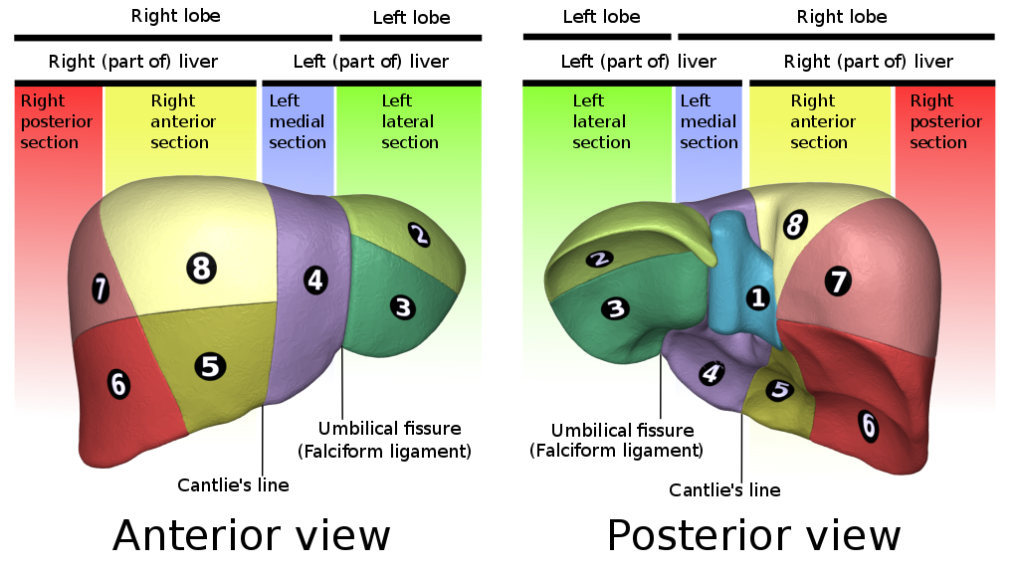
COUINAUD SEGMENTS

Slide 42
FUNCTIONAL LOBES

Slide 43
FUNCTIONAL LOBES

Slide 44
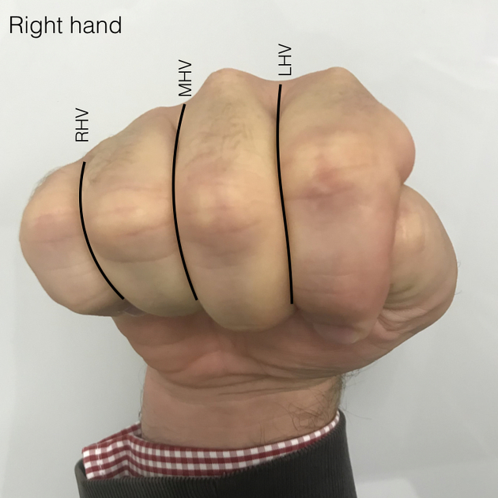

Slide 45
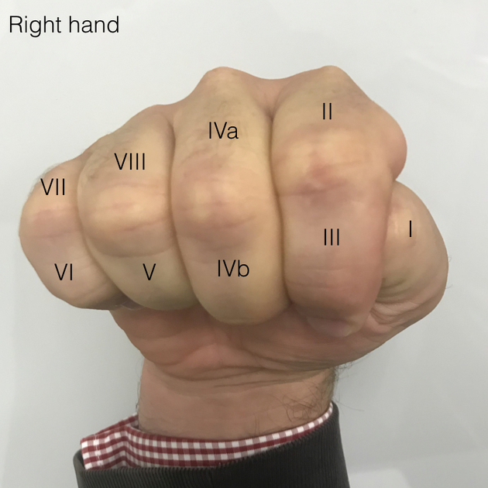

Slide 46
BLOOD SUPPLY
Rt. & Lt. hepatic arteries carry oxygenated blood (25%).
Portal vein (valveless) carries venous blood (75%) rich in nutrients.
Hepatic veins drain venous blood to IVC.
Right & left branches -> segmental vessels -> Interlobular – Hepatic sinusoids. Mixes
Venous Drainage- Hepatic sinusoids- interlobular + sublobular veins + Hepatic veins IVC

Slide 47
CONTD….
Hepatic Veins (Right, Middle, Left)
Interlobular veins
Central Vein
Portal Venules Hepatic Arterioles
IVC
Heart
Aorta
Hepatic Artery
Spleen
Splenic Vein
Portal Vein
Messenteric Vein
Intestine

Slide 48
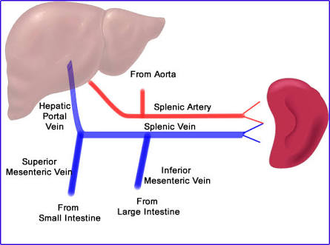

Slide 49
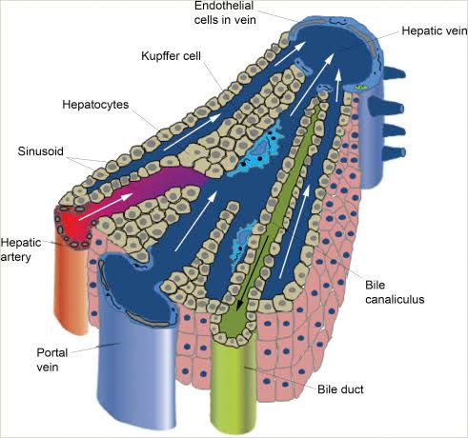
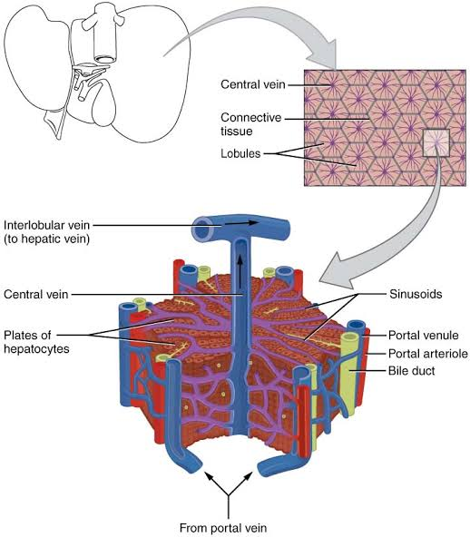
VENOUS DRAINAGE

Slide 50
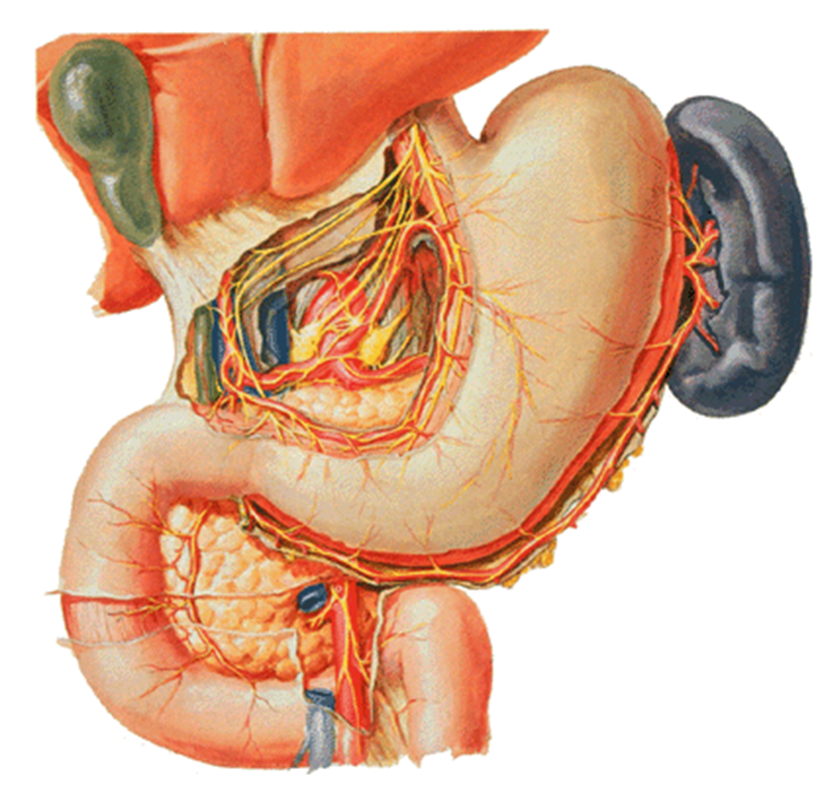
NERVE SUPPLY
Hepatic plexus contains sympathetic & parasympathetic or vagal fibers
Nerve also reach liver various peritoneal ligaments
Capsule is supplied by some fine branches of the lower intercostal nerves, which also supply parietal peritoneum
Particularly in the area of the 'bare area' & superior surface
This is seen clinically when distension or disruption of liver capsule causes quite well localized sharp pain

Slide 51
Hepatic plexus is the largest derivative of the coeliac plexus.
It also receives branches from the anterior and posterior vagi.
These branches not only supply vasomotor fibres to the hepatic vessels and biliary tree, but also innervate the hepatocytes directly and are involved in the control of some homeostatic mechanisms.
Vagal fibres are motor to the musculature of gallbladder and bile ducts & inhibitory to the sphincter of bile duct.

Slide 52
REFERRED PAIN
Pain arising from the parenchyma of liver is poorly localized
In common with other structures of foregut origin, pain is referred to the central epigastrium
Stretch of or involvement of the liver capsule by inflammatory or neoplastic processes rapidly produces well-localized pain of a 'somatic' nature

Slide 53
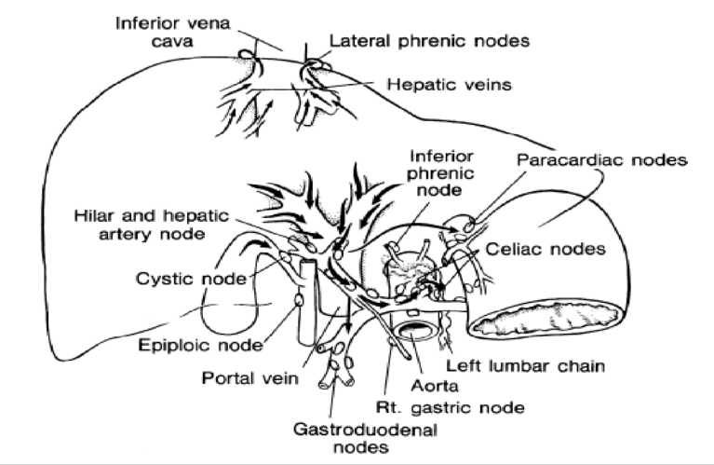
LYMPHATIC DRAINAGE
Liver is a major lymph-producing organ
(1/4 -1/2 of lymph → Thoracic duct)
Diaphragmatic surface of liver drains to Phrenic nodes
Visceral surface & deep lymphatics along portal triads drains to Porta Hepatis → Hepatic nodes → Coeliac nodes → Cisterna chyli → Thoracic duct

Slide 54
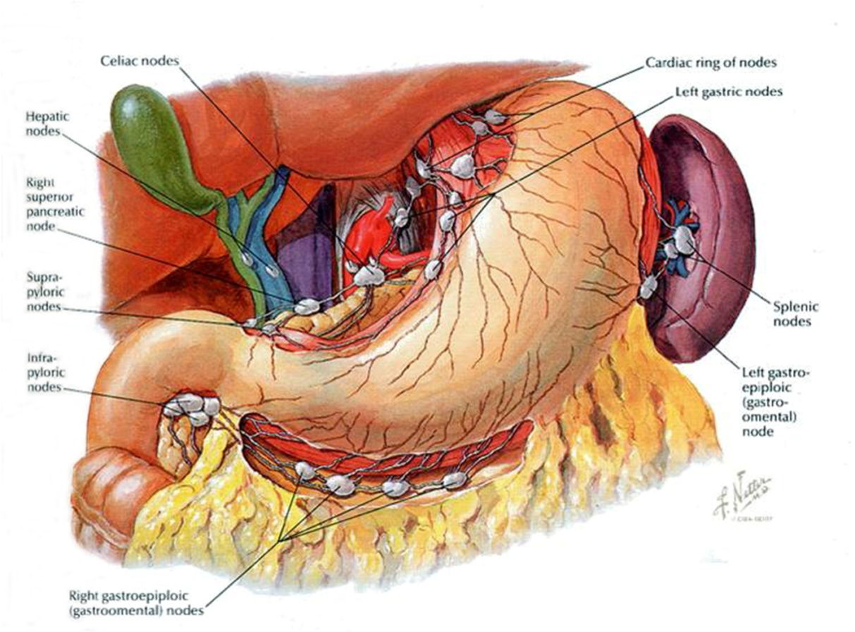

Slide 55
HEPATITIS
Inflammation of liver due to viral infections
Causes- viral infection, autoimmune hepatitis , drugs, toxins, & alcohol
Types –
hepatitis A
hepatitis B
hepatitis C
hepatitis D
hepatitis E

Slide 56
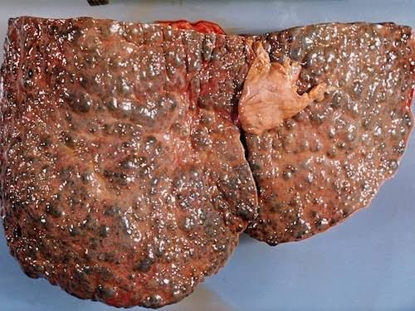
LIVER CIRRHOSIS
Cirrhosis is scarring (fibrosis) of the liver caused by long-term liver damage. The scar tissue prevents the liver working properly
SYMPTOMS:
Early symptoms- asymptomatic
- Non specific (weight loss, weakness & fatigue
Later – jaundice
- Ascites
- Hepatic encephalopathy

Slide 57
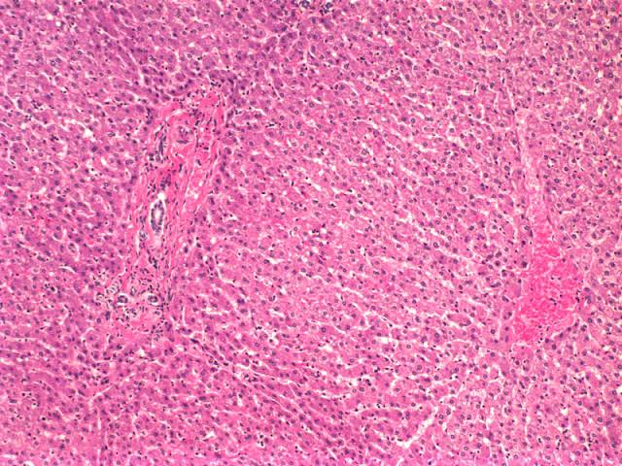
NORMAL LIVER
LIVER CIRRHOSIS

Slide 58
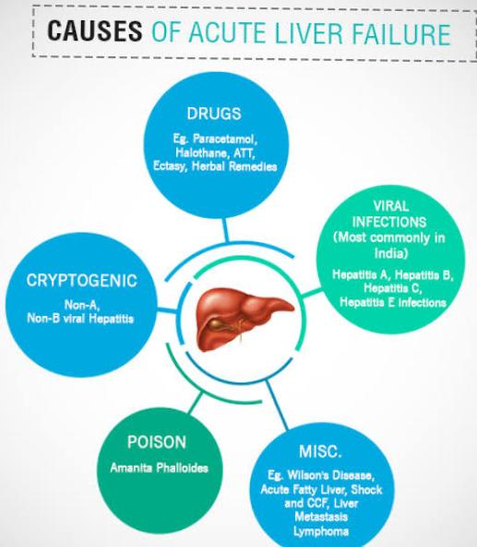
ACUTE LIVER FAILURE
Rapid deterioration of liver function, without known pre existing disease

Slide 59
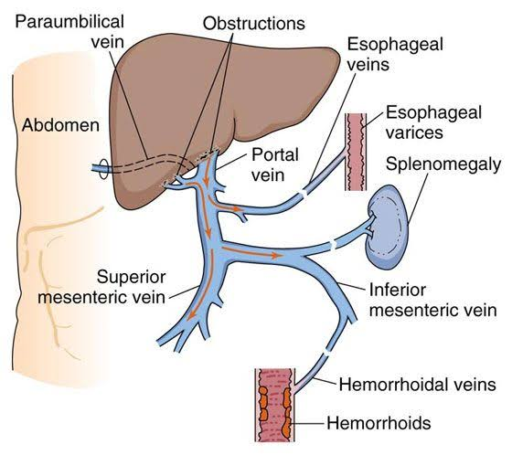
PORTAL HYPERTENSION
Portal vein provides about 75% of the liver's blood flow & about 60% of its O₂ supply
Normal portal pressure is 5-10 mmHg (7-14 cm H₂O), which exceeds inferior vena caval pressure by 4-5 mm Hg (portal venous gradient)
Higher values are defined as portal hypertension

Slide 61
CALOT’S TRIANGLE
The borders are as follows:
Medial – common hepatic duct.
Inferior – cystic duct.
Superior – inferior surface of the liver.
Contents
Right hepatic artery
Cystic artery
Lymph node of Lund – the first lymph node of the gallbladder.
Lymphatics

Slide 62
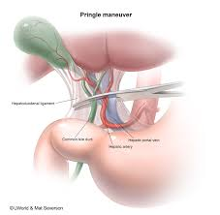
PRINGLE’S MANEUVER

Slide 63
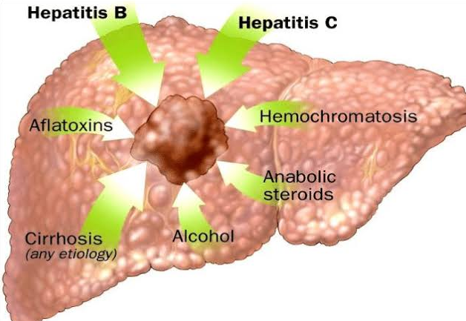
HEPATOCELLULAR CARCINOMA
Cancer that starts in liver
Diagnosis:
- Blood test (alpha fetoprotein)
- Imaging test- CT-scan,MRI, X-ray
- Liver biopsy
Treatment:
Radiation, Chemotherapy, Immunotherapy ,Liver transplant

Slide 64
THANK YOU

