Slide 1
LUNG ANATOMY
BY MBBSPPT.COM

Slide 2
INTRODUCTION
1. Lungs are a pair of respiratory organs situated in the thoracic cavity.
2. Each lung innervates the corresponding pleural cavity
3. In the young ,lungs are brown or grey in color. Gradually, they become mottled black because of the deposition of inhaled carbon particles
4. The right lung weighs about 700g.It is about 50-100g heavier than the left lung.

Slide 3
FEATURES
1. Each lung is conical in shape
2. It has
Apex at the upper end
Base resting on the diaphragm
Three borders, i.e., anterior, posterior, and inferior
Two surfaces, i.e., costal and medial

Slide 4
1. The apex lies above the level of first rib.It reaches 2.5 cm above the medial one third of clavicle, just medial to supraclavicular fossa.
2. The base rests on the diaphragm which separates the right lung from the right lobe of the liver and the left lung from the left lobe of the liver,fundus of stomach and the spleen
3. The anterior border of the left lung shows a wide cardiac notch below the level of the fourth costal cartilage. The heart and pericardium are uncovered by the lung in the region of this notch.

Slide 5
4. The posterior border corresponds to the medial margins of the heads of the ribs. It extends from the level of 7th cervical spine to the 10th thoracic spine.
5. Inferior border separates the base from costal and medial surfaces.
6. The costal surface is large and convex. It is in contact with the costal pleura and the overlying thoracic wall.
7. The medial surface is divided into a vertebral part and mediastinal part. The mediastinal part shows a cardiac impression, the hilum

Slide 6
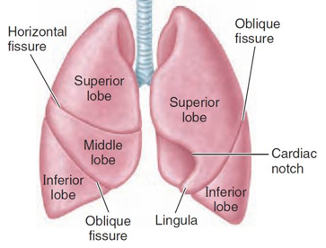
FISSURES AND LOBES OF THE LUNGS
The right lung is divided into three lobes by
two fissures, oblique and horizontal, the left lung is divided into two lobes by oblique fissure

Slide 7
The oblique fissure cuts into whole thickness of the lung, except at the hilum
Due to the oblique plane of the fissure, the lower lobe is more posterior and the upper and the middle lobe more anterior
In the right lung, the horizontal fissure passes from the anterior border upto the oblique fissure and separates a wedge shaped middle lobe from the upper lobe.

Slide 8
The tongue shaped projection of the left lung below the cardiac notch is called lingula. It corresponds to middle lobe of the right lung
The lungs expand maximally in the inferior direction because movements of the thoracic wall and diaphragm are maximal toward the base of the lung
The presence of the the oblique fissure of the each lung allows a more uniform expansion of the whole lung

Slide 9
ROOT OF THE LUNG
The root of the lung is a short ,broad pedicle which connects the medial surface of the lung to the mediastinum
It is formed by the structures which either enter or come out of the lung at the hilum
The roots of lungs lie opposite the bodies of fifth, sixth and seventh thoracic vertebrae

Slide 10
CONTENTS OF ROOT OF THE LUNG
Principal bronchus on the left side, and eparterial and hyparterial bronchi on right side
One pulmonary artery
Two pulmonary veins, superior and inferior
Bronchial arteries, one on the right side and two on the left side
Bronchial veins
Anterior and posterior pulmonary plexuses of nerves
Lymphatics of lung
Bronchopulmonary lymph nodes
Areolar tissue

Slide 11
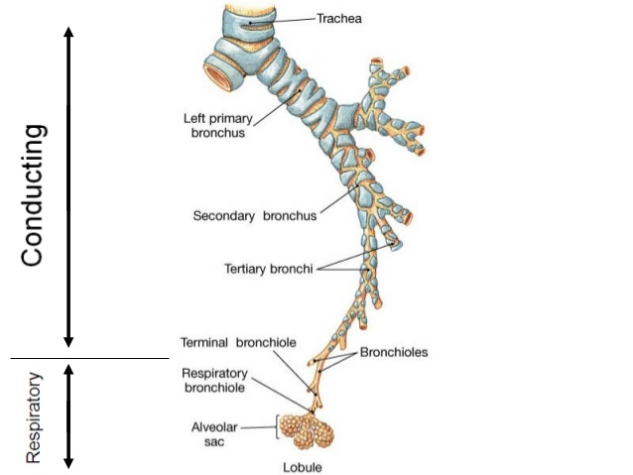
BRONCHIAL TREE

Slide 12
BRONCHO PULMONARY SEGMENTS
These are well defined sectors of the lung each one of which is aerated by a tertiary or segmental bronchus.
Each segment is pyramidal in shape with its apex directed towards the root of the lung.
These bronchopulmonary segments are independent respiratory units

Slide 15
The branches of the pulmonary artery accompany the bronchi, the artery lies dorsolateral to the bronchus, thus each segment has its own separate artery.
The pulmonary veins do not accompany the bronchi or the pulmonary artery, they run in inter segmental planes.
Thus, each segment has more than one vein and each vein drains more than one segment.

Slide 16
Usually the infection of a segment remains restricted to it although some infections like tuberculosis may spread from one segment to the other.
However, the segments are no barriers to the spread of bronchogenic carcinoma.

Slide 17
ARTERIAL SUPPLY
On the right side there is one bronchial artery which arises from either the third posterior intercostal artery or from the upper left bronchial artery
On the left side there are two bronchial arteries both of which arise from the descending thoracic aorta
There are pre capillary anastomoses between bronchial and pulmonary arteries. these connections enlarge when any one of them is obstructed in disease

Slide 18
VENOUS DRAINAGE
Usually there are two bronchial veins on each side, the right bronchial vein drain into the azygous vein.
The left bronchial vein drains either into the left superior intercostal vein or into the hemi azygous vein.
The greater part of the venous blood from the lung is drained by the pulmonary veins.

Slide 19
NERVE SUPPLY
1. Para sympathetic nerves are derived from the vagus. These fibres are:
motor to the bronchial muscles and on stimulation cause bronchospasm
secretomotor to the mucous glands of the bronchial tree
the sensory fibres are responsible for stretch reflex of the lungs and for the cough reflex

Slide 20
2. The sympathetic nerves are derived from second to fifth spinal segments. These are inhibitory to the smooth muscles and glands of bronchial tree.
3. This is how sympathomimetic drugs like adrenaline cause brochodilatation and relieve symptoms of bronchial asthma.

Slide 21
THANK YOU

