Slide 1
Lymphatic drainage of lower limb
BY MBBSPPT.COM

Slide 2
Lymphatic drainage of lower limb
The lymphatic system functions to drain tissue fluid, plasma proteins and other cellular debris back into the blood stream, and is also involved in immune defense.
Once this collection of substances enters the lymphatic vessels it is known as lymph; lymph is subsequently filtered by lymph nodes and directed into the venous system

Slide 3
Q. Describe briefly the lymphatic drainage of lower limb.
A. Lymphatic drainage of lower limb:
Most of the lymph from lower limb is drained into inguinal lymph nodes (except from deep part of gluteal region and back of thigh, which drain into internal iliac lymph nodes).
Lymph nodes are classified as • Superficial- superficial inguinal lymph nodes • Deep- deep inguinal and popliteal lymph nodes

Slide 4
Lymphatic Drainage Of Lower Limb
Three main groups
1. Superficial inguinal lymph nodes
2. Deep inguinal lymph nodes
3. Popliteal lymph nodes

Slide 5
Superficial Lymphatic Vessels
The superficial vessels can be divided into two major subsets;
(i) medial vessels, which closely follow the course of the great saphenous vein
(ii) lateral vessels which are more closely associated with the small saphenous vein.

Slide 6
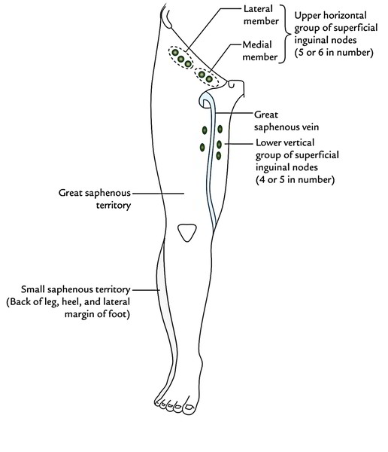
Superficial Lymphatic Vessels

Slide 7
Deep Lymphatic Vessels
These are far fewer in number than their superficial counterparts and accompany the deep arteries of the lower leg.
They are found in 3 main groups:
Anterior tibial,
Posterior tibial
Peroneal
These follow the corresponding artery respectively, and enter the popliteal lymph nodes.

Slide 8
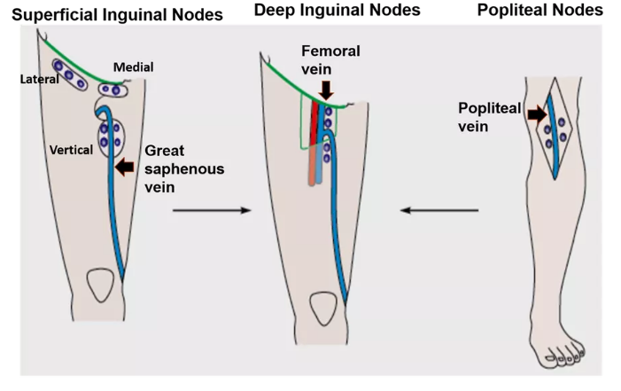

Slide 9
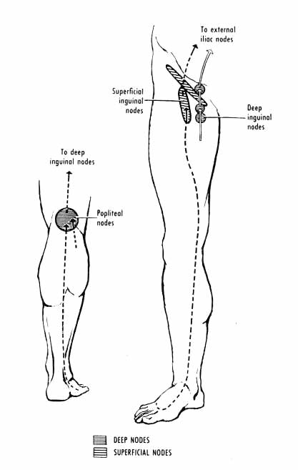
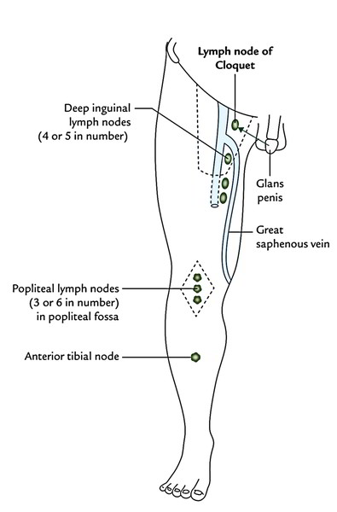

Slide 11
Deep Inguinal lymph nodes
Located medial to femoral V.
Are approximately 3 to 5.
Superior-most node is located in femoral canal(Cloquet's node drains glans penis)
Receive lymphatics from superficial inguinal lymph nodes, popliteal lymph nodes and deep lymphatics from lower limb.
Drain into external iliac nodes.

Slide 12
Popliteal lymph nodes
Lie in popliteal fossa
Receive lymph from:
Knee joint
Deep lymph vessels from leg
Superficial lymph vessels from lateral aspect of leg & foot
Drain into deep inguinal lymph nodes

Slide 13
Elephantiasis
Caused by parasitic worms such as Wuchereia bancrofti.
Lymph vessels are inflammed and blocked.
Result in edema of lower limb.
Hypertrophy of skin & subcutaneous tissue

Slide 14
Clinical Relevance: Lymphadenopathy
Lymphadenopathy is characterised by an abnormality in size, number or consistency of any lymphatic nodes within the body. This is usually in response to infection, malignancy or an auto-immune condition.
Abnormality of the inguinal vessels should always be viewed suspiciously. The superficial inguinal nodes receive drainage from the penis, scrotum, buttocks and abdominal wall as far as the umbilicus. Suspicion of lower limb lymphadenopathy therefore should include a full examination of both the lower limb and these structures.
In males, the testicles follow a different lymphatic route, and drain directly to the para-aortic nodes and therefore will rarely cause inguinal lymph node enlargement.

Slide 15
THANK
YOU!

