Slide 1
major histocompatibility complex
by mbbsppt.com

Slide 2
major histocompatibility complex (mhc)
or
Human leukocyte antigen (hla)
Almost all humen tissues contain SURFACE ANTIGEN on their plasma membrane.
They binds to antigen and present them to T cells& are responsible for antigen recognition by the T cell receptors.
Helpful in protection against microbial infection.
Also responsible for rejection of allograft.

Slide 3
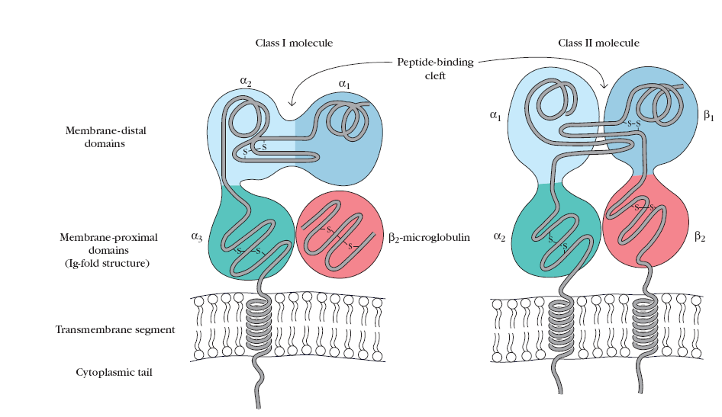

Slide 4
MHC I
Found on all cells(nucleated).
Main antigen involved in graft rejection & cell mediated cytolysis.
The CD8 T cell will recognize the antigen only when presented as a complex with the MHC I molecule
This phenomenon is called MHC RESTRICTION
MHC II
More restricted in distribution .
Found only on cells of immune system such as
Macrophages ,Dendritic cells, Langerhans cells ,Activated T cells, B cells
Main antigen involved in Graft versus host Reaction

Slide 5
Clinical applications of HLA testing
Organ Transplantation.
Platelet donor selection for highly sensitized Thrombocytopenic patients.
Genetic identification of unknown individuals involved in criminal disputes.

Slide 6
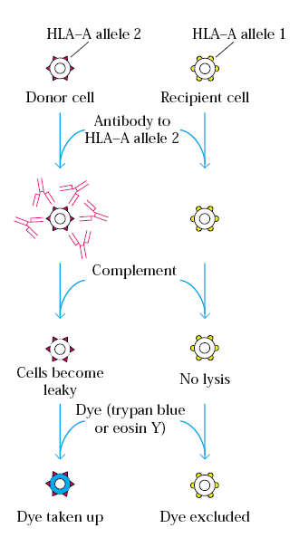
hla typing by microcytotoxicity

Slide 7
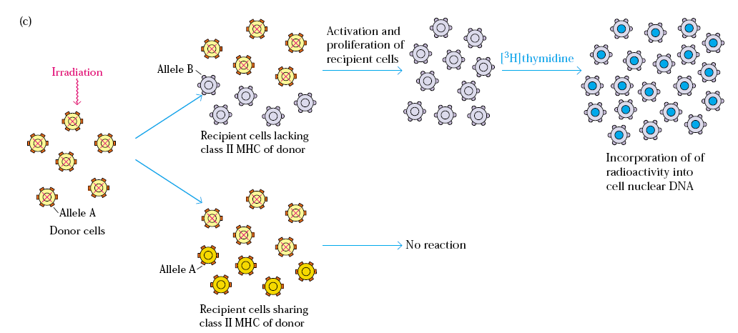
Mixed lymphocytes culture
Notes:
Class II Mhc antigen are identiied by this method
Irradiated to prevent DNA synthesis.

Slide 8
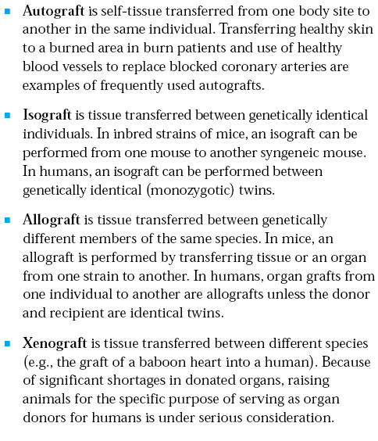

Slide 9
Graft Versus Host Reaction
The GVH reaction occurs when the following
conditons are present.
The recipient possesses HLA antigens that are absent in the graft.
The graft contains immunocompetent T-lymphocytes .

Slide 10
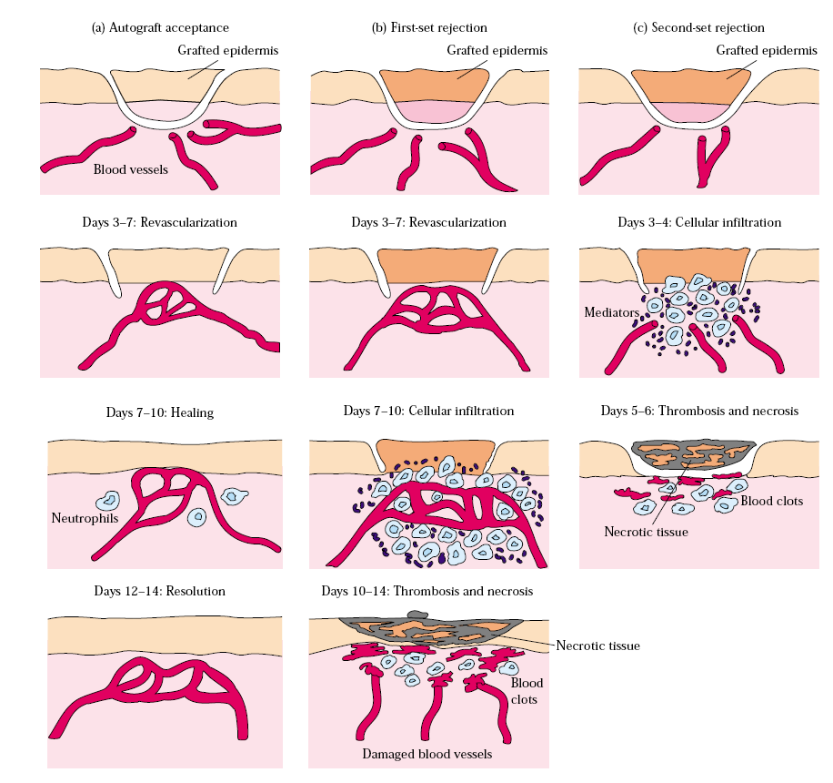

Slide 13
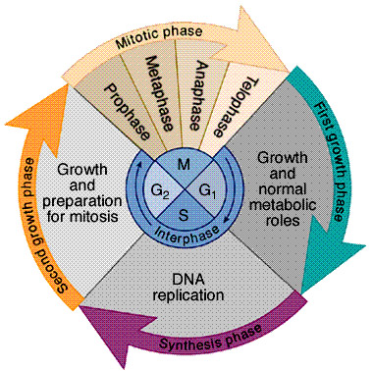
ONCOGENES
Proto-oncogenes
Proto-oncogenes
Cellular oncogenes(C-onc)
Viral oncogenes
(V-onc)
M
G₂
S
Helped in :
Discovery & analysis of cellular growth control pathways.
Synthesis of current concepts of cancer biology.
Stop
Tumor suppressor genes

Slide 14
TUMOUR IMMUNOLOGY
When a cell undergoes malignant transformation ,it expresses new surface ag and may also lose some normal antigen .
The tumour associated ag are immunologically distinct from normal tissue ag.
The host recognises the tumour associated ag as ‘nonself’ therefore,tumour can be considered as an allograft & is expected to induce an immune response.

Slide 15
Tumour antigen
Tumour Specific Antigen
Present on the membrane of cancer cells and not on the normal cells
Tumour Associated Antigen
Present on tumour cells & also on some normal cells :
Tumour associated carbohydrate antigens
Oncofetal antigens
Differentiation antigens
Notes:
Tumour associated carbohydrate antigens : presents abnormal forms of glycoproteins and glycolipids such as mucin –associated antigen detected in pancreatic and breast cancer .
Oncofetal antigens:present in embryonic and malignant cells but not in normal adult cells .ex- alfafetoprotein in hepaomas and carcinoembryonic antigen in colonic cancer.
Differentiation antigens:CD10 an ag expressed in early B-cell leukaemias , and Prostate specific antigen in prostatic cancer

Slide 16
IMMUNOTHERAPY OF CANCER
SPECIFIC IMMUNOTHERAPY
NON SPECIFIC ACTIVE IMMUNOTHERAPY
IMMUNTHERAPY
Notes:
BACILLE CALMETTE GUERIN : M.bovis(malignant carcinoma/bladder cancer ,lung cancer )
C.parvum-lung cancer and metastatic breast cancer
Specific :attempted by vaccination wit tumour antigen, monoclonal antibody to tumour ag

Slide 17
Thank You

