Slide 1
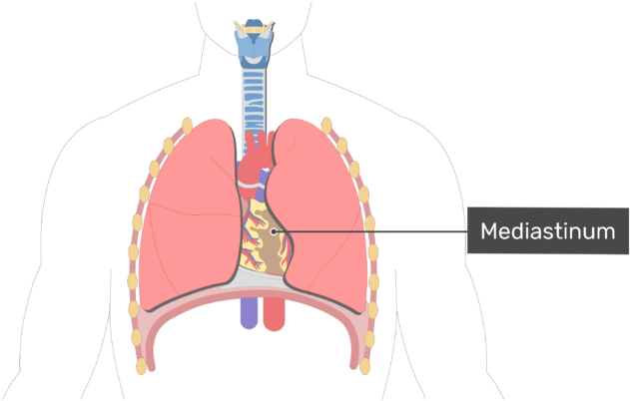
MEDIASTINUM

Slide 2
The Mediastinum
The Mediastinum is a compartment located between two pleural sacs.
It is a thick, broad, midline, bulky partition between two lungs.
It goes from the sternum anteriorly to the thoracic vertebrae posteriorly.
Also it goes from the superior thoracic aperture to the inferior thoracic aperture.

Slide 3
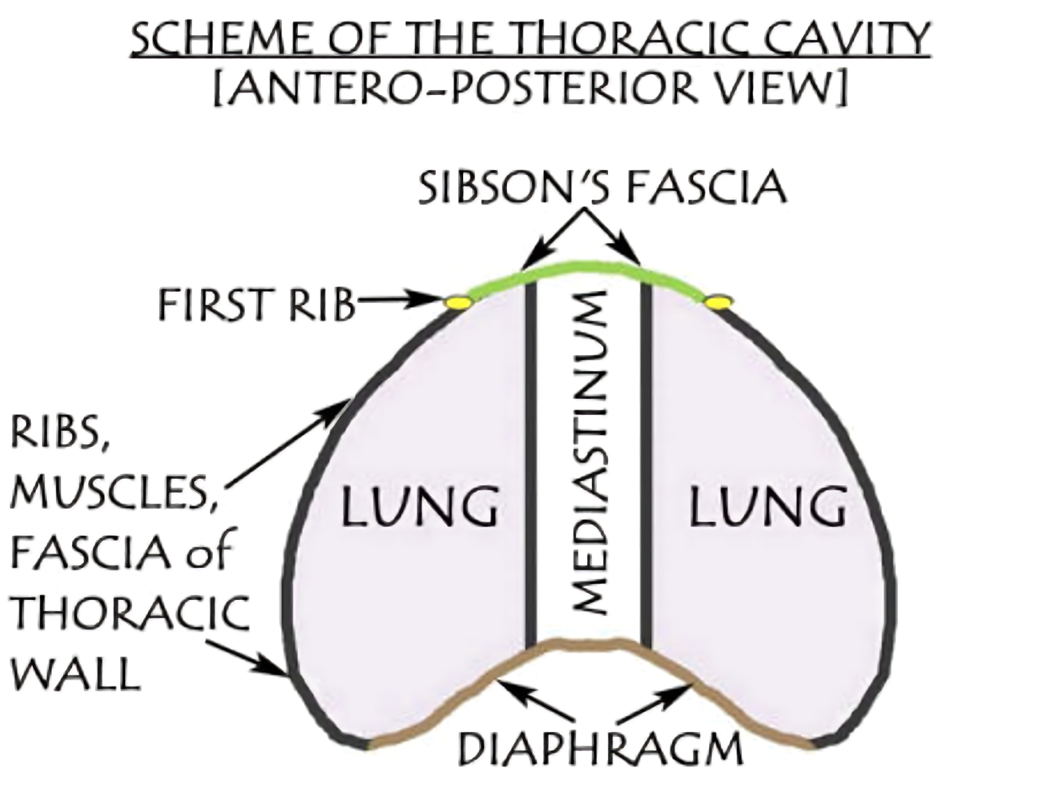

Slide 4
Mediastinum
Anatomically, the mediastinum is divided into two parts by an imaginary line that runs from the sternal angle anteriorly, intervertebral disc between T4 and T5 vertebrae posteriorly.
Superior mediastinum – extends upwards, terminating at the superior thoracic aperture.
Inferior mediastinum – extends downwards, terminating at the diaphragm.
It is further subdivided into
Anterior mediastinum.
Middle mediastinum.
Posterior mediastinum.
It contains most of the thoracic organs, and acts as a conduit for structures traversing the thorax on their way into the abdomen.

Slide 5
Boundaries of mediastinum
Anterior:
Sternum.
Posterior:
Vertebral column (bodies of thoracic vertebrae and intervening intervertebral discs).
Superior:
Superior thoracic aperture.
Inferior:
Diaphragm.
On every side:
Mediastinal pleura.

Slide 6
Mediastinum

Slide 7
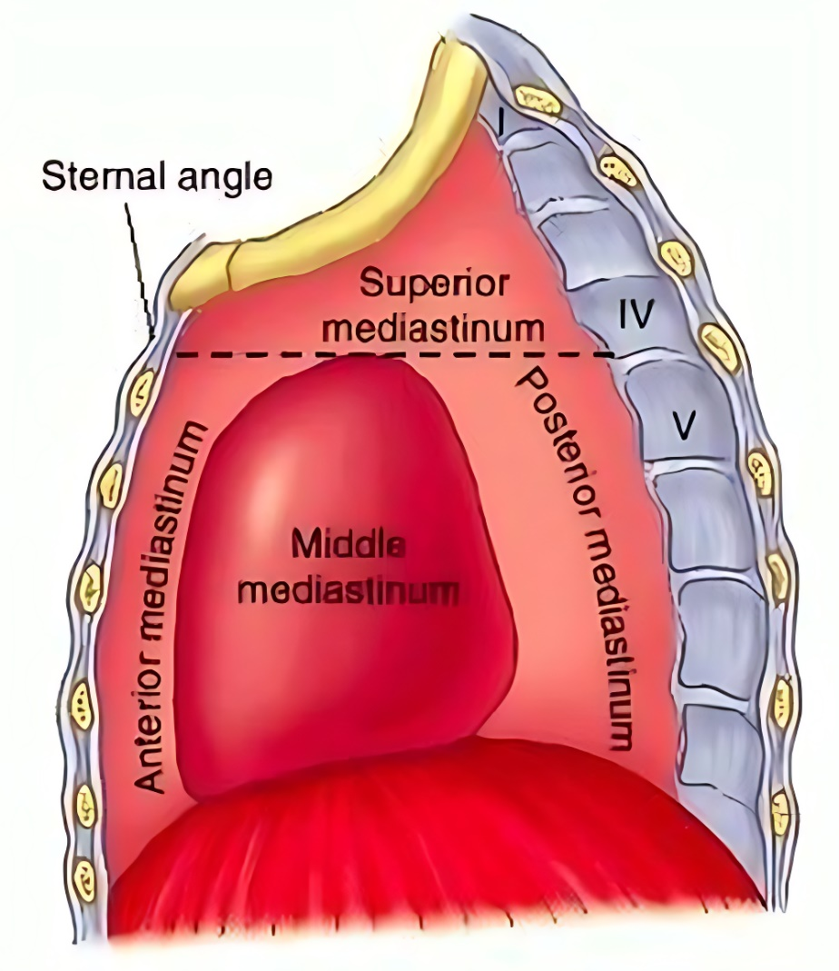
Mediastinum
Inferior Mediastinum
Superior boundaries:
Sternal Angle to T4/5 (Inter VD)
Inferior boundaries:
Middle of Xiphoid process to T9

Slide 8
Divisions
The mediastinum is divided into 2 parts:
1. Superior mediastinum
Lies above “transverse thoracic plane” that runs from the sternal angle anteriorly, fourth thoracic vertebra/intervertebral disc between T4 and T5 vertebrae posteriorly.
2. The inferior mediastinum is further subdivided into 3 parts by the pericardium (enclosing heart).
The part in front of the pericardium is referred to as anterior mediastinum.
The part supporting the pericardium is referred to as posterior mediastinum.
The pericardium and its contents (heart and roots of its great vessels) constitute the middle mediastinum.

Slide 9
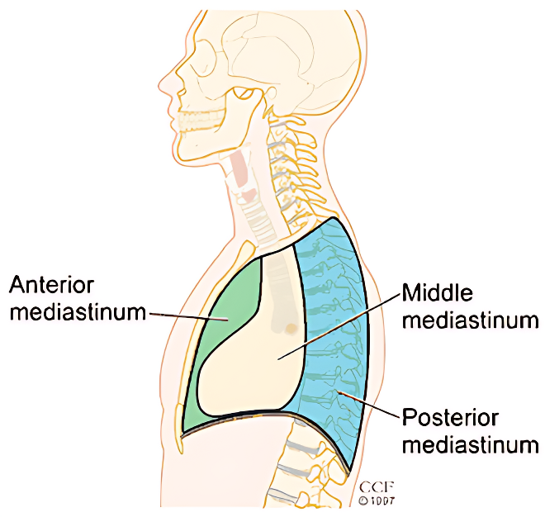

Slide 10
Contents
The major contents of mediastinum are:
Thymus.
Heart enclosed in the pericardial sac.
Major arteries and veins like thoracic aorta, pulmonary trunk, etc.
Trachea.
Esophagus.
Thoracic duct.
Neural structures, like sympathetic trunks, vagus nerves, phrenic nerve, etc.
Lymph nodes.

Slide 12
Superior Mediastinum
Borders
The superior mediastinum is bordered by the following thoracic structures:
Superior: Thoracic inlet.
Inferior: Continuous with the inferior mediastinum at the level of the sternal angle.
Anterior: Manubrium of the sternum.
Posterior: Vertebral bodies of T1-4.
Lateral: Pleurae of the lungs.

Slide 13
Superior Mediastinum

Slide 15
Superior Mediastinum

Slide 16
Contents
Great Vessels
Arch of Aorta with three major branches are within the superior mediastinum:
Brachiocephalic artery – supplying the right side of the head & neck and the right upper limb.
Left Common carotid artery – to the left side of the head & neck.
Left Subclavian artery – to the left upper limb.
Superior Vena Cava with its tributaries are located within the superior mediastinum:
Brachiocephalic veins – draining blood from the upper body.
Left superior intercostal vein – collects blood from the left 2nd and 3rd intercostal vein. It drains into the left brachiocephalic vein.
Supreme intercostal vein – drains the vein from first intercostal space directly into the brachiocephalic veins.
Azygos vein – receiving blood from the right posterior intercostal veins. The left intercostal veins drain first into the hemiazygos and accessory hemiazygos veins before joining the azygos vein around T7-T9.

Slide 17
Nerves
Right vagus nerve – runs parallel to the trachea and passes posteriorly to the superior vena cava and the right primary bronchus.
Left vagus nerve – enters the superior mediastinum between the left common carotid and the left subclavian arteries.
The left recurrent laryngeal nerve arises from the left vagus nerve as it passes the aortic arch.
Phrenic Nerve From the anterior surface of the anterior scalene muscle, the phrenic nerves (roots C3, C4 and C5) enter the superior mediastinum lateral to the great vessels.
Other Nerves
Cardiac nerves – originate from the superior, middle and inferior cardiac ganglion and form the superficial and deep cardiac plexuses in the superior mediastinum.
Sympathetic trunk – runs bilaterally to the vertebral bodies along the entire length of the vertebral column.

Slide 18
Other Structures in the Superior Mediastinum
Thymus: The thymus gland is the most anterior structure within the superior mediastinum. It sits flush against the posterior surface of the sternum and extends into the anterior mediastinum and can often reach into the neck.
Trachea: The trachea bifurcates into the primary bronchi posterior to the ascending aorta at the level of the sternal angle.
Esophagus: The esophagus ascends towards the pharynx, which it joins at the level of C6.
Thoracic duct: the superior mediastinum, the thoracic duct passes to the left of the esophagus on its path to the junction of the left internal jugular and subclavian veins.
Muscles: The sternohyoid and sternothyroid muscles originate from the posterior surface of the manubrium. They are part of the infrahyoid muscle group of the neck.
The inferior aspect of the longus colli muscle also originates within the superior mediastinum

Slide 19
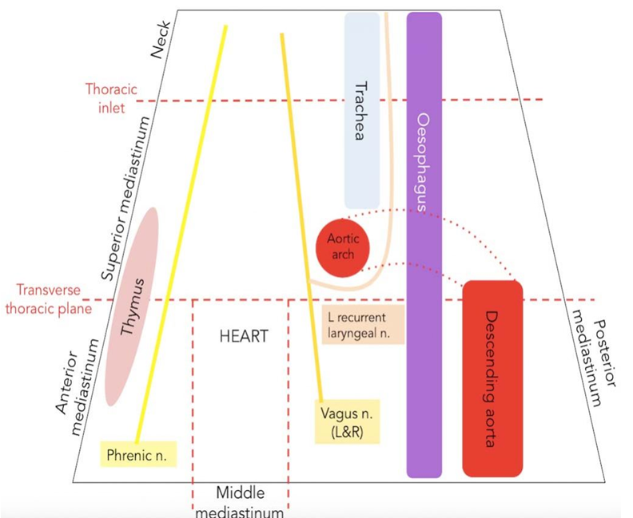

Slide 20
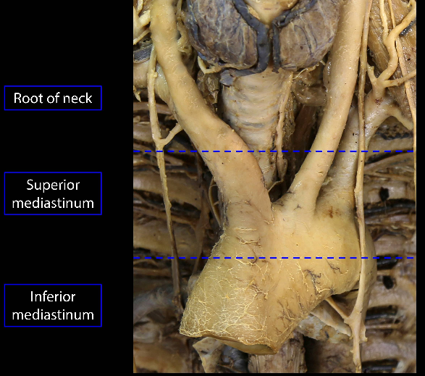

Slide 21
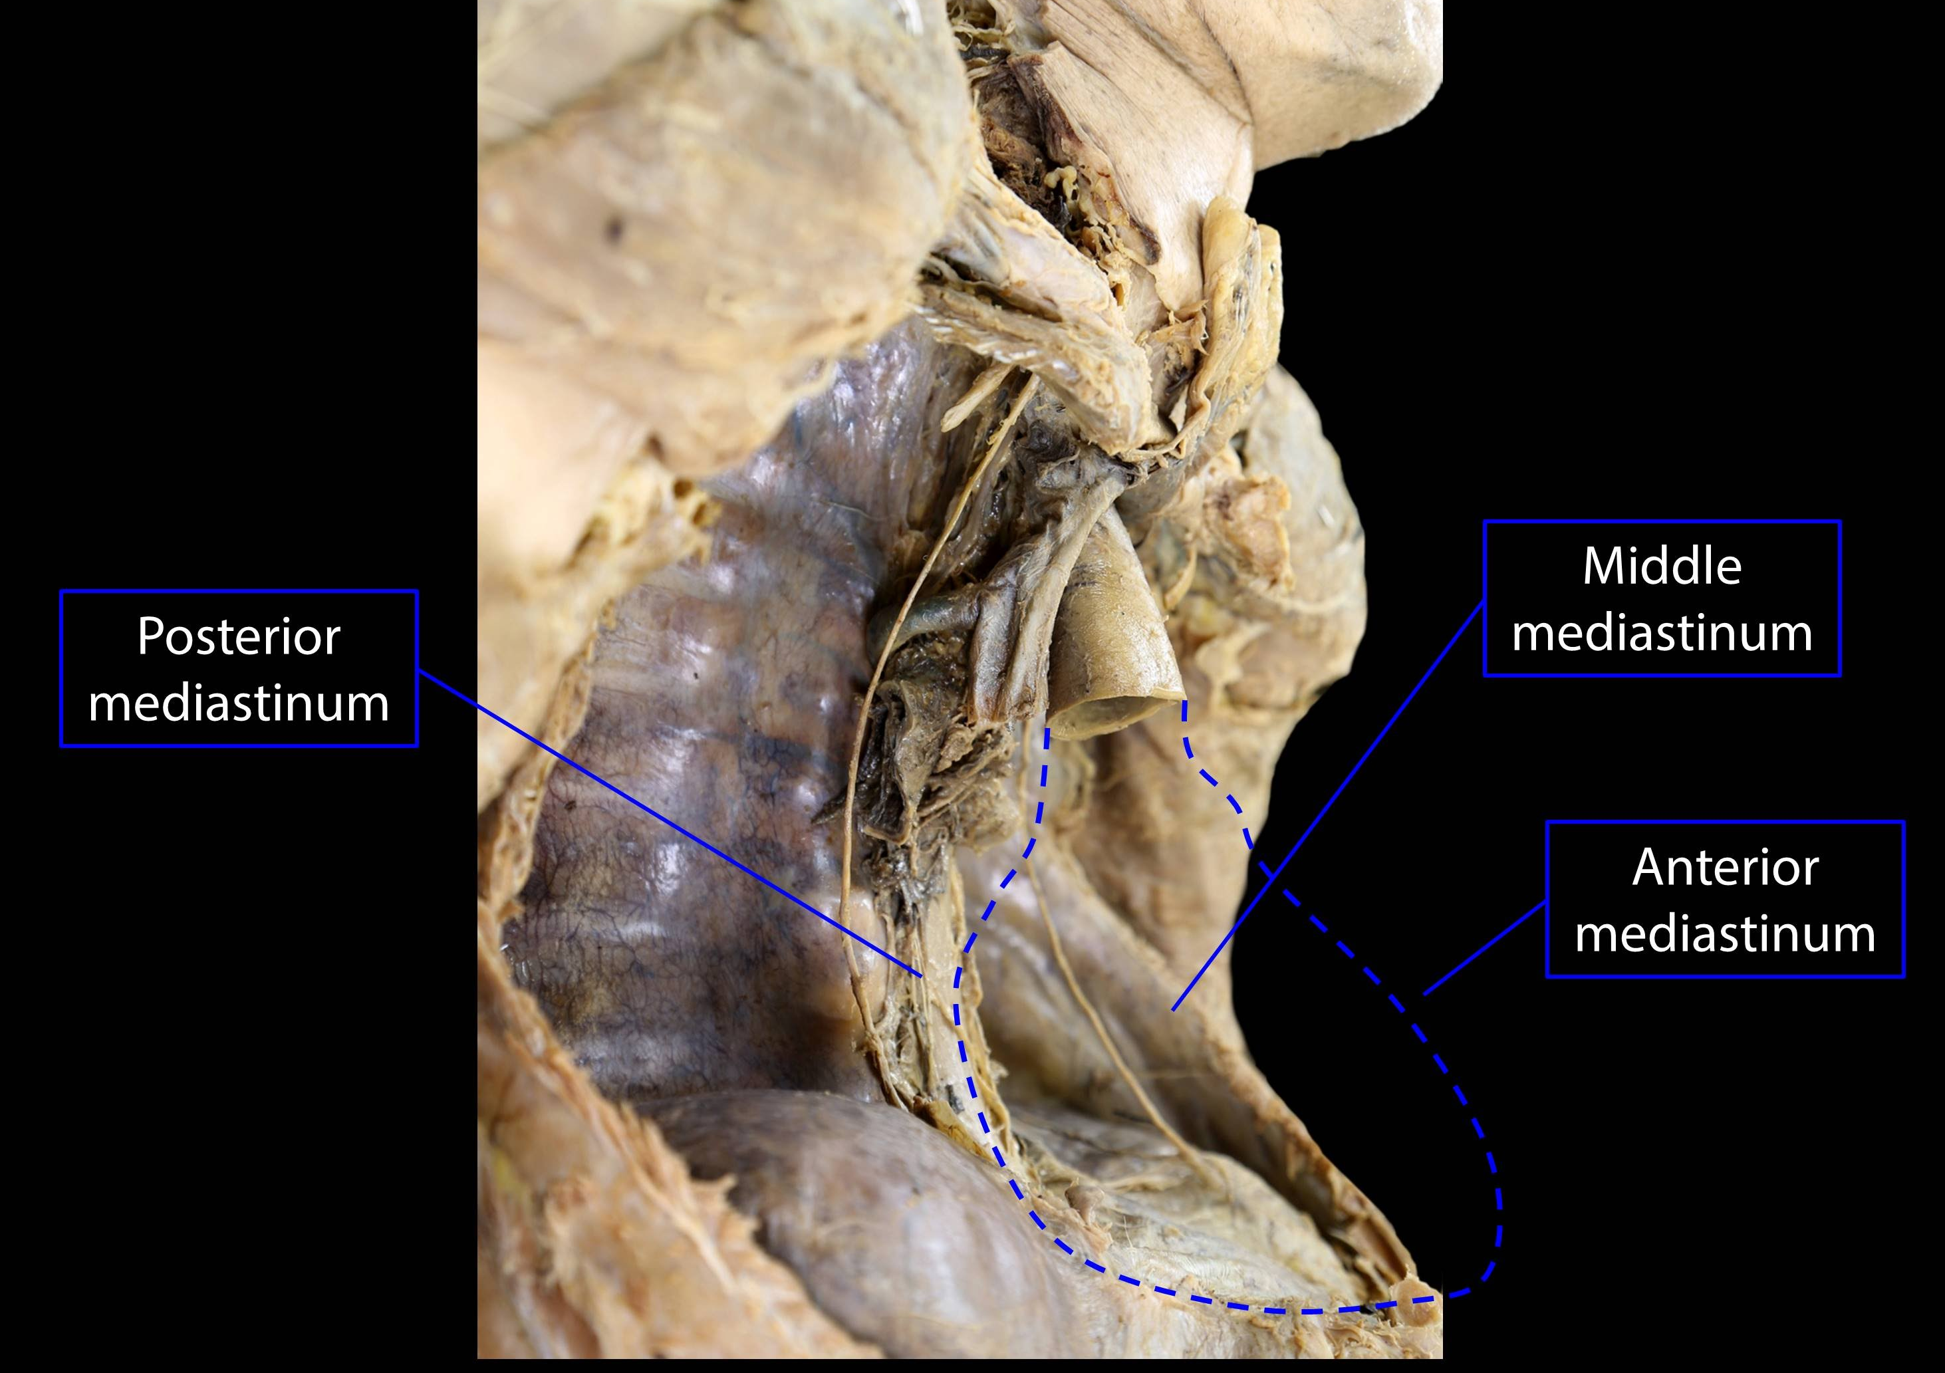

Slide 23
The anterior mediastinum
Borders
Lateral borders:
Mediastinal pleura (part of the parietal pleural membrane).
Anterior border:
Body of the sternum and the transversus thoracis muscles.
Posterior border:
Pericardium.
Roof:
Continuous with the superior mediastinum at the level of the sternal angle.
Floor:
Diaphragm.

Slide 24
The anterior mediastinum contains no major structures. It accommodates loose connective tissue (including the sternopericardial ligaments), fat, some lymphatic vessels, lymph nodes and branches of the internal thoracic vessels.
In infants and children, the thymus extends inferiorly into the anterior mediastinum.
However the thymus recedes during puberty and is mostly replaced by adipose tissue in the adult

Slide 26
The Middle Mediastinum
Borders
Anterior:
Anterior margin of the pericardium.
Posterior:
Posterior border of the pericardium.
Laterally:
pleura of the lungs.
Superiorly:
Line extending between the sternal angle (the angle formed by the junction of the sternal body and manubrium) and the T4 vertebrae.
Inferiorly:
Superior surface of the diaphragm.

Slide 28
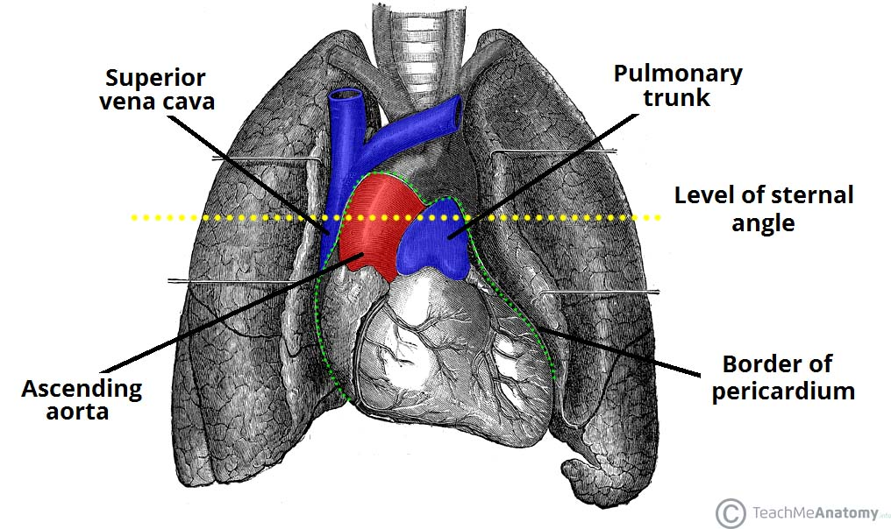

Slide 29
Contents
The middle mediastinum contains:
Organs:
The heart,
The pericardium.
The tracheal bifurcation and the left and right main bronchi.
Vessels: The middle mediastinum is associated with the origins of the great vessels that run to and from the heart:
Ascending aorta – the first part of the aorta. It moves upwards, exiting the fibrous pericardium and entering the superior mediastinum
Pulmonary trunk – gives rise to the left and right pulmonary arteries.
Superior vena cava – returns deoxygenated blood from the upper half of the body.
It is formed by the right and left brachiocephalic veins.

Slide 30
Nerves
The cardiac plexus and the phrenic nerves are both located within the middle mediastinum.
Cardiac plexus – a network of nerves located at the base of the heart, containing sympathetic and parasympathetic fibres. The sympathetic nerves are derived from the T1-T4 segments of the spinal cord, and the parasympathetic innervation is supplied by the vagus nerve. The plexus can be subdivided into superficial and deep components.
Phrenic nerves (left and right) – mixed nerves that provides motor innervation to the diaphragm. They arise in the neck, and descend through the middle mediastinum to reach the diaphragm.

Slide 31
Lymphatics
The tracheobronchial lymph nodes are located within the middle mediastinum.
They are a group of nodes associated with the trachea and bronchi of the respiratory tract.
They form from the gathering of bronchial nodes within the hila of the lungs.
Individual groups of nodes are connected via fine lymphatic channels.

Slide 33
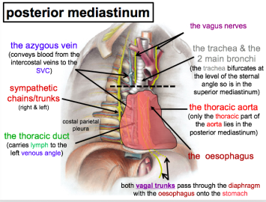

Slide 35
The Posterior Mediastinum

Slide 36
Thoracic Aorta
The thoracic (descending) aorta is a continuation of the arch of the aorta. It descends through the posterior mediastinum to the left of the vertebrae. At the inferior border of T12, the thoracic aorta becomes the abdominal aorta, and passes through the aortic hiatus of the diaphragm.
A number of branches arise from the thoracic aorta in the posterior mediastinum.
Unpaired branches to viscera extend anteriorly,
Paired branches to viscera extend laterally, and
Paired segmental parietal branches extend mostly posterolaterally.
The major branches are:
Posterior intercostal arteries
Bronchial arteries
Esophageal arteries
Superior phrenic arteries

Slide 37
Thoracic Duct
The thoracic duct is the largest lymphatic vessel in the body, allowing return of lymph from most of the body (all but the right superior quadrant) into the venous system.
The duct originates from the cisterna chyli in the abdomen, and enters the mediastinum through the aortic hiatus.
It ascends to lie directly anterior to the T6-T12 vertebrae, before deviating left as it ascends into the superior mediastinum.
While located in the posterior mediastinum, the thoracic duct receives lymphatic drainage from the intercostal spaces.

Slide 38
Azygos System of Veins
This venous network drains blood from the body walls and mediastinal viscera, and empties into the superior vena cava. It consists of three major veins:
Azygos vein – Formed by the union of the right lumbar vein and the right subcostal vein. It enters the mediastinum via the aortic hiatus and drains into the superior vena cava.
Hemiazygos vein – Formed by the union of the left lumbar vein and left subcostal vein. It enters the mediastinum through the left crus of the diaphragm, ascending on the left side.
Accessory hemiazygos vein – Formed by the union of the fourth to eighth intercostal veins. It drains into the azygos vein at T7.

Slide 39
Esophagus
It passes into the posterior mediastinum from the superior mediastinum, descending posteriorly to the arch of the aorta and the heart.
Whilst initially positioned to the right, the oesophagus deviates to the left as it moves downwards.
It leaves the mediastinum via the esophageal hiatus of the diaphragm.
The esophageal plexus is a network of nerves surrounding the oesophagus as it descends, comprising of branches from the left and right vagus nerves.
The fibres of the plexus converge to form the anterior vagal trunk and posterior vagal trunk, which travel along the surface of the oesophagus as it exits the thorax

Slide 40
Sympathetic Trunks
The sympathetic trunks are paired bundles of nerves that extend from the base of the skull to the coccyx.
In the thoracic region, these nerve bundles are known as the thoracic sympathetic trunks. As they descend through the thorax, they lie within the posterior mediastinum.
Arising from these trunks are the lower thoracic splanchnic nerves – they continue inferiorly to supply the viscera of the abdomen.

Slide 41
Visualization of Subdivisions of Mediastinum in Chest Radiograph
The subdivisions of mediastinum are well-appreciated in lateral view of X-ray chest. The shadow above the sternal plane represents superior mediastinum.
The subdivisions of inferior mediastinum are demarcated as under:
1. Cardiac shadow above the anterior part of diaphragm represents the middle mediastinum.
2. Retrosternal space/space in the front of cardiac shadow represents the anterior mediastinum.
3. Retrocardiac space/space between the cardiac shadow and shadow of vertebral column represents the posterior mediastinum.

Slide 42
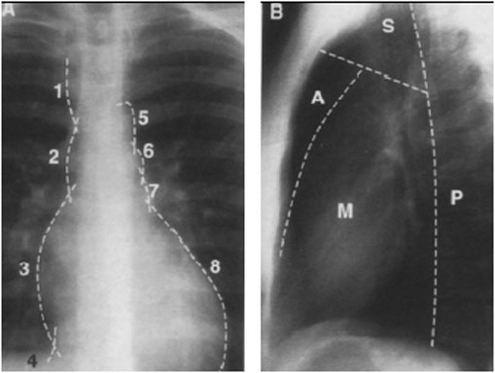
X-Ray chest PA(A) include SVC (1), ascending aorta (2), RA (3), IVC (4), aortic arch (5), pulmonary trunk (6), LA appendage (7), and LV (8). Lateral film (B) include: superior (S), anterior (A), middle (M) and posterior (P) compartments.

Slide 43
Mediastinitis
It is the inflammation of the loose connective tissue of the mediastinum.
The fascial spaces of the neck (example: pretracheal and retropharyngeal spaces) extend below into the mediastinum inside the thoracic cavity.
Deep infections of the neck may readily spread into the thoracic cavity causing mediastinitis.

Slide 44
Subcutaneous Emphysema in The Root of Neck
The structures that make up mediastinum are embedded in the loose connective tissue that is continuous with the loose connective tissue of the root of the neck.
For that reason, in esophageal perforations caused by penetrating wounds, air escapes into the connective tissue spaces of mediastinum and could ascend below the fascia to the root of the neck producing subcutaneous emphysema.

Slide 45
Mediastinal Syndrome
The compression of mediastinal structures by any growth like tumor or cyst gives rise to a group of signs and symptoms. syndrome.
The common causes of mediastinal syndrome are bronchiogenic carcinoma, aneurysm of aorta, enlargement of mediastinal lymph nodes in Hodgkin disease.
The clinical features of mediastinal syndrome are:
Engorgement of veins in the upper half of the body: because of obstruction of SVC,
Dyspnea (difficulty in breathing): because of compression of trachea,
Dysphagia (difficulty in swallowing): because of compression of esophagus,
Dyspnea (hoarseness of voice): because of compression of left recurrent laryngeal nerve, and
Erosion of bodies of thoracic vertebrae: because of pressure on the vertebral column

Slide 46
Widening of The Mediastinum
The widening of mediastinum is frequently observed in chest radiographs. It can happen because of a number of reasons, like
(a) hemorrhage into the mediastinum from lacerated great vessels (aorta, SVC) following trauma, example: head on collision,
(b) Massive enlargement of mediastinal lymph nodes because of cancer of lymphoid tissue, viz. malignant lymphoma,
( c) Enlargement (hypertrophy) of heart because of congestive heart failure (CHF).

Slide 47
Mediastinal Shift
The mediastinal shift is common in lung and pleural pathology.
The mediastinum shifts to the affected (diseased) side because of appreciable reduction in lung volume and decrease in intrapleural pressure- as in collapse of lung and atelectasis.
The mediastinum shifts to the healthy side when the intrapleural pressure is appreciably high on the affected side – as in pneumothorax and hydrothorax.
Mediastinal shift indicates lung pathology. The mediastinal shift can be discovered by palpating the trachea in the suprasternal notch.

Slide 48
Extension of Pus Into The Posterior Mediastinum From Neck
The posterior mediastinum is continuous via superior mediastinum with spaces in the neck between pretracheal and prevertebral layers of deep cervical fascia like retropharyngeal space, etc.
For That Reason, pus from neck can extend into the posterior mediastinum.

Slide 49
THANK YOU!

