Slide 1
MEDICAL INSTRUMENTS
BY MBBSPPT.COM

Slide 2
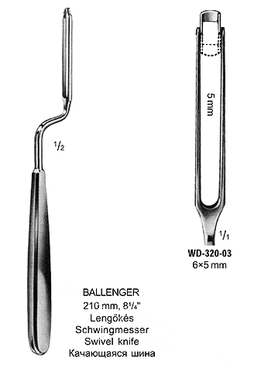
BALLENGER SWIVEL KNIFE

Slide 3
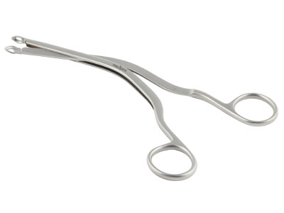
LUC’S FORCEP

Slide 4
KILLIAN’S NASAL GAUGE

Slide 5
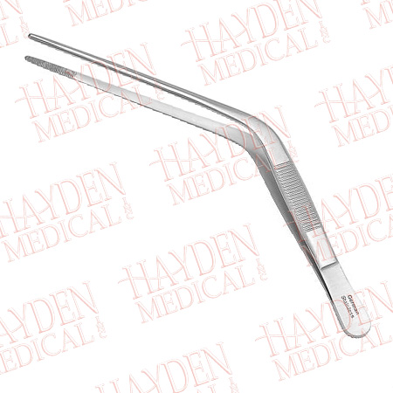
WILDE’S DRESSING FORCEP

Slide 6
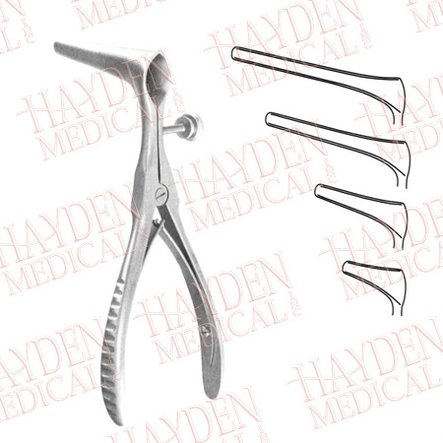
KILLIAN’S LONG BLADED NASAL SPECULUM

Slide 7
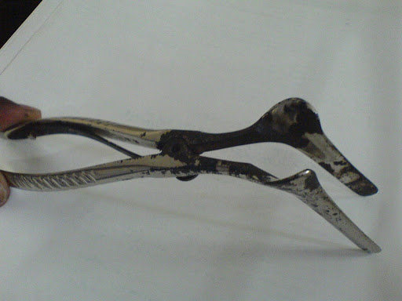
ST. CLAIR THOMSON’S NASAL SPECULUM

Slide 8
Thank You

