Slide 1
MEDICO-LEGAL ASPECT OF DRUG ABUSE by mbbsppt.com

Slide 2
Legal aspect of drug abuse
Narcotic Drugs and Psychotropic Substances
Act, 1985 (NDPS Act )
is the anti-drug law of India.
NDPS Act empowers central government to frame rules for
certain purposes and state governments to frame rules for
certain others. Violation of any rule of either the state or
central NDPS Rules are punishable by law.

Slide 3
SERIAL NO. | DESCRIPTION OF OFFENCE | MINI. | MINI. | MAX. | MAX.
 |  | IMPRISONMENT | FINE | IMPRISONMENT | FINE
1. | Cultivation, production, manufacture, possession, sale, purchase, transportation, use or consumption Poppy straw (Sec 15) Coco plant and coco leaves (Sec 16) Opium poppy, opium & prepared opium (Sec 17,18.19) Cannabis (Sec 20) Ganja (Sec 20) Manufactured drugs (Sec 21) All psychotropic substances (Sec 22) | 10yrs R.I 10yrs R.I 10yrs R.I 10yrs R.I 10yrs R.I 10yrs R.I 10yrs R.I | Rs. 1 L Rs. 1 L Rs. 1 L Rs. 1 L Rs. 1 L Rs. 1 L Rs. 1 L | 20yrs R.I 20yrs R.I 20yrs R.I 20yrs R.I 20yrs R.I 20yrs R.I 20yrs R.I | Rs. 2 L Rs. 2 L Rs. 2 L Rs. 2 L Rs. 2 L Rs. 2 L Rs. 2 L
2. | Illegal import and export (Sec 23) | 10yrs R.I | Rs. 1 L | 20yrs R.I | Rs. 2 L

Slide 4
SERIAL NO. | DESCRIPTION OF OFFENCE | MINI. | MINI. | MAX. | MAX.
 |  | IMPRISONMENT | FINE | IMPRISONMENT | FINE
3. | Allowing premises, animal or conveyance knowingly for commencement of offence (Sec 25) | 10yrs R.I | Rs. 1 L | 20yrs R.I | Rs. 2 L
4. | Certain acts by licensee or his/her servants (Sec 26)
5. | - Possession in small quantity as specified by the central government(Sec 27)
6. | - Financing directly or indirectly in furtherance of such an offence (Sec 27A) | 10yrs R.I | Rs. 1 L | 20yrs R.I | Rs. 2 L
9. | - Repeat offence (Sec 31) | Double | Double | DEATH PENALTY
Upto 3 yrs or fine or both
Upto 1 yr or fine or both

Slide 5
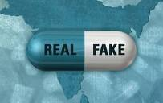
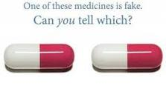
PHARMACEUTICAL DRUG ABUSE
A counterfeit medication or a counterfeit drug is a medication or
pharmaceutical product which is produced and sold with the intent to deceptively represent its origin, authenticity or effectiveness. A counterfeit drug may contain inappropriate quantities of active ingredients, or none, may contain ingredients that are not on the label (which may or may not be harmful), or may be supplied fake packaging and labeling. Counterfeit drugs are related to Pharma Fraud.

Slide 6
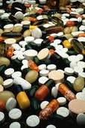
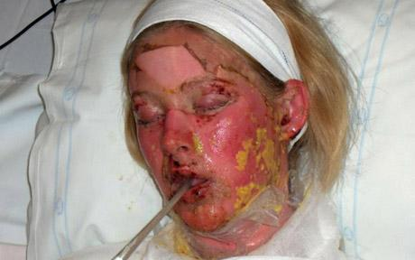
Fake antibiotics with a low concentration of the active ingredients can do damage world wide by stimulating the development of drug resistance in surviving bacteria
Low-quality counterfeit medication may caause any of several dangerous health consequences including side effects, allergic reactions, in addition to their obvious lack of efficacy due to having less or none of their active ingredients.

Slide 7
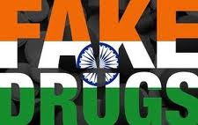
According to a report released by the Organization for Economic Co-operation and Development (OECD), 7.5 percent of fake drugs supplied world over have some origins in India.

Slide 8
International laws
against drug abuse
Comprehensive Drug Abuse Prevention and
Control Act of 1970 (USA)
The Misuse of Drugs Act 1971 (U.K)
National Campaign Against Drug Abuse (NCADA) (Australia)

Slide 9
List of major cases related
to drug abuse in last 1 year
1. Wednesday, March 31, 2010
A huge fake drugs racket has been busted in Chennai, India.
2. June 30, 2010: Authorities of India and Myanmar have mutually decided to strengthen checking of drug smuggling across the international border.
November 17, 2010:
list of drugs prohibited for import to india by the ministry of health and family welfare

Slide 10
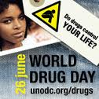
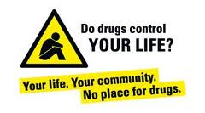
International Day against Drug abuse and Illicit Trafficking
June 26

Slide 11
The use of performance-enhancing drugs in sport is commonly referred to by the term "doping," particularly by those organizations that regulate competitions. The use of performance enhancing drugs is mostly done to improve athletic performance. This is why many sports ban the use of performance enhancing drugs. Another similar use of medical technology is called blood doping, either by blood transfusion or use of the hormone erythropoietin (EPO). The use of drugs to enhance performance is considered unethical by most international sports organizations and especially the International Olympic Committee, although ethicists have argued that it is little different from the use of new materials in the construction of suits and sporting equipment, which similarly aid performance and can give competitors advantage over others. The reasons for the ban are mainly the alleged health threat of performance-enhancing drugs, the equality of opportunity for athletes and the supposedly exemplary effect of "clean" ("doping-free") sports in the public.
In 1998 the entire Festina team were excluded from the Tour de France following the discovery of a team car containing large amounts of various performance-enhancing drugs. The team director later admitted that some of the cyclists were routinely given banned substances. Six other teams pulled out in protest including Dutch team TVM who left the tour still being questioned by the police. The Festina scandal overshadowed cyclist Marco Pantani's tour win, but he himself later failed a test. The infamous "pot belge" or "Belgian mix" has a decades-long history in pro cycling, among both riders and support staff. More recently David Millar, the 2003 World-Time Trial Champion, admitted using EPO, and was stripped of his title and suspended for two years. Still later, Roberto Heras was stripped of his victory in the 2005 Vuelta a España and suspended for two years after testing positive for EPO.

Slide 12
Prescription Drug Abuse
The most prevalent drug overdose and death culprits appear to be Vicodin, Oxycontin, and Methadone all opiods. The overuse of Vicodin can lead to increased tolerance and addiction. One risk of Vicodin addiction includes liver toxicity, which increases for users without a tolerance to the drug. Oxycontin users may suffer from respiratory depression or arrest, skeletal-muscle flaccidity, blood-pressure and heart-rate reduction, coma and death.
from LSD in the 1960s, heroin in the 1970s, crack cocaine in the 1980s, crystal meth in the 1990s to the current prescription drug abuse.

Slide 13
MEDICAL CONSEQUENCES
OF DRUG ABUSE

Slide 14
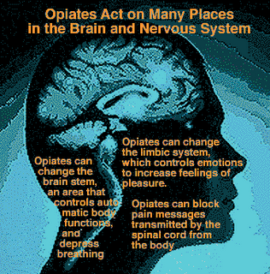
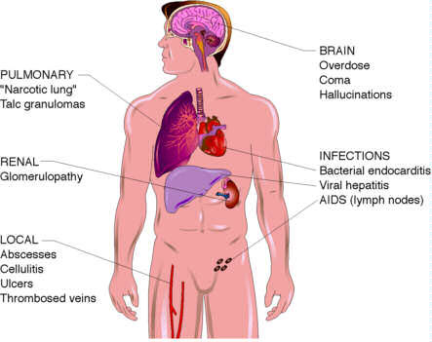

Slide 15
June 26 is celebrated as International Day against Drug Abuse and Illicit Trafficking every year.
India has braced itself to face the menace of drug trafficking both at the national and international levels. Several measures involving innovative changes in enforcement, legal and judicial systems have been brought into effect. The introduction of death penalty for drug-related offences has been a major deterrent. The Narcotic Drugs and Psychotropic Substances Act, 1985, were enacted with stringent provisions to curb this menace. The Act envisages a minimum term of 10 years imprisonment extendable to 20 years and fine of Rs. 1 lakh extendable up to Rs. 2 lakhs for the offenders. The Act has been further amended by making provisions for the forfeiture of properties derived from illicit drugs trafficking. Comprehensive strategy involving specific programmes to bring about an overall reduction in use of drugs has been evolved by the various government agencies and NGOs and is further supplemented by measures like education, counseling, treatment and rehabilitation programmes. India has bilateral agreements on drug trafficking with 13 countries, including Pakistan and Burma. Prior to 1999, extradition between India and the United States occurred under the auspices of a 1931 treaty signed by the United States and the United Kingdom, which was made applicable to India in 1942. However, a new extradition treaty between India and the United States entered into force in July 1999. A Mutual Legal Assistance Treaty was signed by India and the United States in October 2001. India also is signatory to the following treaties and conventions: 1961 U.N. Convention on Narcotic Drugs
1971 U.N. Convention on Psychotropic Substances
1988 U.N. Convention Against Illicit Traffic in Narcotic Drugs and Psychotropic Substances
2000 Transnational Crime Convention

Slide 16
The use of performance-enhancing drugs in sport is commonly referred to by the term "doping," particularly by those organizations that regulate competitions. The use of performance enhancing drugs is mostly done to improve athletic performance. This is why many sports ban the use of performance enhancing drugs. Another similar use of medical technology is called blood doping, either by blood transfusion or use of the hormone erythropoietin (EPO). The use of drugs to enhance performance is considered unethical by most international sports organizations and especially the International Olympic Committee, although ethicists have argued that it is little different from the use of new materials in the construction of suits and sporting equipment, which similarly aid performance and can give competitors advantage over others. The reasons for the ban are mainly the alleged health threat of performance-enhancing drugs, the equality of opportunity for athletes and the supposedly exemplary effect of "clean" ("doping-free") sports in the public.
In 1998 the entire Festina team were excluded from the Tour de France following the discovery of a team car containing large amounts of various performance-enhancing drugs. The team director later admitted that some of the cyclists were routinely given banned substances. Six other teams pulled out in protest including Dutch team TVM who left the tour still being questioned by the police. The Festina scandal overshadowed cyclist Marco Pantani's tour win, but he himself later failed a test. The infamous "pot belge" or "Belgian mix" has a decades-long history in pro cycling, among both riders and support staff. More recently David Millar, the 2003 World-Time Trial Champion, admitted using EPO, and was stripped of his title and suspended for two years. Still later, Roberto Heras was stripped of his victory in the 2005 Vuelta a España and suspended for two years after testing positive for EPO.

Slide 17
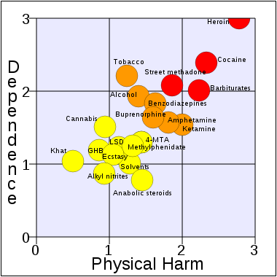
A substance-related disorder is an umbrella term used to describe several different conditions (such as intoxication, harmful use/abuse, dependence, withdrawal, and psychoses or amnesia associated with the use of the substance) associated with several different substances (such as alcohol or opiods.)
Substance-related disorders can be subcategorized into "substance use disorders" (SUD) and "substance-induced disorders" (SID). Though DSM-IV makes a firm distinction between the two, SIDs often occur in the context of SUDs.

Slide 18
Substance-induced disorders
Substance-induced disorders include medical conditions that can be directly attributed to the use of a substance. These conditions include intoxication, withdrawal, substance-induced delirium, substance-induced psychosis, and substance-induced mood disorders.

Slide 19
DRUGS USED IN SUBSTANCE ABUSE
The Internet is a major source of prescription drugs that are used for nonmedical uses. A 2006 survey documented that 89% of sites selling controlled prescription drugs have no prescription requirements, a figure that is down from 94% in 2004. Of the 11% of sites that required a prescription, 70% only required a prescription be faxed, allowing a customer to easily forge prescriptions or fax the same prescription to several Internet pharmacies. There has also been a trend toward online consultation in lieu of a prescription. In 2006, 99 Web sites offered such a service.
Sedatives Barbiturates are typically used as a sedative and anticonvulsant, but they have an equal role as the means to decrease the likelihood of seizures and other symptoms in alcohol, heroin, and other types of drug withdrawal. This class of medications is easily abused as a hypnotic and overdose is common, resulting in death through respiratory depression. They are addictive but tolerance can occur; a withdrawal syndrome exists, consisting of agitation, headaches, psychomotor retardation, confusion, and possible seizures. Addicts may seek out barbiturates as a sleep aid and as a method of self-detoxification if they know that a Department of Transportation drug test is nearing.

Slide 20
Opioids and Morphine Derivatives
Considerable controversy exists about the use of opioids for the treatment of chronic pain not originating from cancer and the resulting increase in medications available for diversion to illicit use. Under-treatment of pain has also become a problem among physicians because of fears of investigation by regulatory agencies. One response to under-treatment has been the appearance of drug-seeking behavior among people with legitimate non-cancer pain.²⁰ Myriad state and Federal laws and polices provide physicians with a confusing picture of when and to whom these medications can be prescribed.
A recent survey of physicians regarding drug abuse showed that doctors perceive the 4 mechanisms of diversion to be (1) doctor shopping to find a cooperative professional; (2) obtaining controlled substances from multiple doctors; (3) patient deception or manipulation of doctors; and (4) forged or altered prescriptions.¹⁶ A fifth source, not well studied, consists of doctors and dentists who prescribe controlled drugs for money or who divert them for their own use. Reports from England document that most opioids that are used by addicts for nonmedical indications are prescribed by a small number of physicians.²¹

Slide 21
Stimulants
Of particular concern are stimulant medications used to treat attention deficit hyperactivity disorder. In 2004, there were 7873 emergency department visits by people who were found to be suffering from poisoning because of the nonmedical use of amphetamine-dextroamphetamine or methylphenidate. Of visits to the emergency department for attention deficit hyperactivity disorder medication problems, 48% were for nonmedical use of the medications, 34% were adverse reactions associated with medical use, 10% were accidental ingestion, and 8% were suicide attempts. The rates were higher for the 12- to 17-year-old age group than for patients aged 18 or older. Over two thirds (68%) of the visits involved nonmedical use of these 2 drugs and another substance, such as alcohol, an illicit drug, or a pharmaceutical.⁸

Slide 22
Tranquilizers and Muscle Relaxers
Benzodiazepines are commonly diverted for nonmedical uses. They are typically prescribed as sleep aids or as anti-anxiety medications. They are also useful in detoxification from alcohol or other substances and are useful in the treatment of convulsive disorders. Overdose can cause respiratory depression, especially when used with other sedative medications or alcohol.²²
There is a syndrome of paradoxical disinhibition that results in increased excitement, irritability, aggression, hostility, and impulsivity. In rare cases, these conditions can lead to attacks of rage or violence or other antisocial behaviors. Tolerance can develop with the use of these medications.²² High benzodiazepine doses are used by addicts to enhance the euphoria effects of opioids; boost methadone or heroin fixes; temper cocaine highs; augment the effects of alcohol; or ease the effects of withdrawal from heroin, methadone, and other drugs.²²
Muscle relaxants can also be addicting. Carisoprodol, a centrally acting muscle relaxant sold under the name of Soma, is an example. Its active metabolite is meprobamate, a class IV substance and a highly addictive and potent sedative-hypnotic. Ingestion can cause addiction and a mild sense of euphoria. Higher doses cause euphoria and impaired hand-eye coordination and balance. Tolerance exists and there is a withdrawal syndrome of anxiety, tremor, muscle twitching, insomnia, auditory and visual hallucinations, and bizarre behavior.²³

Slide 23
Pharmaceuticals for Erectile Dysfunction
Sildenafil (Viagra; Pfizer, Inc., New York, NY) has become the sentinel erectile dysfunction medication in the drug-using culture; an underground network of faked prescriptions, foreign imports, and Internet purchases exists. Both homosexual and heterosexual men and women are documented to have demonstrated drug-seeking behavior with this substance.²⁴ In a survey of sexually active males aged 18 to 25 years, 13% reported erectile dysfunction and 6% used medications, but rarely under medical supervision and often mixed with recreational drugs.²⁵ Among British illicit drug users, Sildenafil use among night clubbers, a sentinel population of illicit drug users, was first reported in 1999. Use by both men and women was reported, with elevated prevalence levels among both gay men and women.²⁶
Among gay men and women, Sildenafil along with cocaine, crystal methamphetamines, amyl nitrate poppers, Ecstasy, gamma-hydroxybuterate, and ketamine has become a "club drug."²⁷ Methamphetamine and Sildenafil use are linked to unprotected receptive and insertive anal sex, respectively, in a sample of gay men.²⁸ Sildenafil use appears to have become a stable fixture of the sexual culture of gay men and is associated with a general behavioral risk patter for transmission of HIV and other sexually transmitted diseases.²⁹ The concomitant use of Viagra, testosterone, and antidepressants among HIV-seropositive gay and bisexual men has been associated with unintended negative effects because of the additive risk of side effects.³⁰
Recent anecdotal evidence suggest that Sildenafil abuse is becoming increasingly popular among Ecstasy users to attempt to negate the erectile dysfunction side-effects of the drug or to enhance the drug experience through the concomitant use of erectile dysfunction drugs.³¹

Slide 24
Table 3. Abused Over-the-Counter Medications (Representative List)
Class | Medication | Medical (Legal) Use | Nonmedical Use | Physical Findings of Nonmedical Use
Dietary supplements | Supplement with piperazine | Anorexia | Hallucinations | Acute psychosis
Dissociative substances | Dextromethorphan | Cough suppressant | Dissociative effect | Psychiatric effects
 | Coricidin | Decongestant | Euphoria | Euphoria psychosis
 | Chlorpheniramine | Decongestant | Euphoria | Euphoria psychosis
 | Dimenhydrinate | Antiemetic | Euphoria, hallucinations | Extreme euphoria, hallucinations
 | Diphenhydramine | Sedation | Euphoria "high" | Tachycardia, euphoria, hallucinations, psychosis
Stomach preparations | Calcium-bromide combinations | Antacid stomach medication | Euphoria, hallucinations | Neuropsychiatric symptoms
Stimulants | Nicotine gum | Smoking cessation | "High" | Agitation
 | Phenylpropanolamine | Decongestant | "High" physical performance enhancement | Agitation, rapid heartbeat
 | Ephedrine | Anti-asthma | Prolonged erection and sexual performance | Priapism
 | Pseudoephedrine | Decongestant | Prolonged erection and sexual performance | Priapism
 | Methylephedrine | Decongestant | Prolonged erection and sexual performance | Priapism
 | Caffeine | Awareness | Performance enhancement | Agitation, rapid heartbeat
 | Ephedra | Stimulant | "High" | Agitation, tachycardia, flushing
 | Cyclizine | Antihistamine | Euphoria | Euphoria
 | Epinephrine | Bronchodilator | Euphoria | Headache, nausea, chest pains
Laxatives | Oral and rectal laxatives | Anticonstipation | Psychological dependence | GI disturbances
Sedatives | Diphenhydramine | Sedation | Sedation | Somnolence, coma
Steroids | Androstenedione (herbal sources) | Hormone replacement | Exercise enhancement | Acne, glandular failure, hyperaggressive behavior
Herbal | Antidepressant | Antidepressant | Adverse psychiatric reactions | Psychosis
 | Detox cocktail | Detox from drugs | Serotonin syndrome | Psychosis

Slide 25
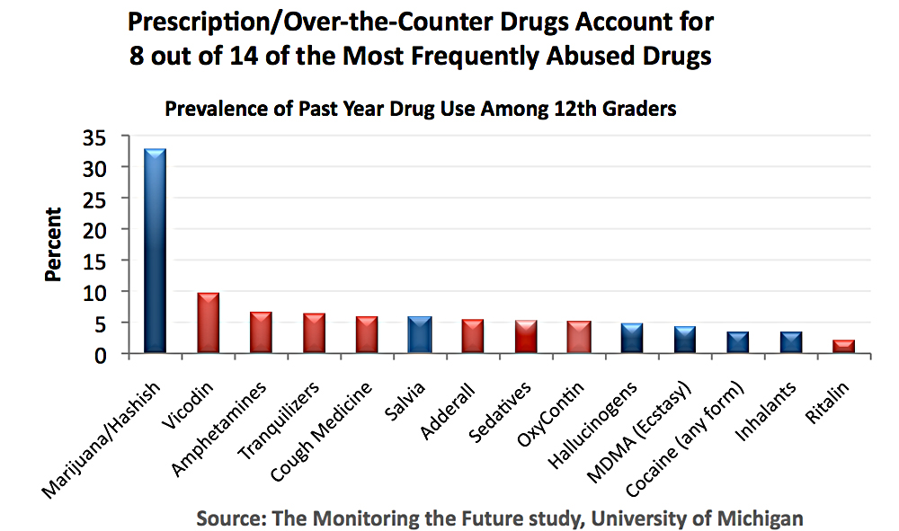

Slide 26
Commonly Used Prescription Drugs with Potential for Abuse
Category | Drugs | Examples
Sedatives | Barbiturates | Amytal, Nebutal
 | Flunitrazepam | Rohypnol
Dissociative anesthetics | Ketamine | Ketalar SV
Opioids and morphine | Codeine | Tylenol with codeine
derivates | Fentanyl | Duragesic
 | Morphine | Duramorph
 | Opium | Laudanum
 | Others | Oxycontin
Stimulants | Amphetamines | Dexedrine
 | Cocaine | Cocaine hydrochloride
 | Methamphetamine | Desoxyn
 | Methylphenidate | Ritalin
Anabolic steroids |  | Anadrol
Tranquilizers and | Benzodiazepines | Ativan, Halcion
muscle relaxers | Carisoprodol | Soma

Slide 27
Thank You

