Slide 1
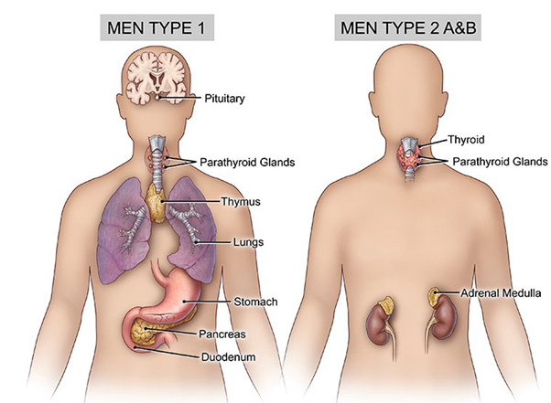
Men syndromes
BY MBBSPPT.COM

Slide 2
Introduction
Multiple endocrine neoplasia (MEN) syndromes are inherited disorders that affect the endocrine system. There are several types of MEN syndromes and each type may cause different conditions or cancers.
It is a hereditary cancer syndromes.
Neoplastic transformation in multiple target endocrine tissues (parathyroid, pituitary) & pathologic involvement of nonendocrine tissues (angiofibroma, neuroma).

Slide 3
Men1 Parathyroid Hyperplasia Or Adenoma. Islet Cell Hyperplasia, Adenoma, Or Carcinoma. Pituitary Hyperplasia Or Adenoma. Other Less Common Manifestations: Foregut Carcinoid, Pheochromocytoma, Subcutaneous Or Visceral Lipomas. | Men2 Men2a MTC Pheochromocytoma Parathyroid Adenoma Men2a With Cutaneous Lichen Amyloidosis Men2a With Hirschsprung Disease Men2b MTC Pheochromocytoma Mucosal And Gastrointestinal Neuromas Marfanoid Features (MTC=Medullary Thyroid Ca.) | Mixed Syndromes Von Hippel–lindau Syndrome Pheochromocytoma Islet Cell Tumor Renal Cell Carcinoma Hemangioblastoma of Central Nervous System Retinal Angiomas Neurofibromatosis with Features of MEN1 Or 2 Carney Complex, Myxomas Of Heart, Skin, And Breast Spotty Cutaneous Pigmentation

Slide 4
MEN TYPE 1- wermer’s syndrome
It is inherited as an autosomal dominant trait.
Generally, manifest by the 3rd or 4th decade.
Although rare, MEN1 is the most common MEN syndrome with prevalence of 2–20 per 100,000.

Slide 5
MEN 1
The MEN1 tumor suppressor gene, whose mutations are responsible for the MEN1 syndrome is located on chromosome 11q13 and codes for the MENIN protein:
Location
Chromosome 11q13
Protein
Menin, a 610 amino acid protein
Function
Regulates cell functions like DNA replication and repair, and transcriptional machinery
Role in disease
Inactivating mutations of the MEN1 gene cause multiple endocrine neoplasia type 1 (MEN1) syndrome

Slide 6
MENIN - genetics
Menin- predominantly a nuclear protein - binds to jun, a member of the AP-1 transcription factor family and represses jund-mediated transcription
Menin has been shown to interact physically with a diverse variety of other proteins that consists transcription factors, DNA processing factors, and cytoskeletal proteins (e.g., Smad3).
Studies have suggested a possible role for menin in repressing telomerase activity in somatic cells.
Menin promotes the maintenance of transcription of critical cell cycle regulators essential for normal endocrine cell growth control.

Slide 7
MEN 1 clinical features
Clinically, MEN1 - defined as the occurrence of neoplasms in at least 2 target endocrine tissues (parathyroid, endocrine pancreas, pituitary).
Familial MEN1 is defined as the additional occurrence of at least one tumor type in a first-degree relative.
The MEN1 trait - almost 100% penetrance - but with variable expressivity, so that each affected person may - exhibit some but not necessarily all components of the syndrome.

Slide 8
MEN 1 clinical features
The most common abnormality in MEN1 is multiple parathyroid tumors 98-100 %
Duodenopancreatic NET 30-80 %
Pituitary tumors 15-50 %
Familial MEN1
Early age of onset
Multifocal involvement within a target endocrine tissue
Development of concurrent neoplasms in multiple endocrine tissues.

Slide 9
MEN 1 clinical features
The principal feature - MEN1 mutation is hypercalcemia caused by multiglandular parathyroid tumors (1st biochem abn detected).
Other clinical features depend on the endocrine tissue involved, specific hormone overproduced, or local mass effect and malignant progression of the neoplasm.
Presenting complaint-severe ulcer disease, hypoglycemia.
Principal cause of mortality-malignant progression of net of duodenopancreatic tumours/intrathoracic malignant carcinoids.

Slide 10
MEN1 – parathyroids
Most common - >98%
Typically, enlargement of parathyroid - MEN1 patients is ASYMMETRICAL at any point in the intervention.
Hypercalcemia (asymptomatic for long period) - may precede the clinical onset of a pancreatic NET or pituitary neoplasm.
Renal lithiasis and skeletal complications occur – uncommon.
In familial men1 hypercalcemia is milder than in sporadic.

Slide 11
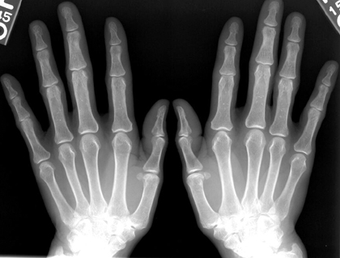
MEN1 – parathyroids
Subperiosteal
Bone resorption

Slide 12
MEN1 – parathyroids
Diagnosis - serum calcium level - with an inappropriately elevated parathyroid hormone level establishes the diagnosis.
Typically have a markedly elevated 24-hour urine calcium excretion.
When prospective biochemical screening - the onset of hypercalcemia - as early as 11 to 14 years of age.

Slide 13
MEN1 – parathyroids
Surgical procedures for multiple endocrine neoplasia type 1 (MEN1)-related hyperparathyroidism (PHPT) include:
Subtotal parathyroidectomy (SPT)
Removal of at least 3–3.5 parathyroid glands, or three glands and part of a fourth. This procedure is intended to reduce the risk of permanent hypoparathyroidism and early postoperative hypocalcemia.
Total parathyroidectomy (TPX)
Removal of all parathyroid glands, with autologous parathyroid tissue grafting.
Both procedures require a transcervical thymectomy, as the thymus can contain an ectopic parathyroid gland. Thymectomy can also help prevent thymic carcinoids.

Slide 14
MEN1 – parathyroids
A transcervical partial thymectomy - the possibility of an ectopic or supernumerary parathyroid gland within the cranial horns of the thymus.
Recurrence is 30% to 40% 5 years post surgery.
Delayed transplantation of cryopreserved autologous parathyroid tissue.

Slide 15
MEN1 – pancreas & duodenum
30% to 80% of patients with MEN1 develop NET – 2nd most common manifestation of MEN1.
Typically multifocal, and diffuse islet cell hyperplasia and microadenomas .
Gastrinomas - frequently occur within the wall of the duodenum or in extra pancreatic sites.
Significant malignant potential and result in most of the MEN1 disease-related morbidity and mortality.

Slide 16
MEN1 – pancreas & duodenum
IMAGING
CT or MRI should be performed as an initial test in almost all patients – exclude macro tumors & mets.
sensitivity decreases.
with smaller tumors (<2 cm).
Multiple tumors (as is often the case with MEN1).
tumors located in extra pancreatic locations (duodenal wall).
tumors located in the distal tail of the pancreas.
EUS is an effective and relatively noninvasive localizing test (after initial CT).

Slide 17
MEN1 – pancreas & duodenum
Somatostatin receptor scintigraphy (SRS) may also be used to localize.
Invasive test - selective pancreatic arteriography with provocative stimulation by selected secretagogues and measurement of increment hormone secretion in the hepatic vein.
the most accurate single localizing study.

Slide 18
MEN1 – pancreas & duodenum - c/f
Pancreatic NET are most common – nonfunctioning.
Functioning NET are:
Gatrinomas – m.c
Insulinomas – 2nd m.c
Others – Glucaganomas, Somatostatinoma, VIPoma(rare).

Slide 19
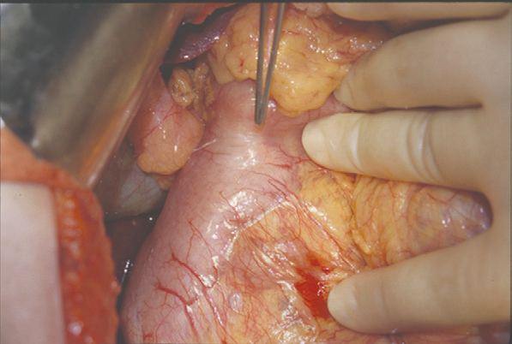
MEN1 – pancreas & duodenum - c/f
GASTRINOMAS
Usually malignant (≈80%)
Previously believed to be located predominantly in the head of the pancreas within the gastrinoma triangle.
Within the wall of the duodenum – recent.
Zollinger-Ellison Syndrome [ZES]:
Epigastric pain.
Reflux esophagitis.
Secretory diarrhea.
Weight loss.

Slide 20
MEN1 – pancreas & duodenum - c/f
GASTRINOMAS
Diagnosis:
Documentation of gastric acid hypersecretion (>15 mEq/liter).
Elevated fasting levels of serum gastrin (>100 pg/mL).
Confirmed by an abnormal secretin test.
Treatment:
Localized resection of a potentially malignant NET is indicated& extensive regional lymphadenectomy.
Unresectable gastrinoma or extensive metastatic disease.
Medical managemnt with PPI.
Parathyroidectomy - because normalization of the serum calcium level improves the ZES.

Slide 21
MEN1 – pancreas & duodenum - c/f
INSULINOMAS
Usually small (<2 cm) & occur with even distribution throughout the pancreas.
Recurrent symptoms of neuroglycopenia—
Sweating, dizziness, confusion, or syncope.
Whipples triad.
Diagnosis:
Documenting symptomatic hypoglycemia in association with inappropriately elevated plasma levels of insulin and C-peptide during a supervised 72-hour fast.

Slide 22
MEN1 – pancreas & duodenum - c/f
INSULINOMAS
Treatment:
Accurate localization and surgical resection of the functioning tumor.
MEN1 characteristically develop multiple NET.
Preoperative regional localization - selective catheterization of the arteries supplying the pancreas - followed by injection of an insulin secretagogue (calcium gluconate) - measurement of insulin gradients in the hepatic veins.
Disseminated metastases - may respond to streptozocin.
Control of hypoglycemia – may be by diazoxide or octreotide.

Slide 23
MEN1 – pituitary
The most frequent pituitary tumour MEN1 - Prolactinoma.
Symptoms are due to hypersecretion of hormones or compression of adjacent structures.
Large adenomas – Visual disturbances, hypopituitarism.
Prolactinomas - Amenorrhea and galactorrhea in women hypogonadism in men.
Acromegaly - GH secreting tumour.
Cushing’s disease - ACTH secreting tumours.

Slide 24
MEN1 – pituitary
Prolactinomas - dopamine agonist such as bromocriptine or cabergoline.
Octreotide and lanreotide – GH screting tumours.
Rapidly enlarging, nonfunctional macroadenomasthat are unresponsive to medical therapy - Trans-sphenoidal pituitary microsurgery or radiation therapy.

Slide 25
MEN 2
MEN2A, MEN2B, and medullary thyroid carcinoma (FMTC)
Hallmark – MTC
MEN 2A – MTC, Pheochromocytoma, Parathyroid hyperplasia or adenoma
MEN 2B – MTC, Pheochromocytoma, Mucosal and gastrointestinal neuromas, Marfanoid features

Slide 26
Pathology – genetics
RET (rearranged during transfection) - chromosome 10
proto-oncogene encodes a receptor tyrosine kinase protein involved in growth, differentiation, and migration of developing tissues
Specific mutations in RET decide the phenotype
mutations in extracellular cysteine codons of RET – MEN2A
mutation in tyrosine kinase domain of RET – MEN 2B
mutations in extracellular or intracellular cysteine codons of RET - FMTC

Slide 27
Pathology – genetics
These mutations de-stabilize the normal tertiary structure of the RET protein, which results in ligand-independent dimerization and persistent intracellular signaling by RET.

Slide 28
MEN 2A – sipple’s syndrome
MTC – penetrance is almost 100 %
40% to 50% will develop pheochromocytoma
The degree of penetrance for pheochromocytoma in MEN2A correlates with specific RET mutations, with the highest expression in carriers of mutations at codon 634.
Hyperparathyroidism in 20% to 35%

Slide 29
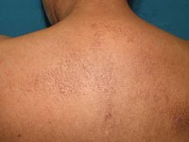
MEN 2A – sipple’s syndrome
Cutaneous lichen amyloidosis - amyloid deposition in the papillary dermis - pruritic cutaneous plaques - interscapular region or extensor surfaces of the extremities.
Hirschsprung’s disease has been associated with MEN2A

Slide 30
MEN 2B -
MTC.
MTC in MEN2B - a very young age, in infancy, most aggressive form of hereditary MTC.
All MEN2B individuals have mucosal neuromas,
40% to 50% of patients develop pheochromocytomas
Distinct physical appearance with a prominent mid–upper lip, everted eyebrows, multiple tongue nodules, and marfanoid Habitus ganglioneuromas of the intestine in the submucosal and myenteric plexus

Slide 31
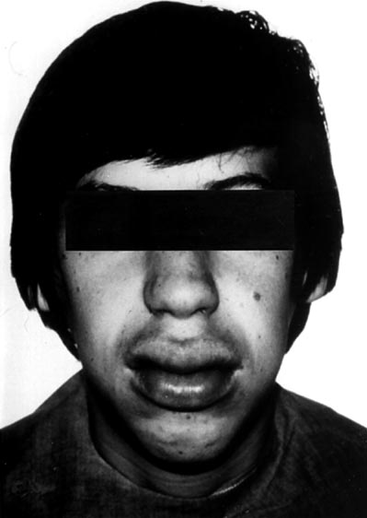
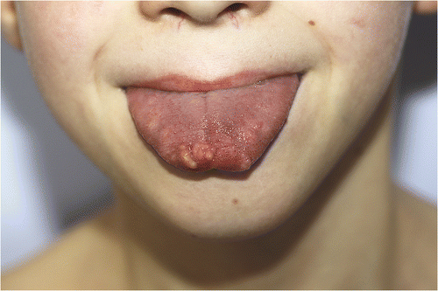
MEN 2B

Slide 32
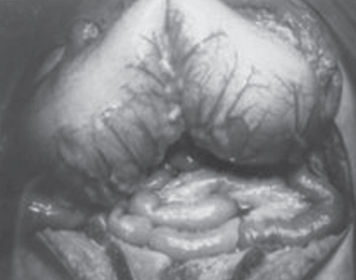
MEN 2B
All pts have megacolon and usually have chronic bowel problems.
Intestinal dysfunction may manifest early in life with poor feeding, failure to thrive, constipation, or pseudo-obstruction
Adults with this disorder may have dysphagia from esophageal dysmotility.

Slide 33
Screening and Genetic Testing
Past – pentagastrin stimulated calcitonin testing
now the standard screening test for MEN2 - Sequencing of the RET gene to detect germline mutations
If possible, testing should occur at birth – clinical screening & preventive surgery
When an MTC patient with no known family history of MTC or MEN2 is found to have a RET mutation (index case), all first-degree family members should be offered genetic counseling and testing. RET mutation testing is also indicated for adult or pediatric patients who present with MTC or pheochromocytoma24% of pheochromocytomas are hereditary, with 5%

Slide 34
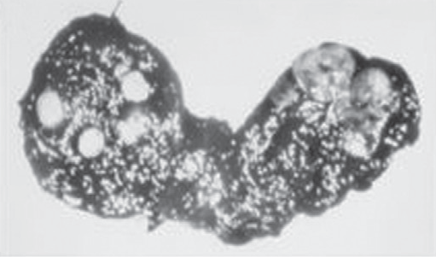
MCT
25% occur within the spectrum of MEN syndromes
Patients with familial syndromes present at a younger age group
Multicentric - familial MTC cases
Bilateral (90%) – familial syndrome cases

Slide 35
MCT – clinical features
Neck mass
15 – 20 % may have cervical lymphadenopathy
Pain or aching is more common in these tumours when compared to other tumors
Local infiltration - dyspnoea , dysphagia , dysphonia
Distant mets – liver , bone(osteoblastic) ,lung appear in late stages.

Slide 36
MCT – clinical features
Extensive metastatic disease frequently develop diarrhea - result from increased intestinal motility and impaired intestinal water and electrolyte flux.
Cushings syndrome - 2-4 % - ectopic production of ACTH
Calcitonin and carcinoembryonic antigen (CEA), calcitonin gene–related peptide, histaminadases, prostaglandins E2 and F2α, and serotonin.

Slide 37
MCT – diagnosis
most commonly IHC for CALCITONIN is used as diagnostic marker
Presence of Amyloid is also diagnostic
Also stain positively for CEA and calcitonin gene–related peptide
FNA cytology of the thyroid mass.
should be screened for RET point mutations, pheochromocytoma, and HPT

Slide 38
MCT – management
A neck ultrasound is recommended to evaluate the central and lateral neck compartments and the superior mediastinum
Calcitonin levels >400 pg/mL, additional imaging includes neck and chest CT and a triple-phase liver CT or contrast-enhanced MRI is recommended to assess for metastatic disease

Slide 39
MCT – management
Total thyroidectomy is the treatment of choice for patients with MTC because of the high incidence of multicentricity, the more aggressive course, and the fact that 131 I therapy usually is not effective
Central compartment nodes frequently are involved - bilateral prophylactic central neck node dissection - routinely performed.
Prophylactic lateral neck dissection is if central neck lymph nodes are involved or if the primary tumour is ≥1.5 cm.

Slide 40
MCT – management
MEN 2B with RET – total thyroidectomy (<1yr)
RET (sporadic) – total thytroidectomy
Level VI lymph node dissection can be ommitted if
MEN 2B <1yr
MEN 2A ,FMTC <5yr , <5mm , low calcitonin , no lymph node mets

Slide 41
MCT – management
Patients are followed by annual measurements of calcitonin and CEA levels
Ultrasound, CT, MRI, FDG-PET/CT scans - used to localize recurrent disease
The 10-year survival rate is 80%
45% in patients with lymph node involvement.
Survival best in non-MEN familial MTC >> MEN2A >> sporadic disease
Prognosis is the worst (survival of 35% at 10 years) in patients with MEN2B.

Slide 42
Pheochromocytoma
neoplasms arising from chromaffin cells in the adrenal medulla – catecholamines
40% to 50% of all patients with MEN2A / MEN2B
Age at dx - 30 to 40 years
associated with MEN2 are almost always benign and confined to the adrenal medulla
multifocal & bilateral >50% of cases

Slide 43
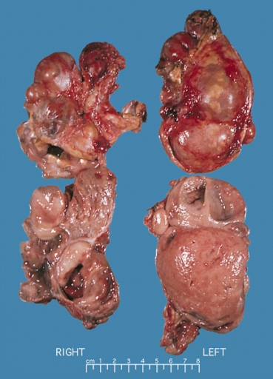
Pheochromocytoma
Clinical Features:
Symptoms of catecholamine excess
headache, hypertension, palpitations, tremors,
and anxiety.
unregulated catecholamine - devastating consequences
stroke, myocardial infarction, and sudden death.

Slide 44
Pheochromocytoma
Screening for pheochromocytomas should be done in all pts diagnosed with MEN2
24-hour urine metanephrine levels
Negative - testing should be done annually thereafter.
Positive or borderline results - CT or MRI.
TREATMENT:
In the past - Recommended bilateral adrenalectomies for all MEN2 patients.
significant risk of adrenal insufficiency and addisonian crisis.

Slide 45
Pheochromocytoma

Slide 46
Pheochromocytoma
TREATMENT :
In the past - Recommended bilateral adrenalectomies for all MEN2 patients.
significant risk of adrenal insufficiency and addisonian crisis.
Pheochromocytomas are not malignant in MEN2 patients,
and the interval between the development of a pheochromocytoma on one side and the other side is more than 10 yrs
now recommend removing only the affected adrenal in the setting of unilateral pheochromocytoma in MEN2 patients, with annual screening (lap is preferred if tumour is < 9 to10 cm)

Slide 47
Thank You

