Slide 1
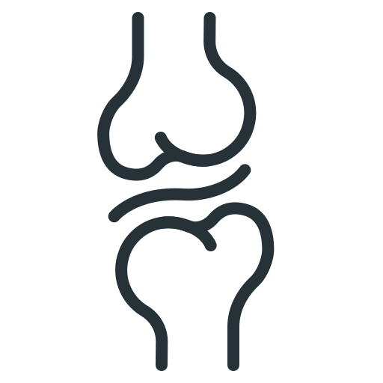
Meniscus
Anatomy, Function and Injury
BY MBBSPPT.COM
Notes:
The menisci are described as moving with the femoral condyles with flexion and extension but moving with the tibia with rotary movements.
The articular surface of the medial condyle is prolonged anteriorly, and as the knee comes into the fully extended position, the femur internally rotates until the remaining articular surface on the medial condyle is in contact. The posterior portion of the lateral condyle rotates forward laterally, thus producing a “screwing home” movement, locking the knee in the fully extended position. When flexion is initiated, unscrewing of the joint occurs by external rotation of the femur on the tibia.

Slide 2
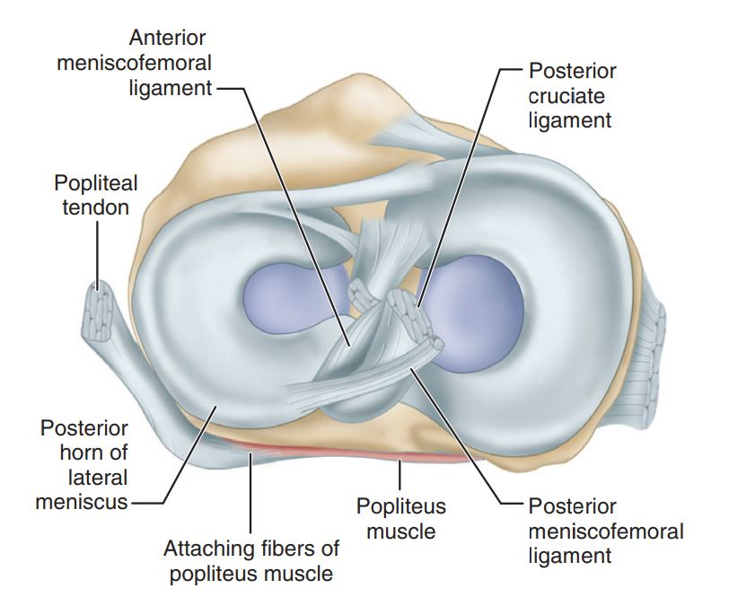
Meniscus
Greek word meniskos, meaning “crescent”.

Slide 3
Embryology and Development
Characteristic shape of the lateral and medial menisci is attained between the 8th and 10th week of gestation.
Highly cellular and vascular, with the blood supply entering from the periphery and extending through the entire width of the menisci.

Slide 4
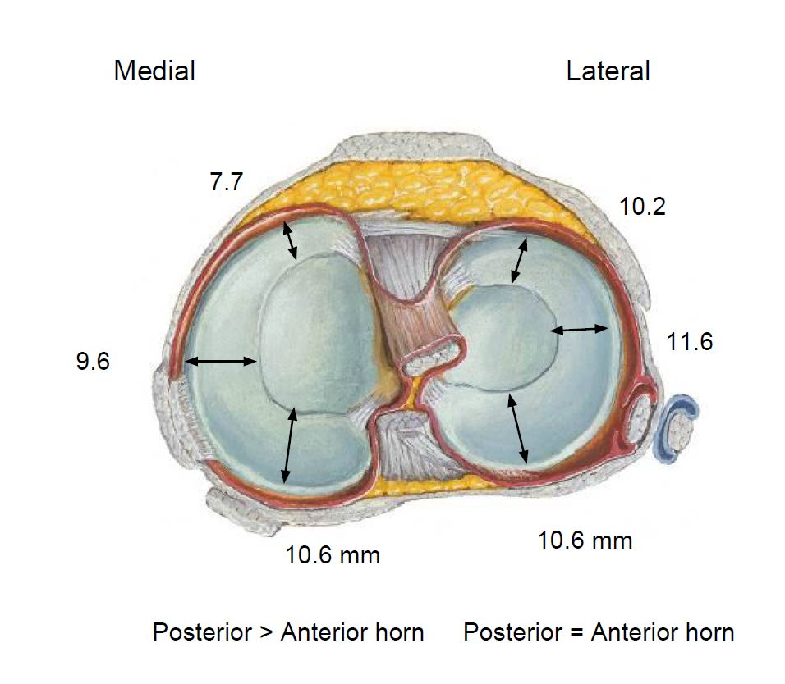

Slide 5
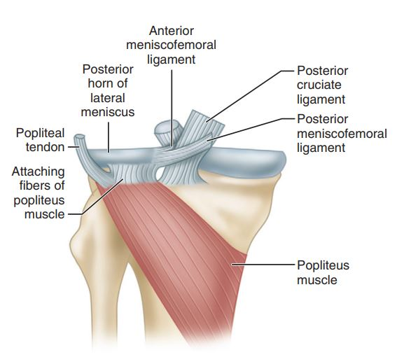

Slide 6
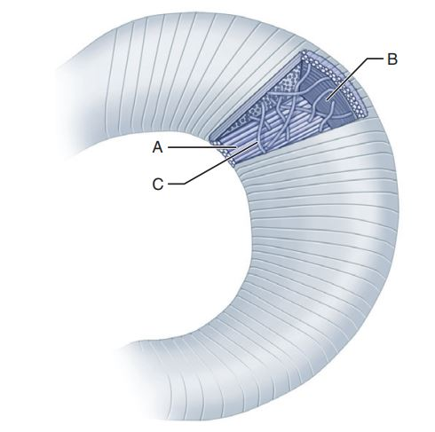
Radial fibers (A). Circumferential fibers (B). Perforating fibers (C).

Slide 7
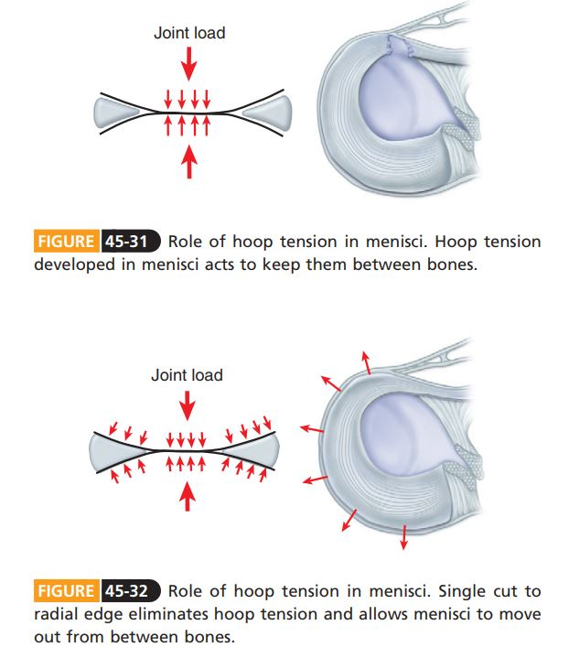

Slide 8
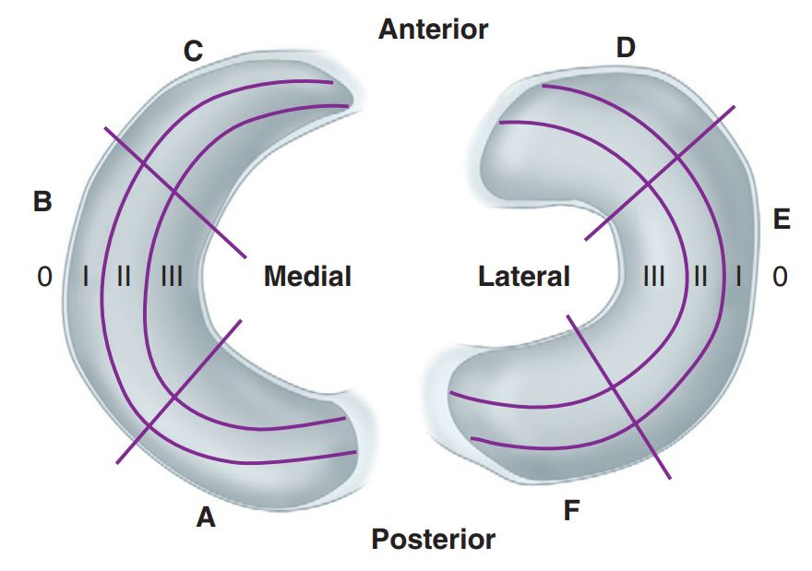
Zone classification of meniscus

Slide 9
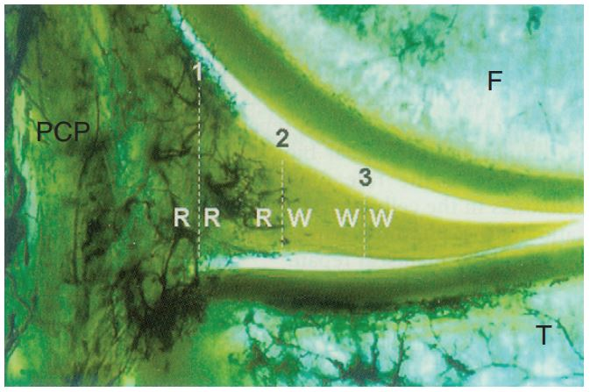

Slide 10
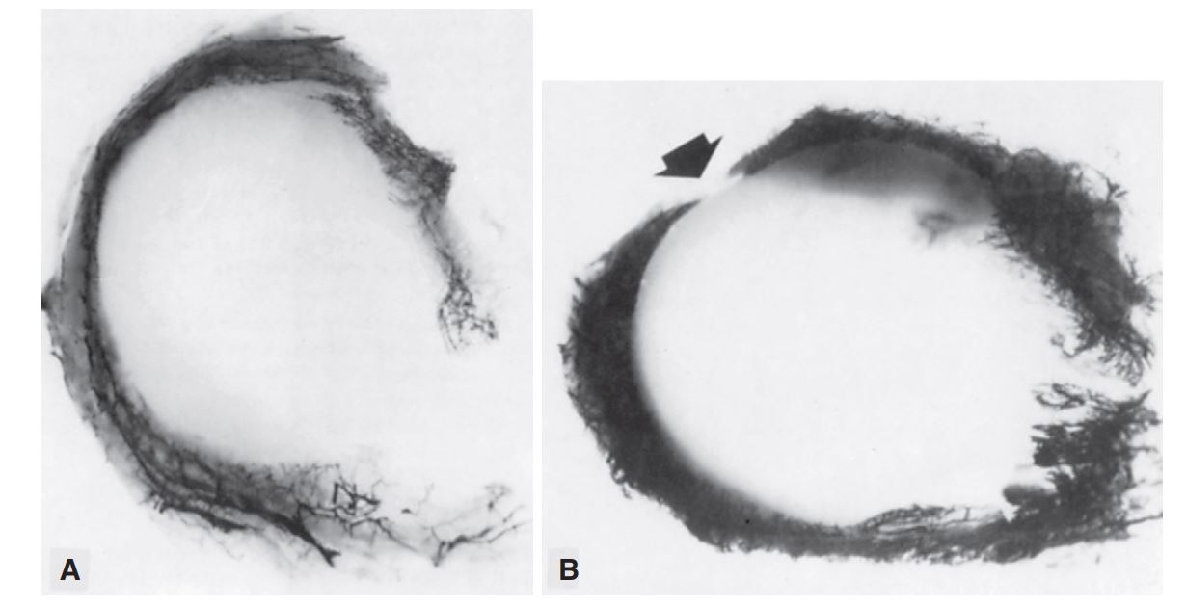

Slide 11
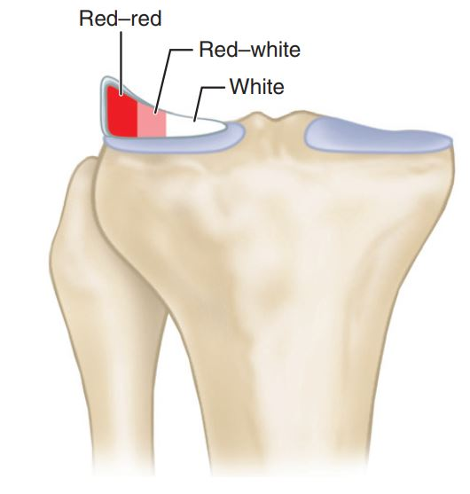
Zones of potential meniscal healing

Slide 12
Function
Joint Filler.
Prevent Capsular and Synovial Impingement.
Joint Lubrication.
Contribute to Stability.
Nutrition.
Load Bearing / Weight Bearing.
Stabilization of the Joint.

Slide 13
Tears of Menisci
Most commonly by rotation as the flexed knee moves toward an extended position.
Most common location for injury is the posterior horn of the meniscus, and longitudinal tears are the most common type of injury.

Slide 14
More With,
Peripheral Cystic Formation.
Previous Injury or Disease.
Discoid Lateral Meniscus.
Aging.
Incongruities or Ligamentous Disruptions.
Congenitally Relaxed Joints.
Inadequate Musculature, Especially the Quadriceps.

Slide 15
Mechanism of tear
Rotational force incurred while the joint is partially flexed.
The meniscus is entrapped between the femoral and tibial condyles in flexion, tearing as the knee is extended.

Slide 16
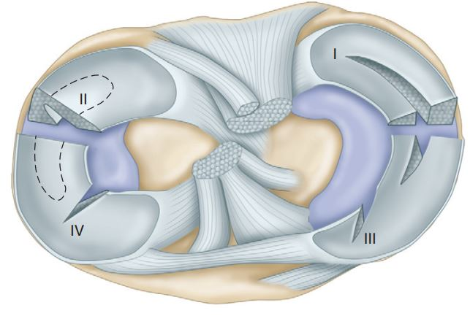
Classification
Types of Meniscal Tears:
I- longitudinal; II- horizontal; III- oblique; and IV- radial.

Slide 17
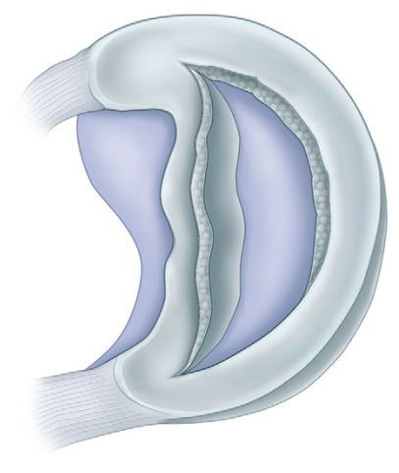
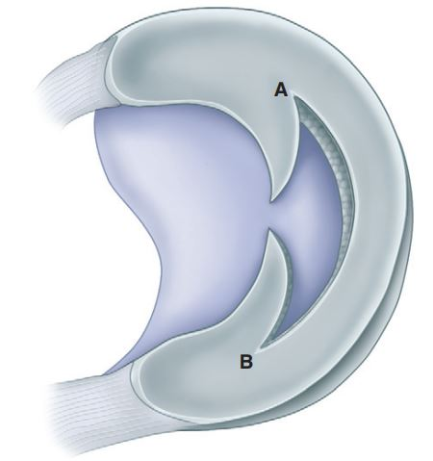
Diagram of Posterior Oblique (A) and Anterior oblique (B) Tears.
Bucket-handle Tear, Displaced Centrally.

Slide 18
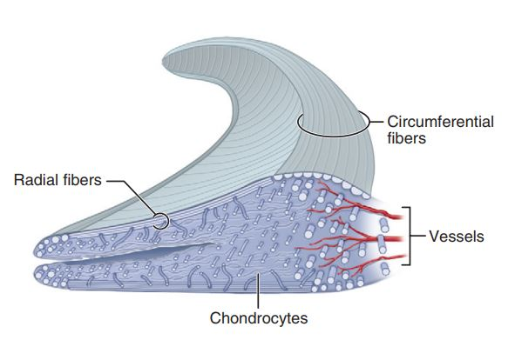

Slide 19
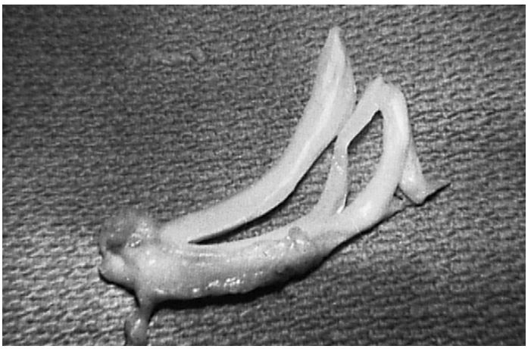

Slide 20
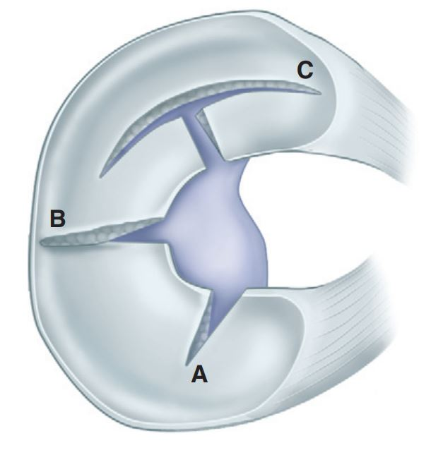
Radial tears

Slide 21
Presentation
Catching, Snapping, or Clicking.
Occasional Pain and Mild Swelling.
Locking/No Locking.
Atrophy of the Quadriceps.
Significant: Giving Way and Locking.

Slide 22
Diagnosis
Difficult
Careful history, physical examination, standard X rays, MRI and Arthroscopy – reduces errors to <5%.

Slide 23
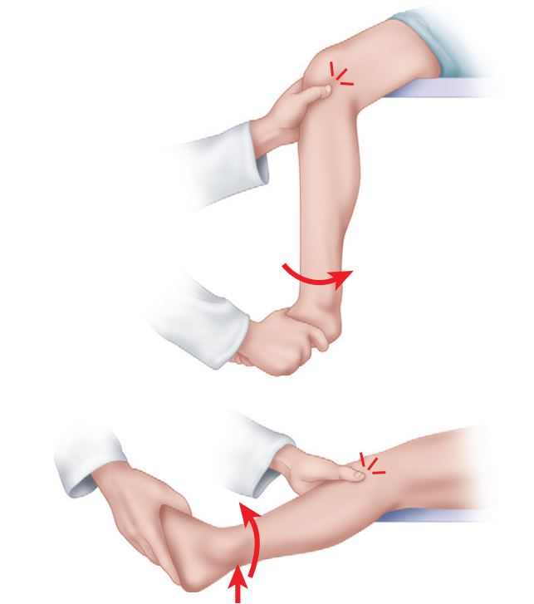
McMurray’s Test
The McMurray test is probably best known and is carried out as follows. With the patient supine and the knee acutely and forcibly flexed, the examiner can check the medial meniscus by palpating the posteromedial margin of the joint with one hand while grasping the foot with the other hand. Keeping the knee completely flexed, the leg is externally rotated as far as possible and then the knee is slowly extended. As the femur passes over a tear in the meniscus, a click may be heard or felt. The lateral meniscus is checked by palpating the posterolateral margin of the joint, internally rotating the leg as far as possible, and slowly extending the knee while listening and feeling for a click. A click produced by the McMurray test usually is caused by a posterior peripheral tear of the meniscus and occurs between complete flexion of the knee and 90 degrees. Popping, which occurs with greater degrees of extension when it is definitely localized to the joint line, suggests a tear of the middle and anterior portions of the meniscus. The position of the knee when the click occurs thus may help locate the lesion. A McMurray click localized to the joint line is additional evidence that the meniscus is torn; a negative result of the McMurray test does not rule out a tear.

Slide 24
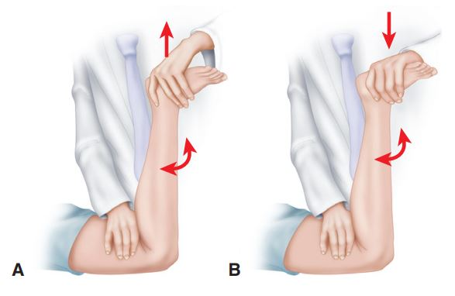
Apley grind test
Caution: Tears of one meniscus can produce pain in the opposite compartment of the knee. This is most commonly seen with posterior tears of the lateral meniscus.

Slide 25
Squat Test
Thessaly Test
 | Sensitivity (%) | Specificity (%)
McMurray’s test | 70 | 71
Apley | 60 | 70
Joint line tenderness | 63 | 77

Slide 26
Karachalios et al. described a test for early detection of meniscal tears (Thessaly test) for which they reported diagnostic accuracy rates of 94% in detecting tears of the medial meniscus and 96% in the detection of tears of the lateral meniscus. The examiner supports the patient by holding his or her outstretched hands while the patient stands flatfooted on the floor. The patient then rotates his or her knee and body, internally and externally, three times with the knee in slight flexion (5 degrees). The same procedure is carried out with the knee flexed 20 degrees. Patients with suspected meniscal tears experience medial or lateral joint-line discomfort and may have a sense of locking or catching. The test is always done on the normal knee first to teach the patient how to keep the knee in 5 and 20 degrees of flexion and how to recognize a possible positive result in the symptomatic knee. The Thessaly test at 20 degrees of knee flexion was suggested to be effective as a first-line clinical screening test for meniscal tears.

Slide 27
The grinding test, as described by Apley, is carried out as follows. With the patient prone, the knee is flexed to 90 degrees and the anterior thigh is fixed against the examining table. The foot and leg are then pulled upward to distract the joint and rotated to place rotational strain on the ligaments; when ligaments have been torn, this part of thetest usually is painful. Next, with the knee in the same position, the foot and leg are pressed downward and rotated as the joint is slowly flexed and extended when a meniscus has been torn, popping and pain localized to the joint line may be noted.

Slide 28
Diagnostic investigations
X-Ray
Arthrography
MRI: 98% Accuracy for Medial Meniscal Tears and 90% for Lateral Meniscal Tears.

Slide 29
Non-operative Management
An incomplete Meniscal Tear or a Small (5 Mm) Stable Peripheral Tear with No other Pathological Condition, such as a Torn Anterior Cruciate Ligament, can be treated Nonoperatively with Predictably Good Results.
Stable Vertical Longitudinal Tears, which tend to occur in the Peripheral Vascular Portions of the Menisci.
Groin-to-ankle Cylinder Cast or Knee Immobilizer worn for 4 to 6 weeks.
Crutch Walking with touch-down Weight Bearing is Permitted.
Progressive Isometric Exercise Program.

Slide 30
Operative management
1.
Open
Arthroscopic
2.
Partial Meniscectomy
Subtotal Meniscectomy
Total Meniscectomy
3.
Meniscal Repair

Slide 31
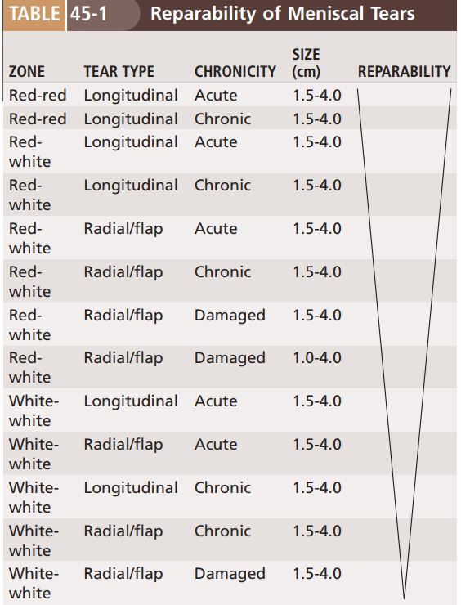

Slide 32
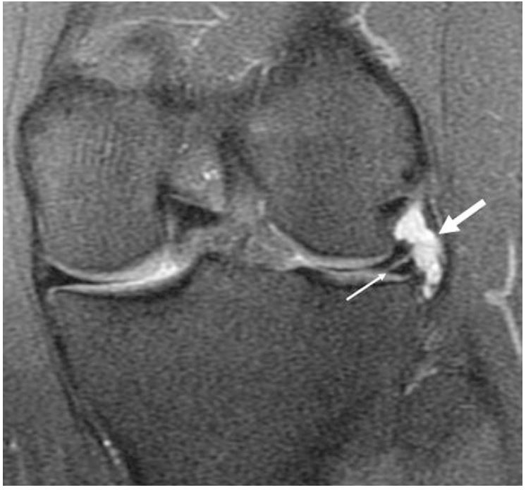
Meniscal cyst
Cysts of the menisci are frequently associated with tears and are nine times more common on the lateral than on the medial side. The most common cause is trauma that produces degeneration and secondary mucinous and cystic changes in the periphery of the meniscus; when inflammatory changes follow, the meniscus may become less mobile during flexion, extension, and rotary motions and thus more susceptible to additional longitudinal or transverse tearing.

Slide 33
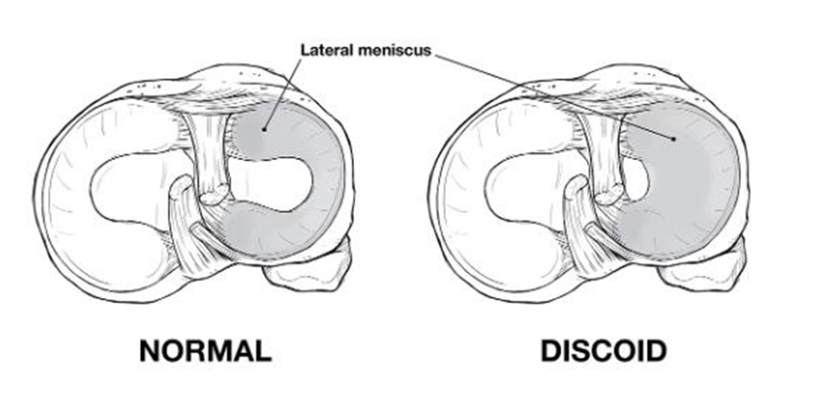
Discoid Meniscus

Slide 34
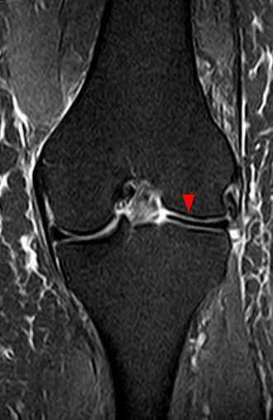
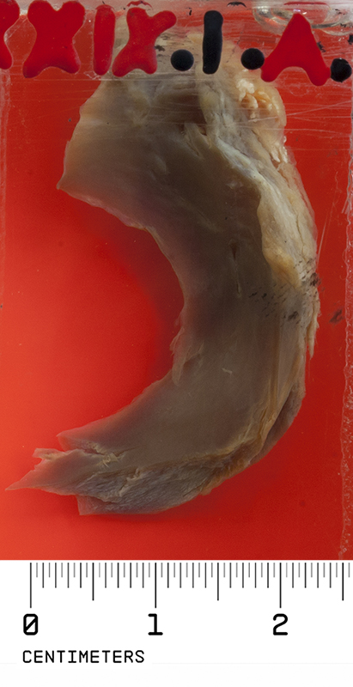

Slide 35
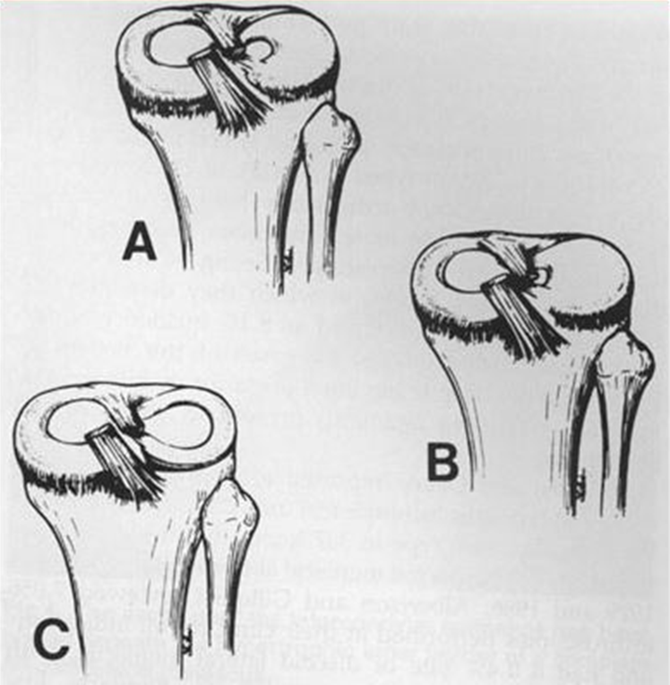
Watanabe Classification (A). Incomplete (B). Complete (C). Wrisberg

Slide 36
Discoid menisci are abnormal, and because of hypermobility and the bulk of the tissue between the articular surfaces, they are vulnerable to compression and rotary stresses.
Degeneration within the discoid meniscus, as well as tears, may develop. The diagnosis often is not made until surgery, since the discoid meniscus may not produce significant symptoms until some derangement of the meniscus occurs.

Slide 37
Thank You

