Slide 1
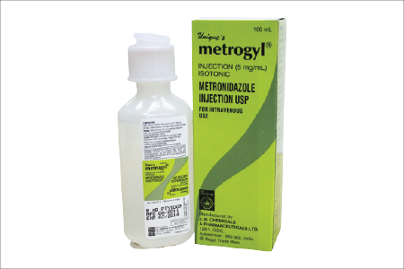
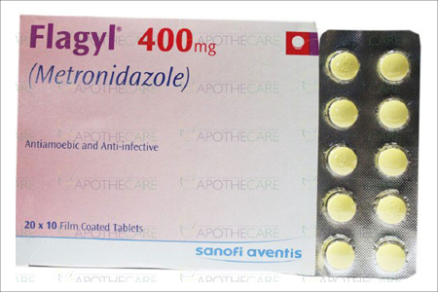
Metronidazole
By Rajesh Patel

Slide 2
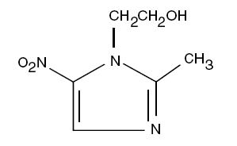
INTRODUCTION
Metronidazole is a synthetic antiprotozoal and antibacterial agent,( l-β-hydroxyethyl)-2-methyl-5-nitroimidazole, which has the following structural formula:
It belongs to the group of nitro imidazoles.
Other members related to Metronidazole are tinidazole and others.

Slide 3
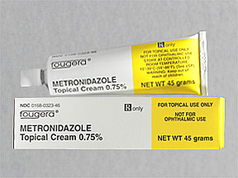
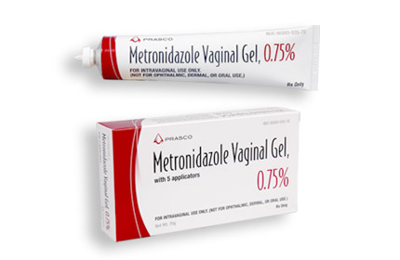
DOSAGE FORMS & TRADE NAMES
Trade names: Flagyl, Flagyl ER.
Dosage Forms: Tablet, Gel, Cream, Capsule, Suspension
Flagyl tablets contain 250 mg or 500 mg of Metronidazole.
Inactive ingredients include cellulose, hydroxypropyl cellulose.

Slide 4
Pharmacokinetics
Absorption
Bioavailability: 80% absorption from GI tract (PO)
Protein binding (<20%)
Peak serum time: 1-2 hr
Distribution
Widely distributed; similar pattern for PO and IV
Metabolism
Liver
Enzymes inhibited: Hepatic CytochromeCYP2C9
Elimination
Half-life: 25-75 hr (neonates); 8 hr (others); prolonged in patients with hepatic impairment
Excretion: Urine (77%); feces (14%)

Slide 5
MECHANISM OF ACTION
Metronidazole acts by inhibiting nucleic acid synthesis by disrupting the DNA of microbial cells.
This function only occurs when Metronidazole is partially reduced, and because this reduction usually happens only in anaerobic cells, it has relatively little effect upon human cells or aerobic cells.

Slide 6
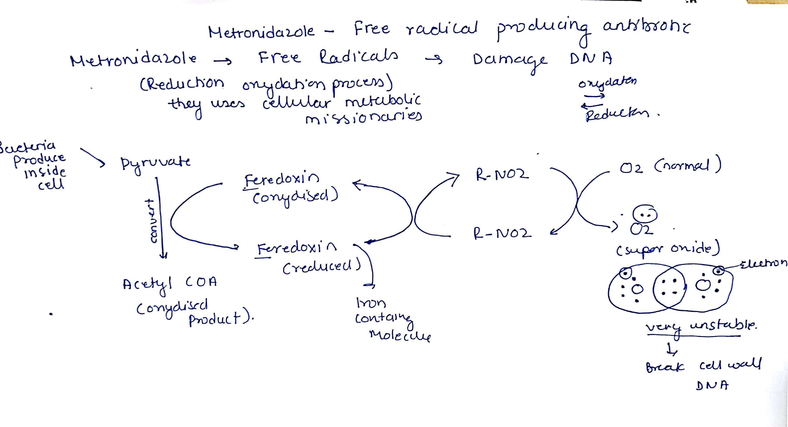

Slide 7
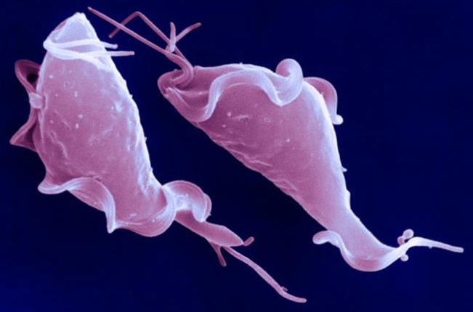
INDICATIONS
Anaerobe infections
Clostridium difficile
H. pylori
Bacterial vaginosis
Trichomonas vaginitis
Amebiasis
Giardiasis
Notes:
Antacids (↓ absorption)
CyA/tacro: increased levels of immunosuppression
Increased li and pheny → decreased metro levels
Phen, rif, pred → decreased levels of metro
Warfarin: increased in warfarin follow INR

Slide 8
SIDE EFFECTS OF METRONIDAZOLE
Epigastric distress
Seizures
Metallic taste
Darkening of urine
Peripheral neuropathy
Pancreatitis
Hepatitis
Fever
Reversible neutropenia
Stevens–Johnson syndrome: Metronidazole alone rarely causes Stevens–Johnson syndrome, but is reported to occur at high rates when combined with mebendazole. Very rare Fewer than 20K US cases per year

Slide 9
DRUG INTERACTIONS
DRUG | INTERACTION
ALCOHOL | Mild disulfiram like reaction (Nausea, headache, vomiting, abdominal cramps)
ANTICOAGULANTS (WARFARIN) | Prolonged PT(Prothrombin time)
CIMETIDINE | Prolong half life & decrease clearance of Metronidazole
PHENYTOIN & PHENOBARBITONE | Decrease serum concentration and increase metabolism of Metronidazole

Slide 10
Pregnancy & Lactation
Pregnancy category: B
May be acceptable. Either animal studies show no risk but human studies not available or animal studies showed minor risks and human studies done and showed no risk.
Lactation
Excreted in human milk; not recommended
Following PO administration, concentrations in human milk are similar to concentrations in plasma.

Slide 11
WHAT HAPPENS IF ONE MISSES THE DOSE
The decision of drug dose is a practical issue after many complicated trials both in-vitro and in-vivo.
Missing a dose in any cause of treatment will disturb the optimal therapeutic concentration which in turn may compromise treatment, and hence impair healing.

Slide 12
IMPORTANT THINGS TO REMEMBER BEFORE DISPENSING METRONIDAZOLE
Any woman in child bearing age should be asked if she is pregnant.
old patient’s should be asked about history of chronic illness, especially hepatic and renal diseases.
Social history must inquire alcohol consumption of the patient.
Patient should be asked about other medications he/she is taking as well as other important questions like allergies and intolerances.

