Slide 1
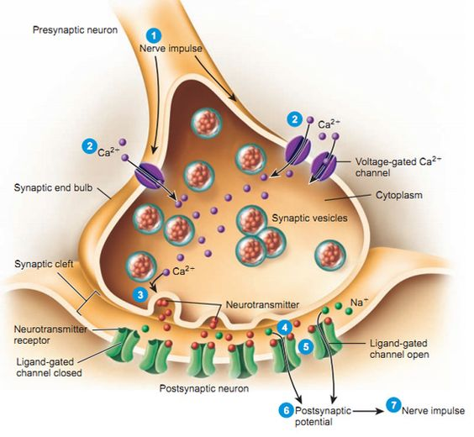
Neuromuscular Physiology
BY MBBSPPT.COM

Slide 2
History
In the 19th century and early years of the 20th century ,there was broad support for the concept that impulse in nerves acted directly on muscle, resulting in muscular contraction-”electrical theory”
In 1936, the Nobel prize in physiology or medicine was award to sir Henry hallet dale and Otto Loewi “for their discoveries relating to chemical transmission of nerve impulses”

Slide 4
The nerve synthesizes acetylcholine and stores it in small, uniformly sized packages called vesicles.
Stimulation of the nerve causes these vesicles to migrate to the surface of the nerve, rupture, and discharge acetylcholine into the cleft separating the nerve from muscle.
AChRs in the end plate of the muscle respond by opening their channels for influx of sodium ions into the muscle to depolarize the muscle.

Slide 5
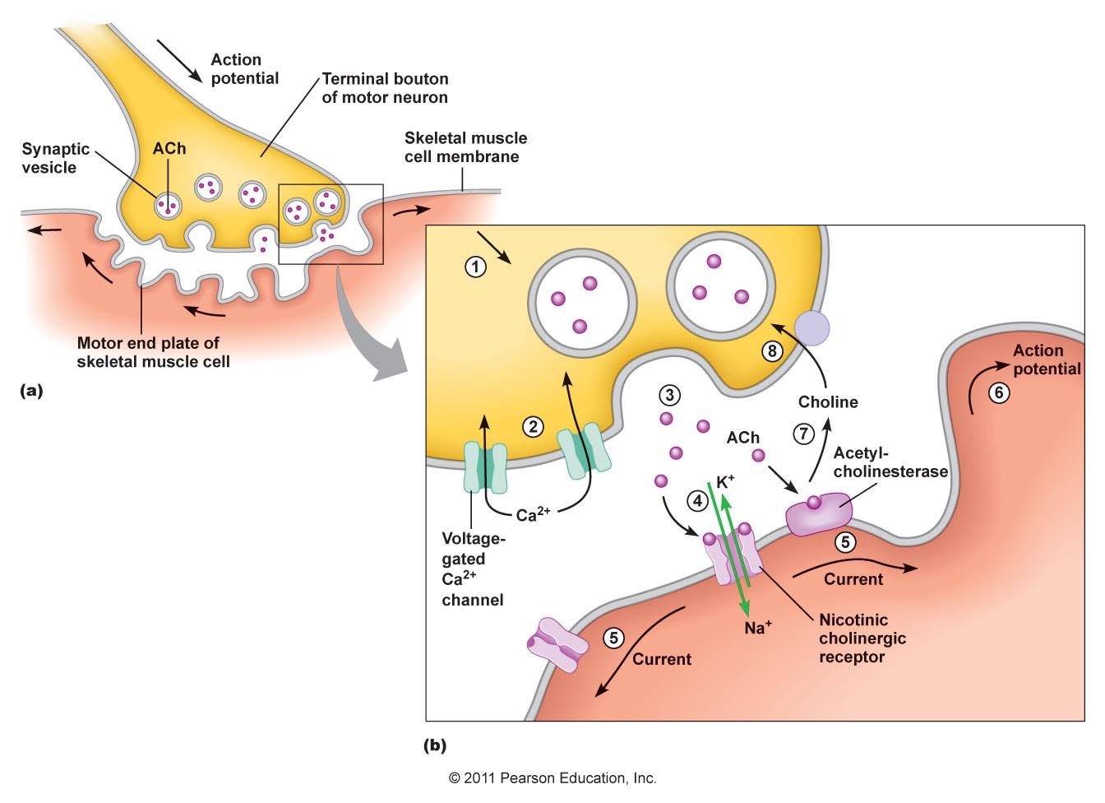
The endplate potential created is continued along the muscle membrane by the opening of sodium channels -contraction.
The acetylcholine immediately detaches from the receptor and is destroyed- acetylcholinesterase.
Drugs, notably depolarizing muscle relaxants or nicotine and carbachol (a synthetic analog of acetylcholine not destroyed by acetylcholinesterase), can also act on these receptors to mimic the effect of acetylcholine and cause depolarization of the end plate. These drugs are therefore called agonists.

Slide 6
NDMRs also act on the receptors, but they prevent acetylcholine from binding to the receptor and thus prevent depolarization by agonists. Because these NDMRs prevent the action of agonists (e.g., acetylcholine, carbachol, succinylcholine), they belong to the class of compounds known as antagonists at the muscle AChRs.
Other compounds, frequently called reversal drugs or antagonists of neuromuscular paralysis (e.g., neostigmine, prostigmine), inhibit acetylcholinesterase and therefore impair the hydrolysis of acetylcholine. The increased accumulation of acetylcholine can effectively compete with NDMRs and thereby displace the latter from the receptor (i.e., law of mass action) and antagonize the effects of NDMR

Slide 7
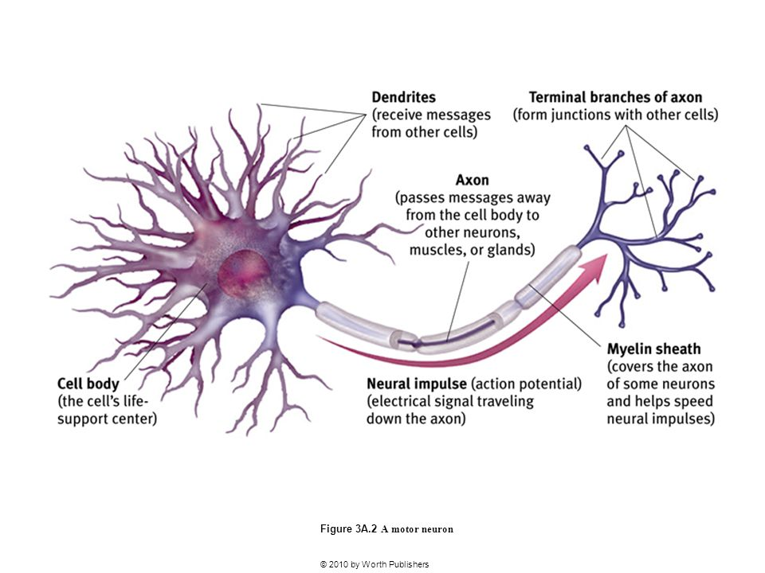
The Motor Neuron
Motor neurons are the nerves that control skeletal muscle activity.
Axons are 10-20µm in diameter and surrounded by a myelin sheath produced by Schwann cell.
The myelin sheath is interrupted by nodes of Ranvier between which the action potential jumps causing rapid conduction of the nerve impulse.

Slide 8
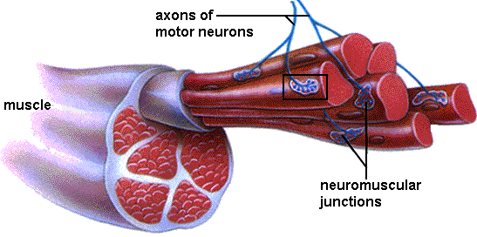
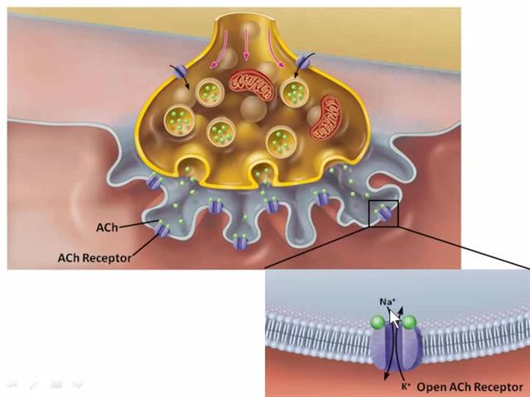
Each motor neuron connects to several skeletal muscle fibers to form a motor unit.
As the motor neuron enters a muscle, the axon divides into telodendria, the ends of which, the terminal buttons, synapse with the motor endplate.
The nerve is separated from the surface of the muscle by a gap of approximately 20 nm, called the junctional cleft or synaptic cleft
The muscle surface is heavily corrugated, with deep invaginations of the junctional cleft—the primary and secondary cleft.
The shoulders of the folds are densely populated with AChRs, approximately 5 million of them in each junction.

Slide 9
Because all the muscle cells in a unit are excited by a single neuron, stimulation of the nerve electrically or by an action potential originating from the ventral horn or by any agonist, including depolarizing relaxants (e.g., succinylcholine), causes all muscle cells in the motor unit to contract synchronously.
Synchronous contraction of the cells in a motor unit is called fasciculation and is often vigorous enough to be observed through the skin.
Although most adult human muscles have only one neuromuscular junction per cell, an important exception is some of the cells in extra ocular muscles.

Slide 10
The extraocular muscles are tonic muscles, and, unlike other mammalian striated muscles, they are multiply innervated with several neuromuscular junctions strung along the surface of each muscle fiber.
The ocular muscles slowly contract and relax rather than quickly as do other striated muscles; they can maintain a steady contraction, or contracture, the strength of which is proportional to the stimulus received.
Succinylcholine causes a long-lasting contracture response that pulls the eye against the orbit and could contribute to an increase in intraocular fluid pressure.
Succinylcholine-induced contractions of the extraocular muscles can last as long as 1 to 2 minutes.
Thus succinylcholine probably should not be given to patients with open eye injuries

Slide 11
Quantal Theory
These vesicles are loaded with acetylcholine via a magnesium dependent active transport system in exchange for a hydrogen ion.
Once synthesized the molecules of acetylcholine are stored in vesicles within the terminal button, each vesicle containing approximately 10,000 molecules of acetylcholine.
The release of acetylcholine into the synaptic cleft may be spontaneous or in response to a nerve impulse
Spontaneous release of single vesicles of acetylcholine occurs randomly and results in miniature endplate potentials of 0.5-1mV.

Slide 12
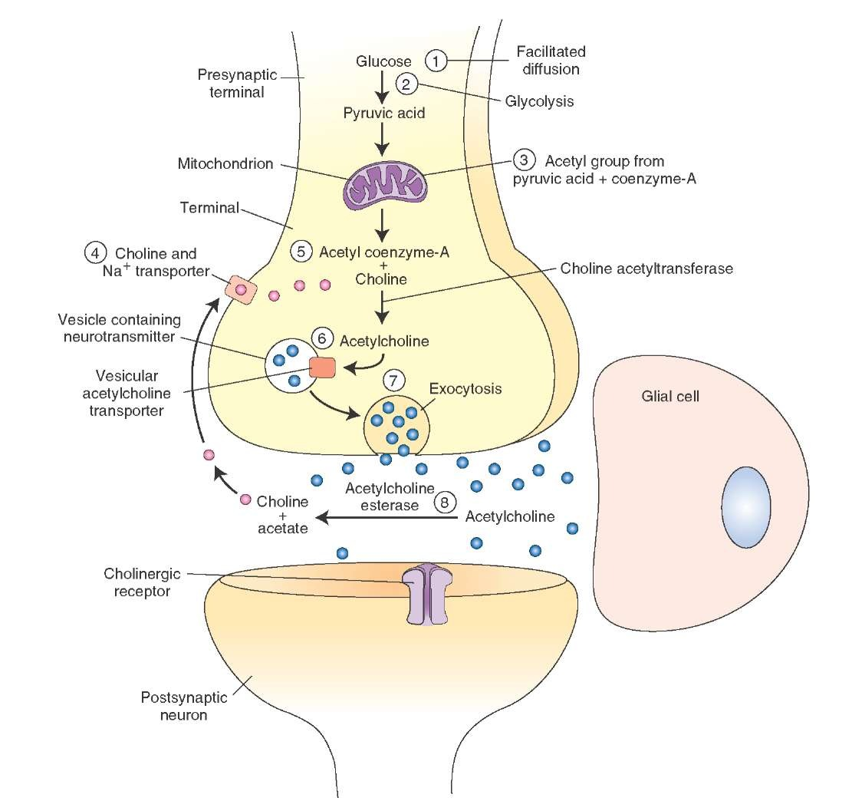
Acetylcholine is synthesized from choline and acetyl-coenzyme A (acetyl-coA) in the terminal axoplasm of motor neurons and is catalyzed by the enzyme cholinacetlytransferase.
Acetyl-coA is synthesized from pyruvate in the mitochondria in the axon terminals.
Approximately 50% of the choline is extracted from extracellular fluid by a sodium dependant active transport system, the other 50% is from acetylcholine breakdown at the neuromuscular junction
The majority of the choline originates from the diet with hepatic synthesis only accounting for a small proportion.
Choline acetyltransferase is produced on the ribosome in the cell body of the motor neuron.

Slide 13
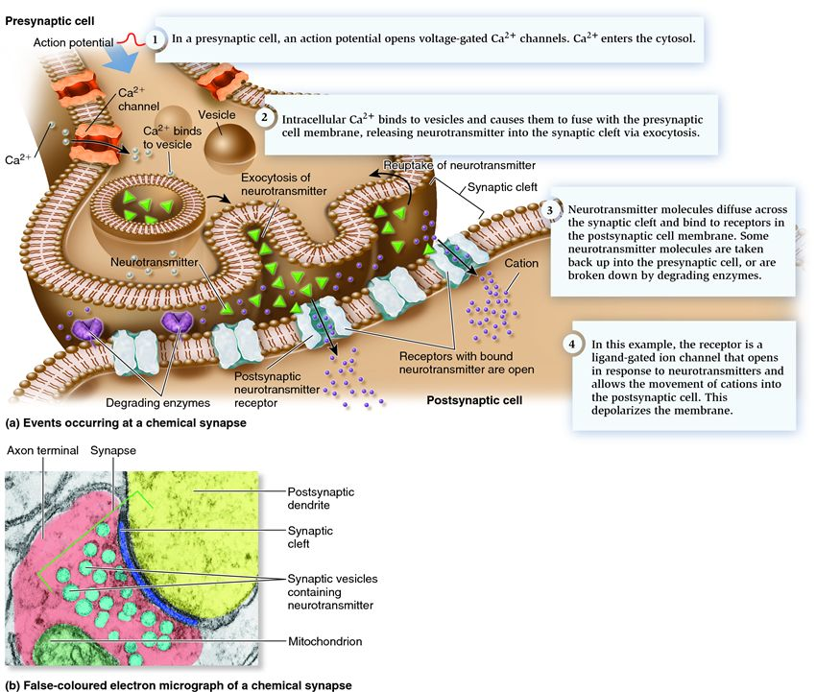
Nerve action potential
During a nerve action potential, sodium from outside flows across the membrane, and the resulting depolarizing voltage opens the calcium channels, which allows entry of calcium ions into the nerve and causes acetylcholine to be released.

Slide 14
A nerve action potential is the normal activator that releases the transmitter acetylcholine.
If calcium is not present, then depolarization of the nerve, even by electrical stimulation, will not produce the release of transmitter.
An effect of increasing calcium in the nerve ending is also clinically observed as the so-called posttetanic potentiation, which occurs after a nerve of a patient paralyzed with an NDMR is stimulated at high, tetanic frequencies.
Calcium enters the nerve with every stimulus, but it accumulates during the tetanic period because it cannot be excreted as quickly as the nerve is stimulated.

Slide 15
Because the nerve ending contains more than the normal amount of calcium for some time after the tetanus, a stimulus applied to the nerve during this time causes the release of more than the normal amount of acetylcholine.
The abnormally large amount of acetylcholine antagonizes the relaxant and causes the characteristic increase in the size of the twitch.
The Eaton-Lambert myasthenic syndrome, decreased function of the calcium channel causes decreased release of transmitter, which results in inadequate depolarization and muscle weakness.

Slide 16
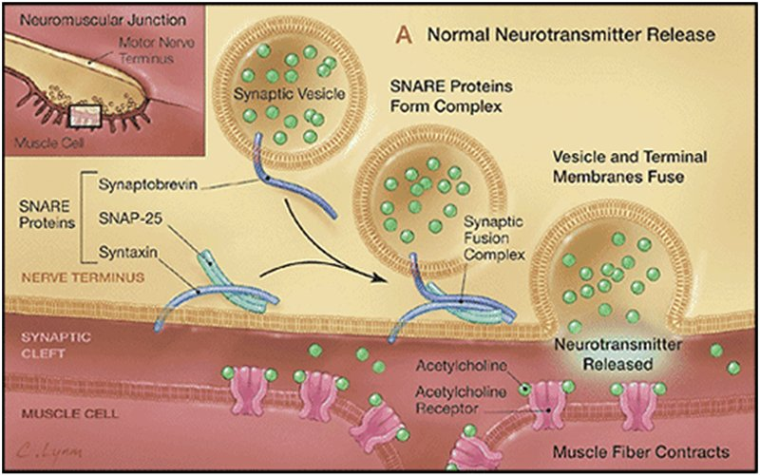
Synaptic vesicles and recycling
Release occurs when calcium ions enter the nerve through the P channels lined up on the sides of the active zones by soluble N-ethylmaleimide–sensitive attachment protein receptor (SNARE) proteins
The SNARE proteins are involved in fusion, docking, and release of acetylcholine at the active zone.

Slide 17
Calcium needs to move only a very short distance to encounter a vesicle and activate the proteins in the vesicle wall involved in a process known as docking
Calcium may penetrate more deeply than normal into the nerve or may enter through L channels to activate calcium-dependent enzymes that break the synapsin links holding the vesicles to the cytoskeleton, thereby allowing the vesicles to be moved to the release sites.
Repeated stimulation requires the nerve ending to replenish its store of vesicles filled with transmitter, a process known as mobilization.

Slide 18
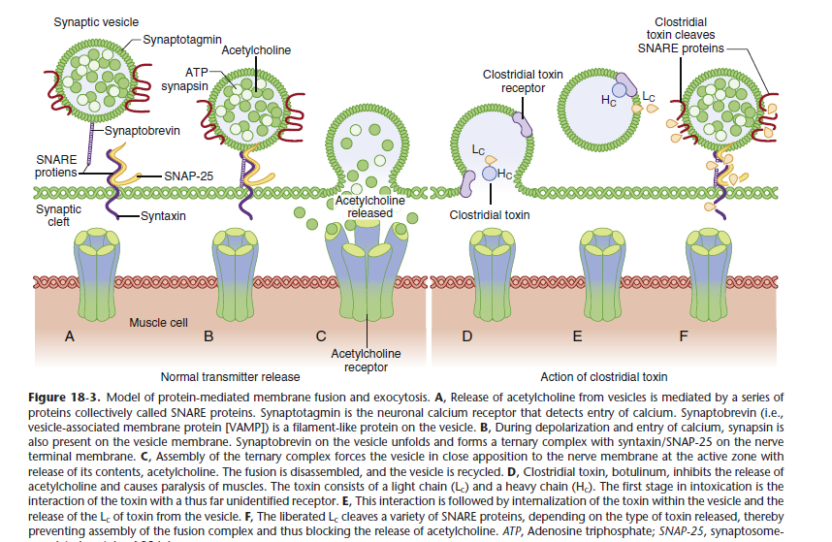
Process of Exocytosis
During an action potential and calcium influx, neurotransmitter is released. The whole process is called exocytosis

Slide 20
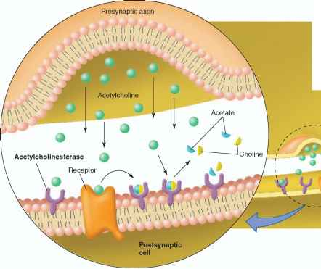
Acetylcholinesterase
Acetylcholinesterase enzyme is secreted by the muscle cell but remains attached to it by thin collagen threads linking it to the basement membrane
Acetylcholinesterase is found in the junctional gap and the clefts of the postsynaptic folds and breaks down acetylcholine within 1 msec of being released.

Slide 21
Acetyl cholinesterase
Acetylcholine is removed rapidly from the junctional gap or synaptic cleft. This is achieved by hydrolysis of acetylcholine to choline and acetate in a reaction catalysed by the enzyme acetylcholinesterase (AChE).
Hydrolysis occurs with transfer of the acetyl group to the serine group resulting in an acetylated molecule of the enzyme and free choline.
The speed at which this occurs can be gauged by the fact that approximately 10,000 molecules of acetylcholine can be hydrolysed per second by a single site.

Slide 22
The congenital absence of the secreted enzyme leads to impaired maintenance of the motor neuronal system and organization of nerve terminal branches.
Congenital abnormalities in cholinesterase function have been described and result in neuromuscular disorders whose symptoms and signs usually resemble those of myasthenia gravis or myasthenic syndromes.
Other acquired diseases involving cholinesterases are related to chronic inhibition of acetylcholinesterase by organophosphate pesticides or nerve gas (e.g., sarin)

Slide 23
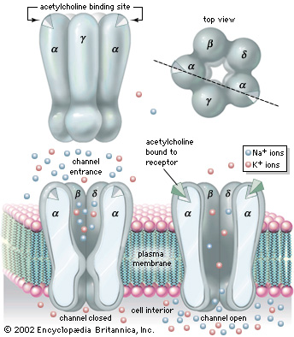
Acetylcholine Receptors
AChRs are synthesized in muscle cells and are anchored to the end-plate membrane by a special 43-kd protein known as rapsyn.
Each nicotinic receptor is a protein comprised of five polypeptide subunits that form a ring structure around a central, funnel-shaped pore (the ion channel). The mature adult receptor has two identical α (alpha) subunits, one β (beta), one δ (delta) and one ε (epsilon) subunit. In the fetus a γ (gamma) subunit replaces the ε.

Slide 24
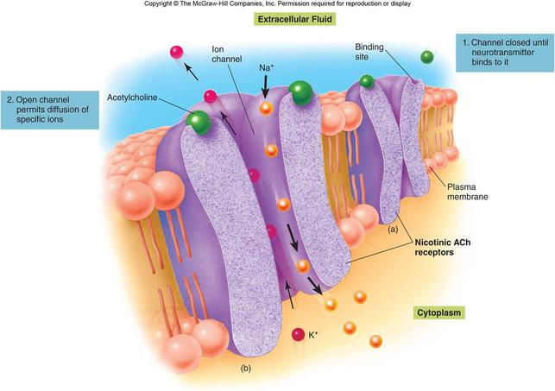
Average 50 million acetylcholine receptors on a normal endplate, situated on the crests of the junctional folds.
Acetylcholine molecules bind to specific sites on the α subunits and when both are occupied a conformational change occurs.

Slide 25
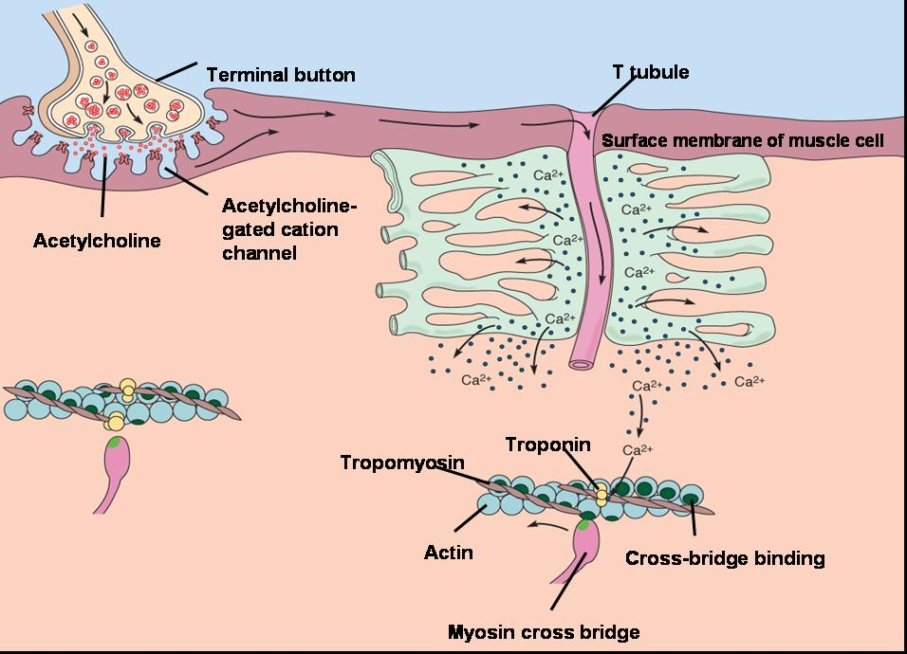
The channel allows movement of all cations – sodium, This causes depolarisation, the cell becomes less negative compared with the extracellular surroundings. When a threshold of –50mV is achieved (from a resting potential of –80mV), voltage- gated sodium channels open, thereby increasing the rate of depolarisation and resulting in an end plate potential (EPP) Of 50-100mV.
This in turn triggers the muscle action potential that results in muscle contraction

Slide 26
Synthesis And Stabilization of AchRs
Muscle tissue is formed from the mesoderm and initially appears as myoblasts.
Myoblasts fuse to produce myotubes, which therefore have multiple nuclei. As the myotubes mature, the sarcomere, which is the contractile element of the muscle consisting of actin and myosin develops.
Agrin is a protein from the nerve that stimulates postsynaptic differentiation by activating muscle-specific tyrosine kinase (MuSK), a tyrosine kinase expressed selectively in muscle.
Agrin, together with neuregulins and other growth factors, induce the clustering of other critical muscle-derived proteins, including MuSK, rapsyn proteins, all of which are necessary for maturation and stabilization of AChRs at the junction

Slide 27
Electrophysiology Of Neurotransmission
When an agonist occupies both α-subunit sites, the protein molecule undergoes a conformational change with a twisting movement along the central axis of the receptor that results in the opening of the central channel through which ions can flow along a concentration gradient.
When the central channel is open, sodium and calcium flow from the outside of the cell to the inside and potassium flows from the inside to the outside.

Slide 28
Action of antagonists such as curare (filled square). Acetylcholine is in competition with tubocurarine for the receptor’s recognition site but may also react with acetylcholinesterase. Tubocurarine is a prototypical nondepolarizing muscle relaxant. Inhibiting the acetylcholinesterase enzyme increases the lifetime of acetylcholine and the probability that it will react with a receptor. When one of the two binding (recognition) sites is occupied by curare, the receptor will not open, even if the other binding site is occupied by acetylcholine.

Slide 29
Classic actions of nondepolarizing muscle relaxants
Muscle relaxants (e.g., pancuronium, vecuronium )have similar actions as that of tubocurarine.
Normally, acetylcholinesterase destroys acetylcholine and removes it from competition for a receptor; therefore tubocurarine has a better chance of inhibiting transmission.
If, however, an inhibitor of acetylcholinesterase such as neostigmine is added, then the cholinesterase cannot destroy acetylcholine.

Slide 30
Classic Actions Of Depolarizing Muscle Relaxants
Depolarizing relaxants (e.g., succinylcholine, decamethonium) initially simulate the effect of acetylcholine and can therefore be considered agonists.
Structurally, succinylcholine is very similar to the natural ligand acetylcholine.
Succinylcholine or decamethonium can bind to the receptor, open the channel, pass current, and depolarize the end plate.
In contrast, the depolarizing relaxants characteristically have a biphasic action on muscle—an initial contraction, followed by relaxation lasting from minutes to hours.

Slide 31
Desensitization Block
The AChR, as a result of its flexibility and the fluidity of the lipid around it, is capable of existing in a number of conformational states
Some receptors that bind to agonists, however, do not undergo the conformational change to open the channel. Receptors in these states are called desensitized (i.e., they are not sensitive to the channel-opening actions of agonists).
The receptor macromolecule, 1000 times larger by weight than most drugs or gases, provides many places at which the smaller molecules may act.

Slide 32
Many other drugs used by anesthetists also promote the shift of receptors from a normal state to a desensitized state.
Desensitization may also be a part of the phenomenon known as phase II block which is caused by a prolonged administration of depolarizing relaxants
Drugs That Can Cause or Promote Desensitization of Nicotinic Cholinergic Receptors
Volatile anesthetics
Halothane
Sevoflurane
Isoflurane
Barbiturates
Thiopental
Pentobarbital

Slide 33
Agonists
Acetylcholine
Decamethonium
Carbachol
Succinylcholine
Acetylcholinesterase inhibitors
Neostigmine
Pyridostigmine
Local anesthetics
Dibucaine
Lidocaine
Prilocaine

Slide 34
Channel Block
Local anesthetics and calcium entry blockers prevent the flow of sodium or calcium through their respective channels, thus explaining the term channel-blocking drugs.
In a closed-channel block, certain drugs can occupy the mouth of the channel and prevent ions from passing through the channel to depolarize the end plate.
In an open-channel block, a drug molecule enters a channel that has been opened by reaction with acetylcholine but does not necessarily penetrate all the way through.

Slide 35
Increasing the concentration of acetylcholine may cause the channels to open more often and, consequently, become more susceptible to blockade by use-dependent compounds.
Evidence suggests that neostigmine and related cholinesterase inhibitors can act as channel-blocking drugs.
Channel block may account for the antibiotic-, cocaine, quinidine-, piperocaine-, tricyclic antidepressant–, naltrexone-, naloxone-induced alterations in neuromuscular function.

Slide 36
Phase II Block
A phase II block is a complex phenomenon associated with a typical fade in muscle during continuous exposure to depolarizing drugs.
However, fade in muscle during repetitive nerve stimulation can also be attributable to postjunctional AChR block.
The repeated opening of channels allows a continuous efflux of potassium and influx of sodium, and the resulting abnormal electrolyte balance distorts the function of the junctional membrane.
As long as the depolarizing drug is present, the receptor channels remain open and ion flux through them remains frequent.

Slide 37
Thank You…

