Slide 1
OBSTETRIC CARE BY MBBSPPT.COM

Slide 2
SPECIFIC HEALTH PROTECTION
ANEMIA
- 50 to 60 % of women belonging to low socio-economic groups
are anaemic in the last Trimester of pregnancy.
- most common type is iron and folic acid deficiency.
- it is associated with premature birth, postpartum
haemorrhage, puerperal sepsis.
- The Government has initiated a programme in which 100mg
of elemental iron and 500 mcg of folic acid are distributed
daily to pregnant women in antenatal clinics, PHC etc.

Slide 3
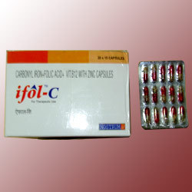
(ii) OTHER NUTRITIONAL DEFICIENCIES
Particularly protein, vitamin (vit A) , mineral deficiencies.
In some MCH centres milk and vit A & D capsules are supplied free of cost.

Slide 4
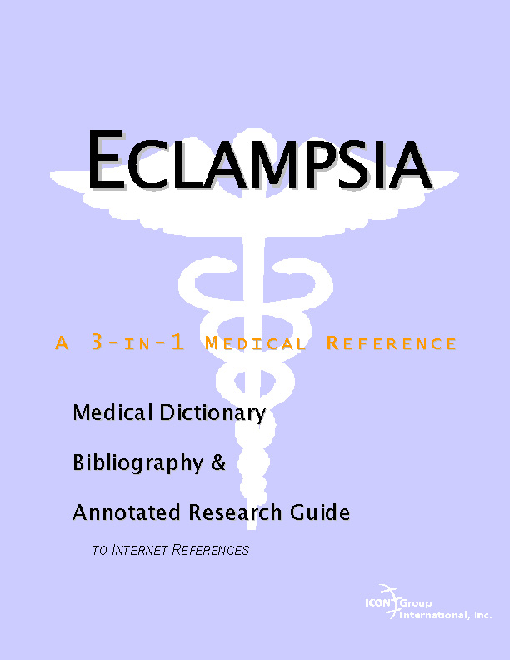
(iii) TOXEMIAS OF PREGNANCY
- presence of albumin in urine and increase in BP may
indicate presence of toxemias of Pregnancy.
- early detection and management are indicated.

Slide 5
(iv) TETANUS
- if the mother was not previously immunised ,2 doses of tetanus toxoid should be Given at 16-20 and 10-24 weeks of Pregnancy.
- the interval between the 2 should be atleast a month
- second dose should preferably be given one month before EDD.
- if she is seen only in late pregnancy then atleast one dose should be given.
- If she has been immunsed earlier only a booster dose will
suffice and this booster will Provide cover of all her consequetive pregnancies for the next 5 yrs.

Slide 6
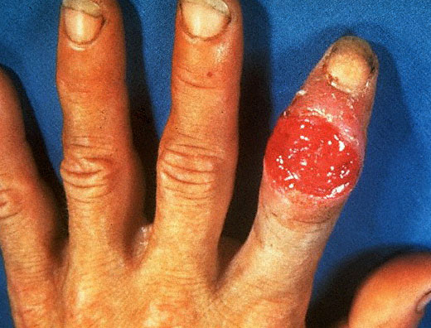
(v) SYPHILIS
- pregnancies in women with primary and secondary often
end in spontaneous abortion , still birth, perinatal death and congenital syphilis
- syphilitic infection is transferrable from mother to foetus.
- routine testing for syphilis is done inn ante-natal clinics since the chances of foetus geting infected is more after the 6th month so testing should be Done both in early and late pregnancy.
In case of infection : ten daily injections of
procaine penicillin (600,000 units)

Slide 7
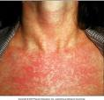
(vi) GERMAN MEASLES
Rubella when contracted in the first 16 weeks of pregnancy often leads to foetal death Or death during first year of life.
Major defects : cataract, deafness and congenital heart disease
risk of malformations upto 20th weeks
vaccination is advised in all women of child-bearing age
Contraception should be maintained for eight weeks after vaccination.

Slide 8
(vii) Rh STATUS
If mother is Rh –ve and foetus is Rh +ve it provokes an immune response in her so she forms antibodies to Rh which can cross the placanta and lead to foetal haemolysis.
Isoimmunization occurs during labour so even if first child is uneffected the subsequent Pregnancies will be harmed (hydrops foetalis, icterus gravis neonatorum).

Slide 9
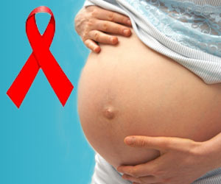
(viii) HIV INFECTION
Through placenta, or during delivery, or during breast feeding
risk of infection is higher if mother is newly infected or has already developed AIDS
voluntary prenatal testing for HIV infection should be done. But screening should not be used As a substitute for primary prevention.

Slide 10
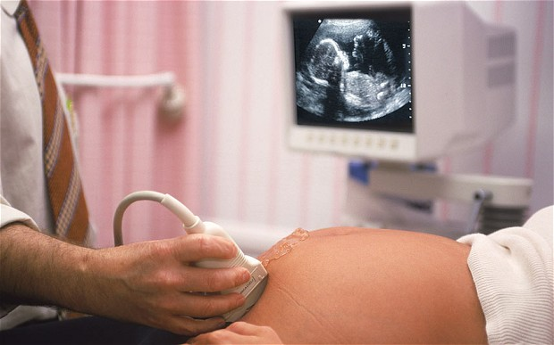
(ix) PRENATAL GENETIC SCREENING
Includes screening for chromosomal abnormalities associated with serous birth defects.
screening for direct evidance of congenital structural anomalies.
screening for haemoglobinopathies
Other inherited conditions detectable by biochemical assay
specially in women above 35 yrs of age.

Slide 11
MENTAL PREPARATION
- mother craft classes at MCH centres
FAMILY PLANNING

Slide 12
Thank You

