Slide 1
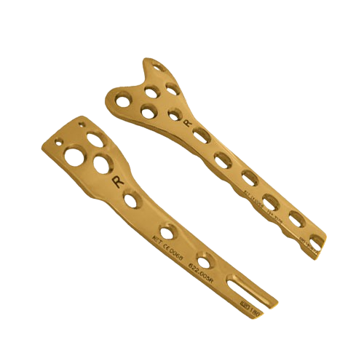
Orthopaedic Implants
BY MBBSPPT.COM

Slide 2
Implant
An implant is a medical device manufactured to replace a missing biological structure, support a damaged biological structure, or enhance an existing biological structure. It is placed (or planted) inside human body.

Slide 3
Implant requirements
It must be biocompatible (able to function in vivo without eliciting detrimental local or systemic responses),
It should be resistant to corrosion and degradation (able to withstand the in vivo environment), and
It should be desirably strong and stiff enough to withstand the forces imposed upon it (mechanical and wear properties).

Slide 4
Implant Materials
Orthopaedic implants are either metallic or non-metallic.
Metallic: Stainless Steel 316L , Titanium, Cobalt Chrome alloy
Non-Metallic: Alumina, Silica, High molecular weight polyethylene[HMWPE], Bone Cement or Polymethyl methacrylate (PMMA)

Slide 5
Historical Implant Materials
Ivory
Bone
Metal
- Gold, silver, lead, aluminium: too weak
- Iron, steel, copper, nickel, zinc: adverse response

Slide 6
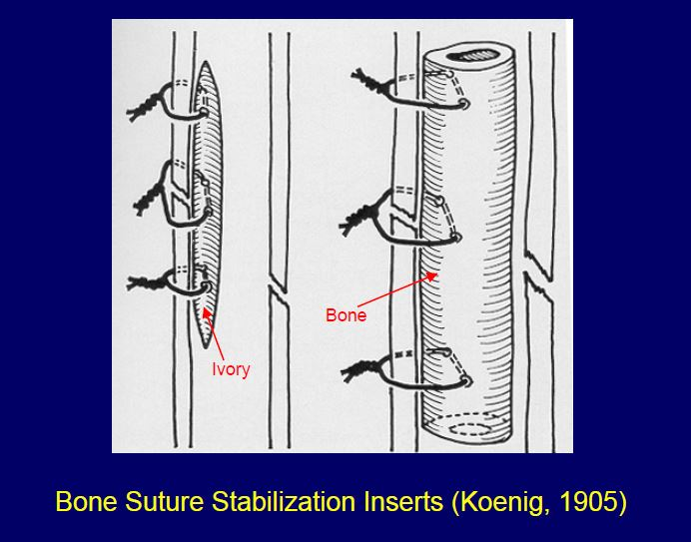
Implant Materials

Slide 7
Methods of Metal Working
  Forging is the process of heating the metal and hammering it to shape
  Casting consist of heating the metal to molten state and pouring it to a mould
  Rolling and Drawing: rolling between rollers and drawing through a hole in a hardened plate are used to form bar and wire
  Cold working is a finishing process employed after the metal has been shaped by hot forging but the work is performed below the recrystallization temperature
  Annealing is heating to about half the melting point followed by controlled cooling
  Case hardening is the process that cause the outside surface of the rod to be harder than the inner core
  Geometric features like holes or grooves require machining

Slide 8
Surface Treatment
Polishing and passivation: polishing removes scratches which could act as local stress risers
  Passivation process produces a protective oxide layer such that corrosion is prevented
  It involves immersion of the material in a strong nitric acid solution for a specified time
  It dissolves embedded iron particles left by machine working and generates a thin transparent but dense oxide film on the surface
  Stainless steel forms chromium oxide; titanium forms dioxide
  Passivation can be damaged by cold working, scratching and other mechanical trauma
Nitriding or allowing the surface to react with ammonia or potassium cyanate is used to harden the surface of titanium implants

Slide 9
Corrosion
Corrosion is the gradual degradation of metal by electrochemical attack
It weakens the implanted metal, changes the surface of the metal and releases metal ions into the body
Types:
  Galvanic
  Crevice
  Pitting
  Fretting
  Stress
  Intergranular
  Ion release corrosion

Slide 10
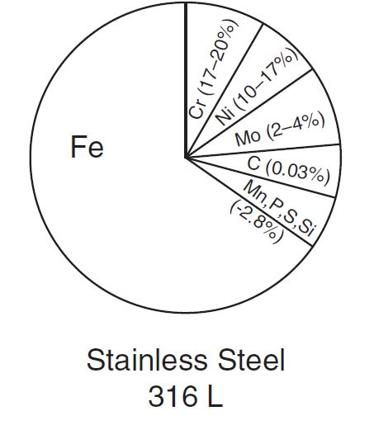
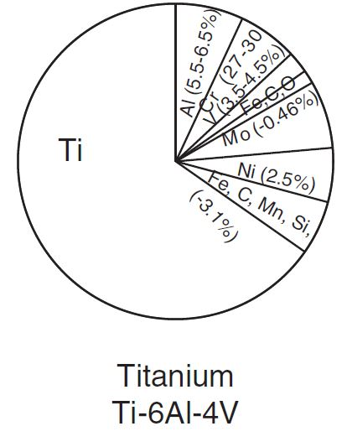
Composition
Modulus of elasticity- 12x Modulus of elasticity- 6x

Slide 11
Bioabsorbable Polymers
Advantages:
  Adequate Stability For Healing And Then It Is Gradually Resorbed
    Limit Stress Shielding Of Bone And As They Degrade
  No Hardware Removal
  Radiography- Radiolucency
Disadvantages:
  Soft Tissue Complications - Sterile Sinus Tract Formation, Hypertrophic Fibrous Encapsulation, And Osteolysis
  Use limited to Pediatric #, D/E radius, small bones of hand , ankle #

Slide 12
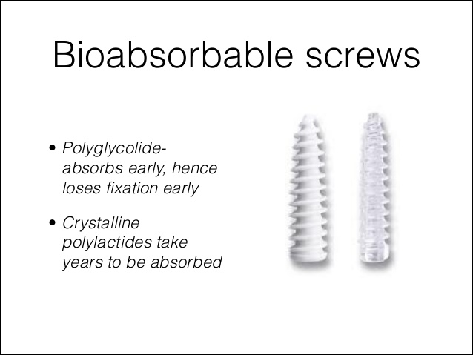
Bioabsorbable polymers

Slide 13
Implant fatigue
  Fatigue fracture is a break of a metal caused by repetitive applications of loads below the yield strength
  Fatigue strength is the maximal cyclic load that a metal can withstand without fracturing when subjected to a designated number of cycles, typically 5 or 10 million
  Fatigue life is the number of cycles that a metal can withstand without breaking when subjected to a given cyclic load

Slide 14
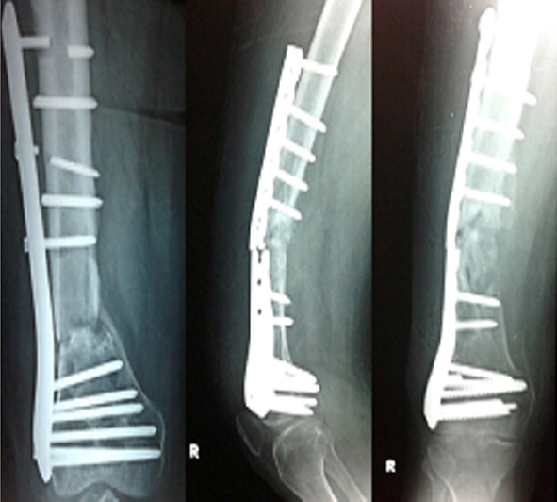
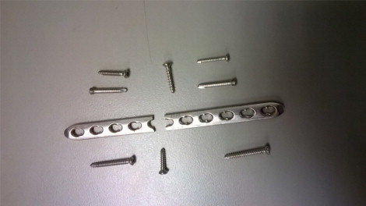

Slide 15
Implant Removal
Disadvantages:
  High Cost,
  2nd Surgery- Sometimes with Complications,
  Carcinogenic Risk Between Metallic Implants and Tumours Has Been Established in Experimental Animals
Indications:
  Children
  Symptomatic Implants
  Plates in Lower Limb

Slide 16
Mixing of Implants
Disadvantages:
  High Risk of Corrosion
  Jamming, Broken Drills and Taps, Gaps, Loose Fits and
  Loosening

Slide 17
Implants
Wires: Stainless Steel wire (SS-wire), Kirschner wire (K- wire)
Pins: Steinmann’s pin, Denham’s Pin, Schanz Pin
Screws: Cortical / Cancellous, Fully threaded / Partially threaded, Cannulated / Non-cannulated ,Self-tapping / non-tapping
Plates: Ordinary plate, DCP, LCDCP, LCP, 1/3rd Tubular Plate, Reconstruction Plate
Barrel Plates: Dynamic Hip Screw (DHS), Dynamic Condylar Screw (DCS)
Nails: Kuntscher’s Nail (K-Nail), Intramedullary Interlocking Nail (IM-ILN) IM-ILN for Femur IM-ILN for Tibia

Slide 18
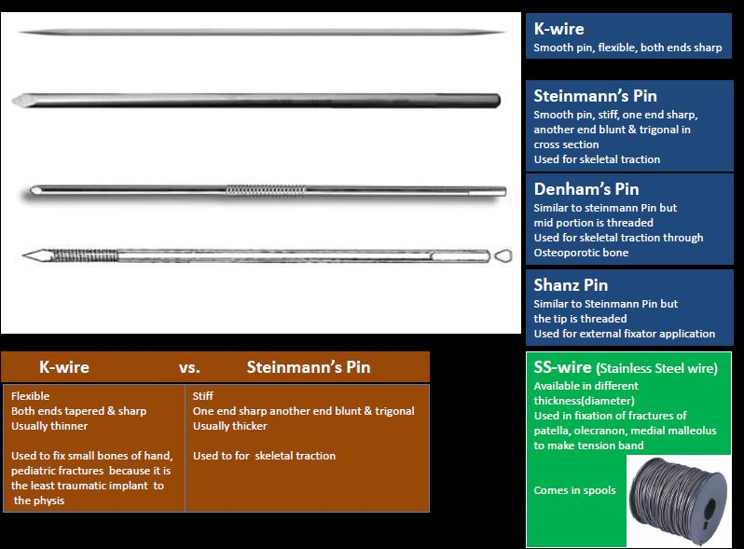

Slide 19
Screw
A screw is a simple machine that converts a small applied rotational force (torque) into a large linear compressive force to keep the two fragments together.
It works on the principle of an inclined plane. Although it looks simple, its design involves a lot of engineering.
It has four parts: head, shaft, thread and tip.

Slide 20
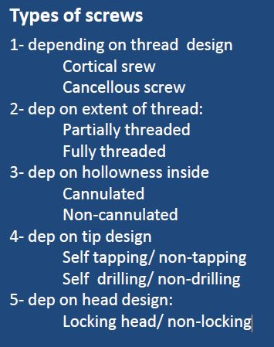

Slide 21
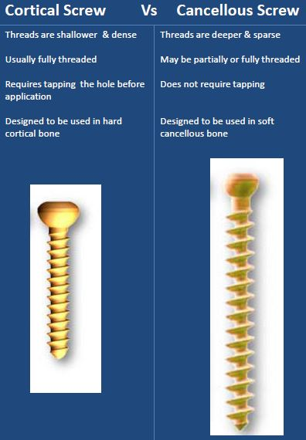

Slide 22
Screw instruments
Drill Bit: Makes Hole In The Bone
Drill Sleeve: Protects Soft Tissues Around
Depth Gauge: Measures Desired Length
Bone Tap: Cuts Threads On The Walls Of Hole
Screw Driver: To Insert Screw

Slide 23
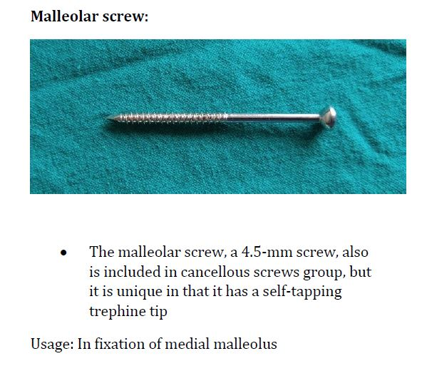

Slide 24
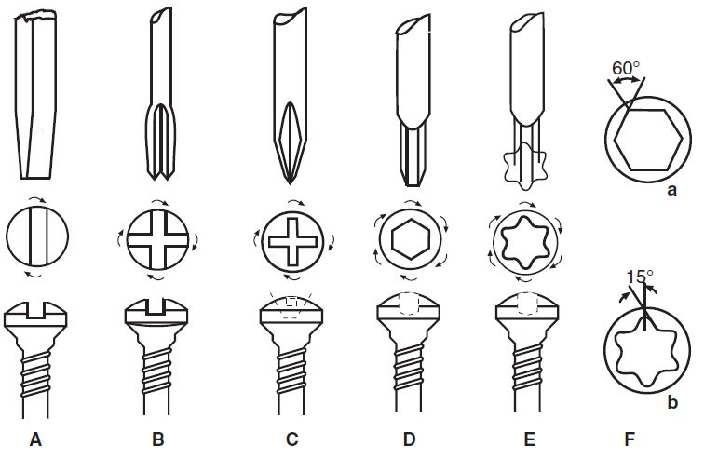
Single Slot (A); Cruciate (B);1 Phillips (C); Recessed Hexagonal (D);torx-6 Stardrive

Slide 25
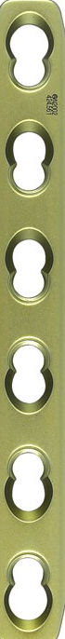
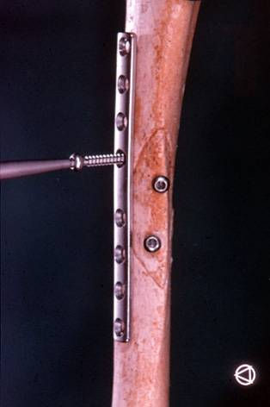
Plates
  Form standard plates
  preshaped plates (Anatomical plates)
  Size standard (4.5 mm)
  small fragment (3.5 mm)
  mini (1–2.7 mm)
  Holes round hole
  dynamic compression hole (DCP)
  threaded hole (locking hole)
  combination hole
  Others: Broad / Narrow
  1/3 TP
  DCP/ LCDCP/ LCLCP/ Combi

Slide 26
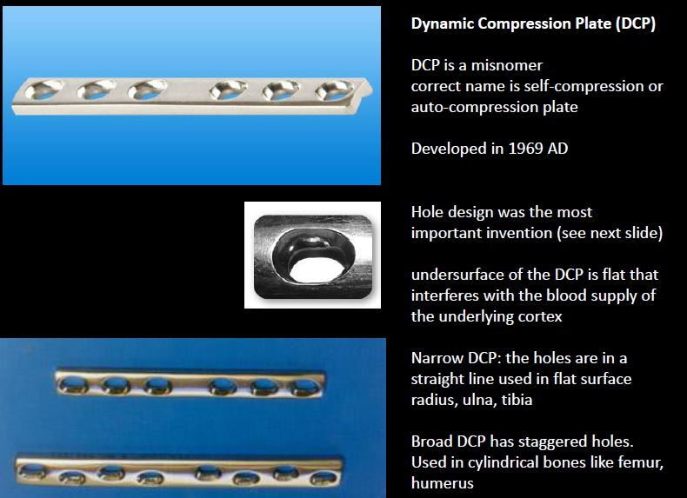

Slide 27
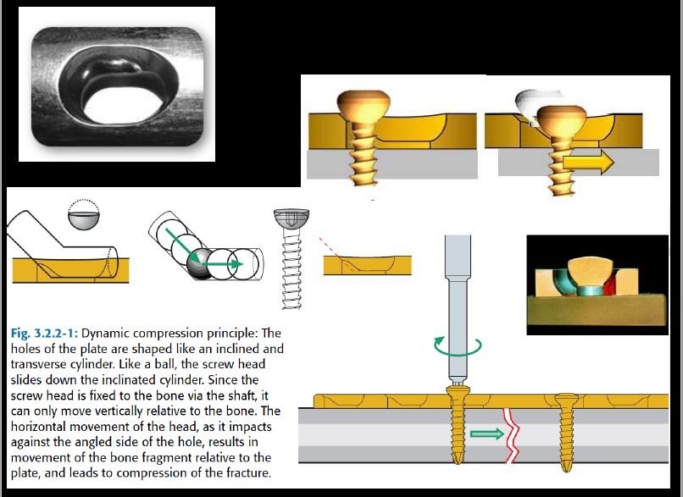

Slide 28
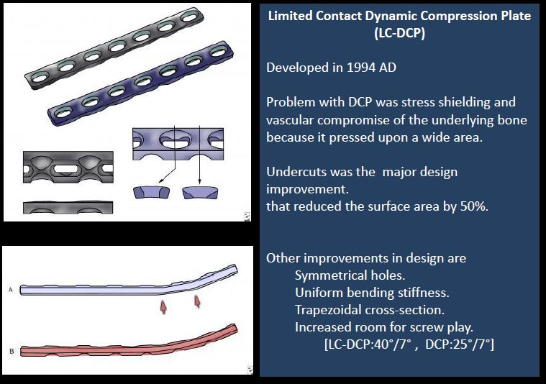

Slide 29
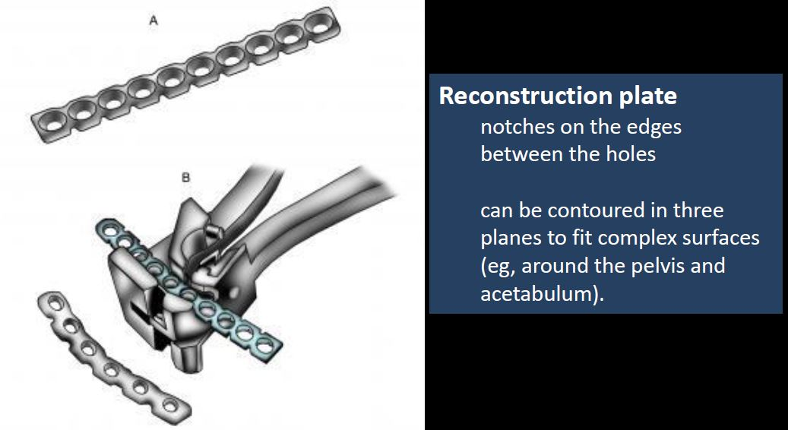

Slide 30
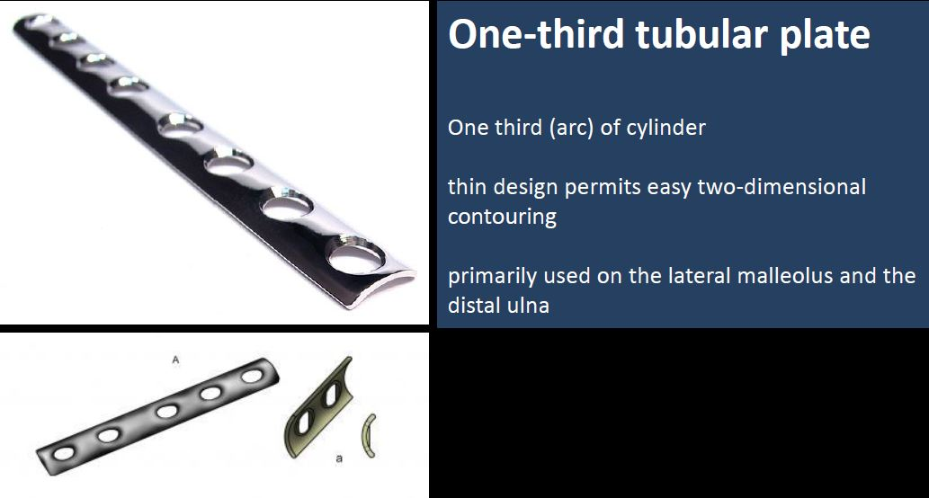

Slide 31
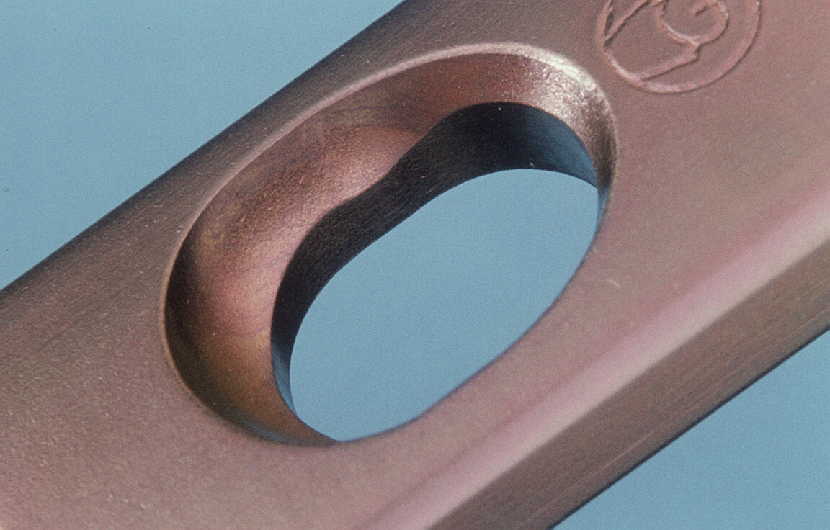
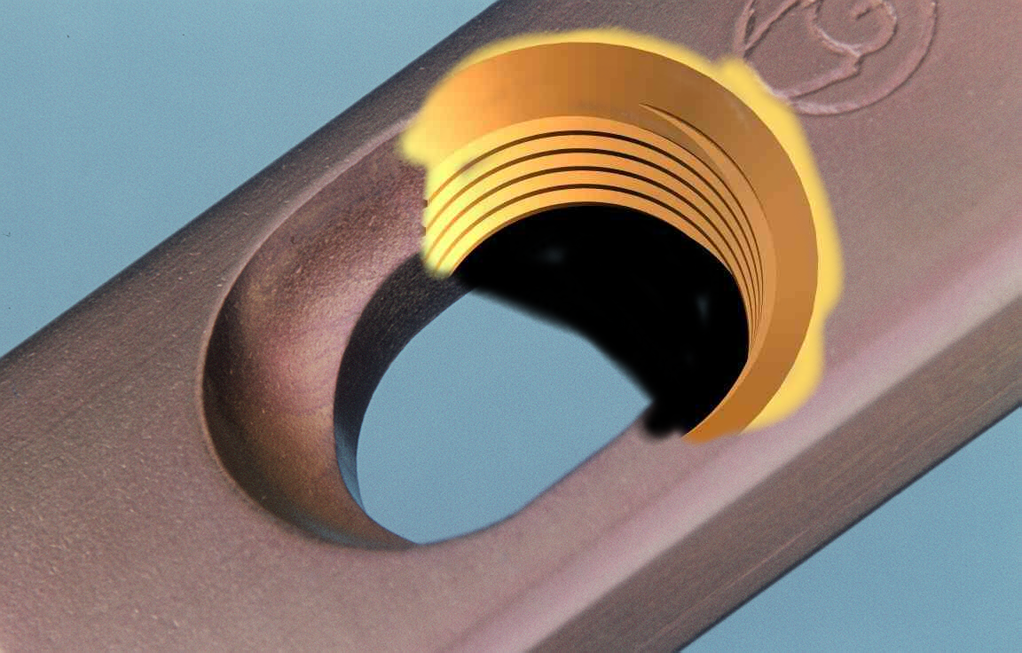
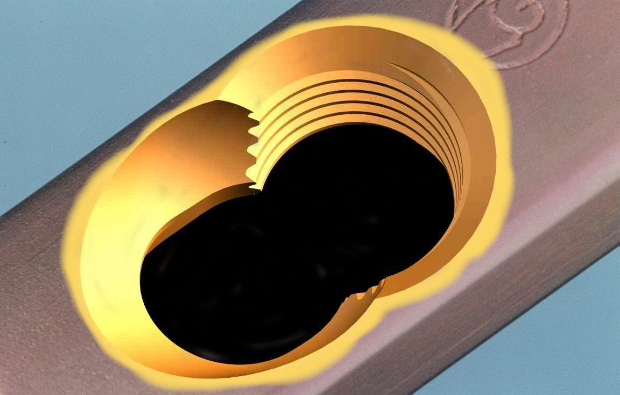
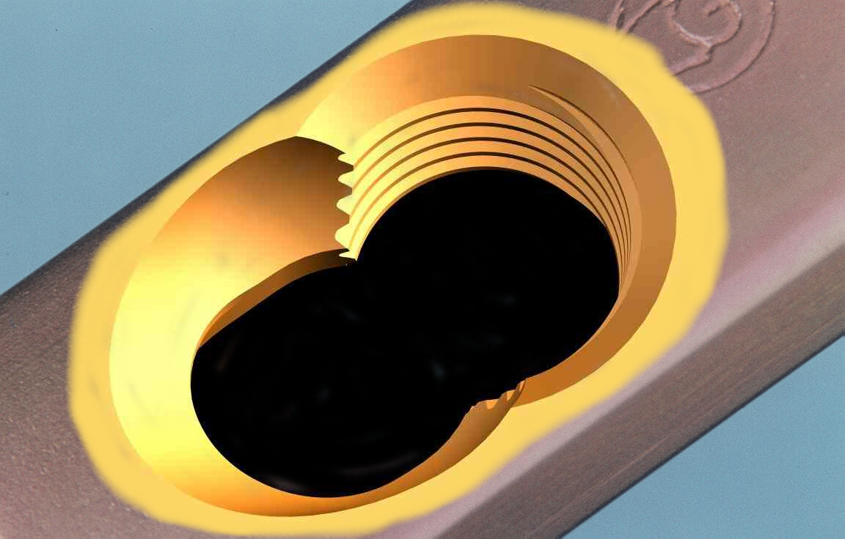
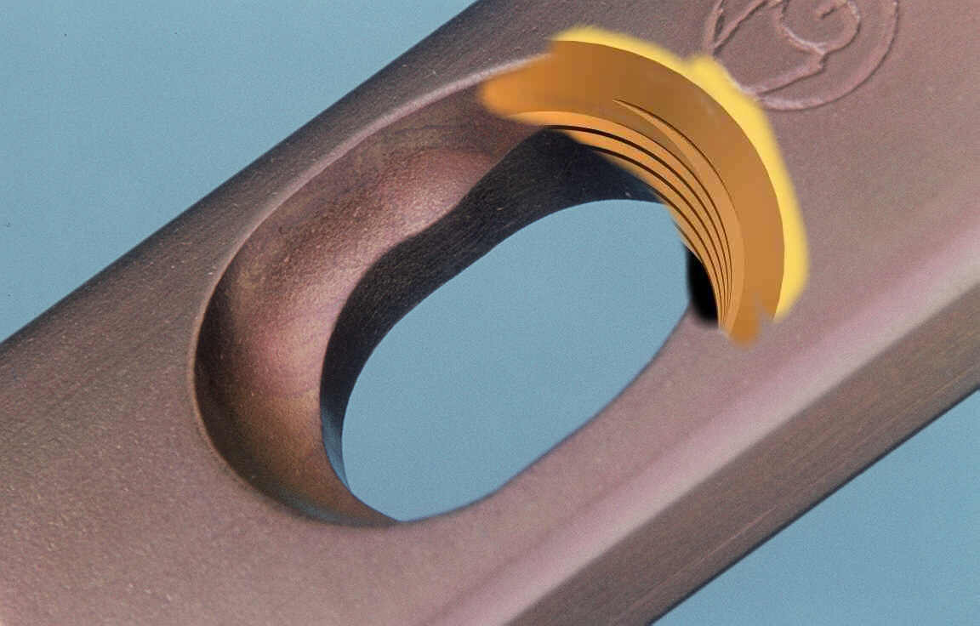
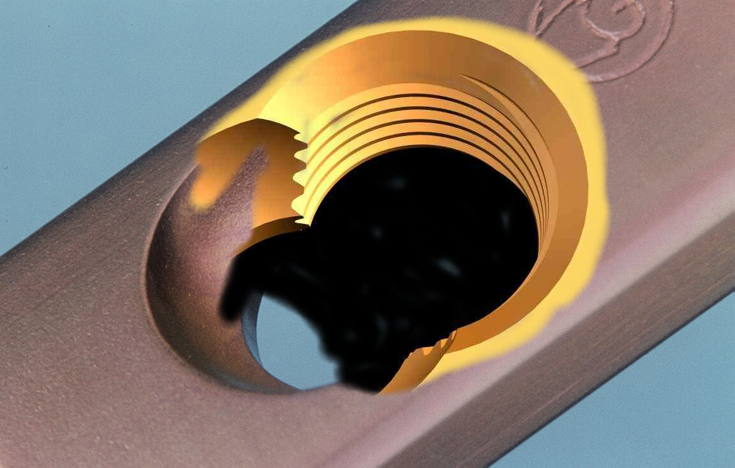
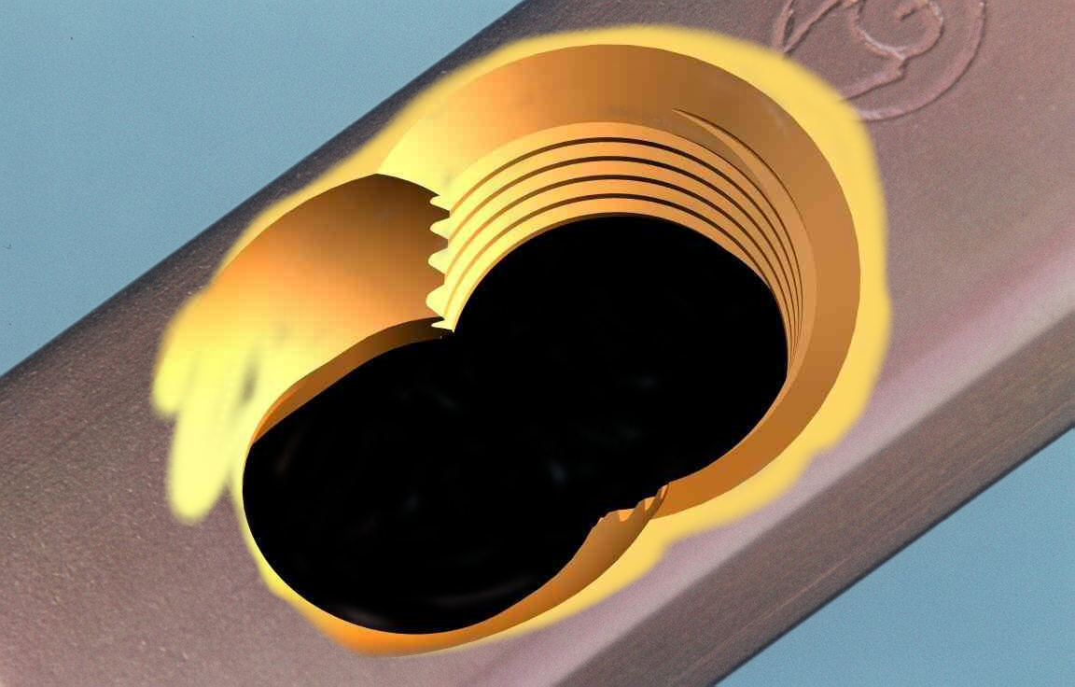
combination hole
Locking Compression Plate (LCP)
Locking Hole
DCP – Hole

Slide 32
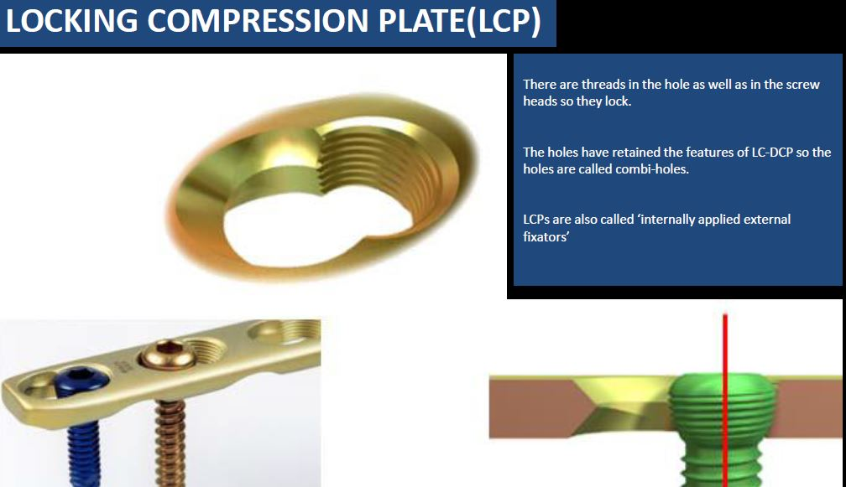

Slide 33
Function:
1. Neutralization plates
2. Compression plates
3. Buttress plates
4. Condylar plates

Slide 34
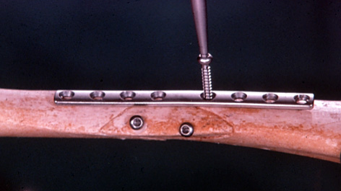
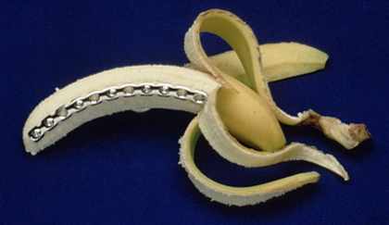
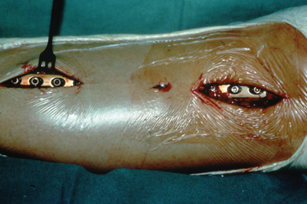
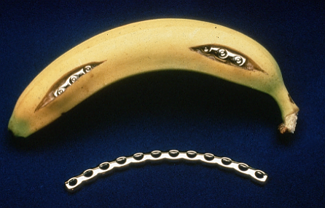
AO - Principles 1958
Anatomical reduction
Stable internal fixation
Preservation of blood supply
Early active motion
AO - Principles 2018
Adequate reduction
Adequate stability
Preservation of blood supply
Early active motion

Slide 35
Interfragmentary compression
Danis of Belgium was the first surgeon to report the use of interfragmentary compression

Slide 36
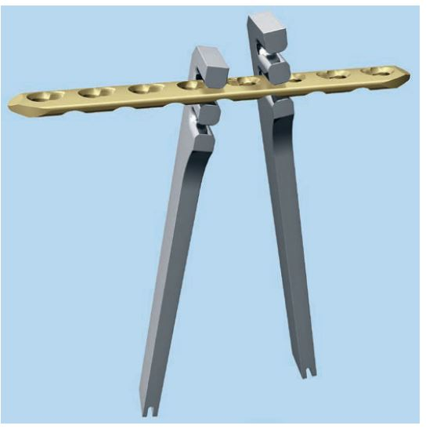

Slide 37
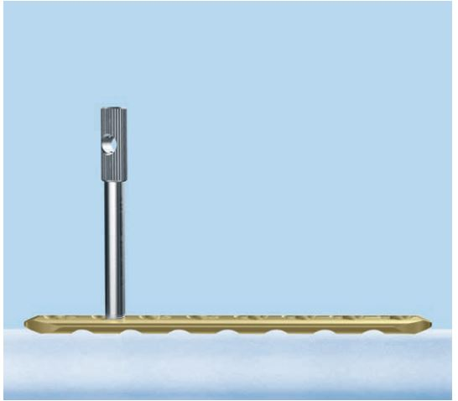
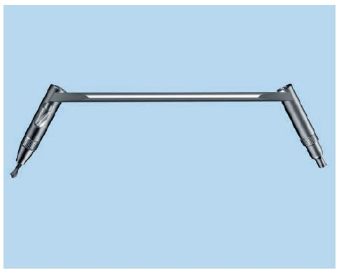

Slide 38
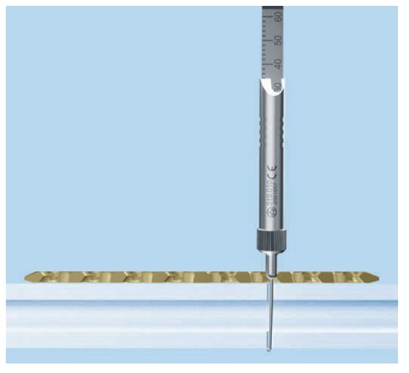
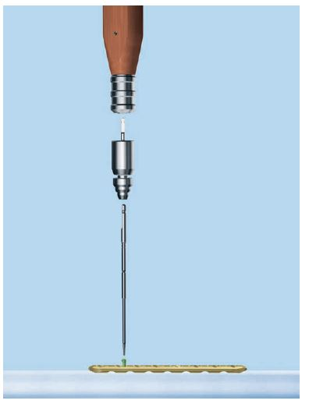

Slide 39
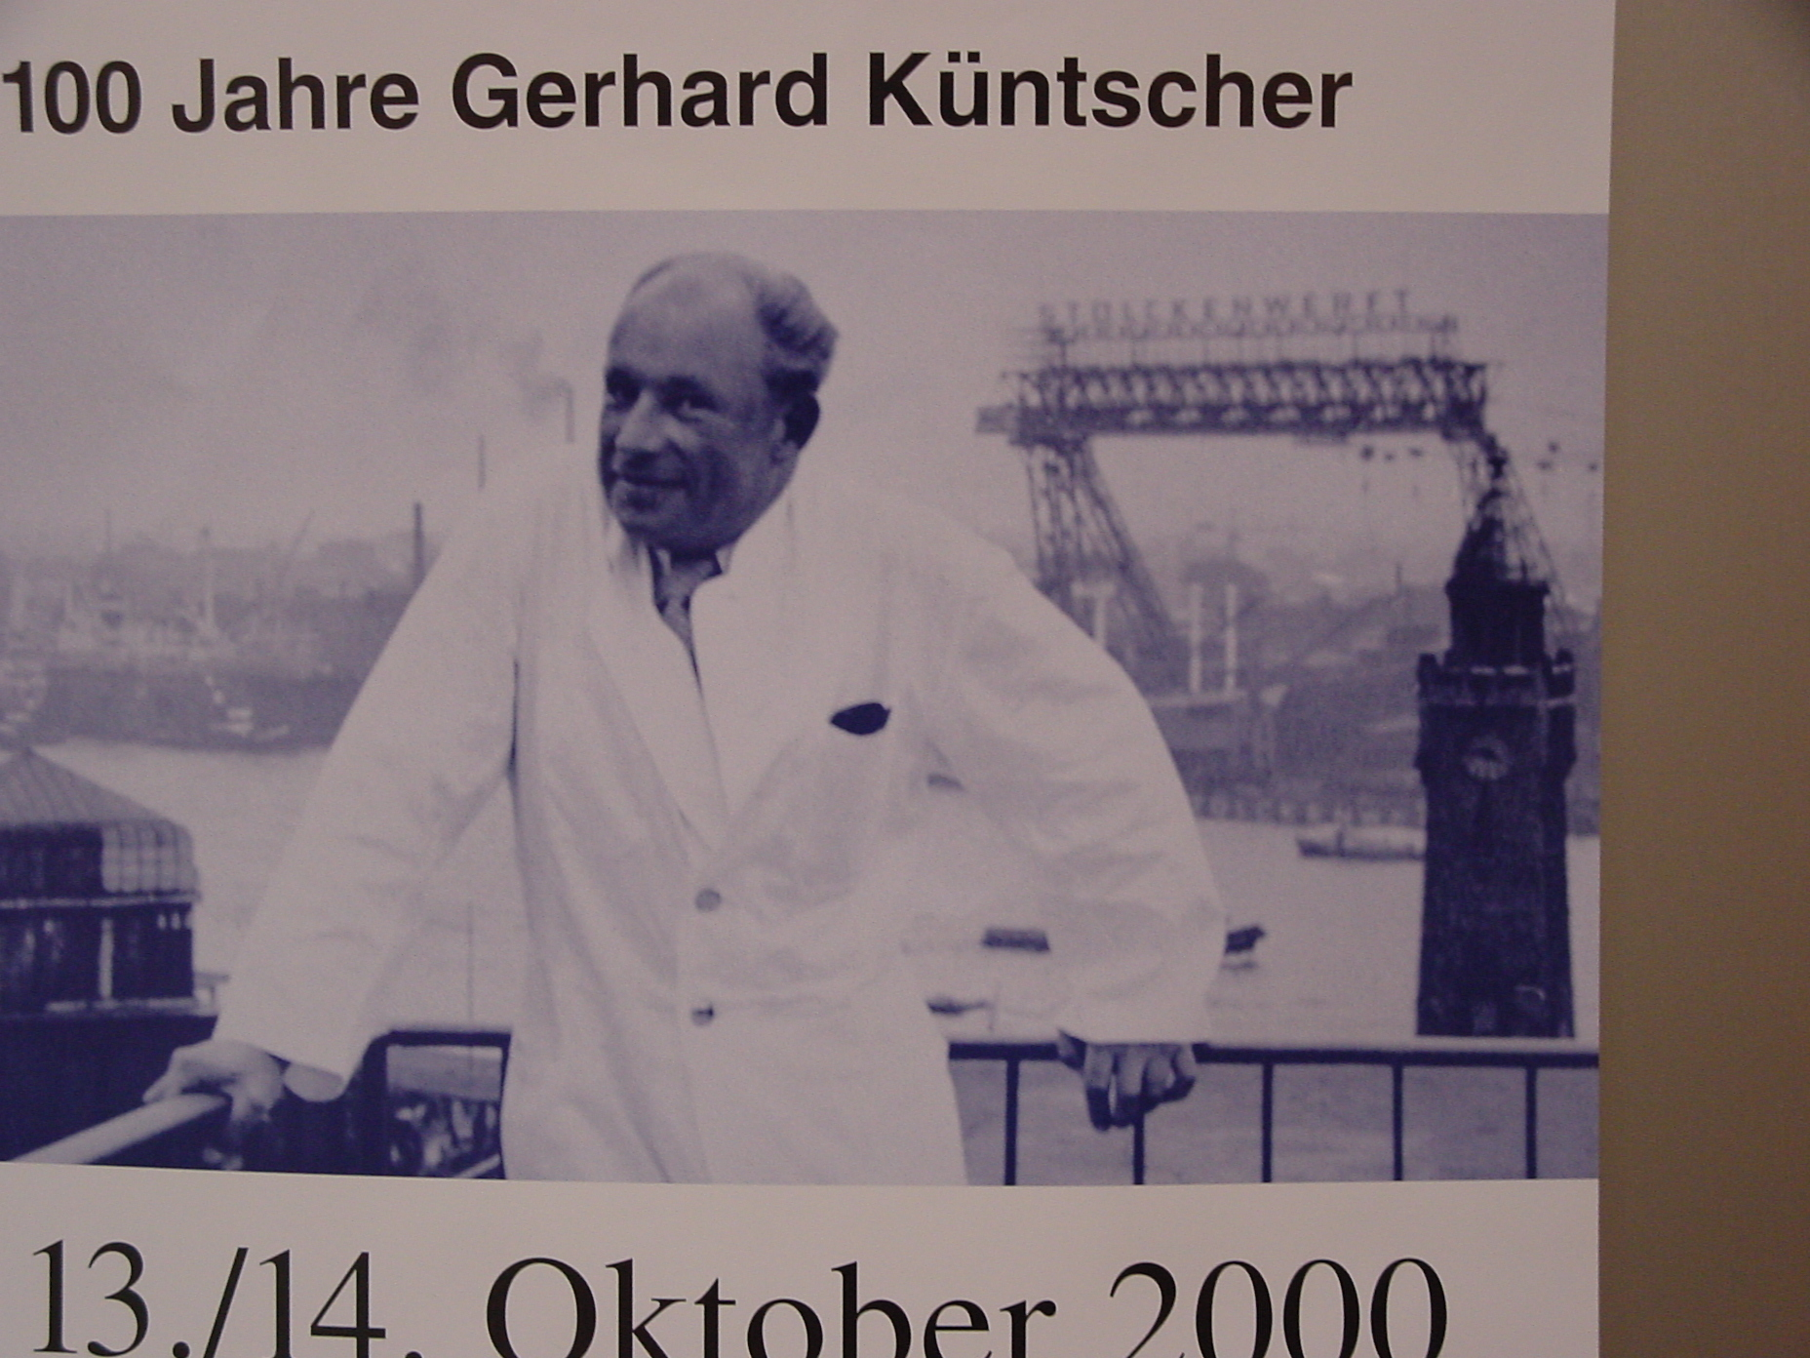
Gerhard Kuentscher 1900 - 1972
We are the nailors from Hesterberge,
We nail everything whether big or small.
We nail humerus, we nail forearm,
We even nail the most deformed leg.
It’s a pity, its such a pity
That not everyone is breaking his leg
Because folks, how nice would be life
Everyone could be nailed one time.
Intramedullary Nailing

Slide 40
Nails
Minimal Invasive
For All Long Bones
Retrograde / Antegrade
All Are Cannulated
All Are To Interlock
Many Are Angle Stable Locking Nails
Some Are Coated (Antibiotics)

Slide 41
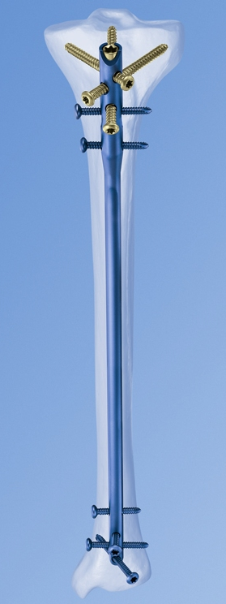
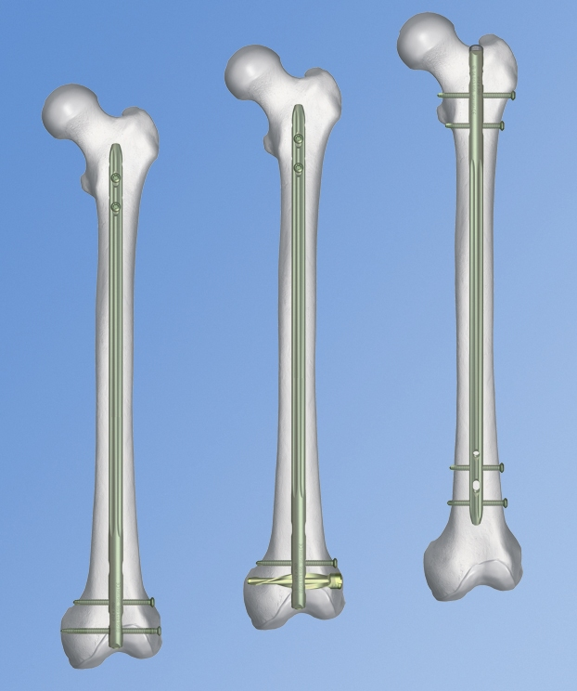
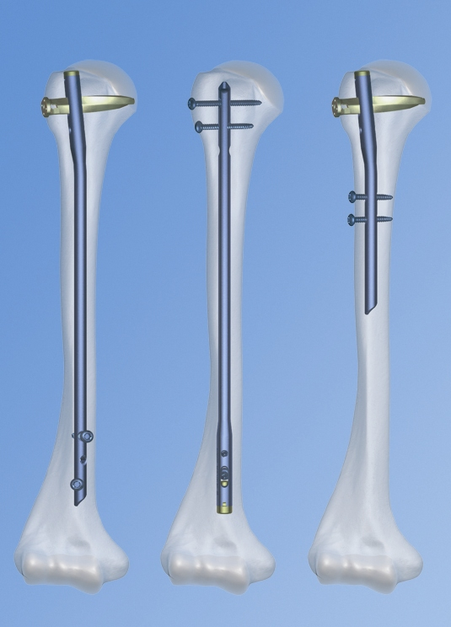
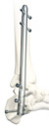
IM nails
Tibia
Femur
Humerus
ankle

Slide 42
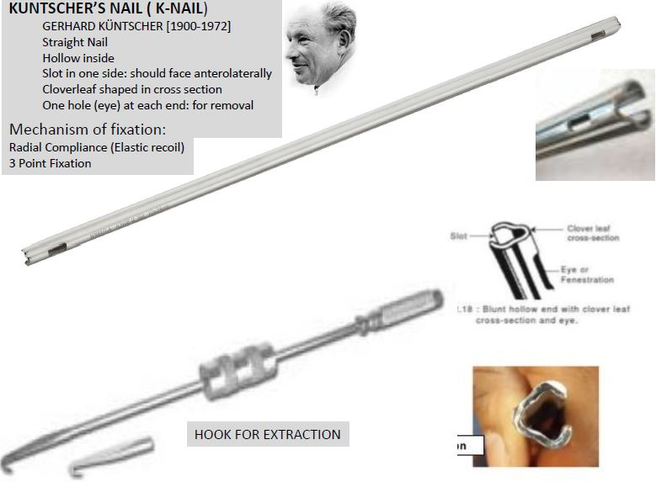

Slide 43
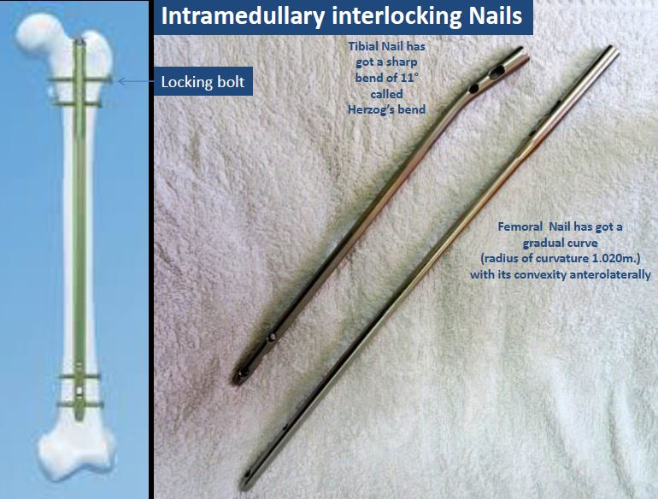

Slide 44
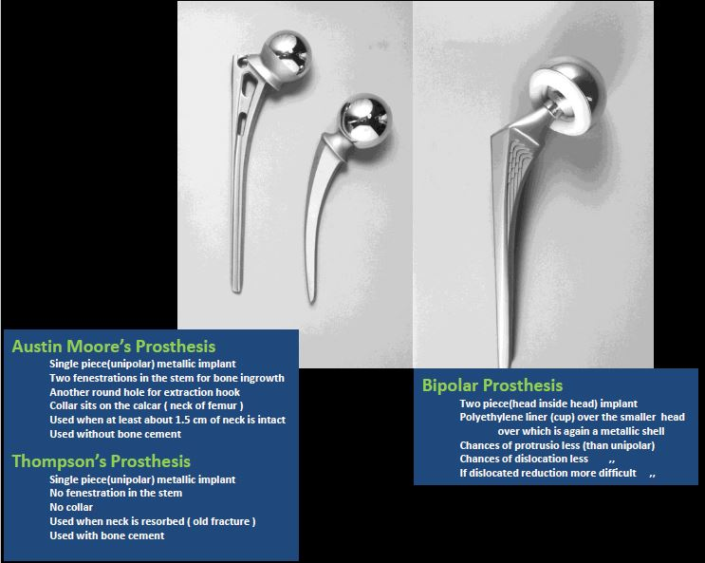
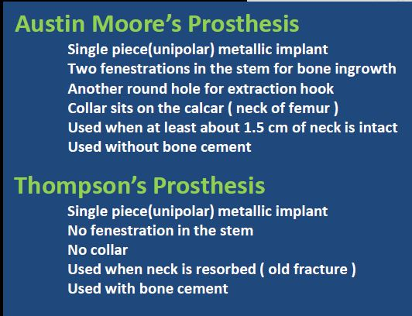
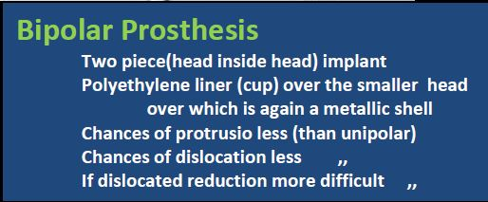

Slide 45
Thank You

