Slide 1
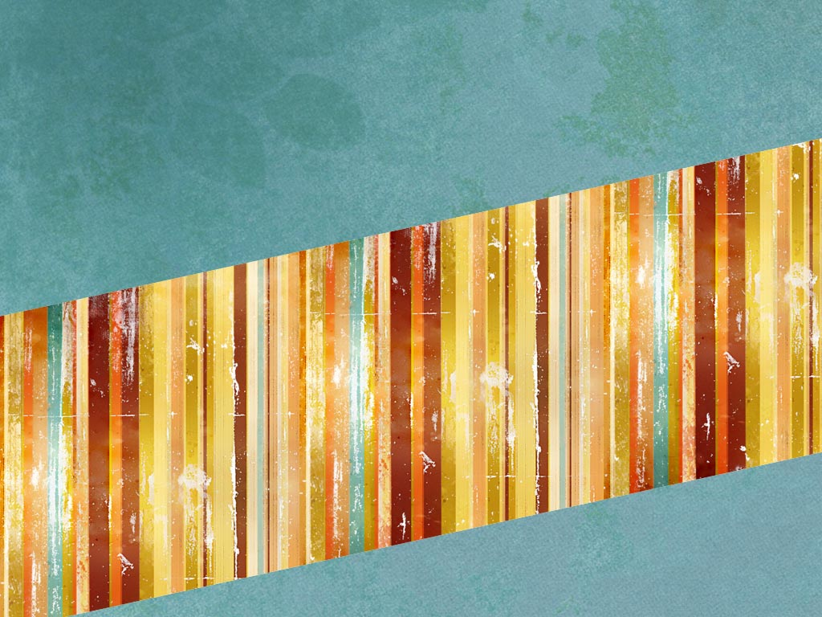
OVERVIEW OF CHD & VSD BY MBBSPPT.COM

Slide 2
Objective
Classification of CHD
Presentation of CHD according to various age group
Signs and symptoms of CHD
Diagnostic criteria
VSD hemodynamics, clinical features ,treatment, complications and prognosis

Slide 3
Introduction
Commonest group of life threatening anomalies
The majority of congenital anomalies of the heart are present 6wks after conception & most anomalies compatible with 6mths of intrauterine life permit live offspring at term

Slide 4
Epidemiology
8/1000 live births
VSD 30-50%, PDA 10%, ASD 7%
PS 7%
Coarctation 6%, AS 5%
Tetralogy 5%, TGA 5%
AV canal defects 3%

Slide 5
Epidemiology
India : no community based data available
25% of total defects are critical requires surgery in first year of life (critical CHD)
10% of infant mortality in India due to CHD
In preterm infants (gestational age <37 weeks), CHD is two to three times that found in term infants

Slide 6
Presentation During Fetal Life
Valve regurgitation (especially TR,Truncus)
Arrhythmia
Slow (complete heart block)
Fast (usually atrial arrhythmias)
May cause fetal loss or hydrops

Slide 7
Transition From the Fetal Circulation
Pulmonary vascular resistance falls
Ductus venosus and ductus arteriosus close
Right-to-left shunting through foramen ovale ceases
Timing of these events determines the timing of presentation of congenital heart defects

Slide 8
TYPES OF CHD
Gr 1 Lt to Rt shunts
Gr 2 Rt to Lt shunts
Gr 3 Obsructive lesions

Slide 9
Presentation First 24 Hours
Critically ill” - like asphyxia
Cyanosis (may be mild)
Pure heart failure is uncommon
Murmur

Slide 10
24 Hours to 2 weeks = 3 types of “Ductal Dependent” Lesions
Depend on patent duct for either
pulmonary blood flow,
systemic blood flow, or
mixing of systemic and pulmonary blood

Slide 11
24 Hours to 2 weeks = 3 types of “Ductal Dependent” Lesions
CXR helps in diagnosis
oligaemic lungfields
PS, pulmonary atresia etc
plethoric lungfields
TGA
congestion
TAPVD
massive cardiomegaly
Ebstein’s

Slide 12
24 Hours to 2 weeks = 3 types of “Ductal Dependent” Lesions
Heart failure is due to left heart obstruction NOT L-R shunts at this age! eg.
Coarctation
Critical Aortic stenosis
Hypoplastic left heart
Mitral stenosis (rare)

Slide 13
Cyanotic infant- a lung problem or a heart problem?
Investigations- suggests heart if:
CXR- clear lung fields and
ECG- normal and
Hyperoxia test normal: rules out CCHD
(Echocardiogram is the definitive test)

Slide 14
HYPEROXIA TEST
For all neonates with suspected critical congenital heart disease.
Method:
Patient breathes 100% oxygen
pO2 of >250 mm Hg in both upper and lower limb :Passed Hyperoxia test.
pO2 <100 mm Hg in absence of clear cut lung disease : Failed hyperoxia test.
pO2 between 100 and 250 : structural heart disease with complete cardiac mixing.

Slide 15
Symptoms of cardiac failure in the infant
Poor feeding/ sweating during feeding
Irritability
Failure to thrive
Fatigue

Slide 16
Signs of cardiac failure in the infant
Tachypnoea
Tachycardia
Hepatomegally

Slide 17
LEFT to RIGHT shunts (acyanotic heart disease)
Frequent chest infections (6-8 attacks first year of life)
Tendency for increased sweating with related their tendency for developing CCF
Precordial bulge
Hyperkinetic precordium
Tricuspid /mitral MDM
X-ray plethoric +cardiomegaly
VSD,ASD, PDA, AVcanal

Slide 18
RIGHT to LEFT shunts (cyanotic heart disease)
increased pulm. blood flow
* mildly cyanotic
* CCF
* FTT
* plethoric lung fields
* cardiomegaly
*TGA,singlventricle, TAPVR w/o obstruction
decreased pulm.blood flow
* mod. to severe cyanosis
* ESM, delayed and diminished P2 (PS)
* in PH ,accentuated & palpable P2,ESM
* oligemic lung fields
* TOF,PA,TA,total anomalous pulm. return with obstruction

Slide 19
Cyanotic CHD (R →L)
Tetralogy of Fallot (TOF)
Tricuspid atresia (TA)
Total anomalous pulmonary venous return (TAPVR)
Truncus arteriosus
Transposition of the great vessels
Hypoplastic left heart syndrome (HLH)
Pulmonary atresia (PA) / critical PS
Double outlet right ventricle (DORV)

Slide 20
Obstructive lesions
absence of frequent chest infections
absense of cyanosis
absence of precordial bulge
presence of forcible &heaving cardiac impulse
systolic thrill +ESM & delayed corresponding S2
ECG shows obstructive lesions
X-ray normal sized heart & pulm. Vasculature
pulm.stenosis(rt side) & aortic stenosis,coarctation of aorta(lt side)

Slide 21
EVALUATION
Presence / absence of cyanosis
CXR : increased , normaAl, decreased pulmonary vascular markings
ECG: Left, right or biventricular hypertrophy.
Echo/ Cardiac Cath.

Slide 22
NADA’S CRITERIA
MAJOR
systolic murmur gr III or more
diastolic murmur
cyanosis
ccf one major &two minor are essential
MINOR
systolic murmur less than gr III
abnormal S2
abnormal ECG
abnormal X-ray
abnormal BP

Slide 23
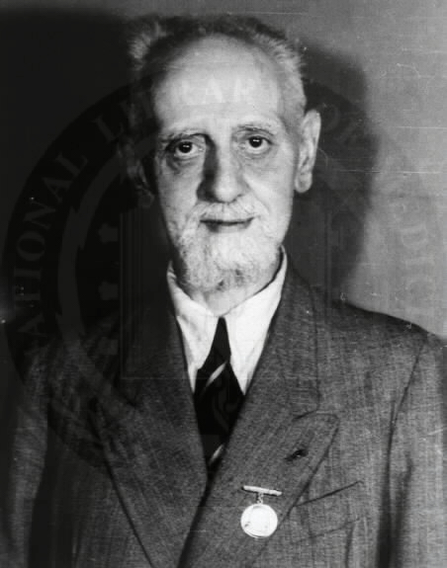
Ventricular Septal Defect
Henri Roger was the first man to describe a ventricular septal defect, in 1879 he wrote:
“A developmental defect of the heart occurs from which cyanosis does not ensue in spite of the fact that a communication exists between the cavities of the two ventricles and in spite of the fact that the admixture of venous blood and arterial blood occurs. This congenital defect, which is even compatible with long life, is a simple one. It comprises a defect in the interventricular septum”

Slide 24
VSD
Communication between two ventricles.
Sites: Membranous 90%, muscular, multiple.
27% of all heart disease.
Hemodynamics:
L to R shunt
LV to RV to PA to Lungs to PV to LA to LV
M1 M2 M3.

Slide 25
MURMURS
M1: Pansystolic murmur with thrill
M2: Ejection systolic murmur
M3: Mid diastolic murmur at apex directly proportional to the size of the shunt.
S2 : Widely split varies with respiration.

Slide 26
Hemodynamics
Magnitude of shunt depends on the size of defect &PVR
4 anatomic-physiologic group
-Small VSD with normal PVR
-Moderated VSD with variable PVR
-Large VSD with moderated elevation of PVR (hyperkinetic PHT)
-Large VSD with marked elevation of PVR

Slide 27
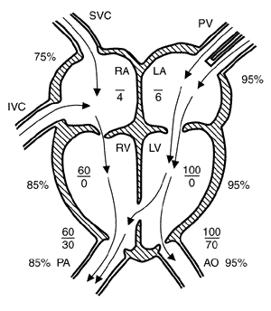

Slide 28
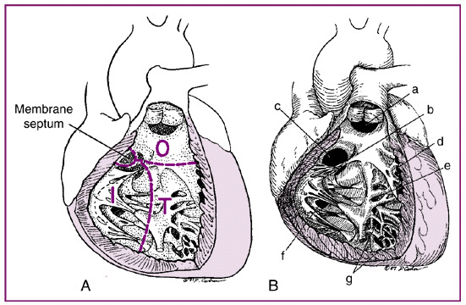
Ventricular Septum: embryology
Partitioning begins as a muscular ridge near the apex
Ridge undergoes active growth which forms the muscular septAum (inlet, trabecular, and outlet)
Concomitantly endocardial cushions fuse and the two regions meet
Outlet
Inlet
Trabecular

Slide 29
Classification
1.According to number
-Isolated single defect
-Multiple (Swiss-chess type)
2. According to size
- Small- <0.5cm2/m2-known as maladie de Roger
-Moderate- 0.5-1cm2/m2
-Large ->1cm2/m2

Slide 30
Classification continued…..
3. According to site
-Supracristal or subaortic
-Infracristal
Membranous & perimembranous (90% cases)
Muscular defect(10% cases)
4.According to flow in VSD
-Restrictive (<0.5cm2/m2)
-Non-restricetive (>1cm2/m2)

Slide 31
CLINICAL FEATURES
Small VSD – asymptomatic, normal growth
Moderate to large VSD
CCF at 6-10 weeks ( fall in PVR), Recurrent chest infections,, poor growth, Dyspnoea on exertion
Large VSD with marked PHT (reversal of shunt-Eisenmenger’ syndrome)
2nd decade, cynosis,clubbing,polycythemia

Slide 32
EXAMINATION
Wide pulse pressure
Hyperkinetic precordium
Apex LV type
S1 and S 2 masked by pansystolic murmur.
S2 widely split and variable.
Murmur at left sternal border at 3,4,5 ICS.
Delayed/mid diastolic murmur at apex.

Slide 33
ECG/ECHO/CXR
ECG: Small/Medium defects: Normal.Large defects:LVH.PAH: RVH/BIVEN.
ECHO: Defect visualization,increased LV size, increased LA size.
CXR: Cardiac size directly proportional to size of lesion.Increased pulmonary vasculature.

Slide 34
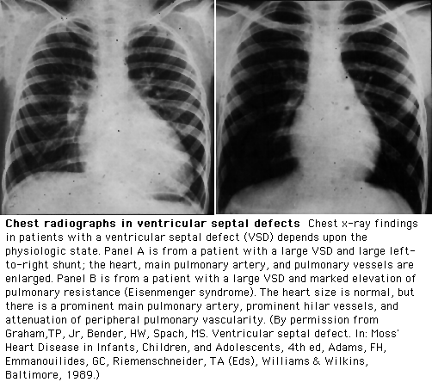
CXR in VSD
Cardiomegaly with LAE and LVE will be seen with large L to R shunts
A large defect associated with a small heart and oligemic lung fields should raise the suspicion of pulmonary vascular disease

Slide 35
ASSESSMENT OF SEVERITY
Small VSD: PSM , No MDM, no PHT, Normal cardiac size, no cardiac failure, normal ECG.
Moderate VSD : PSM with thrill, ESM, MDM at apex S2 widely split, Loud P2,S3 present, PHT mild to moderate,, cardiomegaly, LVH on ECG
Large VSD: PSM to short early SM, S2 closely split, MDM,ESM, mod.PHT,cardiomegaly,CCF,Growth failure, BVH on ECG.
Large VSD with marked PHT: quite heart,S2 single,p2loud,no VSD murmur, EDM of PR (graham steel ) present, minimal cardiomegaly, RVH on ECG

Slide 36
COURSE
70-80% Decrease in size and disappear by 3 y .
In some large VSD infundibular stenosis develops leading to decrease L→R shunt.
CCF with Large VSD at 6-8 weeks of age.
Rest may have PAH, AR and IE.

Slide 37
TREATMENT
MEDICAL:
Control of CCF
TT of chest infections
Prev. and treat anemia and IE

Slide 38
SURGERY INDICATIONS
Ideal age for closure is below 2 yr.Moderate VSD at 2-5 yr age, Large VSD at 6-9 months.
Failure of medical treatment with CCF in infancy
Infants b/w 6-12mths of age with large defects ass. with PH ,even if symptoms are controlled by medication.
Pt is older than 24mths of age with Qp:Qs is greater than 2:1 Qp/Qs = 2:1
Associated PS, reversible PAH, AR, multiple lesions (even with small VSD),IE,FTT despite of anti failure treatment.
When associated with other cardiac defects.

Slide 39
Contraindications of surgery
Development of irreversible PHT
Eisinmenger’s complex
Complications of surgery
RBBB
Residual VSD
Surgical risk is higher for swiss-cheese type VSD

Slide 40
Complications of VSD
CCF (moderate/Large VSD)
IE (small VSD, Less in trabecular type))
PHT (Large VSD)
Eisenmenger’s complex
Recurrent LRTI
Paradoxical emboli
FTT
AR (Supracristal VSD)

Slide 41
Prognosis
Small VSD- spontaneous closure
Moderate VSD – some close spontaneous or decrease with time
Large VSD with moderate elevation of PVR- risk of POVD is high
Large VSD with marked increase in PVR-poor prognosis, die of CCF and hemoptysis

Slide 42
Thank You

