Slide 1
Paronychia
BY MBBSPPT.COM

Slide 2
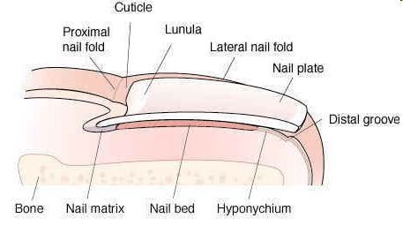
Nail Anatomy
Nail Plate (body):
is the clear, firm & translucent portion, (hard keratin)
is created by the nail matrix
is bordered by proximal & lateral folds

Slide 3
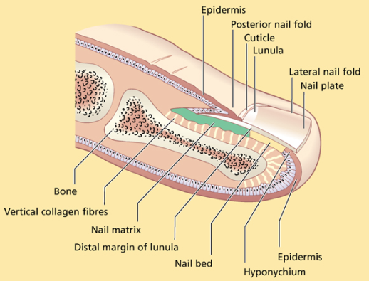
Nail Anatomy
Nail Matrix: Directly below the cuticle.
Produces The Nail Plate.
Contains Blood Vessels And Nerves.
If The Matrix Is Damaged The Nail Will Grow Deformed

Slide 4
Nail Anatomy
Lunula: Is the crescent shaped whitish area of the nail bed
Cuticle or (Eponychium): Skin fold at the proximal end of the nail
Nail Fold: Hard skin overlapping the base & sides of the nail
Nail Bed: Is continuation of the matrix & the the nail plate rests on
Hyponychium: Is under the free edge of the nail plate

Slide 5
Paronychia
It is a soft tissue infection around a fingernail
It is the most common hand infection
Occurs in the subcuticular area under the eponychium

Slide 6
Acute Paronychia
Minor injury to the finger is the common cause (nail biting)
Nail biting breaks down the physical barrier between the nail bed and the nail allowing the infiltration of infectious organisms
Organisms – staph.aureus & strep.pyogenes
It tracks around the skin margin – spreads under the nail causing floating nail or hang nail

Slide 7
Acute Paronychia
Clinical Features:
Edema, erythema and severe THROBBING pain along the lateral edge of the nail fold.
Nail on touch is very tender
May have extension to the proximal nail edge.
Presence of frank abscess and fluctuation
Subungual abscess ( floating nail ) if pus has extended under the nail plate.

Slide 8
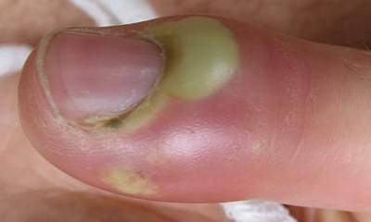
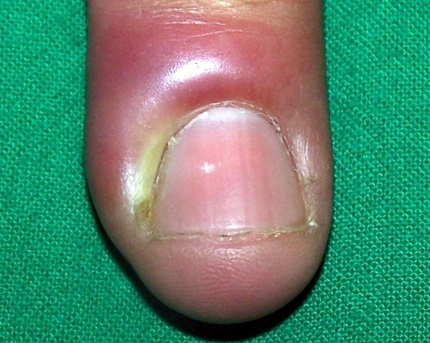
Acute Paronychia

Slide 9
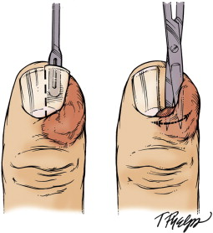
Acute Paronychia
Treatment:
Pus is drained by making an incision over eponychium
Pus is sent for c/s
Antibiotics like cloxacillin, amoxycillin
Floating nail – indicates that nail is dead – excision of nail is done

Slide 10
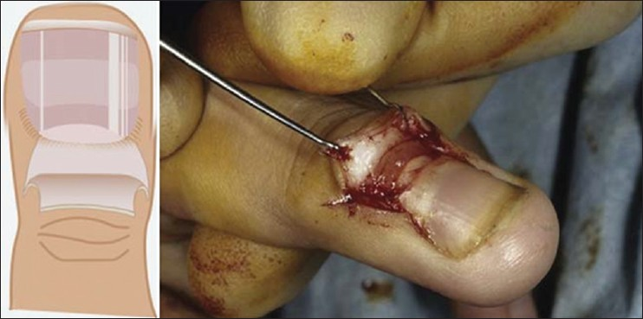
Acute Paronychia
Surgical Treatment – Pus drained by making incision over eponychium

Slide 11
Chronic Paronychia
Symptoms present for 6 weeks or longer
Caused by Candida Albicans
Secondary bacterial infection may supervene
Can be a complication of eczema
In housekeepers, dishwashers, and swimmers

Slide 12
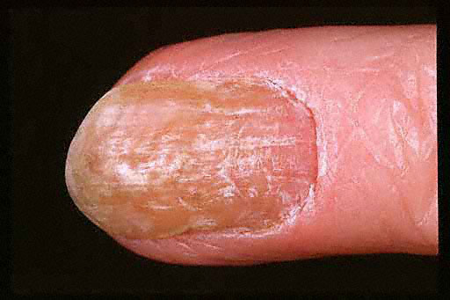
Chronic Paronychia
Clinical Features:
Itching in nail bed
Recurrent pain
Discharge
The nail folds are swollen, erythematous, and tender with pronounced transverse ridges

Slide 13
Chronic Paronychia

Slide 14
Chronic Paronychia
Management:
Culture of scrapings for fungus and other causative agents.
Long term anti fungal therapy
Antibiotics – if bacterial infection supervenes
In severe cases – removal of nail

Slide 15
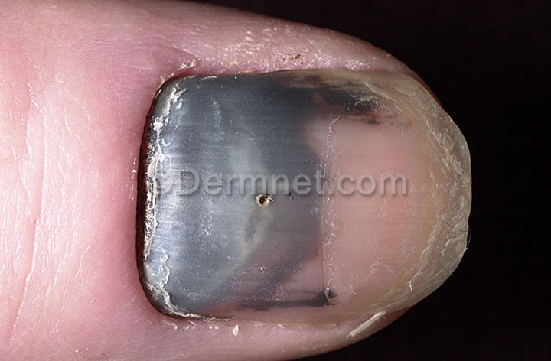
Subungual Hematoma
Collection of blood in the space between the nailbed and fingernail.
The pressure generated by this collection of blood under the nail causes intense pain.

Slide 16
Subungual Hematoma
Etiology:
They occur most commonly due to a crush type injury to the tip of the finger or toe.
This injury can occur in many ways:
Hitting your finger with a hammer
Dropping a heavy object on your toe
Closing your finger in a door

Slide 17
Subungual Hematoma
Clinical Features:
The most common symptom is intense pain.
Pressure generated between the nail and the nailbed, where the blood collects, causes this pain.
You will have a discoloration of red, maroon, or other dark color beneath the nail after an injury.

Slide 18
Subungual Hematoma
Management :
Ice, limb elevation, and anti-inflammatory medications, such as ibuprofen, are recommended for minor hematomas
If the hematoma is 25% or more of the underlying nail area, then medical attention is required.
x-ray is taken to look for the possibility of a fracture

Slide 19
Subungual Hematoma
Management :
Cautery: A battery-operated device is used to burn a hole in the nail until the blood is reached and drains out the hole.
Needle: A large diameter needle is used to drill or bore into the nail to create a hole to allow the blood to drain out.

Slide 20
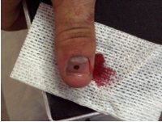
Subungual Hematoma

Slide 21
THANKS!!

