Slide 1
Physiology of Nose & PNS, Olfaction
BY MBBSPPT.COM

Slide 2
Functions of Nose
Functions of PNS
Respiration
Heat exchange
Humidification
Filtration
Nasal resistance
Nasal fluids & cilliary function
Nasal neurovascular reflexes
Voice modification
Olfaction
Vocal resonance
Air conditioning of the inspired air
Pressure damper 0
Reduction of skull weight
Floatation of skull in water
Increasing the olfactory area

Slide 3
Respiration
Inspiration
Air current passes along mid-portion of nasal cavity in lamellar flow
Expiration
Resistance of nasal valve & turbinate's leads to formation of eddy current in expired air
Results in awareness of breathing and ventilation of paranasal sinus

Slide 4
Air Conditioning
Filtration: Particles > 5 μm in inspired air are trapped by nasal vibrissae
Temperature control
Heat exchange between blood in cavernous venous sinusoids of turbinate's and inspired air (radiation)
Humidification
Secretions of nasal & PNS mucosa; for better ciliary function

Slide 5
Protection of lower airway
Muco-ciliary blanket: Traps pathogens in inspired air > 0.5 μm & transports them to nasopharynx for swallowing
Sneezing: protects against irritants
Lysozyme: kills bacteria & viruses
Immunoglobulins A & E: protection against bacteria
Interferon: for protection against virus

Slide 6
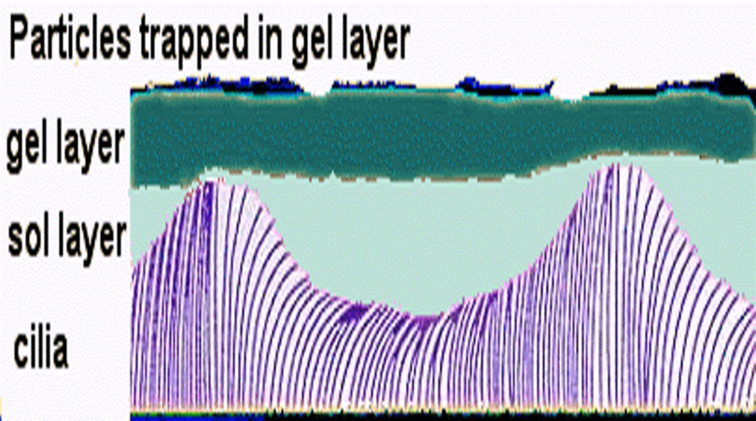
Muco-Ciliary Blanket
Goblet cells in nasal mucosa secrete a mucous blanket that moves backwards like a conveyer belt into the nasopharynx
Consists of superficial mucous or gel layer and deep serous or sol layer

Slide 7
Factors Decreasing Mucociliary Function
Dry atmosphere (absence of humidity)
Smoking, air pollutants , nasal irritants
Infection
Extremes of temperature
Hypoxia
Drugs: anesthetics, sedatives, beta blockers, topical nasal decongestants

Slide 8
Ventilation of PNS
Inspiration
Negative pressure created in nasal cavity sucks out air from paranasal sinuses via their ostium
Expiration
Eddies within nasal cavity create positive pressure that ventilates paranasal sinuses via their ostium

Slide 9
Drainage of the Sinuses
Anterior sinuses drain in lateral pharyngeal gutter
Posterior sinuses drain over posterior pharyngeal wall

Slide 10
Nasal Resistance
Nasal resistance to expired air (by nasal valve) keeps positive pressure in respiratory tract & prevents alveolar collapse

Slide 11
Vocal Resonance
Nasal cavity & paranasal sinuses provide vocal resonance for nasal consonants M, N, nG
De-nasal voice (Hypo nasal Voice)
Seen in nasal obstruction
Nasal consonants M, N & nG pronounced as B, D & G respectively

Slide 12
Nasal Reflexes
Smell reflex: Increases secretions of saliva & gastric juice
Naso-pulmonary reflex: Chronic, severe nasal obstruction leads to increased pulmonary resistance and pulmonary hypertension
Sneeze reflex: Protection against F.B., irritants

Slide 13
Nasal Cycle
Reflex, periodic alternation in nasal airflow resistance between two nasal cavities
Regulated by autonomic nervous system
Due to congestion & decongestion of venous sinusoids of inferior turbinates & anterior nasal septum
Each cycle lasts for 4 -12 hours

Slide 14
Factors modifying nasal cycle
Temperature & humidity of surrounding air
Head position
Body temperature
Physical activity
Emotional & psychological status
Hypothyroidism & hyperthyroidism
Nasal decongestants & anti- hypertensives

Slide 15
Olfaction

Slide 16
Olfactory area of Nose
Located on the roof of the nasal cavity
Cribriform plate
Superior part of the nasal septum
Superior turbinate
Upper part of middle turbinate

Slide 17
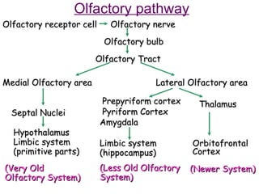

Slide 19
Olfactory Neural Pathway
Olfactory receptors on nasal mucosa → Olfactory nerve bundles (20) → synapse with Mitral & Tufted cells in Olfactory bulb → Axons unite to form Olfactory tract → flattens distally to form Olfactory trigone → trifurcates into Olfactory striae → synapse with 1⁰ & 2⁰ Olfactory cortex + hypothalamus + hippocampus + amygdala

Slide 23
Olfaction is the only sensation to reach cerebral cortex directly without first relaying at thalamus
Olfactory pathway incorporates limbic system & is concerned with emotional behaviour, mood & recent memory

Slide 24
Causes of Olfactory Dysfunction
1 . Upper respiratory viral infection (30 %)
2. Idiopathic (25 %)
3. Head trauma (20 %)
4. Obstructive sinonasal disease (15 %): Rhino –sinusitis , nasal polyp , neoplasm
5. Neurologic & Psychiatric diseases
6. Intra-cranial neoplasm
7. Toxic chemicals & surgical trauma

Slide 25
Classification
Conductive loss: obstruction of nasal passages
Chronic nasal inflammation, polyposis
Sensorineural loss: damage to neuroepithelium
Viral infection, airborne toxin
Central olfactory neural loss: C.N.S. damage
Tumors, neurodegenerative disorders

Slide 26
Types of Olfactory dysfunction
Anosmia: absence of olfactory sensation
Hyposmia: decreased olfactory sensation
Parosmia / cachosmia: perception of a pleasant odour as unpleasant odour
Phantosmia: perception of odour in absence of olfactory stimulus
Hypersomnia: increased olfactory sensation
Olfactory agnosia: unable to identify odour

Slide 27
Olfactory function tests
Supra-threshold test: only identifies odour
Smell bottles
Smell Identification Test (S.I.T.)
2. Threshold Olfactometry: measures weakest perceptible odour with help of serial dilution
Manual
Dynamic (automated)

Slide 28
Manual Threshold Olfactometry

Slide 29
Dynamic Threshold Olfactometry

Slide 30
University of Pennsylvania Smell Identification Test (UPSIT)
Most commonly used test of smell worldwide
4 booklets of 10 microencapsulated odors stimuli
Scratch and sniff format
Four responses accompanying each odor
Forced choice design
Scores are compared to normal (sex- and age-related)

Slide 31
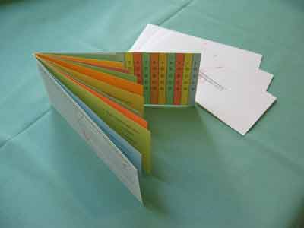
Smell Identification Test sample

Slide 32
Results
36 – 40: Normal
16-35 : Partial anosmia
6-15: Total anosmia
0-5: Malingering

