Slide 1
POSTNATAL CARE BY MBBSPPT.COM

Slide 2
What is POSTNATAL CARE?
Definition- Care of the mother & the newborn after delivery is known as postpartal care.

Slide 3
CARE OF THE MOTHER
The objectives of postpartal care are -:
To prevent complications of the postpartal period.
To provide care for the rapid restoration pf the mother to optimum health.
To check adequacy of breast feeding.
To provide family planning services.
To provide basic health education to mother family.

Slide 4
1) Complications
Puerperal sepsis-:
this is infection of the genital tract within 3 weeks after delivery.
2. Thrombophlebitis –
this is infection of the veins of the legs.
3. Secondary haemorrhage-
bleeding from vagina anytime from 6hours after delivery to the end of the puerperium(6weeks).
4. Others
Urinary infection & mastitis.

Slide 5
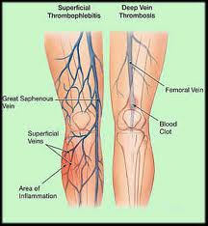
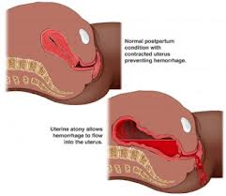

Slide 6
2) Restoration of Mother to optimum health
1. PHYSICAL
a) Postnatal examinations
Twice a day during 1st 3 days & subsequently 1ce a day till umblical cord drops off.
At the end of 6 wks,an examination is necessary to check –up involuton of uterus.
once a month-till 6month
2/3times –till end of the year
b) Anaemia-routine Hg examination
c) Nutrition
d) Postnatal exercises- bring thee stretched abdominal & pelvic muscles back to normal
2. PSYCHOLOGICAL – Fear, timidity & insecurity.
3. SOCIAL

Slide 7
3) BREAST FEEDING
A great asset in India is that an average indian mother although poor in nutritional status, has a remarkabe ability to breast feed her infant for prolonged periods sometimes extending to nearly 2 years.
EBF

Slide 9
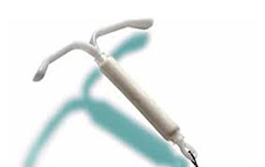
4) FAMILY PLANNING

Slide 10
5) BASIC HEALTH EDUCATION
HYGEINE
FEEDING FOR MOTHER & INFANT
PREGNANCY SPACING
IMPORRTANCE OF HEALTH CHECK UP
BIRTH REGISTRATION

Slide 11
CARE OF CHILDREN
1 Infancy (upto 1yr of age)
Neonatal period (1st 28 days of life)
Postneonatal period (28th d-1yr )
Preschool age (1-4yr )
School age (5-14 yr )

Slide 12
Thank You

