Slide 1
Protein Energy Malnutrition MBBSPPT.COM

Slide 2
Malnutrition
Leading cause of morbidity & mortality in children through out the world
10% of under 5 year olds world wide are wasted & 27% stunted & 25% underweight
Direct cause of death in 7% & underlying cause in 46% of <5 yr old children
In India: (NFHS - 3 data)
Prevalence of under nutrition (0-3 years): 46%
Prevalence of wasting (0-3 years): 23%
Prevalence of stunting (0-3 years):38%

Slide 3
Etiology
Low birth weight baby: Maternal malnutrition LBW & growth retarded babies with poor nutritional reserve.In India 28% babies born are LBW.
Feeding habits: Lack of exclusive breast feeding in first 6 mths, introduction of artificial feeds , inappropriate hand and bottle hygiene, delayed introduction of complimentary food

Slide 4
Etiology
Infections: diarrhea, malaria, measles, whooping cough & tuberculosis precipitate & aggravate the existing nutritional deficit
Impaired appetite
Iatrogenic food restriction by parents
Metabolic demands high
Catabolism of body tissue
Loss of protein in infected material
Impaired immunity & vicious cycle

Slide 5
Etiology
High pressure advertising baby food in market
Social factors : Repeated pregnancies, inadequate spacing, food taboos, broken homes, separation of child from parents, natural disaster e.g. earthquake, droughts, flood
Poverty:

Slide 6
Malnutrition: a medical & social disorder
Poverty
Poor understanding
Family problems
Nutritional deprivation
Emotional deprivation
Malnutrition
infections

Slide 7
Classification of PEM
IAP classification: wt >80% expected for that age is normal
Grade I – 71-80%
Grade II – 61-70%
Grade III – 51- 60%
Grade IV - <= 50%
Alphabet k is postfixed in the presence of pedal edema e.g. PEM grade II(k)

Slide 8
Classification of PEM
Gomez classification: > 90% expected wt for age is normal
Grade I – 76-90%
Grade II – 61- 75%
Grade III - <= 60%

Slide 9
Classification of PEM
Welcome trust classification: based on wt for age & presence or absence of edema
Wt between 60-80% with edema- Kwashiorkor
Wt 60-80% without edema – undernutrition
Wt <60 % without edema – Marasmus
Wt <60% with edema – marasmic kwashiorkor

Slide 10
Classification of PEM(WHO)
Malnutrition
Parameters moderate severe
Wt for Ht 70-79%(-2 to _3 SD) <70%(<- 3 SD)
(severe wasting)*
Ht for age 85-89% <85%(<-3 SD)
(severe stunting)
Oedema No Yes
(oedematous
malnutrition.)*

Slide 11
Severe acute malnutrition(sam)
WHO & UNICEF coined this term to identify malnourished children with highest risk of death & for therapeutic feeding
Criteria for SAM (presence of any one of the following:
Wt for length/ht < 3 SD of the median WHO growth chart
Visible severe wasting
Bilateral pedal edema (dorsum)
Mid upper arm circumference <11.5 cm between 6mths - 5 yrs age

Slide 12
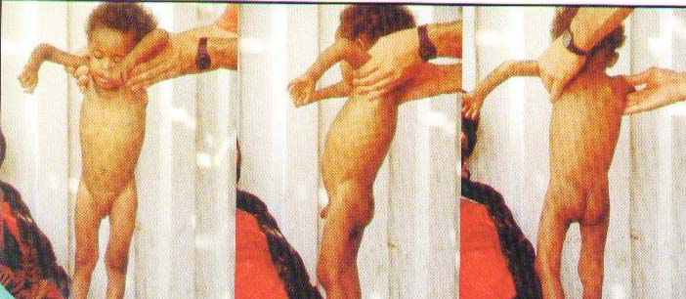

Slide 13
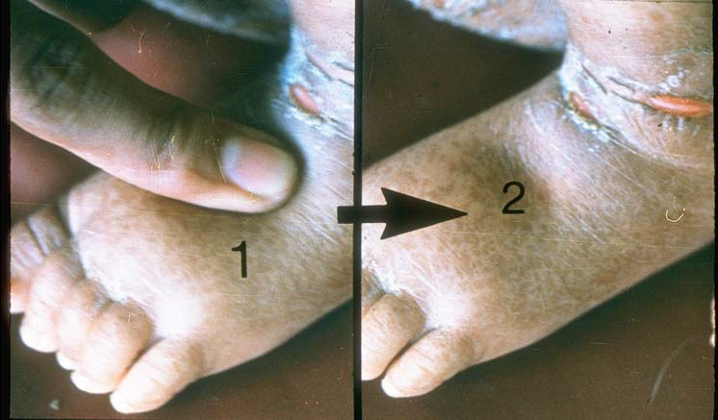

Slide 14
Pathophysiology
Classical theory:
In kwashiorkor- mainly deficiency of protein leading to hypoalbuminemia leading to edema
In marasmus- Deficiency of energy
Gopalan’s theory of adaptation:
In marasmus – adaptation to chronic nutritional deficiency via cortisol
In Kwashiorkor- body fails to adapt & its an acute condition

Slide 15
Pathophysiology
Golden theory of free radicals:
Kwashiorkor develops due to imbalance between the production of free radicals & their safe disposal
Oxidative toxic stress releases excess of free radicals
Free radicals cause cell membrane damage & increased permeability & hence edema
In marasmus,free radical damage is less

Slide 16
Changes in body composition & function
Loss of muscle & subcutaneous tisssue
Body fat & total bone mass is reduced
Total body water in PEM –increased to 70-80% body wt (60% in normal children)
Increased intracellular Na & reduced total body K & Mg.
Dehydration should be corrected with caution, preferablly orally

Slide 17
Changes in body composition & function
Metabolic alteration:
BMR reduced by 30% & energy expenditure due to poor activity
Heat generation and heat losses affected
Biochemical changes:
Liver – synthesis of all proteins reduced, gluconeogenesis & metabolism of liver impaired leading to incresed risk of hypoglycemia

Slide 18
Biochemical changes
Plasma transferin concn markedly reduced
Plasma triglyceride, Cholesterol & beta lipoprotein reduced in Kwashiorkor
VLDL account for most of the triglyceride in Kwashiorkor
In marasmus above parameters may be normal or reduced

Slide 19
Immunity
Impaired cell mediated immunity due to atrophy of thymus & lymphoid tissue
Tuberculosis tends to be unusually severe
Mx reaction poor
Humoral immunity less affected
Circulating immunoglobulin levels –normal or elevated
Secretory IGA may be reduced

Slide 20
Immunity
Leukocyte count is usually normal
Leukopenia may be present in vit B12 & folic acid deficiency
Chemotaxis is impaired but phagocytosis is normal
Impaired fungicidal & bactericidal activity of leukocytes
Physical barrier is impaired

Slide 21
Gastro intestinal system
Atrophy of salivary gland
Fatty infiltration of liver
Atrophy of pancreatic acini
Intestinal villi atrophied reducing total absorptive surface
Steatorrhea may occur
Protuberant abdomen and rectal prolapse due to laxity of muscles

Slide 22
Other systems
CNS:
Growth & development of brain affected if malnutrion sets in in first two years
Associtaed micronutrient deficiency e.g. iron, B1, B12, Zinc & iodine further impairs brain function and lowers development score

Slide 23
Other systems
Renal:
GFR & renal plasma flow reduced in severe PEM
Urinay sodium & phosphorus excretion reduced
Endocrine: Insulin level reduced, cortisol & growth hormone level increased
CVS: Cardiac output & stroke vol. reduced,BP –low & renal perfusion reduced

Slide 24
Clinical features
Depends on
Severity
Duration
Age
Relative deficiency of diff component of food
Presence of associated infection
In India major limiting factor in diet is energy
Nutritional marasmus & Kwashiorkor are two extreme form of PEM

Slide 25
Marasmus
Visible severe wasting of muscle & subcutaneous tissues
Usually alert child
Emaciated look
No edema
Skin –dry, scaly, thin, wrinkled with loose folds (thigh & gluteal region)
Abdomen distended, hair hypopigmented
Appetite usually more unless infection

Slide 26
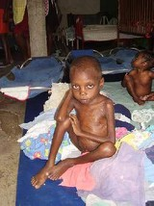

Slide 27
Kwashiorkor
Essential features:
Edema of the dependent parts
Marked growth retardation
Psychomotor changes
Other features:
Skin changes, hair changes, hepatomegaly, poor appetite & associated nutritional deficiencies

Slide 28
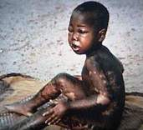

Slide 29
Kwashiorkor
Edema – due to
i) Hypoalbuminemia,
ii) Capillary leak due to infection & hypokalemia
iii) Free radical induced damage to cell membrane
Edema starts from lower extremities and spreads upwards with puffy face

Slide 30
Psychomotor changes
Lethargic, listless & apathetic
Play activity & interaction with others reduced
Resents examination
Poor appetite

Slide 31
Skin & hair changes
Skin
Hair
Dry and scaly
Cracking giving mosaic appearance
Crazy pavement dermatitis (black patches over flexors & pressure sites)
Raw hypopigmented or hyperpigmented patches
Flaky paint dermatitis
Perioral ulcers
Hypopigmented
Lustureless
Thin & easily pluckable
Flag sign

Slide 32
Management of SAM
SAM out patient management program
In patient management:
Initial Treatment: 2-7 days
Rehabilitation: 2-6 weeks
Follow up: After discharge

Slide 33
Management of moderate malnutrition
Managed at out-patient level
Home based with Angadwadi supervision
Screen and treat for infections & other associated nutritional deficiencies
De-worm
Gradual increase in food intake to provide 150-200 Cal/kg/day & protiens 2-3gm/kg/day
Monitor Progress
Parental education

Slide 34
Moderate malnutrition contd...
Parental education:
Stress on simple modifications in the home cooked food without resorting to expensive supplemental foods
Stress importance of breast feeding
addition of oil / butter
Green leafy vegetables
Small frequent feeds -at-least 5 /day
Hygiene
Home treatment for diarrhoea, fever, ARI and recognition of danger signs

Slide 35
Management <6 mths age
Continuing or re initiating breast feeding
Supplemental suckling technique for re initiation of breast feeding
If no prospect of continuing or re initiation of breast feed – F- 75 formula feeding

Slide 36
Appetite test (criteria for passing test)
Body weight | Minimum amount of RUTF in ml/gm to be consumed for passing the test
<4 Kg | 15
4-6.9 Kg | 25
7-9.9 Kg | 35
10-14.9 Kg | 50

Slide 37
Ready to use treatment formula (RUTF)
Soft & crushable food used in community treatment of SAM
It is calorie dense milk based sold diet
It is best used when home based food can not be made
It contains approx 100 kcal & 2.9 gms protein/100 gms
It is advised to be given 2-3 hrly with lots of water to drink

Slide 38
Amount of RUTF
WT | Amount of RUTF Gms/day
3-4.9 Kg | 105-130
5-6.9 Kg | 200-260
7-9.9 Kg | 260- 400
10- 14.9 Kg | 400- 460

Slide 39
Non responders
Non responders:
Failure to gain wt. for 21 days
Wt. loss since admission to program for 14 days
Secondary Failure
Failure of appetite test in any visit or
Wt loss of 5 % body wt. at any visit
Defaulters: not traceable for two weeks
Non responders & anyone developing danger signs – refer to hospital

Slide 40
Indications for admission
Presence of medical complications e.g Diarrhea, Pneumonia, Sepsis, Hypoglycemia, Electrolyte disturbances etc.
Decreased appetite
Presence of bilateral pitting edema feet
Age <6 months

Slide 41
Step wise management of severe PEM
Step 1-6 (1-2 days)
SHIELDED
S- Sugar deficiency (hypoglycemia)
H - Hypothermia
I - Infection & septic shock
EL- Electrolyte disturbances
DE – Dehydration
D – Deficiencies of iron, vitamins & other micronutrients

Slide 42
Step wise management of severe PEM
Step 7 –(3-7 days) – Initiation of feeding
Step 8 – (2-6 weeks) – catch up growth & rehabilitation
Step 9 – (6-8 weeks) – Discharge
Step 10 ( 8-36 weeks) – Follow up

Slide 43
Malnourished children need BEST diet
B – Beginning of feeding,
E- Energy dense feed,
S- Sensory stimulation & emotional support,
T- Transfer to home based diet & follow up

Slide 44
Initial treatment
Treat or prevent hypoglycemia (Blood sugar < 54 mg%)
Frequent monitoring of blood sugar
Treat with 5ml/Kg of 10% dextrose I/V
Early & frequent feeding
Treat or prevent hypothermia ( rectal temp, <35.5 C)
Re- warm using warmer / Kangaroo technique
Treat for associated hypoglycemia

Slide 45
Initial treatment contd..
Dehydration
Diarrhoea common
Assessment of dehydration difficult
Unreliable signs:
Mental state
Dryness of mouth tongue & tears
Skin elasticity

Slide 46
Dehydration Contd.
Reliable signs
thirst
recent sinking of eyes
cold hands and feet
Treatment:
Slow rehydration
Preferably oral : WHO - ORS with free access to water
Give @ 70 -100 ml/kg over 12 hrs

Slide 47
Infections
Infections common
Host response masked
Start antibiotics in presence of
Shock
Hypoglycemia
Hypothermia
Skin infections
Respiratory infections
Lethargic/ sick looking

Slide 48
Infections Contd.
Obtain appropriate cultures
Start Broad spectrum antibiotics:
Give for at-least 5 days
Review after culture reports available/ child fails to improve
Treat for specific infections if detected

Slide 49
Vitamin Deficiencies
Vit. A : Day 1 in all children,
Additional doses on day 2 and 2 weeks later in children with signs of deficiency
Dose:
< 6 months : 50,000 U
6 - 12 months: 1 lakh U
>12 months : 2 lakh U

Slide 50
Vitamin Deficiency Contd.
Folic acid: 5 mg on Day 1 and 1mg thereafter
Vit. K if marantic purpura present
Oral multi-vitamin supplements

Slide 51
Anemia
Mild to moderate anemia always present due to:
Iron & folic acid deficiency
Worm infestation
Malaria
Recurrent infection
Severe anemia: Packed cell transfusion @ 5-10 ml/kg over 3 hrs
Exchange transfusion in presence of CHF
Do not give iron during initial phase

Slide 52
CHF
More common in kwashiorkor
Complication of over-hydration
Blood/ plasma transfusion
Treatment
Stop oral intake and I/V fluids
Give I/V diuretic

Slide 53
Step 7( initiation of feeding)
Begin feeding as soon as possible
Gradual re-introduction
Small frequent feeds
Milk is the usual introductory food
Start with 80 - 100 kcal/kg body wt
Gradually increase the amount
May give naso-gastric feeds initially

Slide 54
Dietary management contd...
Caloric density built by adding sugar & oil
Cereal Powder/ egg may be added later
In children with lactose intolerance rice gruel / cereal pulse gruel may be used
Add a multi vitamin preparation
Total feed volume should not exceed 120 ml/kg/day
Shift to oral feeding
Intensive phase completed when the appetite improves

Slide 55
Acute phase
> 6 mths age :
F-75 formula or its equivalent:
Contains 75 kcal/100 ml & 0.9 gms protein
Dried full cream milk powder 35 gm or fresh undiluted cow’s milk/full cream packet milk 300 ml+ sugar 100 gms+vegetable oil 20 gm+ electrolyte & mineral solution 20 ml- all mixed and water added to make it 1000 ml

Slide 56
Amount of feed
Days | Frequency | Vol/kg/feed | Vol/kg/day
1-2 | 2 hrly | 11ml | 130 ml
3-5 | 3 hrly | 16 ml | 130 ml
6-7+ | 4 hrly | 22 ml | 130 ml

Slide 57
Step -8 (rehabilitation Phase)
Built upto 150 - 220 kcal & protein 4-6 gms/kg/day by increasing the caloric density of food
F-100 formula to be started initially
Amount of milk gradually decreased and semi- solids introduced
Re-initiate & encourage breast feeding
Add iron
Shift to the family type of diet

Slide 58
Rehabilitative phase
F-100 catch up formula diet or its equivalent is started at rehabilitation phase initially.
F-110 contains 100 kcal & 2.9 gms protein /100 ml
It contains dried full cream milk powder 110 gms or 950 ml cows milk+ sugar 50 gms + vegetable oil 30 gms + electrolyte solution 20 ml & all added to make it 1000 ml

Slide 59
Step 9 (Discharge) criteria
Good appetite
No edema
Continuous weight gain of > 5 gm/kg/day x 3 consecutive days
Completed appropriate antimicrobials treatment & proper immunization
Care giver trained, motivated & skilled to provide care

Slide 60
Step 10 (follow-up)
Monitor progress
Usual wt. Gain 10 -15 gm/kg/d
Re-inforce maternal education & motivation
Encourage child to eat as much as possible
150 -200 Cal/kg/d
Stimulate emotional & physical dvpt.
Rehabilitation phase complete when child achieves 90% of expected wt. for ht.

Slide 61
Prevention of malnutrition
Tack the chief causes of malnutrition:
Delayed weaning
Diluted top milk
Late introduction of semisolids & solids
Maternal education
Prevention of L.B.W.
Access to health care
Provision of comprehensive health care services

Slide 62
Thank yOU

