Slide 1
PSOAS ABSCESS
BY MBBSPPT.COM

Slide 2
Psoas Muscle
Fusiform shaped muscle, cover Anterio-lateral surface of lumbar vertebral bodies.
ORIGIN: Lateral surface, intervertebral disc and transverse process of T12 -L5
COURSE: Passing inferiorly along pelvic brim and iliacus muscle beneath inguinal ligament towards anterior thigh.
INSERTION: Lesser trochanter of femur

Slide 3
INNERVATION: L1-L3
Lies close to sigmoid colon, appendix, kidney, ureters, LS spine, abdominal aorta, iliac lymph nodes.
Psoas fascia covers the muscle

Slide 4
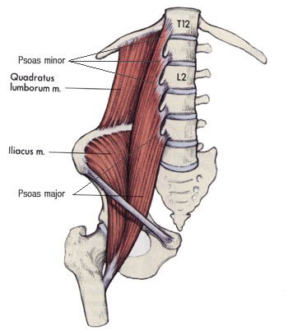

Slide 5
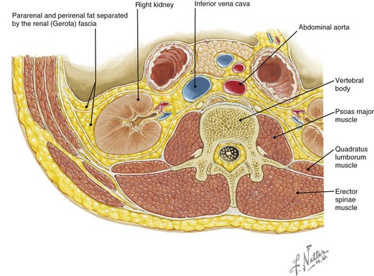

Slide 6
Psoas abscess is the collection of pus in psoas compartment, within psoas fascia
PRIMARY: from hematogenous spread
SECONDARY: from adjacent organs

Slide 7
Primary Psoas Abscess
Results from hematogenous spread from an occult source.-11%
Seen in patient with immunocompromised state( AIDS, DM, CRF, )

Slide 8
Secondary Psoas Abscess
Due to infections from adjacent organs
Tubercular: from potts spine
Pyogenic
Renal diseases: chronic uti, malignancies- 47%
GI diseases: appendicitis, diverticulitis, crohn’s disease”- 16%
Bone infections, including tb spine- 7%

Slide 9
Trauma: 4.5%
Malignant neoplasms: 4%

Slide 11
Microbiology
Related to cause.
Renal diseases- E. Coli, Proteus,
GI Tract diseases: Polymicrobial- E. Coli, enterococci, bacteroides,
Hematogenous spread: Monomicrobial- staph. Aureus
Potts spine: M. Tuberculi

Slide 12
Clinical Features
Abdominal/flank pain: 60-75%
Fever and chills: 30-90%
Limp.
Malaise: 10-22%, weight loss, nausea.
Referred pain to hip groin, knee.
Pain less swelling in inguinal region.
Position of comfort: supine with knee flexed and hip mildly externally rotated.

Slide 14
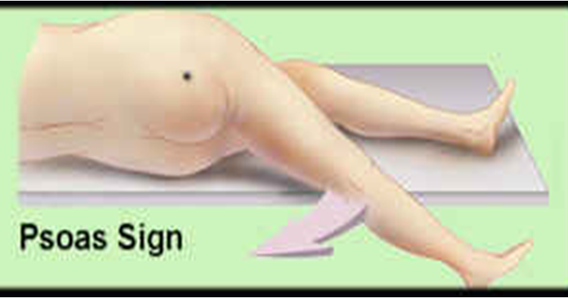
Clinical Tests- Psoas Sign
Patient lying on normal side , hyperextension of affected hip- PAIN in lower quadrant.

Slide 15
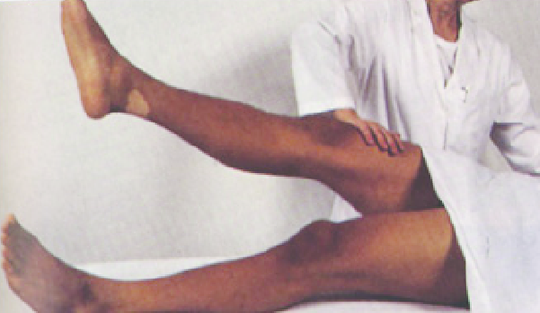
2. Place hand proximal to knee and tell patient to lift the leg.- PAIN

Slide 16
Investigations
Elevated total counts, ESR, CRP.
Blood, urine, pus – culture
Radiography of spine, kidney abdomen
Ultrasonography
CT scan- gold standard- shows hypodense lesion
MRI

Slide 17
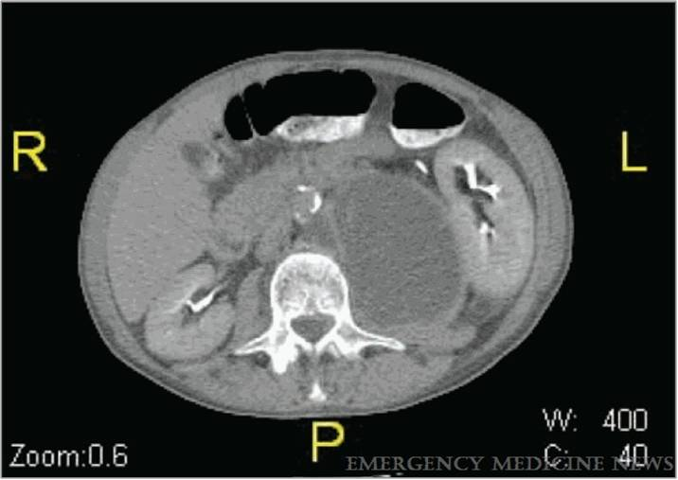

Slide 19
Management
MEDICAL
Antibiotics- Anti staph.
Specific: depends on culture and sensitivity.
Anti Tubercular drugs if TB.
Control diabetes and other comorbidities.

Slide 20
SURGICAL
CT/USG guided catheter insertion and drainage.
Drainage of abscess
Through lateral loin incision- via Petit’s triangle.
Through anterior incision
Ludloff approach. When abscess points subcutaneously at adductor region of thigh.

Slide 22
Anterior Approach
5-7 cm long vertical incision from ASIS to anterior thigh.
Identify Sartorius-dissect medially to it upto AIIS. Care of femoral nerve
Insert an artery along medial side of wing of ilium under poupart’s ligament
Drain abscess and close

Slide 24
Complications
Intraperitoneal rupture
Pressure symptoms – Hydroureteronephrosis
Deep vein thrombosis
Septicaemia

Slide 25
THANK
YOU!

