Slide 1
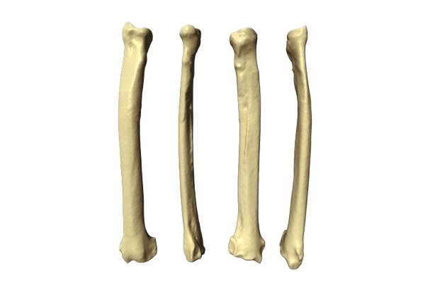
RADIUS BONE
BY MBBSPPT.COM

Slide 2
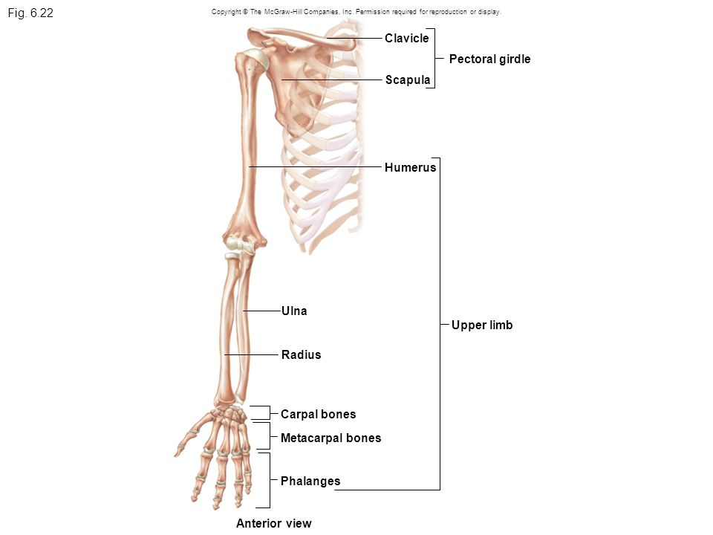
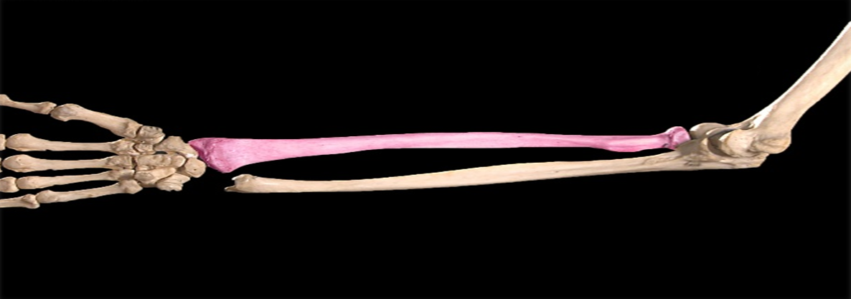
Radius
It is the lateral bone of forearm.
It is a type of long bone.
Has an upper end, lower end and a shaft.
The Radius is one of two bones in the forearm.
It lies laterally.

Slide 3
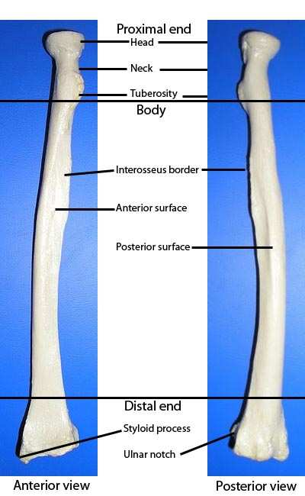
Side determination
Upper end-disc shaped head.
Lower end-expanded, styloid process.
Medial border is sharpest.
Lower end- tubercle of lister on posterior surface.

Slide 4
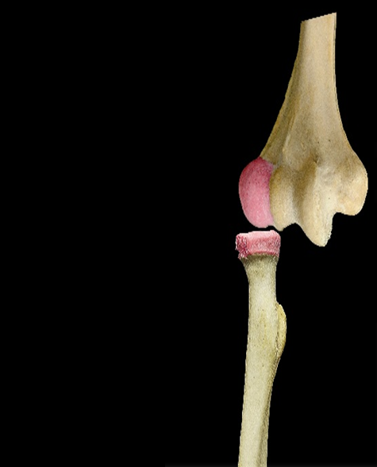
Features
Upper end:
Head (disc- shaped, articulates with capitulum of humerus).
Neck (annular ligament).
Tuberosity.
Capitulum of
Distal Humerus
Articulates with
Head of Promial Radius.
Right Side

Slide 5
Shaft
Anterior Border
Borders Posterior Border
Medial/Interosseous Border
Anterior Surface
Surfaces Posterior Surface
Lateral Surface

Slide 6
Right Radius and Ulna; Anterior View

Slide 7
Lower end
Widest part of bone
5 surfaces
Anterior surface, posterior surface, medial, lateral, inferior surface.
Lister tubercle-0n posterior surface
Ulnar notch- on medial surface
Lateral surface-styloid process
Inferior surface- area for scaphoid and lunate

Slide 8
Attachments
Inserts on radial tuberosity.
Supinator- insBiceps brachii- erted into upper part of lateral surface.
Pronator teres- inserted into middle of lateral surface.
Brachioradialis- inserts above the styloid process.
Pronator quadratus- inserted into lower part of anterior surface.
Flexor digitorum superficialis- origin from upper part of anterior border.
Flexor pollicis longus- origin form upper 2/3 of anterior surface.
Abductor pollicis longus- arise form posterior surface.
Extensor pollicis brevis- posterior surface.
Interosseous membrane- attached to interosseous border.

Slide 9
Flexor Pollicis Longus
Brachioradialis
Posterior view
The Radius
Muscles attaching to Volar Aspect
Pronator Teres
Pronator Quadratus

Slide 10
Muscles attaching to dorsal aspect of Radius
Muscles attaching to dorsal aspect of Radius
Abductor Pollicis Longus
Supinator
Muscles attaching to Volar Aspect
Muscles attaching to dorsal aspect of Radius
Biceps
Extensor Pollicis Brevis

Slide 11
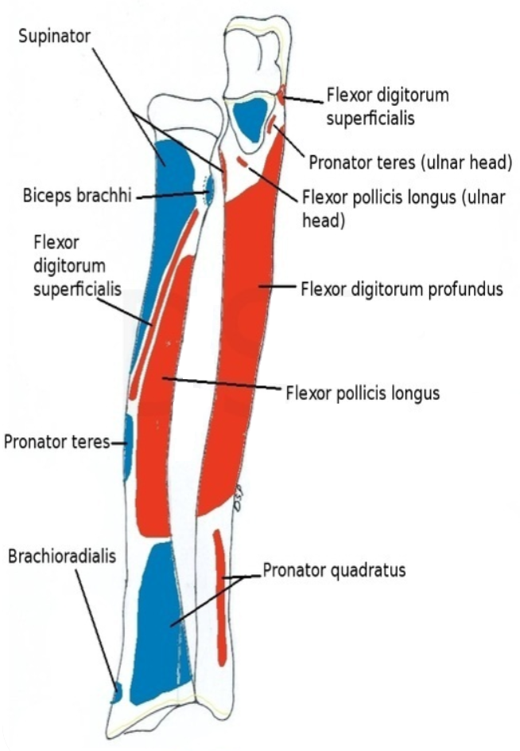
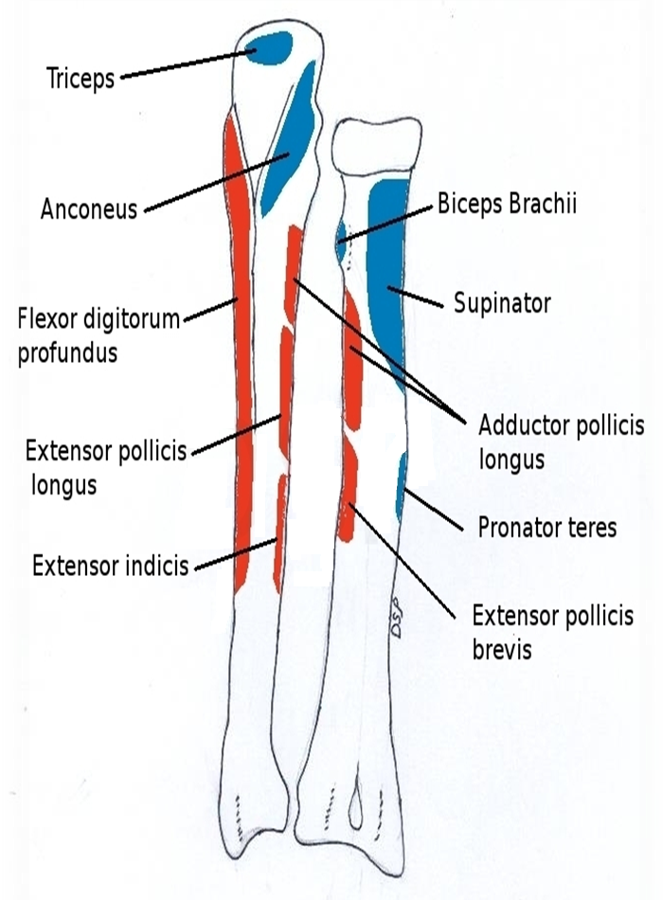

Slide 12
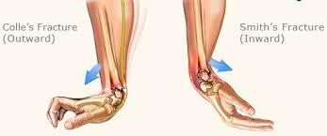
Clinical Anatomy
Colles’ fracture = radius gets fractured about 2cm above its lower end due to fall on outstretched hand.
Smith’s fracture = if distal fragments gets displaced anteriorly.
The Radius is one of two bones in the forearm.
It lies laterally.

Slide 13
Colle’s vs smiths
The Radius is one of two bones in the forearm.
It lies laterally.

Slide 14
Pulled or nursemaid’s elbow
Subluxation of head of radius – due to sudden powerful jerk on the hand of a child may dislodge the head of radius from the annular ligament.

Slide 15
Thank You

