Slide 1
Respiratory acidosis and alkalosis
BY MBBSPPT.COM

Slide 2
OBJECTIVEs
Introduction
Causes
Diagnosis
Management

Slide 3
Introduction
Respiratory acid-base disorders are those abnormalities in acid-base equilibrium initiated by a change in the arterial carbon dioxide tension (PaCO₂ ) -- the respiratory determinant of acidity in the Henderson equation:
H+= 24 x PaCO₂ / [HCO₃⁻]
There are two respiratory acid-base disorders:
respiratory acidosis and
respiratory alkalosis.

Slide 4
RESPIRATORY ACIDOSIS
Respiratory acidosis is the acid-base disturbance initiated by an increase in PaCO₂.
The level of PaCO₂ is determined by the interaction of two factors, the rate of carbon dioxide production (VCO₂) and the rate of alveolar ventilation (VA), as follows:
PaCO₂ = K x VCO₂ / VA
where K is a constant.
An increase in arterial pCO₂ can occur by one of three possible mechanisms:
Presence of excess CO₂ in the inspired gas.
Decreased alveolar ventilation.
Increased production of CO₂ by the body.

Slide 5
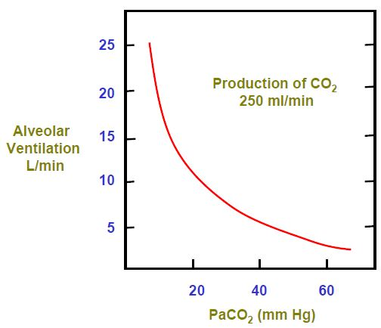
By far, most cases of respiratory acidosis reflect a decrease in alveolar ventilation.
Overproduction of carbon dioxide is usually matched by increased excretion (due to increased alveolar ventilation) such that hypercapnia is prevented.
Secondary physiologic response –
Respiratory acidosis acidifies body fluids.
It elicits adaptive increments in plasma bicarbonate concentration that attenuate the impact of hypercapnia on systemic acidity; these increments in plasma bicarbonate should be viewed as an integral part of the respiratory acidosis.

Slide 6
In acute respiratory acidosis, the PaCO₂ is elevated above the upper limit of the reference range (over 6.3 kPa or 45 mm Hg) with an accompanying acidemia (pH <7.36). Acute respiratory acidosis occurs when an abrupt failure of ventilation occurs.
In chronic respiratory acidosis, the PaCO₂ is elevated above the upper limit of the reference range, with a normal blood pH (7.35 to 7.45) or near-normal pH secondary to renal compensation and an elevated serum bicarbonate (HCO₃⁻ >30 mm Hg).

Slide 7
ACUTE CAUSES
Normal airway and lungs | Abnormal airway and lungs
Central nervous system depression GA/ Sedative overdose Head trauma/Cerebrovascular accident Cerebral edema Brain tumor/Encephalitis | Upper airway obstruction Coma induced hypopharyngeal obstruction Aspiration of foreign body or vomitus Laryngospasm or angioedema Obstructive sleep apnea
Neuromuscular impairment High spinal cord injury, Guillain-Barre syndrome Status epilepticus, Botulism, tetanus Crisis in myathenia gravis Hypokalemic myopathy Drugs or toxic agents (curare, succinylcholine, aminoglycosides, organophosphates) | Lower airway obstruction Generalized bronchospasm Severe asthma Bronchiolitis of infants and adults
Ventilatory restriction Rib fractures with flail chest Pneumothorax, Hemothorax Impaired diaphragmatic function | Disorders involving pulmonary alveoli Severe bilateral pneumonia Acute respiratory distress syndrome Severe pulmonary edema
Iatrogenic events Misplacement of airway cannula during mechanical ventilation Bronchoscopy associated respiratory arrest Increased CO2 production with constant mechanical Ventilation | Pulmonary perfusion defect Cardiac arrest, Severe circulatory failure Massive pulmonary thromboembolism, Fat or air embolus

Slide 8
CHRONIC CAUSES
Normal airway and lungs | Abnormal airway and lungs
Central nervous system depression Sedative overdose Methadone/heroin addiction Primary alveolar hypoventilation Obesity-hypoventilation syndrome Brain tumor Bulbar poliomyelitis | Upper airway obstruction Tonsillar and peritonsillar hypertrophy Paralysis of vocal cords Tumor of the cords or larynx Airway stenosis post prolonged intubation Thymoma, aortic aneurysm
Neuromuscular impairment Poliomyelitis Multiple sclerosis Muscular dystrophy Amyotrophic lateral sclerosis Diaphragmatic paralysis Myxedema Myopathic disease | Lower airway obstruction Chronic obstructive lung disease (bronchitis, Bronchiolitis, bronchiectasis, emphysema)
Ventilatory restriction Kyphoscoliosis, spinal arthritis Obesity Fibrothorax Hydrothorax Impaired diaphragmatic Function | Disorders involving pulmonary alveoli Severe chronic pneumonitis Diffuse infiltrative disease Interstitial fibrosis

Slide 9
Acute Adaptation:
It is completed within 5-10 min from onset of hypercapnia.
It originates exclusively from acidic titration of the body’s non-bicarbonate buffers (hemoglobin, intracellular proteins and phosphates, plasma proteins):
CO₂ + H₂O ↔ H₂CO₃ ↔ HCO₃⁻ + H⁺
H⁺ + Buf- ↔ HBuf
where Buf- refers to the base component and HBuf to the acid component of non-bicarbonate buffers.
On average, plasma bicarbonate concentration increases by about 0.1 mEq/L for each 1 mmHg acute increment in PaCO₂; as a result, plasma hydrogen ion concentration increases by about 0.75 nEq/L for each mm Hg acute rise in PaCO₂.

Slide 10
Chronic Adaptation:
It requires 3-5 days of sustained hypercapnia for completion.
It originates from up regulation of renal acidification mechanisms (both in the proximal and distal segments of the nephron) that result in:
A transient increase in urinary net acid excretion; and
A persistent increase in the rate of renal bicarbonate reabsorption that maintains the increased plasma bicarbonate level.
On average, plasma HCO₃⁻ concentration increases by about 0.3 mEq/L for each mm Hg chronic increment in PaCO₂; as a result, plasma H+ concentration increases by about 0.3 nEq/L for each mm Hg chronic rise in PaCO₂.
Thus, at a given PaCO2 value, chronic adaptation provides better defense of systemic acidity than acute adaptation.
The renal response to chronic hypercapnia includes a transient increase in chloride excretion and generation of hypochloremia. This reduction in plasma chloride concentration balances the increase in plasma bicarbonate concentration, plasma anion gap remaining unchanged.

Slide 11
CLINICAL FEATURES
Varies according to the severity and duration of respiratory acidosis, the underlying disease, and whether there is accompanying hypoxemia.
Neurological: “hypercapnic encephalopathy” include
Irritability, inability to concentrate.
Headache, anorexia.
Apathy, confusion, combativeness, hallucinations, delirium.
Transient psychosis, progressive narcosis, and coma.
Frank papilledema (pseudotumor cerebri) and motor disturbances (myoclonic jerks, flapping tremor, and seizures).
The occurrence and severity of neurological manifestations depend on the magnitude of hypercapnia, the rapidity with which it develops, the severity of the acidemia, and the degree of the accompanying hypoxemia.

Slide 12
Cardiovascular: inhibition of myocardial contractility, direct systemic vasodilation (especially in the cerebral circulation), but also beta-adrenergic stimulation.
The effect in mild to moderate hypercapnia is usually increased cardiac output, normal or increased blood pressure, and increased cerebral blood flow.
When hypercapnia is severe or considerable hypoxemia is present, decreases in both cardiac output and blood pressure might be observed.
Renal: Salt and water retention often attends chronic hypercapnia, especially in the presence of cor pulmonale.
In addition to the effects of heart failure on the kidney, contributing factors include the stimulation of the beta-adrenergic system and the renin-angiotensin-aldosterone axis, and the increased levels of anti-diuretic hormone and cortisol.

Slide 13
DIAGNOSIS
Requires the measurement of PaCO₂ and arterial pH (ABG analysis).
A detailed history and physical examination may indicate the cause.
Pulmonary function studies including spirometry, diffusion capacity for CO, lung volumes and arterial PaCO₂ and O₂ saturation helps if resp. acidosis is secondary to lung disease.
For non-pulmonary causes, a detailed drug history, measurement of hematocrit, and assessment of upper airway, chest wall, pleura and neuromuscular function.

Slide 14
ARTERIAL FINDINGS IN RESP. ACIDOSIS
PCO₂ is always raised.
In acute respiratory failure.
pH is low
HCO₃⁻ is high normal or slightly raised as compensatory changes take sometimes to occur.
In chronic respiratory failure.
Ph is normal or low, depending on chronicity(time for compensation to occur)
HCO₃⁻ is raised

Slide 15
MANAGEMENT
Primarily directed at the underlying disorder or patho-physiologic process.
Caution should be exercised in the correction of chronic hypercapnia: too-rapid correction of the hypercapnia can result in metabolic alkalemia.
Alkalization of the cerebrospinal fluid (CSF) can result in seizures.

Slide 16
Pharmacologic Therapy
Pharmacologic therapies are generally used as treatment of the underlying disease process.
Bronchodilators: such as beta agonists (eg, albuterol and salmeterol), anticholinergic agents (eg, ipratropium bromide and tiotropium), and methylxanthines (eg, theophylline) are helpful in treating patients with obstructive airway disease and severe bronchospasm. Theophylline may improve diaphragm muscle contractility and may stimulate the respiratory center.
Drug antagonists: Drug therapy aimed at reversing the effects of certain sedative drugs may be helpful in the event of an accidental or intentional overdosage. Naloxone may be used to reverse the effects of narcotics. Flumazenil may be used to reverse the effects of benzodiazepines.

Slide 17
Respiratory stimulants: Respiratory stimulants have been used but have limited efficacy in respiratory acidosis caused by disease.
Medroxyprogesterone increases central respiratory drive and may be effective in treating obesity-hypoventilation syndrome (OHS). Medroxyprogesterone has also been shown to stimulate ventilation is some patients with COPD and alveolar hypoventilation.
Acetazolamide is a diuretic that increases bicarbonate excretion and induces a metabolic acidosis, which subsequently stimulates ventilation.
Theophylline increases diaphragm muscle strength and stimulates the central ventilatory drive. In addition, theophylline is a bronchodilator.

Slide 18
Oxygen Therapy
Because many patients with hypercapnia are also hypoxemic, oxygen therapy may be indicated.
Oxygen therapy is employed to prevent the sequelae of long-standing hypoxemia.
Hypercapnia is best avoided by titrating oxygen delivery to maintain oxygen saturation in the low 90% range and partial arterial pressure of oxygen (PaO₂) in the range of 60-65 mm Hg.
Ventilatory Support
Therapeutic measures that may be lifesaving in severe hypercapnia and respiratory acidosis include endotracheal intubation with mechanical ventilation and noninvasive positive pressure ventilation (NIPPV)(they help improve PaO₂ and decrease the PaCO₂ ) techniques such as nasal continuous positive-pressure ventilation (NCPAP) and nasal bilevel ventilation.
Rapid correction of the hypercapnia by the application of external noninvasive positive-pressure ventilation or invasive mechanical ventilation can result in alkalemia and the development of sudden post- hypercapnic alkalosis with potential serious consequences.

Slide 19
Respiratory alkalosis
Respiratory alkalosis is the acid-base disturbance initiated by a reduction in PaCO₂.
This occurs when there is excessive loss of CO₂ by hyperventilation of lungs.
Hypocapnia develops when a sufficiently strong ventilatory stimulus causes CO₂ output in the lungs to exceed its metabolic production by the tissues.
As a result, partial pressure of CO₂ and H⁺ conc. falls and so there is a decrease in bicarbonate levels.

Slide 20
Pathophysiology
By far, most cases of respiratory alkalosis reflect an increase in alveolar ventilation.
Primary decreases in CO2 production are generally attended by parallel decreases in alveolar ventilation, thus preventing expression of respiratory alkalosis.
However, in the presence of constant alveolar ventilation (i.e., mechanical ventilation), decreased carbon dioxide production (e.g., sedation, skeletal muscle paralysis, hypothermia, hypothyroidism) can cause respiratory alkalosis.

Slide 21
Secondary physiologic response
Respiratory alkalosis alkalinizes body fluids. It elicits adaptive decrements in plasma bicarbonate concentration that attenuate the impact of hypocapnia on systemic acidity; these decrements in plasma bicarbonate should be viewed as an integral part of the respiratory alkalosis.

Slide 22
Acute Adaptation:
It is completed within 5-10 min from onset of hypocapnia.
It originates principally from alkaline titration of the body’s nonbicarbonate buffers (hemoglobin, intracellular proteins and phosphates, plasma proteins):
HBuf ↔ H+ + Buf-
HCO₃⁻ + H+ ↔ H₂CO₃ ↔ H₂O + CO₂
where HBuf refers to the acid component and Buf- to the base component ofnonbicarbonate buffers.
On average, plasma bicarbonate concentration falls by about 0.2 mEq/L for each mm Hg acute decrement in PaCO₂; as a result, plasma hydrogen ion concentration decreases by about 0.75 nEq/L for each mm Hg acute reduction in PaCO₂.

Slide 23
Chronic Adaptation:
It requires 2-3 days of sustained hypocapnia for completion.
It originates from downregulation of renal acidification mechanisms (both in the proximal and distal segments of the nephron) that result in:
A transient decrease in urinary net acid excretion (mostly a fall in ammonium excretion and an early component of increased bicarbonate excretion) that reduces the body’s bicarbonate stores; and
A persistent decrease in the rate of renal bicarbonate reabsorption that maintains the decreased plasma bicarbonate level.
On average, plasma bicarbonate concentration decreases by about 0.4 mEq/L for each mm Hg chronic decrement in PaCO₂; as a result, plasma hydrogen ion concentration decreases by about 0.4 nEq/L for each mm Hg chronic reduction in PaCO₂.
Thus, at a given PaCO₂ value, chronic adaptation provides better defense of systemic acidity than acute adaptation.
Chronic hypocapnia is characterized by an increase in plasma chloride concentration that balances most of the fall in plasma bicarbonate concentration, the remainder reflecting a small increase in the plasma anion gap.

Slide 24
CAUSES
Hypoxemia or tissue hypoxia Decreased inspired O₂ tension/High altitude Bacterial or viral pneumonia Aspiration of food, foreign body, or vomitus Larygospasm, Drowning Cyanotic heart disease, Severe ciurculatory failure Severe anemia,Hypotension Left shift deviation of HbO₂ curve Pulmonary embolism | Central nervous system stimulation Voluntarily Pain, Anxiety, Psychosis, Fever Subarachnoid hemorrhage Cerebrovascular accident Meningoencephalitis Tumor, Trauma
Stimulation of chest receptors Pneumonia, Asthma Pneumothorax, Hemothorax, Flail chest Infant or adult respiratory distress syndrome Cardiac failure Noncardiogenic pulmonary edema Pulmonary embolism, Interstitial lung disease | Drugs or hormones Nikethamide, ethamivan Doxapram, Xanthines Salicylates, Catecholamines Angiotensin II, Vasopressor agents Progesterone, Medroxyprogesterone Dinitrophenol, Nicotine
 | Miscellaneous Pregnancy, Sepsis, Hepatic failure Mechanical hyperventilation Heat exposure, Recovery form metabolic acidosis

Slide 25
CLINICAL FEATURES
Effects varies according to the severity and duration but are primarily those of the underlying disease.
Neurological: Rapid decrements in PaCO₂ to half the normal values or lower are typically accompanied by
paresthesias of the extremities,
chest discomfort,
circumoral numbness, lightheadedness,
confusion, and infrequently, tetany or generalized seizures. These manifestations are seldom present in the chronic phase.
Acute hypocapnia causes cerebral vasoconstriction and decreases cerebral blood flow (in severe cases it can reach values less than 50% of normal) but flow essentially normalizes during sustained hypocapnia.

Slide 26
Cardiovascular:
No appreciable changes in cardiac output, systemic blood pressure, or cardiac rhythm occur in actively hyperventilating subjects.
However, major reductions in cardiac output and blood pressure, and substantial hyperlactatemia frequently occur in passively hyperventilating subjects (i.e., during mechanical ventilation) most likely reflecting the decreased venous return associated with mechanical ventilation.
In addition, patients with CAD might suffer hypocapnia-induced coronary vasoconstriction, resulting in angina pectoris and arrhythmias.

Slide 27
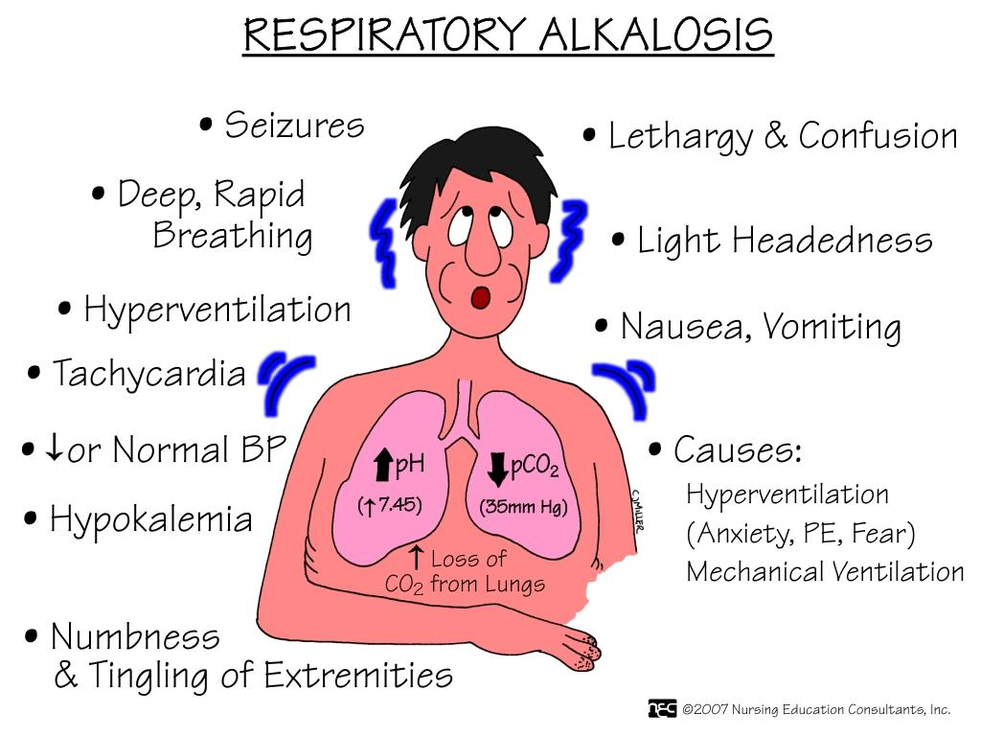

Slide 28
DIAGNOSIS
Requires the measurement of PaCO₂ and arterial pH.
Plasma K⁺ is often reduced and the Cl⁻ is increased.

Slide 29
ARTERIAL FINDINGS IN RESP. ALKALOSIS
PCO₂ is always reduced.
HCO₃⁻ is low normal or low.
Ph is raised or normal.

Slide 30
TREATMENT
The treatment of respiratory alkalosis is primarily directed at correcting the underlying disorder. Respiratory alkalosis itself is rarely life threatening.
Therefore, emergent treatment is usually not indicated unless the pH level is greater than 7.5. Because respiratory alkalosis usually occurs in response to some stimulus, treatment is usually unsuccessful unless the stimulus is controlled.
If the PaCO₂ is corrected rapidly in patients with chronic respiratory alkalosis, metabolic acidosis may develop due to the renal compensatory drop in serum bicarbonate.
In mechanically ventilated patients who have respiratory alkalosis, the tidal volume and/or respiratory rate may need to be decreased. Inadequate sedation and pain control may contribute to respiratory alkalosis in patients breathing over the set ventilator rate.

Slide 31
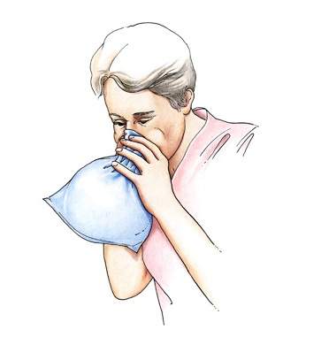
In hyperventilation syndrome, patients benefit from reassurance, rebreathing into a paper bag during acute episodes, and treatment for underlying psychological stress.
Sedatives and/or antidepressants should be reserved for patients who have not responded to conservative treatment.
Beta-adrenergic blockers may help control the manifestations of the hyperadrenergic state that can lead to hyperventilation syndrome in some patients.

Slide 32
Thank You

