Slide 1
Types of epilepsy BY MBBSPPT.COM

Slide 2
Types of epilepsy
Partial (focal) Primary generalised Status epilepticus
Seizures seizures
1. Simple 1. Tonic-clonic (Grand mal) 1.Tonic-clonic status
-motor 2. Tonic 2.Absence status
-sensory 3. Absence 3.Focal status
-others 4. Atypical absence 4.Epilepsia partialis
2. Complex 5. Myoclonic continua
3. Secondary 6. Atonic
generalised 7. Clonic

Slide 3
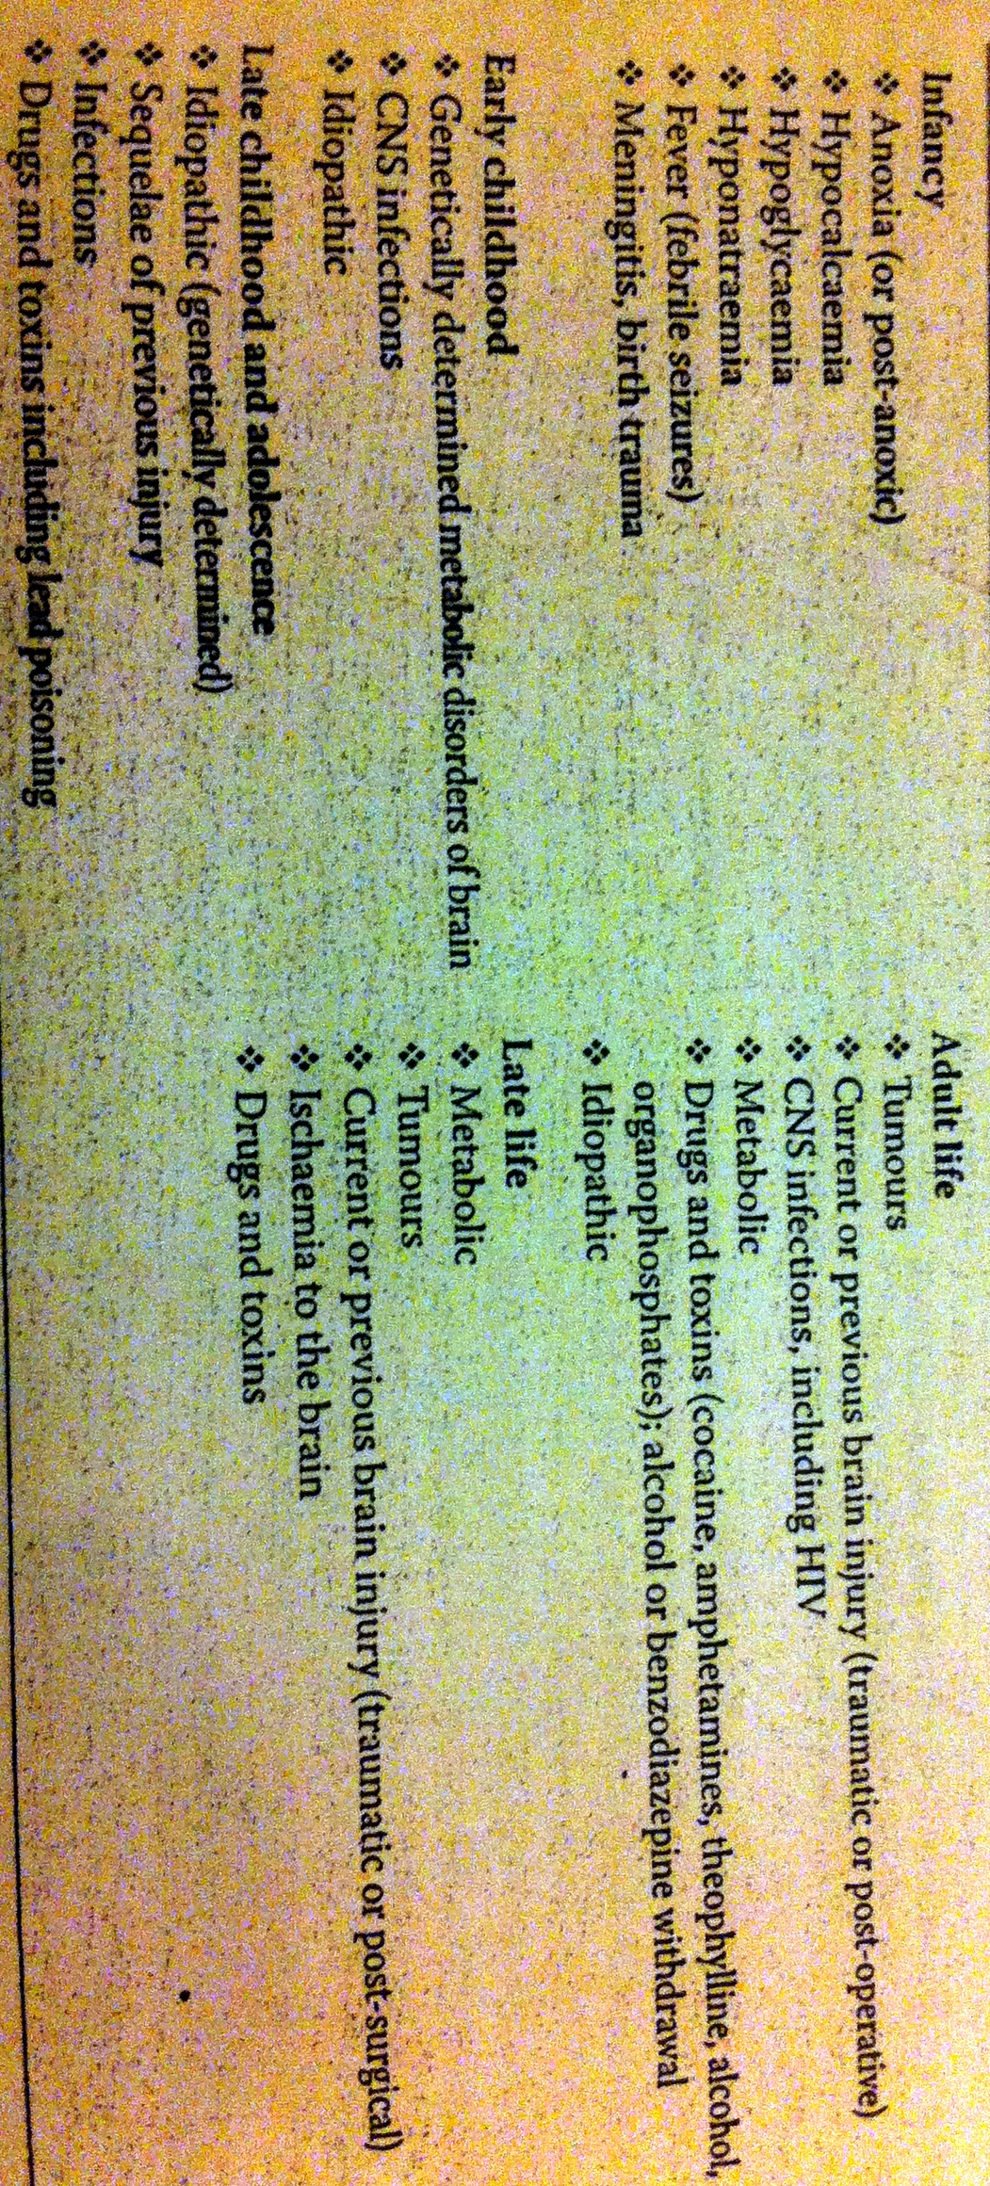
PARTICULARS
AGE

Slide 4
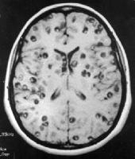
PLACE
- prevalence of epilepsy is 5 times higher and incidence double in developing countries
- neurocysticercosis is a common public health problem in india and south america.

Slide 5
CHIEF COMPLAINTS
Loss / altered consciousness
Fit (a single episode or multiple episodes)
Associated pre or post disease or illness

Slide 6
HISTORY OF PRESENT ILLNESS

Slide 7
GRAND MAL
Altered consciousness
Fit starts simultaneously with generalised tonic clonic state that lasts for few seconds to minutes. Patient is unconscious and cyanosed and pupils are dialated. Change or stopping of heart rate. This is followed by a clonic state where rhythmic jerks appear and last for 1-2 mins
This is followed by post-ictal phase where patient passes off into sleepy state and may have headache and vomiting.

Slide 8
ABSENCE SEIZURES
Transient loss of conciousness
An interruption occurs in current activity and patient may stare blankly ahead. It lasts 15-20 sec only. Petit mal occurs in childhood and may persist into adulthood. Attacks are frequent and upto 100 per day may be seen.
Brief loss of conciousness may be associated with myoclonic jerking of arms
Akinetic seizure – pt falls to the ground, loses consciousness , recovers and rises up immediately

Slide 9
COMPLEX ABSENCE SEIZURES
Usually absence attacks last for a few seconds, occasional jerks, automatic behaviour and chewing and smacking movements may be seen.

Slide 10
JUVENILE MYOCLONIC EPILEPSY
It is characterised by myoclonic jerks, generalised tonic clonic seizures and sometimes absence seizures.
Onset is around adolescenece
It may be precipitated by sleep deprivation and psychological stress, seizures usually occur shortly after wakening
Patient gets bilateral, single or repetitive, arrhythmic, irregular myoclonic jerks, predominantly in arms

Slide 11
PARTIAL FOCAL SEIZURES
May or may not have change in consciousness and may be associated with altered awareness of surroundings
The attacks may terminate as focal seizures or may develop into secondary generalized tonic clonic fits

Slide 12
SIMPLE PARTIAL SEIZURES
Symptoms at onset may be motor (jerking of muscles at one area, head turning), sensory (parasthesia), visual (flashing of light), auditory (ringing sound), gustatory, olfactory

Slide 13
JACKSONIAN SEIZURES
Clonic jerking starts at a point like face and spreads to upper arm, then to lower limb and then onto the opposite side to become a generalized fit

Slide 14
COMPLEX PARTIAL SEIZURES
Altered awareness of surrounding.
Patients may stare off into space or remain still or demonstrate abnormal repetitive movements
- Psychomotor
- Psychosensory
- Affective
- Conciousness
Typically lasts for less than 3 mins

Slide 15
SECONDARY GENERALISED SEIZURES
Aura formation followed by loss of conciousness and generalized tonic clonic seizures

Slide 16
REFLEX EPILEPSY
Precipitated by a sensory stimulus e.g. television epilepsy, musicogenic, eating, hot water

Slide 17
Status Epilepticus
Sustained epileptic activity
- two fits occur without the recovery of consciousness between them
-a single fit lasting longer than 30mins with or without loss of consciousness

Slide 18
Febrile Seizures
Simple or typical febrile seizure (85% of febrile seizures): generalized, less than 15 minutes, occur within 24 hours of onset of fever
Complex: longer than 15 minutes, onset more than 24 hours after onset of fever or multiple seizures in 24 hours

Slide 19
ASSOCIATED FACTORS
History of high grade fever
History of head injury or cerebrovascular accidents
Cyanosis (grand mal, breath holding in children)
Tongue may be bitten
Urinary and bowel incontinence
Headache and vomiting following the seizure
Sleep deprivation
Psychological stress
Post-ictal confusion
Post-ictal headache

Slide 20
PAST HISTORY
Childhood onset
Similar previous episodes
History of black outs or memory loss
History of birth trauma
History of hyperglycaemia or hypoglycaemia
History of tuberculosis

Slide 21
FAMILY HISTORY
In primary epilepsy , juvenile myoclonic epilepsy and febrile seizures there is positive family history

Slide 22
PERSONAL HISTORY
Ingestion of drugs or alcohol
Bowel and bladder incontinence

Slide 23
DIAGNOSIS OF SEIZURES
Differentiate seizures from syncope (transient loss of consciousness and postural tone, characterized by rapid onset, short duration, and spontaneous recovery)and psychogenic non epileptic seizures
(psychogenic non epileptic seizures is an abrupt paroxysmal change in behaviour or conciousness that resembles an epileptic seizure but no electrophysiological changes that accompany an epileptic seizure or clinical evidence of epilepsy are seen)
Type of fit – generalized, focal or secondary generalized

Slide 24
INVESTIGATIONS
EEG
-confirms clinical diagnosis
- differentiate between epileptic and non-epileptic seizures
- differentiate between primary generalised and focal epilepsies
- prolonged EEG video monitoring provides information about electrograhic seizures and seizure activity

Slide 25
INVESTIGATIONS
CSF examination (when suspecting an infection)
Other parameters like blood sugar, sodium, calcium, urea, creatinine, acid-base balance, magnesium
Neuroimaging
- MRI is superior ton CT scan for detection of cerebral lesions
- FLAIR : fluid attenuated inversions recovery (increased sensitivity for detection of abnormalities of cortical area)
-PET and SPECT imaging

Slide 26
EXAMINATION
Epilepsy: examination includes a search for skin stigmata (neurofibromatosis, tuberous sclerosis), dysmorphic features, body size asymmetry (for example, nail size), and cerebral bruit.
Long term AEDs may result in tremor, hair loss, weight gain (for example, sodium valproate, gabapentin), gum hypertrophy, hirsutism, acne, ataxia, or absent reflexes (for example, phenytoin).
Patients with focal onset seizures require examination for visual field defects .
Probable syncope: cardiovascular examination is essential, particularly in the elderly patient.

Slide 27
Thank You

