Slide 1
Serology BY MBBSPPT.COM

Slide 2
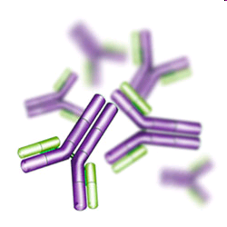
Purpose of Serological Tests
Serological tests may be performed for diagnostic purposes when an infection is suspected, in rheumatic illnesses, and in many other situations, such as checking an individual's blood type. Serology blood tests help to diagnose patients with certain immune deficiencies associated with the lack of antibodies, such as X-linked agammaglobulinemia.

Slide 3
Serology
The branch of laboratory medicine that studies blood serum for evidence of infection and other parameters by evaluating antigen-antibody reactions in vitro

Slide 4
Serology
Serology is the scientific study of blood serum. In practice, the term usually refers to the diagnostic identification of antibodies in the serum
We can detect antigens too

Slide 5
Serology prerogative of Microbiology
for a multitude of constituents in biocIt is rather curious that, although serum hemistry and haematological laboratories, the term serology has come to imply almost exclusively the detection of antibodies in serum for antibodies in infectious diseases, and terminology has become prerogative of microbiologists.

Slide 6
Terms used in evaluating test methodology
Sensitivity
Analytical Sensitivity – ability of a test to detect very small amounts of a substance
Clinical Sensitivity – ability of test to give positive result if patient has the disease (no false negative results)

Slide 7
Specificity
Analytical Specificity – ability of test to detect substance without interference from cross-reacting substances
Clinical Specificity – ability of test to give negative result if patient does not have disease (no false positive results)

Slide 8
Affinity
Affinity refers to the strength of binding between a single antigenic determinant and an individual antibody combining site.

Slide 9
Affinity
Antibody affinity is the strength of the reaction between a single antigenic determinant and a single combining site on the antibody.
It is the sum of the attractive and repulsive forces operating between the antigenic determinant and the combining site .

Slide 10
Avidity
Avidity is a measure of the overall strength of binding of an antigen with many antigenic determinants and multivalent antibodies
Avidity is more than the sum of the individual affinities.

Slide 12
Dilution
Estimating the antibody by determining the greatest degree to which the serum may be diluted without losing the power to given an observable effect in a mixture with specific antigen

Slide 13
Titer
Different dilutions of serum are tested in mixture with a constant amount of antigen and greatest reacting dilution is taken as the measure or Titer

Slide 14
Expression of Titers
Dilution 1 in 8 is a dilution made by mixing one volume of serum with seven volumes of diluents (Normal Saline )
Incorrect to express dilution as 1/8

Slide 15
Sero Conversion
Seroconversion is the development of detectable specific antibodies to microorganisms in the blood serum as a result of infection or immunization.

Slide 16
Sero reversion
Seroreversion is the opposite of seroconversion. This is when the tests can no longer detect antibodies or antigens in a patient’s serum

Slide 17
Testing paired Samples
Testing for infectious diseases is performed on acute and convalescent specimens (about 2 weeks apart) Paired sample.
Must see 4-fold or 2-tube rise in titre to be clinically significant

Slide 18
Majoritytests Diagnostic tests are Serological
There are several serology techniques that can be used depending on the antibodies being studied. These include: ELISA, agglutination, precipitation, complement-fixation, and fluorescent antibodies.

Slide 19
Antigen and Antibody reactions can be identified by different methods

Slide 20
Precipitation
Principle
Soluble antigen + antibody (in proper proportions) –> visible precipitate
Lattice formation (antigen binds with Fab sites of 2 antibodies)
Examples
Double diffusion (Ouchterlony)
Single diffusion (radial immunodiffusion)
Imunoelectrphoresis
Immunofixation

Slide 21
Agglutination
Principle
Particulate antigen + antibody –> clumping
Lattice formation (antigen binds with Fab sites of 2 antibodies forming bridges between antigens)
Examples
Direct agglutination (Blood Bank)
Passive Hemagglutination (treat RBC's with tannic acid to allow adsorption of protein antigens)
Passive latex agglutination (antigen attached to latex particle)

Slide 22
Neutralization reactions
Bacterial exotoxins produce neutralising antibodies (Antitoxins) which are protective.
Toxin-antitoxin neutralisation can be measured invivo (Schick test in Diphtheria) & invitro
Viruses are neutralised by their antibodies
Example of neutralization: antistreptolysin O test (ASO)

Slide 23
Complement fixation test
In presence of appropriate Abs complement:
lyses erythrocytes,
Kills & lyses bacteria
Immobilize motile bacteria
Promotes phagocytosis
Promotes immune adherence
Tissue damage in Hypersensitivity

Slide 24
The ability of antigen-antibody complexes to fix complement is the basis of CFT.
To detect the fixation of complement,
Sheep RBC coated with amboceptor is
used as the indicator system
Very sensitive method to detect Ags & Abs.
Two types of CFT-
Direct - Wassermann reaction
Indirect

Slide 25
Antigen+Test serum (ContainsAb)+Complement
+ Hemolytic system
- Complement fixed
- No hemolysis, +ve CFT

Slide 26
Antigen+Test serum (Contains no Ab)
+ Complement
+ Hemolytic system
- Complement not fixed
- Hemolysis, -ve CFT

Slide 27
Serology can be done on various speciemns
Some serological tests are not limited to blood serum, but can also be performed on other bodily fluids such as semen and saliva, which have (roughly) similar properties to serum.
Serological tests may also be used forensically, generally to link a perpetrator to a piece of evidence (e.g., linking a rapist to a semen sample).

Slide 28
ELISA
Enzyme linked immunosorbent assay(1971)
Done in microtitre plates
Ag or Ab coated on wells by immunosorbents like :
Cellulose
Agarose
Polystyrene
Polyvinyl

Slide 29
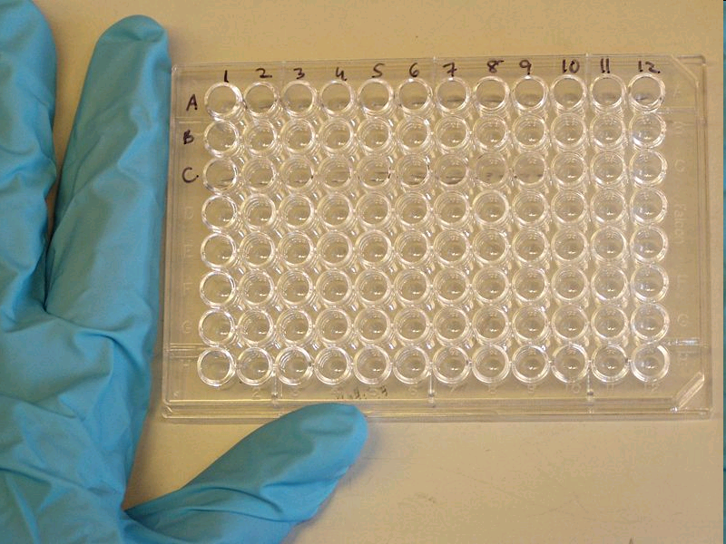
Enzyme is used for labeling antihuman Ig Ab
Enzyme acts on substrate to produce a colour in a positive test.
Used in the detection of Ag as well as Ab
Types of ELISA:
Indirect
Sandwich
Competitive

Slide 30
ELISA PLATE
ELISA methods can detect any infectious disease provided if we have antibodies and antigen to any infection, enzyme or any substance

Slide 31
Indirect ELISA
For Ab detection,
Ag coated wells used
If Ab present, it binds to Ag
Add goat anti-human Ig antibody conjugated with enzyme
Add a substrate. Enzyme acts & colour produced

Slide 36
Sandwich ELISA
For Ag detection, wells coated with Sp. Ab.
Ag in specimen binds to coated Ab.
Add enzyme conjugated antiserum.
Add substrate.
Colour produced

Slide 41
Competitive ELISA
Ag coated wells
Two specific Abs, (enzyme conj.& test Ab) added simultaneously
More specific test Abs attach to Ag
Substrate added
No colour since enzyme not available
Positive test- no colour

Slide 44
Immomatographyunochr
Simple, economic & reliable
Ag or Ab may be detected
Memb. strips impregnated with conjugate of colloidal gold dye & specific Ab / Ag
Test serum added
Coloured dots or bands if positive

Slide 45
Serology applications in..
HIV testing
Serum HCG (pregnancy)
Tests for hepatitis antigens and antibodies
Antibodies to bacteria
Hepatitis Serology

Slide 46
Immunofluorescence
Direct – add fluorescein-labeled antibody to patient tissue, wash, and examine under fluorescent microscope
Indirect – add patient serum to tissue containing known antigen, wash, add labeled antiglobulin, wash, and examine under fluorescent microscope
Examples
Testing for Antinuclear Antibodies (ANA)
Fluorescent Treponemal Antibody Test (FTA-Abs)

Slide 47
Other Applications of agglutination tests in Serology
i. Determination of blood types or antibodies to blood group antigens.
ii. To assess bacterial infections
e.g. A rise in titer of an antibody to a particular bacterium indicates an infection with that bacterial type. N.B. a fourfold rise in titer is generally taken as a significant rise in antibody titer.

Slide 48
Widal test a Popular test in diagnosis of Typhoid Fever
The Widal test is a presumptive serological test for Enteric fever.In case of Salmonella infections, it is a demonstration of agglutinating antibodies against antigens O-somatic and H-flagellar in the blood.

Slide 49
In this reaction antibodies react with antigens on
the surface of particulate objects and cause the
objects to clump together, or agglutinate. These reactions were the earliest to be adapted to diagnostic laboratory. Widal test is used for diagnosis of typhoid fever.

Slide 50
Widal test – A standard tube agglutination test
Test can be performed by the tube dilution technique which permits, the assay of antibody titre. In this, a constant amount of the antigen is added to a series of tubes containing serum dilutions. After mixing, the tubes are incubated at a particular temperature and the highest dilution of serum showing visible agglutination is determined.

Slide 51
Agglutination how it appear after reactivity
O agglutination is granular
H agglutination is loose and floccular

Slide 53
Principle of the Test
A classic example of the agglutination reaction is seen in the widal test for diagnosis of typhoid fever. In this test the antibody content of the patient's serum, is measured by adding a constant amount of antigen (Salmonella typhi) to the serially diluted serum.

Slide 54
Reading the Widal Test
Read the results by viewing the tubes under good light against the dark background with magnifying lens
Do not shake tubes before reading the results
Read titers as greatest dilutions giving visible agglutinations.
Limiting agglutination is 1in 200 the titer is 200 not to be reported as 1/200.

Slide 55
Interpretation of Widal test
Test results need to be interpreted carefully in the light of past history of enteric fever, typhoid vaccination, general level of antibodies in the populations in endemic areas of the world.

Slide 56
Prozone phenomenon in Agglutination tests
Prozone effect - Occasionally, it is observed that when the concentration of antibody is high (i.e. lower dilutions), there is no agglutination and then, as the sample is diluted, agglutination occurs.
The lack of agglutination at high concentrations of antibodies is called the prozone effect. Lack of agglutination in the prozone is due to antibody excess resulting in very small complexes that do not clump to form visible agglutination

Slide 57
Causes Of False-positive Widal Agglutination Tests
Previous immunization with Salmonella antigen.
Cross-reaction with non – typhoidal Salmonella.
Variability and poorly standardized commercial antigen preparation.
Infection with malaria

Slide 58
Causes of Negative Widal Agglutination Test
The carrier state
An inadequate inoculum of bacterial antigen in the host to induce antibody production
Technical difficulty or errors in the performance of the test.
Previous antibiotic treatment
Variability in the preparation of commercial antigens.

Slide 59
Declining importance of Widal test
The value of the salmonella agglutination tests has declined as the incidence of typhoid fever has decreased, at least in the developed world, the general use of vaccines has increased, and ever increasing -numbers of antigenically related serotypes of Salmonella have been recognised.

Slide 60
Antigen -Antibody reactions presenting with precipitation

Slide 61
VDRL – A standard test for Syphilis
NONTREPONEMAL ANTIGEN TESTS. Nontreponemal antigen tests are used as screeners. They measure the presence of reagin, which is an antibody formed in reaction to syphilis. In the venereal disease research laboratory (VDRL) test, a sample of the patient's blood is mixed with cardiolipin and cholesterol. If the mixture forms clumps or masses of matter, the test is considered reactive or positive. The serum sample can be diluted several times to determine the concentration of reagin in the patient's blood.

Slide 62
Non reactive and Reactive VDRL Tests

Slide 63
Other Emerging Serological Tests

Slide 64
Co-agglutination
Co agglutination is similar to the latex agglutination technique for detecting antigen (described above). Protein A, a uniformly distributed cell wall component of Staphylococcus aureus, is able to bind to the Fc region of most IgG isotype antibodies leaving the Fab region free to interact with antigens present in the applied specimens. The visible agglutination of the S. Aureus particles indicates the antigen-antibody reactions

Slide 65
Co agglutination Test
Agglutination test in which inert particles (latex beads or heat-killed S aureus Cowan 1 strain with protein A) are coated with antibody to any of a variety of antigens and then used to detect the antigen in specimens or in isolated bacteria.

Slide 66
False Positive Serological Tests
Cross reacting antibody
Cross reactivation of latent organism (Influenza Virus A infection activate CMV IgM – production
Presence of Rheumatoid factors

Slide 67
False Negative Serologic Test
Immune system not intact
Delay in Antibody response (Lyme disease - Legionnaire’s Disease)
Competition for Antigen binding site of antibody)
IgM binds to the Antigen IgG site
IgG binds to the Antigen IgM site
Prozone Phenomena

Slide 68
Usefulness of Serological Results
How useful a serological result is depends on the individual virus.
For example, for viruses such as rubella and hepatitis A, the onset of clinical symptoms coincide with the development of antibodies. The detection of IgM or rising titers of IgG in the serum of the patient would indicate active disease.

Slide 69
Antibody detection is definitive Diagnosis
There are also viruses which produce clinical disease months or years after seroconversion e.g. HIV and rabies. In the case of these viruses, the mere presence of antibody is sufficient to make a definitive diagnosis.

Slide 70
Problems with Serology
Long period of time required for diagnosis for paired acute and convalescent sera.
Mild local infections such as HSV genitalis may not produce a detectable humoral immune response.
Extensive antigenic cross-reactivity between related viruses e.g. HSV and VZV, Japanese B encephalitis and Dengue, may lead to false positive results.

Slide 71
Problems with Serology Other Health condtions interfere
Immunocompromised patients often give a reduced or absent humoral immune response.
Patients with infectious mononucleosis and those with connective tissue diseases such as SLE may react non-specifically giving a false positive result.
Patients given blood or blood products may give a false positive result due to the transfer of antibody

Slide 72
Thank You

