Slide 1
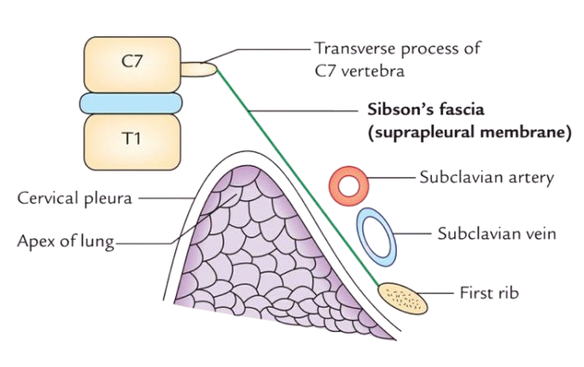
SIBSON’S FASCIA (SUPRAPLEURAL MEMBRANE)
BY MBBSPPT.COM

Slide 2
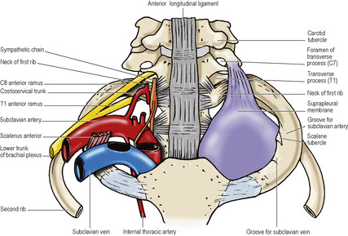

Slide 3
The suprapleural membrane
This is a strong fascial connective tissue layer above the superior thoracic aperture on each side, placed on the apices of the lungs.
It slopes down towards the horizontal as the inlet on the identical oblique angle.
It is incomplete diaphragm derived from the endothoracic fascia that extends over superior aperture of thorax.
It can be said to be an extension of the tendinous attachment of the Scalenus Minimus muscle.

Slide 4
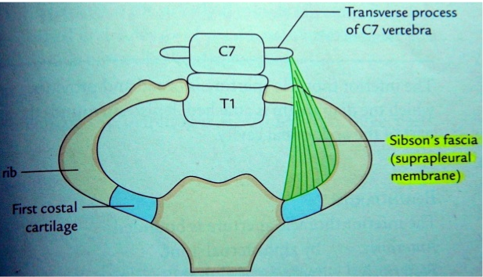
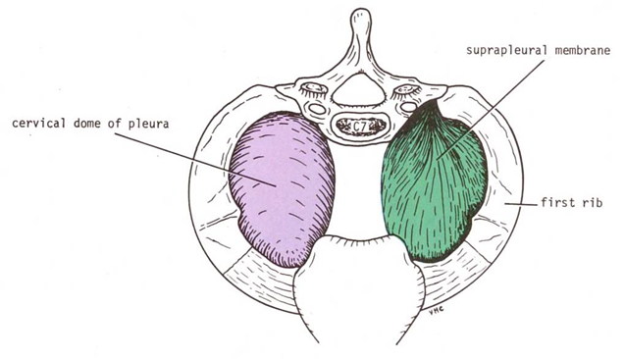
It is flat and lies in the oblique plane of the thoracic inlet, with a cervical dome of pleura attached to its under surface.
Lying on it are the subclavian vessels and other structures in the root of the neck.

Slide 5
STRUCTURE
Triangular in shape.
Its apex is attached to the tip of the transverse process of the seventh cervical vertebra.
The base is attached to the medial margin of the first rib along with costal cartilage.
Deep portion of the membrane can be quite strong and aponeurotic.
The Scalenus Minimus occasionally swaps the deep or posterior portion of the membrane.

Slide 6
Attachments
Anteriorly : | 1st costal cartilage, deep surface of first rib
Laterally : | First rib
Medially : | Merges with mediastinal pleura projecting inferiorly. Attached to the fascia that covers the structures going from the thorax inside the neck.
Posteriorly : | Transverse process of C7 vertebra
Inferiorly: | The dome of cervical pleura of the lung.
Superiorly: | The structures at the base of the neck e.g. the subclavian vessels.

Slide 7
RELATIONS
Its superior surface is associated with the subclavian vessels and its inferior surface is related to cervical pleura, covering the apex of the lung.

Slide 8
FUNCTIONS
It protects the underlying cervical pleura, beneath which is located the apex of the lung.
It resists the intrathoracic pressure at the time of respiration. Consequently, the root of neck is not puffed up and down during respiration.
Gives rigidity to the thoracic inlet.

Slide 9
Thank You

