Slide 1
Superior Vena Cava
BY MBBSPPT.COM

Slide 2
Superior Vena Cava
The superior vena cava receives deoxygenated blood from the upper body (superior to the diaphragm, excluding the lungs and heart), delivering it to the right atrium.
It is formed by merging of the brachiocephalic veins, travelling inferiorly through the thoracic region until draining into the superior portion of the right atrium at the level of the 3rd rib.
As the superior vena cava makes its descent it is located in the right side of the superior mediastinum, before entering the middle mediastinum to lie beside the ascending aorta.

Slide 3
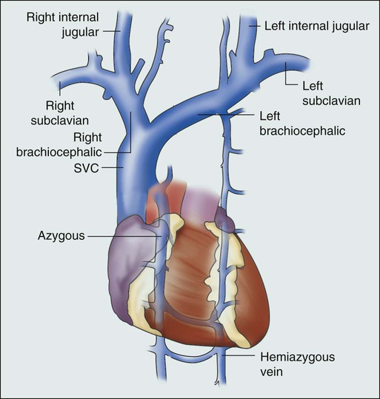

Slide 4
Superior Vena Cava
The following tributaries of the superior vena cava are located within the superior mediastinum:
Brachiocephalic veins – draining blood from the upper body.
Left superior intercostal vein – collects blood from the left 2nd and 3rd intercostal vein. It drains into the left brachiocephalic vein.
Supreme intercostal vein – drains the vein from first intercostal space directly into the brachiocephalic veins.
Azygos vein – receiving blood from the right posterior intercostal veins. The left intercostal veins drain first into the hemiazygos and accessory hemiazygos veins before joining the azygos vein around T7-T9.

Slide 5
Superior Vena Cava

Slide 6
Important lengths to remember (1,2,3 Inches)
The Right brachiocephalic vein: About 1 inch long.
The Superior Vena Cava: About 2 inches long
The left brachiocephalic vein: About 3 inch long.

Slide 7
Superior Vena Cava
Superior Vena Cava is about 7 cm long and 1.25 cm in diameter.
Its location is in the superior and middle mediastina.
The extra pericardial part is located in the superior mediastinum and intrapericardial part is located in the middle mediastinum.
Different collateral pathways develop depending on the site of obstruction. The signs of obstruction of superior vena cava appear first in mediastinal syndrome.

Slide 8
Superior Vena Cava
The superior vena cava is composed at the lower border of the right 1st costal cartilage by the union of left and right brachiocephalic (innominate) veins.
It enters vertically downwards behind the right border of the sternum and pierces the pericardium in the level of the right 2nd costal cartilage, and opens/ends into the upper part of the right atrium at the lower border of the right 3rd costal cartilage.
It has no valves in its lumen because gravity facilitates the blood flow in it.

Slide 9
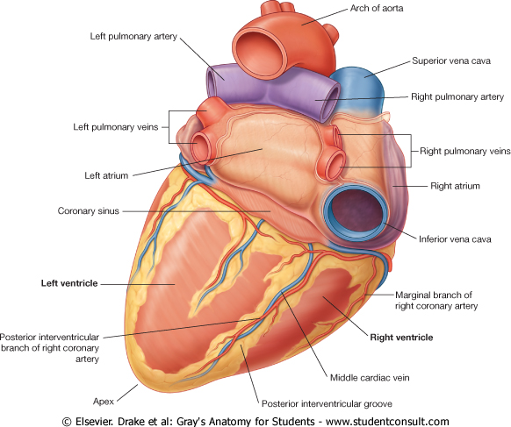
Base of the Heart.
Diaphragmatic surface of the Heart.

Slide 10
Important levels to remember in relation to Superior Vena Cava (1,2,3 Costal Cartilages)
The Superior Vena Cava:
Begins opposite the lower border of 1st costal cartilage.
It receives the azygos vein opposite the sternal end of the 2nd costal cartilage.
It ends opposite the 3rd costal cartilage to enter right atrium

Slide 11
Superior Vena Cava
ANTERIOR: | A. Right internal thoracic vessels. B. Margin of right lung and pleura. C. Chest wall.
POSTERIOR: | A. Trachea (posteromedial). B. Right pulmonary artery and right bronchus.
TO THE LEFT: | A. Ascending aorta (anteromedial). B. Brachiocephalic artery.
TO THE RIGHT: | A. Right phrenic nerve and pericardiophrenic vessels. B. Right lung and pleura.

Slide 12
Superior Vena Cava
SUBDIVISIONS
The superior vena cava is subdivided into the following 2 parts:
1. Extra Pericardial part (in superior mediastinum).
2. Intrapericardial part (in middle mediastinum).

Slide 13
Superior Vena Cava
TRIBUTARIES
A. Left and right brachiocephalic veins.
B. Azygos vein, which arches over the root of the right lung and opens into SVC just before it pierces fibrous pericardium.
C. Mediastinal and pericardial veins.

Slide 14
Superior Vena Cava
OBSTRUCTION OF SVC AND DEVELOPMENT OF COLLATERAL PATHWAYS
The SVC could be obstructed (compressed) at 2 sites:
(a) above the opening of azygos vein (i.e., in superior mediastinum),
(b) below the opening of azygos vein (i.e., in the middle mediastinum).
If SVC is obstructed above the opening of azygos vein, the venous blood from the upper half of the body is shunted to right atrium via azygos vein.
If SVC is obstructed below the opening of the azygos vein, the venous blood from the upper half of the body is returned to the right atrium via inferior vena cava via the collateral pathways, created between the tributaries of superior and inferior vena cavae (caval- caval shunt).

Slide 15
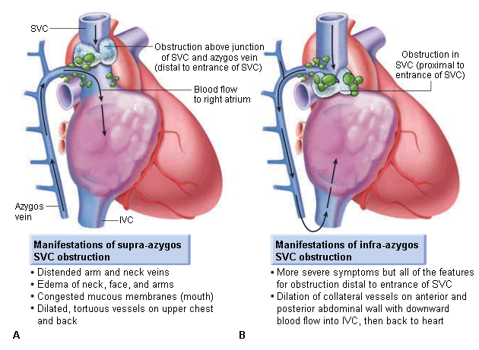

Slide 16
THANK YOU!

