Slide 1
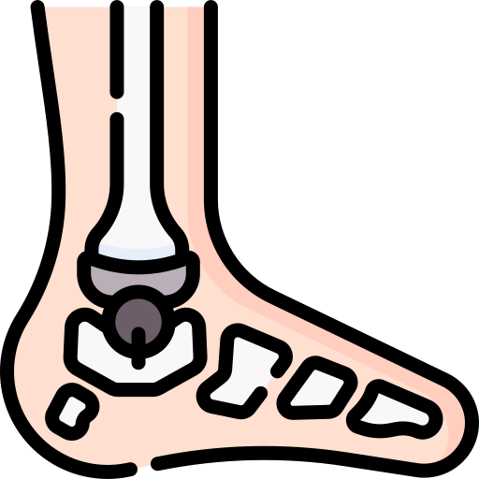
The Ankle Joint (also known as the Talocrural Joint)
BY MBBSPPT.COM

Slide 3
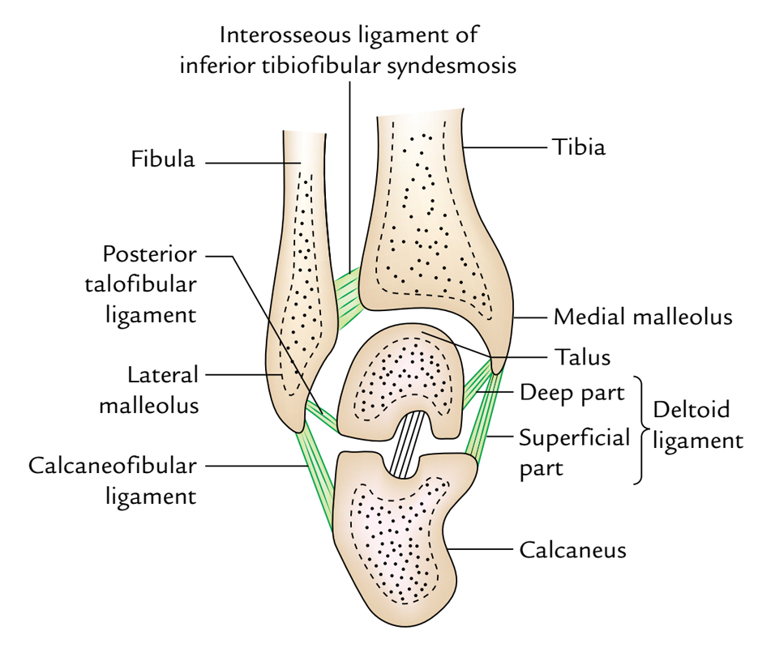

Slide 5
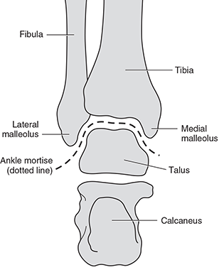

Slide 6
The ankle joint
The ankle joint is a hinged synovial joint.
It connects:
with
The distal ends of the tibia and fibula
The proximal end of the talus.

Slide 7
Articulating Surfaces
Trochlea of Talus.
Malleolar (lateral & medial) Mortis formed by Tibia & Fibula.
Lateral & Medial Malleolus.

Slide 8
The ankle joint
Proximal articular outermost layer of the ankle joint is made by the articular facets of the:
Lower end of tibia consisting of its medial malleolus.
Lateral malleolus.
Inferior transverse tibiofibular ligament.
These 3 together create a deep tibiofibular socket (also termed “tibiofibular mortise”).
Distal articular outermost layer of the ankle joint is composed by:
The articular facets on the upper, medial, and lateral aspects of the body of the talus.

Slide 9
Articulating Surfaces
The body of the talus fits snugly into the mortise formed by the bones of the leg.
The body of talus presents 3 articular surfaces:
Superior pulley-shaped articular surface (trochlear surface).
Articulate the inferior aspect of the lower end of tibia.
Medial comma-shaped articular surface.
Articulates the lateral aspect of medial malleolus.
Lateral triangular articular surface.
Articulates the medial aspect of lateral malleolus.
The wedge shaped body of the talus fits into the socket above.

Slide 10
The socket
The socket is provided flexibility by
The tibiofibular ligaments,
The flexibility of the fibula,
Slight movements of the fibula at the superior tibiofibular joint.

Slide 11
SOLIDITY OF THE ANKLE JOINT
The trochlear surface on the superior aspect of the body of talus is wider in front than behind.
During dorsiflexion, ankle joint of the anterior wider part of the trochlea moves posteriorly and fits correctly into the tibiofibular mortise, thus joint is stable.
During plantar flexion, the narrow posterior part of the trochlea doesn’t fit correctly in the tibiofibular mortise, thus the joint is unstable during plantar flexion.

Slide 12
VARIABLES KEEPING THE SOLIDITY OF THE ANKLE JOINT
Close interlocking of its articular surfaces.
Strong, medial, and lateral collateral ligaments.
Deepening of tibiofibular socket posteriorly by the inferior transverse tibiofibular ligament.
Tendons (4 in front and 5 behind) crossing the ankle joint.
Other ligaments of the joint.

Slide 13
Stability of Ankle Joint
Ankle joint is a strong joint made stable by
Close interlocking of the articular surfaces.
Strong collateral ligaments on the sides.
The tendons that cross the joint (four in front, and five behind).
The depth of the superior articular socket is contributed to
The downward projection of the medial and lateral malleoli.
Transverse tibiofibular ligament.

Slide 14
Factors tend to displace
the tibia and fibula forwards
Anatomically, two factors tend to displace the tibia and fibula forwards over the talus
The forward pull of tendons passes from the leg to the foot.
Pull of gravity. When standing line of gravity falls in front of ankle joint.
But following factors are responsible for prevention of displacement:
The talus is wedge shaped, being wider anteriorly.
The posterior border of the lower end of the tibia is prolonged downwards.
Ligamentous structures

Slide 15
LIGAMENTS
The essential ligaments of ankle joint are:
Capsular ligament.
Medial and lateral collateral ligaments.

Slide 16
Joint Capsule
The articular capsule surrounds the joints, and is attached,
Above, to the borders of the articular surfaces of the tibia and malleoli; and
Below, to the talus around its upper articular surface.
Anteriorly:
The joint capsule is a broad, thin, fibrous layer.
Posteriorly:
The fibers are thin and run mainly transversely blending with the transverse ligament.
Laterally:
The capsule is thickened, and attaches to the hollow on the medial surface of the lateral malleolus.
The synovial membrane extends superiorly between Tibia & Fibula as far as the Interosseous Tibiofibular Ligament.

Slide 17
FIBROUS CAPSULE
The joint capsule is thin in front and behind to enable hinge movements and thick on either side where it combines with the collateral ligaments.
It encompasses the joint entirely. It is connected to the articular margins of the joint all around with two exceptions:
Posterosuperiorly it is connected to the inferior transverse tibiofibular ligament.
Anteroinferiorly it is connected to the dorsum of the neck of talus at some distance from the trochlear surface.

Slide 18
The synovial membrane
The synovial membrane lines the inner surface of the joint capsule, but ends at the periphery of the articular cartilages.
A small synovial process goes upward into the inferior tibiofibular syndesmosis.

Slide 19
Medial Ligament
The medial ligament (or deltoid ligament) is attached to the medial malleolus (a bony prominence projecting from the medial aspect of the distal tibia).
It consists of an apex attached to tip and margins of medial malleolus and a base which fan out attaching to: (3 tarsal bones)
The talus.
The Calcaneus .
The Navicular bones.
The primary action of the medial ligament is to resist over-eversion of the foot.

Slide 20
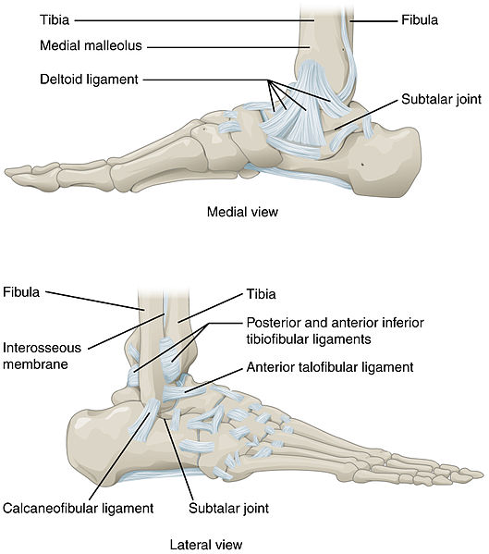

Slide 21
DELTOID OR MEDIAL LIGAMENT
The deltoid ligament is an extremely triangular ligament on the medial side of the ankle compensating the shortness of medial malleolus.
It splits into 2 parts:
Superficial and Deep.
Above, both the parts have a common connection to the apex and margins of the medial malleolus.
Below, the connection of superficial and deep parts differs.
Superficial part: Its fibers are split into 3 parts:
Anterior:
Anterior fibers (tibionavicular) are connected to the tuberosity of navicular bone and the medial.
Middle:
Middle fibers (tibiocalcanean) are connected to the entire length of sustentaculum tali.
Posterior:
Posterior fibers (posterior tibiotalar) to the medial tubercle and adjoining part of the medial surface of talus.
Deep part (anterior tibiotalar) is connected to the anterior part of the medial surface of talus.

Slide 22
The lateral ligament
The lateral ligament is composed of 3 parts:
Anterior talofibular – (poor flat band) spans between the lateral malleolus and lateral aspect of the talus.
Posterior talofibular – (powerful band) spans between the lateral malleolus and the posterior aspect of the talus.
Calcaneofibular – (long rounded cord) spans between the lateral malleolus and the calcaneus
Superficially, the deltoid ligament is crossed by the tendons of tibialis posterior and flexor digitorum longus on the other hand lateral ligament is crossed superficially by the tendons of peroneus longus and brevis.
It resists over-inversion of the foot.

Slide 23
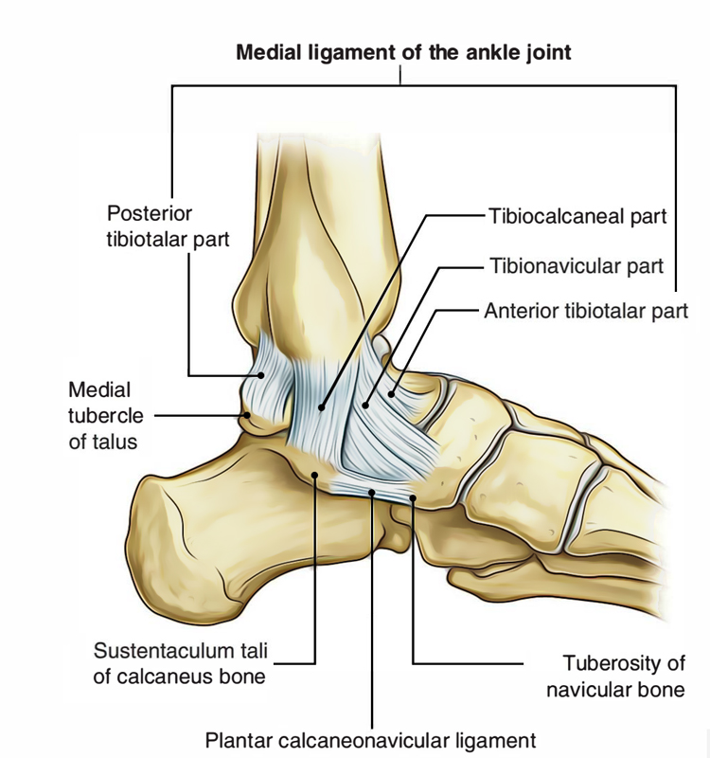

Slide 24
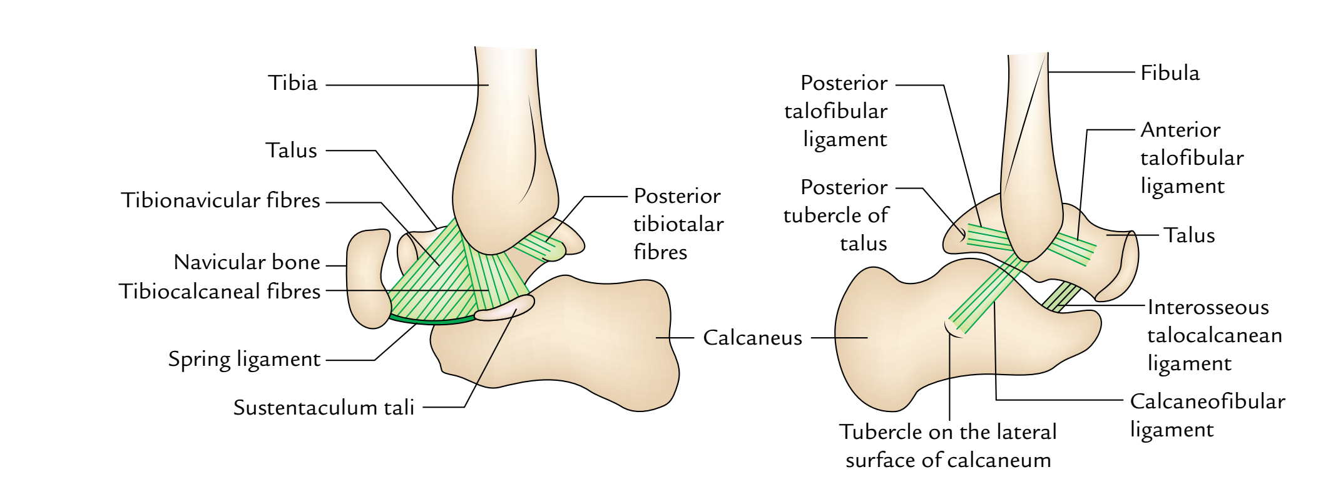

Slide 25
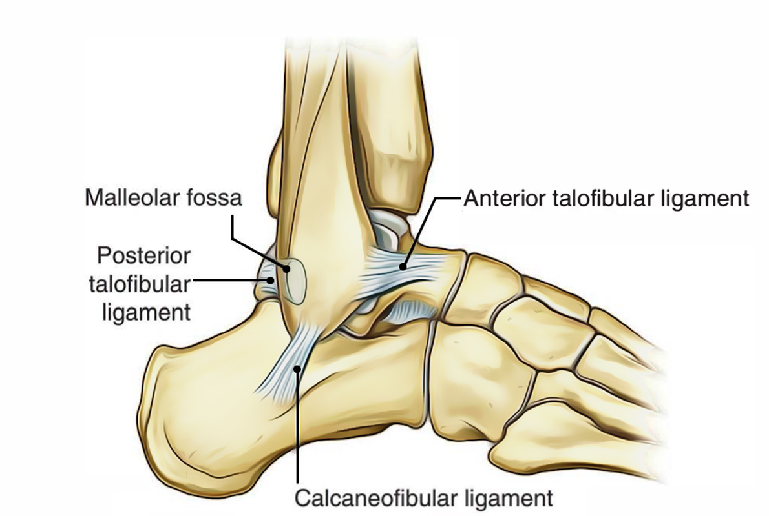

Slide 26
LIGAMENT | DESCRIPTION | PROXIMAL ATTACHMENT | DISTAL ATTACHMENT | ROLE
Anterior Talofibular Ligament (ATFL) | Flat Weak Band that extends Anteromedially. Most commonly damaged ligament of the ankle. | Lateral Malleolus | Neck of Talus | Restrain anterior displacement of the talus in respect to the fibula and tibia. Resists Inversion in planterflexion.
Posterior Talofibular Ligament (PTFL) | Thick, fairly strong band that runs horizontally medially. This ligament is under greater strain in full dorsiflexion of ankle. Rarely injured because bony stability protects ligaments when ankle in dorsiflexion. | Malleolar Fossa of Fibula | Lateral Tubercle of Talus | Forms the back wall of the recipient socket for the talus' trochlea. Resists posterior displacement of the talus.
Calcaneofibular Ligament (CFL) | Round cord that passes posteroinferiorly | Tip of Lateral Malleolus | Lateral Surface of Calcaneus | Aids Talofibular stability during Dorsiflexion. Restrain inversion of the calcaneus with respect to the fibula. Prevent Talar tilt into Inversion.

Slide 27
LIGAMENTS | DESCRIPTION | PROXIMAL ATTACHMENT | DISTAL ATTACHMENT | ROLE
Anterior Tibiotalar Ligament |  | Medial Malleolus | Head of Talus | Reinforces Ankle Joint. Control Plantarflexion & Eversion
Posterior Tibiotalar Ligament |  |  | Talus Posteriorly | Control Dorsiflexion
Tibionavicular Ligament | Forms most anterior part of the Deltoid Ligament |  | Dorsomedial Aspect of Navicular | Reinforces Ankle Joint
Tibiocalcaneal Ligament | Very thin ligament |  | Sustentaculum Tali | Reinforces Ankle Joint

Slide 28
The Ankle ‘Ring’
The ankle joint and associated ligaments can be visualised as a ring in the coronal plane:
The upper part of the ring is formed by the articular surfaces of the tibia and fibula.
The lower part of the ring is formed by the subtalar joint (between the talus and the calcaneus).
The sides of the ring are formed by the medial and lateral ligaments.
A ring, when broken, usually breaks in two places (the best way of illustrating with is with a polo mint – it is very difficult to break one side without breaking the other).

Slide 29
RELATIONS OF THE ANKLE JOINT
Anterior: Anteriorly from medial to lateral side the ankle joint is related to these structures:
Tibialis anterior.
Extensor Hallucis longus.
Anterior tibial Artery.
Deep peroneal Nerve.
Extensor Digitorum longus.
Peroneus tertius.
Mnemonic: The Himalayas Are Not Dry Tablelands.

Slide 30
RELATIONS OF THE ANKLE JOINT
Posterior: Posteriorly from medial to lateral side the ankle joint is related to these structures:
Tibialis posterior.
Flexion Digitorum longus.
Posterior Tibial Artery.
Posterior Tibial Nerve.
Flexor Hallucis longus.
Mnemonic: The Doctors Are Not Here.

Slide 31
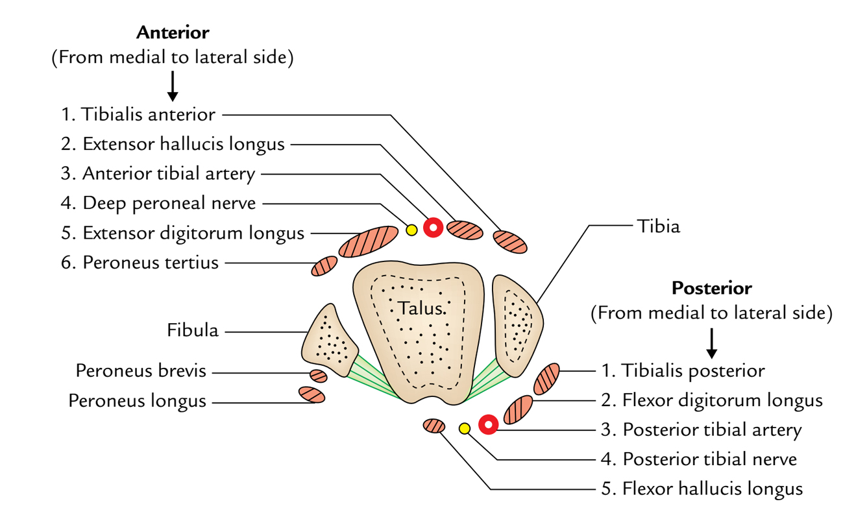

Slide 32
POSTERIOR COMPARTMENT (SUPERFICIAL)
MUSCLE | ACTION | PROXIMAL ATTACHMENT | DISTAL ATTACHMENT | INNERVATION
Gastrocnemius | Plantarflexion when Knee Extended Flexion Knee Raises Heel during Walking | Lateral Head: Lateral Aspect of Lateral Femoral Condyle Medial Head: Popliteal Surface of Femur Superior to Medial Femoral Condyle | Posterior Surface Calcaneus via Calcaneal Tendon (Achilles Tendon) | Tibial Nerve S1-S2
Soleus | Plantarflexion Steadies Leg on Foot | Posterior Aspect of Head Fibula Superior ¼ Posterior Surface Tibia Soleal Line & Medial Border Tibia
Plantaris | Weakly Assists Gastrocnemius in Plantarflexion | Inferior end Lateral Supracondylar Line of Femur Oblique Popliteal Ligament

Slide 33
POSTERIOR COMPARTMENT (DEEP)
MUSCLE | ACTION | PROXIMAL ATTACHMENT | DISTAL ATTACHMENT | INNERVATION
Tibialis Posterior | Plantarflexion Inversion Supports Medial Longitudinal Arch | Interosseous Membrane Posterior Surface Tibia inferior to Soleal Line Posterior Surface Fibula | Navicular Tuberosity Cuneiform Cuboid Bases of Metatarsals 2-4 | Tibial Nerve L4-L5
Flexor Digitorum Longus | Plantarflexion Flexion Lateral Four Digits Supports Longitudinal Arch | Medial Part Posterior Surface Tibia inferior to Soleal Line Broad Tendon to Fibula | Base Distal Phalanges Digits 2-4 | Tibial Nerve S2-S3
Flexor Hallucis Longus | Weak Plantarflexion Flexion Big Toe at all Joints Supports Medial Longitudinal Arch | Inferior 2/3 Posterior Surface Fibula Inferior Part Interosseous Membrane | Base Distal Phalanx of Big Toe

Slide 34
LATERAL COMPARTMENT
MUSCLE | ACTION | PROXIMAL ATTACHMENT | DISTAL ATTACHMENT | INNERVATION
Peroneus Brevis | Weak Plantarflexion Eversion | Inferior 2/3 of Lateral Surface Fibula | Dorsal Surface Tuberosity of Base 5th Metatarsal | Superficial Peroneal Nerve (Superficial Fibular Nerve) L5 - S2
Peroneus Longus | Weak Plantarflexion Eversion Supports Transverse Arch | Head & Superior 2/3 of Lateral Surface Fibula | Base 1st Metatarsal Medial Cuniform

Slide 35
ANTERIOR COMPARTMENT
MUSCLE | ACTION | PROXIMAL ATTACHMENT | DISTAL ATTACHMENT | INNERVATION
Tibialis Anterior | Dorsiflexion Inversion Supports Medial Longitudinal Arch | Lateral Condyle Tibia Superior ½ Lateral Surface Tibia Interosseous Membrane | Medial & Inferior Surfaces Medial Cuniform Base of 1st Metatarsal | Deep Peroneal Nerve (Deep Fibular Nerve) L4-L5
Extensor Digitorum Longus | Dorsiflexion Extends Lateral Four Digits | Lateral Condyle Tibia Superior ¾ Anterior Surface Interosseous Membrane | Middle & Distal Phalanges of Lateral Four Digits | Deep Peroneal Nerve (Deep Fibular Nerve) L5-S1
Extensor Hallucis Longus | Dorsiflexion Extends Big Toe | Middle Part Anterior Surface Fibula Interosseous Membrane | Dorsal Aspect of Base Distal Phalanx of Big Toe
Peroneus Tertius | Dorsiflexion Aids Eversion | Inferior 1/3 Anterior Surface Fibula Interosseous Membrane | Dorsum Base 5th Metatarsal

Slide 36
ARTERIAL & NERVE SUPPLY
ARTERIAL SUPPLY
It is by the malleolar branches of anterior tibial, posterior tibial, and peroneal arteries.
NERVE SUPPLY
It is by the branches of deep peroneal and tibial nerves. (The segmental innervations is by L4, L5; S1, S2 spinal sections).

Slide 37
Movements
Movements | Principal muscles | Accessory muscles
Dorsiflexion | Tibialis anterior | 1.Extensor digitorum longus. 2.Extensor hallucis longus. 3.Peroneus tertius.
Plantar flexion | 1.Gastrocnemius. 2.Soleus. | 1.Plantaris. 2.Tibialis posterior. 3.Flexor hallucis longus. 4.Flexor digitorum longus.
The ankle joint is stable in dorsiflexion and shaky in plantar flexion.
The dorsiflexion is restrained by the L4, L5 spinal segments and plantar flexion by the S1, S2 spinal sections.

Slide 38
ANKLE SPRAINS
The excessive stretches and/or tearing of ligaments of the ankle joint is named the ankle sprain. The ankle sprains are normally caused by the falls from height or spins of ankle.
When the plantar-flexed foot is excessively inverted, the anterior and posterior talofibular and calcaneofibular ligaments are stretched and torn. The anterior talofibular ligament is most commonly torn.
When the plantar-flexed foot is excessively everted, the deltoid ligament isn’t torn; instead there’s an avulsion fracture of medial malleolus.
The inversion sprains are much more common than eversion sprains.

Slide 39
DISLOCATION OF THE ANKLE
The dislocations of ankle joint are uncommon because it is a quite stable joint because of tibiofibular mortise.
Nevertheless, whenever dislocation takes place it is constantly escorted by the fracture of one of the malleoli.

Slide 40
POTT’S FRACTURE (FRACTURE DISLOCATION OF THE ANKLE)
It takes place when the foot is caught in the rabbit hole and everted forcibly.
Oblique fracture of the lateral malleolus because of internal rotation of the tibia.
Transverse fracture of the medial malleolus as a result of pull by powerful deltoid ligament.
Fracture of the posterior margin of the lower end of tibia (third malleolus) because it’s carried forward.
These phases are also referred to as first, 2nd, and third degree of Pott’s fracture, respectively. The third degree of Potts fracture is also termed trimalleolar fracture.

Slide 41
OPTIMUM POSITION
OF THE ANKLE
The optimum position of the ankle is one where ankle joint is in slight plantar flexion.
understanding of position is important for using plaster cast in the ankle region.

Slide 42
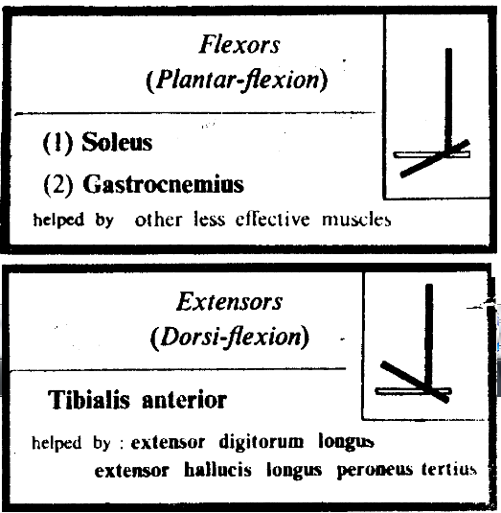

Slide 43
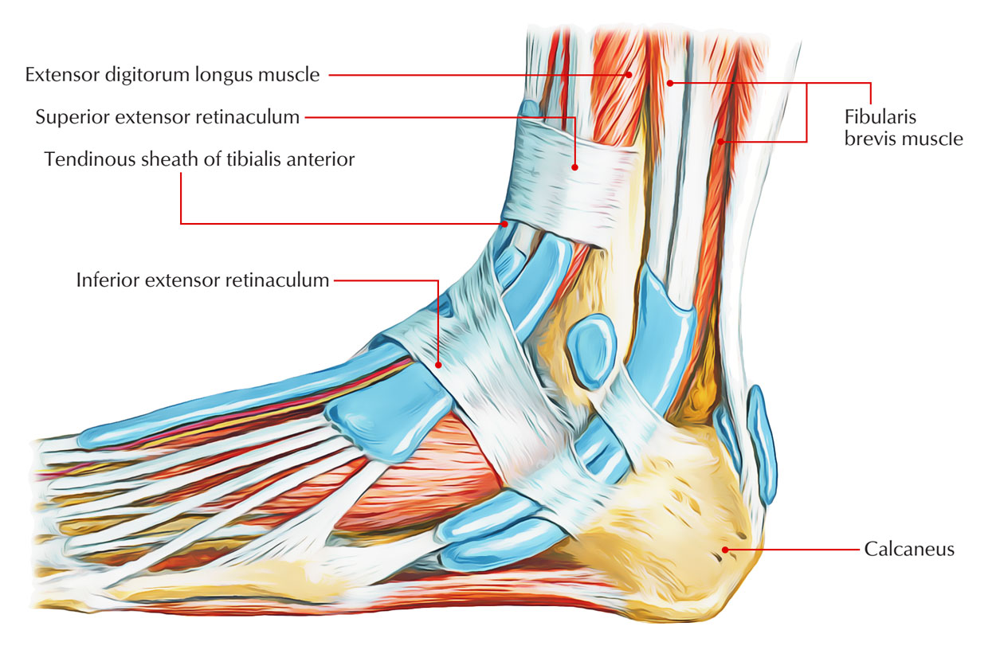

Slide 44
Thank You

