Slide 1
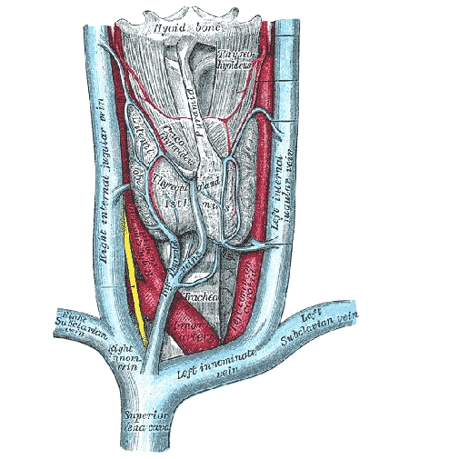
The brachiocephalic veins
BY MBBSPPT.COM

Slide 2
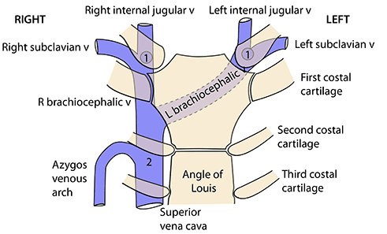

Slide 3
Important lengths to remember (1,2,3 inches)
The right brachiocephalic vein:
…about 1 inch long.
The Superior Vena Cava:
…about 2 inch long.
The left brachiocephalic vein:
…about 3 inch long.

Slide 4
The brachiocephalic veins
The brachiocephalic veins are formed behind the sternoclavicular joints by confluence of the internal jugular and subclavian veins.
These veins descend from the neck into the superior mediastinum just posterior to the thymus gland or its remnants.
Medial to scalenus anterior, in front of the first part of the subclavian artery, the vein has been joined by the internal jugular vein and is thence called the brachiocephalic.
This part of each brachiocephalic vein receives tributaries corresponding to the branches of the first part of the subclavian artery (vertebral, inferior thyroid, internal thoracic and, on the left side only, superior intercostal).

Slide 5
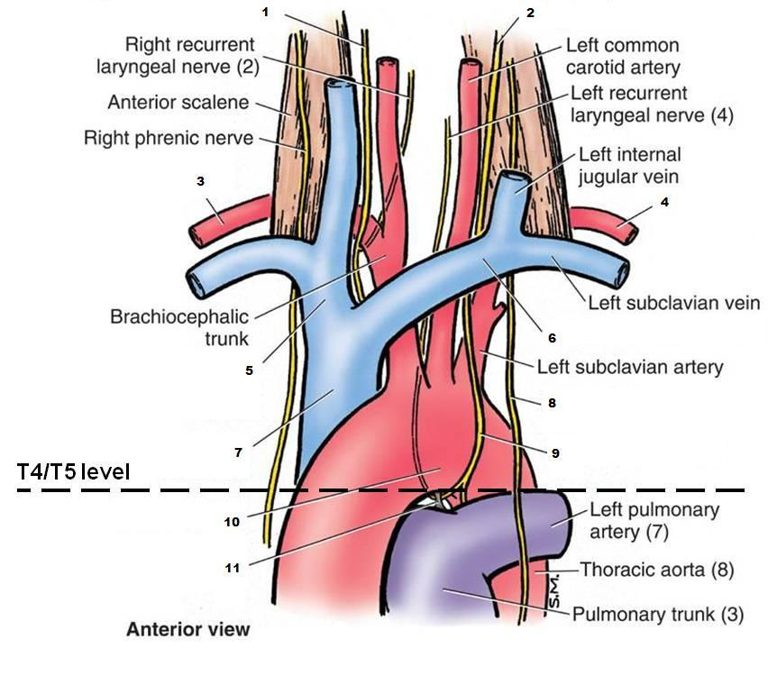

Slide 6
BRACHIOCEPHALIC VEINS
There are 2 brachiocephalic veins:
Right Brachiocephalic Vein.
Left Brachiocephalic Vein.
The brachiocephalic veins are formed at the confluence of the subclavian and internal jugular veins behind the sternoclavicular joints.
They unite to create superior veva cava.
Both, the brachiocephalic veins and superior veva cava are devoid of valves.

Slide 7
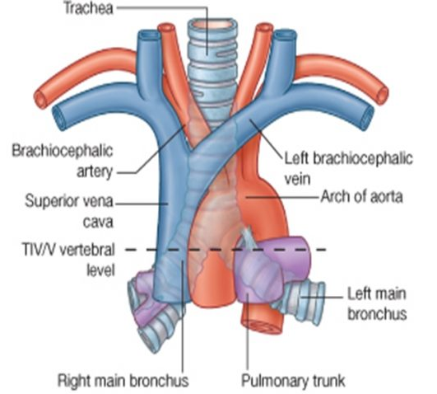

Slide 8
DIFFERENCES BETWEEN LEFT AND RIGHT BRACHIOCEPHALIC VEINS
 | Right brachiocephalic vein | Left brachiocephalic vein
Length | • Short (2.5 cm) | • Long (6 cm)
Formation | Posterior to the medial end of the right clavicle | Posterior to the medial end of the left clavicle
Course | • Vertical (runs vertically downwards from right sternoclavicular joint to the lower margin of the right 1st costal cartilage) | • Oblique (runs obliquely across the superior mediastinum from left sternoclavicular joint to the lower margin of the right 1st costal cartilage)
Relations | Lies anterior to the brachiocephalic artery | Lies anterior to the left subclavian, common carotid arteries, and superior to the aortic arch.
Tributaries | • Right vertebral vein • Right internal thoracic vein • Right inferior thyroid vein • First right posterior intercostal vein | • Left vertebral vein • Left internal thoracic vein • Left inferior thyroid vein •First left posterior intercostal vein •Left superior intercostal vein
 | * Receives right lymphatic duct | * Receives thoracic duct

Slide 9
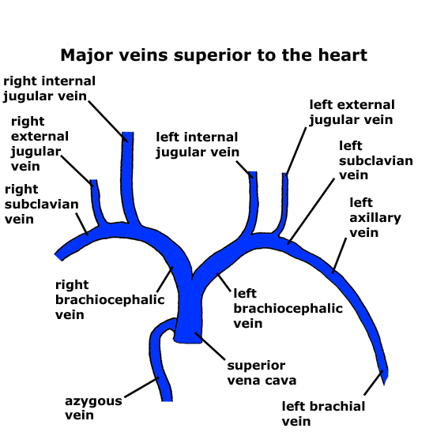

Slide 10
Right brachiocephalic vein
The right brachiocephalic vein commences behind the right sternoclavicular joint and runs vertically downwards.
It receives the right lymphatic duct and right jugular and subclavian lymph trunks, which normally enter independently of each other.

Slide 11
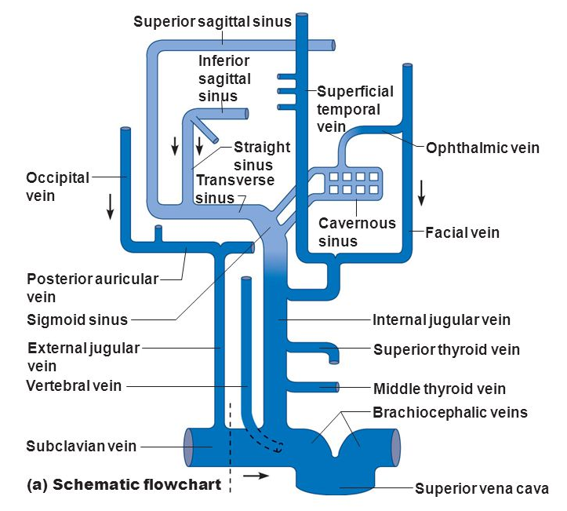

Slide 12
The left brachiocephalic vein
The left brachiocephalic vein passes almost horizontally across the superior mediastinum to join the right vein at the lower border of the first right costal cartilage.
The beginning of the vein receives the thoracic duct, which often divides into two or three branches that join the vein separately.
In addition to the vertebral and internal thoracic veins the left brachiocephalic vein receives most of the blood from the inferior thyroid plexus of veins.
The left superior intercostal vein joins it near the midline of the body and a large thymic vein commonly enters nearby.

Slide 13
Clinical
Abnormalities in the neck, such as compression of the trachea (windpipe) by the brachiocephalic vein on either or both sides of the neck, have been associated with apnea in infants.
Apnea is a condition where breathing abnormally stops and starts during sleep.
Magnetic resonance imaging is used to diagnose this condition.

Slide 14
Thank You

