Slide 1
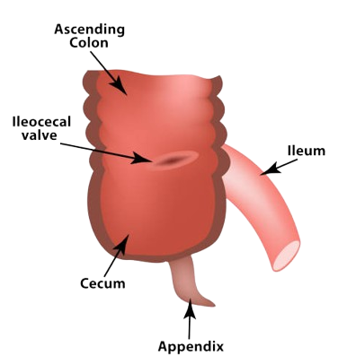
The caecum
BY MBBSPPT.COM

Slide 2
The caecum
The caecum is that part of the large intestine that lies below the level of the junction of the ileum with the large intestine.
It is a blind-ended pouch that is situated in the right iliac fossa.
It possesses a considerable amount of mobility, although it does not have a mesentery.
Attached to its posteromedial surface is the appendix.
The appendix communicates with the cavity of the cecum through an opening located below and behind the ileocecal opening.

Slide 3
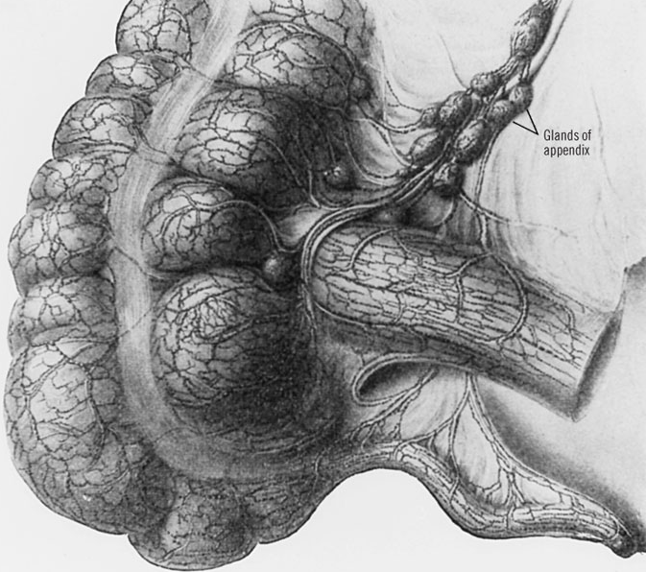

Slide 4
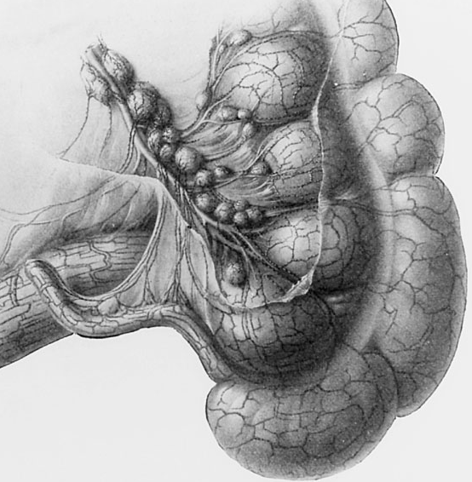
A large blind pouch of large intestine lying in the right iliac fossa below the ileocecal valve and continuing distally as the ascending colon.

Slide 5
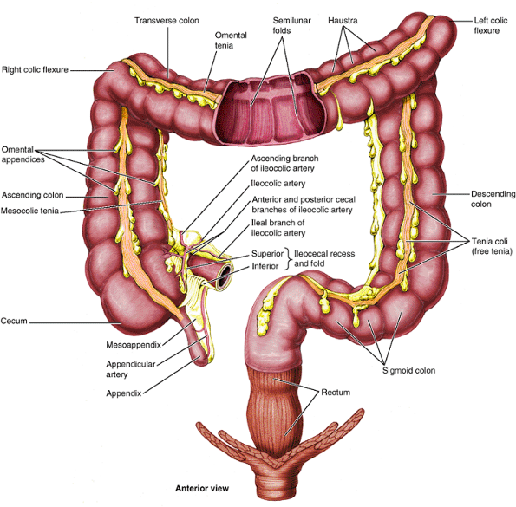

Slide 6
Length & Location
It is a blind intestinal pouch, approximately 7.5 cm in both length and breadth, located in the right lower quadrant, where it lies in the iliac fossa inferior to the junction of the terminal ileum and cecum.

Slide 7
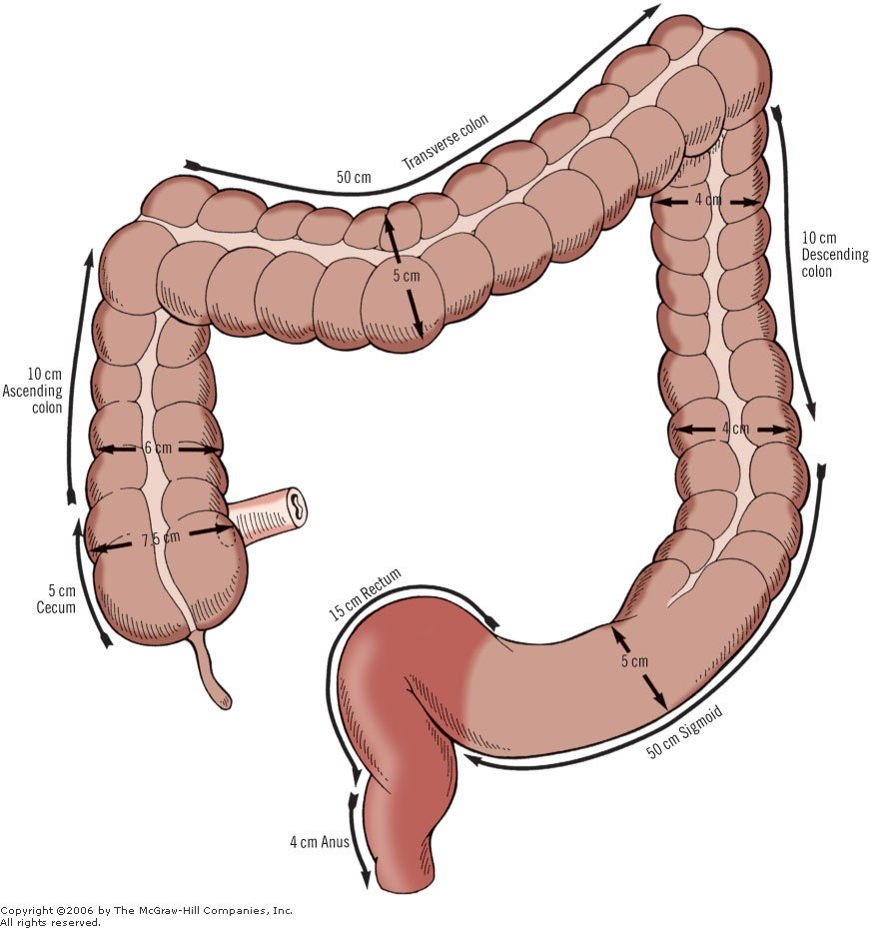

Slide 8
As in the colon, the longitudinal muscle is restricted to three flat bands, the teniae coli, which converge on the base of the appendix and provide for it a complete longitudinal muscle coat.
Usually the caecum is entirely covered by peritoneum, but occasionally this is incomplete posterosuperior where it lies attached to the iliac fascia by loose connective tissue.

Slide 9
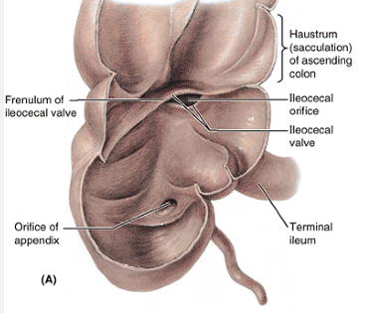

Slide 10
Relations
In front:
Greater omentum
Coils of small intestine
Anterior abdominal wall
Behind:
Two Muscles: Iliacus & Psoas
Three Nerves: Femoral, Lateral Cutaneous Nerve Of Thigh & Genitofemoral
Two Vessels: Gonadal & External Iliac Artery
Medially:
The appendix arises from the cecum on its medial side.

Slide 11
ILEOCAECAL VALVE
The terminal ileum enters the cecum obliquely and partly invaginates into it.
Traditionally, based on cadaveric studies, this manner of entrance produces ileocolic lips(folds) (superior and inferior) at the ileal orifice, which form the ileal papilla.
The folds meet laterally to form ridges, called the frenula of the valve.
When the cecum is distended or when it contracts, the frenula tighten, closing the valve to prevent reflux from the cecum into the ileum.
The valve is unlikely to have any sphincteric action that controls passage of the intestinal contents from the ileum into the cecum.

Slide 12
IleocAecal recesses
The presence of peritoneal folds in the vicinity of the cecum creates:
The superior ileocecal recess,
The inferior ileocecal recess,
The retrocecal recesses.

Slide 13
Functions
The caecum commences the process of fluid and electrolyte reabsorption, which occurs to a large extent in the ascending and transverse colon.
The distensible nature and 'sac-like' morphology of the caecum are adaptations for the storage of larger volumes of semi-liquid chyme entering from the small bowel via the ileocaecal valve.

Slide 14
ILEOCOLIC ARTERY
The caecum is supplied principally from the ileocolic artery, which is the last branch from the right side of the superior mesenteric artery
The ileocolic artery crosses anterior to the right ureter, testicular or ovarian vessels, and psoas major.
It descends to the right beneath the parietal peritoneum into the right iliac fossa, where it divides into two branches:
The superior branch anastomoses with the right colic artery, and the inferior branch anastomoses with the end of the superior mesenteric artery.
The inferior branch approaches the superior border of the ileocolic junction. It has the following named branches:
Ascending (colic) artery.
Anterior and posterior caecal arteries.
Appendicular artery.
Ileal artery.
ILEAL ARTERIES: The terminal arcades of the ileal arteries provide a collateral supply to the caecum via anastomoses with the ileal branch of the ileocolic artery.

Slide 15
ILEOCOLIC VEIN
The ileocolic vein is formed from superior and inferior tributaries and ascends alongside the ileocolic artery beneath the peritoneum of the ileocaecal mesentery to drain into the superior mesenteric vein.
The inferior tributary receives appendicular, anterior and posterior caecal and ileal veins and the superior tributary drains the ascending colic veins.

Slide 16
LYMPHATIC DRAINAGE
Anterior lymphatic vessels pass in front of the caecum and drain to the anterior ileocolic nodes and nodes of the ileocolic chain; posterior vessels ascend behind the caecum to the posterior and inferior ileocolic nodes.
Lymph drains from the nodes in the ileocolic chain into the superior mesenteric nodes in the root of the small bowel mesentery.

Slide 17
INNERVATION
The caecum is innervated by sympathetic and parasympathetic nerves via the superior mesenteric plexus.

Slide 18
CAECAL VOLVULUS
Because the caecum and ascending colon may possess a mesentery to a variable degree, it is possible for the caecum (and lower portion of the ascending colon) to rotate about their mesenteric attachment (mesentero-axial volvulus) such that the lower pole of the caecum comes to lie in the left or right upper quadrant of the abdomen.
Volvulus is extremely unlikely in individuals where the caecum and ascending colon possess a short broadly attached mesentery.
Volvulus occurs most commonly in those individuals where a large portion of the ascending colon lies on a mesentery and the common origin of the caecal and ascending colic mesentery is narrow. True isolated volvulus of the caecum is extremely rare.

Slide 19
Ileocecal intussusception
Ileocecal intussusception can be idiopathic or secondary to benign or malignant tumors of the terminal ileum and of the ileocecal area generally.
Idiopathic intussusception is a disease of the neonatal period; it may be secondary to the hypertrophy of the patches of Peyer.
In adult intussusception surgical reduction is recommended; colectomy was recommended only if the bowel is gangrenous.

Slide 20
Cecal diverticulitis
Cecal diverticulitis is rare. It is always solitary, in contrast to that of the left colon, where the diverticula are multiple. Efforts must be made to save the ileocecal valve if possible when operating in the ileocecal area.

Slide 21
Thank You

