Slide 1
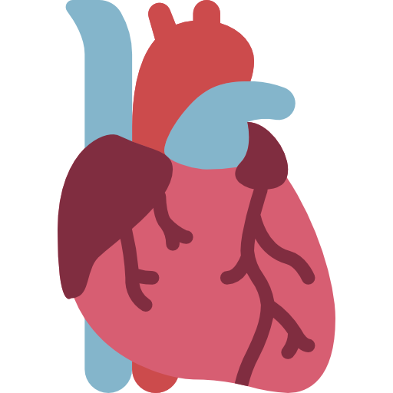
THE CONDUCTING SYSTEM OF THE HEART
By MBBSPPT.COM

Slide 2
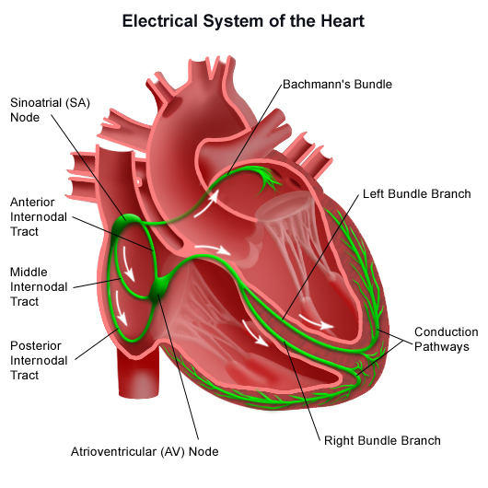

Slide 3
THE CONDUCTING SYSTEM
The heart is able to contract on its own because it contains specialized cardiac muscle tissue that spontaneously forms impulses and transmits them to the myocardium to initiate contraction.

Slide 4
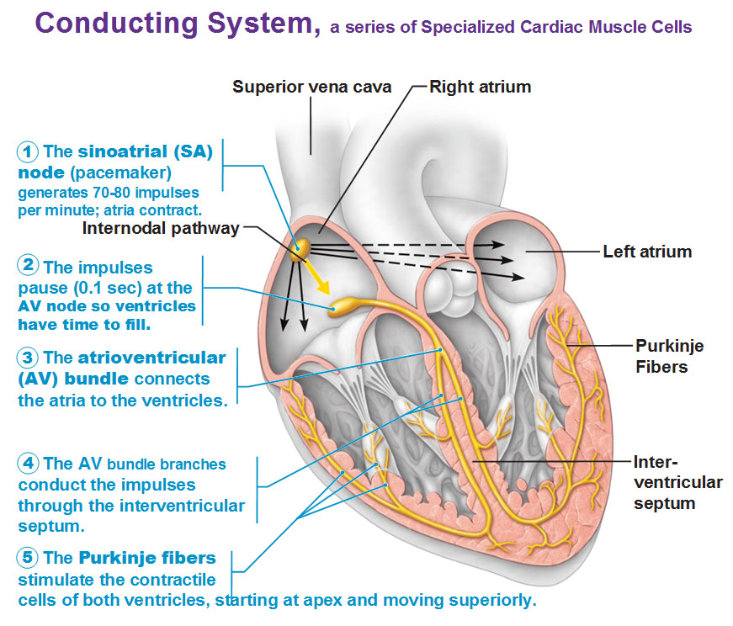

Slide 5
COMPONENTS
The conducting system of the heart is composed of the following 5 components:
Sinoatrial Node (SA node).
Atrioventricular Node (AV node).
Atrioventricular Bundle (of His).
Left and right branches of bundle (of His).
Subendocardial Purkinje fibers.

Slide 6
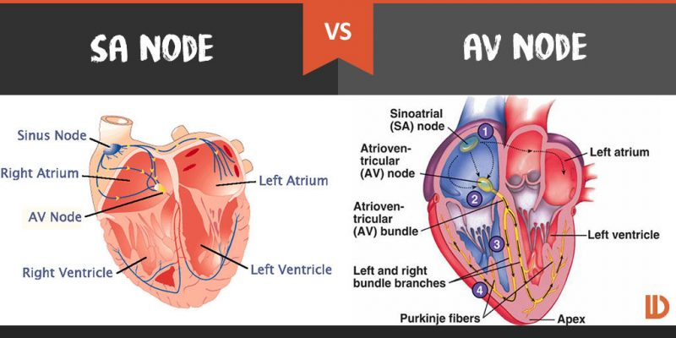

Slide 7
SINUATRIAL NODE (SA NODE OR NODE OF KEITH FLACK)
It is a small horseshoe-shaped mass having specialized myocardial fibres, situated in the wall of the right atrium in the upper part of sulcus terminalis just below the opening of superior vena cava.
It is called pacemaker of the heart since it generates impulses (about 70/minute).
It initiates the contraction of cardiac muscle producing heart beat.

Slide 8
Sinoatrial Node
The rate at which the SA node generates impulses is influenced by the autonomic nervous system:
Sympathetic nervous system – increases firing rate of the SA node, and thus increases heart rate.
Parasympathetic nervous system – decreases firing rate of the SA node, and thus decreases heart rate.

Slide 9
SA NODE
The flow of impulses causes contraction of the atria from superior to inferior, forcing blood into the ventricles. At the same time, the impulses are carried to the atrioventricular node (AV node).
There is a brief time delay as the impulses pass slowly through the AV node, which allows time for the ventricles to fill with blood.

Slide 10
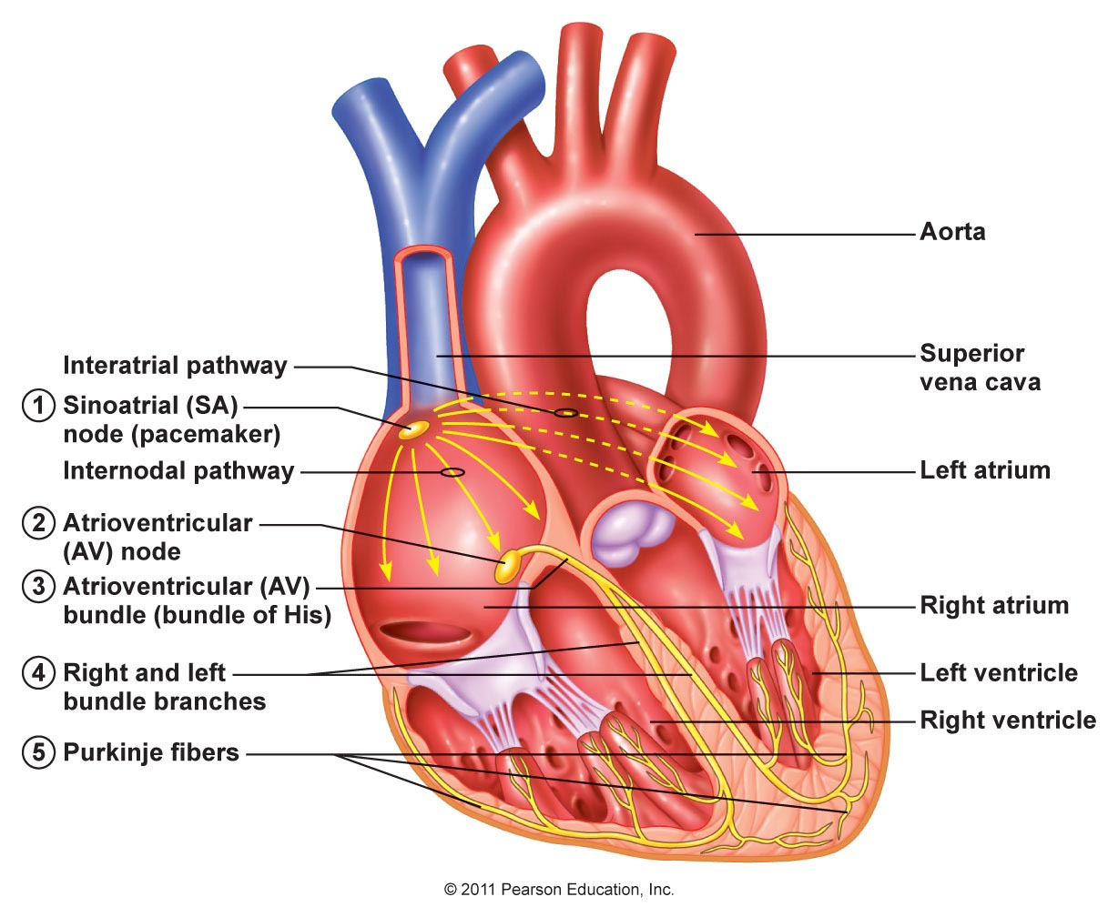

Slide 11
ATRIOVENTRICULAR NODE
(AV NODE/NODE OF TAWARA)
It is smaller compared to the SA node.
located in the right atrium near the junction with the interventricular septum near the opening of the coronary sinus.
It conducts the cardiac impulse to the ventricle by the atrioventricular bundle.

Slide 12
Atrioventricular Node
After the electrical impulses spread across the atria, they converge at the AV node.
The AV node acts to delay the impulses by approximately 120ms, to ensure the atria have enough time to fully eject blood into the ventricles before ventricular systole.
The wave of excitation then passes from the atrioventricular node into the atrioventricular bundle.

Slide 13
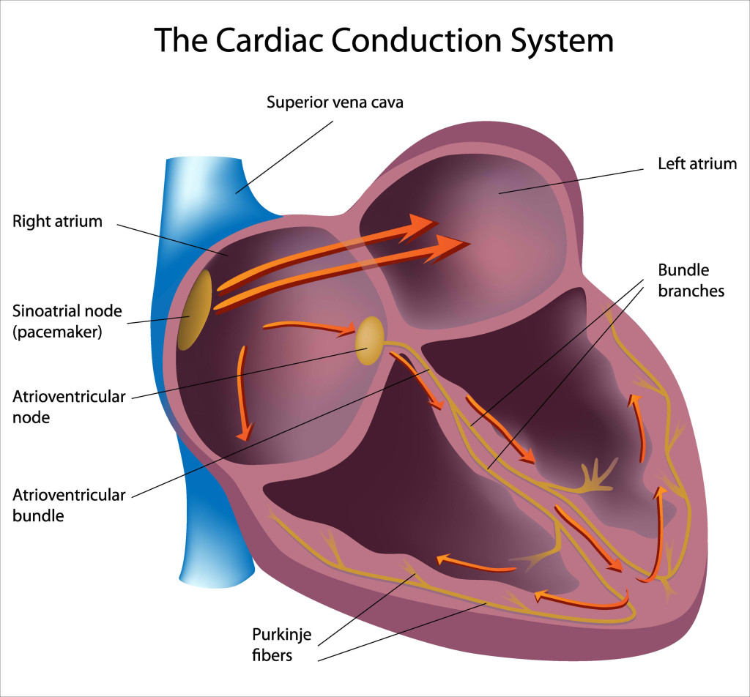

Slide 14
ATRIOVENTRICULAR BUNDLE
(OF HIS)
After the electrical impulses spread across the atria, they converge at the AV node.
The AV node acts to delay the impulses by approximately 120ms, to ensure the atria have enough time to fully eject blood into the ventricles before ventricular systole.
The wave of excitation then passes from the atrioventricular node into the atrioventricular bundle.
It begins from AV node, crosses the AV ring and runs along the inferior part of the membranous part of the interventricular septum where it divides into the right and left branches extending inferiorly to the interventricular septum and superior to the lateral walls of the ventricles.
Since the skeleton (fibrous framework) of the heart separates the muscles of atria from the muscles of the ventricles, the bundle of His is the only means of conducting impulses from the atria to the ventricles.

Slide 15
ATRIOVENTRICULAR BUNDLE
The atrioventricular bundle (bundle of His) is a continuation of the specialized tissue of the AV node, and serves to transmit the electrical impulse from the AV node to the Purkinje fibres of the ventricles.
It descends down the membranous part of the interventricular septum, before dividing into two main bundles:
Right bundle branch – conducts the impulse to the Purkinje fibres of the right ventricle.
Left bundle branch – conducts the impulse to the Purkinje fibres of the left ventricle.

Slide 16
LEFT AND RIGHT BRANCHES OF THE BUNDLE (OF HIS)
The right branch enters down the right side of the interventricular septum and after that becomes subendocardial on the right side of the septum.
A large part of it continues in the Septomarginal Trabecula (moderator band) to reach the anterior papillary muscle and anterior wall of the ventricle. Its Purkinje fibers then spread out underneath the endocardium.
The left branch descends on the left side of the ventricular septum, divides into Purkinje fibers that are distributed to the septum and left ventricle.

Slide 17
Cardiac plexus
Branches from both the parasympathetic and sympathetic systems contribute to the formation of the cardiac plexus. This plexus consists of a superficial part, inferior to the aortic arch and between it and the pulmonary trunk and a deep part, between the aortic arch and the tracheal bifurcation.

Slide 18
Parasympathetic Innervation
Stimulation of the parasympathetic system:
Decreases heart rate,
Reduces force of contraction, and
Constricts the coronary arteries.
The preganglionic parasympathetic fibers reach the heart as cardiac branches from the right and left vagus nerves. They enter the cardiac plexus and synapse in ganglia located either within the plexus or in the walls of the atria.
Sympathetic Innervation
Stimulation of the sympathetic system:
increases heart rate, and
increases the force of contraction.

Slide 20
Purkinje Fibres
The Purkinje fibers (sub-endocardial plexus of conduction cells) are a network of specialized cells. They are abundant with glycogen and have extensive gap junctions.
These cells are located in the subendocardial surface of the ventricular walls, and are able to rapidly transmit cardiac action potentials from the atrioventricular bundle to the myocardium of the ventricles.
This rapid conduction allows coordinated ventricular contraction (ventricular systole) and blood is moved from the right and left ventricles to the pulmonary artery and aorta respectively.

Slide 21
Overview of Heart Conduction
The sequence of electrical events during one full contraction of the heart muscle:
An excitation signal (an action potential) is created by the sinoatrial (SA) node.
The wave of excitation spreads across the atria, causing them to contract.
Upon reaching the atrioventricular (AV) node, the signal is delayed.
It is then conducted into the bundle of His, down the interventricular septum.
The bundle of His and the Purkinje fibres spread the wave impulses along the ventricles, causing them to contract.

Slide 22
Clinical Relevance: Artificial Pacemaker
An artificial pacemaker is a small electrical device commonly fitted to monitor and correct heart rate and rhythm. It is inserted into the chest under the left clavicle, with wires connected to the heart via the venous system.
The most common indication for a pacemaker is bradycardia. Once inserted, the pacemaker monitors the heart rate, and only fires if the rate becomes too slow. Pacemakers can also be used to treat some tachycardias, certain types of heart block and other rhythm abnormalities.

Slide 23
ARTERIAL SUPPLY
OF THE CONDUCTING SYSTEM
The whole of the conducting system of the heart is provided by the right coronary artery with the exception of a part of the left branch of the AV bundle that is provided by the left coronary artery.

Slide 24
CONDUCTING SYSTEM DEFECTS
The defect/damage of conducting system causes cardiac arrhythmias.
If the AV bundle fails to conduct normal impulses, there takes place alteration in the rhythmic contraction of the ventricles (arrhythmias). If complete bundle block takes place there is complete dissociation in the rate of contraction of atria and ventricles. The common cause of defective conduction via AV bundle is atherosclerosis of the coronary arteries which leads to diminished blood supply to the conducting system.
The rapid pulse is referred to as tachycardia, the slow pulse is named bradycardia on the other hand irregular pulse is named arrhythmia.

Slide 25
Bundle of KENT
Conduction from the atria to the ventricles normally occurs via the AV- node-His-Purkinje system.
Patients with a preexcitation syndrome have an additional or alternative pathway, known as an accessory pathway, which directly connects the atria and ventricle and bypasses the AV node.
AV conduction through an accessory pathway (most commonly a direct AV connection) results in the earlier activation of the ventricles than if the impulse had traveled through the AV node; hence causes proxysmal atrial tachycardia.

Slide 26
Thank You

