Slide 1
The Coronary Circulation
BY MBBSPPT.COM

Slide 2
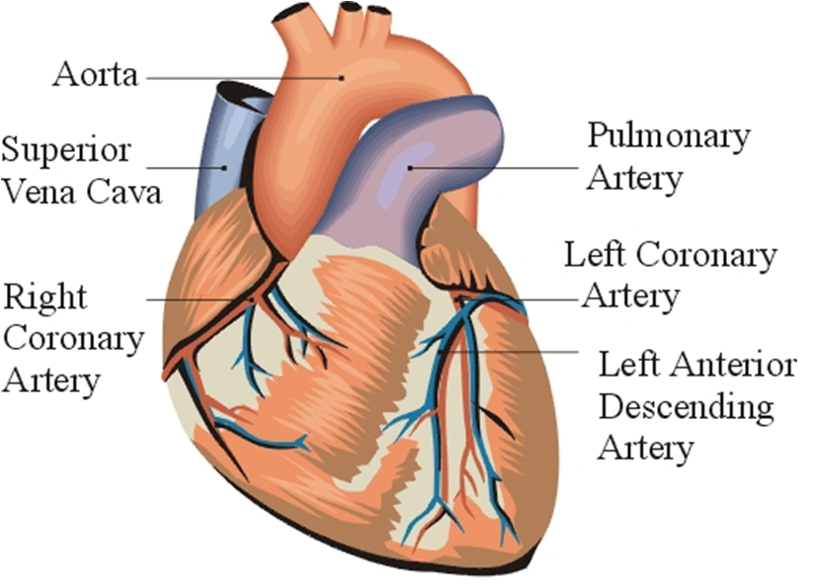

Slide 3
The Coronary Circulation
The coronary circulation refers to the vessels that supply and drain the heart.
Coronary arteries are named as such due to the way they encircle the heart, much like a crown.
An arterial circle surrounds the heart in coronary (AV) sulcus. From this arterial circle an arterial loop runs in the anterior & inferior interventricular grooves.

Slide 4
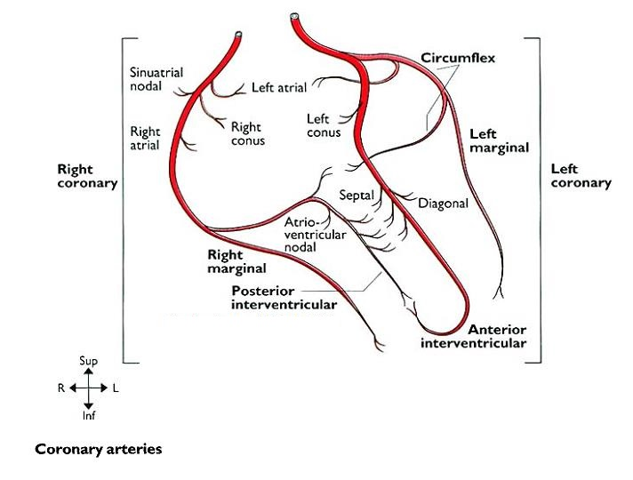

Slide 5
The Arterial Supply of the Heart
The Arterial Supply of the Heart is mostly supplied by 2 coronary arteries, which originate from the ascending aorta immediately above the aortic valve from the aortic sinuses.
The coronary arteries and their branches run on the surface of heart being located inside the subpericardial fibrofatty tissue.
Coronary arteries are vasa vasorum of the ascending aorta.
Anatomically coronary arteries are not end-arteries but functionally they behave like end-arteries.

Slide 6
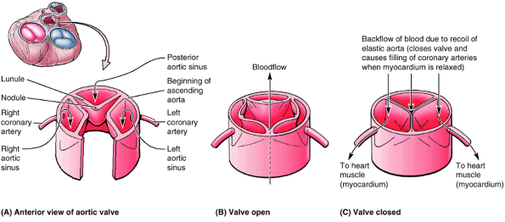
Like the pulmonary valve, the aortic valve has three semilunar cusps: right, posterior, and left. Each cusp has a fibrous nodule at the midpoint of its free edge and a thin connective tissue area, the lunule, to each side of the nodule.
Blood ejected from the left ventricle forces the cusps apart.
When the valve closes, the nodules and lunules meet in the center. The coronary arteries arise from the right and left aortic sinuses (spaces superior to the cusps).

Slide 7
Coronary Arteries
There are two main coronary arteries which branch to supply the entire heart.
They are named the left and right coronary arteries, and arise from the left and right aortic sinuses within the aorta.
The aortic sinuses are small openings found within the aorta behind the left and right flaps of the aortic valve.
When the heart is relaxed, the back-flow of blood fills these valve pockets, therefore allowing blood to enter the coronary arteries.

Slide 8
Characteristics of Coronary Arteries
Coronary arteries are vasa vasorum of the ascending aorta.
Anatomically coronary arteries are not end-arteries but functionally they behave like end-arteries.
The only branches of ascending aorta.
The only arteries which get filled up during diastole of heart.

Slide 9
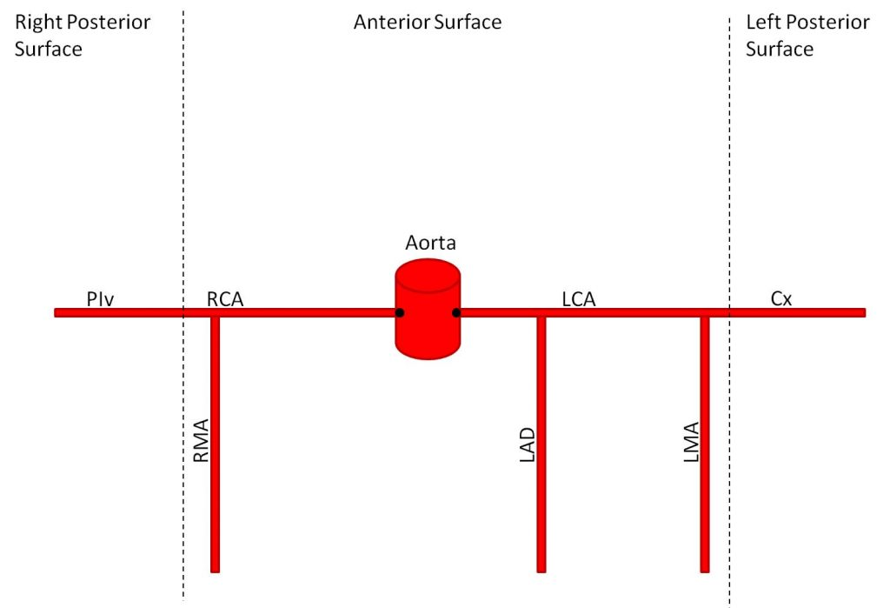

Slide 10
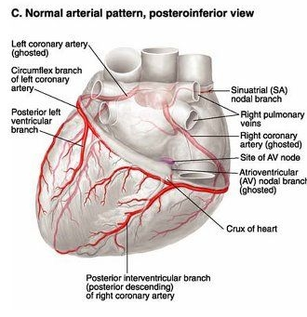

Slide 11
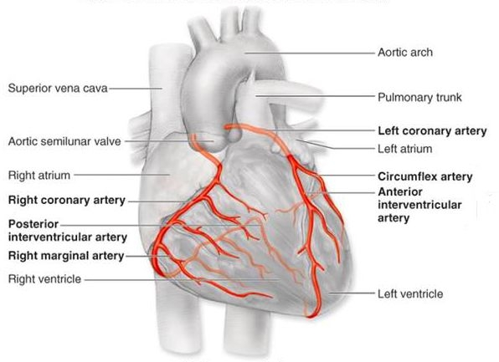

Slide 12
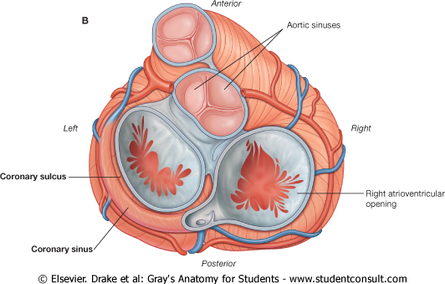

Slide 13
Left Coronary Artery

Slide 14
The Left Coronary Artery
The left coronary artery, which is usually larger than the right coronary artery, supplies the major part of the heart, including
The greater part of the left atrium,
Left ventricle, and
Interventricular septum.
The left coronary artery originates from the left posterior aortic sinus of the ascending aorta, immediately above the aortic valve.

Slide 15
The Left Coronary Artery Course
After arising from ascending aorta, the left coronary artery runs forwards and to the left between the pulmonary trunk and the left auricle.
It then divides into an anterior interventricular and circumflex artery.
The anterior interventricular artery (left anterior descending/LAD) runs downwards in the anterior interventricular groove to the apex of the heart. It then enters posteriorly around the apex of the heart to go into the posterior interventricular groove to terminate by anastomosing with the posterior interventricular artery which is a branch of the right coronary artery.
The circumflex artery winds around the left margin of the heart and continues in the left posterior coronary sulcus up to the posterior interventricular groove where it ends by anastomosing with the right coronary artery.

Slide 16
Branches and Distribution
1) Anterior interventricular artery (or left anterior descending (LAD) artery):
It supplies :
(a) anterior part of interventricular septum,
(b) greater part of the left ventricle and part of right ventricle,
(c) a part of left bundle branch (of His)
2) Circumflex artery: It supplies a left marginal artery that provides the left margin of the left ventricle up to the apex of the heart.
3) Diagonal artery: It may originate directly from the trunk of the left coronary artery.
4) Conus artery: It supplies the pulmonary conus.
5) Atrial branches: They supply the left atrium.

Slide 17
The Left Coronary Artery
Areas supplied
Left atrium
Left ventricle except the area adjoining posterior interventricular groove.
Right ventricle adjacent to the anterior interventricular sulcus.
Anterior 2/3rd of the interventricular septum
SA node in 35% of the cases.
Part of the left branch of bundle of His.

Slide 18
Right Coronary Artery
The right coronary artery (RCA) arises from the right aortic sinus of the ascending aorta.
Passes to the right of the pulmonary trunk and runs along the coronary sulcus before branching.
Near its origin, the RCA usually gives off an ascending sinuatrial nodal branch, which supplies the SA node.
The right marginal artery arises and moves along the right and inferior border of the heart towards the apex.

Slide 19
Right Coronary Artery

Slide 20
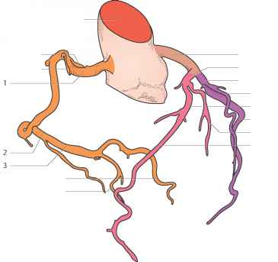
Right Coronary Artery
The right coronary artery is angiographically divided into three segments:
1st Segment: (from the origin to the first curve);
Passes forward for a distance. i.e. between pulmonary trunk(to its left) & right auricle(to its right).
2nd Segment: (first curvature to a second curvature);
Lies in the anterior part of AV groove.i.e. on sternocostal surface between right auricle right ventricle.
3rd Segment: (from the second curve to the crux cordis).
Lies in the posterior part of AV groove.

Slide 21
Right Coronary Artery
Branches
An early atrial branch passes in the groove between the right auricle and ascending aorta.
The sinu-atrial nodal branch, which passes posteriorly around the superior vena cava to supply the sinu-atrial node;
A right marginal branch is given off as the right coronary artery approaches the inferior (acute) margin of the heart and continues along this border toward the apex of the heart;
A small branch to the atrioventricular node before giving off its final major branch.
The posterior interventricular branch, which lies in the posterior interventricular sulcus.

Slide 22
Area Supplied
The right coronary artery supplies
The right atrium and right ventricle,
The sinu-atrial and atrioventricular nodes,
The interatrial septum,
A portion of the left atrium,
The posteroinferior one-third of the interventricular septum, and
A portion of the posterior part of the left ventricle.

Slide 23
Dominance
ADAM
Coronary dominance is based on the vessel that gives rise to the posterior descending artery which supplies the Atrio-ventricular node.
Recognized by the presence of septal perforating branches, arises from the RCA in 80% and from the LCX in 10% of the population.
Co-Dominance is found in 10% of the population where the posterior interventricular artery is formed by both the RCA and LCx.

Slide 24
Variations of the Coronary Arteries
In the most common right dominant pattern, present in approximately 67% of people. The posterior interventricular branch arises from the right coronary artery.
In approximately 15% of hearts, left dominance the Left Coronary Artery is dominant in that the posterior interventricular branch is a branch of the circumflex artery.
There is codominance in approximately 18% of people, in which branches of both the right and left coronary arteries give rise to branches that course in or near the posterior IV groove.
Approximately 4% of people have an accessory coronary artery.
Another point of variation relates to the arterial supply to the sinu-atrial and atrioventricular nodes. In most cases, these two structures are supplied by the right coronary artery.

Slide 25
Variations in distribution of coronary arteries. A. In the most common pattern (67%), the right coronary artery is dominant, giving rise to the posterior interventricular branch. B and C. The left coronary artery gives rise to the posterior interventricular branch in approximately 15% of individuals. D. Many other variations occur.

Slide 26
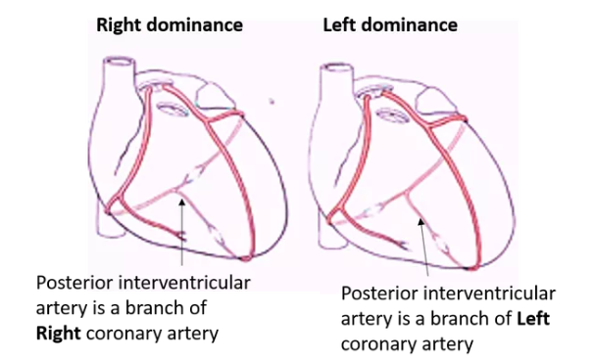

Slide 27
Artery | Region Supplied | Vein Draining Region
Right coronary | Right atrium SA and AV nodes Posterior part of interventricular septum (IVS) | Small cardiac vein Middle cardiac vein
Right marginal | Right ventricle Apex | Small cardiac vein Middle cardiac vein
Posterior interventricular | Right ventricle Left ventricle Posterior 1/3 of IVS | Left posterior ventricular vein
Left coronary | Left atrium Left ventricle IVS AV bundles | Great cardiac vein
Left anterior descending | Right ventricle Left ventricle Anterior 2/3 IVS | Great cardiac vein
Left marginal | Left ventricle | Left marginal vein Great cardiac vein
Circumflex | Left atrium Left ventricle | Great cardiac vein

Slide 28
Coronary Artery Anastomoses
Anastomoses between the terminal branches of the right and left coronary arteries (collateral circulation) exist, but they are usually not large enough to provide an adequate blood supply to the cardiac muscle should one of the large branches become blocked by disease. A sudden block of one of the larger branches of either coronary artery usu- ally leads to myocardial death (myocardial infarction), although sometimes the collateral circulation is enough to sustain the muscle.

Slide 29
Summary of the Overall Arterial Supply to the Heart in Most Individuals
The right coronary artery supplies all of the right ventricle (except for the small area to the right of the anterior inter- ventricular groove), the variable part of the diaphragmatic surface of the left ventricle, the posteroinferior third of the ventricular septum, the right atrium and part of the left atrium, and the sinoatrial node and the atrioventricular node and bundle. The LBB also receives small branches.
The left coronary artery supplies most of the left ventricle, a small area of the right ventricle to the right of the interventricular groove, the anterior two thirds of the ventricular septum, most of the left atrium, the RBB, and the LBB.

Slide 30
Major Branches of The Left And Right Coronary Arteries
Right Coronary Artery | Left Coronary Artery
Right Marginal Artery | Anterior Interventricular Artery
Posterior Interventricular Artery | Circumflex Artery
Sinuatrial Nodal Artery | Diagonal Artery

Slide 31
Coronary Heart Disease
Coronary artery disease or coronary heart disease (CHD) is a leading cause of death worldwide. It describes a reduction in blood flow to the myocardium and has several causes and consequences.
CHD can result due to atherosclerosis, thrombosis, high blood pressure, diabetes or smoking. All these factors lead to a reduced flow of blood to the heart through physical obstruction or changes in the vessel wall.
Angina pectoris describes the transient pain a person may feel on exercise as a result of lack of oxygen supplied to the heart. This pain is felt across the chest but is quickly resolved upon rest.
If left untreated, angina can soon progress to more severe consequences, such as a myocardial infarction.

Slide 32
Angiography

Slide 33
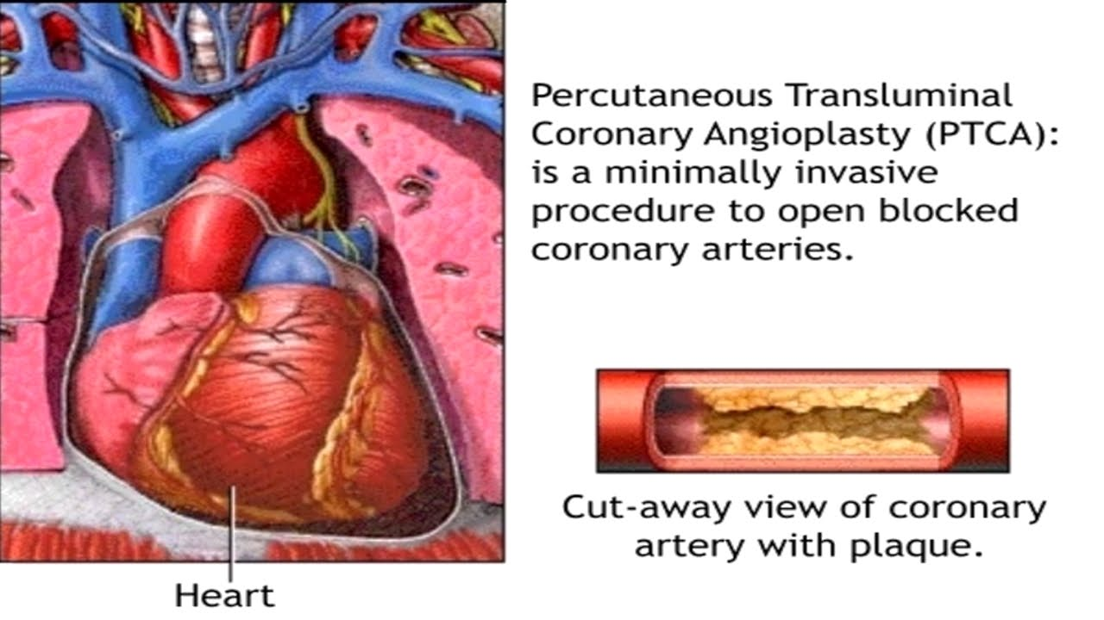
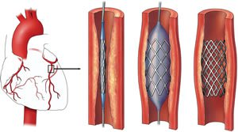

Slide 34
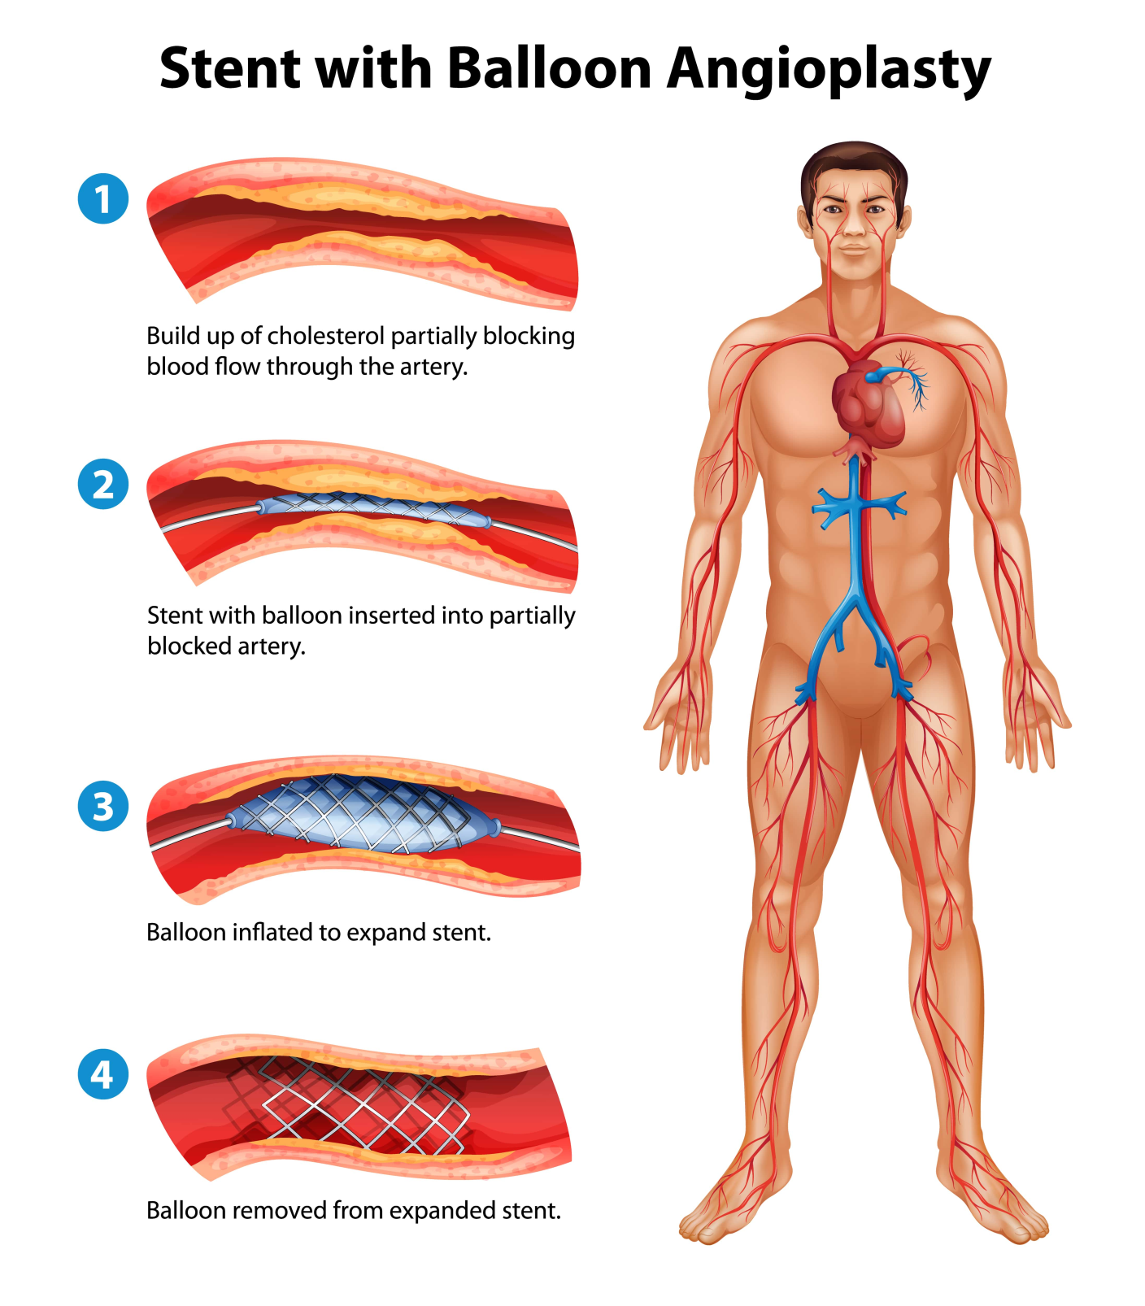

Slide 35
Venous Drainage of Heart
Venous blood from the heart is drained into right atrium by the following:
Coronary sinus.
Anterior cardiac veins.
Venae cordisminimae (Thebesian veins).

Slide 36
Cardiac Veins
Blood travels from the subendocardium into the Thebesian veins, which are small tributaries running throughout the myocardium.
These in turn drain into larger veins that empty into the coronary sinus.
The coronary sinus is the main vein of the heart, located on the posterior surface in the coronary sulcus, which runs between the left atrium and left ventricle.
The sinus drains into the right atrium.
Within the right atrium, the opening of the coronary sinus is located between the right atrioventricular orifice and the inferior vena cava orifice.

Slide 37
Coronary Sinus
Tributaries: The coronary sinus gets the following tributaries:
Great cardiac vein: It accompanies anterior interventricular and circumflex arteries to join the left end of the coronary sinus.
Middle cardiac vein: It accompanies the posterior interventricular artery and joins the coronary sinus near its termination.
Small cardiac vein: It accompanies the right ventricular artery in the right posterior coronary sulcus and the right end of the coronary sinus.
Posterior vein of the left ventricle: It runs on the diaphragmatic surface of the left ventricle and joins the sinus to the left of the middle cardiac vein.
Oblique vein of the left atrium (Vein of Marshall): It’s a small vein which runs downwards on the posterior surface of the left atrium to goes into the left end of the coronary sinus. It develops from the left common cardinal vein (duct of Cuvier).
Right marginal vein: It accompanies the marginal branch of the right coronary artery and joins the small cardiac vein or drains directly into the right atrium.
Left marginal vein: It accompanies the marginal branch of the left coronary artery and drains into the coronary sinus

Slide 38
Veins of heart which do not open into Coronary Sinus
Anterior Cardiac Veins
These are series of small veins (3 or 4) which run parallel to every other across the surface of right ventricle to open into the right atrium.
Venae Cordis Minimae (Thebesian Veins)
All these are extremely small veins in the walls of all the 4 chambers of the heart. These open directly into the respective chambers. These are most numerous in the right atrium.

Slide 39
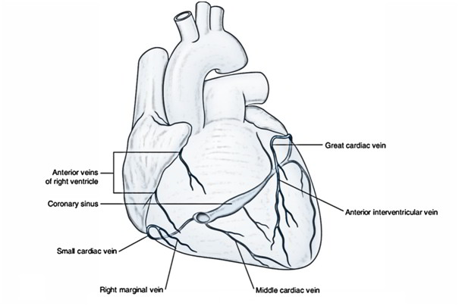
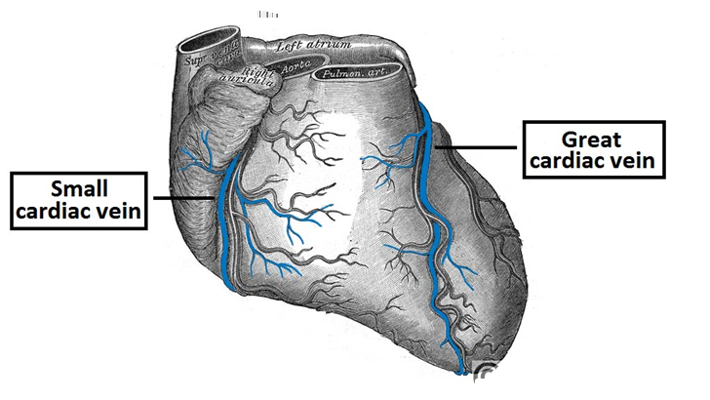
Cardiac veins: The great, middle, and small cardiac veins; the oblique vein of the left atrium; and the left posterior ventricular vein are the main vessels draining into the coronary sinus. The coronary sinus, in turn, empties into the right atrium. The anterior cardiac veins drain directly into the auricle of the right atrium.

Slide 40
THANKS!

