Slide 1
The Heart External
features
BY MBBSPPT.COM

Slide 2
The heart
The Heart is a hollow muscular organ situated in the mediastinum of the thoracic cavity, enclosed in the pericardium.
It is somewhat pyramidal in shape and placed obliquely behind the sternum and adjoining parts of costal cartilages so that 1/3rd of the heart is to the right of median plane and 2/3rd of the heart is to the left of the median plane.

Slide 3
The heart
The heart is composed of 4 chambers:
Right atrium,
Right ventricle,
Left atrium,
Left ventricle.
Blood returning to the heart enters the atria, and is then pumped into the ventricles.
From the left ventricle, blood passes into the aorta and enters the systemic circulation.
From the right, it enters the pulmonary circulation via the pulmonary arteries.

Slide 4
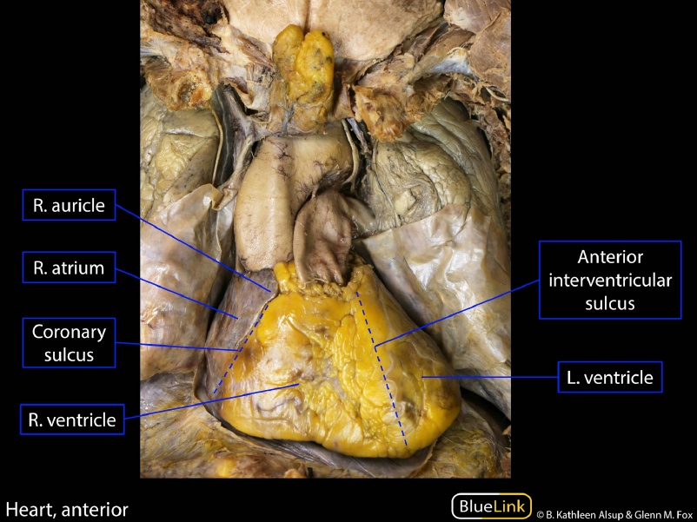

Slide 5
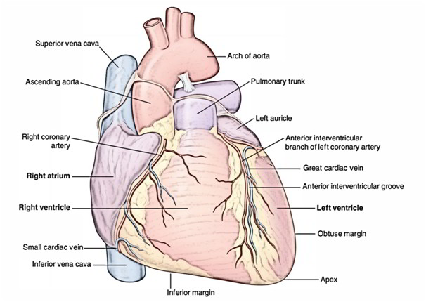

Slide 6
SHAPE AND MEASUREMENTS
Shape: Pyramidal or conical.
Measurements:
Length = 12 cm.
Width = 9 cm.
Weight = 300 g in males; 250 g in females.
The heart is somewhat larger than one’s own clenched fist.

Slide 7
EXTERNAL FEATURES
The heart presents the following external features:
A. Apex.
B. Base (quadrilateral and directed posteriorly).
C. 4 surfaces:
Sternocostal,
Diaphragmatic,
Left pulmonary.
Right pulmonary.
D. 4 borders:
Right,
Left,
Superior,
Inferior.

Slide 8
APEX OF THE HEART
The apex of the heart is a conical area created by left ventricle.
It is directed downwards and forwards, and to the left.
It is located at the level of the 5th left intercostal space, 3.5 inches (9 cm) from the midline and just medial to the midclavicular line.

Slide 9
Apex Beat
It is the outermost and lowermost thrust of the cardiac contraction (during ventricular systole) felt on the very front of the chest or it is the Point of Maximum Cardiac Impulse (PMCI).
Normally the apex beat is felt as a light tap in left 5th intercostal space in the midclavicular line.
Normally, the apex of the heart is on the left side and apex beat is felt on the left side (left 5th intercostal space).

Slide 10
Orientation and Surfaces
The heart is pyramidal in shape.
The apex of this pyramid pointing in an anterior-inferior direction.
The base is opposite to the apex and forms posterior surface.
In its typical anatomical orientation, the heart has 4 surfaces, formed by different internal divisions of the heart:
Anterior (or sternocostal) – Right ventricle.
Inferior (or diaphragmatic) – Left and right ventricles.
Right pulmonary – Right atrium.
Left pulmonary – Left ventricle.

Slide 11
Sulci of the Heart
The heart is a hollow structure. On the interior, it is divided into four chambers. These divisions create grooves on the surface of the heart – these are known as sulci.
The coronary sulcus (atrioventricular groove) runs transversely around the heart – it represents the wall dividing the atria from the ventricles. The sulcus contains important vasculature, such as the right coronary artery.
The anterior and posterior interventricular sulci can be found running vertically on their respective sides of the heart separating both ventricles.

Slide 12
BASE OF THE HEART
The base (or posterior surface) of the heart is composed by 2 atria, primarily by the left atrium.
Strictly speaking 2/3rd of the base is composed by the posterior surface of the left atrium and 1/3rd by the posterior surface of the right atrium.
It is directed backwards and to the right (i.e., opposite to the apex).
It is rather flat.

Slide 13
Characteristic features
of the base
A. It is located opposite to the apex.
B. It is located in front of the middle 4 thoracic vertebrae (i.e., T5-T8) in the lying -down position and descends one vertebra in the erect posture (T6-T9).
C. The base is separated from vertebral column by the oblique pericardial sinus, esophagus, and aorta.
D. Base is the part of the heart where great blood vessels (superior vena cava, ascending aorta, and pulmonary trunk) are connected.

Slide 14
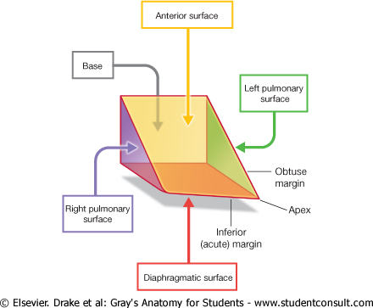

Slide 15
STERNOCOSTAL SURFACE
It is created primarily by the right atrium and right ventricle, that are divided from every other by the anterior part of atrioventricular groove.
The sternocostal surface is also partly created by the left auricle and left ventricle. The right ventricle is divided from left ventricle by the anterior interventricular groove.
The left atrium is hidden on the front by the ascending aorta and pulmonary trunk.
The part of sternocostal surface is uncovered by the left lung (cardiac notch) creating an area of superficial cardiac dullness.

Slide 16
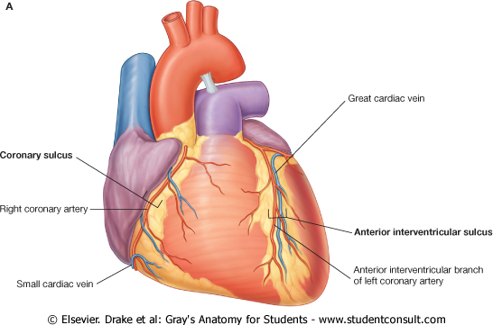
STERNOCOSTAL SURFACE
Here can be seen-
Four borders of the heart:
Right
Left
Inferior
Superior
Two grooves:
Parts of AV coronary sulcus
Anterior interventricular sulcus
The four chambers of the heart:
Right ventricle
Right atrium
Left ventricle
The tip of the left auricle
A. Anterior Surface of the Heart

Slide 17
DIAPHRAGMATIC SURFACE
This surface is flat and rests on the central tendon of the diaphragm.
It is created by the right and left ventricles that are divided from every other by the posterior interventricular groove.
The left ventricles create left 2/3rd of this surface and right ventricle creates only right 1/3rd of this surface.

Slide 18
LEFT & Right pulmonary SURFACEs
The left pulmonary surface faces the left lung, is broad and convex, and consists of the left ventricle and a portion of the left atrium.
The right pulmonary surface faces the right lung, is broad and convex, and consists of the right atrium.

Slide 19
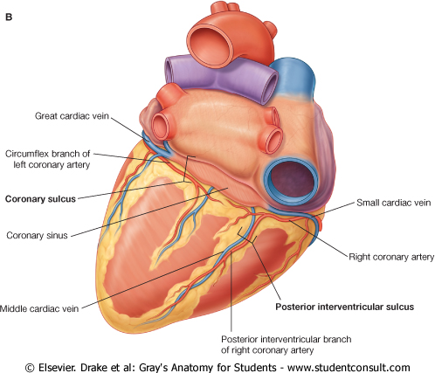
B. Diaphragmatic Surface and Base of the Heart

Slide 20
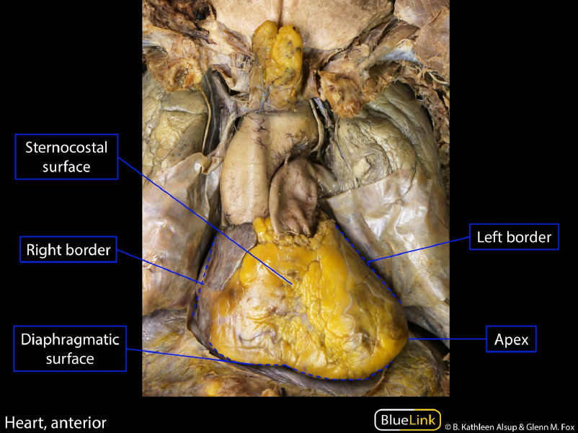

Slide 21
Borders
Separating the surfaces of the heart are its borders.
There are four main borders of the heart:
Right border – Right atrium.
Inferior border – Left ventricle and right ventricle.
Left border – Left ventricle (and some of the left atrium).
Superior border – Right and left atrium and the great vessels.

Slide 22
RIGHT BORDER
It is more or less vertical and is composed by the right atrium.
It extends from the right side of the opening of SVC to that of IVC and separates the base from the sternocostal surface.

Slide 23
LEFT BORDER
It is curved and oblique.
It is created primarily by the left ventricle and partly by the left auricle.
It extends from left auricle to the apex of the heart and separates sternocostal and left surfaces.

Slide 24
INFERIOR BORDER
It is almost horizontal and extends from the opening of IVC to the apex of the heart.
It is created by the right ventricle.
The right atrium also creates a part of the border.
The inferior border separates the sternocostal surface from the diaphragmatic surface.
Near the apex it presents a notch termed incisura apiciscordis.

Slide 25
UPPER BORDER
It is somewhat oblique and is composed by the left and right atria.
The upper border is obscured from the view on the sternocostal surface because ascending aorta and pulmonary trunk is located in front of it.
On the surface of the body it can be marked by a line joining a point on the lower border of the 2nd left costal cartilage, 1.5 in from the median plane to a point on the upper border of 3rd right costal cartilage, 1 inch far from the median plane.

Slide 26
Surface Anatomy of the Heart
The superior border corresponds to a line connecting the inferior border of the 2nd left costal cartilage to the superior border of the 3rd right costal cartilage.
The right border corresponds to a line drawn from the 3rd right costal cartilage to the 6th right costal cartilage; this border is slightly convex to the right.
The inferior border corresponds to a line drawn from the inferior end of the right border to a point in the 5th intercostal space close to the left MCL; the left end of this line corresponds to the location of the apex of the heart and the apex beat.
The left border corresponds to a line connecting the left ends of the lines representing the superior and inferior borders.

Slide 27
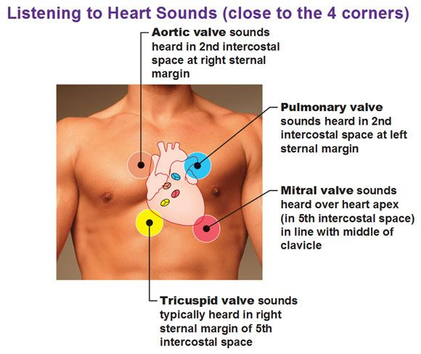

Slide 28
CLINICAL SIGNIFICANCE
Cardiac shadow in chest radiograph:
In X-ray of chest, PA view, the term cardiac-shadow is utilized for mediastinal shadow.
The left border of cardiac shadow, from above downwards is composed by:
Aortic arch,
Pulmonary trunk,
Left auricle and
Left ventricle.
The right border from above downwards is composed by SVC and right atrium.

Slide 29
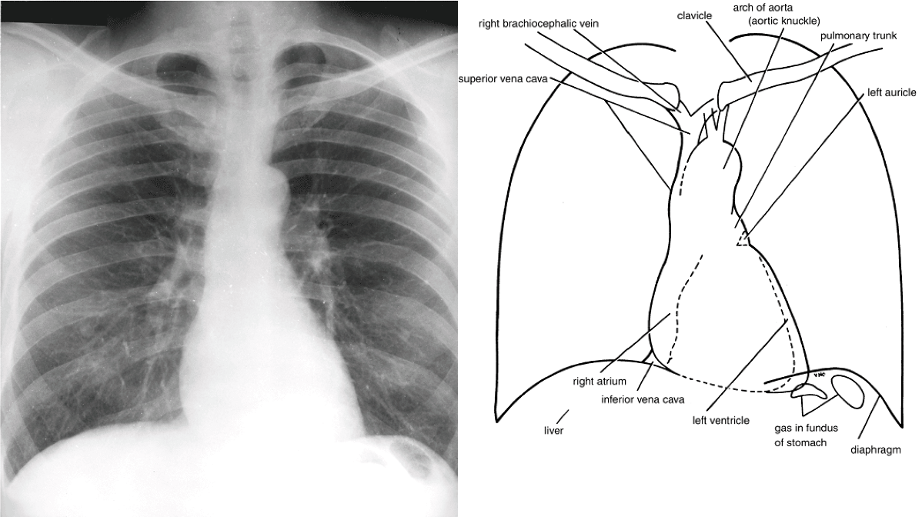

Slide 30
Thank You

