Slide 1
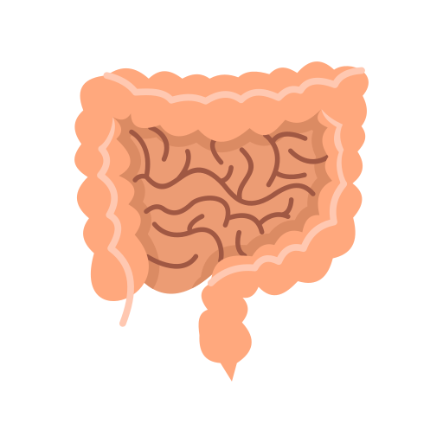
The Jejunum and Ileum
BY MBBSPPT.COM

Slide 2
The jejunum and the ileum
The Jejunum begins at the duodenojejunal flexure.
Together, the jejunum and ileum are 5 to 7 meters long (avg 6m)
The jejunum and ileum are the greatly coiled parts of the small intestine.
They are covered to varying extents by the greater omentum.
Although there is no clear line of demarcation, the character of the intestine gradually changes.

Slide 3
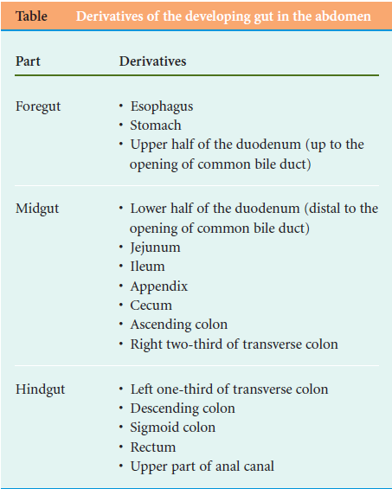

Slide 4
The differences between the duodenum and small intestine
Duodenum | Small intestine proper
Short in length (25 cm) | Long in length (avg 6 m)
Supplied by two rows of vasa recta | Supplied by single row of vasa recta
Presence of Brunner glands in submucous coat | Absence of glands in submucous coat

Slide 5
The jejunum
The jejunum is middle part of the small intestine in humans and most higher vertebrates.
It lies between duodenum and the ileum.
The jejunum arises from the duodenojejunal flexure.

Slide 6
Ileum
Part of the small intestine beyond the jejunum and up to to the ileocecal valve i.e. before the colon(large intestine).
The wall itself is made up of folds, each of which has many tiny finger-like projections known as villi on its surface.
The function of the ileum is mainly to absorb vitamin B12 and bile salts and whatever products of digestion were not absorbed by the jejunum.

Slide 7
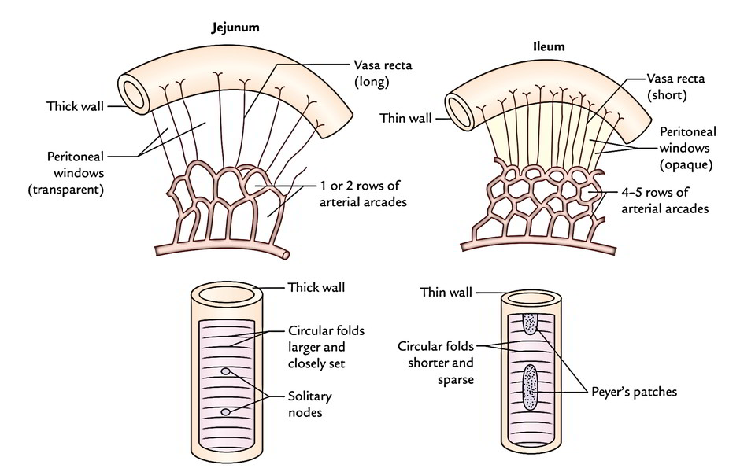

Slide 8
STRUCTURE of the small intestine
The wall structure of the small intestine includes four layers.
From inside to outside, these are:
Mucosa
Submucosa
Muscle layer
Serosa

Slide 9
MESENTERY OF THE SMALL INTESTINE
It is a broad fan-shaped fold of the peritoneum, which suspends the small intestine (jejunum and ileum) to the posterior abdominal wall.
It has the root (connected margin) as well as free margin (intestinal margin).
The root extends from the duodenojejunal flexure to the ileocaecal junction and is connected to an oblique line throughout the posterior abdominal wall.
The duodenojejunal flexure lies to the left side of second lumbar vertebra, whereas ileocaecal junction lies at the right sacroiliac joint.

Slide 10
Differences Between The Jejunum And Ileum
Features | Jejunum | Ileum
Location | Umbilical region | Hypogastric region
Walls | Thicker and more vascular | Thinner and less vascular
Lumen | Wider and often found empty (diameter = 4 cm) | Narrower and often found full (diameter = 3.5 cm)
Circular folds/plicae circulares (valves of Kerckring) | Longer and closely set | Smaller and sparsely set
Villi | More, larger, thicker, and leaf-like | Less, shorter, thinner, and finger-like
Aggregated lymph follicles (Peyer’s patches) | Small, circular, and few in number, and found only in the distal part of the jejunum | Large oval and more in number and found throughout the extent of ileum being maximum in the distal part
Mesentery | Contains less fat and becomes semitranslucent between the vasa recta called peritoneal windows | Contains more fat and there are no peritoneal windows between the vasa recta
Arterial arcades | One or two rows with long vasa recta | Four or five rows with short vasa recta

Slide 12
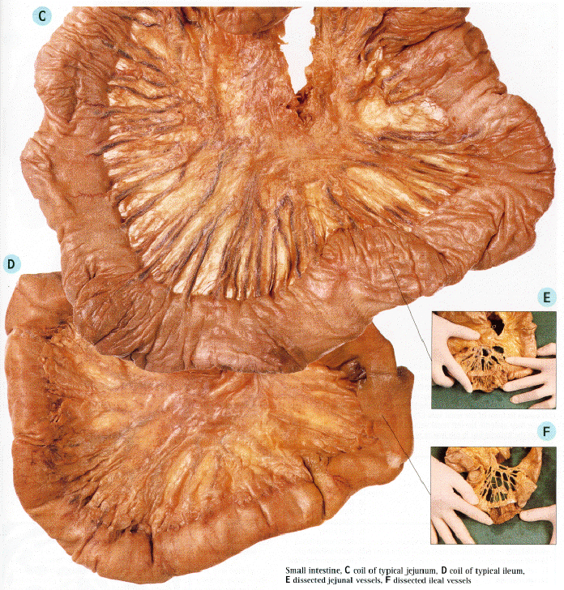

Slide 17
The mesentery
Fold of peritoneum that suspends the small intestine from the posterior abdominal wall
Broad and a fan-shaped
Consists of two peritoneal layers

Slide 18
The mesentery
The jejunum and ileum are attached to the posterior abdominal wall by the root of the mesentery (about 15 cm long) is directed obliquely.
It extends from the duodenojejunal junction on the left side of vertebra L2 to the ileocolic junction and the right sacroiliac joint.
Between these two points, the root of the mesentery crosses:
The horizontal (3rd & 4rh ) parts of the duodenum
Aorta
Inferior vena cava
Psoas major muscle
Right ureter
Right testicular (or ovarian) vessels

Slide 20
Contents of mesentery
Between the two layers of the mesentery are
Coils of intestine
The superior mesenteric artery
The superior mesenteric vein
Lymph nodes,
Small nodes in free border of the mesentery
Medium sized in middle
Large sized at root of the mastery
A variable amount of fat, and
Autonomic Nerves.

Slide 22
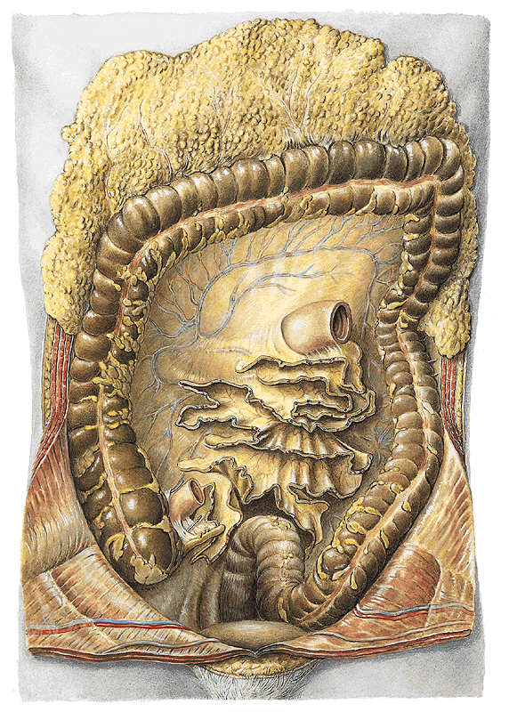

Slide 23
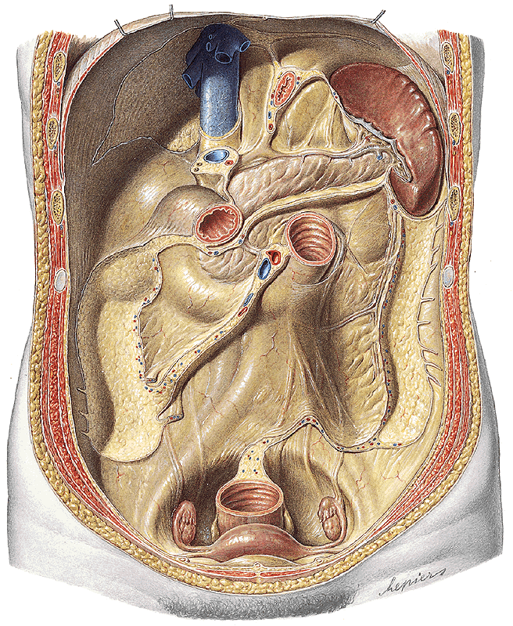

Slide 24
Blood Supply of the Jejunum and Ileum
The arterial supply to the jejunoileum is from the superior mesenteric artery.
The superior mesenteric artery arises from the aorta at the level of the L1 vertebrae, immediately inferior to the coeliac trunk.
It moves in between layers of mesentery, splitting into approximately 20 branches.
These branches anastomose to form loops, called arcades. From the arcades, long and straight arteries arise, called vasa recta.

Slide 25
Venous Drainage of the Jejunum and Ileum
The superior mesenteric vein drains the jejunum and ileum.
This accompanies the superior mesenteric artery, lying anterior and to its right in the root of the mesentery.
This vein unites with the splenic vein to form the portal vein

Slide 26
Lymphatic Drainage of the Jejunum and Ileum
The lacteals in the intestinal villi empty their milk-like fluid (L. lactis, milk) into a plexus of lymph vessels in the walls of the jejunum and ileum.
These lymph vessels pass between the two layers of mesentery to the mesenteric lymph nodes.
From here, the lymph drains ultimately to the thoracic duct.

Slide 27
Innervation of the Jejunum and Ileum
The innervation is through the superior mesenteric plexus extensions along the arteries.
The sympathetic supply is from the greater splanchnic and lesser splanchnic nerves.
The parasympathetic supply is from the posterior vagal trunk via the coeliac plexus.

Slide 28
Ileal Diverticulum (of Meckel)
An ileal diverticulum (of Meckel) is a congenital anomaly that occurs in 1 to 2% of the population.
A remnant of the vitello-intestinal duct, the diverticulum usually appears as a finger-like pouch.
The diverticulum is usually located 30 to 60 cm from the ileocecal junction in infants and 50 cm in adults.
It may be free (74%) or attached to the umbilicus (26%). it may also include areas of acid-producing gastric tissue, pancreatic tissue, or jejunal or colonic mucosa.
An ileal diverticulum may become inflamed and produce pain mimicking that produced by appendicitis.
If gastric tissue is in diverticulum, a peptic ulcer may occur here.

Slide 29
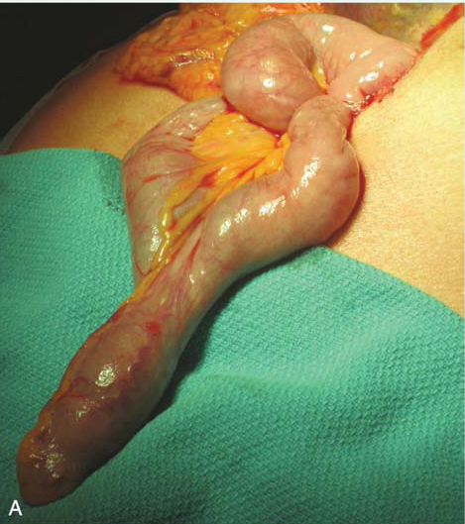

Slide 30
Trauma to the Jejunum and Ileum
Because of its extent and position, the small intestine is commonly damaged by trauma.
The extreme mobility and elasticity permit the coils to move freely over one another in instances of blunt trauma.
Material from large wounds leaks freely into the peritoneal cavity.
The presence of the vertebral column and the prominent anterior margin of the first sacral vertebra may provide a firm background for intestinal crushing in cases of midline crush injuries.

Slide 31
Tumors and Cysts of the Mesentery of the Small Intestine
The line of attachment of the small intestine to the posterior abdominal wall should be remembered.
It extends from a point just to the left of the midline about 2 in. (5 cm) below the transpyloric plane (L1) downward to the right iliac fossa.
A tumor or cyst of the mesentery, when palpated through the anterior abdominal wall, is more mobile in a direction at right angles to the line of attachment than along the line of attachment.

Slide 32
Pain Fibers from the Jejunum and Ileum
Referred pain from this segment of the gastrointestinal tract is felt in the dermatomes supplied by the 9th, 10th, and 11th thoracic nerves.
Strangulation of a coil of small intestine in an inguinal hernia first gives rise to pain in the region of the umbilicus.
Only later, when the parietal peritoneum of the hernial sac becomes inflamed, does the pain become more intense and localized to the inguinal region

Slide 33
Mesenteric Arterial Occlusion
The superior mesenteric artery, a branch of the abdominal aorta, supplies an extensive territory of the gut, from halfway down the second part of the duodenum to the left colic flexure.
Occlusion of the artery or one of its branches results in death of all or part of this segment of the gut.
The occlusion may occur as the result of an embolus, a thrombus, an aortic dissection, or an abdominal aneurysm

Slide 34
Mesenteric Vein Thrombosis
The superior mesenteric vein, which drains the same area of the gut supplied by the superior mesenteric artery, may undergo thrombosis after stasis of the venous bed.
Cirrhosis of the liver with portal hypertension may predispose to this condition.

Slide 35
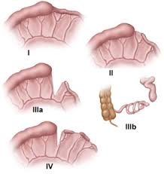
Atresias and Stenoses
Congenital intestinal atresia is a major cause of intestinal obstruction in infants. As in the duodenum, jejunoileal atresia occurs.

Slide 36
Thank You!

