Slide 1
The Orbit of eye
BY MBBSPPT.COM

Slide 2
Identify the elements of the bony orbit on a skull or x-ray

Slide 3
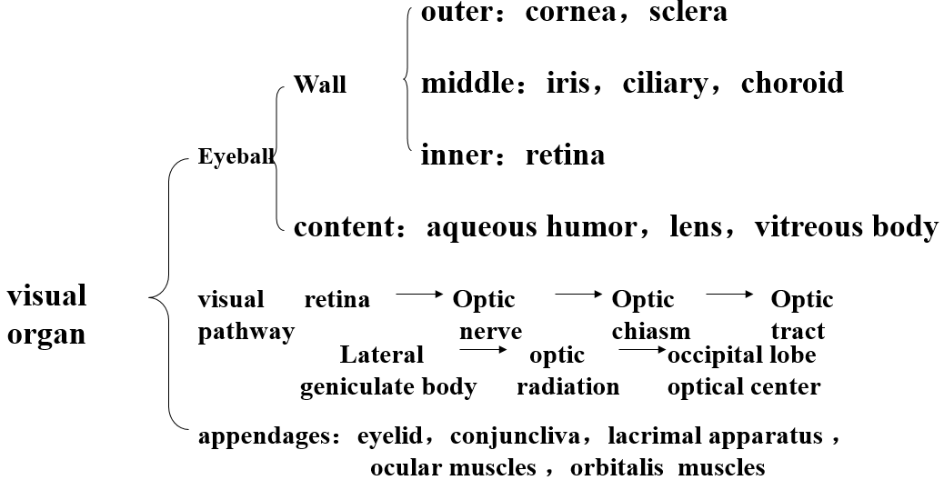
visual organ

Slide 4
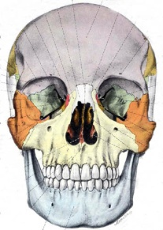
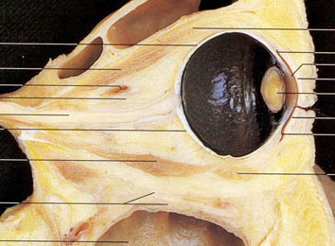
Contents
1. Bony orbit,
Orbital openings,
Orbital fasciae
2. Surface anatomy of eyeball and eyelids
3. Orbital contents
Eyeball
Lacrimal Gland
Ocular Muscles
Ophthalmic Vessels
C.N. II, III, IV, V1 & VI
Ciliary Ganglion

Slide 5
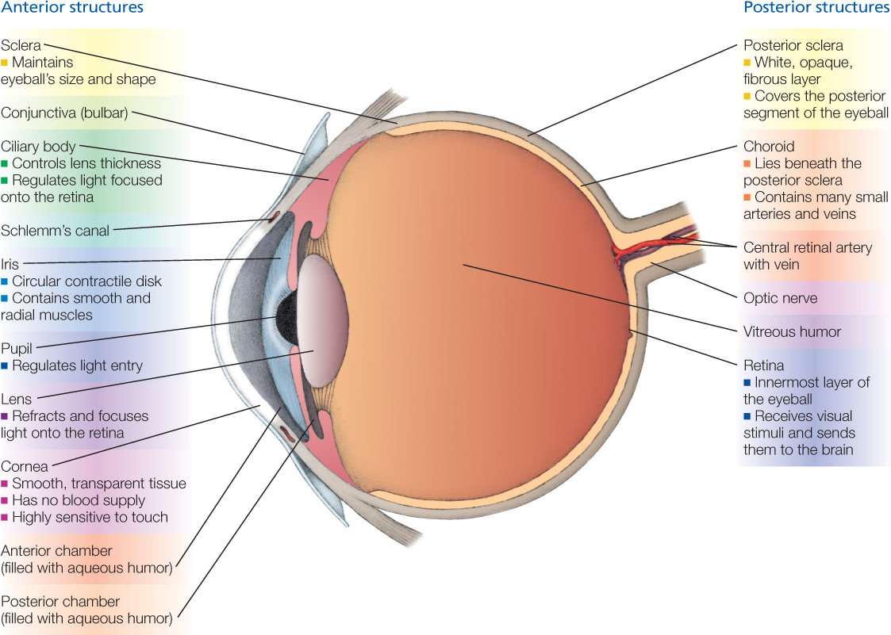

Slide 6
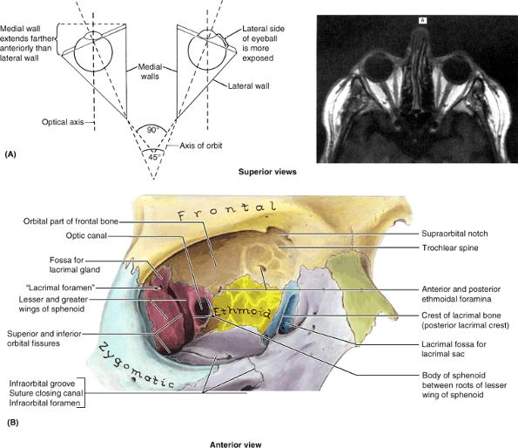

Slide 8
Optic axis
The axis of the eye connecting the anterior and posterior poles; it usually diverges from the visual axis by five degrees or more.
Syn: axis opticus [NA].
Orbital axis
The line from the center of the optic foramen (apex of orbit) extending anteriorly, laterally, and inferiorly to the middle of the orbital opening.
Visual axis
The straight line extending from the object seen, through the center of the pupil, to the macula lutea of the retina.
Syn: line of vision.

Slide 9
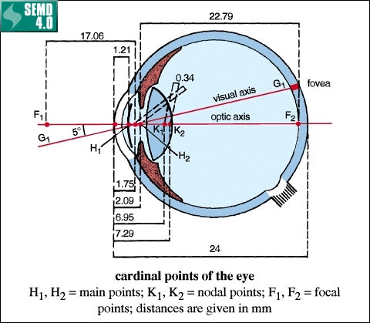

Slide 10
These resemble hollow quadrangular pyramids with their bases directed anterolaterally and their apices, posteromedially.
The medial walls of the two orbits, separated by the ethmoidal sinuses and the upper parts of the nasal cavity, are parallel, whereas their lateral walls are nearly at a right (90Â°) angle.
Consequently, the axes of the orbits diverge at approximately 45Â°.
The optical axes (axes of gaze, the direction or line of sight) for the two eyeballs, are parallel, however.

Slide 11
Anterior pole:
(center of anterior curvature) of the eyeball, which is determined by the corneal vertex.
Posterior pole:
(center of posterior curvature) of the eyeball, which lies lateral to the exit of the optic nerve and opposite to the anterior pole.
Equator:
Greatest circumference of the eyeball located equidistant from the anterior and posterior poles.

Slide 12
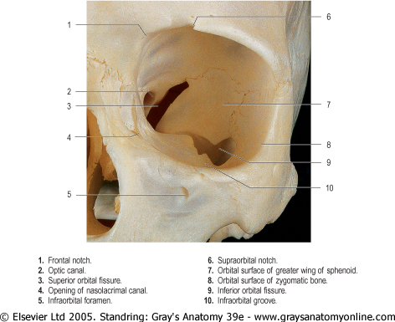

Slide 13
Orbital cavity

Slide 15
Relations of orbit
Above:
Anterior cranial fossa.
Below:
Maxillary sinus
Medial:
Nasal cavity, ethmoidal sinus, sphenoidal sinus.
Lateral:
Infratemporal fossa
Posterior:
Middle cranial fossa.

Slide 16
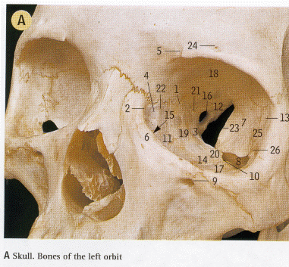
I Anterior ethmoidal foramen
2 Anterior lacrimal crest
3 Body of sphenoid bone, forming medial wall
4 Fossa for lacrimal sac
5 Frontal notch
6 Frontal process of maxilla, forming medial wall
7 Greater wing of sphenoid bone, forming lateral wall
8 Inferior orbital fissure
9 Infra-orbital foramen
10 Infra-orbital groove
11 Lacrimal bone, forming medial wall
12 Lesser wing of sphenoid bone, forming roof
13 Marginal tubercle
14 Maxilla, forming floor
15 Nasolacrimal canal
16 Optic canal
17 Orbital border of zygomatic bone, forming floor
18 Orbital part of frontal bone, forming roof
19 Orbital plate of ethmoid bone, forming medial wall
20 Orbital process of palatine bone, forming floor
21 Posterior ethmoidal foramen
22 Posterior lacrimal crest
23 Superior orbital fissure
24 Supra-orbital foramen
25 Zygomatic bone forming lateral wall

Slide 17
The Orbit
It has
A base (orbital margins).
An apex .
An inferior wall (floor).
A superior wall.
A medial wall.
A lateral wall.

Slide 18
The base
The base of the orbit is outlined by the orbital margin that surrounds the orbital opening.
Supraorbital margin:
by frontal bone perforated by supraorbital & supratrochlear foramina.
Lateral margins:
formed by the frontal, zygomatic bones.
Infraorbital margin:
by zygomatic & maxillary bones.
Medial margin formed
by anterior lacrimal crest(maxilla) & frontal bone.
The bone forming the orbital margin is reinforced to afford protection to the orbital contents and provides attachment for the orbital septum, an interrupted fibrous sheet that extends into the eyelids.

Slide 19
The apex
The apex of the orbit is at the optic canal in the lesser wing of the sphenoid just medial to the superior orbital fissure.
Features:
Apex of bony orbit has 3 apertures.
The optic canal.
Supraorbital orbital fissure.
Inferior orbital fissure.

Slide 20
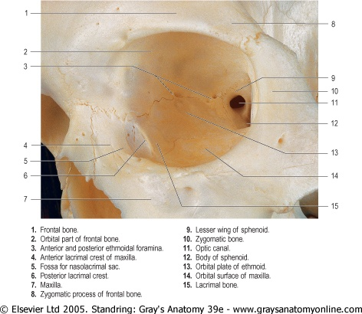

Slide 21
Relations to bony walls
Triangular expansions from sheath over lateral & medial recti which are attached to zygomatic & lacrimal bones respectively. Thickenings of this fascial sheath forms different check ligaments.

Slide 22
The inferior wall (floor)
Is formed mainly by the maxilla and partly by the zygomatic(orbital surface) and palatine bones(minute contribution).
The thin inferior wall is shared by the orbit and maxillary sinus. It slants inferiorly from the apex to the inferior orbital margin. The inferior wall is demarcated from the lateral wall of the orbit by the inferior orbital fissure.

Slide 23
Features of floor
From the middle of inferior orbital fissure starts the infraorbital groove which passes forwards in the middle line of the floor. It then becomes converted into an infraorbital canal which ends on the anterior surface of the skull as the infraorbital foramen(below the inferior orbital margins) which transmits infraorbital branch of maxillary nerve.

Slide 24
The superior wall (roof)
Is approximately horizontal and is formed mainly by the orbital part of the frontal bone, which separates the orbital cavity from the anterior cranial fossa and anteromedially from frontal sinus near the apex of the orbit, the superior wall is formed by the lesser wing of the sphenoid.

Slide 25
Features of roof
Anterolaterally, a shallow depression in the orbital part of the frontal bone, called the fossa for the lacrimal gland (lacrimal fossa), accommodates the lacrimal gland.
Anteromedially, there is trochlear fossa ( the trochlea of superior oblique muscle)
In most posterior part there is optic foramen which lies between the two roots of lesser wings of sphenoid.

Slide 27
The medial walls
The medial walls of the contralateral orbits are essentially parallel.
Formed primarily by the ethmoid bone, along with contributions from the frontal, lacrimal, and sphenoids. Anteriorly, the medial wall is indented by the lacrimal groove and fossa for the lacrimal sac.
Much of the bone forming the medial wall is paper thin; the ethmoid bone is highly pneumatized with ethmoidal cells, often visible through the bone of a dried cranium.

Slide 28
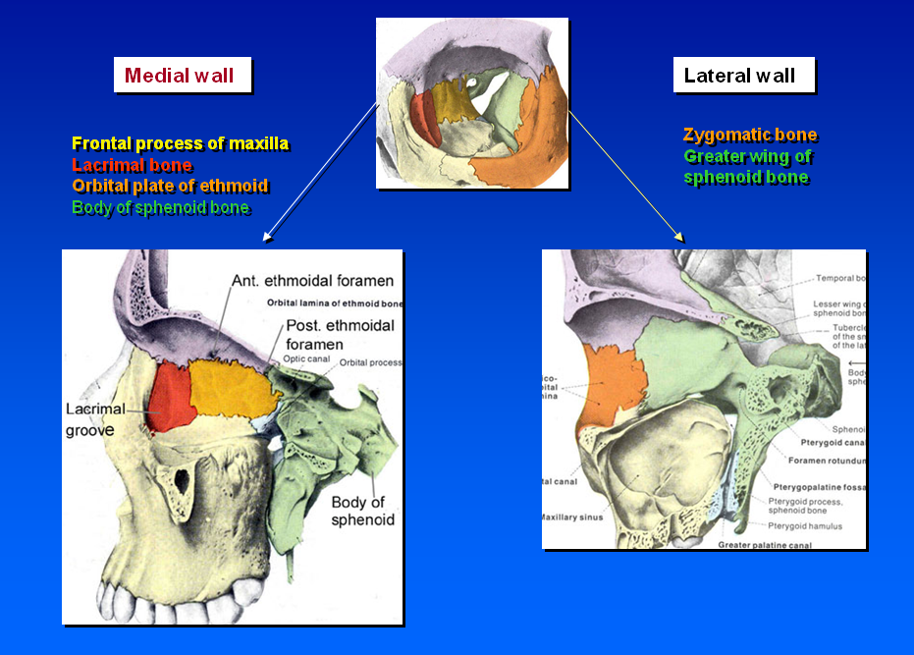

Slide 29
Features of medial wall
Anteriorly: there is a deep lacrimal groove (fossa) for lacrimal sac. The lacrimal groove is bounded by, in front, by the anterior lacrimal crest (of maxilla) & behind, behind by posterior lacrimal crest (of lacrimal bone) & is traversed by a vertical suture between frontal process of maxilla & lacrimal bone.
The lacrimal groove leads downwards to the nasolacrimal canal which communicates with inferior meatus of nose.
At the junction of medial wall & roof and lying in the frontoethmoidal suture(between the frontal & ethmoidal bones) are the anterior & posterior ethmoidal foramina (which transmit the anterior & posterior ethmoidal nerves & vessels). These foramina lead into canals which connect the orbit with anterior cranial fossa.

Slide 30
The lateral wall
Is formed by the frontal process of the zygomatic bone and the greater wing of the sphenoid.
This is the strongest and thickest wall, which is important because it is most exposed and vulnerable to direct trauma.
Its posterior part separates the orbit from the temporal and middle cranial fossae.
The lateral walls of the contralateral orbits are nearly perpendicular to each other.

Slide 31
Weber's suture
It lies anterior to the lacrimal fossa
■ Also known as sutura longitudinal is imperfecta
■ This suture runs parallel to anterior lacrimal crest
■ Branches of infraorbital artery pass through this groove to supply the nasal mucosa
■ Bleeding occurs from these vessels during lacrimal sac surgeries

Slide 32
Features of lateral wall
In front, it is continuous with the roof of orbit but behind, the lateral wall & the roof are separated from each other by the superior orbital fissure(which connect the orbit with middle cranial fossa).
In front, the lateral wall is also continuous with the floor of orbit but behind these are separated from each other by inferior orbital fissure.

Slide 33
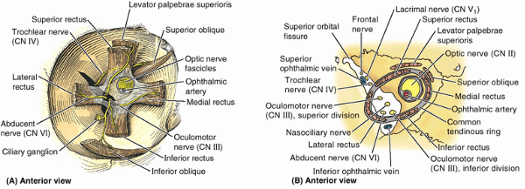

Slide 34
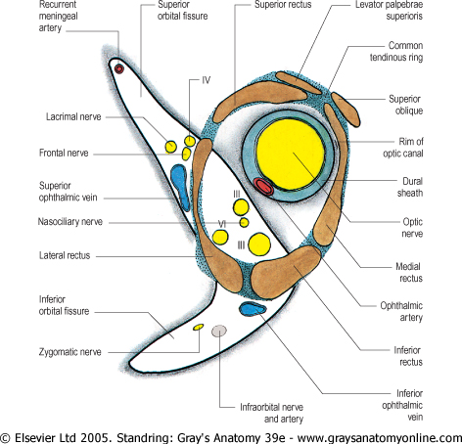

Slide 35
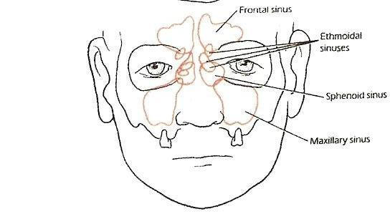
Periorbital Sinuses
The eyes lie within two bony orbits, located on either side of the root of the nose.
They border the nasal cavity anteriorly and the ethmoidal air cells and the sphenoid sinus posteriorly.
The lateral walls border the middle cranial, temporal, and pterygopalatine fossae.
Superior to the orbit are the anterior cranial fossa and the frontal and supraorbital sinus.
The maxillary sinus and the palatine air cells are located inferiorly.

Slide 36
Fissure/canal/foramina
in orbit
Superior orbital fissure
Inferior orbital fissure
Optic canal
Infraorbital groove/foramen
Supraorbital notch & groove
Anterior & posterior ethmoidal foramen
Nasolacrimal duct
Frontal notch/foramen

Slide 37
Fissure/canal/foramina in orbit | Contains
Superior orbital fissure | Lacrimal nerve,frontal nerve,trochlear nerve, superior division of 3rd cranial nerve, nasociliary nerve, inferior division of 3rd nerve, abducebt nerve
Inferior orbital fissure | Bridged by Muller’muscle. transmits maxillary nerve, zygomatic nerve, infraorbital vessel & nerve, branch of pterygopalatine ganglion, connection between inferior ophthalmic vein & pterygoid plexus.
Optic canal | Optic nerve & ophthalmic artery
Infraorbital groove/foramen | Infraorbital nerve & vessels
Supraorbital notch & groove | Supraorbital nerve & vessels
Anterior & posterior ethmoidal foramen | Corresponding nerve & vessels
Nasolacrimal duct | Nasolacrimal duct from lacrimal sac to inferior nasal meatus
Frontal notch/foramen | Supratrochlear nerve & vessel.

Slide 38
The optic canal
Connects the orbit with middle cranial fossa.
Contains the optic nerve & ophthalmic artery.

Slide 39
Supraorbital orbital fissure
Connects orbit with middle cranial fossa.
Transmits from above downwards
L-lacrimal nerve
F-frontal nerve
T-trochlear nerve
S-superior division of 3rd cranial nerve
N-nasociliary nerve
I-inferior division of 3rd nerve
A-abducent nerve
1st three LFT pass above lateral rectus.
Last four SNIA pass between two heads of lateral rectus.
Three nerves are sensory branches of ophthalmic nerve: lacrimal, frontal, nasociliary.
Three nerves are motor to eye muscles: 3rd, 4th, 6th.

Slide 40
Inferior orbital fissure
Connects orbit with pterygopalatine fossa in front behind with infratemporal fossa.
Is spanned in large by involuntary orbitalis muscle (Muller’s).
It transmits:
Maxillary nerve,
Zygomatic nerve,
Infraorbital vessel & nerve,
Branch of pterygopalatine ganglion,
Connection between inferior ophthalmic vein & pterygoid plexus.

Slide 41
Deep in the orbit, the greater and lesser wings of the sphenoid bone are separated by the superior orbital fissure.
The inferior orbital fissure is a gap between the maxillary bone and the greater wing of the sphenoid bone.
The widest part of the orbit corresponds to the equator of the eyeball, an imaginary line encircling the eyeball equidistant from its anterior and posterior poles.
The optic canal lies in the root of the lesser wing of the sphenoid bone.

Slide 42
The fibromuscular cone
Except for the inferior oblique muscle, all the muscles of the eyeball originate from or near a fibrous ring that includes the lower part of the inferior orbital fissure and the optic canal.
From the fibrous ring, the muscles spread out to attach around the periphery of the eyeball.
A fascial sheath is continuous around and between the muscles, forming a fibromuscular cone.
The interior of the cone is filled with fat and contains the optic nerve.

Slide 43
The orbits contain and protect the eyeballs (globes of yes)and accessory visual structures, which include the:
Eyelids, which bound the orbits anteriorly, controlling exposure of the anterior eyeball.
Extraocular muscles, which position the eyeballs and raise the superior eyelids.
Nerves and vessels in transit to the eyeballs and muscles.
Orbital fascia surrounding the eyeballs and muscles.
Mucous membrane (conjunctiva) lining the eyelids and anterior aspect of the eyeballs and most of the lacrimal apparatus, which lubricates it.
All space within the orbits not occupied by the above structures is filled with orbital fat; thus it forms a matrix in which the structures of the orbit are embedded.
The bones forming the orbit are lined with periorbita (periosteum of orbit).

Slide 44
The periorbita
The periorbita is continuous at the optic canal and superior orbital fissure with the periosteal layer of the dura mater. The bones forming the orbit are lined with periorbita (periosteum of orbit).
The periorbita is also continuous over the orbital margins and through the inferior orbital fissure with the periosteum covering the external surface of the cranium (pericranium), and with the orbital septa at the orbital margins, with the fascial sheaths of the extraocular muscles, and with orbital fascia that forms the fascial sheath of the eyeball.

Slide 45
The orbital septum
The orbital septum is an interrupted, weak fibrous membranous sheet which is attached to the orbital rim where it becomes continuous with the periosteum & extends into the eyelids. It passes inwards into each eyelid and blends with the tarsal plates, and, in the upper eyelid, with the superficial lamella of levator palpebrae superioris.
The orbital septum is thickest laterally, where it lies in front of the lateral palpebral ligament. It passes behind the medial palpebral ligament and nasolacrimal sac, but in front of the pulley of superior oblique.
The orbital septum is pierced above by levator palpebrae superioris and below by the ligament from inferior rectus.
The lacrimal, supratrochlear, infratrochlear and supraorbital nerves and vessels pass through the septum from the orbit on the way to the face and scalp.

Slide 46
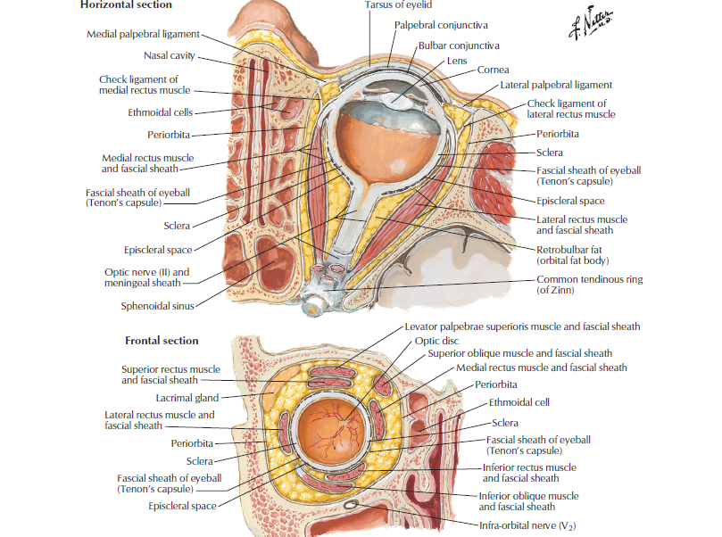

Slide 47
Fascial Sheath of the Eyeball (L. fascia bulbi, Tenon capsule)
It is connective tissue socket in which eye ball is suspended.
It envelops posterior 5/6 of the eyeball from the optic nerve nearly to the corneoscleral junction, forming the actual socket for the eyeball.

Slide 48
Relations of sheath to the extraocular muscles
The fascial sheath is pierced by the tendons of the extraocular muscles and is reflected onto each of them as a tubular muscle sheath. The muscle sheaths of the levator and superior rectus muscles are fused; thus, when the gaze is directed superiorly, the superior eyelid is further elevated out of the line of vision.
Triangular expansions from the sheaths of the medial and lateral rectus muscles, called the medial and lateral check ligaments, are attached to the lacrimal and zygomatic bones, respectively. These ligaments limit abduction and adduction. A blending of the check ligaments with the fascia of the inferior rectus and inferior oblique muscles forms a hammock-like sling, the suspensory ligament of the eyeball.
A potential episcleral space between the eyeball and the fascial sheath allows the eyeball to move inside the cup-like sheath. A similar check ligament from the fascial sheath of the inferior rectus retracts the inferior eyelid when the gaze is directed downward.

Slide 49
Relations of sheath
to eye ball
It forms a membranous socket for eye ball but is deficient over cornea in front. It is separated from eye ball by some soft, semifluid areolar tissue which allows eye ball to slide freely in sheath. The sheath is loosely attached to orbital fat.

Slide 50
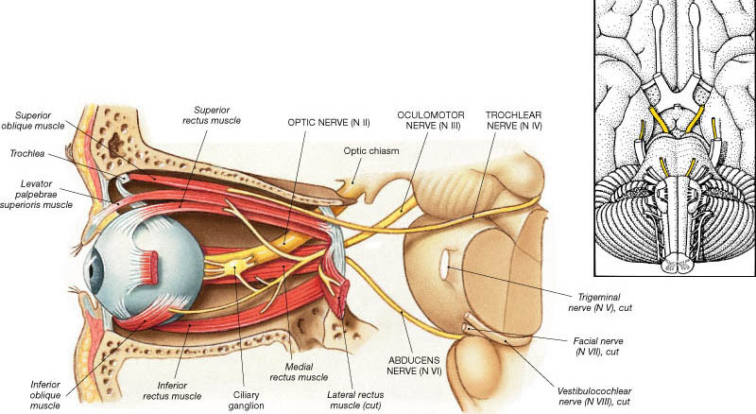

Slide 51
Thank You

