Slide 1
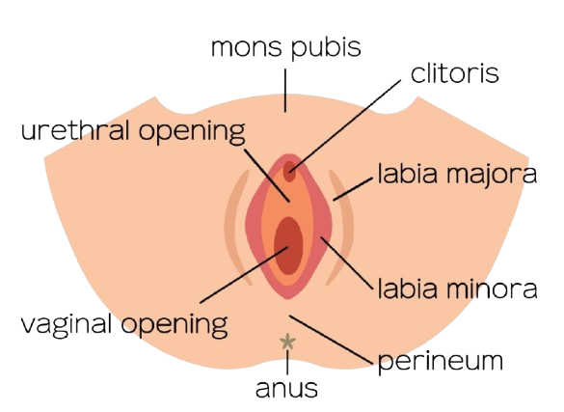
THE PERINEUM
BY MBBSPPT.COM

Slide 2
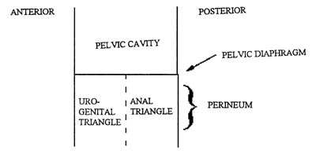
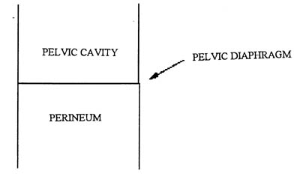
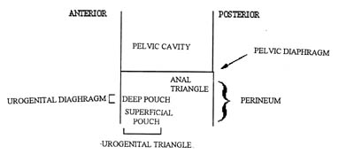
Schematic division of the perineum

Slide 6
General Boundaries
Where is it?
The perineum lies inferior to the pelvic outlet. It is physically separated from the pelvic cavity by the pelvic diaphragm.
In the anatomical position, it is the narrow region between the proximal thighs
In the lithotomy position, its a diamond shaped area.
It is a diamond-shaped area extending from the mons pubis anteriorly,
The medial surfaces (insides) of the thighs laterally, the gluteal folds and superior end of the intergluteal (natal) cleft posteriorly.

Slide 7
Definitions
The perineum is the specific portion of the pelvic region that contains the external genitalia and the anal opening.
The perineum (perineal compartment) is bounded by the pelvic outlet and is separated from the pelvic cavity by the pelvic diaphragm, which is formed by the levator ani and coccygeus muscles.*
The perinieum consists of structures that fill inferior aperture of pelvis.**
The pelvic outlet is diamond-shaped and can be divided into 2 triangles: The anal triangle and the urogenital triangle.
The superficial part of this region is called the perineum including the external genitalia ( in the urogenital triangle) and the anus ( in the anal triangle). It is also called the pudendal region, being supplied by the pudendal nerves and vessels. * Snell ** Last

Slide 8
Specific Deep Boundaries/ Fibrosseous
Landmarks that can be palpated: 4 angles & 4 sides
Anterior angle: Pubic Symphysis, arcuate pubic ligament. Note the acute angle in male Note wider angle in females causing more flaring of ischial tuberosities
Anterolateral sides: Ischiopubic rami.
Lateral angles: Two Ischial tuberosities
Posterolateral sides: Sacrotuberous ligaments on the right and left.
Posterior angle: Tip of coccyx - serving as a point of attachment for pubococcygeus muscle.

Slide 9
Artificial Divisions of the Superficial Perineal Region
A line joining the two ischial tuberosities divides the perineum into:
Urogenital Triangle - the anterior area
Anal Triangle - the posterior area
In the anatomical position, these two triangles are positioned at an angle to each other.

Slide 10
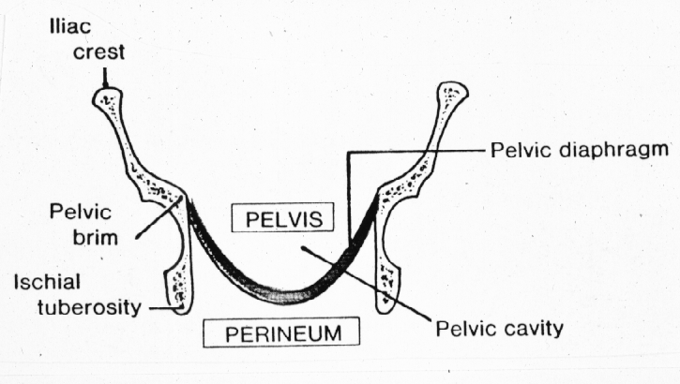
Peritoneum
Visceral pelvic fascia
Infraperitoneal space contains pelvic fascia
continuous with transversalis fascia
parietal fascia on pelvic walls & muscles
visceral layer on viscera

Slide 11
The urogenital triangle
Laterally by the ischiopubic rami.
Posteriorly by an imaginary line between the ischial tuberosities.
Anteriorly by the inferior margin of the pubic symphysis.

Slide 12
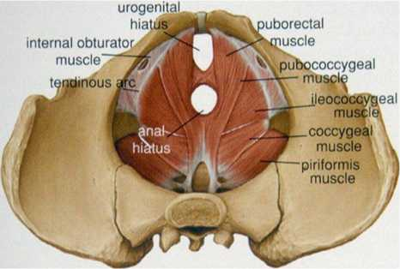

Slide 13
Membranes in Urogenital
Triangle
3 membranes in this region stretching across the rami. From above downwards-
Superior fascia of UGD. i.e. part of pelvic fascia
Inferior fascia of UGD. i.e. perineal membrane.
The most superficial membrane is membranous layer of superficial fascia. i.e. colle’s fascia.

Slide 14
Membranes in Urogenital Triangle
Between upper & middle is deep perineal space
Between middle & lower is superficial perineal space
Posteriorly all 3 membranes are attached to each other & perineal body; thus closing superficial & deep spaces behind.
Anteriorly superior & inferior fasciae of UGD fuse a little behind pubic symphysis & form transverse ligament of pubis = arcuate pubic ligament.

Slide 16
Perineal Fasciae
The perineal fascia consists of superficial and deep layers.
The subcutaneous tissue of the perineum, or superficial perineal fascia, like that of the inferior anterior abdominal wall, consists of
Superficial fatty layer and
Deep membranous layer (Colles fascia).
In females, the fatty layer makes up the substance of the labia majora and mons pubis and is continuous anteriorly and superiorly with the fatty layer of subcutaneous tissue of the abdomen (Camper fascia).
In males, the fatty layer is greatly diminished in the urogenital triangle, being replaced altogether in the penis and scrotum with smooth (dartos) muscle. It is continuous between the penis or scrotum and thighs with the fatty layer of subcutaneous tissue of the abdomen.
In both sexes, the fatty layer of subcutaneous tissue of the perineum is continuous posteriorly with the ischioanal fat pad in the anal region.

Slide 17
Colle’s fascia (Deep membranous layer)
The membranous layer of subcutaneous tissue of the perineum does not extend into the anal triangle, being attached posteriorly to the posterior margin of the perineal membrane and the perineal body.
Laterally it is attached to the fascia lata (deep fascia) of the superiormost medial aspect of the thigh.
Anteriorly,
in the male, the membranous layer of subcutaneous tissue is continuous with the dartos fascia of the penis and scrotum; however, on each side of and anterior to the scrotum, the membranous layer becomes continuous with the membranous layer of subcutaneous tissue of the abdomen (Scarpa fascia).
In females, the membranous layer passes superior to the fatty layer forming the labia majora and becomes continuous with the membranous layer of subcutaneous tissue of the abdomen.
This forms superficial wall of superficial perineal pouch/space.

Slide 18
Perineal membrane (Inferior fascial layer of UGD)
Triangular strong fibrous tissue sheet which fill the space between pubic arches stretches between the two sides of the pubic arch, covering the anterior part of the pelvic outlet. .
In contrast to the open anal triangle, the UG triangle is closed
Anteriorly, perineal membrane does not reach symphysis pubis but ends in an anterior transverse border called transverse perineal ligament.
In the gap between it & syphysis pubis the deep dorsal vein of penis leves the penis & enters pelvis to end in prostatic venous plexus.
It is perforated by the urethra in both sexes and by the vagina of the female.
This membrane is hidden from view from the structures i.e. the external genitalia ,the penis and scrotum of males and the vulva of females which are the superficial features of the triangle.

Slide 19
Perineal membrane
Pierced by.—
At base.—Perineal nerve.
At margins.—Internal pudendal artery, dorsal nerve of penis.
Centre.—The urethra, the ducts of the bulbo-urethral glands, arteries to the bulb.
In female the vagina pierces it in addition to the above.

Slide 20
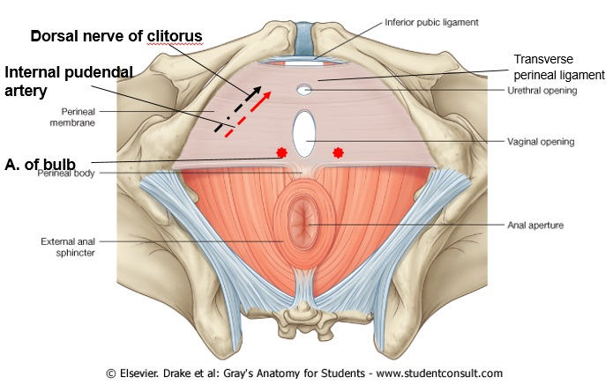
Perineal membrane (Inferior fascial of UGD)

Slide 21
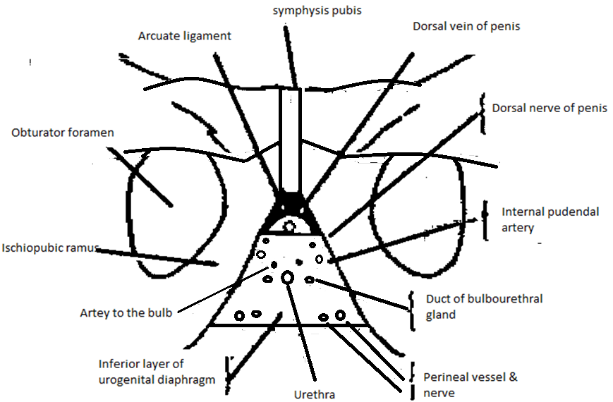

Slide 22
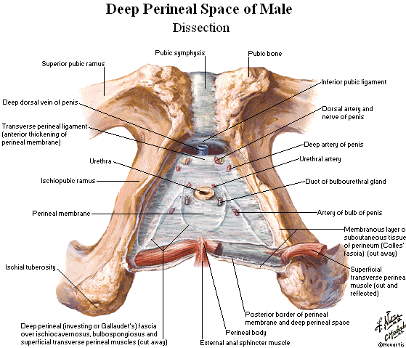

Slide 23
The planar perineal membrane divides the urogenital triangle of the perineum into superficial and deep perineal pouches.
The superficial perineal pouch:
Lies between the membranous layer of subcutaneous tissue of the perineum and the perineal membrane and is bounded laterally by the ischiopubic rami.
The deep perineal pouch:
Lies between the perineal membrane and the inferior fascia of the pelvic diaphragm and is bounded laterally by the obturator fascia.

Slide 24
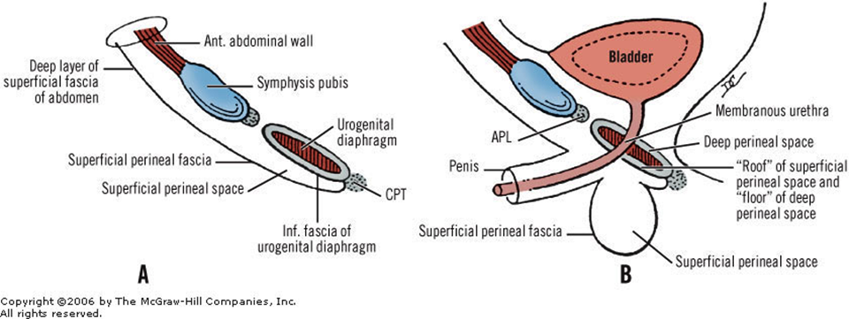

Slide 25
The Urogenital Diaphragm (Old concept)
This is a thin sheet of striated muscle stretching between the two sides of the pubic arch.
It covers the anterior part of the inferior pelvic aperture –urogenital hiatus.
The most anterior and posterior fibres of the urogenital diaphragm (deep transverse perineal muscle) run transversely.
The middle fibres (sphincter urethrae muscle) surround the membranous urethra.
The old view of the perineal membrane was that it was merely the thickened inferior fascia of a muscular urogenital diaphragm. This is incorrect. No muscular urogenital diaphragm exists. If one wishes to retain the term urogenital diaphragm, it becomes synonymous with perineal membrane.

Slide 26
The Urogenital Diaphragm OR TRIANGULAR LIGAMENT (Old concept)
This consists of two muscles,
The sphincter urethrae membranaccie, in which lies the membranous part of the urethra (3/4 in. long), and
The deep transverse perineus.
These muscles are enveloped in two layers of fascia, the fasciae superior and inferior of the urogenital diaphragm (upper and lower layers of the triangular ligament), forming the deep perineal pouch.
MUSCLES:
THE SPHINCTER URETHRAE MEHBRANACEAE - Arises from ramus of pubis. its fibres surround the urethra. When the sphincter vesicae (internal sphincter) is destroyed, as after the operation of prostatectomy, the sphincter urethrae membranaceae is the only sphincter left to the urethra.
THE DEEP TRANSVERSE PERINEUS - Arises from the junction of ischial and pubic rami and is inserted into a median raphe behind the sphincter.

Slide 29
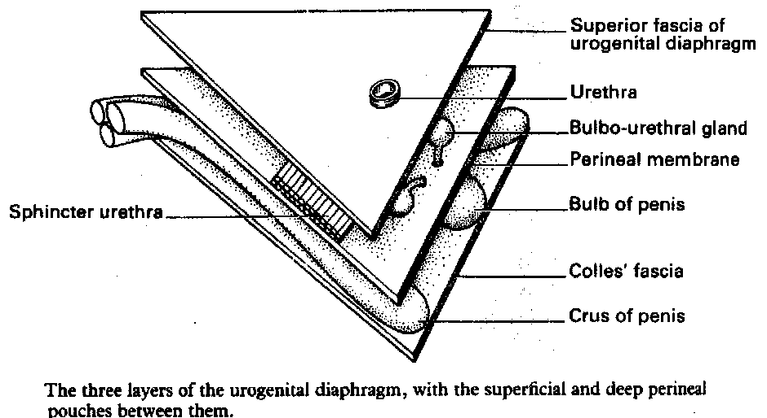

Slide 30
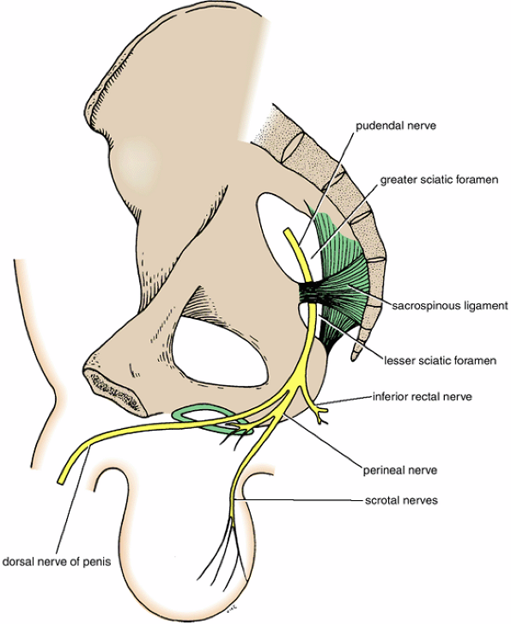
Course and branches of the pudendal nerve in the male.

Slide 31
Perineal body
The midpoint of the line joining the ischial tuberosities is the central point of the perineum. This is the location of the perineal body, which is an irregular mass, variable in size and consistency and containing collagenous and elastic fibers and both skeletal and smooth muscle.
The perineal body lies deep to the skin, with relatively little overlying subcutaneous tissue, posterior to the vestibule or bulb of the penis and anterior to the anus and anal canal.

Slide 32
Perineal body
The perineal body is the site of convergence and interlacing of fibers of several muscles, including the:
Bulbospongiosus.
External anal sphincter.
Superficial and deep transverse perineal muscles.
Smooth and voluntary slips of muscle from the external urethral sphincter, levator ani, and muscular coats of the rectum.
Anteriorly, the perineal body blends with the posterior border of the perineal membrane and superiorly with the rectovesical or rectovaginal septum

Slide 33
Disruption of the Perineal Body
The perineal body is an especially important structure in women because it is the final support of the pelvic viscera, linking muscles that extend across the pelvic outlet, like crossing beams supporting the overlying pelvic diaphragm.
Stretching or tearing the attachments of perineal muscles from the perineal body can occur during childbirth, removing support from the pelvic floor.
As a result, prolapse of pelvic viscera, including prolapse of the bladder (through the urethra) and prolapse of the uterus and/or vagina (through the vaginal orifice) may occur.

Slide 34
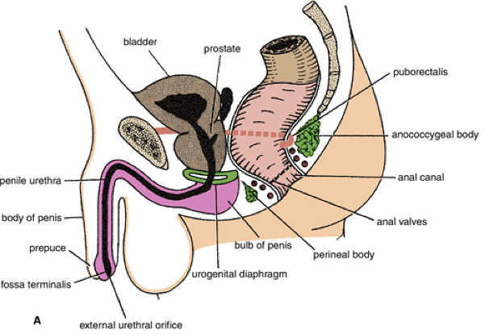
Fascia in male

Slide 35
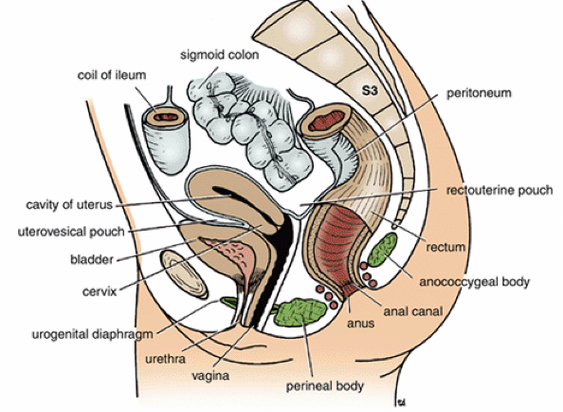
Fascia in female

Slide 36
The (deep) perineal fascia (investing or Gallaudet fascia)
Intimately invests the ischiocavernosus, bulbospongiosus, and superficial transverse perineal muscles. It is also attached laterally to the ischiopubic rami.
Anteriorly it is fused to the suspensory ligament of the penis and is continuous with the deep fascia covering the external oblique muscle of the abdomen and the rectus sheath. In females, the perineal fascia is fused with the suspensory ligament of the clitoris and, as in males, with the deep fascia of the abdomen.

Slide 37
Perineal cleft
Between the deep perineal fascia and Colle's fascia is a thin fluid-filled space called the perineal cleft.
It lies between deep and superficial fascia.
It is continuous with the space between deep and superficial fascia in other regions of the body:
(1) the space within the scrotum between the external spermatic fascia and the tunica dartos
(2) the space between Buck's fascia and the superficial fascia of the penis, and
(3) the space between the deep fascia on the outer surface of the external abdominal oblique and Scarpa's fascia.

Slide 38
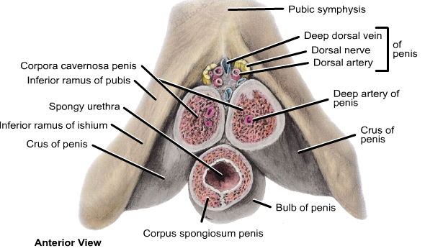

Slide 39
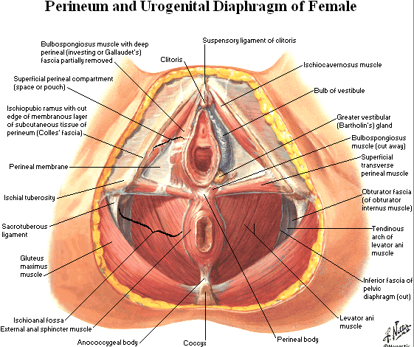

Slide 40
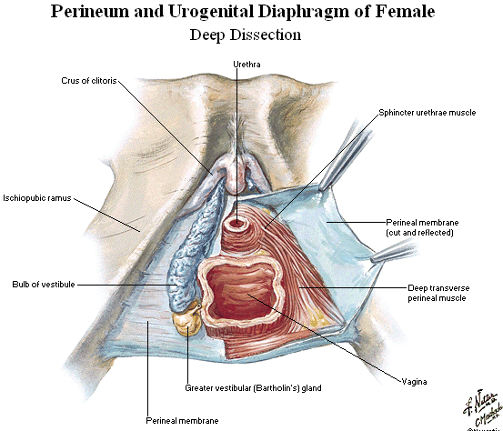

Slide 41
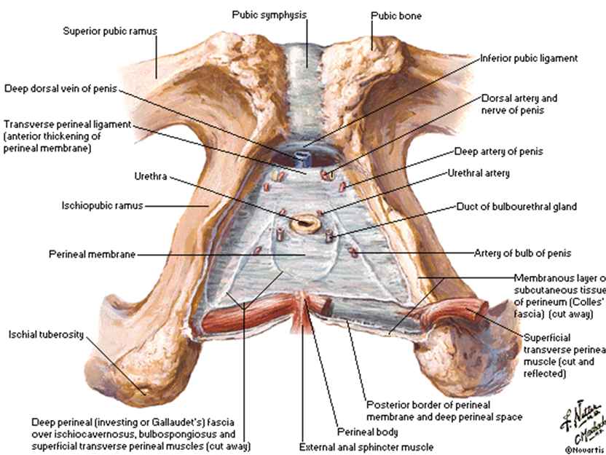

Slide 42
Contents of superficial perineal pouch

Slide 43
Boundaries of the perineal pouches
The superficial perineal pouch (compartment) is a potential space between:
The membranous layer of subcutaneous tissue (colle’s fascia).
The perineal membrane (superiorly).
The ischiopubic rami (laterally).
Closed posteriorly and continuous anteriorly with the space between the membranous layer of superficial fascia and external oblique
The deep perineal pouch (space) is bounded by:
The perineal membrane (inferiorly).
The superior fascia of urogenital diaphragm (superiorly).
The ischiopubic rami (laterally).
Closed anterioly and posteriorly by the fusion of the two layers bounding it.

Slide 44
 | Males | Females
Superficial perineal pouch contents | Root (bulb and crura of the penis and associated muscles) | Root (crura) of the clitoris and the muscles associated with it (ischiocavernosus)
 | Proximal part of the spongy urethra | Bulbs of the vestible and the surrounding muscle (bulbospongiosus)
 | Superficial transverse perineal muscles | Superficial tranverse perineal muscles
 | Branches of the internal pudendal vessels | Related vessels and nerves (branches of internal pudendal vessels, perineal nerves)
 | Branches of the pudendal nerves (perineal nerves) | Greater vestibular glands
Deep perineal pouch contents | Intermediate part of the urethra | Proximal part of the urethra
 | External urethral sphincter muscles | External urethral sphincter muscle
 | Bulbourethral glands | Deep transverse perineal muscles
 | Deep transverse perineal muscles | Related vessels nerves
 | Related vessels and nerves

Slide 45
Vessels & nerves of the superficial perineal pouch
In male:
Vessels: Dorsal and deep artery of penis (terminal branches of internal pudendal artery) + scrotal arteries.
Nerves: dorsal nerve of penis & scrotal nerves.
In female:
Vessels: Dorsal and deep artery of clitoris (terminal branches of internal pudendal artery + labial arteries.
Nerves: dorsal nerve of clitoris & labial nerves.

Slide 46
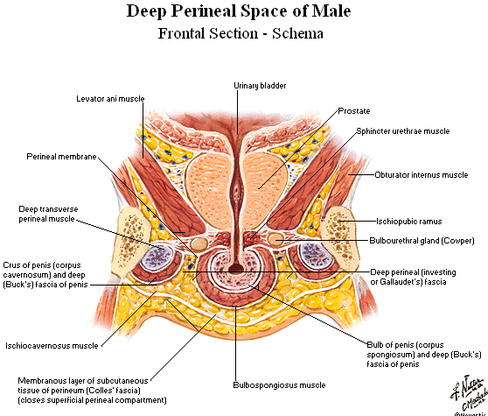

Slide 47
Contents of the deep perineal pouch
In both sexes, the deep perineal pouch contains
Part of the urethra, centrally.
The inferior part of the external urethral sphincter muscle, above the center of the perineal membrane, surrounding the urethra.
Anterior extensions of the ischioanal fat pads.
In males, the deep perineal pouch contains the:
Intermediate part of the urethra, the narrowest part of the male urethra.
Deep transverse perineal muscles
Bulbourethral glands, embedded within the deep perineal musculature.
Dorsal neurovascular structures of the penis.
In females, the deep perineal pouch contains the:
Proximal part of the urethra.
A mass of smooth muscle in the place of deep transverse perineal muscles on the posterior edge of the perineal membrane, associated with the perineal body.
Dorsal neurovasculature of the clitoris.

Slide 49
Muscle | Origin | Insertion | Innervation | Actions
Bulbospongiousus | Male: median raphe, ventral surface of bulb of penis, and perineal body | Corpora spongiosum and cavernosa and fascia of bulb of penis | Deep branch of perineal nerve, a branch of pudendal nerve | Compresses bulb of penis and assists in erection
 | Female: perineal body | Fascia of corpus cavernosa | Deep branch of perineal nerve, a branch of pudendal nerve | Reduces lumen of vagina and assists in erection of clitoris
Ischiocavernosus | Ischial ramus and tuberosity | Crus of penis or clitoris | Deep branch of perineal nerve, a branch of pudendal nerve | Maintain erection of penis or clitoris by compression of outflow veins
Superficial transverse perineal | Ischial ramus and tuberosity | Perineal body | Deep branch of perineal nerve, a branch of pudendal nerve | Supports perienal body
Deep transverse perineal | Inner aspect of ischiopubic ramus | Median raphe, perineal body, and external anal sphincter | Deep branch of perineal nerve, a branch of pudendal nerve | Fixes perineal body
External urethral sphincter | Inferior pubic ramus and ischial tuberosity | Surrounds urethra; in females some fibers also enclose vagina | Deep branch of perineal nerve, a branch of pudendal nerve | Compresses urethra; also compresses vagina in females.

Slide 50
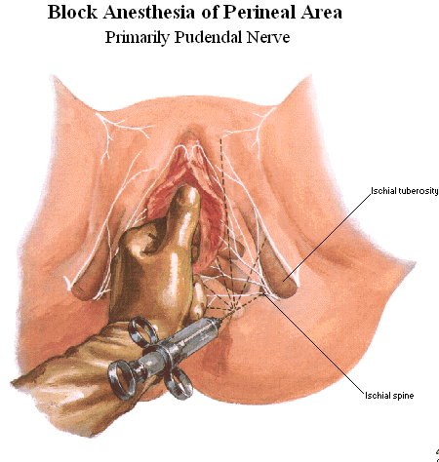

Slide 51
Thank You

