Slide 1
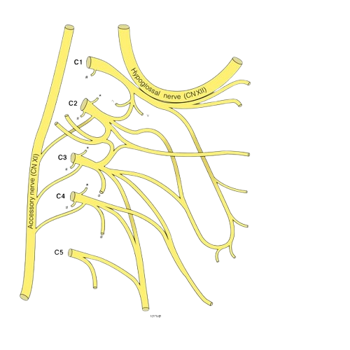
THE PHRENIC NERVE
BY MBBSPPT.COM

Slide 2
The phrenic nerve
The phrenic nerve is a bilateral, mixed nerve that originates in the neck and descends through the thorax to reach the diaphragm.
As the only source of motor innervation to the diaphragm, this nerve has an important role in breathing.

Slide 3
The phrenic nerve
Motor Functions:
The phrenic nerve provides motor innervation to the diaphragm; the main muscle of respiration.
As the phrenic nerve is a bilateral structure, each nerve supplies the ipsilateral side of the diaphragm (i.e. the hemi-diaphragm on the same side as itself).

Slide 4
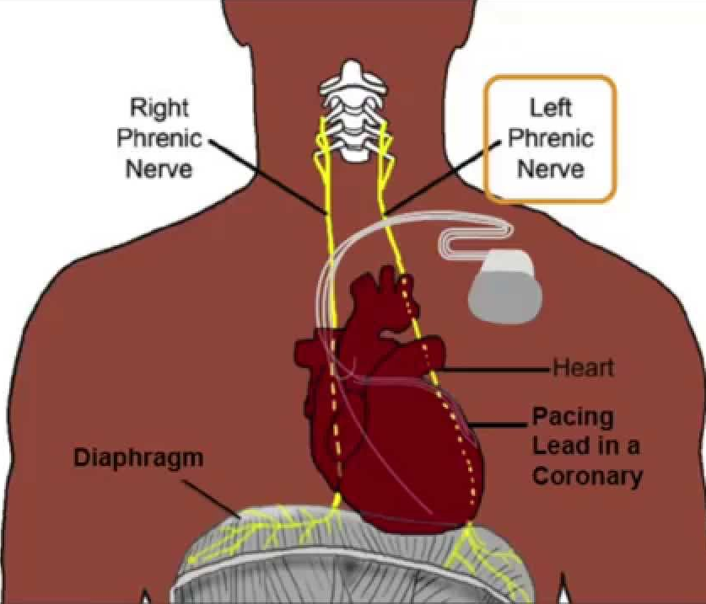

Slide 5
The phrenic nerve
Sensory Functions:
Sensory fibers from the phrenic nerve supply the central part of the diaphragm, including the (diaphragmatic) pleura and peritoneum.
The nerve also supplies sensation to:
The mediastinal pleura and
The pericardium.

Slide 6
The phrenic nerve
Origin:
The point of origin is from ventral rami of C3, C4 and C5 but primarily from C4.
(the root from C5 may reach the phrenic nerve directly or from the nerve to subclavius muscle)
Course:
It runs vertically downwards on the anterior surface of the scalenus anterior, which it crosses obliquely from lateral to medial side.
Afterward it runs downwards on the cervical pleura to go into the thorax behind first costal cartilage.

Slide 7
The phrenic nerve
Distribution:
The phrenic nerve gives -
Single Motor Supply to the diaphragm (muscle of respiration) and
Sensory innervation to diaphragmatic pleura, pericardium and subdiaphragmatic pleura.

Slide 8
The phrenic nerve at the root of the neck
The nerve begins at the lateral border of the anterior scalene muscle.
It then continues inferiorly over the anterior surface of anterior scalene, deep to the prevertebral layer of deep cervical fascia.
At the root of the neck, it runs anterior to the second part of the subclavian artery and posterior to the subclavian vein.
The anterior scalene muscle separates the subclavian artery & the subclavian vein.
The phrenic nerve enters the thorax by crossing medially in front of the internal thoracic artery.

Slide 9
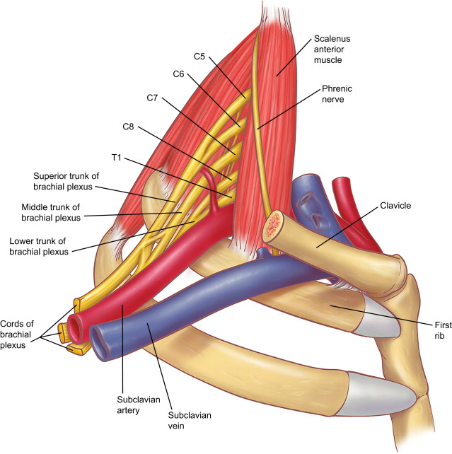

Slide 10
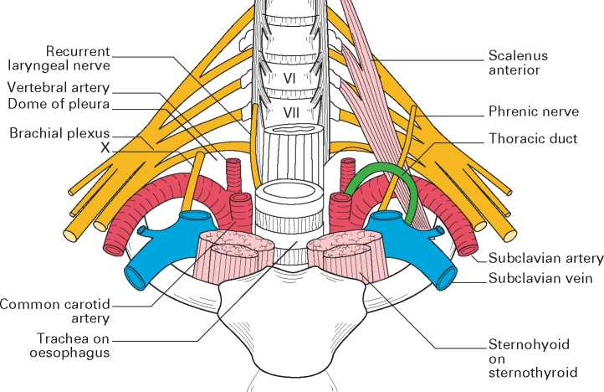

Slide 11
The phrenic nerve in the thorax
After it enters the thorax descends first through the superior and then through middle mediastinum.
Each phrenic nerve passes a finger’s breadth in front of the root of its lung.
Laterally covered by the right and left mediastinal pleurae.
Medially the two nerves have different relations.

Slide 12
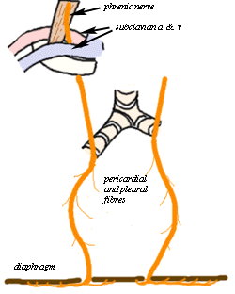

Slide 13
Right Phrenic Nerve
The right phrenic nerve descends along the venous side of the mediastinum. i.e.
It descends in contact with right side of the following venous structures from above downwards:
The right brachiocephalic vein.
The superior vene cava.
Passes anteriorly to second part of the subclavian artery, and posteriorly to the subclavian vein.
The pericardium.
The inferior vena cava.
Pierces the diaphragm via vena caval opening on the right side of the inferior vena cava.

Slide 14
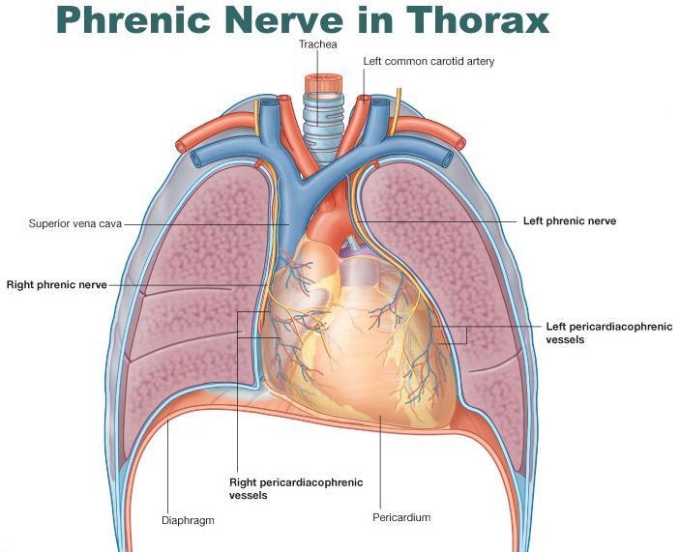

Slide 15
Left Phrenic Nerve
Left phrenic nerve descends along the arterial side of the mediastinum.
Enters the thorax via the superior thoracic aperture.
It descends in relation to following arterial structures from above downwards:
Passes lateral to the common carotid artery
On the left side of the aortic arch and vagus nerve, and descends anteriorly to the left lung root,
On the left side of the pericardium which covers the left ventricle.

Slide 17
The phrenic nerve

Slide 18
ACCESSORY PHRENIC NERVE
It’s the branch from nerve to subclavius featuring C5 fibers. It runs Lateral to phrenic nerve and descends behind or occasionally in front of the subclavian vein to join the chief phrenic nerve near the 1st rib.
In case of accessory phrenic nerve, the fibers of C5 nerve inspite of joining the phrenic nerve at its commencement runs via, nerve to subclavius and after that leaves it as accessory nerve to join the principal phrenic nerve in the thoracic inlet.

Slide 19
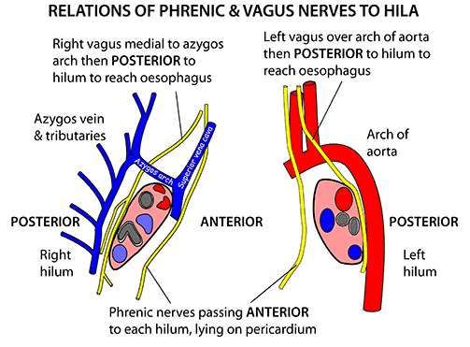

Slide 20
The phrenic nerve
Q. Why do the phrenic nerve arise in the neck?
A. Originally the diaphragm develops in the neck, and then descends pulling the phrenic nerve with it.
Q. Why the phrenic nerve supply the abdominal surface of the diaphragm?
A. In embryonic life due to folding of the disc the upper(cranial) surface becomes directed caudally towards the abdomen.

Slide 21
The phrenic nerve
Diaphragmatic Paralysis
The phrenic nerve provides motor innervation to the diaphragm. If the nerve becomes damaged, paralysis of the diaphragm will result. Causes of phrenic nerve palsy include:
Mechanical trauma – ligation or damage to the nerve during surgery.
Compression – due to a tumor within the chest cavity.
Neuropathies – such diabetic neuropathy.
Paralysis of the diaphragm produces a paradoxical movement. The affected side of the diaphragm moves upwards during inspiration, and downwards during expiration.

Slide 22
The phrenic nerve
Clinical Significance:
Phrenic crush/avulsion: Before the arrival of contemporary antitubercular treatment, phrenic crush utilized to be done to create paralysis of the corresponding half of the diaphragm to be able to give rest to the diseased lung and so encourage healing.
In phrenic crush the accessory phrenic nerve, if present, should also be smashed, otherwise C5 fibers will escape and diaphragm will continue to operate.

Slide 23
Thank You

