Slide 1
The Pleurae
BY MBBSPPT.COM

Slide 2
The pleurae is a thin, smooth, glistening, delicate serous membrane which
Covers the lungs
Lines the wall of the thorax
This is a layer of mesothelial cells, supported by connective tissue.

Slide 3
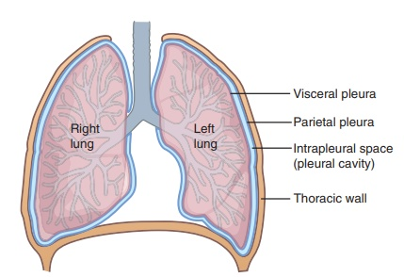
Layers of the Pleura
Two layers that are contained by the pleura:
(a) Visceral pleura
(b) Parietal pleura.
Pleural Cavity is a potential space between the viscera and parietal pleura.

Slide 4
Structure of the Pleurae
Each pleura can be divided into two parts:
Parietal pleura- Covers the internal surface of the thoracic cavity.
Visceral Pleura- Covers the lungs.
The visceral pleura covers the outer surface of the lungs, and extends into the interlobar fissures.
It is continuous with the parietal pleura at the hilum of each lung (this is where structures enter and leave the lung).

Slide 5
Parietal Pleura
The parietal pleura covers the internal surface of the thoracic cavity. It is thicker than the visceral pleura, and can be subdivided according to the part of the body that it is contact with:
Therefore parietal pleura is split into the following 4 parts:
Costal pleura.
Diaphragmatic pleura.
Mediastinal pleura.
Cervical pleura.

Slide 6
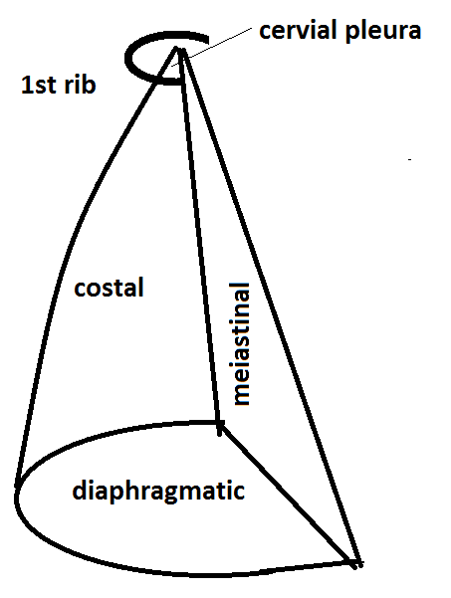
Parietal Pleura
Mediastinal pleura – Covers the lateral aspect of the mediastinum (the central component of the thoracic cavity, containing a number of organ).
Cervical pleura – Lines the extension of the pleural cavity into the neck.
Costal pleura – Covers the inner aspect of the ribs, costal cartilages, and intercostal muscles.
Diaphragmatic pleura – Covers the thoracic (superior) surface of the diaphragm.

Slide 7
Visceral Pleura (Pulmonary Pleura)
The visceral pleura entirely covers the top layer of the lung with the exception of at the hilum and along the connection of the pulmonary ligament.
It also extends in the depths of the fissures of the lungs.
It is firmly adherent to the lung surface and can’t be divided from it.

Slide 8
Costal Pleura
It lines the inner surface of the thoracic wall (being composed of ribs, costal cartilages, and intercostal spaces) to which it’s loosely connected by a thin layer of loose areolar tissue termed endothoracic fascia.
In living beings, endothoracic fascia is easily separable from the thoracic wall.

Slide 10
Relations of the Costal Pleura
ANTERIOR RELATIONS
The internal thoracic vessels are directly located on the pleura within the first intercostal space.
Sternum
Costal cartilages
Ribs
Intercostal muscles
POSTERIOR RELATIONS
The costal pleura is related to the sympathetic chain as well as its branches.
The intercostal nerve is located in the middle of the costal pleura as well as the posterior intercostal membrane at the posterior end of the intercostal space.

Slide 12
The Diaphragmatic Pleura
The thoracic surface of the diaphragm is covered by the diaphragmatic pleura.
Below the lower border of the lung, the costal and diaphragmatic pleurae are in apposition to each other in quiet respiration.
The margins of the base of the lung decline and the costal and diaphragmatic pleurae split up in deep inspiration.
On inspiration this lower zone of the pleural cavity into which the lung enlarges is called the Costo diaphragmatic recess.

Slide 13
Mediastinal Pleura
It lines the corresponding outermost layer of the mediastinum and creates its lateral boundary.
It is represented as a cuff over the root of the lung and becomes constant with the visceral pleura.

Slide 14
Cervical Pleura
It is the dome of parietal pleura, which extends into the root of the neck about 1 inch (2.5 cm) above the medial end of clavicle and 2 inches (5 cm) above the 1st costal cartilage.
It is termed cupola and covers the apex of the lung.
It is covered by the suprapleural membrane.

Slide 15
Connections of Cervical Pleura
Anteriorly:
Subclavian artery and scalenus anterior muscle.
Posteriorly:
Neck of 1st rib and structures passing in front of it.
Laterally:
Scalenus Medius muscle.
Medially:
Great vessels of the neck.

Slide 16
Cervical Pleura
Cervical pleura is the topmost part of parietal pleura, inside the root of the neck which spreads out nearly 1 inch or 2.5 cm superior towards the medial end of clavicle as well as 2 inches or 5 cm superior towards the 1st costal cartilage.
It is called cupola and the apex of the lung is enclosed by it.
It is enclosed by the suprapleural membrane.

Slide 18
Relations of the Cervical Pleura
The scaleus anterior envelops the anterolateral part of the dome of the pleura, parting it from the subclavian vein that terminates at the medial border of the muscle.
The subclavian artery traverses directly superior towards the vein the dome below its peak, and from the subclavian the vertebral artery rises above it.
The internal mammary artery goes downwards from the subclavian after it travels behind the innominate vein.
The costocervical trunk arcs towards the back from the subclavian and goes across the summit of the dome.
Its superior intercostal branch goes downwards behind the dome, in the middle of the first intercostal nerve on the lateral side as well as the first thoracic sympathetic ganglion on the medial side.
The vagus nerve goes down on the right side in front of the medial part of the subclavian artery.
Its continuing laryngeal branch turns around the lower border of the artery.
The ansa subclavia is located towards the lateral side of the recurrent nerve.

Slide 19
Pleural Cavity
The pleural cavity is a potential space between the parietal and visceral pleura. It contains a small volume of serous fluid, which has two major functions.
It lubricates the surfaces of the pleurae, allowing them to slide over each other.
The serous fluid also produces a surface tension, pulling the parietal and visceral pleura together.
This ensures that when the thorax expands, the lung also expands, filling with air.

Slide 21
Pleural Recesses
Anteriorly and posteroinferiorly, the pleural cavity is not completely filled by the lungs. This gives rise to recesses – where the opposing surfaces of the parietal pleura touch.
There are two recesses present in each pleural cavity:
Costo diaphragmatic – located between the costal pleurae and the diaphragmatic pleura.
Costo mediastinal – located between the costal pleurae and the mediastinal pleurae, behind the sternum.
These recesses are of clinical importance, as they provide a location where fluid can collect (such as in a pleural effusion).

Slide 23
Neurovascular Supply
The two parts of the pleurae receive a different neurovascular supply:
Parietal Pleura
The parietal pleura is sensitive to pressure, pain, and temperature. It produces a well localised pain, and is innervated by the phrenic and intercostal nerves.
The blood supply is derived from the intercostal arteries.
Visceral Pleura
The visceral pleura is not sensitive to pain, temperature or touch. Its sensory fibres only detect stretch. It also receives autonomic innervation from the pulmonary plexus (a network of nerves derived from the sympathetic trunk and vagus nerve).
Arterial supply is via the bronchial arteries (branches of the descending aorta), which also supply the parenchyma of the lungs.

Slide 24
Pneumothorax
A pneumothorax (commonly referred to a collapsed lung) occurs when air or gas is present within the pleural space. This removes the surface tension of the serous fluid present in the space, reducing lung extension.
Clinical features include chest pain, and shortness of breath, and asymmetrical chest expansion. Upon percussion, the affected side may be hyper-resonant (due to excess air within the chest).
Spontaneous: A spontaneous pneumothorax occurs without a specific cause. It is sub-divided into primary (no underlying respiratory disease) and secondary (underlying respiratory disease present).
Traumatic: A traumatic pneumothorax occurs as a result of blunt or penetrating chest trauma, such as a rib fracture (often seen in road traffic collisions).
It may require decompression to remove the extra air/gas in order for the lung to reinflate (this is achieved via the insertion of a chest drain).

Slide 25
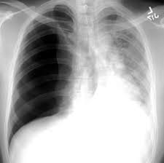

Slide 26
THANK YOU!

