Slide 1

The Prostate
BY MBBSPPT.COM

Slide 2
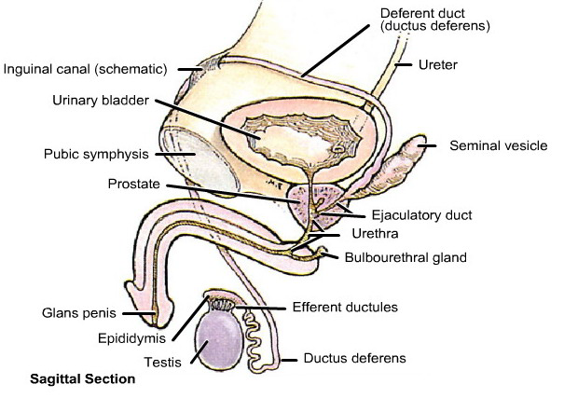

Slide 3
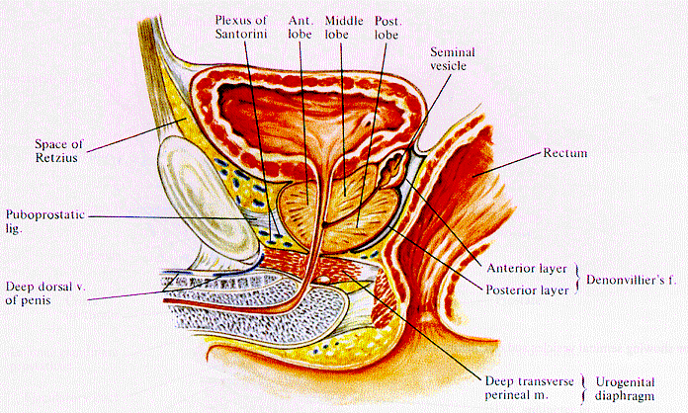
Sagittal View of the Prostate
Plexus of Santorini
Anterior lobe
Middle lobe
Posterior lobe
Seminal vesicle
Base of
prostate
Rectum
Pubic bone
Puboprostatic ligament
Apex of prostate
Denonvillier's fascia
Penis and Urethra
Deep transverse perineal muscle
Notes:
Codes 50-70 indicate further direct extension beyond the prostate. Code 50 is extension or fixation to adjacent structures including the bladder neck, bladder NOS, Denonvillier’s fascia, and rectum. Code 52 is extension to the skeletal and levator muscles and to the ureter. Code 60 is extension to the pubic (pelvic) bone or pelvic wall as well as ‘frozen pelvis’. Code 70 is other contiguous extension including the penis, Cowper’s gland, sigmoid colon, and soft tissue other than periprostatic tissue.

Slide 4
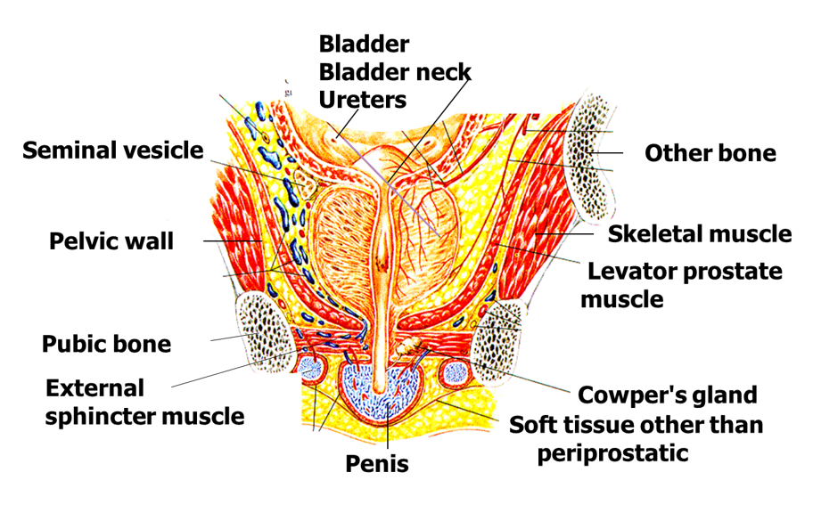
Prostate
Notes:
Codes 50-70 indicate further direct extension beyond the prostate. Code 50 is extension or fixation to adjacent structures including the bladder neck, bladder NOS, Denonvillier’s fascia, and rectum. Code 52 is extension to the skeletal and levator muscles and to the ureter. Code 60 is extension to the pubic (pelvic) bone or pelvic wall as well as ‘frozen pelvis’. Code 70 is other contiguous extension including the penis, Cowper’s gland, sigmoid colon, and soft tissue other than periprostatic tissue.

Slide 5
The prostate (prostate gland) is partly glandular and partly fibromuscular
  Glandular tissue (1/2)
  Involuntary (smooth) muscle(1/4)
  Fibrous tissue(1/4)

Slide 6
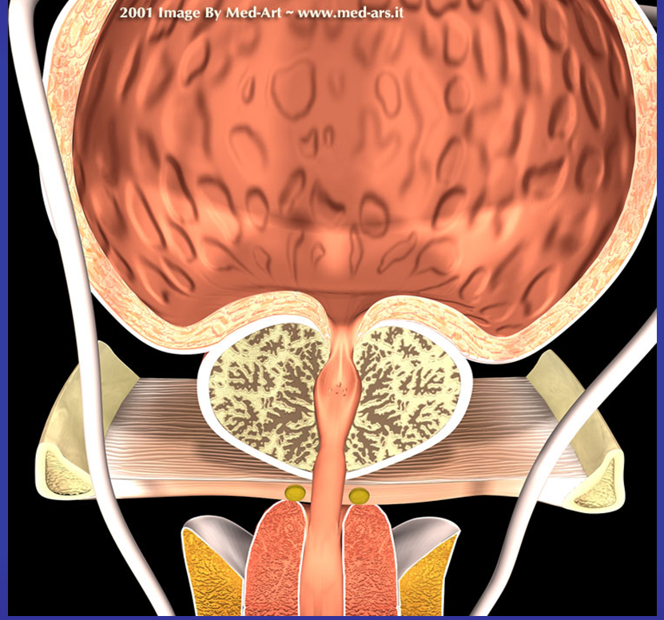

Slide 7
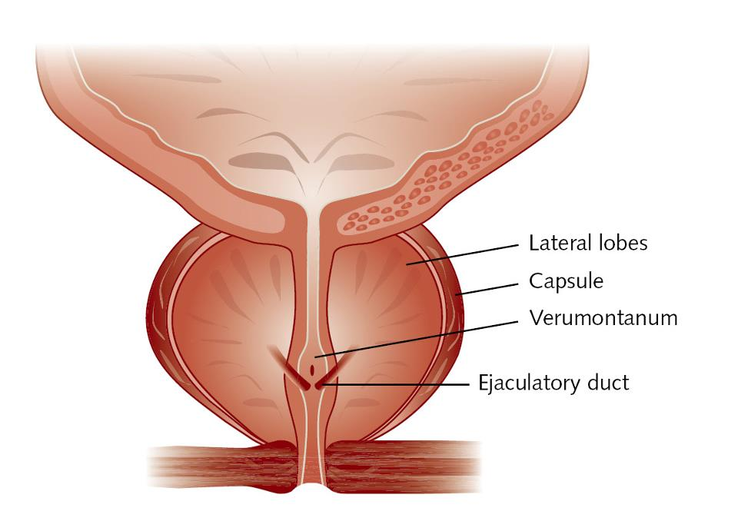

Slide 8
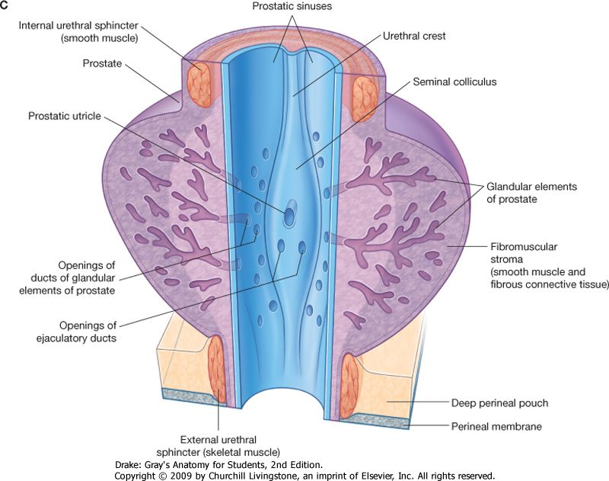

Slide 9
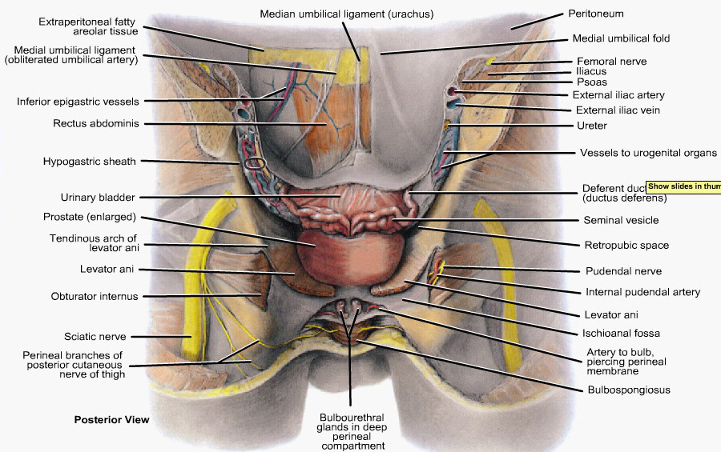

Slide 10
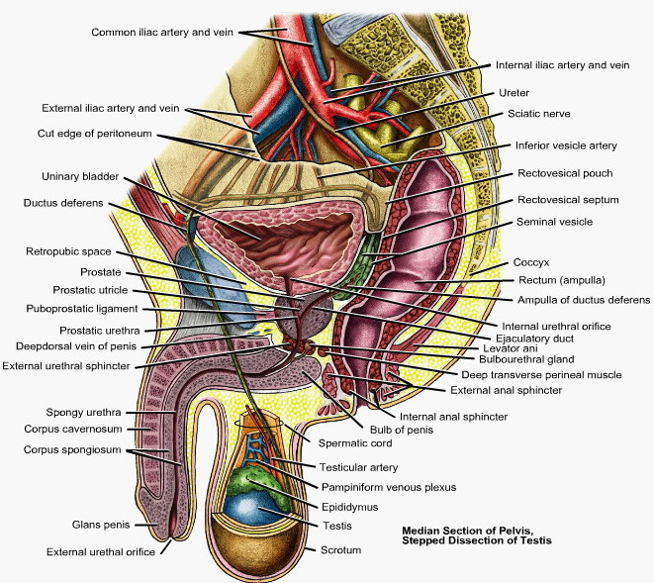

Slide 11
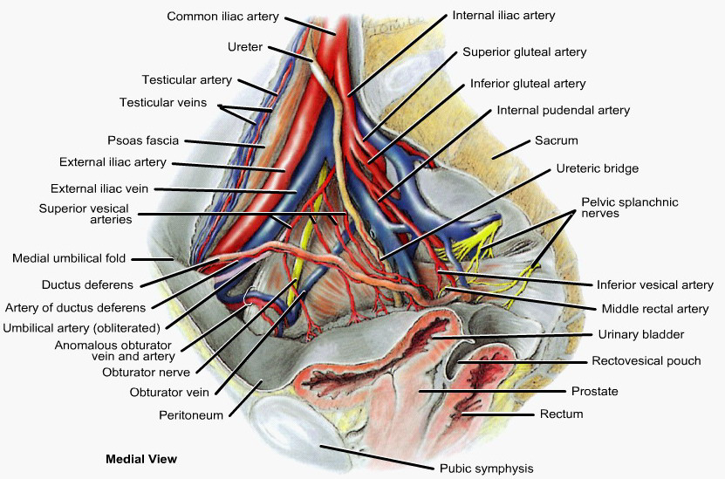

Slide 12
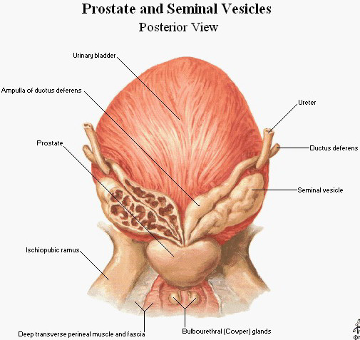

Slide 13
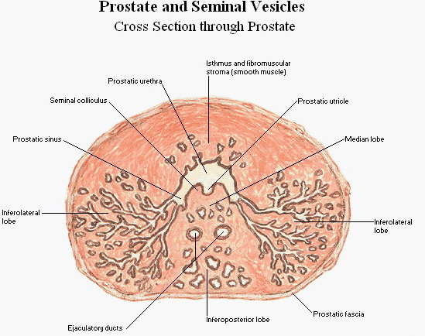

Slide 14
Size & shape
It resembles the size and shape of a chestnut which lies below the bladder and above urogenital diaphragm & surrounds 1st part of urethra.
Broader than longer.
4x3x2 cm
THE OTHER ORGAN HAVING BREADTH MORE THAN LENGTH IS CAECUM.

Slide 15
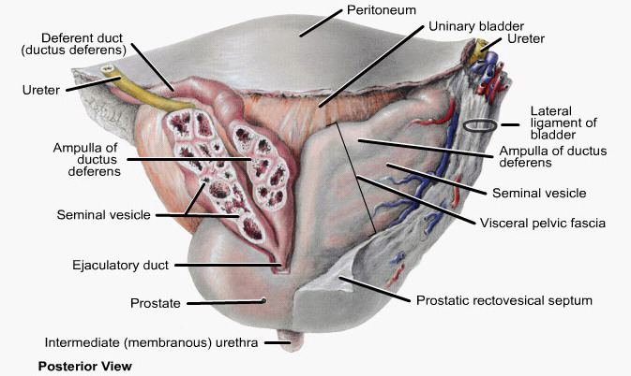

Slide 16
The prostate
The prostate has
A base,
An apex, and
4 surfaces
    Posterior ,
    Anterior , and
    2 inferolateral surfaces).

Slide 17
The prostate
The prostate looks like an inverted cone having its 'base' above and its 'apex' below'.
Its shape resembles - in general - the shape of the urinary bladder in having 4 surfaces
  Anterior or superior(base)
  2 inferolateral and
  Posteroinferior or posterior
  but in stead of the urinary bladder having its apex in front and base behind prostate its base above (its superior surface) and its apex below.
All surfaces merge indistinctly into one another with no sharp borders between them.

Slide 18
Surfaces
The base (or superior surface) lies below the bladder and is continuous with its neck and is separated from it by a circular groove.
The posteroinferior or posterior surface Iies on the rectum (rectal ampulla) but is separated from it by the fascia of Denonvielliers. This surface can be easily palpated on per rectum (P.R.) examination.
The 2 inferolateral surfaces lion the anterior fibres of the levator ani and are separated from each other the rounded anterior aspect of the prostate.
The apex lies where the 2 inferolateral surfaces meet the posteroinferior surface; the apex abuts against perineal memberane and between the anterior borders of the levator ani and is separated from the anal canal by perineal body.
Anterior surface rounded where two inferolateral surfaces meet behind pubic symphysis & retroperitoneal fat in retropubic space.

Slide 21
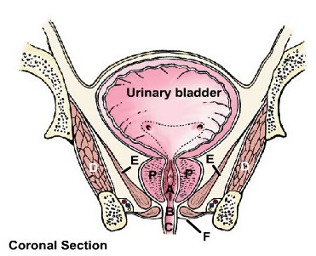

Slide 22
The urethra enters the base (or upper surface) of the prostate near its anterior border; passes downwards forwards and emerges from its anterior aspect a little above its apex (anterosuperior to apex)
Two ejaculatory ducts (one on each side of the median plane) enter the upper part of the posterior aspect the prostate to open into the prostatic urethra.
The anterior aspect of the prostate is separated from the posterior surface of the symphysis pubis by the retropubic space (of Retzius)
* Two cord-like condensations of fibrous tissue called the pubo-prostatic ligaments lie close together one on each side of the median plane, connect the upper part of the anterior aspect of the prostate with Iower end of the symphysis pubis (and adjacent posterior aspect of the pubic bone).

Slide 23
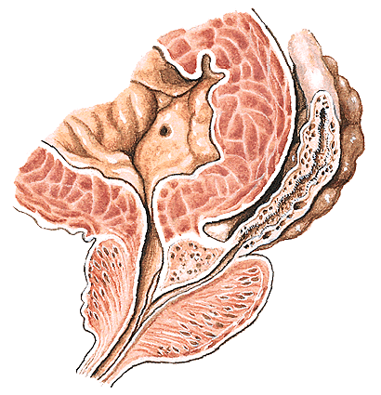
vas
S.V.
median lobe of prostate

Slide 24
*The retropubic space
*The retropubic space is filled with pad of fat which extend posterolateral.
Inferiorly, the space is limited by puboprostatic in males & pubovesicle ligament in female.
Superiorly it is continuous with extraperitoneal tissue of anterior abdominal wall lateral to umbilical ligament.

Slide 25
Rectovesical septum
Rectovesical septum or prostatoperitoneal membrane or Denovillier’s fascia
A dense condensation of pelvic fascia which develops by obliteration of the rectovesical peritoneal pouch. It is obliterated from below upwards as fetal life progresses so that at birth this fascia separates the prostate, the seminal vesicles and the ampullae of the vasa deferentia from the rectum.
Contents: in upper part contain seminal vesicles.

Slide 26
RELATIONS
Base
  Continuous with neck of bladder, a groove intervening in which are veins.
Apex
  Rests on upper surface of superior layer of the urogenital diaphragm.
Posterior
  Rests on anterior wall of rectum and can be felt by a finger in the rectum.
Inferolateral. (2)
  Related to and supported by that part of the levator ani called the levator prostate.
Anterior Border or Surface
  Behind the symphysis and connected with it by puboprostatic ligaments.

Slide 27
The Base of the Prostate
The base of the prostate (its vesicular surface) is closely related to the neck of the urinary bladder.
The prostatic urethra enters the middle of the base near its anterior surface.

Slide 28
The Apex of the Prostate
The apex of the prostate is inferior and is related to the superior fascia of the urogenital diaphragm.
It rests on the sphincter urethrae muscle and is embraced by the medial margins of the levator ani muscles.

Slide 29
The Posterior Surface of the Prostate
This is triangular and flattened transversely. It faces posteriorly and slightly inferiorly toward the urogenital diaphragm.
It rests on the ampulla of the rectum.
  This surface can be palpated by a digit in the rectum.
Usually, the posterior surface has a shallow median groove, demarcating the lateral lobes. The lateral lobes are often fused and clinicians often refer to them as the posterior lobe.
Superiorly on the posterior surface, there is a shallow groove where the ejaculatory ducts enter the prostate. This groove indicates the middle lobe, the small section of the prostate between the ejaculatory ducts and the urethra. The middle lobe lies posterior to the uvula vesica of the urinary bladder. The prostatic utricle is located in the substance of the middle lobe.

Slide 30
The Anterior Surface of the Prostate
This is transversely narrow and convex and extends from the apex to the base.

Slide 31
The Inferolateral Surfaces of the Prostate
These meet anteriorly with the convex anterior surface and rests on the fascia covering the levator ani muscles.

Slide 32
The Prostatic Ductules or Ducts
There are 20 to 30 of these in number.
They open chiefly into the prostatic sinuses on each side of the urethral crest on the posterior wall of the prostatic urethra.
This occurs because most glandular tissue is located posterior and lateral to the prostatic urethra.
The prostatic secretion, a thin milky fluid, is discharged into the prostatic part of the urethra by contraction of the smooth muscle.
Prostatic fluid provides about 20% of the volume of the semen.

Slide 33
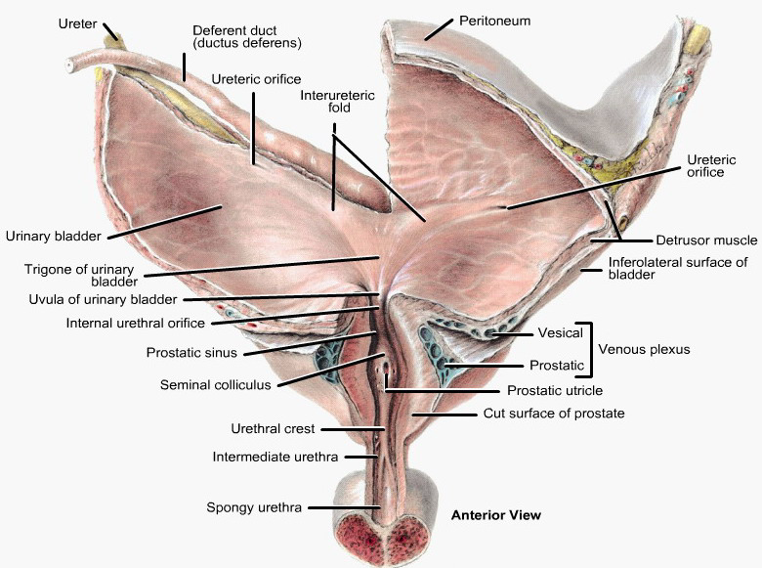

Slide 34
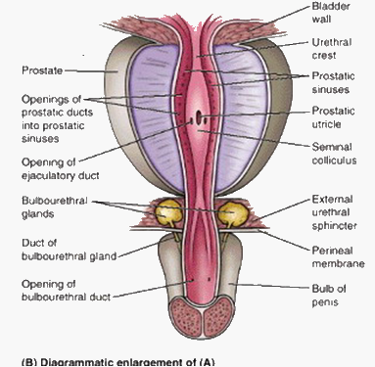

Slide 35
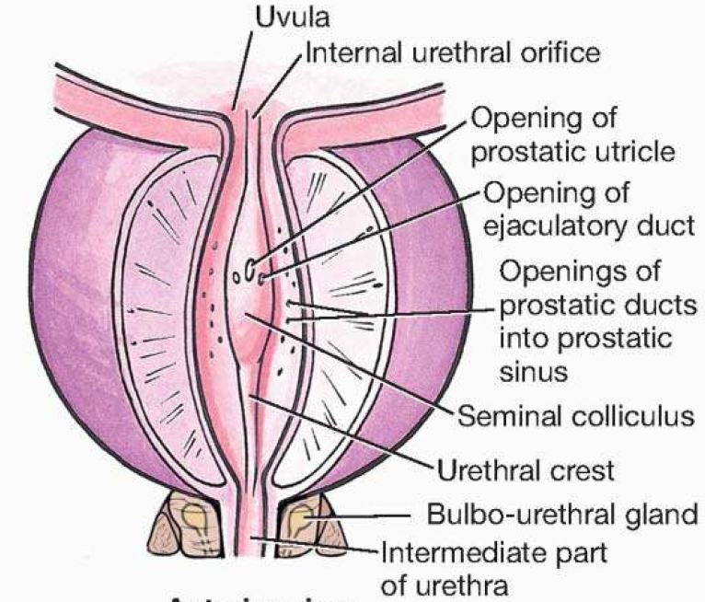

Slide 36
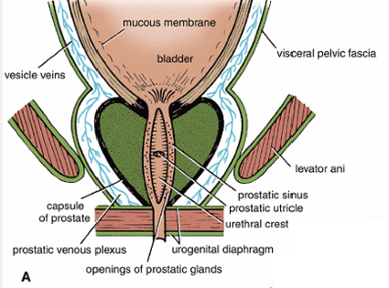

Slide 37
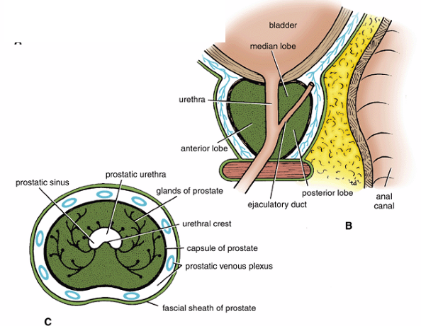

Slide 38
Prostatic urethra
Widest and most dilatable part, 3 to 4 cm long.
The most prominent feature of the prostatic urethra is the urethral crest, a median ridge between bilateral grooves, the prostatic sinuses .
  The secretory ducts of the prostate, the prostatic ducts, open into the prostatic sinuses.
The seminal colliculus is a rounded eminence in the middle of the urethral crest with a slit-like orifice that opens into a small cul-de-sac, the prostatic utricle.
(The prostatic utricle is the vestigial remnant of the embryonic uterovaginal canal, the surrounding walls of which, in the female, constitute the primordium of the uterus and a part of the vagina)
The ejaculatory ducts open into the prostatic urethra via minute, slit-like openings located adjacent to and occasionally just within the orifice of the prostatic utricle. Thus urinary and reproductive tracts merge at this point.
Verumontanum is term used to describe urethral crest(RJL) or seminal colliculus (Gray’s).

Slide 39
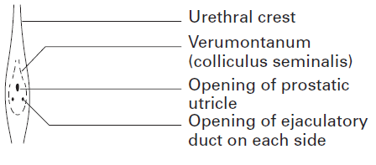

Slide 40
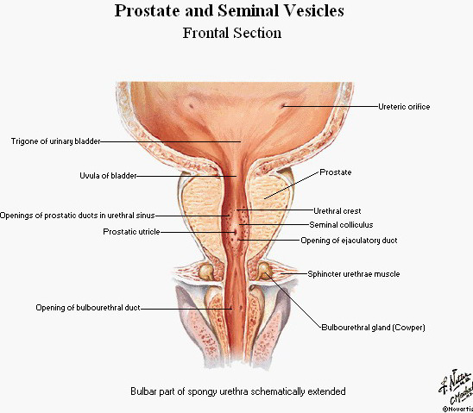

Slide 41
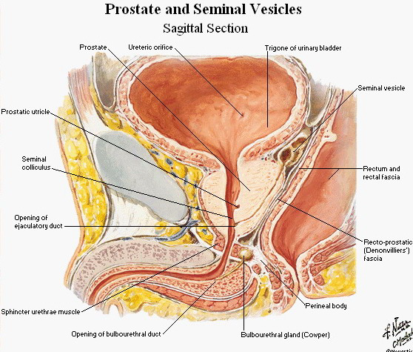

Slide 42
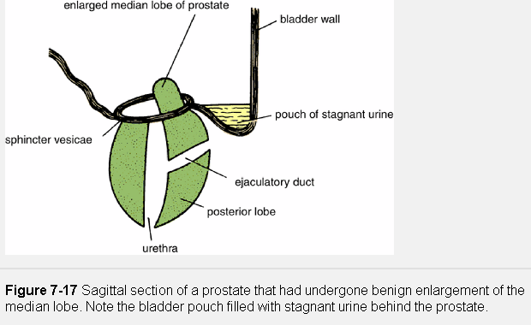

Slide 43
The prostate gland was initially thought to be divided into five anatomical lobes, but it is now recognized that five lobes can only be distinguished in the fetal gland.
The glandular tissue may be subdivided into three distinct zones, peripheral (70% by volume), central (25% by volume), and transition (5% by volume).
Non-glandular tissue (fibromuscular stoma) fills up the space between the peripheral zones anterior to the preprostatic urethra Non-glandular tissue (fibromuscular stoma) fills up the space between the peripheral zones anterior to the preprostatic urethra.

Slide 44
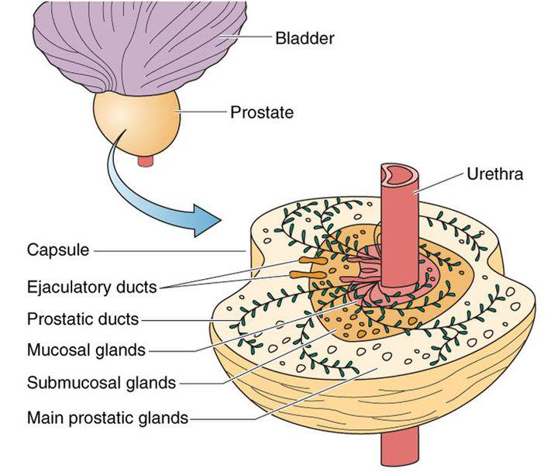

Slide 45
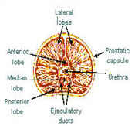
Lobes of the Prostate
The prostate is divided into lobes:
The anterior lobe
  the portion of the gland that lies in front of the urethra.
  It contains no glandular tissue but is made up completely of
  fibromuscular tissue.
The median or middle lobe
  situated between the two ejaculatory ducts and the urethra.
The lateral lobes
  make up the main mass of the prostate. They are divided into a right and left lobe and are separated by the prostatic urethra.
The posterior lobe
  the medial part of the lateral lobes and can be palpated through the rectum during digital rectal exam (DRE).

Slide 46
The isthmus of the prostate
The isthmus of the prostate (anterior muscular zone; historically, the anterior lobe) lies anterior to the urethra.
It is primarily muscular and represents the superior continuation of the urethral sphincter muscle.

Slide 47
zones
Some authors, especially urologists and sonographers, divide the prostate into peripheral and central (internal) zones. The central zone is comparable to the middle lobe. Within each lobe are four lobules, which are defined by the arrangement of the ducts and connective tissue.

Slide 48
The prostate is now considered to consist of
    A central zone approximately 25% of the glandular substance
    A peripheral zone, 75% of the glandular substance
  The central zone is wedge-shaped and forms the base of the gland with its apex at the verumontanum ; it surrounds the ejaculatory ducts as they course through the gland.
  The peripheral zone surrounds the central zone from behind and below, but does not reach up to the base; it extends downwards to form the lower part of the gland. The ducts of the central zone open on the verumontanum around the orifices of the ejaculatory ducts. The ducts of the peripheral zone open into the prostatic sinuses.
  Benign prostatic hyper­plasia occurs in the central zone. The peripheral zone is almost exclusively the site of origin for carcinoma of the prostate.
      There is very little glandular tissue anterior to the prostatic urethra, the anterior part of the prostate being mainly fibromuscular; it is overlapped from above by the detrusor muscle of the bladder and from below by the striated muscle of the urethral sphincter.

Slide 49
Lymphatic Drainage of the Prostate
The lymph vessels terminate chiefly in the internal iliac and sacral lymph nodes.
Some vessels from its posterior surface pass with the lymph vessels of the bladder to the external iliac lymph nodes.

Slide 50
Innervation of the Prostate
Parasympathetic fibres arise from the pelvic splanchnic nerves (S2, S3, and S4).
The sympathetic fibres are from the inferior hypogastric plexuses.

Slide 51
Prostatic sheath
It is enveloped in a thin, dense fibrous capsule (true capsule), which is enclosed within a loose sheath derived from the pelvic fascia called the prostatic sheath (false capsule).
It is continuous inferiorly with the superior fascia of the urogenital diaphragm.
Posteriorly, the prostatic sheath is part of the rectovesical septum.
This separates the bladder, seminal vesicles, and prostate from the rectum.

Slide 52
Prostatic capsules
Normally the prostate has 2 capsules: one false and one true. Pathologically a third prostatic capsule may be found.
1. False capsule (prostatic fascia): this is a dense envelope of the pelvic fascia surrounding the prostate(similar to fascia to all other organs which lie in the pelvis: bladder, rectum, seminal vesicles etc).
The fascial 'envelope' of the prostate is continuous with the fascia covering the bladder and is anchored to the back of the symphysis pubis and pubic bones by the 2 puboprostatic ligaments.
**The posterior part of the envelope of prostatic fascia forms a broad strong sheet called the fascia of Denonvilliers which can be easily separated from the loose rectal fascia behind.
2. True capsule: this is a thin fibrous sheath which forms the outermost part of the prostate.
* On each side of the prostate the false and true capsules are separated from each other by a prostatic venous plexus.

Slide 53
Prostatic capsules
The pathological capsule — when benign ‘adenomatous’ hypertrophy of the prostate takes place, the normal peripheral part of the gland becomes compressed into a capsule around this enlarging mass.
In performing an enucleation of the prostate, the plane between the adenomatous mass and this compressed peripheral tissue is entered, the ‘tumour’ enucleated and a condensed rim of prostate tissue, lying deep to the true capsule, left behind.
  The prostatic venous plexus, lying external to this, is thus undisturbed.

Slide 54
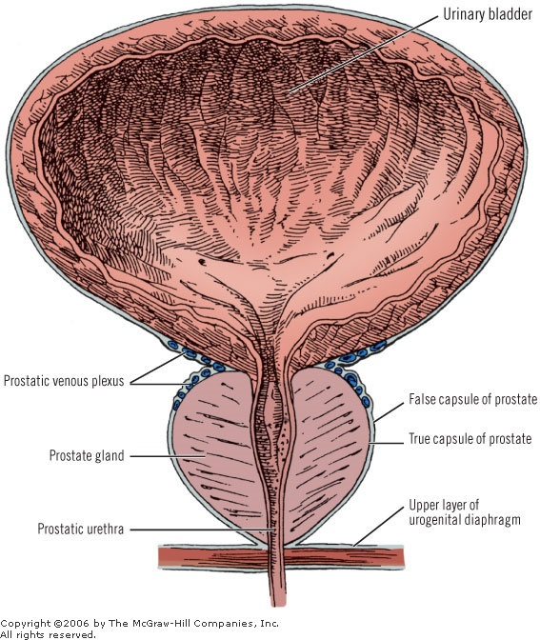

Slide 55
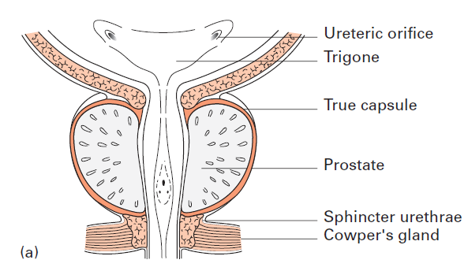

Slide 56
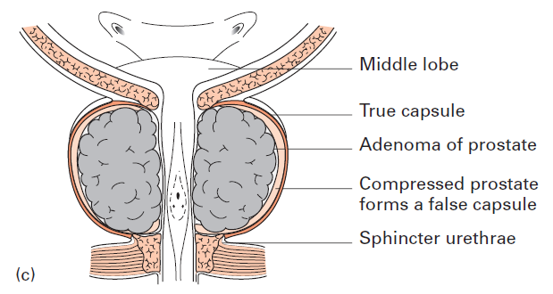

Slide 57
The prostatic venous plexus
In all operations on the prostate, the surgeon regards the prostatic venous plexus with respect.
The veins have thin walls, are valveless, and are drained by several large trunks directly into the internal iliac veins.
Damage to these veins can result in a severe hemorrhage.

Slide 58
Features of prostatic venous plexus
Veins are thin walled.
Veins are valveless.
Veins end in internal iliac vein.
The venous plexus is connected with vertebral veins(skeletal metastases in prstatic Ca).

Slide 59
Blood supply of the male internal genital organs: prostate and others
All the structures which lie between the bladder and rectum (prostate, seminal vesicles, ampullae of vas deferens on either side as well as the lower ends of the 2 ureters) are supplied by the inferior vesical with a little help of the middle rectal artery.
* The branch to the prostate enters the gland on each side at its lateral extremity.
* The artery to vas deferens arises from the inferior vesical artery and runs in close relation with Vas from the base of the bladder to the epididymis (where it anastomoses with the testicular artery)
The prostatic venous plexus (a) receives the deep dorsal vein of the in front, (b) drains into the internal iliac vein... behind and (c) communicates with the vesical venous plexus... above. ,
As the radicles from the prostatic. plexus run backwards to drain into the internal iliac vein they pass lateral to the seminal vesicle and below the ureter.
The pudendal plexus of veins (prostatic) lies between the two capsules and receives in front the deep dorsal vein of the penis.

Slide 60
Structures within the prostate
Prostatic urethra
Ejaculatory ducts (2)
Prostatic utricle

Slide 61
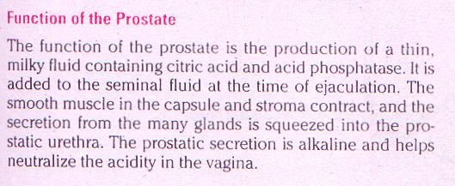
Prostatic fluid, a thin, milky fluid, provides approximately 20% of the volume of semen (a mixture of secretions produced by the testes, seminal glands, prostate, and bulbourethral glands) and plays a role in activating the sperms.

Slide 62
PROSTATE EXAMINATION & PROSTATE ACTIVITY AND DISEASE
Prostate Examination- The prostate can be examined clinically by palpation by performing a rectal examination. The exam­iner's gloved finger can feel the posterior surface of the prostate through the anterior rectal wall.
Prostate Activity and Disease- It is now generally believed that the normal glandular activity of the prostate is controlled by the androgens and estrogens circulating in the bloodstream. The secretions of the prostate are poured into the urethra during ejaculation and are added to the seminal fluid. Acid phosphatase is an important enzyme present in the secretion in large amounts. When the glandular cells producing this enzyme cannot discharge their secretion into the ducts, as in carcinoma of the prostate, the serum acid phosphatase level of the blood rises.
The specific protein level can be measured by a simple laboratory test called the PSA (prostatic-specific antigen) test.

Slide 63
BENIGN ENLARGEMENT OF THE PROSTATE
Benign enlargement of the prostate is common in men older than 50 years. The cause is possibly an imbalance in the hormonal control of the gland.
The median lobe of the gland enlarges upward and encroaches within the sphincter vesicae, located at the neck of the bladder.
The enlargement of the median and lateral lobes of the gland produces elongation and lateral compression and distortion of the urethra so that the patient experiences difficulty in passing urine and the stream is weak. backpressure effects on the ureters and both kidneys are a common complication.
The enlargement of the uvula vesicae (owing to the en­larged median lobe) results in the formation of a pouch of stagnant urine behind the urethral orifice within the bladder. The stagnant urine frequently be­comes infected, and the inflamed bladder (cystitis) adds to the patient's symptoms.

Slide 64
PROSTATE CANCER AND
THE PROSTATIC VENOUS PLEXUS
Many connections between the prostatic venous plexus and the vertebral veins exist.
During coughing and sneez­ing or abdominal straining, it is possible for prostatic ve­nous blood to flow in a reverse direction and enter the vertebral veins.
This explains the frequent occurrence of skeletal metastases in the lower vertebral column and pelvic bones of patients with carcinoma of the prostate.
Cancer cells enter the skull via this route by floating up the valveless prostatic and vertebral veins.

Slide 65
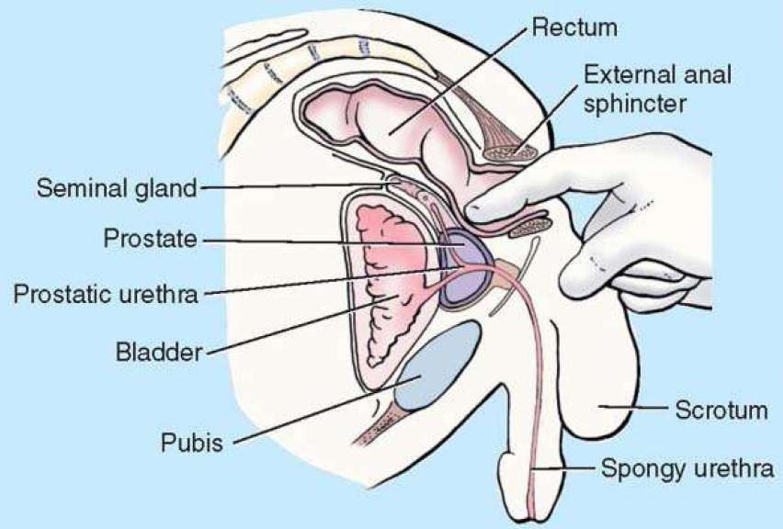

Slide 66
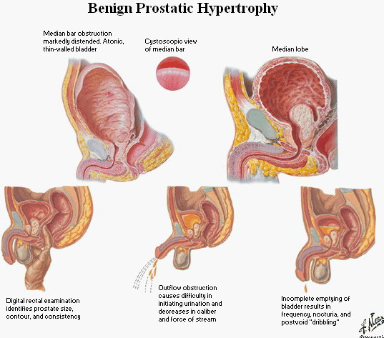

Slide 67
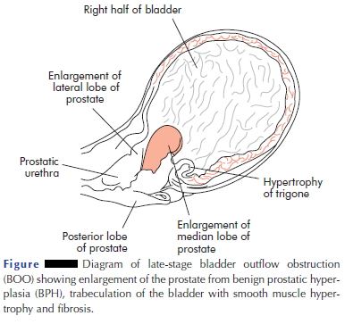

Slide 68
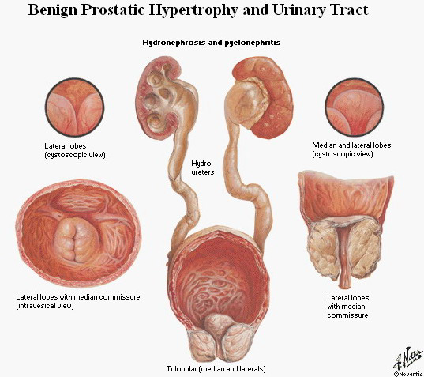

Slide 69
The primary cancer sites which give rise to skeletal metastasis
Prostate (typically osteoblastic metastases)
Breast
Kidney
Bronchus
Thyroid

Slide 70
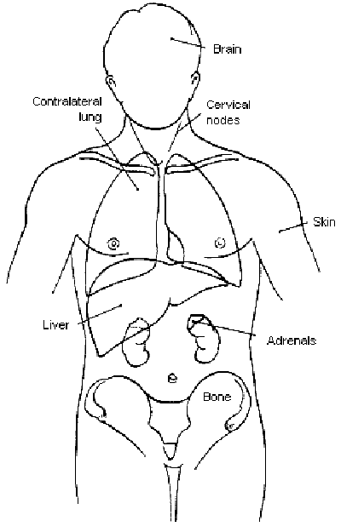
Prostate -- CS Mets
Brain
Lung
Specific distant lymph nodes
(except common iliac)
Liver
Adrenal
Common
iliac nodes
Bone

Slide 71
Valveless vertebral veins of Beteson:
Some of venous drainage from prostate passes to plexus of veins lying in front of bodies of vertebrae & within neural canal. These veins between prostate & vertebral bodies contain no valves & are called Valveless vertebral veins of Beteson. It may explain spread of Ca prostate to vertebrae.
Prostatectomy:
i.e. enucleation
Approaches:
  1. Transvesical
  2. Retropubic
  3. Perineal
  4. Transurethral via cystoscope

Slide 72
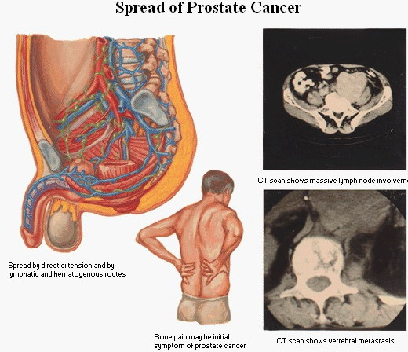

Slide 73
RISK OF PROSTATE CANCER BY AGE*
< 39 years 1 in 10,100
40-59 years 1 in 38
60-79 years 1 in 14
Lifetime 1 in 6
*American Cancer Society 2006

Slide 74
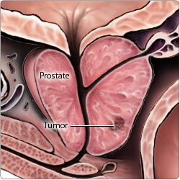
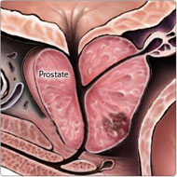
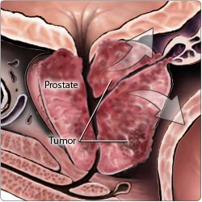
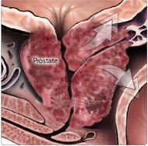
TUMOR STAGE

Slide 75
Prostate Cancer Work-up
Imaging studies:
  Transrectal ultrasound (TRUS)
  CT scans
    Abdomen/pelvis
    Bone
    Liver/spleen
    Brain
  Chest x-ray
Endoscopy
  Cystoscopy, proctosigmoidoscopy, laparoscopy
Transrectal needle biopsy
Transperineal needle biopsy
Sextant biopsy

Slide 76
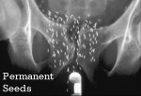
WHAT IS BRACHYTHERAPY?
Brachytherapy is a form of radiotherapy where a radioactive source is placed inside or next to the area being treated.
Brachytherapy is commonly used to treat localized prostate cancer.
Brachytherapy involves injecting radioactive seeds into the prostate gland.
They give off their radiation at a low dose rate over several months.
The seeds remain in the prostate gland permanently.

Slide 77
Hormone Therapy: Prostate
Estrogens
  Anisene, rianil
Anti-androgens
  Flutamide, lupron, zoladex
Progestins
  Amadinone, clogestone

Slide 78
Endocrine Procedures: Prostate
Orchiectomy
  Removal of testes to suppress testosterone production effecting tumor growth
  Removal must be bilateral

Slide 79
Thank You

