Slide 1
The pulmonary trunk
BY MBBSPPT.COM

Slide 2
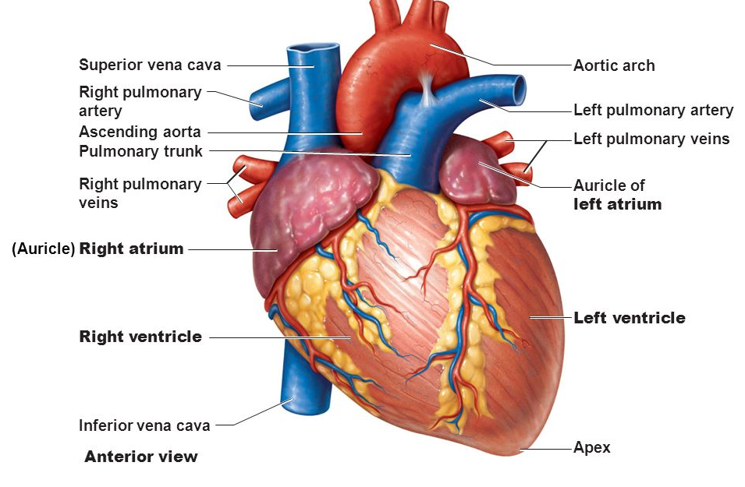

Slide 3
The pulmonary trunk
The pulmonary trunk and the ascending aorta lie with in the fibrous pericardium.
The pulmonary arteries receive deoxygenated blood from the right ventricle, and deliver it to the lungs for gas exchange to take place.
The pulmonary arteries begin as the pulmonary trunk, a thick and short vessel, which is separated from the right ventricle by the pulmonary valve.
The trunk is located anteriorly and medially to the right atrium. Behind them lies the transverse pericardium.
It continues upwards, overlapping the root of the aorta and passing posteriorly.

Slide 4
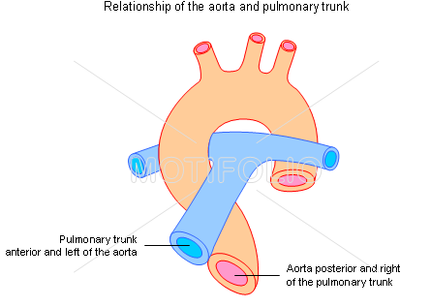

Slide 5
The pulmonary trunk
Origin:
The Pulmonary Trunk is about 5 cm long and originates from the upper part (infundibulum) of the right ventricle in the level of the sternal end of left 3rd costal cartilage.

Slide 6
The pulmonary trunk

Slide 7
The pulmonary trunk
Course:
After arising from infundibulum in the middle mediastinum, it enters backwards and to the left and ends below the arch of aorta and in front of left principal bronchus by dividing into left and right pulmonary arteries at around the level of T5-T6.

Slide 8
Relations
ANTERIOR: | A. Sternal end of left 2nd intercostal space. B. Left lung and pleura.
POSTERIOR: | A. Ascending aorta. B. Commence of left coronary artery. C. Transverse sinus of pericardium.
TO THE RIGHT: | A. Ascending aorta. B. Origin of right coronary artery. C. Right auricle.
TO THE LEFT: | A. Left coronary artery. B. Left auricle.
The two pulmonary arteries lie in front of the bronchi and the inferior tracheobronchial lymph nodes.

Slide 9
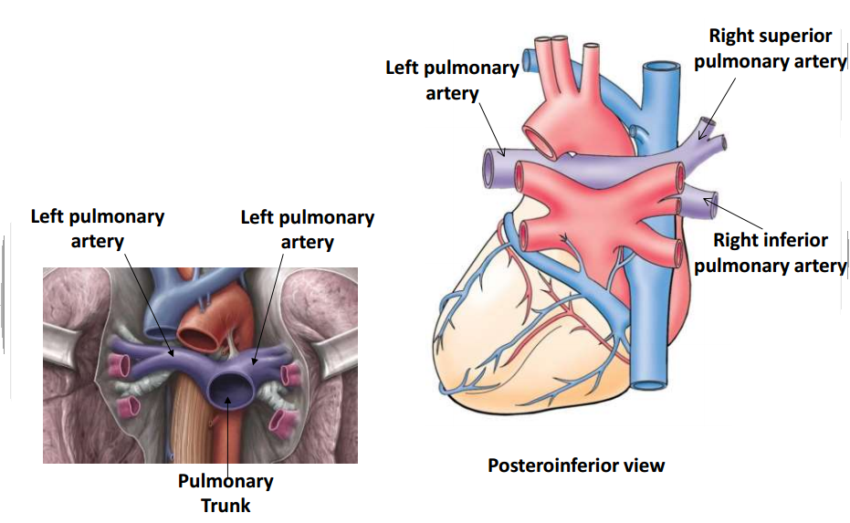

Slide 10
The pulmonary trunk
Branches:
Left and right pulmonary arteries.
The right pulmonary artery is larger compared to the left and is located somewhat at a lower level.
The right and left pulmonary arteries lie along the upper borders of the right and left atria and of the upper pulmonary veins like the transverse piece of the letter “T”.

Slide 11
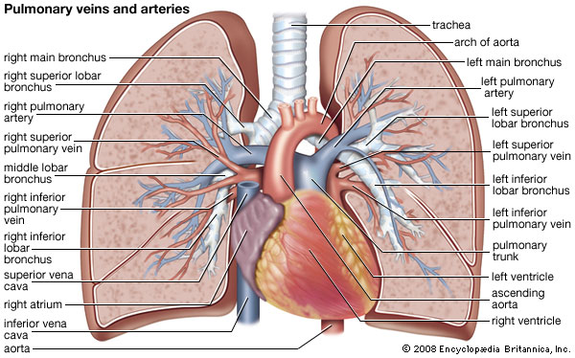

Slide 12
The right & left pulmonary artery
The left pulmonary artery supplies blood to the left lung, bifurcating into two branches to supply each lobe of the lung.
The right pulmonary artery is the thicker and longer artery of the two, supplying blood to the right lung. It also further divides into two branches.

Slide 13
The pulmonary arteries
The right pulmonary artery | The left pulmonary artery
Longer | Shorter
Wider | Narrower
Passes behind the ascending aorta and superior vena cava | Passes along the upper border of the left atrium
Then passes in front of right bronchus to reach the hilum of the right lung. | Then passes in front of the left bronchus and the descending aorta to reach the root of the left lung.
The left pulmonary artery is connected to the lower aspect of the ligamentum arteriosum.

Slide 14
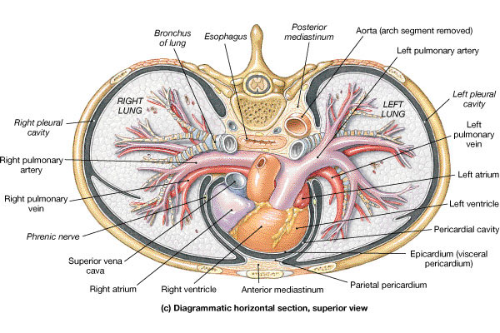

Slide 15
PULMONARY ARTERY CATHETERIZATION
Different aspects of cardiopulmonary functions are monitored by the cardiologists by pulmonary artery catheterization.
The catheter is passed successively as follows:
Internal jugular vein/subclavian vein ► Right atrium ► Right ventricle ► Pulmonary trunk ► Pulmonary artery.
Sudden occlusion of pulmonary trunk by an embolus may be a sequel to the thrombosis of deep veins of the calf. When the block is complete, death ensues rapidly.

Slide 16
Thank You

