Slide 1
The Ribs
BY MBBSPPT.COM

Slide 2
The Ribs
The ribs are curved strips of bone, stretches posteriorly from thoracic vertebrae to the anterior lateral edges of the sternum.
They are ribbon like, elastic bony arches and flat in shape. Coastal cartilages are joined to the anterior ends.
The costal cartilage and ribs together makes the costa.
The large part of the thoracic skeleton is created by the ribs and their costal cartilages.
Normally there are 12 pairs of ribs.

Slide 3
Emryology
Ribs apperar as mesenchymal condensation in the somatopleure.
Chondrification starts immediately.
Ossification begins towards the back and spreads rapidly forward.
A segment remains unossified, persists as costal cartilage.

Slide 4
Thoracic Cage
Thoracic Cage is a skeletal framework which supports the thorax.
It’s nature is osteocartilaginous and elastic.
The thoracic vertebrae, ribs, costal cartilages, and sternum form the thoracic cage.
It gives protection for the internal organs of the thoracic cavity and supports the superior trunk, pectoral girdle, and upper limbs.
It has a significant role play for raising or reducing the intrathoracic pressure to ensure mechanism of respiration

Slide 5
The Ribs
The ribs are a set of twelve bones which form the protective ‘cage’ of the thorax.
They articulate with the vertebral column posteriorly, and terminate anteriorly as cartilage (known as costal cartilage).

Slide 7
Categorization
ACCORDING TO FEATURES | Typical ribs: 3rd-9th.
 | Atypical ribs: 1st, 2nd, 10th, 11th, and 12th.
 | The normal ribs have same general features, on the other hand the atypical ribs have special features and thus can be discerned from the rest of the ribs.
ACCORDING TO RELATIONSHIP WITH THE STERNUM | True ribs: lst-7th (i.e., upper 7 ribs).
 | False ribs: 8th-12th (i.e., lower 5 ribs).
 | True ribs articulate with the sternum anteriorly, on the other hand false ribs don’t articulate with the sternum anteriorly.
ACCORDING TO ARTICULATION | Vertebrosternal ribs: lst-7th. The vertebrosternal ribs joint posteriorly with vertebrae and anteriorly with the sternum.
 | Vertebrochondral ribs: 8th-10th. The vertebrochondral ribs joint posteriorly with vertebrae and anteriorly their cartilages join the cartilage of the higher rib.
 | Vertebral (floating) ribs: 11th and 12th. The vertebral or floating ribs joint posteriorly with the vertebrae but their anterior ends are free.

Slide 8
ARRANGEMENT AND GENERAL OUTLINE
The ribs are arranged one below the other and the gaps between the adjacent ribs are termed intercostals spaces.
The length of ribs increases from 1st to 7th rib and after that slowly falls; therefore, seventh rib is the longest rib
The transverse diameter of thorax increases progressively from 1st to 8th rib, thus 8th rib has the best lateral projection.
The ribs are arranged obliquely, i.e., their anterior ends be located at lower level than their posterior ends.
The obliquity of ribs rises progressively from 1st to 9th rib, for this reason 9th rib is most obliquely set.
The width of ribs slowly reduced from above downward.

Slide 9
Costal Cartilages
The anterior ends of first 7 ribs are joined to the sternum via their costal cartilages.
The cartilages at the anterior ends of 8th, 9th, and 10th ribs are joined to the next higher cartilage.
The anterior ends of 11th and 12th ribs are free and hence named floating ribs.

Slide 10
Parts of a Typical Ribs
Every rib has 3 parts:
(a) The anterior end,
It carries a small cup shaped depression, which joins the corresponding costal cartilage to create a primary cartilaginous costochondral joint.
The anterior end bears a concave depression.
(b) The posterior end is composed of:
Head ,
Neck ,
Tubercle
(c) shaft.
The shaft is the longest part and goes between anterior and posterior ends.

Slide 11
Typical Ribs

Slide 12
The head of Typical Ribs
The head is wedge shaped, and has two articular facets separated by a wedge of bone.
It has 2 articular facets:
lower and upper.
The lower bigger facet articulates with the body of numerically corresponding vertebra.
The upper smaller facet articulates with the next higher vertebra.
The crest separating the 2 articular facets is located opposite the intervertebral disc.
The head is connected to these structures by “triradiate ligamens”

Slide 13
The Neck of Typical Ribs
The neck contains no bony prominences, but simply connects the head with the body.
It is located in front of the transverse process of the corresponding vertebra.
The neck has 2 borders –
Superior and inferior.
2 surfaces–
Anterior and posterior.
The upper border is sharp crest like, on the other hand the lower border is rounded.
The posterior surface is rough and pierced by foramina.

Slide 14
The Tubercle of Typical Ribs
It is situated on the posterosuperior aspect of the rib in the junction of neck and shaft.
It is divided into 2 parts:
Medial articular part and
Lateral non-articular part.
The articular part bears a small oval facet, which articulates with all the transverse process of corresponding vertebra.
The non-articular part is rough and gives connection to ligaments:
The tubercle of each of upper 7 ribs is olive shaped. This allows upper 7 ribs to rotate.
The tubercle of each of 3 ribs(8,9,10) is flat. This allows these ribs to slide.
The floating ribs (11&12) have no tubercle.

Slide 15
The body of Typical Rib
It is thin and flattened.
It presents 2 surfaces :–
Outer
Inner.
2 borders: –
Upper
Lower.
2 angles :–
Posterior
Anterior.

Slide 16
Surface of the Body
Outer Surface
It is smooth and convex, and presents 2 angles:–
Posterior and anterior.
The posterior angle (typically referred to as only angle) is marked by an oblique ridge.
The anterior angle is marked by an indistinct oblique line.
Inner Surface
It’s smooth and concave. It presents a costal groove near its lower border. The costal groove becomes unrecognizable in the anterior part.
The costal groove lodges from above downwards, as follows (Mnemonic: VAN):.
Intercostal Vein.
Intercostal Artery.
Intercostal Nerve.
The internal intercostal muscle is connected to the floor of the groove (interceding between intercostal nerves and vessels, and bone).
The intercostalis intimus is connected to the upper border of the costal groove.

Slide 17
Boorders of the body
Superior Border
The superior border is thick and rounded, and presents outer and inner lips:
The outer lip gives connection to the external intercostal muscles.
The inner lip gives connection to the internal intercostal and innermost intercostal muscles.
Lower Border
The lower border is sharp and creates the lower border of the costal groove, and gives origin to the external intercostals muscle.

Slide 18
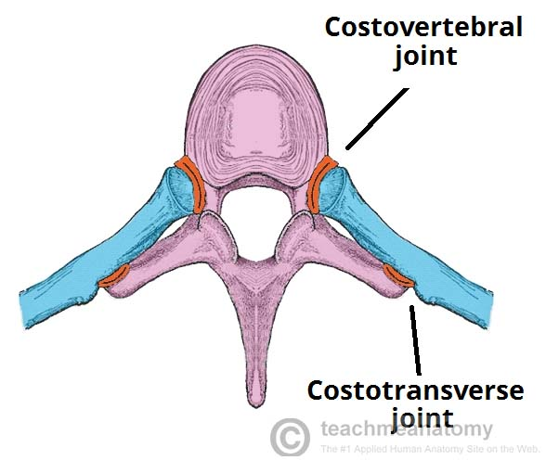
Articulations
The majority of the ribs have an anterior and posterior articulation.
Anterior attachments of ribs The anterior attachment of the ribs vary:
Ribs 1-7 attach independently to the sternum.
Ribs 8 – 10 attach to the costal cartilages superior to them.
Ribs 11 and 12 do not have an anterior attachment and end in the abdominal musculature. Because of this, they are sometimes called ‘floating ribs’.

Slide 19
Articulations
Posterior
All of the twelve ribs articulate posteriorly with the vertebrae of the spine.
Each rib forms two joints:
Costotransverse joint – Between the tubercle of the rib, and the transverse costal facet of the corresponding vertebrae.
Costovertebral joint – Between the head of the rib, superior costal facet of the corresponding vertebrae, and the inferior costal facet of the vertebrae above.

Slide 20
Side Conclusion and Anatomical Position
The side of the rib can be figured out by holding it in this type of style that its posterior end having head, neck, and tubercle is directed posteriorly, its concavity faces medially and its sharp border is directed inferiorly.
In an anatomical position, the posterior end is higher and nearer the median plane in relation to the anterior end.

Slide 21
3 Characteristic Features of Typical Rib
It is curved along its whole extent
It is angulated, i.e. presents 2 curves 1 5 cm in front of tubercle and 1 2 cm behind the anterior end
It is twisted, in order that both ends of the rib can not contact the same horizontal plane
(Mnemonic: CAT – Curve, Angle, and Twisted)

Slide 22
Atypical Ribs
Ribs 1, 2, 10 11 and 12 are ‘atypical’ as they have features that are not common to all the ribs.
Rib 1 is shorter and wider than the other ribs. It only has one facet on its head for articulation with its corresponding vertebrae (there isn’t a thoracic vertebrae above it). The superior surface is marked by two grooves, which make way for the subclavian vessels.
Rib 2 is thinner and longer than rib 1, and has two articular facets on the head as normal. It has a roughened area on its upper surface, where the serratus anterior muscle attaches.
Rib 10 only has one facet – for articulation with its numerically corresponding vertebrae.
Ribs 11 and 12 have no neck, and only contain one facet, which is for articulation with their corresponding vertebrae.

Slide 23
First Rib
Highest,
Shortest ,
Strongest ,
Flattest ,
Most curved,
Most fixed &
Broadest
The shaft of the very first rib slopes obliquely downwards and forwards to its sternal end.
It only has one facet on its head for articulation with its corresponding vertebrae (there isn’t a thoracic vertebrae above it).
The upper surface has two grooves for the subclavian artery and subclavian vein, separated by the scalene tubercle for the attachment of the scalene anterior muscle
It has no angle.
There is no costal groove.

Slide 24
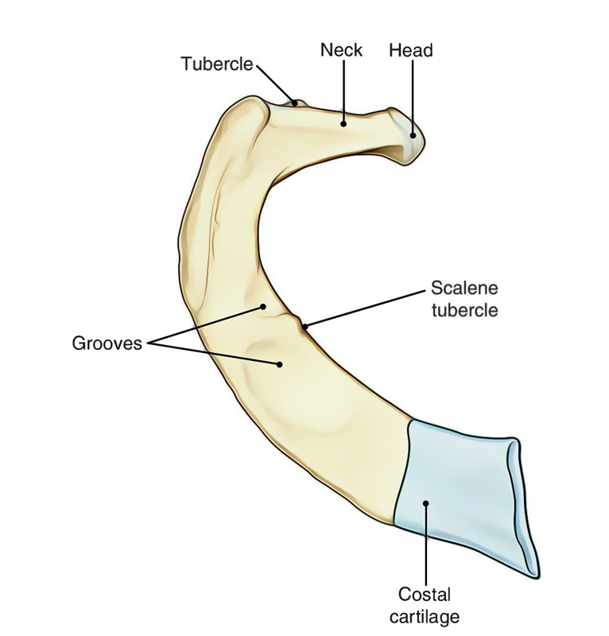
first rib

Slide 25
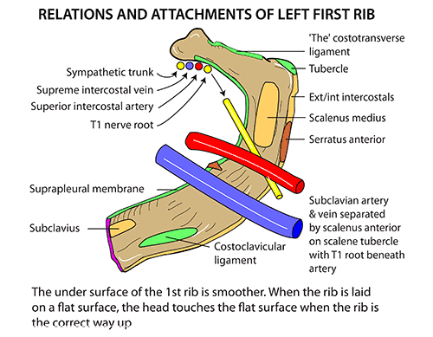

Slide 26
Features of 1st rib
Inner Border
It presents a scalene tubercle about its middle. Tubercle and adjoining part of the upper surface gives connection to the scalenus anterior muscle
It gives connection to the Sibson’s fascia (suprapleural membrane)
Outer Border
It gives origin to the first digitation of serratus anterior about its middle, just behind the groove for the subclavian artery.

Slide 27
Surfaces of 1st rib
Superior (Upper) Surface
It is crossed obliquely by 2 shallow grooves (anterior and posterior) divided by a little ridge.
The ridge is constant with the scalene tubercle for insertion of scalenus anterior.
The anterior groove lodges subclavian vein, while posterior groove lodges the subclavian artery and lower trunk of the brachial plexus
The area behind posterior groove up to the costal tubercle gives connection to the scalenus medius muscle
The area in front anterior groove and near the anterior end gives connection to subclavius muscle (anteriorly) and costoclavicular ligament (posteriorly)
Lower Surface
It is related to the costal pleura.

Slide 28
Neck of 1st rib
It is elongated and pointed upwards, backwards, and laterally.
The subsequent structures create anterior relationships of neck from medial to lateral side
Sympathetic chain(inferior cervical sympathetic ganglion)
First posterior intercostal Vein
Superior intercostal Artery
Ventral ramus of first thoracic Nerve
Memory apparatus: Chain pulling the VAN

Slide 29
Side Decision of 1st rib
Side of the very first rib can be figured out by supporting the rib in this manner that:
Its bigger end is directed anteriorly and its smaller end is directed posteriorly
The surface of its shaft having 2 grooves divided by a ridge is directed superiorly
Its concave border is directed inwards and its convex border is directed outwards

Slide 30
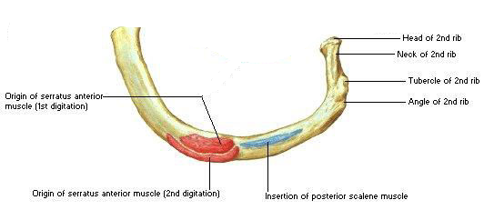
SECOND RIB

Slide 31
Distinguishing Features of 2nd rib
Rib 2 is thinner and longer than 1st rib (two times).
It has two articular facets on the head as normal. It has a roughened area on its upper surface, where the serratus anterior muscle attaches.
Its shaft is sharply bent not twisted; thus both the ends of rib touch the table top when put on it.
Near its middle, the outer convex surface of shaft presents a rough impression or tubercle, which gives connection to the serratus anterior muscle (lower part of first and whole of 2nd digitation)
Posterior part of internal surface presents a short costal groove poorly developed)
The upper border and adjoining part of upper surface supply connection to the scalenus posterior and serratus posterior superior muscles

Slide 32
Tenth Rib
Distinguishing Features
It is single articular facet on its head, which articulates with the body of corresponding thoracic vertebra
It is somewhat shorter in relation to the conventional rib.

Slide 33
Eleventh Rib
Distinguishing Features
It is single large, articular facet on its head.
It is no neck and no tubercle.
Its anterior end is pointed and tipped with cartilage.
It is little angle and a shallow costal groove.
Its inner surface is pointed upwards and inwards.

Slide 34
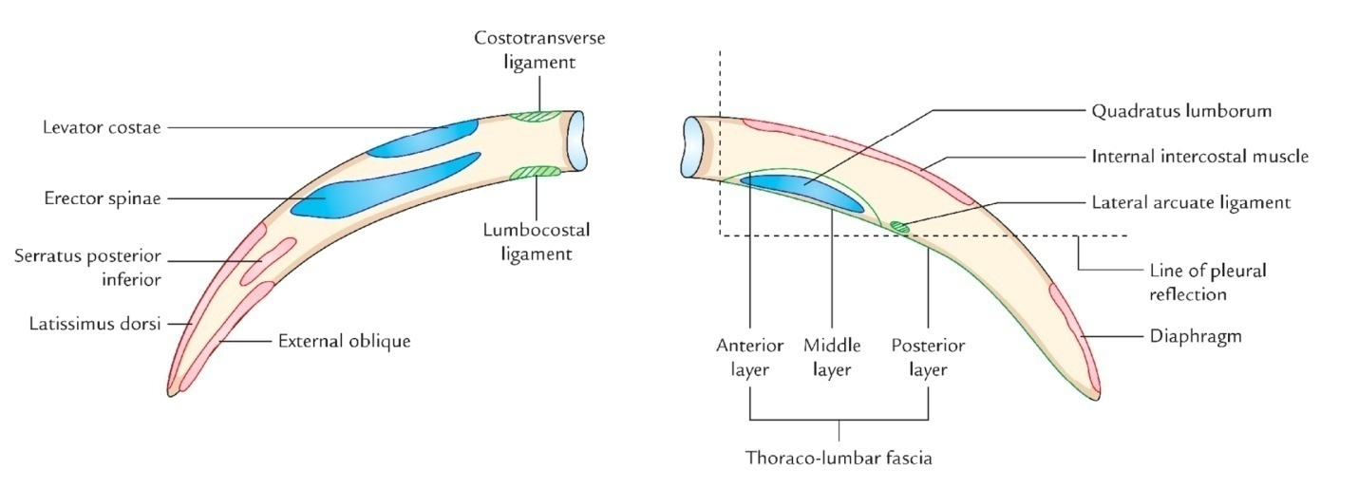
Twelfth Rib

Slide 35
Distinguishing Features
The 12th rib has identical features as the 11th with the exception of that:
It has no neck, no angle, no tubercle, no costal groove.
It is considerably shorter than 11th( so short in females).
It is as short as 1st rib.
Side Conclusion
The side of 12th rib can be figured out by keeping the rib in this style that:
Its pointed anterior end is directed anterolaterally and its wider end posteromedially.
Its somewhat concave surface faces inwards and upwards.
Its sharper border is directed inferiorly.

Slide 36
Attachments of 12th Rib
Outer Surface
Near the tip, it gives connection to the latissimus dorsi muscle above and external oblique muscle below.
Its medial half gives connection to the erector spinae muscle.
Inner Surface
An oblique line crossing the middle of the surface indicates the line of pleural reflection.
Lower part of medial half gives connection to the quadratus lumborum muscle.
Middle two fourth near the upper border gives connection to the internal intercostal muscle.
Upper part of sidelong quarter near the tip gives connection to the diaphragm.
Lower Border
Close to head it gives connection to the lumbocostal ligament, which stretches from transverse process of LI vertebra.
Lateral arcuate ligament is connected to it just lateral to the quadratus lumborum.
Upper Border
The upper border gives connection to the external and internal intercostal muscles.

Slide 37
Rib Fractures
Rib fractures most commonly occur in the middle ribs, as a consequence of crushing injuries or direct trauma. A common complication of a rib fracture is further soft tissue injury (the lungs, spleen or diaphragm).
If two or more fractures occur in two or more adjacent ribs, the affected area is no longer under control of the thoracic muscles. It displays a paradoxical movement during lung inflation and deflation.
This condition is known as flail chest. It impairs full expansion of the ribcage, thus affecting the oxygen content of the blood. Flail chest is treated by fixing the affected ribs, preventing their paradoxical movement.

Slide 38
Cervical Rib
The costal component of the C7 vertebra may elongate to create a cervical rib in about 5% people.
The state might be unilateral or bilateral. It takes place more commonly unilaterally and somewhat more frequently on the right side.
The cervical rib might have a blind tip or the tip might be joined to the 1st rib by fibrous group or cartilage or bone. It might compress the lower trunk of brachial plexus and subclavian artery.
The compaction generates:
pain along the medial side of forearm and hand and
interference in the circulation of the upper limb.

Slide 39
Lumbar Rib (Gorilla Rib)
It grows from the costal component of L1 vertebra.
Its prevalence is much more common than the cervical rib, but stays undiagnosed as it normally doesn’t cause symptoms.
It might be mistaken with the fracture of transverse process of L1 vertebra.

Slide 40
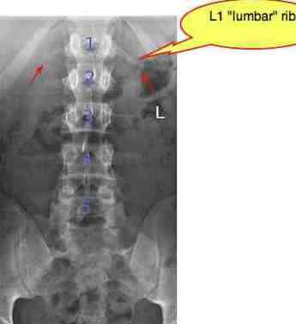
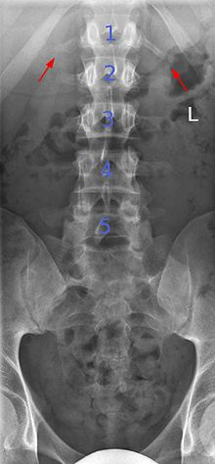

Slide 41
THANKS!!

