Slide 1
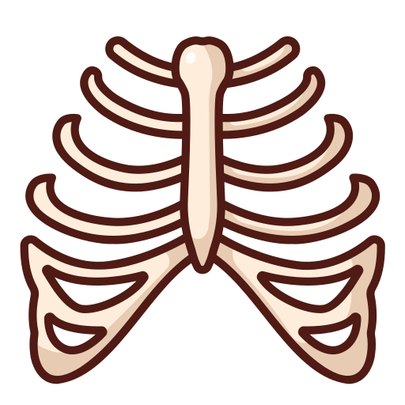
The Thoracic Cage
BY MBBSPPT.COM

Slide 2
Thoracic Cage
Thoracic Cage is a skeletal framework which supports the thorax.
It’s nature is Osteocartilaginous and elastic.
Bony wall of the thorax is formed by:
Thoracic vertebrae, ……………………… behind
Ribs, cartilages, ……………………… on either side
Sternum, ……………………… In front
The ribs are placed obliquely and the vertebral end of 1st rib is higher than its sternal end.
It gives protection for the internal organs of the thoracic cavity and supports the superior trunk, pectoral girdle, and upper limbs.

Slide 3
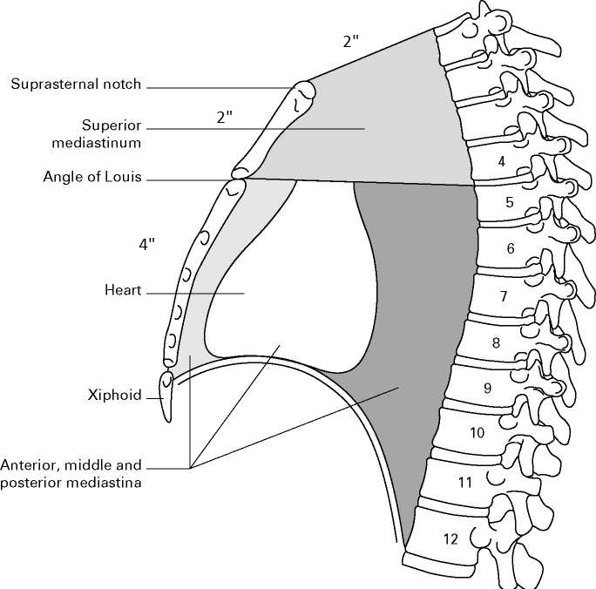
Thoracic Cage
The body of sternum is 4”.
The body is formed of 4 sternebrae.
The body of sternum lies opposite 4 thoracic vertebrae (T5, 6, 7, 8).

Slide 4
THE THORAX
Boundaries:
Posteriorly
The thoracic part of the vertebral column.
Anteriorly
The sternum and costal cartilages.
Laterally
The ribs and intercostal spaces.
Superiorly
The Suprapleural membrane.
Inferiorly
The diaphragm, which separatesthe thoracic cavity from the abdominal cavity.

Slide 5
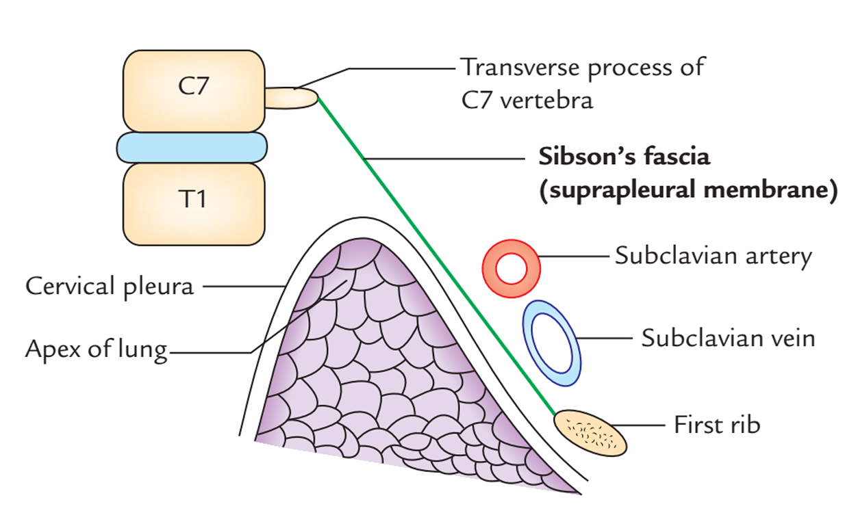
The Suprapleural membrane, also known as Sibson fascia, is a solid fascial connective tissue layer above the superior thoracic inlet on each side, placed on top of the tips of the lungs.
It can be said to be an extension of the tendinous attachment of the scalenus minimus muscle. It slopes down.

Slide 7
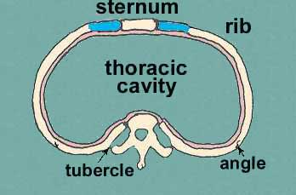
Thoracic Cavity
In cross section, it is kidney shaped.
It has the anterior, posterior and lateral boundaries.
The thoracic wall is made up of the sternum, ribs plus three layers of intercostal muscles, diaphragm and the intercostal vessels and nerves.
The function of the thorax is respiration.

Slide 8
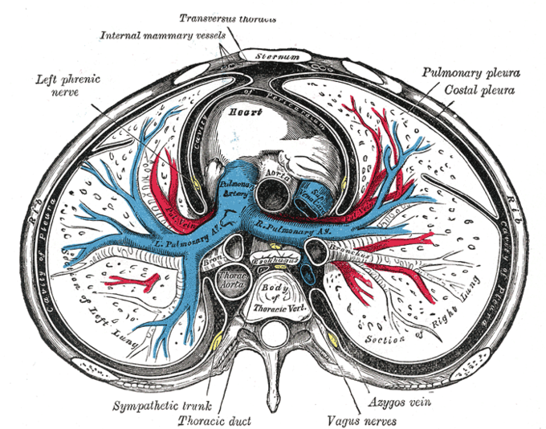
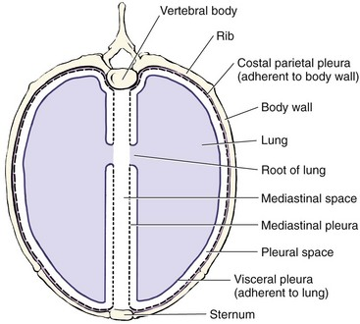
The shape of the thoacic cavity in ‘man’ and in ‘quadripeds’
In men, the thoracic cavity is flattened anteroposteriorly and kidney-shaped on the transverse section (the man can lie on his back).
In quadrupeds, the thoracic cavity is compressed from side to side.

Slide 9
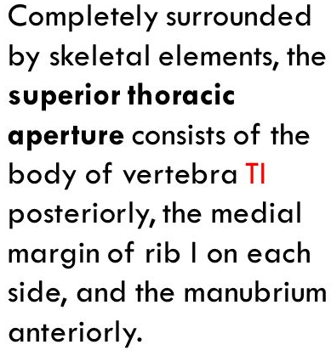
Superior aperture of the thorax
The suprapleural membrane, also known as Sibson fascia is a strong fascial connective tissue layer above the superior thoracic inlet on each side, placed on top of the tips of the lungs.

Slide 10
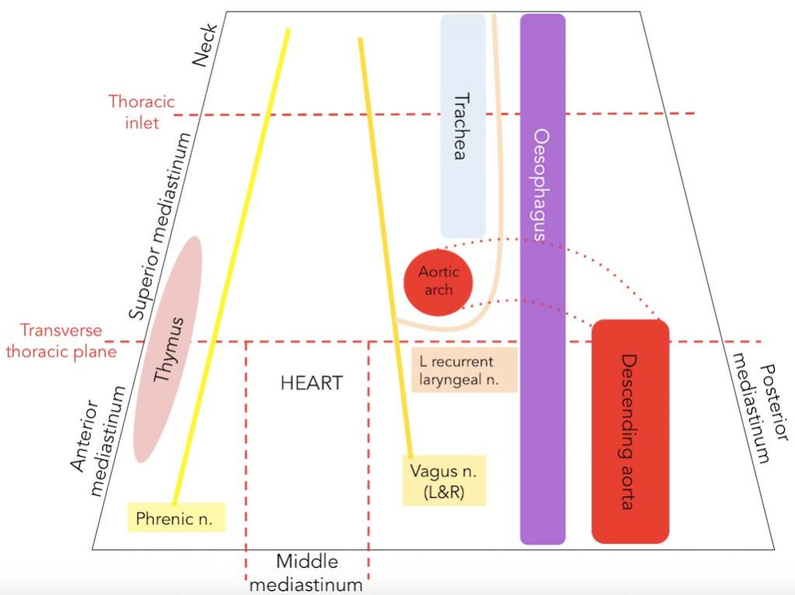
Structures passing through superior thoracic aperture

Slide 11
Structures Passing Through Superior Thoracic Aperture
Three large strucctures | Oesophagus Trachea Apex of the lung
Three large arteries | Brachiocephalic trunk Left common carotid Left subclavian
Two large veins | Right Brachiocephalic Left Brachiocephalic
Many small arteries | R & L internal thoracic R & L superior intercostal R & L 1st intercostal
Many nerves | R & L phrenic R & L vagus Left recurrent laryngeal R & L sympathetic trunks Anterior primary rami of 1st thoracic nerve
Thoracic duct
Muscles | Sternohyoid, sternothyroid, longus colli

Slide 12
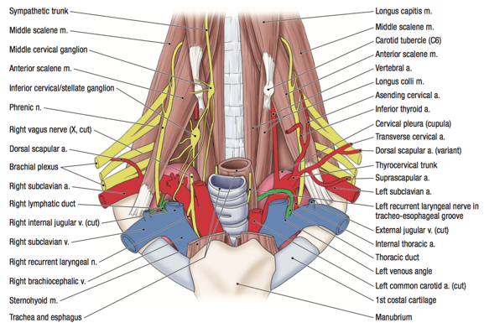

Slide 13
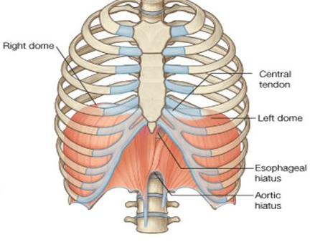
The inferior thoracic aperture is closed by the diaphragm, and structures passing between the abdomen and thorax pierce or pass posteriorly to the diaphragm.

Slide 14
Thoracic outlet syndrome
Thoracic outlet syndrome (TOS) is a term used to describe a group of disorders that occur when there is compression, injury, or irritation of the nerves and blood vessels (arteries and veins) in the lower neck and upper chest area.

Slide 15
Diaphragm
Respiratory
It is a fibromuscular/musculoaponeurotic/musculotendinous sheet which arches over the abdomen.
It separates the abdominal cavity from the thoracic cavity.

Slide 16
Thank You

