Slide 1
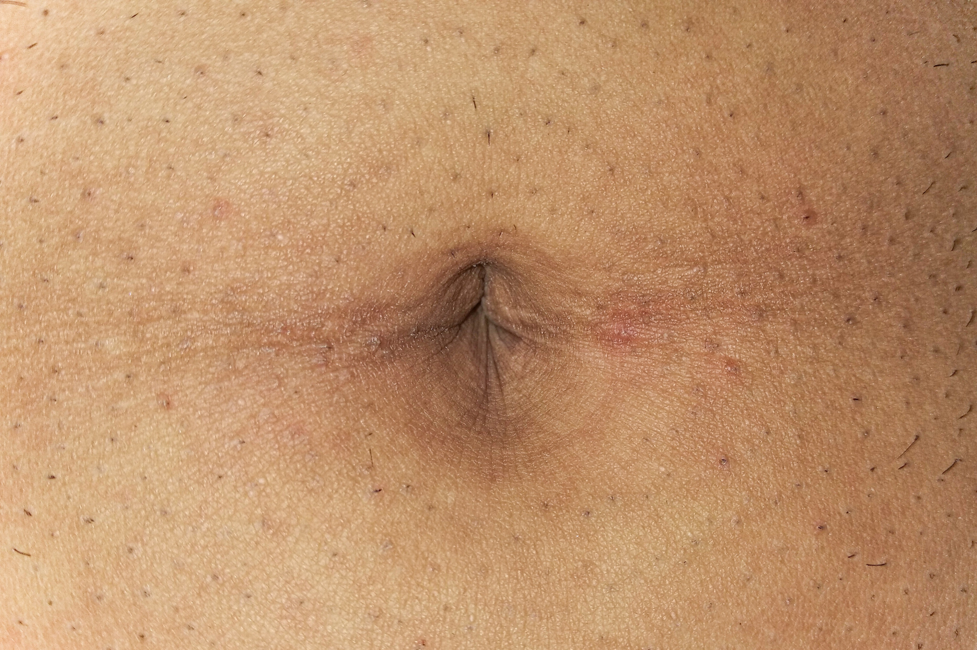
The umbilicus
By MBBSPPT.COM

Slide 2
The umbilicus
The navel, or umbilicus, is the site of attachment of the fetal umbilical cord and is located along the linea alba.
The umbilicus is an inconstant landmark.
In the healthy adult, it lies at the junction of L3 and L4 vertebrae.
It is lower in the infant and, naturally when the abdomen is pendulous.
It is higher in late pregnancy.

Slide 3
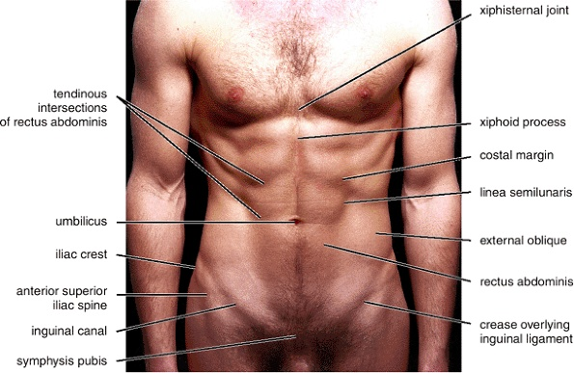

Slide 4
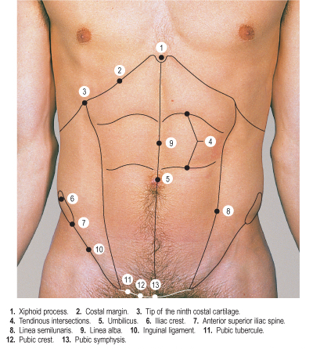

Slide 5
The umbilicus
The umbilicus tightly attached to the underlying fascia contains
Vestiges of the allantois (urachus - median umbilical ligament),
Umbilical arteries (medial umbilical ligaments) and
Umbilical vein (ligamentum teres) which can be seen on the posterior aspect of the anterior abdominal wall .
The inferior epigastric arteries form the lateral umbilical ligaments.

Slide 6
During the period of fetal circulation, the following embryologic entities are found at the umbilicus:
Left Umbilical Vein.
Vitello intestinal Duct.
Vitelline Artery And Vein.
Urachus.
Two Umbilical Arteries.

Slide 8
The umbilicus is the obvious feature:
This puckered scar represents the former site of attachment of the umbilical cord.
In physically fit people, the umbilicus lies at the level of the intervertebral disc between L3 and L4 vertebrae.
This is midway between the xiphoid process and the pubic symphysis.

Slide 9
The superficial fascia
Above the umbilicus, it contains fat and connective tissue fibers as a single layer of tissue.
Below the umbilicus, it is divided into
The subcutaneous camper's fascia and
The deeper scarpa's fascia ( membranous deep layer of superficial fascia;
Scarpa's fascia is continuous with the superficial perineal fascia (Colle's fascia) and attaches to the fascia lata. Scarpa's fascia is used for suturing the subcutaneous fascia in repairs of the anterior abdominal wall.
In rupture of the urethra, urine can extravasate between Scarpa's fascia and the fascia of the muscles of anterior abdominal wall, as high as the axilla.

Slide 10
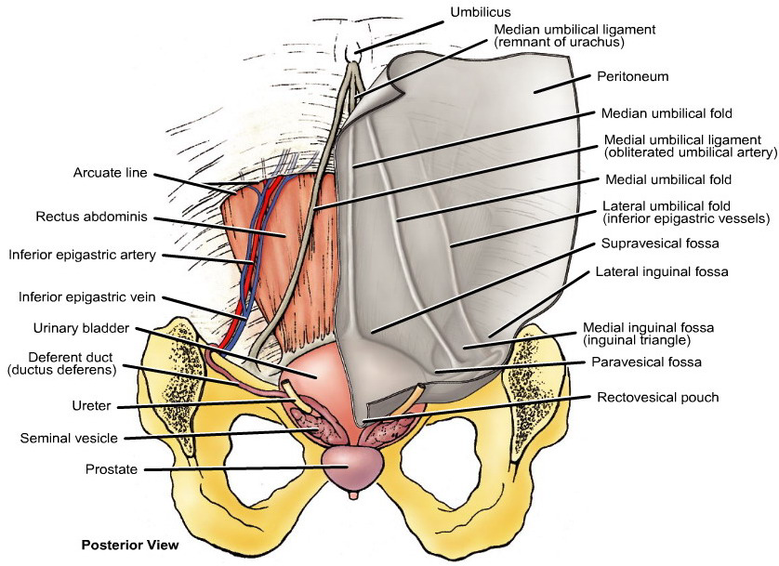

Slide 11
Umbilical cord
The definitive connecting stalk between the embryo or fetus and the placenta; at birth it is primarily composed of Wharton's jelly in which the umbilical vessels are embedded.

Slide 12
Umbilical ring
An opening in the linea alba through which pass the umbilical vessels in the fetus; in young embryos it is relatively nearer to the pubis, but gradually ascends to the center of the abdomen; it is closed in the adult, its site being indicated by the umbilicus or navel.
Syn: Annulus Umbilicalis.

Slide 13
Umbilical Area
Embryologically, the umbilicus is a midline fusion of the medial aponeurotic borders of both rectus abdominis aponeuroses around the umbilical cord.
This fusion may take place around the 10th week, after the herniated midgut returns to the peritoneal cavity.

Slide 14
Attachments at the umbilicus
The median umbilical fold extends from the apex of the urinary bladder to the umbilicus and covers the median umbilical ligament, the remnant of the urachus, which joined the apex of the fetal bladder to the umbilicus.
Two medial umbilical folds, lateral to the median umbilical fold, cover the medial umbilical ligaments, formed by occluded parts of the umbilical arteries.
Two lateral umbilical folds, lateral to the medial umbilical folds, cover the inferior epigastric vessels and therefore bleed if cut.

Slide 15
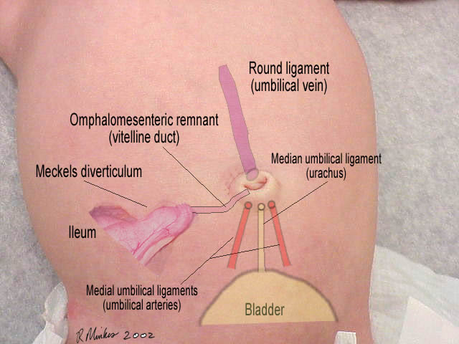

Slide 16
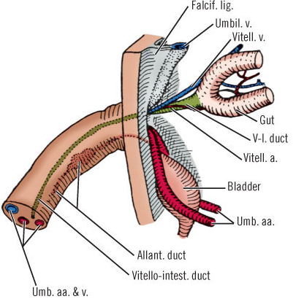

Slide 18
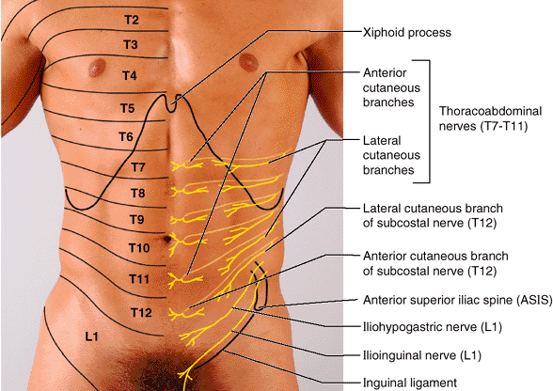

Slide 20
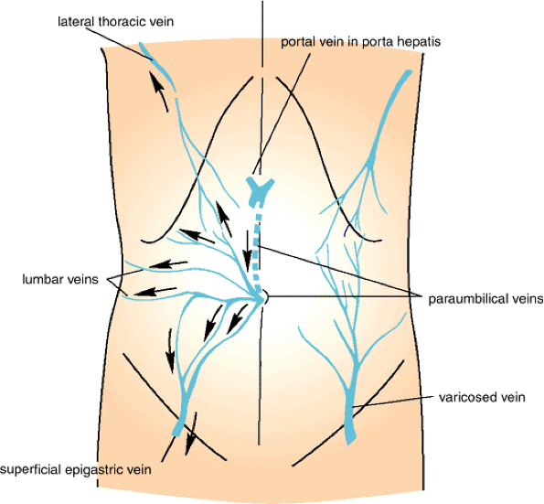
Superficial veins of the anterior abdominal wall. On the left are anastomoses between systemic veins and the portal vein via paraumbilical veins. Arrows indicate the direction taken by venous blood when the portal vein is obstructed. On the right is an enlarged anastomosis between the lateral thoracic vein and the superficial epigastric vein. This occurs if either the superior or the interior vena cava is obstructed.

Slide 21
Caput medusae is the appearance of distended and engorged paraumbilical veins, which are seen radiating from the umbilicus across the abdomen to join systemic veins. The name caput medusae (Latin for "head of Medusa") originates from the apparent similarity to Medusa's hair once Minerva had turned it into snakes [citation needed].

Slide 22
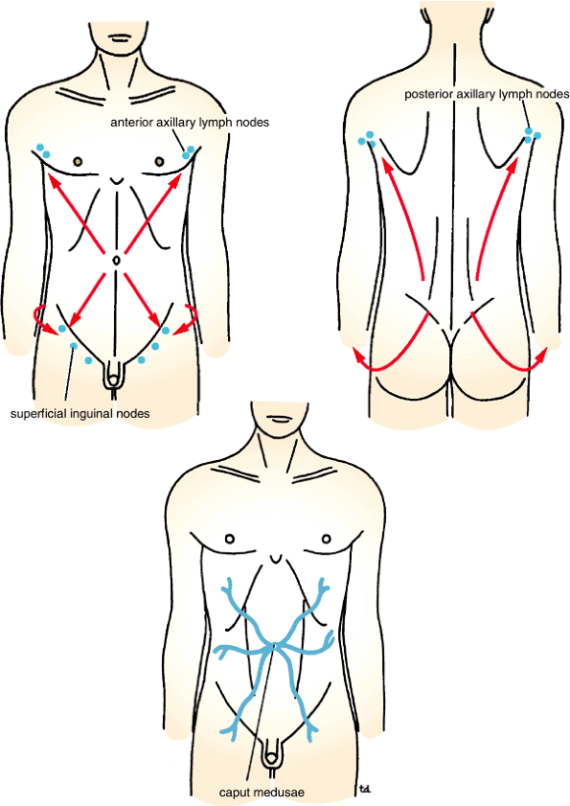

Slide 23
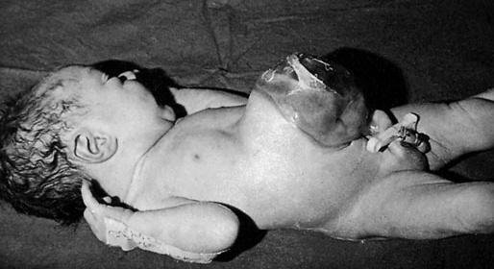

Slide 24
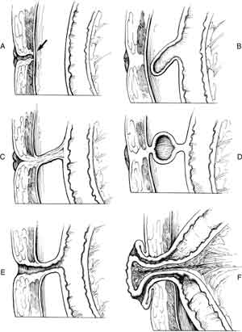

Slide 25
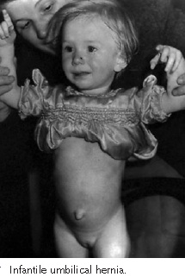

Slide 26
Infection of the umbilical cord
In over 50% of babies born in maternity hospitals the stump of the umbilical cord is found to be carrying staphylococci by the third or fourth-day post delivery. Less commonly the stump of the cord harbors streptococci, and epidemics of puerperal sepsis in maternity hospitals have been traced to the umbilical cord of one infant in the nursery thus infected. Escherichia coli and Clostridium tetani (causing neonatal tetanus) are other possible invaders. The chief prophylaxis is strict asepsis during severance of the cord and the use of 0.1% chlorhexidine locally for a few days.

Slide 27
Omphalitis
The incidence of an infected umbilicus is much higher in communities that do not practise aseptic severance of the umbilical cord. When the stump of the umbilical cord becomes inflamed, antibiotic therapy usually localizes the inflammation. The crusts separate by employing warm, moist dressings, giving exit to pus. Exuberant granulation tissue requires a touch of silver nitrate. In more severe cases, infection is liable to spread along the defunct hypogastric arteries or umbilical vein when, in all probability, one or other of the following complications will supervene:

Slide 28
Umbilical granuloma
Chronic infection of the umbilical cicatrix that continues for weeks causes granulation tissue to pout at the umbilicus. There is no certain means of distinguishing this condition from an adenoma. Usually, an umbilical granuloma can be treated by one application of silver nitrate followed by dry dressings, but an adenoma soon recurs in spite of these measures.

Slide 29
Umbilical fistulae
As the umbilicus is a central abdominal scar it is understandable that a slow leak from any viscus is liable to track to the surface at this point. Added to this, very occasionally, the Vitello intestinal duct or the urachus remains patent; consequently, it has been aptly remarked that the umbilicus is a creek into which many fistulous streams may open.

Slide 30
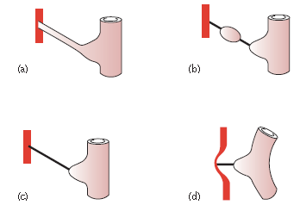
Anomalies connected with the Vitello intestinal duct. (a) Umbilical fistula; (b) intra-abdominal cyst; (c) intraperitoneal band; (d) Meckel’s diverticulum with a band adherent to the sac of a congenital umbilical hernia.

Slide 31
The Vitello intestinal duct
0mphalomesenteric duct
The Vitello intestinal duct occasionally persists & remains patent. The resulting umbilical fistula discharges mucus and, rarely, faeces. Often, a small portion only of the duct near the umbilicus remains unobliterated. This gives rise to a sinus that discharges mucus. The epithelial lining of the sinus often becomes everted to form an ‘adenoma’.
Sometimes both the umbilical and the intestinal ends of the duct close but the mucous membrane of the intervening portion remains and an intra-abdominal cyst develops.
With its lumen obliterated or unobliterated the Vitello intestinal duct provides an intraperitoneal band; this is a potential danger because intestinal obstruction is liable to occur.
Such a band may contract and pull a Meckel’s diverticulum into a congenital umbilical hernia.

Slide 32
Patent urachus
A patent urachus seldom reveals itself until maturity or even old age. This is because the contractions of the bladder commence at the apex of the organ and pass towards the base. Because it opens into the apex of the bladder a patent urachus is closed temporarily during micturition and so the potential urinary stream from the bladder is cut off. Thus, the fistula remains unobtrusive until a time when the organ is overfull, usually due to some form of obstruction.

Slide 33
Neoplasms of the umbilicus
Benign
Umbilical adenoma or raspberry tumor This is commonly seen in infants but only occasionally later in life. It is due to a partially (occasionally a completely) unobliterated Vitello intestinal duct. Mucosa prolapsing through the umbilicus gives rise to a raspberry-like tumor, which is moist and tends to bleed.
Malignant
Secondary carcinoma at the umbilicus (or Sister Joseph’s nodule3) is quite common but is always a late manifestation of the disease. The primary neoplasm is often situated in the stomach, colon or ovary, but a metastasis from the breast, probably transmitted along the lymphatics of the round ligament of the liver, is sometimes located here.

Slide 34
Thank You

