Slide 1
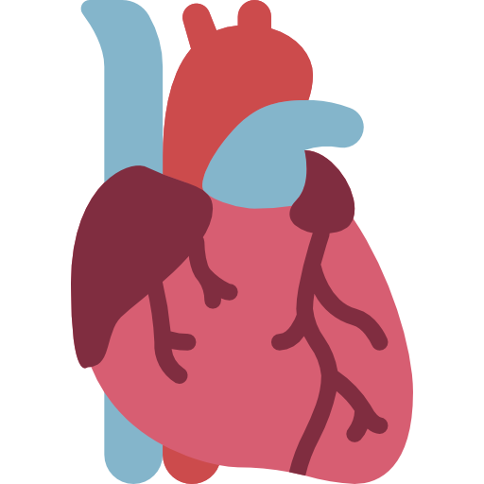
THE VALVES OF THE HEART
BY MBBSPPT.COM

Slide 2
The Valves of the Heart
The Valves of the Heart are present in 2 pairs:
A pair of atrioventricular valves, bring blood to the ventricles.
A pair of semilunar valves, drain blood from the ventricles.
They are composed of connective tissue and endocardium (the inner layer of the heart).
The valves of the heart are structures which ensure blood flows in only one direction.
The valves prevent regurgitation of the blood.

Slide 3
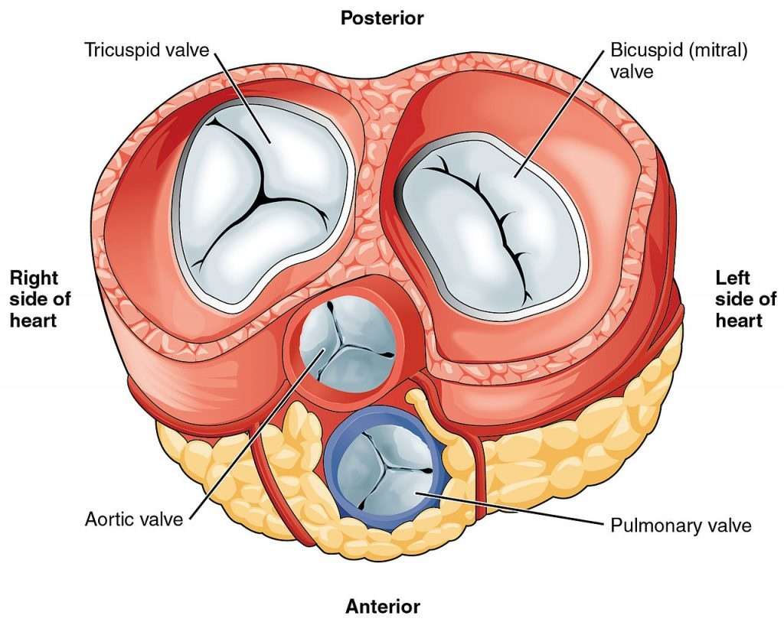

Slide 4
Surface Anatomy of the
Heart Valves
The surface markings of the heart valves are as follows:
The tricuspid valve lies behind the right half of the sternum opposite the 4th intercostal space.
The mitral valve lies behind the left half of the sternum opposite the 4th costal cartilage.
The pulmonary valve lies behind the medial end of the third left costal cartilage and the adjoining part of the sternum.
The aortic valve lies behind the left half of the sternum opposite the 3rd intercostal space.

Slide 5
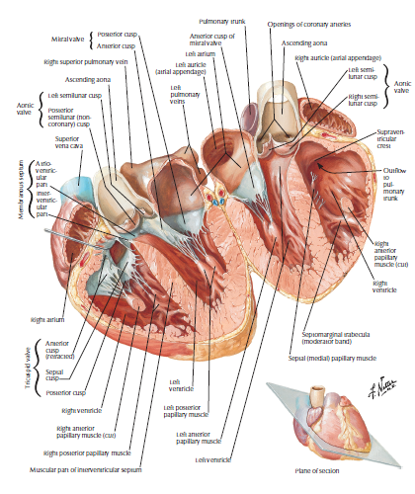

Slide 6
ATRIOVENTRICULAR VALVES
The left and right atria communicate with the left and right ventricles via left and right atrioventricular orifices, respectively.
The atrioventricular valves are located between the atria and the ventricles. They close during the start of ventricular contraction (systole), producing the first heart sound.
The left and right atrioventricular orifices are guarded by the left and right atrioventricular valves respectively:
Tricuspid Valve (right Av Valve).
Mitral Valve (left Av Valve).

Slide 7
AV VALVES
The mitral and tricuspid valves are supported by the attachment of fibrous cords (chordae tendineae) to the free edges of the valve cusps.
The chordae tendineae are, in turn, attached to papillary muscles, located on the interior surface of the ventricles – these muscles contract during ventricular systole to prevent prolapse of the valve leaflets into the atria.

Slide 8
STRUCTURE
The atrioventricular valves are created from 2 components:
A fibrous ring.
Cusps.
The fibrous rings surround the orifice. The cusps are created by the fold of the endocardium enclosing some connective tissue inside it.
Every cusp has a connected and free margin and atrial and ventricular surfaces.
The atrial surfaces are smooth.
The ventricular surfaces and free margins are rough and provide connection to the chordae tendinae.
The chordae tendinae attach the apices of papillary muscles with margins and ventricular surfaces of the cusps.
The chordae tendinae of every papillary muscle are connected to the contiguous halves of the 2 cusps.

Slide 9
Tricuspid (Right AV) Valve
Lies between the right atrium and ventricle, behind the right half of the sternum oppo- site the fourth intercostal space, and is covered by endocardium.
Is most audible over the right (or left for some people) lower part of the body of the sternum.
Has anterior, posterior, and septal cusps, which are attached by the chordae tendineae to three papillary muscles that keep the valve closed against the pressure developed by the pumping action of the heart.
Is closed during the ventricular systole (contraction); its closure contributes to the first ("lub") heart sound.

Slide 10
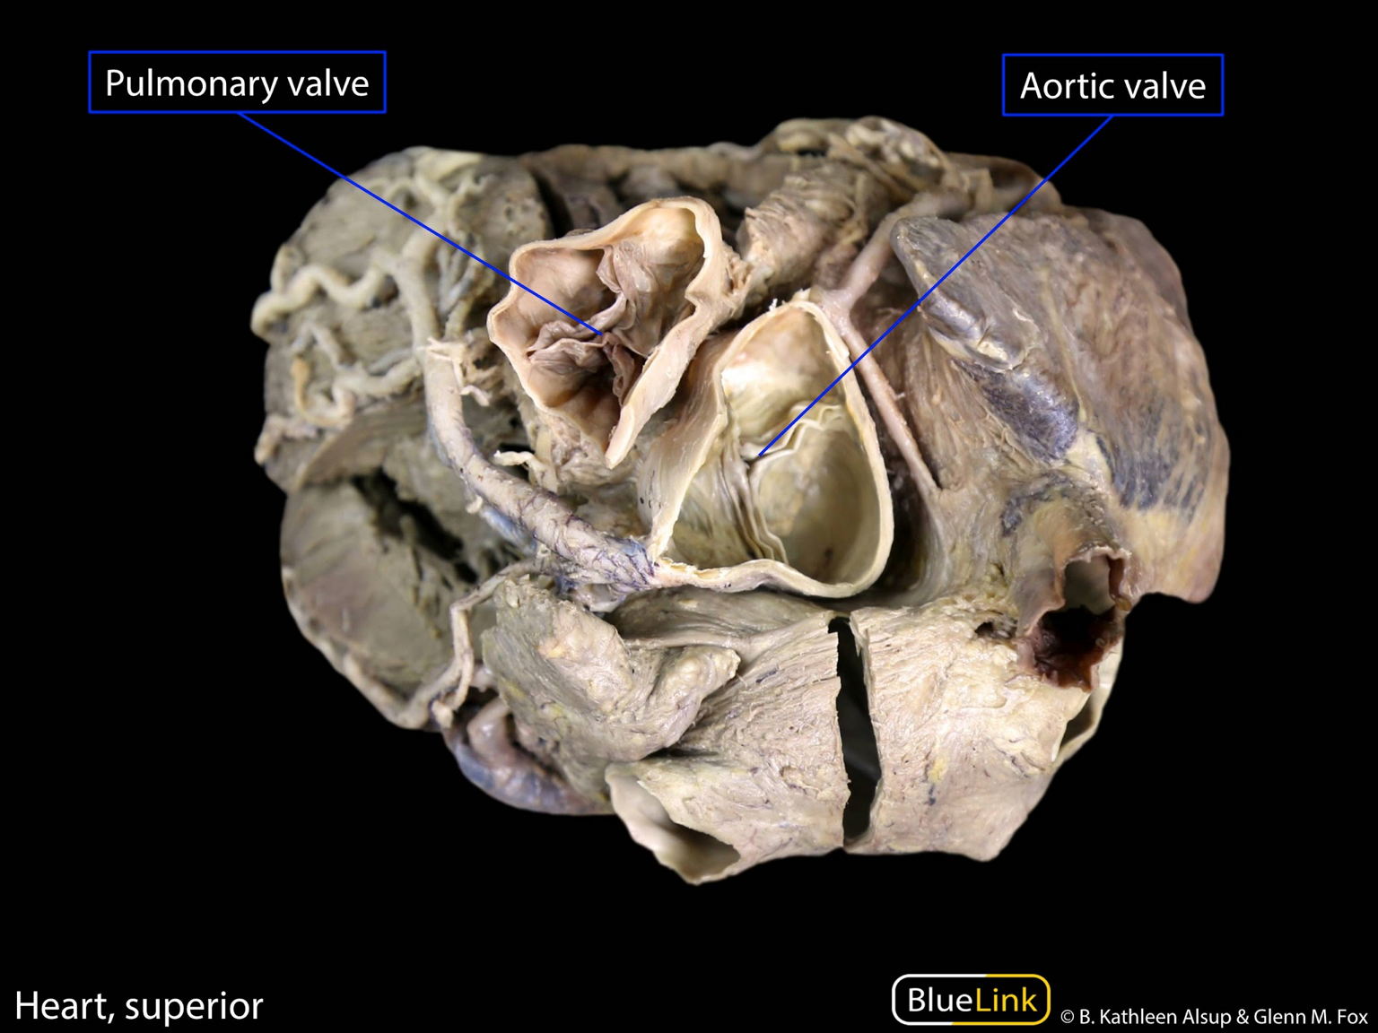

Slide 11
A. Right atrioventricular valve (tricuspid valve)
As the name indicates it is 3 cusps anterior, posterior and septal, which is located against the 3 walls of the ventricle.
Located between the right atrium and the right ventricle (right atrioventricular orifice).
It consists of three cusps (anterior, septal and posterior), with the base of each cusp anchored to a fibrous ring that surrounds the orifice.
The tricuspid valve can admit the tips of 3 fingers.

Slide 12
B. Left atrioventricular valve (bicuspid/mitral valve)
Located between the left atrium and the left ventricle (left atrioventricular orifice).
It is also known as the bicuspid valve because it has two cusps (anterior and posterior).
Like the tricuspid valve, the base of each cusp is secured to fibrous ring that surrounds the orifice.
As the name indicates it is 2 cusps a larger anterior/aortic cusp and a smaller posterior cusp.
The mitral/bicuspid valve can admit the tips of 2 fingers.

Slide 13
Bicuspid (Left AV) Valve
Is called the mitral valve because it is shaped like a bishop's miter.
Lies between the left atrium and ventricle, behind the left half of the sternum at the fourth costal cartilage, and has two cusps: a larger anterior and a smaller posterior.
Is closed slightly before the tricuspid valve by the ventricular contraction (systole); its closure at the onset of ventricular systole causes the first ("lub") heart sound.
Is most audible over the apical region of the heart in the left fifth intercostal space at the midclavicular line.

Slide 14
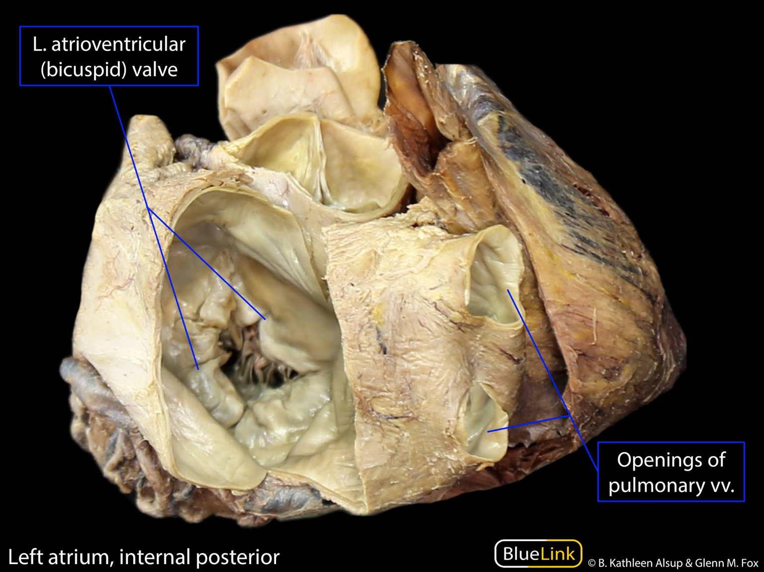

Slide 15
Points to be noted
The nutrition to the fibrous ring and basal 1/3rd of cusps is provided by the blood vessels.
The nutrition to the distal 2/3rd of the cusps is provided directly by the blood inside the chambers of the heart.
The cusps of mitral valve are smaller but thicker than those of tricuspid valve.

Slide 16
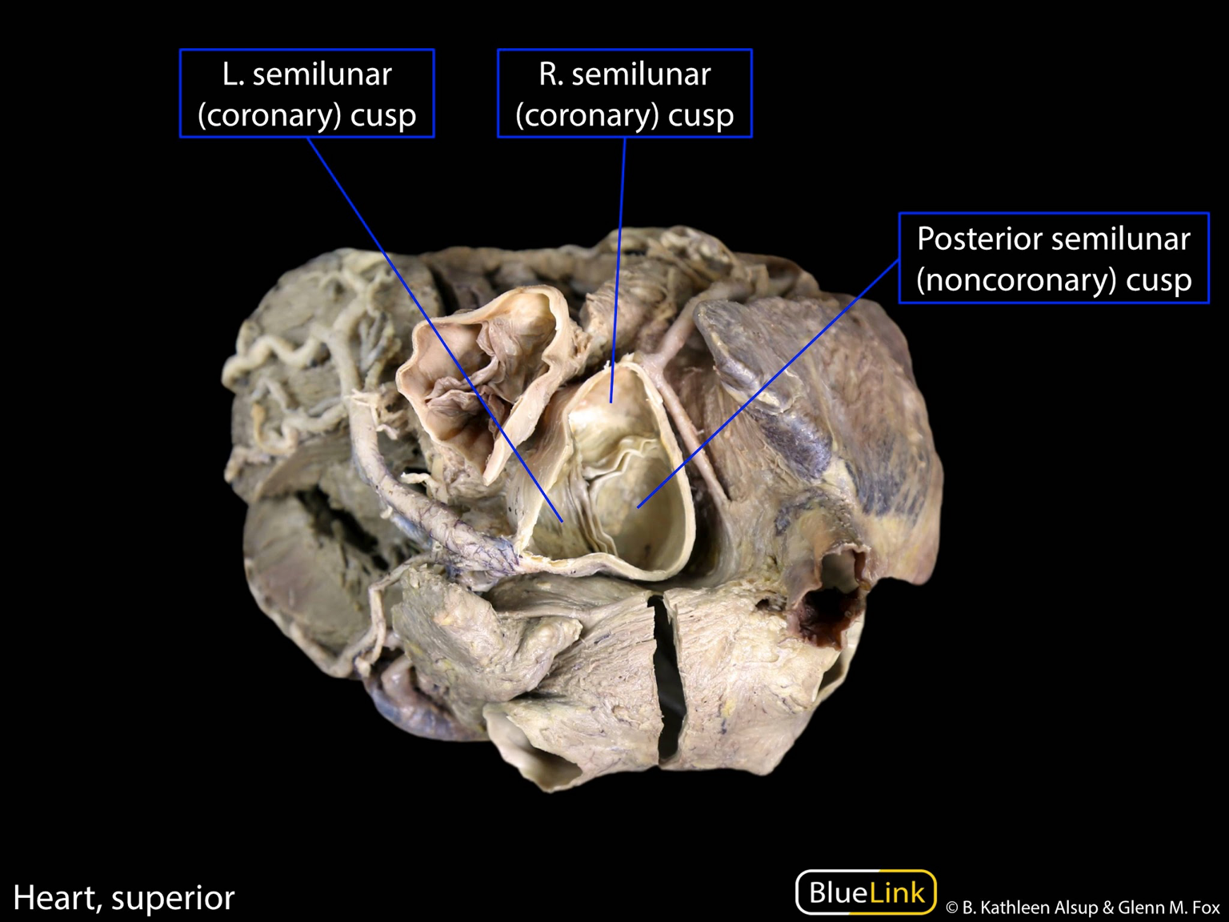

Slide 17
Role Of Papillary Muscle In Acute Cardiac Failure
The papillary muscles prevent the prolapse of atrio-ventricular valves into the atria during ventricular systole.
The rupture of a papillary muscle, following a nearby myocardial infarction, will enable the prolapse of the affected cusp to take place into the atrium at every systole. This may consequently result in acute cardiac failure.

Slide 18
SEMILUNAR VALVES
The left and right ventricles pump out blood via pulmonary and aortic orifices, respectively.
Each of these orifices is guarded by 3 semilunar cusps thus these are referred to as semilunar valves.
Both aortic and pulmonary valves are quite similar to every other in structure and functions.
Every valve has 3 cusps that are connected directly to the wall of aorta/pulmonary trunk.
(Note: these don’t have fibrous ring quite similar to tricuspid and mitral valves).
The cusps of semilunar valves are open and stretched during ventricular systole and closed during ventricular diastole to prevent regurgitation of the blood into the ventricle.

Slide 19
Pulmonary valve
Located between the right ventricle and the pulmonary trunk (pulmonary orifice).
The valve consists of three cusps:
Left,
Right,
Anterior.
(named by their position in the foetus before the heart undergoes rotation).
Blood passes from right atrium to right ventricle & follows U-shaped path to pass through pulmonary orifice.

Slide 20
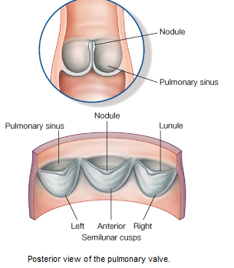

Slide 21
Aortic valve
Located between the left ventricle and the ascending aorta (aortic orifice).
The aortic valve consists of three cusps:
Right,
Left,
Posterior.
The left and right aortic sinuses mark the origin of the left and right coronary arteries.
As blood recoils during ventricular diastole, it fills the aortic sinuses and enters the coronary arteries to supply the myocardium.

Slide 22
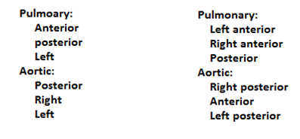
Positions of semilunar valves

Slide 23
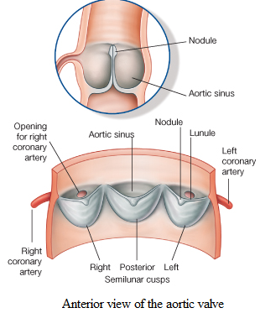

Slide 24
Structure
The pulmonary and aortic valves have a similar structure. The sides of each valve leaflet are attached to the walls of the outflow vessel, which is slightly dilated to form a sinus.
The free superior edge of each leaflet is thickened (the lunule), and is widest in the midline (the nodule).
When the valve is closed, the nodules meet in the center.
At the beginning of ventricular diastole, blood flows back towards the heart, filling the sinuses and pushing the valve cusps together. This closes the valve.

Slide 25
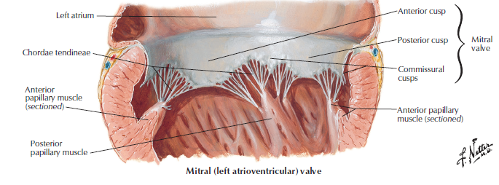
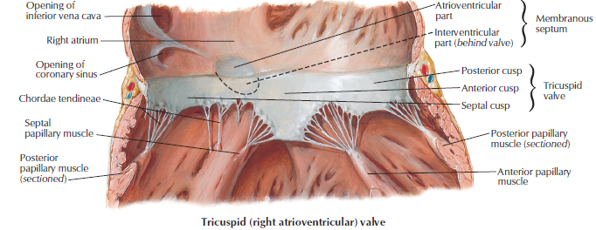

Slide 26
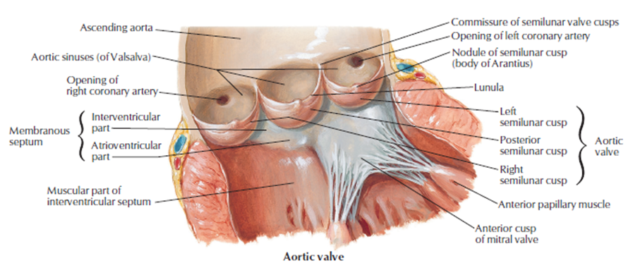

Slide 27
Points to be noted
No chordae tendinae or papillary muscles are related to semilunar valves. The connection of the sides of cusps to the atrial wall prevents regurgitation of blood.
Opposite to the cusps, the roots of pulmonary trunk and ascending aorta present 3 dilatations termed sinuses.
The blood in these types of sinuses prevents the cusps from sticking to the wall of great vessels.
The anterior aortic sinus provides origin to the right coronary artery and left posterior aortic sinus provides origin to the left coronary artery.

Slide 28
POSITIONS OF CUSPS IN THE PULMONARY VALVES
The positions of cusps of pulmonary valves are:
Right Anterior,
Left Anterior, And
Posterior.
Embryologically, pulmonary valve has anterior, left and right cusps.

Slide 29
POSITIONS OF CUSPS in
AORTIC VALVES
The positions of cusps of aortic valve are just opposite to those of the pulmonary valve.
These are:
Right Posterior,
Left Posterior, And
Anterior.
Embryologically, aortic valve has posterior, left and right cusps.
The left coronary artery originates from the left aortic sinus, the right coronary artery from the right aortic sinus and no artery originates from the posterior aortic sinus (non-coronary sinus).

Slide 30
MURMURS
The abnormal heart sounds are named murmurs. These are produced because of regurgitation of blood heard when the valves are either stenosed or when the valves are not closed properly (leading to regurgitation).
In aortic and pulmonary stenosis the murmur is heard during systole and in insufficiency of these valves they’re heard during diastole.
In stenosis of mitral and tricuspid valves, the murmurs are heard during diastole and in their insufficiency during systole.

Slide 31
MITRAL STENOSIS (NARROWING OF MITRAL ORIFICE)
It is most common in young age. Generally, there is history of rheumatic fever in the childhood in these types of cases. This leads to rise in the left atrial pressure and enlargement of left atrium which might press on the esophagus.
Medically features of mitral stenosis will probably be as follows:
Shortness of breath (dyspnea).
Dysphagia (difficulty in swallowing).
Hoarseness of voice (Ortner's syndrome).

Slide 32
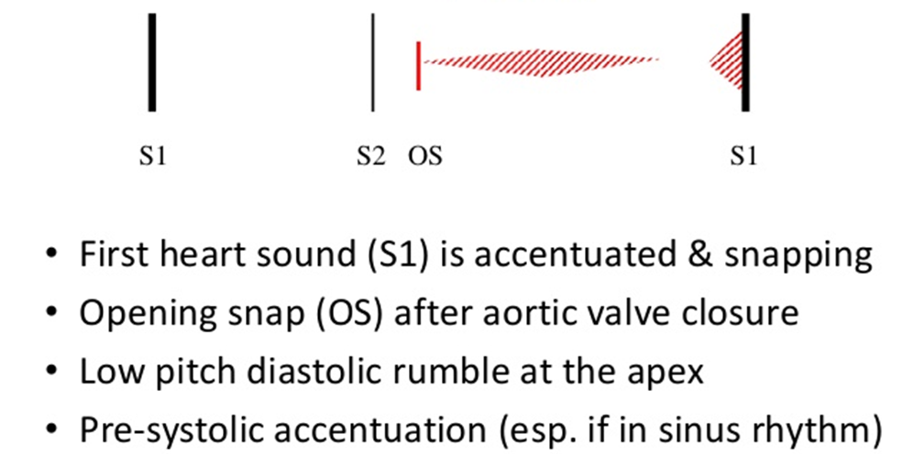
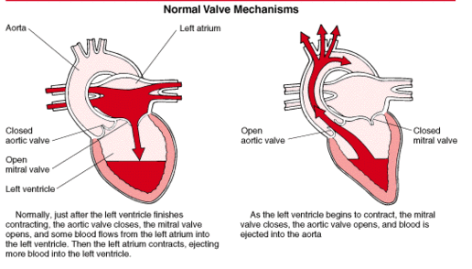
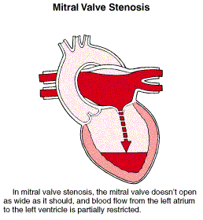
Mitral Stenosis: Physical exam

Slide 33
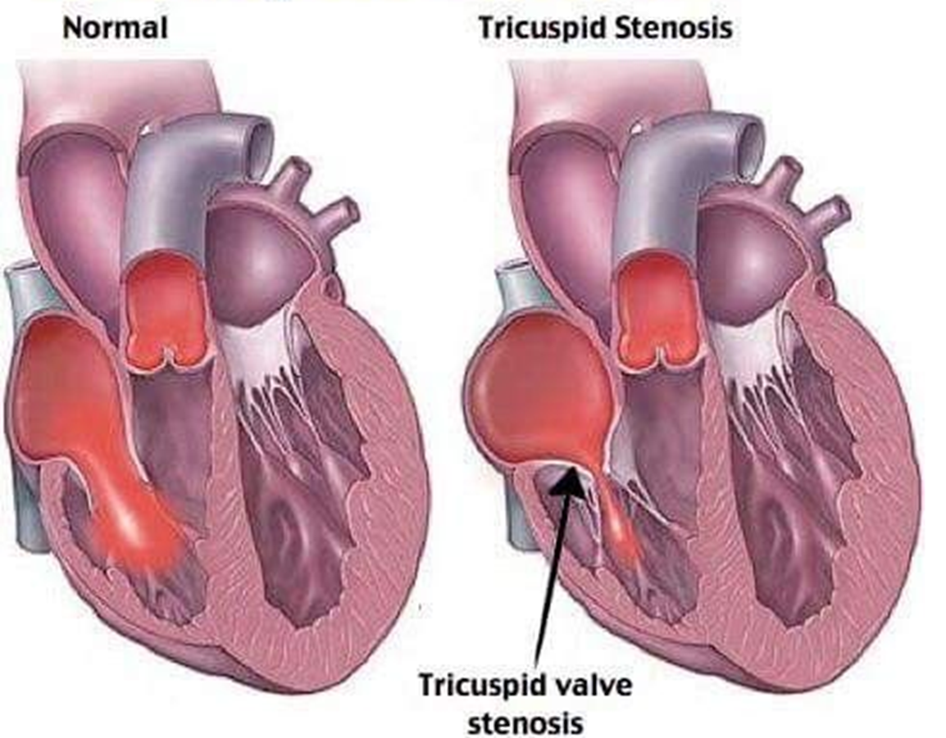
TRICUSPID STENOSIS
In tricuspid stenosis blood flow from right atrium to right ventricle is reduced.
The elevation of right atrial pressure leads to systemic venous congestion and right heart failure.

Slide 34
AORTIC STENOSIS
In aortic stenosis their accumulation of blood in left ventricle, causing its dilatation and hypertrophy.
There is low cardiac output which might manifest as syncope (fainting) on exertion.

Slide 35
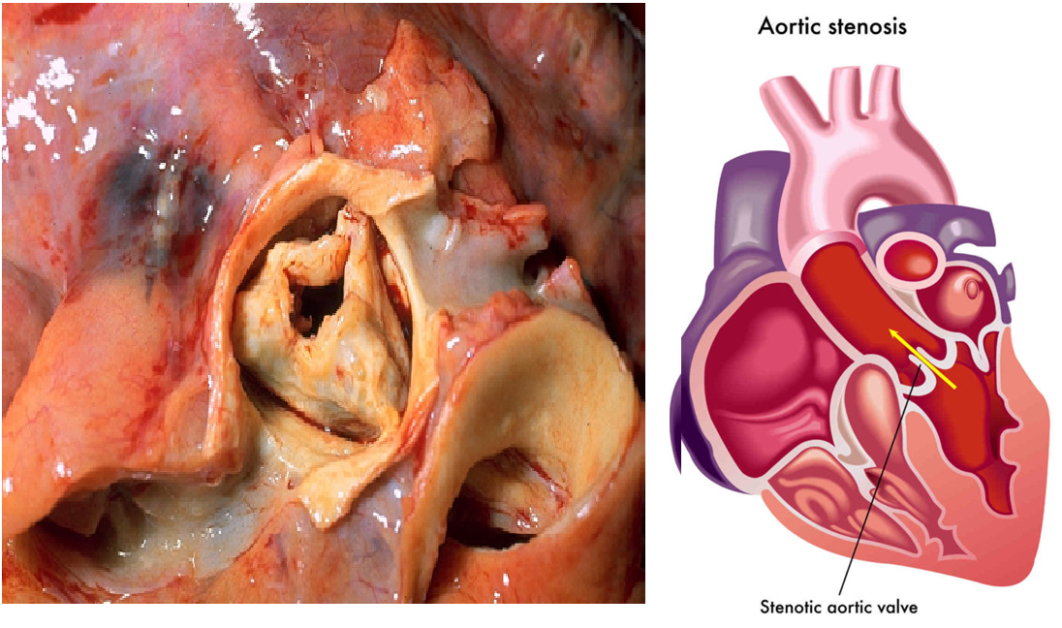

Slide 36
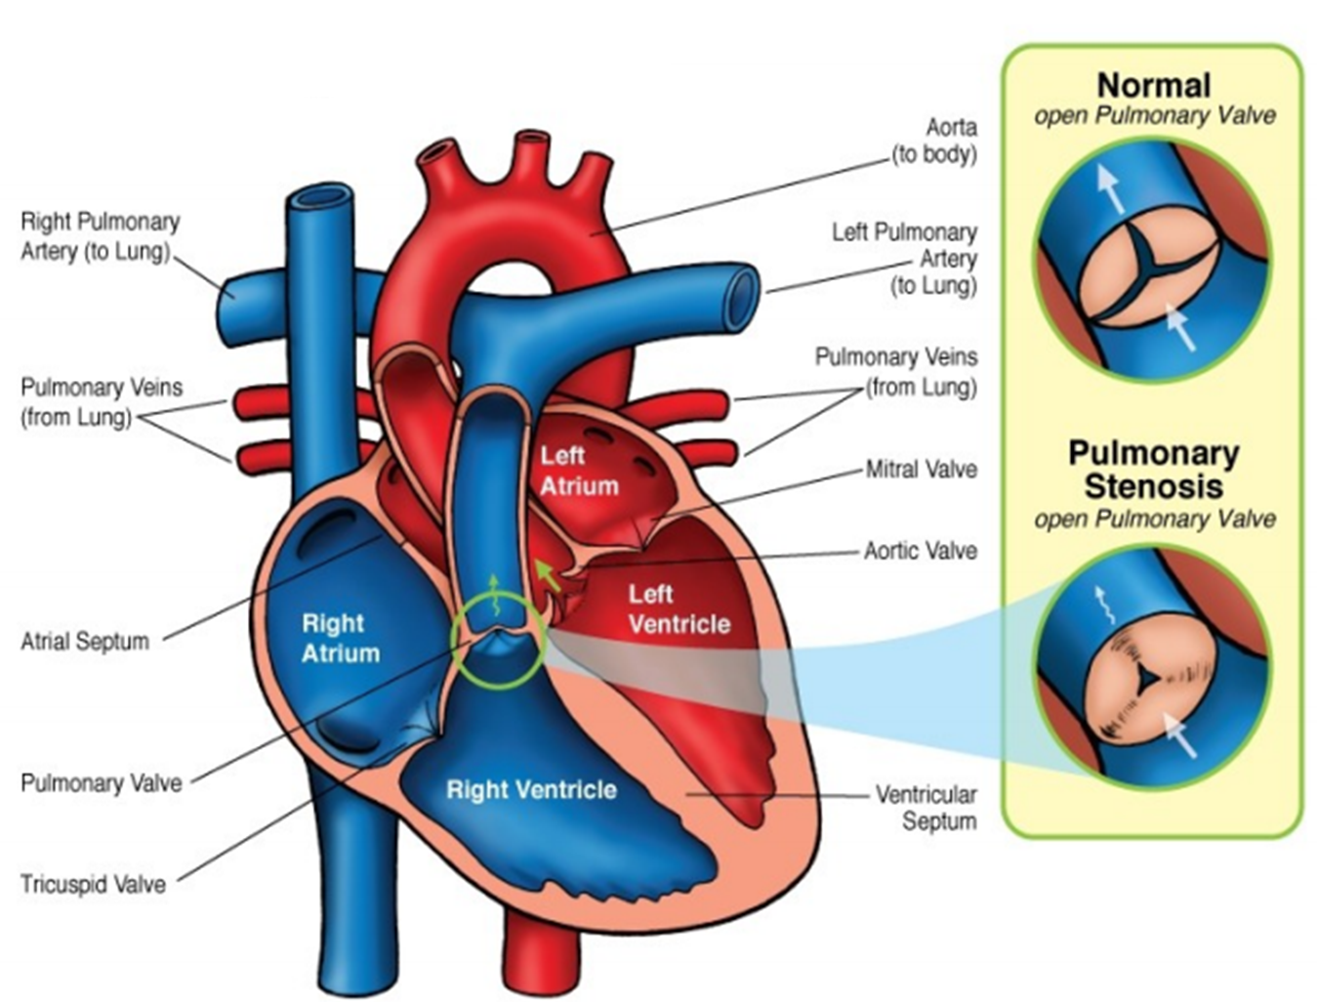
PULMONARY STENOSIS
It is just about always congenital, generally a part of Fallot's tetralogy.
It leads to hypertrophy of right ventricle.

Slide 37
Thank You

