Slide 1
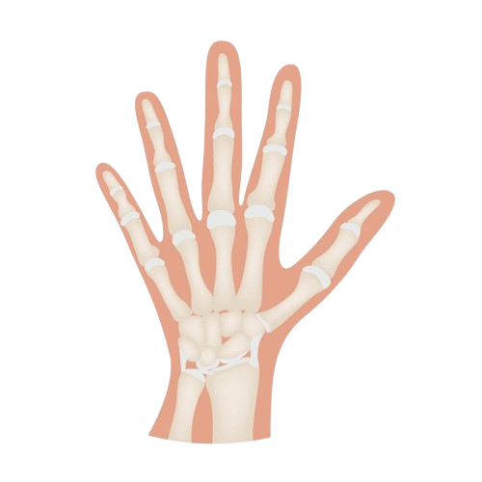
The Wrist Joint
BY MBBSPPT.COM

Slide 2
The Wrist Joint
The wrist joint is the radiocarpal joint which is a complex biaxial synovial joint that bridges the hand to the forearm.
It involves the three carpal bones, the proximal carpal bones – scaphoid, lunate and triquetral.
It also involves the distal end of the radius and an articular disc which lies over the ulna.

Slide 3
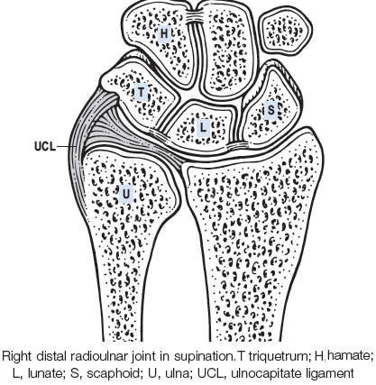

Slide 4
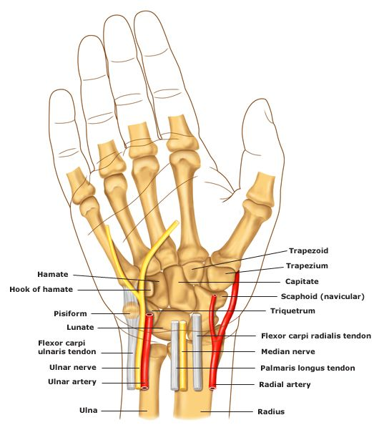

Slide 5
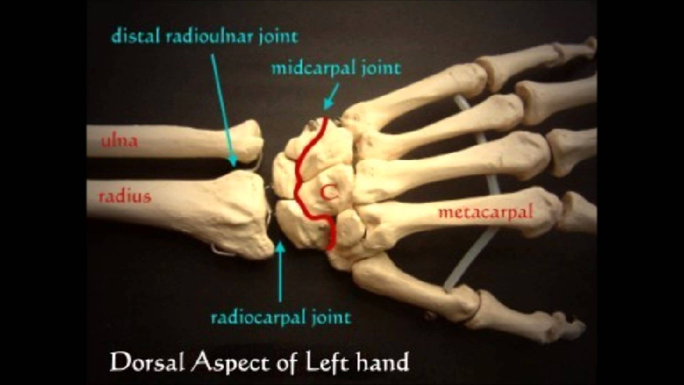

Slide 6
Type
It is the Radio-Carpal Joint, lies at the level of proximal wrist crease.
It is a synovial joint of ellipsoid (condyloid) variety.

Slide 7
Articulating Surfaces
The wrist joint is formed by:
Distally – The proximal row of the 3 carpal bones (scaphoid, lunate and triquetral).
Proximally – The distal end of the radius, and the articular disc(The triangular fibrocartilage complex (TFCC).
The ulna is not part of the wrist joint.
It is prevented from articulating with the carpal bones by an articular disc(TFCC), which lies between the ulna & the proximal row of carpal bones.
Together, the carpal bones form a convex surface, which articulates with the concave surface of the radius and articular disc.

Slide 10
Joint Capsule
(Capsular Ligament)
Like any synovial joint, the capsule is double layered.
The fibrous outer layer attaches to the distal ends of radius, ulna and the proximal row of the carpal bones.
The internal layer, synovial membrane extends up to the margins of the articular surfaces.

Slide 11
Ligaments
There are four ligaments in the wrist joint, one for each side of the joint.
1. Palmar radiocarpal – (on anterior side of the hand). It passes from the radius to both rows of carpal bones.
Its function, apart from increasing stability, is to ensure that the hand follows the forearm during supination.
2. Dorsal radiocarpal – (the dorsum (posterior) side of the hand). It passes from the radius to both rows of carpal bones.
It contributes to the stability of the wrist, but also ensures that the hand follows the forearm during pronation.
3. Ulnar collateral – Runs from the ulnar styloid process to the triquetrum and pisiform.
Works in union with the other collateral ligament to prevent excessive lateral joint displacement.
4. Radial collateral – Runs from the radial styloid process to the scaphoid and trapezium.
Works in union with the other collateral ligament to prevent excessive lateral joint displacement.
Palmar ulnocarpal ligament: It is formed due to thickening of the medial part of the anterior aspect of the fibrous capsule.

Slide 12
Ligaments

Slide 13
Ligaments

Slide 14
Neurovascular Supply
The wrist joint receives blood from branches of the dorsal and palmar carpal arches, which are derived from the ulnar and radial arteries.
Innervation to the wrist is delivered by branches of three nerves:
Median nerve – Anterior interosseous branch.
Radial nerve – Posterior interosseous branch.
Ulnar nerve – deep and dorsal branches.

Slide 15
Relations
ANTERIOR | Tendons of flexor digitorum superficialis, flexor digitorum profundus and associated synovial sheath (ulnar bursa). Tendon of flexor pollicis longus and associated synovial sheath (radial bursa). Median nerve. Tendon of flexor carpi radialis and associated synovial bursa. Ulnar nerve and vessels.
POSTERIOR | Extensor Tendons Of Wrist And Fingers, And Associated Synovial Sheaths.
LATERAL | Radial artery (across the radial collateral ligament). Tendon of abductor pollicis longus. Tendon of extensor pollicis brevis.
MEDIAL | Dorsal cutaneous branch of ulnar nerve.

Slide 16
Structures on the Anterior Aspect of the Wrist Superficial to the flexor retinaculum from medial to lateral
Flexor carpi ulnaris tendon | ending on the pisiform bone. (This tendon does not actually cross the flexor retinaculum but is included for the sake of completeness)
Ulnar nerve | lies lateral to the pisiform bone.
Ulnar artery | lies lateral to the ulnar nerve.
Palmar cutaneous branch of the ulnar nerve
Palmaris longus tendon (if present) | passing to its insertion into the flexor retinaculum and the palmar aponeurosis.
Palmar cutaneous branch of the median nerve

Slide 17
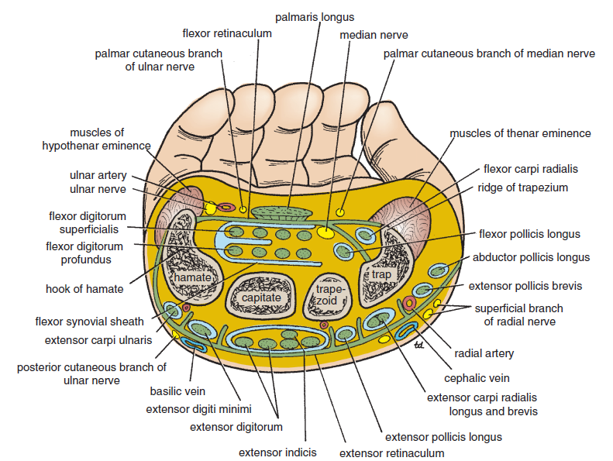

Slide 18
Structures on the Anterior Aspect of the Wrist Deep to the flexor retinaculum from medial to lateral
Flexor digitorum superficialis tendons & posterior to these, the tendons of the flexor digitorum profundus | both groups of tendons share a common synovial sheath
Median nerve
Flexor pollicis longus tendon | surrounded by a synovial sheath
Flexor carpi radialis tendon going through a split in the flexor retinaculum. | The tendon is surrounded by a synovial sheath.

Slide 19
Structures on the Posterior Aspect of the Wrist Superficial to the extensor retinaculum from medial to lateral
Dorsal (posterior) cutaneous branch of the ulnar nerve
Basilic vein
Cephalic vein
Superficial branch of the radial nerve

Slide 20
Structures on the Posterior Aspect of the Wrist Deep to the extensor retinaculum from medial to lateral
Extensor carpi ulnaris tendon | grooves the posterior aspect of the head of the ulna
Extensor carpi ulnaris tendon | grooves the posterior aspect of the head of the ulna
Extensor carpi ulnaris tendon | grooves the posterior aspect of the head of the ulna
Extensor pollicis longus tendon | winds around the medial side of the dorsal tubercle of the radius.
Extensor carpi radialis longus and brevis tendons | share a common synovial sheath and are situated on the lateral part of the posterior surface of the radius.
Abductor pollicis longus and the extensor pollicis brevis tendons | have separate synovial sheaths but share a common compartment.

Slide 21
Movements
The wrist complex consists of radio-carpal joint and midcarpal joint.
Flexion and extension occur along the transverse axis, and abduction and adduction occur along the anteroposterior axis.
The movements at the wrist joint are usually associated with movements at the midcarpal joint (joint between the proximal and distal rows of carpal bones).
The wrist and midcarpal joints together are considered as link joint.
Rotation is not possible at the wrist joint because the articular surfaces are ellipsoid in shape. The lack of rotation at wrist is compensated by the movements of pronation and supination of the forearm.

Slide 22
Movement | Muscles
Flexion (upward bending of the wrist) | Flexor carpi radialis Flexor carpi ulnaris Palmaris longus
Extension (backward bending of the wrist) | Extensor carpi radialis longus Extensor carpi radialis brevis Extensor carpi ulnaris
Abduction (lateral bending of the wrist) | Flexor carpi radialis Extensor carpi radialis longus Extensor carpi radialis brevis Abductor pollicis longus
Adduction (medial bending of the wrist) | Flexor carpi ulnaris Extensor carpi ulnaris

Slide 23
Range of movements of the wrist Joint
Movement | Range
Flexion | 0-60°
Extension | 0-50°
Abduction | 0-15°
Adduction | 0-50°

Slide 24
Movements
Flexion is assisted by long flexor tendons of digits.
It occurs more at the midcarpal joint than at the wrist joint.
Extension is assisted by extensors of the digits.
It occurs more at wrist than at midcarpal joint.
Abduction occurs more at midcarpal joint than the wrist joint.
Adduction mainly occurs at wrist joint.
Flexion and extension of the hand are actually initiated at the midcarpal joint.

Slide 25
Fracture of the Scaphoid
In the event of a blow to the wrist (e.g falling on an outstretched hand), the scaphoid takes most of the force. A fractured scaphoid is more common in the younger population.
The scaphoid has a unique blood supply, which runs distal to proximal. A fracture of the scaphoid can disrupt the blood supply to the proximal portion – this is an emergency. Failure to revascularise the scaphoid can lead to avascular necrosis, and future arthritis for the patient.
The main clinical sign of a scaphoid fracture is tenderness in the anatomical snuffbox

Slide 26
Immobilization of the wrist joint
The wrist joint is immobilized in its optimum position of 30° dorsiflexion.

Slide 27
The midcarpal joint Transverse carpal joint
It is the joint between the proximal & distal rows of crpal bones.
These rows move on each other as units.
This joint acts as a hinge joint. So movements of flexion & extension are possible here.
In adduction the proximal row shifts laterally, in abduction it shifts medially.
The distal row moves with proximal row as the midcarpal joint locks the 2 rows together.
The midcarpal joint is “S-shaped, i.e. concavo-convex”.

Slide 28
Clinical Relevance
Ganglion (Gk = swelling or knot):
It is a non-tender cystic swelling, which sometimes appears on wrist most commonly on its dorsal aspect. Its size varies from a small grape to a plum. It usually occurs due to mucoid degeneration of synovial sheath around the tendon.
The cyst is thin walled and contains clear mucinous fluid.
The flexion of wrist makes the cyst to enlarge and it may become painful.

Slide 29
Anterior Dislocation of the Lunate
This can occur by falling on a dorsiflexed wrist.
The lunate is forced anteriorly, and compresses the carpal tunnel, causing the symptoms of carpal tunnel syndrome.
This manifests clinically as paranesthesia in the sensory distribution of the median nerve and weakness of thenar muscles. The lunate can also undergo avascular necrosis, so immediate clinical attention to the fracture is needed.

Slide 30
Colles’ Fracture
The Colles’ fracture is the most common fracture involving the wrist, caused by falling onto an outstretched hand.
The radius fractures, with the distal fragment being displaced posteriorly. The ulnar styloid process can also be damaged, and is avulsed in the majority of cases.
This clinical condition produces what is known as the ‘dinner fork deformity’.

Slide 31
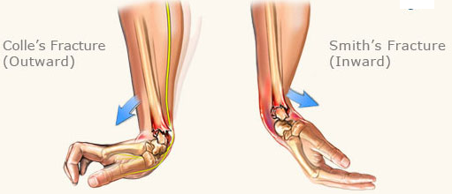

Slide 32
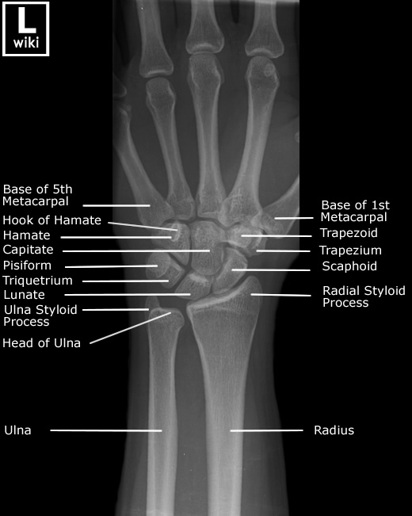
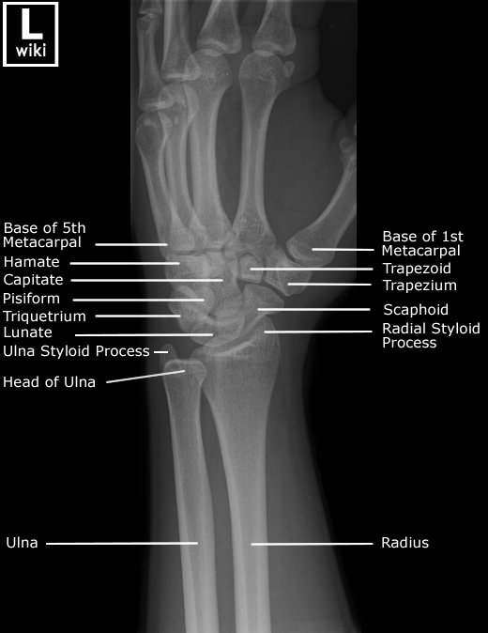
X-Ray

Slide 33
Thank You

