Slide 1
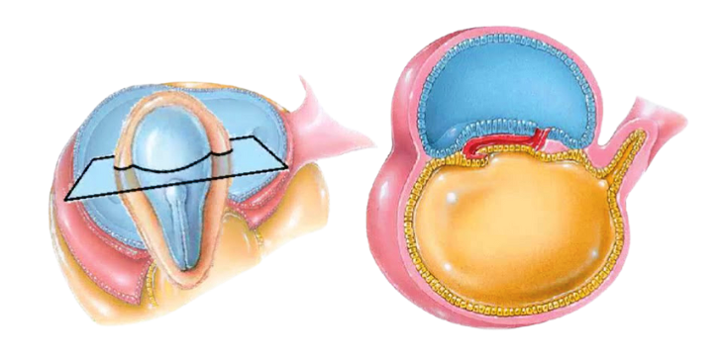
THIRD WEEK OF DEVELOPMENT: Trilaminar germ disc
BY MBBSPPT.COM

Slide 2
Trilaminar germ disc
The most characteristic event occurring during the third week of gestation is gastrulation, the process that establishes all three germ layers (ectoderm, mesoderm, and endoderm) in the embryo.
Gastrulation begins with formation of the primitive streak on the surface of the epiblast. Initially, the streak is vaguely defined, but in a 15- to 16-day embryo, it is clearly visible as a narrow groove with slightly bulging regions on either side.

Slide 3
Implantation site at the end of the 2 week.
View of the germ disc at the end of the 2 week. The amniotic cavity has been opened to permit a view of the dorsal side of epiblast. The hypoblast and epiblast are in contact with each other, and the primitive streak forms a shallow groove in the caudal region of the embryo.

Slide 4
Formation of Primitive node and pit
The cephalic end of the streak, the primitive node, consists of a slightly elevated area surrounding the small primitive pit.
Cells of the epiblast migrate toward the primitive streak.
Upon arrival in the region of the streak, they become flask-shaped, detach from the epiblast, and slip beneath it. This inward movement is known as invagination.

Slide 5
Formation of Prechordal plate
As more and more cells move between the epiblast and hypoblast layers, they begin to spread laterally and cranially. Gradually, they migrate beyond the margin of the disc and establish contact with the extraembryonic mesoderm covering the yolk sac and amnion.
In the cephalic direction, they pass on each side of the prechordal plate.
The prechordal plate itself forms between the tip of the notochord and the oropharyngeal membrane and is derived from some of the first cells that migrate through the node in the midline and move in a cephalic direction. Later, the prechordal plate will be important for induction of the forebrain.
The oropharyngeal membrane at the cranial end of the disc consists of a small region of tightly adherent ectoderm and endoderm cells that represents the future opening of the oral cavity.

Slide 7
Formation of Endoderm, Mesoderm and Ectoderm
Once the cells have invaginated, some displace.
The hypoblast, creating the embryonic endoderm.
And others come to lie between the epiblast and newly created endoderm to form mesoderm.
Cells remaining in the epiblast then form ectoderm.

Slide 8
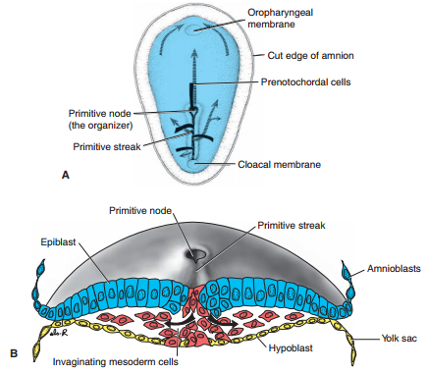
Dorsal side of the germ disc from a 16-day embryo indicating the movement of surface epiblast cells (solid black lines) through the primitive streak and node and the subsequent migration of cells between the hypoblast and epiblast (broken lines).
Cross section through the cranial region of the streak at 15 days showing invagination of epiblast cells. The 1st cells to move inward displace the hypoblast to create the definitive endoderm. Once definitive endoderm is established, inwardly moving epiblast forms mesoderm.

Slide 9
Prenotochordal cells invaginating in the primitive node move forward cranially in the midline until they reach the prechordal plate.
These Prenotochordal cells become intercalated in the hypoblast so that for a short time, the midline of the embryo consists of two cell layers that form the notochordal plate.
As the hypoblast is replaced by endoderm cells moving in at the streak, cells of the notochordal plate proliferate and detach from the endoderm.
They then form a solid cord of cells, the definitive notochord, which underlies the neural tube and serves as the basis for the axial skeleton.

Slide 10
Drawing of a sagittal section through a 17-day embryo. The most cranial portion of the definitive notochord has formed, while Prenotochordal cells caudal to this region are intercalated into the endoderm as the notochordal plate. Note that some cells migrate ahead of the notochord. These mesoderm cells form the prechordal plate that will assist in forebrain induction.
B. Schematic cross section through the region of the notochordal plate. Soon, the notochordal plate will detach from the endoderm to form the definitive notochord.
C. Schematic view showing the definitive notochord.

Slide 11
Derivatives of the Germ layers
Ectoderm:
Epidermis of skin and its derivatives such as hair, nails, sweat, and sebaceous gland.
Epithelial lining of:
Lens of eye.
Enamel of teeth.
Adrenal medulla.
Nervous tissue and sense organ.
Lower part of the anal canal
Distal part of the male urethra
Lower part of vagina
External auditory meatus
Oral cavity
Nasal cavity

Slide 12
Mesoderm Derivatives
Muscle: Smooth, Cardiac, and skeletal.
Bones and cartilages.
Connective tissues
Heart, blood vessels, and lymph vessels.
Epithelial lining of blood vessels, lymph vessels, body cavities, and joint cavities.
Spleen.
Kidney and ureters
Adrenal cortex
Testes and ovaries.

Slide 13
Endoderm Derivatives
Epithelial lining of the gastrointestinal tract (GIT)
Liver
Pancreas
Thyroid
Parathyroid
Respiratory tract
Urinary tract
Biliary tract
Auditory tube and middle ear cavity
Uterus and upper part of vagina

Slide 14
Thank You

