Slide 1
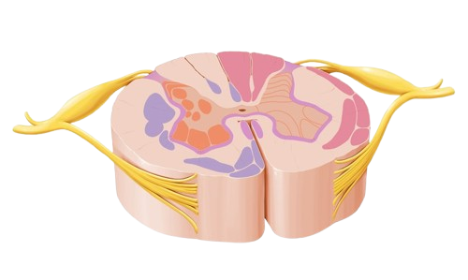
Tractology
Ascending & descending tracts of spinal cord
BY MBBSPPT.COM

Slide 2
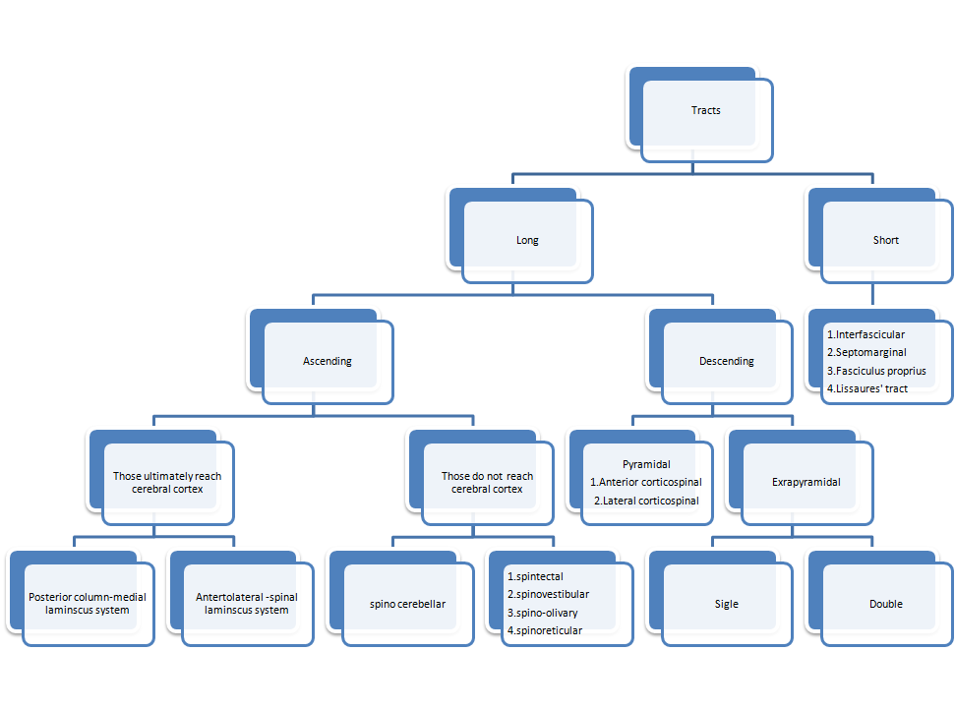

Slide 3
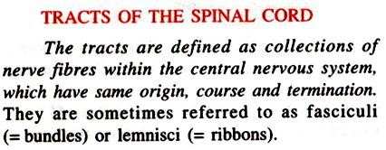
TRACTOLOGY
Study of tracts is called tractology. It is equilant to fasciculus, bundle, or lemniscus.
Tracts may be long or short.
The long tracts may be ascending or descending.
The short tracts are intersegmental & have associative & intergrative functions.
These short tracts are
Fasciculus propria.
Septomarginal.
Interfascicur fascicle.
Dorsal or dorsolateral Lissaure’s tract.

Slide 4
TRACTOLOGY
1. Fasciculus propria (propiospinal):
Begin & end in spinal cord.
Ist to be myelinated.
Just encircle H shaped grey matter like a ring & accordingly are anterior, posterior, & lateral.
Medial longitudinal bundle is continuous with anterior fasciculus propria.
2&3. Septomarginal & Interfascicur fasciculus.
These are descending tracts & end on AHC’s.
4. Dorsal or dorsolateral Lissaure’s tract:
May be ascending or descending. Present at the tip of posterior horn.

Slide 5
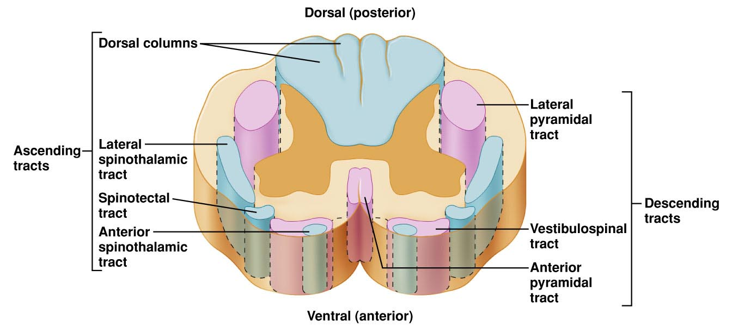

Slide 6
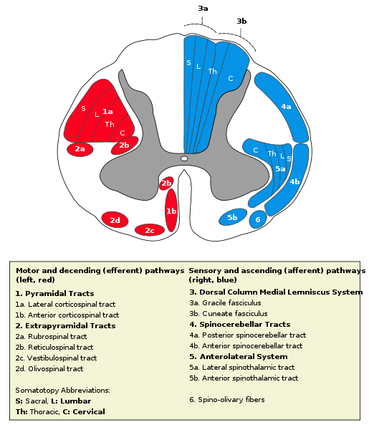
POSTERIOR COLUMN
PYRAMIDAL
TRACT
SPINOTHALAMIC
TRACT

Slide 8
Fasciculus propri
Fiber bundles with a common function are called tracts.

Slide 9
Each propioceptive fibre from lower ½ of body on entering spinal cord bifurcates into two branches:
A long branch forms Gracile tract of same side.
A short branch forms septomarginal tract.
Each propioceptive fibre from upper ½ of body bifurcate into two branches:
A long branch forms cuneate tract of same.
A short branch forms fasciculus interfascicularis (comma shaped).
Tract septomarginal & fasciculus interfascicularis end on AHC’s to complete stretch reflex arch.

Slide 10
Lissauer’s tract
The pain & temperature fibres enter Lissauer’s tract. Each bifurcate into
a very short ascending branch
a very short descending branch
The main fibre & its branches synapse with cells in SGR mainly within same segment.
Lissaure’s tract is part of axon of 1st neuron of pain & temperature.
Exteroceptive sensations (sensations from skin)are pain, temerature & touch.
which reach one segment above & one segment below.

Slide 11
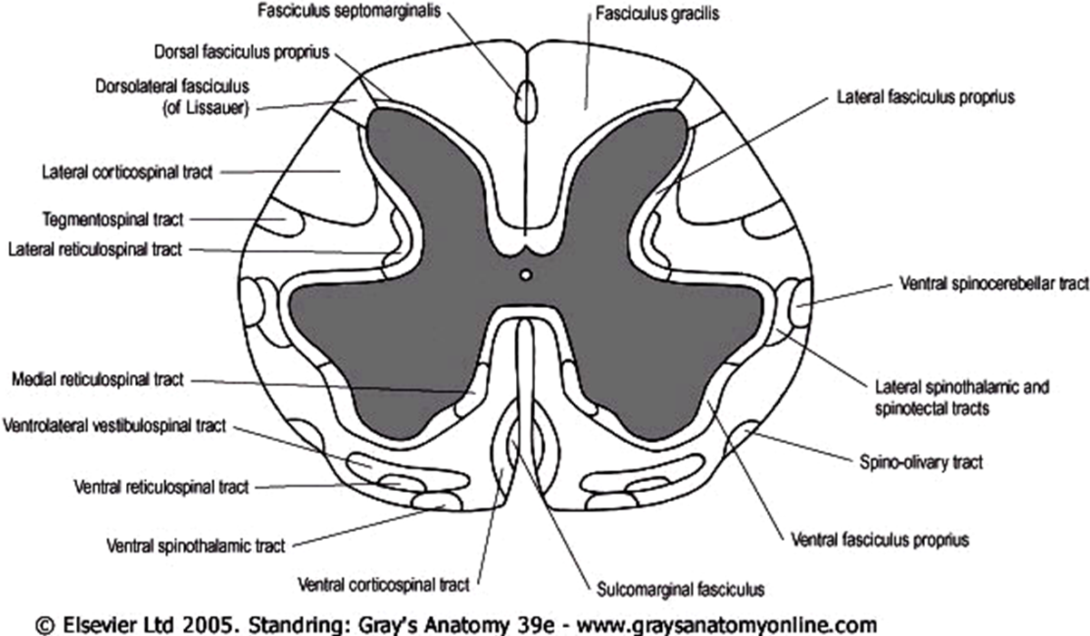

Slide 12
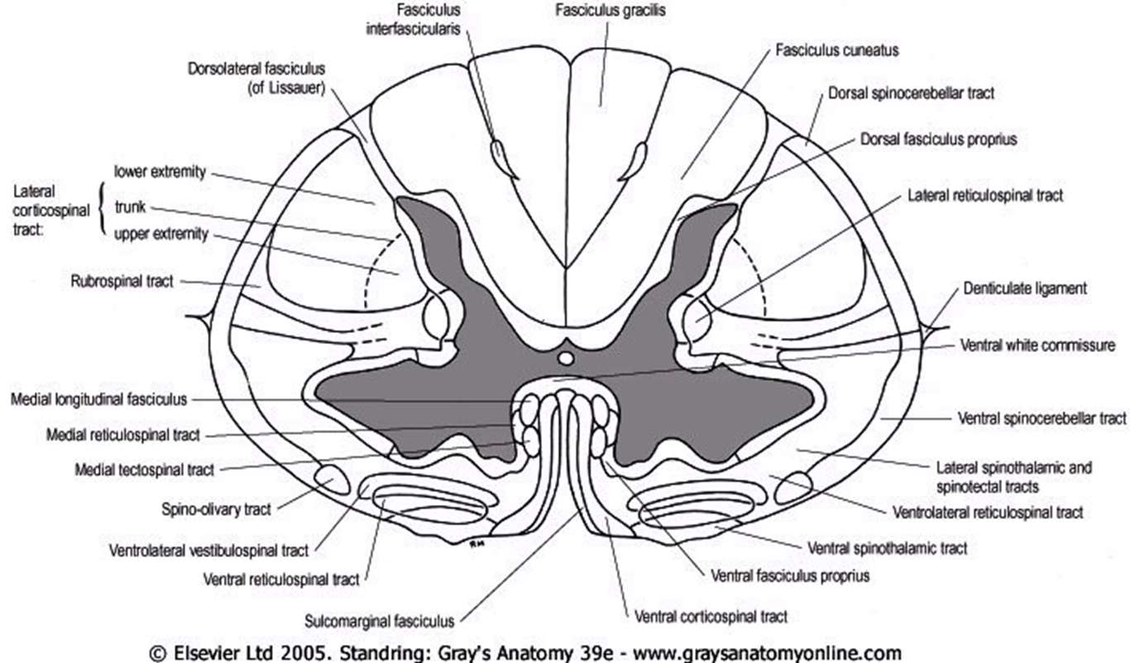

Slide 13
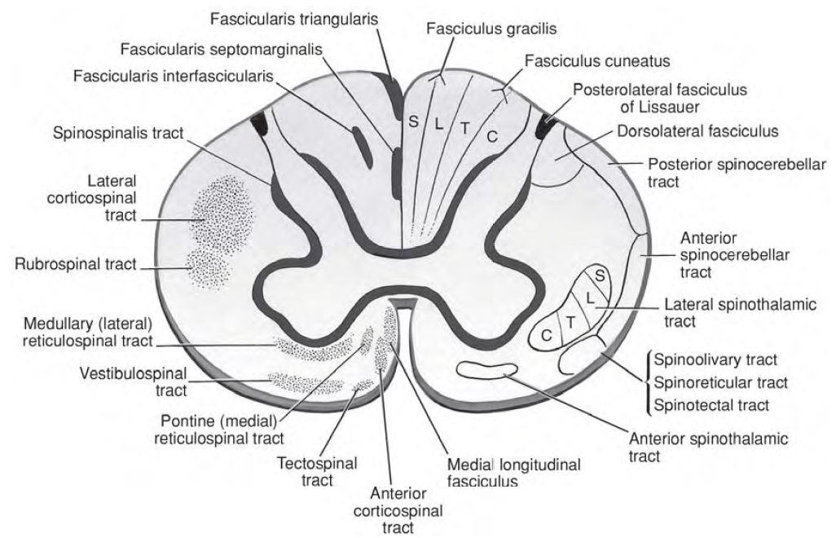

Slide 14
Ascending Tracts For Conscious Sensations
Connecting spinal cord to cerebral cortex:
Posterior column - medial lemniscus pathway
Gracile tract
Cuneate tract
Anterolateral - Spinothalamic - spinal lemniscus tract
Anterior
Lateral
Ascending Tracts For Unconscious Sensations
Connecting spinal cord to brainstem:
Spininotectal
Spino-olivary
Spinovestibular
Connecting spinal cord to cerebellum:
Spinocerebellar (for muscular coordination)

Slide 15
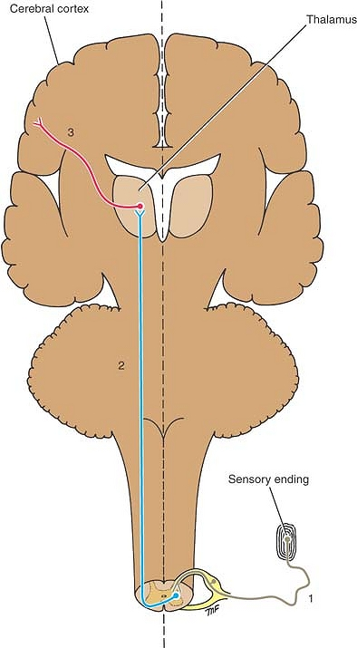
Simplest form of the ascending sensory pathway from the sensory nerve ending to the cerebral cortex. Note the three neurons involved.

Slide 16
ASCENDING TRACTS
Location:
Anterior white column | Lateral white column | Posterior white column
Anterior spinothalamic tract | Lateral spinothalamic tract | Fasciculus gracilis
 | Anterior spinocerebellar tract | Fasciculus cuneate
 | Posterior spinocerebellar tract
Ascending tracts run in each of these columns. Long tracts transmit informations derived from sensory receptors, destined to
produce conscious sensations; somatic & visceral.
Mediate reflex es:somatic or visceral.
Guide motor center in cerebellum, brainstem, diencephalons, basal ganglia & cortex.
TWO TYPES:
which carry sensations that will finally reach cerebral cortex | Which carry impulses which will not finally reach cerebral cortex
These tracts carry sensations which are felt | These tracts carry impulses which are not felt
Consists of a series of 3 orders of neurons | Consists of a series of two orders of neurons
Cutting of these result in loss of sensatios | Cutting of these result in no loss of sensations

Slide 17
Main Somatosensory Pathways
SENSATION | RECEPTORS | PATHWAYS | DESTINATION
Pain and temperature | Free nerve endings | Lateral STT Spinal lemniscus | Postcentral gyrus
Light touch and pressure | Free nerve endings | Anterior STT Spinal lemniscus | Postcentral gyrus
Discriminative touch, vibratory sense, conscious muscle joint sense | Meissner’s corpuscle, pacinian corpuscles, muscle spindles, tendon organs | Fasciculus gracilis and cuneatus Medial lemniscus | Postcentral gyrus

Slide 18
Gracile tract for propioception & fine touch from lower ½ of body. | Spinocerebellar tract: posterior & anterior Both carry propioception to cerebellum for muscular coordination. Cuneocerebellar tract is upward continuation from cuneate nucleus in medulla oblogata to cerebellum via posterior external arcuate fibres.
Cuneate tract carry propioception & fine touch from upper ½ of body. | Spino-olivary tract
Lateral spinothalmic tract carries pain, temperature from all body below head. | Spinotectal tract
Anterior spinothalamic tract carries simple touch from all body below head. | Spinoreticular tract

Slide 19
ASCENDING TRACTS (SENSORY)
Anterior (ventral) spinothalamic crude touch and pressure to thalamus
Lateral spinothalamic tract pain & temperature to thalamus
Fasciculus gracilis touch 2-pt. discrimination,
Fasciculus cuneatus conscious proprioception, stereognosis, weight discrimination, vibration
Posterior spinocerebellar
Subconscious proprioception
Anterior spinocerebellar

Slide 20
Propioception i.e. Discriminative touch, Vibration sense, Body position & Movement sense, Sense of fullness of bladder & rectum. In short, touch discriminative, stereognosis & kinaesthetic sense(muscle & joint). Snell: sense of discriminative touch, sense of vibration,conscious muscle & joint sense. Posterior column is concerned with propioception.

Slide 21
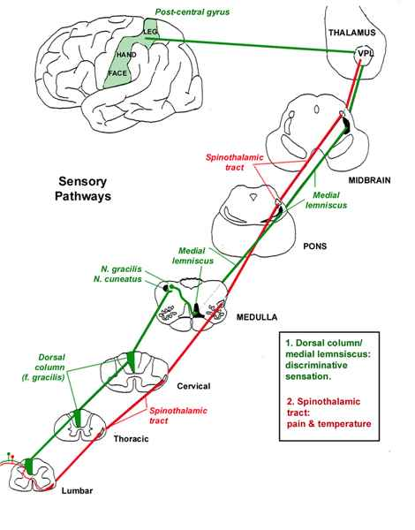

Slide 22
Ascending Pathways
For Conscious Perception:
Spinothalamic-spinal Lemniscal system
Dorsal column- Medial Lemniscal system
For Unconscious Perception:
Spinocerebellar
Spino-olivary
Spinotectal
Spinoreticular
Spinovestibular

Slide 23
Dorsal column – medial lemniscus pathway
Consists of fasciculus gracile(tract of goll) & fasciculus cuneate (tract of Burdach).
Location:
Fasciculus Gracile lies medially.
Located between dorsal median sulcus & dorsal intermediate sulcus & septum.
Found at all cord levels.
Fasciculus cuneate lies laterally.
Located between dorsal intermediate sulcus & septum & dorsolateral sulcus.
Found only at upper thoracic & cervical levels C1-T6.
Functions:
Propioceptive sensations concerned with deep tissues especially locomotor system (muscles & joints).
sensation of position of limb & joint
sense of passive movement of joint
sense of vibration

Slide 25
Posterior White Column – Medial Lemniscal Pathway
Modality: Discriminative Touch Sensation (include Vibration) and Conscious Proprioception (Position Sensation, Kinesthesia).
Modality: Receptor: Most receptors except free nerve endings(Muscle spindle in skeletal muscles Golgi tendon organ in tendons,Pacinian capsules in connective tissues between muscles & in & around capsules of joints).
Ist Neuron: Dorsal Root Ganglion (Spinal Ganglion)
Posterior Root - Posterior White Column
2nd Neuron: Dorsal Column Nuclei (Nucleus Gracilis et Cuneatus)
Internal Arcuate Fiber - Lemniscal Decussation
- Medial Lemniscus
3rd Neuron: Thalamus (VPLc)
Internal Capsule ----- Corona Radiata
Termination: Primary Somesthetic Area (SI)

Slide 26
Posterior White Column – Medial Lemniscal Pathway
Ipsilateral loss of discriminative touch sensation and conscious proprioception below the level of lesion.
Medial Lemniscus
Lemniscal Decussation
Internal Arcuate Fiber
Posterior White Column
Posterior Root

Slide 27
The dorsal column system
Medial lemniscus: A band of white fibers originating from the gracile and cuneate nuclei and decussating in the lower medulla; thence it passes upward through the center of the medulla oblongata, close to the median raphe; on entering the pons it spreads out laterally to form a flat band ascending over the dorsal border of the pontine nuclei; in the mesencephalon it passes over the dorsal border of the substantia nigra and is displaced laterally by the red nucleus; passing medial to the medial geniculate body, the bundle enters and terminates in the ventral posterior nucleus of the thalamus.

Slide 28
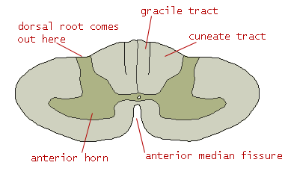
[ nucleus G & C ]
in medulla
fasciculus cuneatus
cervical segments
upper 6 thoracic segments
lower 6 thoracic segments
lumbar segments
sacral segments
G
C
fasciculus gracilis

Slide 29
Clinical application
Destruction of fasciculus gracilias and cuneatus.
Loss of muscle joint sense, position sense, vibration sense and tactile discrimination.
On the same side
below the level of the lesion:
(extremely rare to have a lesion of the spinal cord to be localized as to affect one sensory tract only).

Slide 30
Spinothalamic Tract
Modality: Pain & Temperature Sensation, Light Touch.
Receptor: Free Nerve Ending.
Ist Neuron: Dorsal Root Ganglion (Spinal Ganglion).
Posterior Root.
2nd Neuron: Dorsal Horn (Lamina I, IV, V)
Spinothalamic Tract - (Spinal Lemniscus).
3rd Neuron: Thalamus (VPLc, CL & POm)
Internal Capsule ----- Corona Radiata.
Termination: Primary Somesthetic Area (S I) &
Diffuse Widespread Cortical Region.

Slide 31
Spinothalamic Tract
spinothalamic
tract
anterior white
commissure
posterior root
decussation
contralateral loss of pain and temperature sensation below the level of lesion.

Slide 32
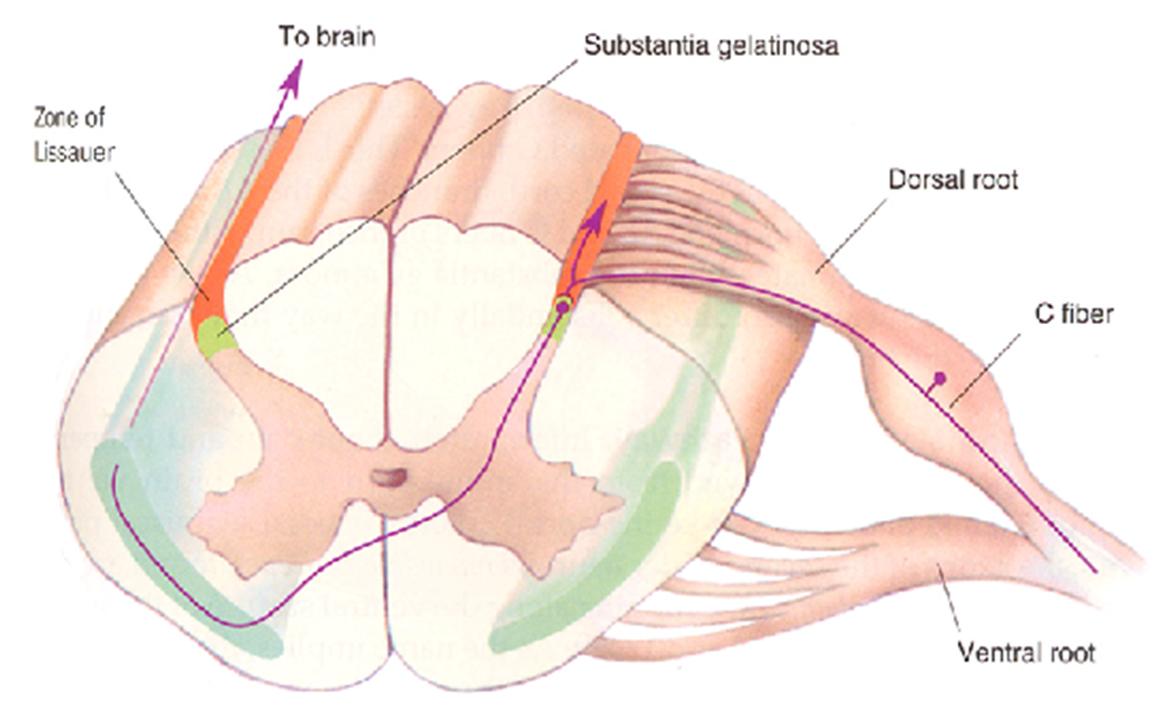

Slide 33
Spinothalamic Tract
& Spinoreticular Tract
NeoSTT PaleoSTT
Primary Motor Area (MI).
VPLc (ventrobasal
nuclear complex).
Spinal lemniscus.
Spinothalamic Tract.
Widespread cortical region
CL (intralaminar thalamic nuclei)
Reticulothalamic pathways
Spinoreticular Tract.

Slide 34
Comparison of Fast and Slow Pain - Spinothalamic Tract
Fast Pain | Slow Pain
Sharp, pricking | Dull, burning
Group III (Aδ ) fiber | Group IV (C) fiber
Short latency | Slower onset
Well localized | Diffuse
Short duration | Long duration
Less emotional | Emotional, autonomic response
Not blocked by morphine | Blocked by morphine
Neospinothalamic Tract | Paleospinothalamic Tract

Slide 35
LATERAL SPINOTHALAMIC TRACT
Pain & Temperature Pathway: Lateral Spinothalmic Tract
LOCATION: Lateral white column medial to anterior nerve root.
ORIGIN: Posterior horn cells of spinal cord of opposite side.
FUNCTION: Concerned with simple touch, pressure, tickle, itch sensations from opposite side of the body.
RECEPTORS: Free nerve ending, Merkel’s tectile discs, Input via A-δ,C fibres.
FIRST ORDER NEURONS:
Posterior root ganglion at all levels
They enter spinal cord in lateral aspect of dorsal root
Reach dorsolateral tract of Lissauer above they divide into ascending & descending branches
Then they leave Lissauer’s tract to SGR & cells in posterior grey column.

Slide 36
LATERAL SPINOTHALAMIC TRACT
SECOND ORDER NEURONS:
Axons of SGR cross to opposite side anterior to central canal in anterior white commissure (all pain & temp. fibres complete their crossing in same segment at which dorsal root enters spinal cord or just one segment above it). After crossing fibres run upward forming lateral spinothalmic tract on opposite side which ascend to brain stem to VPL. Slow pain fibres terminate in (90%) RF via spinoreticulothalamic pathway.
As lateral spinothalamic tract ascend through medulla oblongata, it lies near lateral surface & between inferior olivary nucleus & spinal tract of V nerve. It is now accompanied by anterior spinothalamic tract together they form spinal lemniscus.
3RD ORDER NEURONS:
Axons of VPLfrom sensory radiation which passthrough posterior ½ of posterior limb of internal capsule (corona radiate) to sensory area of cerebral cortex(area 3,1,& 2).
As lateral spinothalamic tract ascend through medulla oblongata, it lies near lateral surface & between inferior olivary nucleus & spinal tract of V nerve. It is now accompanied by anterior spinothalamic tract together they form spinal lemniscus.

Slide 37
Clinical application
Destruction of LSTT:
Loss of,
Pain and thermal sensation.
On the contralateral side.
Below the level of the lesion.
Patient will not,
respond to pinprick.
recognize hot and cold.

Slide 38
The Lateral Spinothalamic Tract

Slide 40
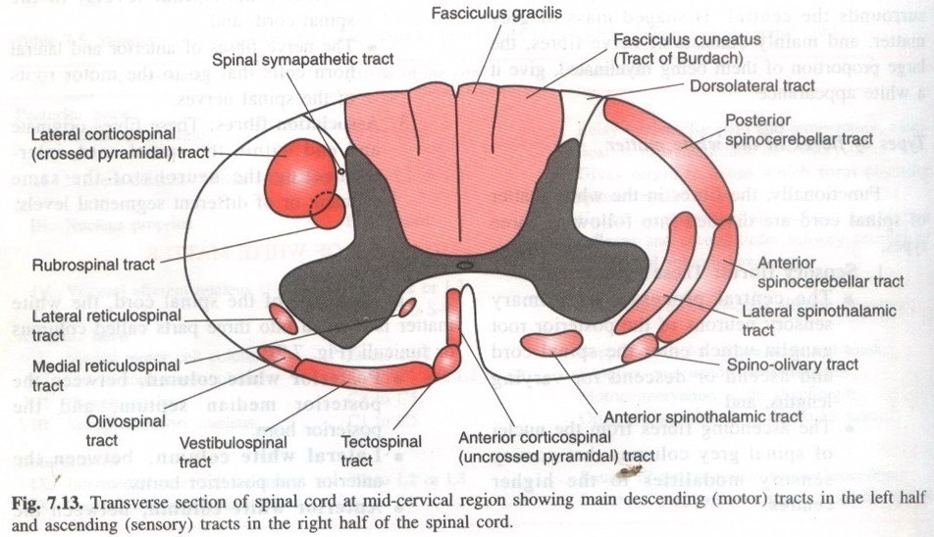

Slide 41
The Ventral (Anterior) Spinothalamic Tract

Slide 42
ANTERIOR SPINOTHALAMIC TRACT
Light (Crude) Touch & Pressure Pathway
LOCATION: Lateral white column medial to anterior nerve root.
ORIGIN: Posterior horn cells of spinal cord of opposite side.
FUNCTIONS: Concerned with simple touch, pressure, tickle & itch sensations from opposite side of body.
RECEPTORS: Free nerve endings & from Merkle’s discs.
FIRST ORDER NEURONS:
The axons enter spinal cord from posterior root gandlion & proceed to tips of posterior grey column where they divide into ascending & descending branches. These branches ascend or descend to one or two segments contributing to posterolateral tract of Lissaure. These terminate by synapsing with cells & in SGR.

Slide 43
ANTERIOR SPINOTHALAMIC TRACT
2nd ORDER NEURONS:
Located in dorsal horn (post. horn cells) cross to opposite side, decussate obliquely in anterior white commissure & ascend in cotralateral anterior funniculus. As anterior spinothalamic tract ascend more & more fibres are added to medial side. So cervical fibres mostly medial & sacral fibres are mostly lateral.
As anterior spinothalamic tract ascend through medulla oblongata, it accompanies lateral spinithalamic & spinotectal tract. All form spinal lemniscus 90% fibres pass to RF via spinoreticulothalamic pathway.
3rd ORDER NEURONS:
Are found in VPL of thalamus as for pain, temperature & propioception project to via posterior limb of internal capsule to postcentral gyrus (area3,1&2).
VPL sensory radiation sensory area of postcentral gyrus.

Slide 44
Clinical application
Destruction of ASTT:
Loss of touch and pressure sense
Below the level of lesion .
On the contralateral side of the body.

Slide 46
The main sensory pathways
to consciousness

Slide 47
Spinocerebellar Tract
Modality: Unconscious Proprioception.
Receptor: Muscle spindle, Golgi tendon organ.
Ist Neuron: Dorsal Root Ganglion (Spinal Ganglion)
Posterior Root , [Posterior Column]
2nd Neuron: 1. Clarke’s column
Posterior Spinocerebellar Tract
2. Accessory Cuneate Nucleus
Cuneocerebellar Tract
3. Posterior Horn
Anterior Spinocerebellar r Tract
Termination: Cerebellar Cortex.

Slide 48
ASCENDING TRACTS FOR UNCONSCIOUS SENSATIOS
Posterior spinocerebellar tract: Flat bands at periphery of lateral column.
Anterior spinocerebellar tracts: in periphery in front of posterior spinocerebellar tract.
Posterior & anterior spinocerebellar tracts carry propioceptive impulses to & cerebellum.
Cuneocerebellar tract.
Spinotectal tract: medial to anterior spinothalamic tract & anterior to lateral spinothalmic Tract.
Spinoolivary tract: at junction of anterior & lateral white columns.
Spinoreticular tract: mixed with lateral spinothalamic tract.
Spinovestibular tract.

Slide 49
SPINOCEREBELLAR TRACT

Slide 50
Spinocerebellar tract Posterior & anterior
Carry sensationsfrom lower limb & trunk.
Both tracts start Clarks column which receive collaterals from propioceptive fibres in posterior root.
Posterior spiocerebellar tract is direct i.e.formed by axons of Clark’s column of same side.
It carries fibres from upper part of spinal cord (C8 to L3).
Enters cerebellum via inferior cerebellar peduncle.
Anterior spinocerebellar tract is crossed. Formed by axons of Clark’s column of opposite side mainly.Carries propioceptive fibres from lower part of spinal cord (L1 toS5).
Enters cerebellum via superior cerebellar peduncle.

Slide 51
Posterior Spinocerebellar Tract | Anterior Spinocerebellar Tract
Arise from Clark’s column. | Arise from Clark’s column.
1st order neuron are found in posterior root ganglia (C8 to L3) nucleus dorsalis. | 1st order neuron are found in posterior root ganglia (L1 to S5) nucleus dorsalis.
2nd order neurons are direct & ipsilateral. | 2nd order neurons are crossed mostly contralateral give rise to axons those decussate in anterior white column & ascend.
Enter cerebellum via inferior cerebellar peduncle. | Enter cerebellum via superior cerebellar peduncle.

Slide 52
Spinocerebellar Tract
Inferior cerebellar
peduncle
posterior
spinocerebellar
tract
Clarke’s column
Posterior white
Column
posterior root
Anterior SCbllT Posterior SCbllT
(superior cerebellar
peduncle).
Anterior spinocerebellar
tract.
Anterior white commissure.
Posterior root.
Inferior cerebellar
peduncle.
Cuneocerebellar tract
(upper body).
Posterior white column.
Posterior root.

Slide 53
Spinocerebellar Tract
Ist order Neuron: In dorsal root ganglion
Axons end in nucleus dorsalis of Clarke.
2nd order Neuron: Cell body in nucleus dorsalis of Clarke.
Give rise to axons ascending to the cerebellum of the same side.
(anterior – crossed & uncrossed fibres/posterior – uncrossed fibres)

Slide 54
Cuneocerebeller tract
It is upper extremity equilant of posterio spinocerebellar tract (C2 to T7). From cervical nerves impulses destined for cerebellum do not travel by these spinocerebellar tracts since nucleus dorsalis does not extend above T1. They reach lateral or accessory cuneate nucleus (homologus for nucleus dorsalis in brain stem). Cuneocerebellar tract reach inferior cerebellar peduncle. These fibres are called external arcuate fibrs.
Ist order Neuron: Found in dorsal root ganglia from C2 to T7.
Project via fsciculus cuneatus to caudal medulla where synapse with lateral or accessory cuneate nucleus.
2nd order Neuron: Located in lateral or accessory cuneate nucleus of medulla oblongata.
Gives rise to axons project to cerebellum via ICP (posterior external fibres) terminate ipsilaterally.

Slide 55
Spino-olivary tract
White Matter In Between Anterior & Lateral Column.
Ist order Neuron: Posterior root ganglia.
2nd order Neuron: In posterior grey column.
Axons cross midline & asend as spino-olovary tract
End in inferior olivary nucleus in medulla oblongata which cross midline, enter ICP.
The axons end by synapsing on third-order neurons in the inferior olivary nuclei in the medulla oblongata . The axons of the third-order neurons cross the midline and enter the cerebellum through the inferior cerebellar peduncle.

Slide 56
Spinotectal tract
Lies in lateral white column.
Ist order Neuron: Posterior root ganglion.
2nd order Neuron: In posterior grey column axons cross median plane or ascend as spinotecatal tract, terminate in superior colliculs of midbrain.
Functions: visiomotor reflex i.e. head & eye movements towards source of stimulation called as spinovisual reflex.

Slide 57
Spinoreticular tract
Lies in lateral white column.
Ist order Neuron: Posterior root ganglion.
2nd order Neuron: Unknown in grey matter, axons ascend in spinoreticular tract mixed with lateral spinothalamic tract. Mostly end at uncrossed in midbrain.
Spinoreticular Pathway

Slide 58
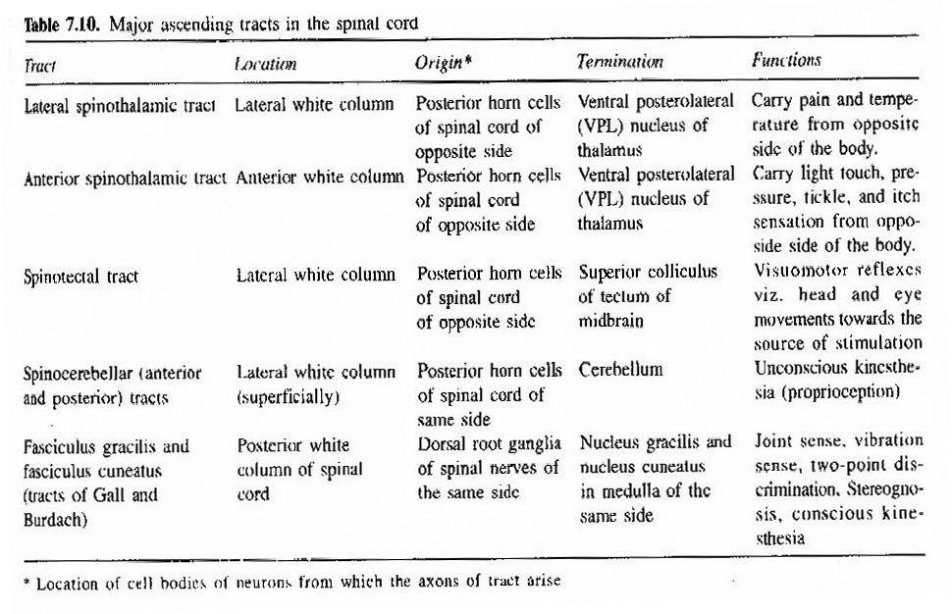

Slide 59
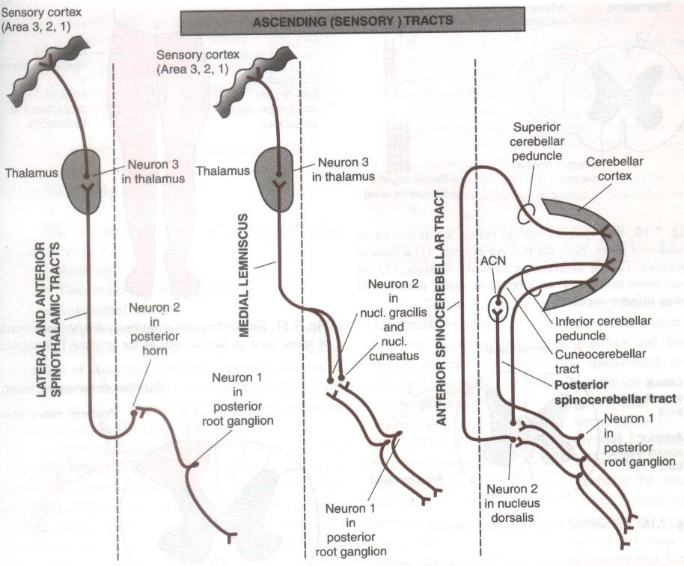
Ascending (sensory) tracts

Slide 60
Although the spinothalamic tract carries some tactile and pressure information, a great deal also travels in the posterior column system.
Destruction of the spinothalamic tract causes no significant tactile deficit.
There are, however, several types of sensation (in addition to pain and temperature) subserved more or less predominantly by the spinothalamic tract.
These are:
Itch
(and probably tickle) sensations;
Pressure sensations
from bladder and bowel;
And sexual sensations.
However, with the exception of itch, this information is carried bilaterally.
However, as the spinothalamic tract is the principal pathway of somatic pain sensations its destruction produces contralateral analgesia.
An operation to destroy the tract (called a cordotomy or chordotomy) is sometimes performed on patients suffering from intractable pain.

Slide 61
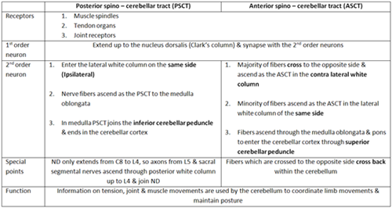
Unconscious muscle joint sense pathways to the cerebellum

Slide 62
OTHER ASCENDING PATHWAYS

Slide 63
DESCENDING TRACTS
PYRAMIDAL
UNCROSSED OR DIRECT
CROSSED
EXTRAPYRAMIDAL
SINGLE (3)
DOUBLE (3)
No long descending tracts in posterior white column.
All descending tracts in lateral white column are crossed except olivospinal & lateal vestibulospinal tract.
All descending tracts in anterior white column are direct except anterior tectospinal.
Descending tracts are either facilitatory or inhibitory.
Stimulation of facilitatory tract leads to increased tone & reflexes.
Cutting of facilitatory tract leads to decreased tone & reflexes.
Stimulation of inhibitory tract leads to decreased tone & reflexes.
Cutting of inhibitory tract leads to increased tone & reflexes & spastic paralysis.
The anterior reticulospinsl tract is very strong inhibitory.
The lateral vestibulospinal tract is very strong facilitatory.
The pyramidal tracts are facilitatory (not inhibitory).

Slide 64
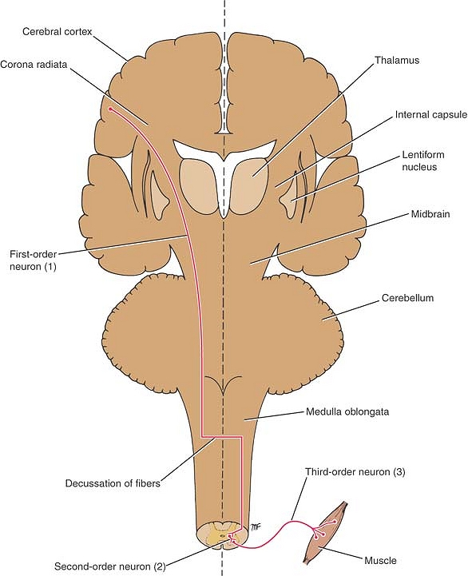
Simple form of the descending motor pathway from the cerebral cortex to the skeletal muscle. Note the three neurons involved.

Slide 65
Pyramidal tract | Extrapyramidal tract
One neuron carries the impulse from cerebral cortex to anterior horn cells. | Many neurons carry impulse from cerebral cortex to anterior horn cells.
In medulla it occupies the pyramid. | In medulla do not occupy pyamid rather scattered.
Arise from a localized area in the precentral gyrus called the motor area or area 4 | Arise from widely distributed area different lobes of cerebral cortex.
All fibres cross to reach the opposite side | Some tracts do cross others not
Functions: On tone: it is facilitatory or excitatory On movements: responsible for fine, isolated, precise & specific mocements which are necessary for all activities which need skill. | On tone: some are facilatatory others or inhibitory On movements: responsible for gross, synergic movements which require the acivity of large groups of muscles. They set background for subsequent activity of pyramidal system.

Slide 66
Clinical Differences
Pyramidal tract | Extrapyramidal tract
Clasp knife spasticity | Lead pipe/cogwheel rigidity
No tremors | Tremors present
Clonus present | Clonus absent
Babinski’s sign present | Babinski’s sign absent
Paralysis present | Paralysis slight/absent

Slide 68
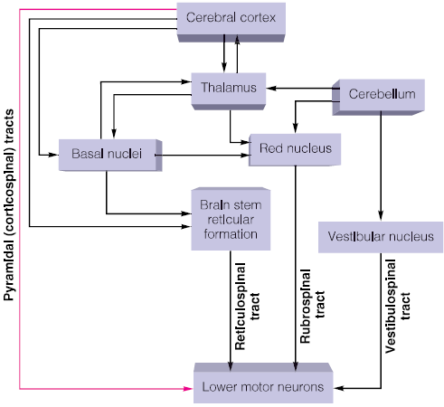

Slide 69
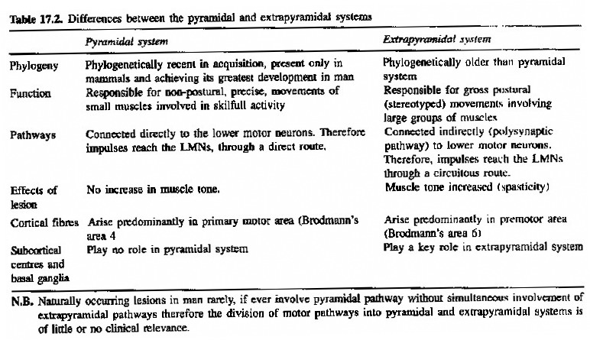

Slide 70
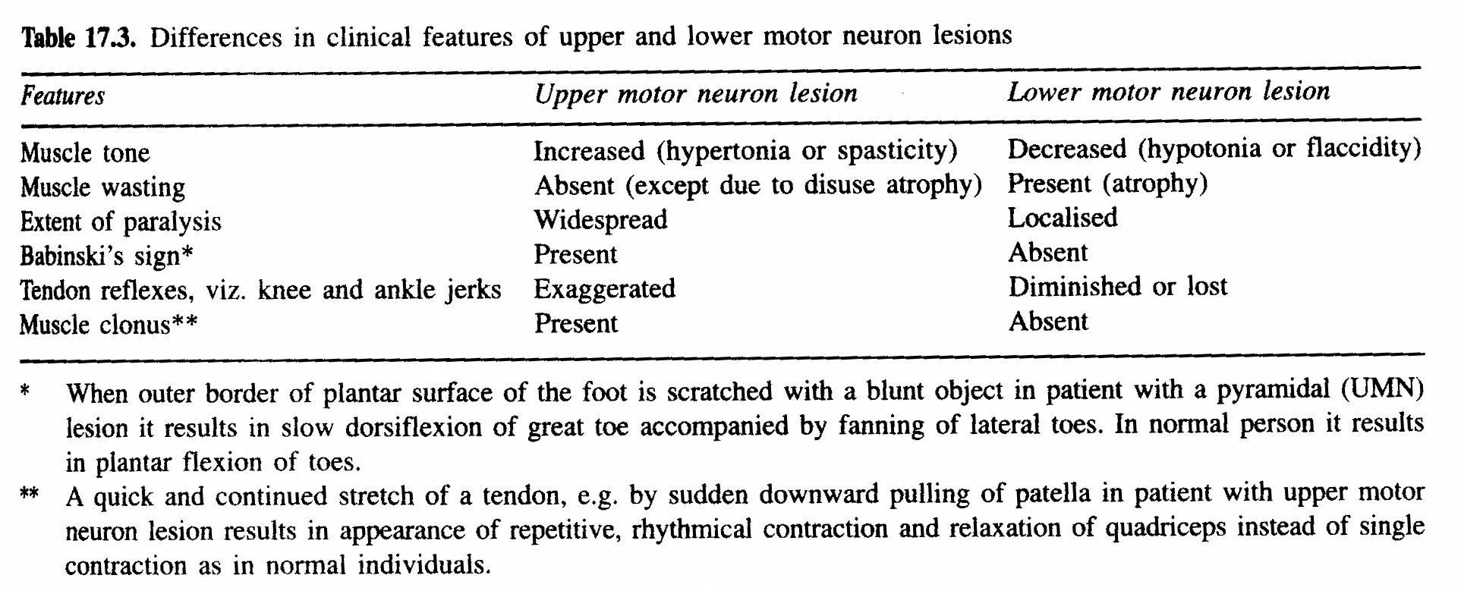

Slide 71
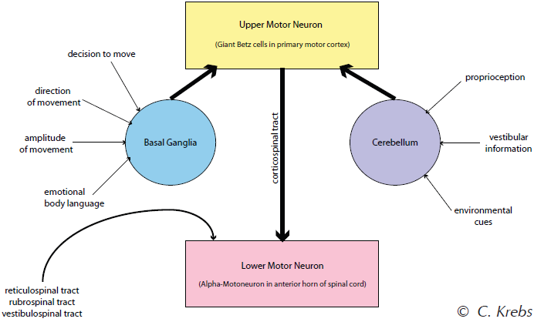

Slide 72
Corticospinal Tract

Slide 73
Reticular tracts. Ascending: blue;
descending: red; medullary: black

Slide 74
Corticospinal Tract
Origin: Cerebral Cortex
Brodmann Area 4 (Primary Motor Area, M I)
Brodmann Area 6 (Premotor Area, PM )
Brodmann Area 3,1,2 (Primary Somesthetic Area, S I)
Brodmann Area 5 (Anterior Portion of Sup. Parietal Lobule)
Corona Radiata
lnternal Capsule, Posterior Limb
Crus Cerebri, Middle Portion
Longitudinal Pontine Fiber
Pyramid - pyramidal decussation
Corticospinal Tract - Lateral and Anterior
Termination: Cerebellar Cortex.

Slide 75
Corona Radiata
lnternal Capsule, Posterior Limb
Crus Cerebri, Middle Portion
Longitudinal Pontine Fiber
Pyramid
Pyramidal Decussation
Corticospinal Tract
- Lateral and Anterior
CR
IC
LPF
Pyr
PD
LCST
- ipsilateral UMN syndrome
at the level of lesion
ACST

Slide 76
Descending Tracts from Brain Stem
Dorsolateral (Motor) Pathway
Rubrospinal Tract
Ventromedial (Motor) Pathway
Tectospinal Tract
Vestibulospinal Tract
MLF (Medial Longitudinal Fasciculus)
- interstitiospinal tract
Sensory Modulation pathways
Raphespinal & Cerulospinal Pathways
Descending Autonomic Pathways

Slide 77
Spinal Cord
Tracts
Descending
Tracts from
Brain Stem
ventromedial
pathway
dorolateral
pathway

Slide 78
DESCENDING TRACTS (MOTOR)
Lateral corticospinal & corticospinal motor output from cortex to anterior motor cells of ant. horn
Rubrospinal motor from midbrain to anterior horn for precise movement
Tectospinal motor from midbrain to
anterior horn; movements in
response to audiovisual/cutaneous stimuli
Vestibulospinal motor from medulla to ant. horn; coordination/balance
Lateral reticulospinal motor from medulla to ant. horn; inhibit ext. reflexes
Medial reticulospinal motor from pons to ant. horn; acilitate ext. reflexes

Slide 80
Extrapyramidal system
3 single | 3 paired
Rubrospinal tract | Lateral & ventral tectospinal tract
Olivospinal tract | Lateral & ventral vestibulospinal tract
Sulcomarginal tract | Lateral & ventral reticulospinal tract
These tract arise from midbrain --- All are crossed
Rubrospinal tract | Lateral & ventral tectospinal tract
These tracts arise from pontomedullary junction --- All are direct
Olivospinal tract | Lateral & ventral vestibulospinal tract
These tracts arise from brainstem as a whole.
Sulcomarginal tract | Lateral & ventral reticulospinal tract
The medial vestibulospinal tract descends in the medial longitudinal fasciculus into the ventral funiculus of the spinal cord where it lies close to the midline in the so-called sulcomarginal fasciculus.

Slide 81
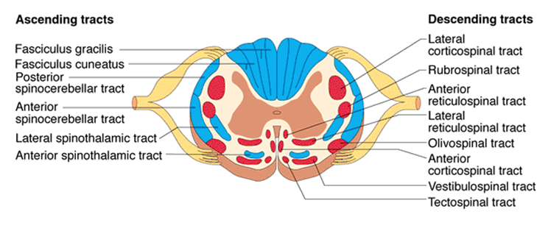

Slide 82
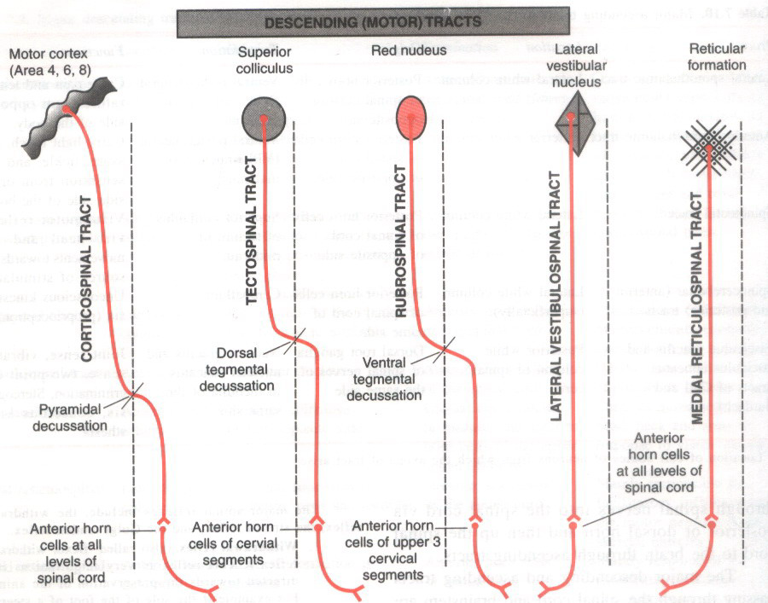
Descending tracts (motor)

Slide 83
Descending Pathways
Corticospinal Tract
Lateral Corticospinal Tract
The lateral corticospinal tract is a large, crossed, descending tract that contains the 85% of fibres from the contralateral pyramid that cross in
pyramidal decussation.
It is also known as the pyramidal tract.
It occupies the posterior portion of the lateral funiculus medial to the posterior spinocerebellar tract.
Its fibres originate in the cerebral cortex (in the precentral gyrus and nearby areas).
They descend through the cerebral peduncle, basal pons, and medullary pyramid.
They then decussate and end in the anterior horn or intermediate grey matter.
They terminate on the motor neurons of the anterior horn or, more often, on smaller interneurons. These in turn synapse on motor neurons.
Lateral corticospinal fibres are arranged somatotopically.
Those destined for more caudal cord levels are located more laterally.
The fibres of the lateral corticospinal tracts usually synapse on motor neurons or interneurons that ultimately go to the distal muscles.
Anterior Corticospinal Tract
The 15% of the fibres in each pyramid that do not cross in the pyramidal decussation continue into the anterior funiculus.
This is located adjacent to the anterior median fissure as the anterior corticospinal tract.
These fibres also terminate on motor neurons or interneurons of the anterior horn or intermediate grey matter, mainly in cervical and thoracic
segments.
Many of them cross in the anterior white commissure before synapsing.
The term "pyramidal tract" refers to the combination of lateral and anterior corticospinal tracts.
These fibres ultimately tend to go to the axial muscles.

Slide 84
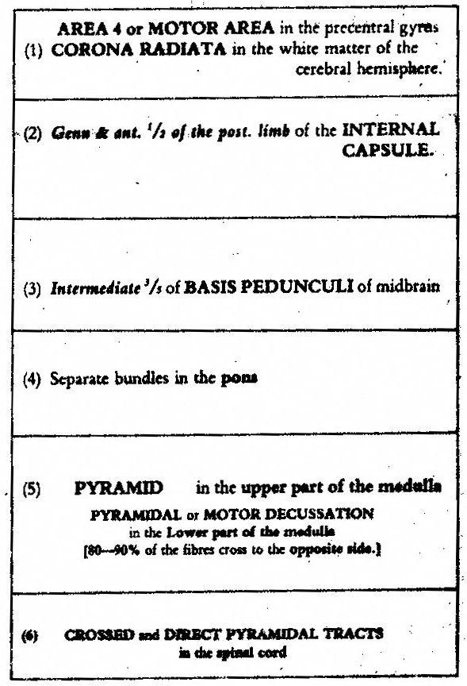

Slide 85
A Simplified Scheme of Some of
the Major Descending Tract Systems.

Slide 86
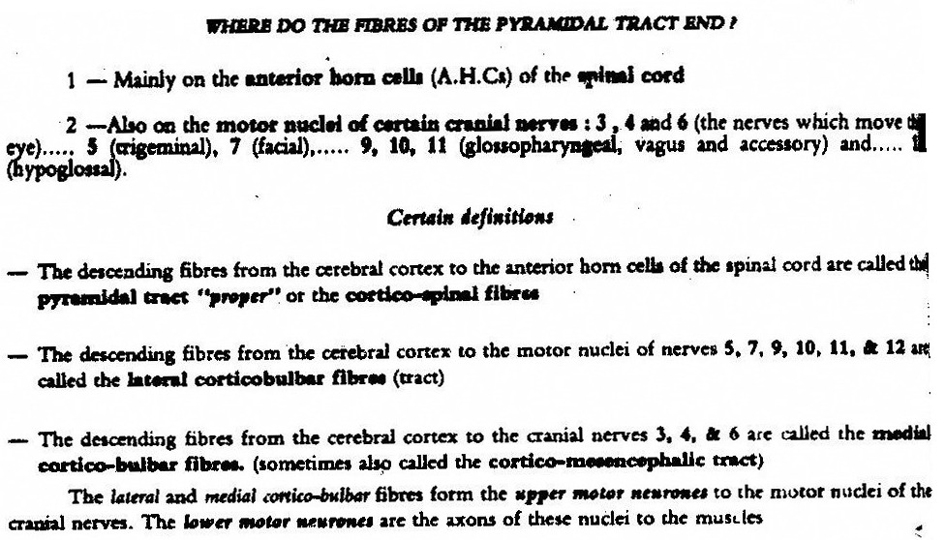

Slide 88
The Vestibulospinal Tracts

Slide 89
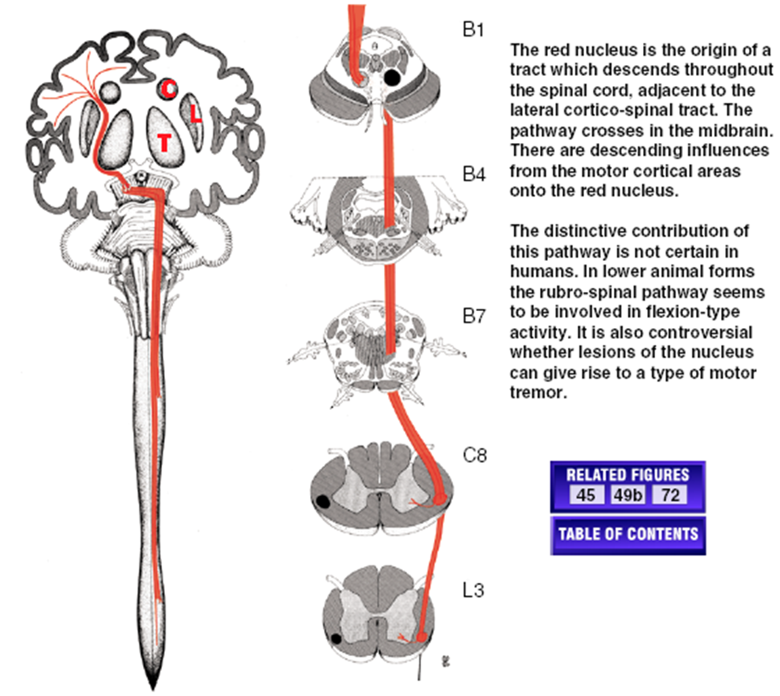
RUBRO-SPINAL TRACT

Slide 90
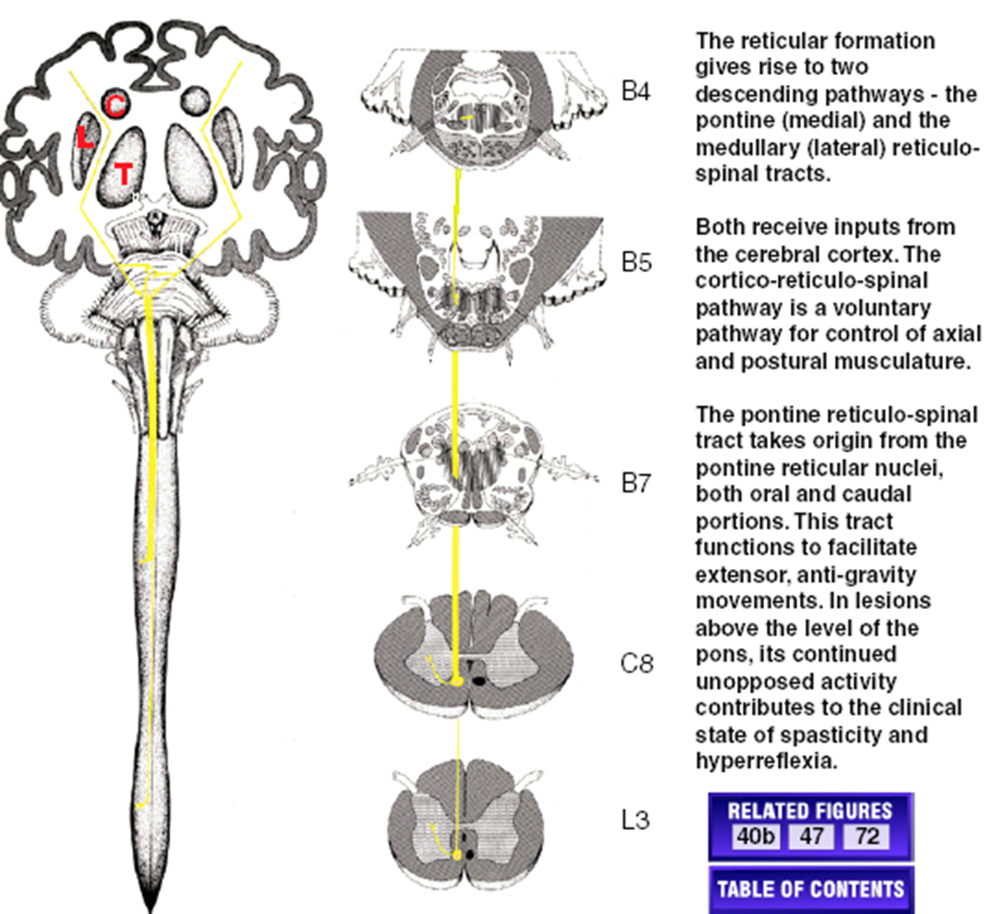
PONTINE (MEDIAL) RETICULO SPINAL TRACT

Slide 91
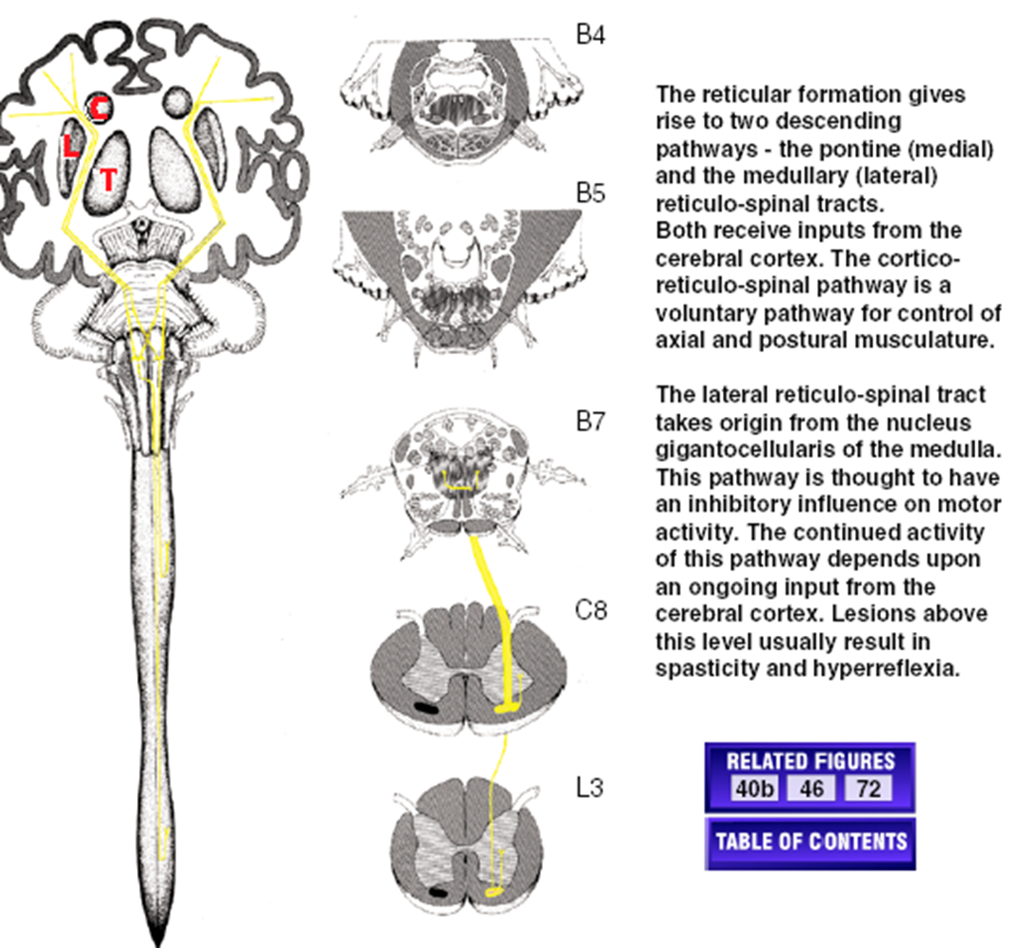
MEDULLARY (LATERAL) RETICULO SPINAL TRACT

Slide 92
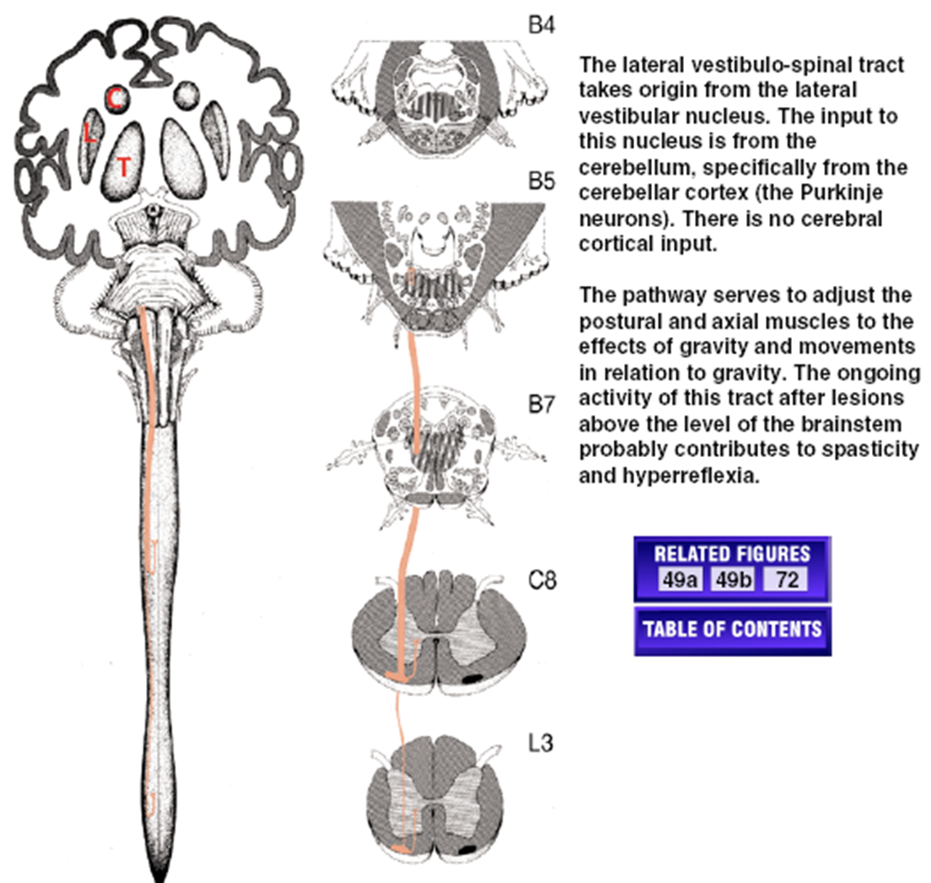
LATERAL VESTIBULO SPINAL TRACT

Slide 93
Rubrospinal Tract
This is an alternative route for the mediation of voluntary movement.
It originates in the red nucleus -----> crosses to the other side of the midbrain -----> descends in the lateral part of the brainstem tegmentum -----> travels through the lateral funiculus of the spinal cord in the company with the lateral corticospinal tract.
It is small and rudimentary in humans.
Vestibulospinal Tracts
Lateral Vestibulospinal Tract
It arises in the lateral vestibular nucleus and projects to all levels of the ipsilateral spinal cord.
It is located in the ventral part of the lateral funiculus.
It is the principal route by which the vestibular system brings about postural changes to compensate for tilts and movements of the body.

Slide 94
Medial Vestibulospinal Tract
This arises mainly in the medial vestibulospinal nucleus and projects bilaterally to the cervical spinal cord.
It is responsible for stabilising the head position as we walk around.
This tract only goes down to the midthoracic level.
Many secondary vestibular fibres project directly through the medial longitudinal fasciculus (MLF) to the motor neurons of the oculomotor, trochlear and abducens nuclei.
This forms much of the basis of the vestibuloocular reflex.

Slide 95
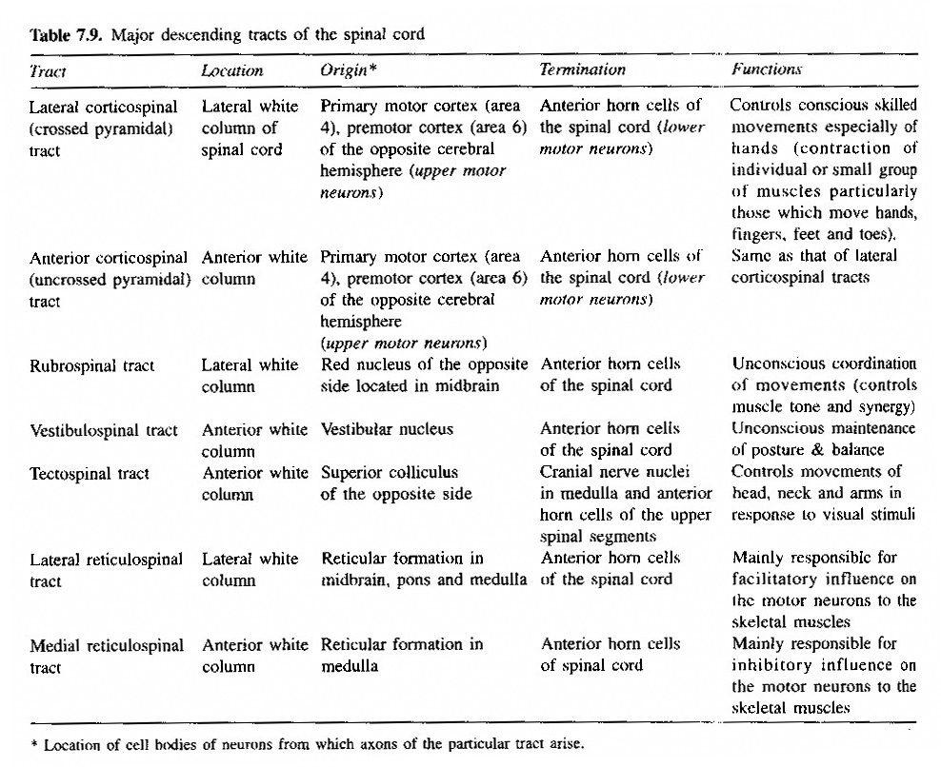
Reticulospinal Tracts

Slide 96
Upper motor neuron lesion
Babinski Sign (Extensor Plantar Response).
Superficial Abdominal Reflexes (Absent).
Cremasteric Reflex (Absent).
Loss of Performance of Fine Skilled Voluntary Movement.

Slide 97
Lower motor neuron lesion
Flaccid Paralysis
Atrophy of Muscles
Loss of Reflexes
Muscular Fasciculation
Muscular Contracture

Slide 98
Extrapyramidal tract lesions
Severe Paralysis With Little or No Atrophy
Spasticity or Hypertonicity
Exaggeration of Deep Muscular Reflexes and Clonus
Clasp-knife Reaction.

Slide 99
The Simple Reflex Arc
1. A special type of conduction pathway
2. Receptor - responds to internal/external stimulus
3. Sensory Neuron - passes impulse to CNS
a. impulse sent along nerve from that organ
b. eventually reaches DORSAL ramus of spinal nerve
c. synapses on neuron somewhere in grey matter
4. Center - point in the CNS where message is accepted
a. sometimes directly to the effector motor neuron
b. most times on an INTERNEURON of dorsal horn
c. passes message to motor neuron in VENTRAL HORN
d. or passes message to brain via specific tract

Slide 100
The Simple Reflex Arc
5. Motor neuron - sends signal to appropriate effector
a. resides in anterior horn - skeletal muscle
b. resides in lateral horn - smooth/cardiac/gland
6. Effector Organ - organ effected by motor neuron
a. simple reflexes and motion - skeletal muscle
b. general physiological - other organs

Slide 101
Major Clinical Reflexes
1. Patellar Reflex (Knee Jerk)
2. Achilles Reflex (Ankle Jerk)
3. Babinski Sign -
Positive (Under 1^{1/2} Years Old)
Negative (After 1^{1/2} Years Old)
4. Abdominal Reflex

Slide 102
Different Reflexes
1. Spinal Reflexes - Spinal Cord Controlled (Posture)
2. Somatic Reflexes - Skeletal Muscles
3. Cranial Reflexes - Brain And Cranial Nerves
4. Visceral (Autonomic) R. - Smooth/Cardiac/Glands
5. Stretch Reflex - Monosynaptic
A. Muscle Spindle Organ (Sense Stretch)
B. Sensory Neuron -> Motor Neuron
C. Ipsilateral (Same Side) Reflex Arc
D. Patellar Tendon Reflex
E. Reciprocal Innervation - Excitatory/Inhibitory
6. Tendon Reflex - Polysynaptic
A. Golgi Tendon Organs (Sense Tension)
B. Sensory Neuron -> Interneuron -> Motor Neuron
C. Ipsilateral Reflex Arc
D. Also Reciprocal Innervation

Slide 103
Different Reflexes
7. Flexor (Withdrawal) Reflex Polysynaptic
A. Pain Receptors
B. Sensory -> Interneurons -> Many Motor Neurons
C. Intersegmental Reflex Arc
I. Many Spinal Segments Involved In Response
Ii. Complex Movement Is Coordinated
D. Crossed-extensor Reflex
I. Sensory Message Crosses To Opposite Side
Ii. Allows Contralateral Muscle Response
Iii. Maintain Body Balance During Reflex

Slide 104
Major Clinical Reflexes
1. Patellar Reflex (Knee Jerk)
2. Achilles Reflex (Ankle Jerk)
3. Babinski Sign -
Positive (Under 1^{1/2} Years Old)
Negative (After 1^{1/2} Years Old)
4. Abdominal Reflex

Slide 107
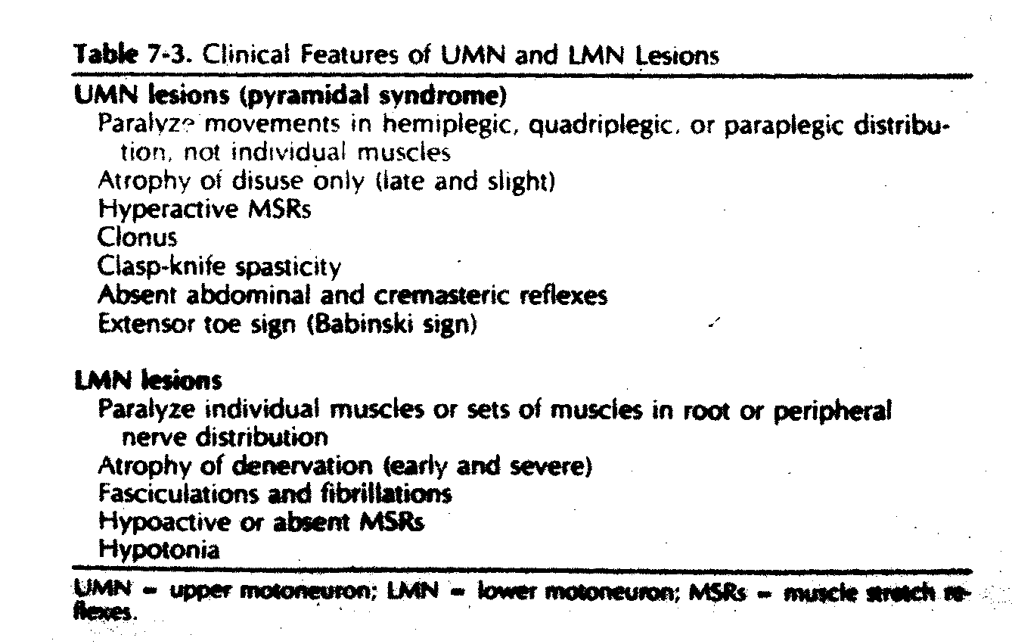

Slide 108
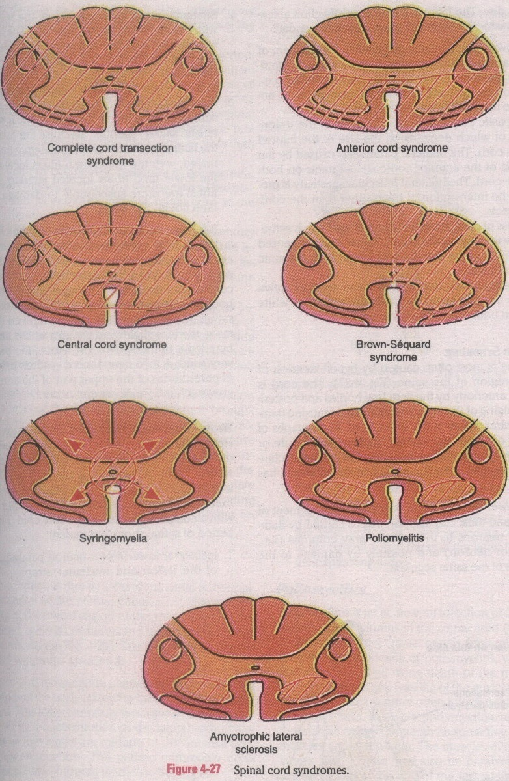

Slide 109
Brown-Séquard's syndrome
Syndrome with unilateral spinal cord lesions, proprioception loss and weakness occur ipsilateral to the lesion, while pain and temperature loss occur contralateral.
Syn: Brown-Séquard's paralysis.

Slide 110
Spinal Cord Syndrome
Brown-sequard Syndrome (Spinal Cord Hemisection)
Major Symptoms
Ipsilateral UMN Syndrome Below the Level of Lesion.
Ipsilateral LMN Syndrome at the Level of Lesion.
Ipsilateral Loss of Discriminative Touch Sensation and Conscious Proprioception below the Level of Lesion (Posterior White Column Lesion).
Contralateral Loss of Pain And Temperature Sensation Below the Level of Lesion (Spinothalamic Tract Lesion).

Slide 112
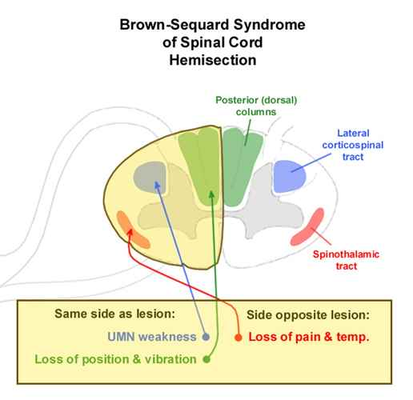

Slide 113
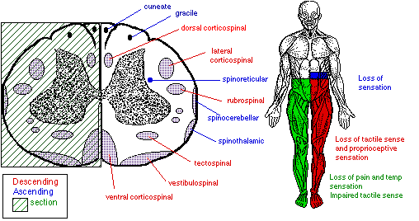

Slide 115
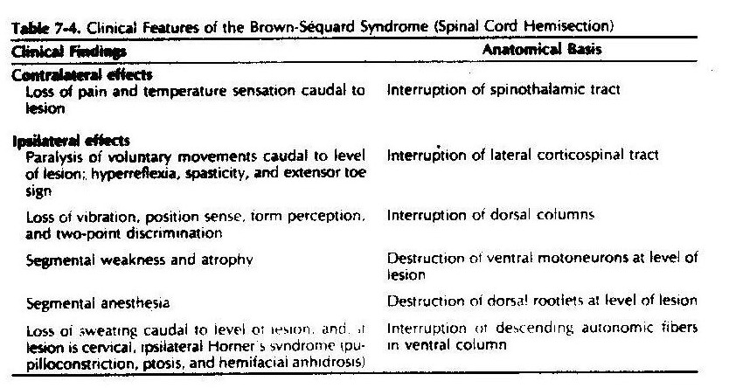

Slide 116
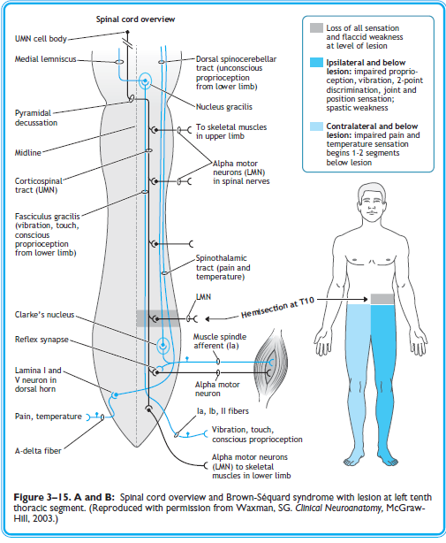

Slide 117
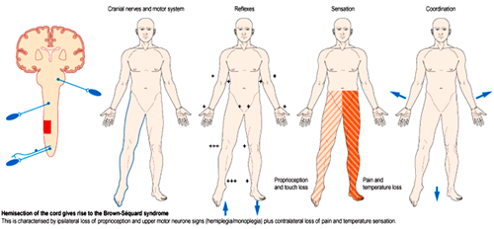
Brown sequard syndrome
(Hemi section of the spinal cord)
Features
Ipsilateral LMN paralysis & muscular atrophy in the corresponding part of the body to the damaged segment of the spinal cord
Ipsilateral spastic paralysis below the of the level lesion (γ motor neuron inhibition is lost)
Ipsilateral loss of cutaneous sensation below the of the level lesion
Ipsilateral loss of dorsal column sensation below the of the level lesion
Contralateral pain, temperature, touch & pressure sensations are lost below the of the level lesion
Tracts which are affected
Dorsal column : Ipsilateral
Lateral Spinothalamic tract : Contralateral
Anterior Spinothalamic tract : Contralateral
Anterior Spino cerebellar tract : Contralateral
Posterior Spino cerebellar tract : Ipsilateral
Anterior corticospinal tract : Ipsilateral
Posterior corticospinal tract : Ipsilateral
Autonomic nervous system : Ipsilateral

Slide 120
Thank You

