Slide 1
Unicondylar Knee Replacement

Slide 3
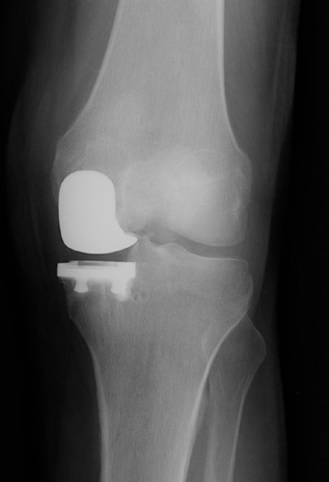
Unlike total knee replacement surgery UKA is
Less invasive procedure
Replaces only damaged or arthritic parts in either compartments
UKA aims to resurface the diseased compartment without altering the kinematics of knee joint by load transfer or sacrificing the cruciate ligaments.

Slide 4
Indications of UKA
Clinically:-
-Pain and tenderness localized to one side of joint line,
-Flexion Arc greater than 90*,
-FFD less than 10*,
-Passively correctable deformity,
-Intact ACL.
Radiologically:-
-Isolated Uni-compartmental OA,
-Varus deformity <10* or Valgus deformity<5*,
-Insignificant degenerative changes in opposite compartment.

Slide 5
Contraindications of UKA
OA involving both compartments ,
Absence of an intact ACL,
Inflammatory Arthritis,
Crystal deposition induced Arthritis,
Full thickness patellar cartilage loss,
Previous HTO,
Previous Patellectomy,
BMI >30 kg/m2.

Slide 6
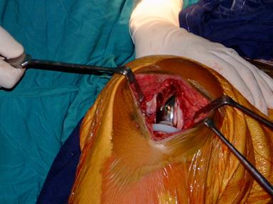
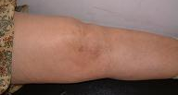

Slide 7
Procedural tips:
Avoid overcorrections
undercorrect the mechanical axis by 2-3 degrees
overcorrection places excess load on unresurfaced compartment.
Remove osteophytes (peripheral and notch)
Resect minimal bone
Avoid extensive soft tissue releases
Avoid edge loading
Prevent tibial spine impingement with proper mediolateral placement.

Slide 8
Advantages of UKA
Preservation of normal knee kinematics (Retaining ACL & PCL)
Small incision size,
Less bone removed,
Less blood loss,
Lower morbidity,
Quicker recovery & Early rehabilitation,
Shorter hospitalization.

Slide 9
Disadvantages of UKA
Inferior survivorship,
Secondary degeneration of opposite compartment,
Patella impingement on femoral component (patella pain),
Stress fracture almost always involving Tibia,
Tibial component collapse due to poor mechanical properties of bone,
Component loosening,
Polyethylene wear.

Slide 10
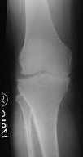
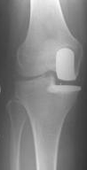
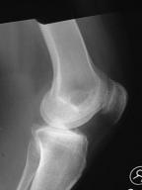
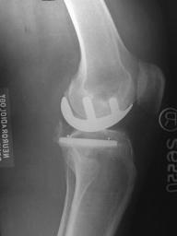

Slide 11
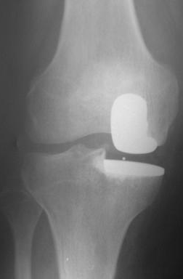
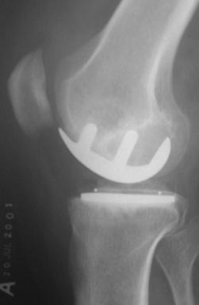
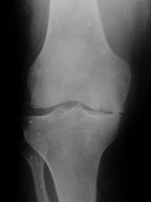
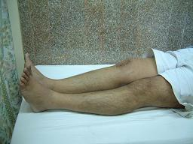
Erect
Postop xrays

Slide 12
Conversion of UKA to TKR

Slide 13
THANK YOU!

