Slide 1
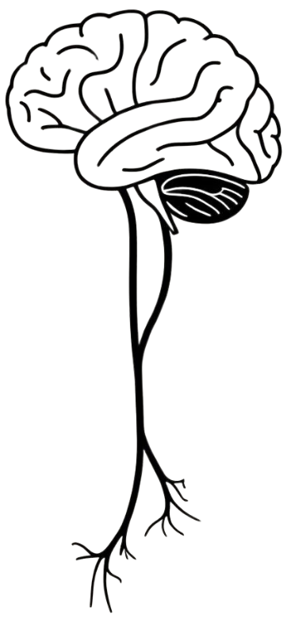
VAGUS NERVE
BY MBBSPPT.COM

Slide 2
VAGUS NERVE
It is a mixed nerve, but mostly it is motor.
Vagus nerve is the 10th cranial nerve.
Its innervation is not limited to the structures in the head, but also extends into the neck, thorax, and abdomen.
It is the longest and most widely distributed cranial nerve.
It is a vagrant or wandering nerve.
It spreads the fibers of a cranial part of the accessory nerve and carries majority of the efferent fibers of the cranial part of the parasympathetic outflow.

Slide 4
VAGUS NERVE
The Vagus nerve is associated with the derivatives of the four pharyngeal arch.
Sensory: Innervates the skin of the external acoustic meatus and the internal surfaces of the laryngopharynx and larynx. Provides visceral sensation to the heart and abdominal viscera.
Special Sensory: Provides taste sensation to the epiglottis and root of the tongue.
Motor: Provides motor innervation to the majority of the muscles of the pharynx, soft palate and larynx.
Parasympathetic: Innervates the smooth muscle of the trachea, bronchi and gastro-intestinal tract and regulates heart rhythm.

Slide 5
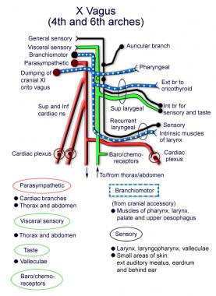

Slide 6
Types of fibers in vagus
Branchial motor - Supplying muscles of the pharynx and larynx.
Visceral sensory - This component of the vagus nerve is responsible for transmitting information from a wide variety of anatomical sites including the heart and lungs, pharynx and larynx, and upper part of the gastrointestinal tract.
Visceral motor - The visceral motor component carries parasympathetic fibers from the smooth muscle of the upper respiratory tract, heart, and gastrointestinal tract.
Special sensory - The special sensation conveyed by the vagus nerve is for taste from the palate and epiglottis.
General sensory - The general sensory component of the vagus nerve is concerned with information from parts of the ear and the dura within the posterior cranial fossa.

Slide 7
Vagus Nerve: Functional Parts and Nuclei

Slide 8
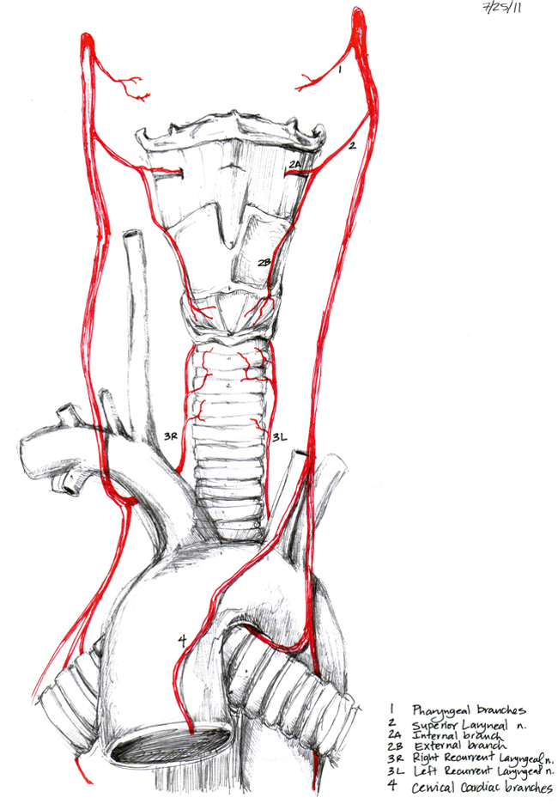
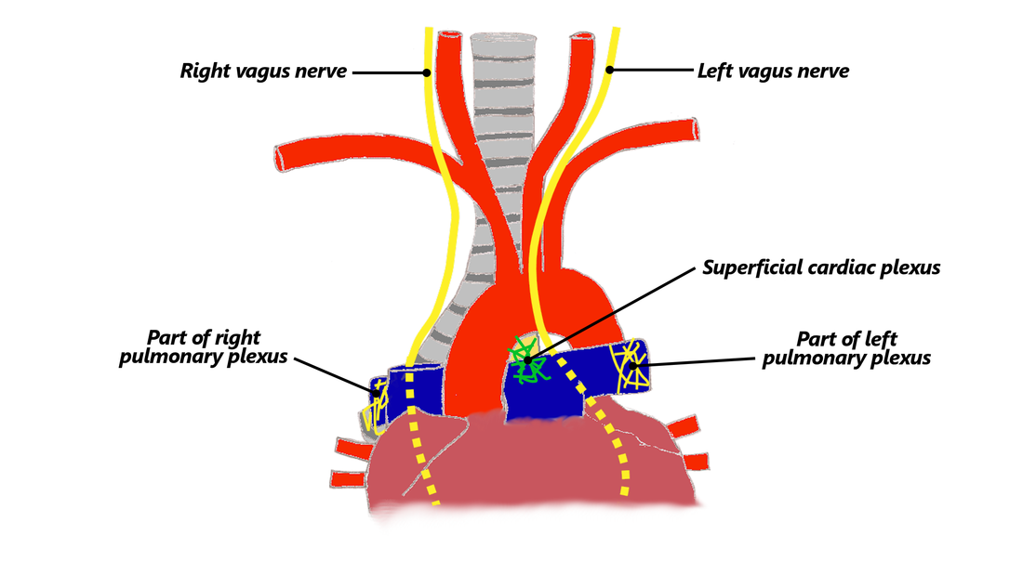

Slide 9
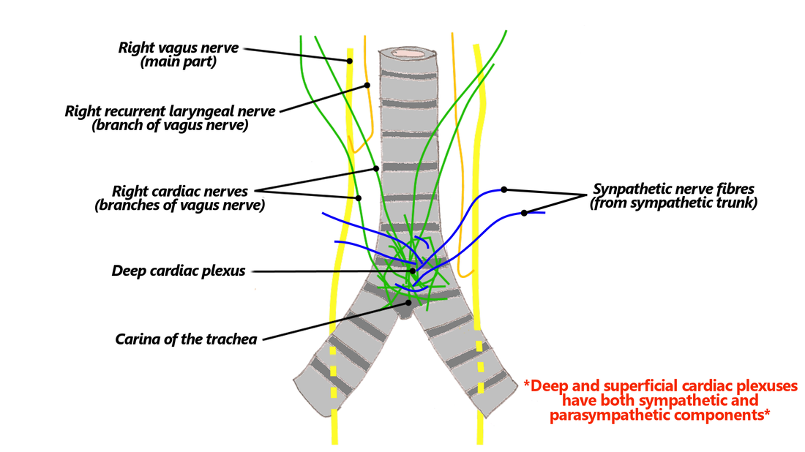

Slide 10
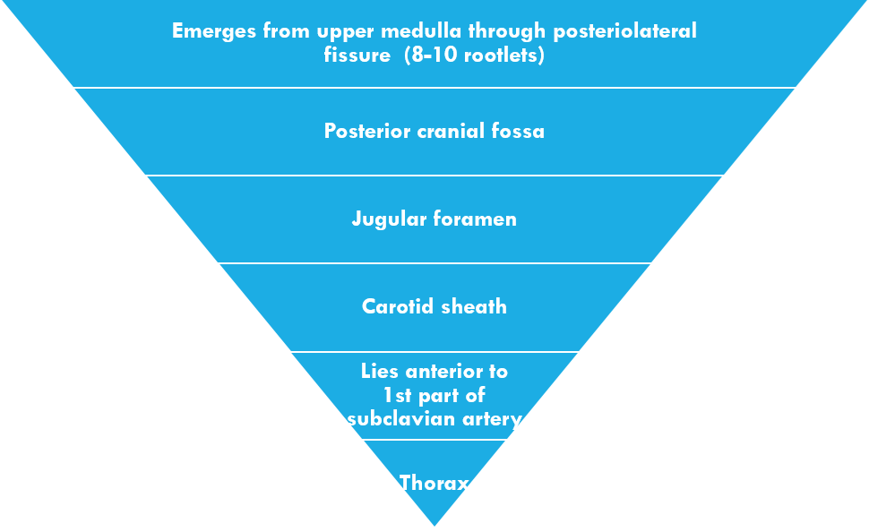
The Vagus Nerve (CN X)

Slide 11
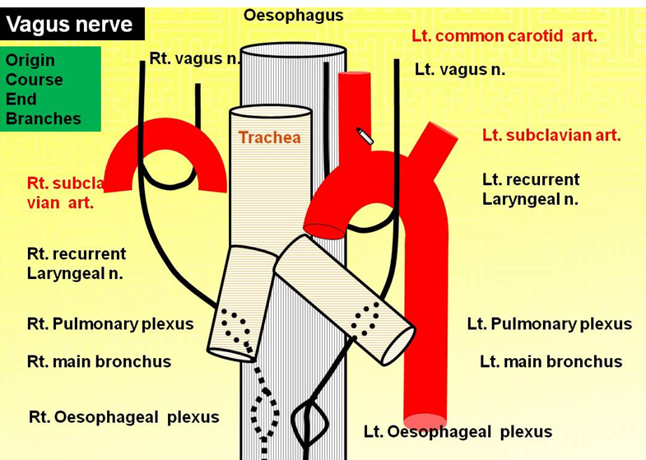

Slide 13
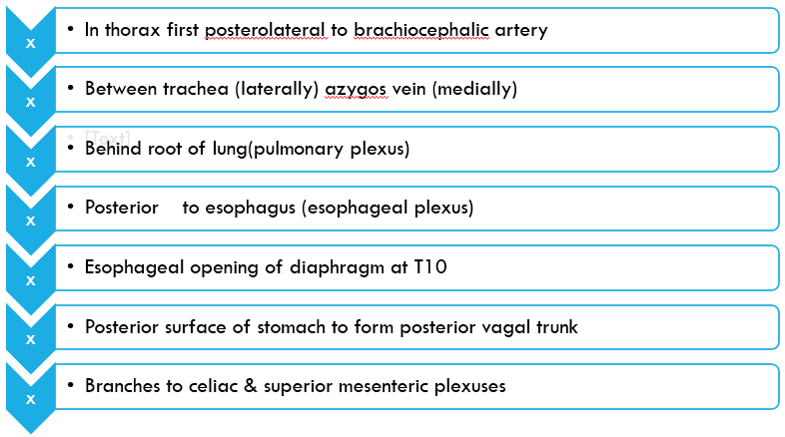
Right vagus

Slide 14
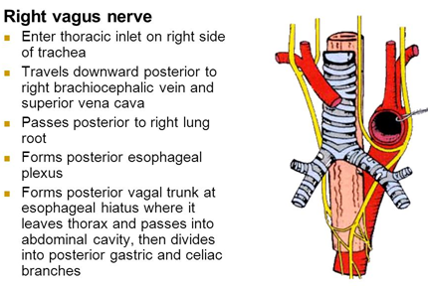

Slide 15
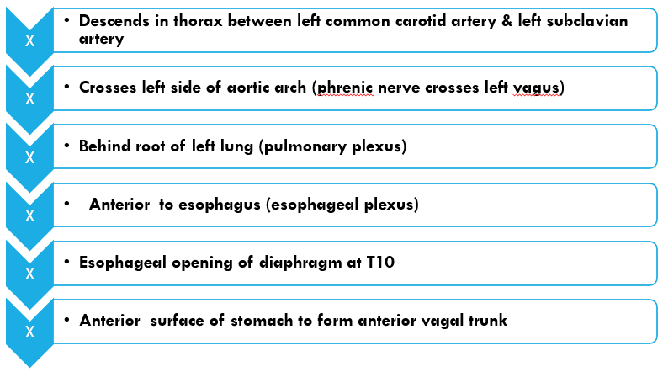
Left vagus nerve

Slide 17
VAGUS NERVE
In the Head:
The vagus nerve originates from the lateral aspect of the medulla between the olive and inferior cerebellar peduncle by about 10 rootlets below and in line of the rootlets of the glossopharyngeal nerve.
It exits the cranium via the jugular foramen, through the middle part of the jugular foramen with the glossopharyngeal and accessory nerves (CN IX and XI respectively).
Within the cranium, the auricular branch arises.
This supplies sensation to the posterior part of the external auditory canal and external ear.
Meningeal Branch:
It appears from the superior ganglion, takes a recurrent course and enters the cranial cavity via the jugular foramen to supply the dura mater of the posterior cranial fossa.

Slide 18
VAGUS NERVE
In the Neck:
The vagus nerve passes into the carotid sheath, travelling inferiorly with the internal jugular vein and common carotid artery.
At the base of the neck, the right and left nerves have differing pathways:
The right vagus nerve passes anterior to the subclavian artery and posterior to the sternoclavicular joint, entering the thorax.
The left vagus nerve passes inferiorly between the left common carotid and left subclavian arteries, posterior to the sternoclavicular joint, entering the thorax.

Slide 19
VAGUS NERVE
Several branches arise in the neck:
Pharyngeal branches – Provides motor innervation to the majority of the muscles of the pharynx and soft palate.
Superior laryngeal nerve – Splits into internal and external branches. The external laryngeal nerve innervates the cricothyroid muscle of the larynx. The internal laryngeal provides sensory innervation to the laryngopharynx and superior part of the larynx.
Recurrent laryngeal nerve (right side only) – Hooks underneath the right subclavian artery, then ascends towards to the larynx. It innervates the majority of the intrinsic muscles of the larynx.

Slide 20
VAGUS NERVE
In the Thorax:
The right vagus nerve forms the posterior vagal trunk, and the left forms the anterior vagal trunk.
The vagal trunks enter the abdomen via the esophageal hiatus.
Branches from the vagal trunks contribute to the formation of the esophageal plexus, which innervates the smooth muscle of the esophagus.
Two other branches arise in the thorax:
Left recurrent laryngeal nerve – it hooks under the arch of the aorta, ascending to innervate the majority of the intrinsic muscles of the larynx.
Cardiac branches – these innervate regulate heart rate and provide visceral sensation to the organ.

Slide 21
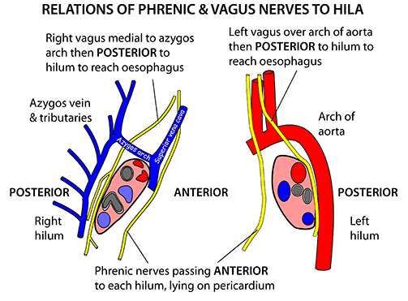

Slide 22
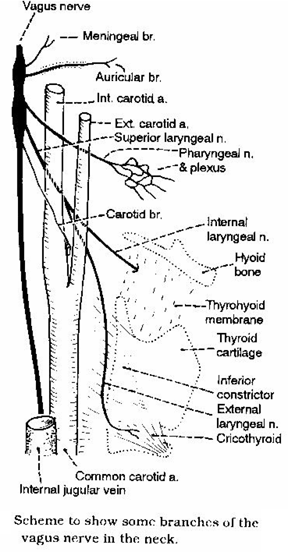
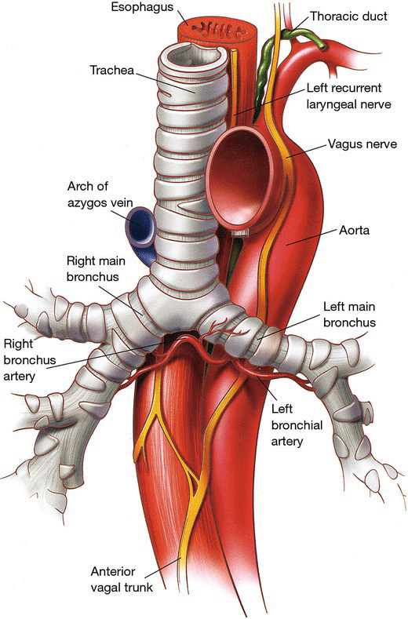

Slide 23
VAGUS NERVE
In the Abdomen
In the abdomen, the vagal trunks terminate by dividing into branches that supply:
The esophagus,
The Stomach and
The small and large bowel (up to the splenic flexure).

Slide 24
vagus nerve : Course and Connections

Slide 25
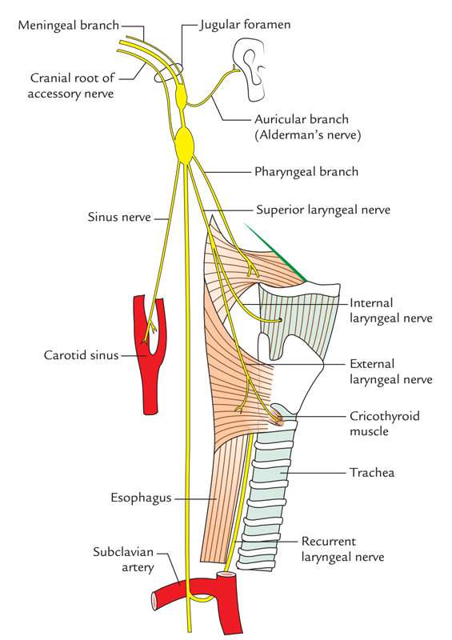
Vagus Nerve: Branches

Slide 26
VAGUS NERVE
It supplies:
All the muscles of pharynx with the exception of the stylopharyngeus that is supplied by the glossopharyngeal nerve and
All the muscles of soft palate with the exception of the tensor palati that is supplied by the mandibular nerve (via the nerve to medial pterygoid).

Slide 27
Recurrent laryngeal nerve (nerve of 6th arch)
On the right side, it originates in the root of the neck from the vagus nerve.
On the left side, it appears in the superior mediastinum from the vagus nerve as it crosses the arch of the aorta(lateral aspect). It hooks below the arch of the aorta on the left side of ligamentum arteriosum behind the arch of aorta on its way to the tracheoesophageal groove.
The recurrent laryngeal nerve gives motor innervation to all the intrinsic muscles of the larynx (with the exception of the cricothyroid that is supplied by the external laryngeal nerve) and sensory innervation to the mucous membrane of laryngeal cavity up to the vocal cord.
Every recurrent laryngeal nerve enters deep to the inferior constrictor muscle to go into the laryngeal cavity deep to the cricothyroid joint. Now it’s named the inferior laryngeal nerve.

Slide 28
ALDERMAN’S NERVE PHENOMENON
The tickling of the cutaneous distribution of the vagus nerve arouses jaded desire.
The Alderman in early Roman days utilized to stimulate their desire by dropping chilly water supporting the ear supplied by the auricular branch of the vagus nerve Because of this, the auricular branch of the vagus nerve is also named Alderman’s nerve.
Seemingly, this happens by a reflex increase in gastric motility supplied by the vagus nerve (to the stomach).

Slide 29
LESIONS OF VAGUS NERVE
The bilateral lesions of vagus nerve cause:
Nasal regurgitation of the swallowed liquids,
Nasal twang of voice,
Hoarseness of voice,
Flattering of palatal arches,
Cadaveric position of sung cards,
Dysphagia and
Reduction of cough reflex.

Slide 30
CLINICAL TESTING OF VAGUS NERVE
The vagus nerve can be analyzed medically by requesting the patient to open his mouth and say ‘ah’ and after that comparing the palatal arches of the 2 sides. If the vagus is undamaged, the soft palate rises (is elevated) in the midline. In bilateral lesions, the soft palate falls. In the unilateral lesion, there’s flattening (drooping) of palate arch on the side of paralysis and uvula pulled to the normal side.

Slide 31
Thank You

