Slide 1
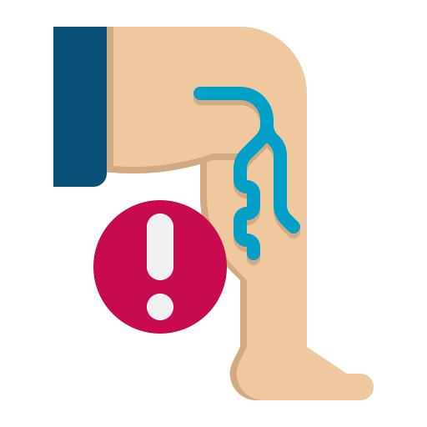
Varicose vein
BY MBBSPPT.COM

Slide 2
Introduction
Elongated, Dilated, tortuous & palpable veins of subcutaneous/superficial venous system.
Pathophysiology is complicated and involves concept of ambulatory venous hypertension.
Two venous system in lower extremity, deep and superficial.
Deep system ultimately leads back to IVC, then to heart.
Superficial system found above deep fascia of lower extremity, within subcutaneous tissue.
Many superficial veins exist, but they all drain into two largest, the great saphenous and short saphenous vein.

Slide 3
ANATOMY

Slide 4
1.Great/Long saphenous vein
Originates from where the dorsal vein of the first digit (the large toe) merges with the dorsal venous arch of the foot.
Passes anterior to the medial malleolus, then crosses the medial tibia in a posterior direction to ascend medially across the knee.
Above the knee, it continues anteromedially, superficial to the deep fascia, and passes through the foramen ovule (an opening in the fascia lata also called the saphenous opening) to join the common femoral vein at the groin crease at a site termed the saphenofemoral junction (SFJ).

Slide 5
2.Short saphenous vein
Its origin is where the dorsal vein from the 5th digit (smallest toe) merges with the dorsal venous arch of the foot.
It passes posteriorly lateral to the Achilles tendon in the lower calf.
The SSV usually lies directly superficial to the deep fascia in the midline as it reaches the upper calf, where it enters the popliteal space between the two heads of the gastrocnemius muscles.
In two-thirds of cases, it joins the popliteal vein above the knee joint, and in one-third of cases, it joins with other veins (most often the GSV or the deep muscular veins of the thigh).
In some patients, the SSV may have two or three different termination sites.
Sural nerve

Slide 6
Deep venous system
These are primary veins that drain venous blood from the lower extremity. They include:
Common Femoral
Deep femoral
External Iliac
Femoral
Popliteal
Tibial (Anterior and Posterior)
Peroneal

Slide 7
Deep venous system
Deep veins are located within the muscle fascia which allows a high volume and pressure of blood to pass through the veins.
They account for approximately 90-95% of venous blood return to the heart.
Deep veins can form deep vein thrombosis, or DVT, which is a dangerous clot in the deep system.

Slide 8
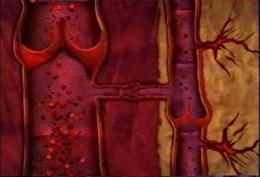
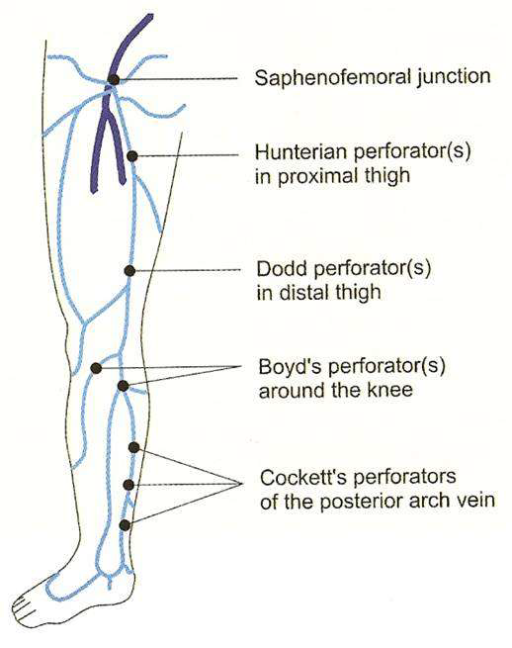
Perforators
Connect deep and superficial systems
Flow normally from superficial to deep
Common GSV perforators:
Hunterian (midthigh)
Dodd’s (above knee)
Boyd’s (below knee)
Cockett (distal leg)
Saphenofemoral junction(SFJ)- Located proximally at groin where GSV meets femoral vein.

Slide 9
Saphenopopliteal Junction-
Behind knee where SSV join Popliteal vein.
Normally, flow of venous blood is through superficial system to deep and up the leg and toward heart.
One-way venous valve in both systems and perforating veins.
Incompetence in any of these valves lead disruption in unidirectional flow result in ambulatory venous HTN.
Incompetence in one system can lead incompetence in another.
Incompetence in superficial venous system alone usually result from failure at valves located at SFJ and SPJ.
Gravitational weight of blood column along the length of vein creates hydrostatic pressure, which is worse at distal aspect of the length of vein.
Incompetence of perforating veins leads to hydrodynamic pressure.
Calf pump mechanism helps to empty deep venous system, but if perforating vein valves fail, then pressure generated in deep venous system are transmitted into superficial system via incompetent perforating veins.

Slide 10
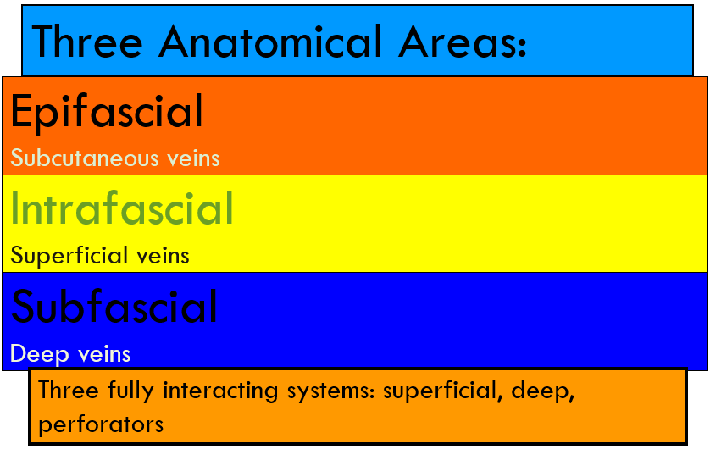

Slide 11
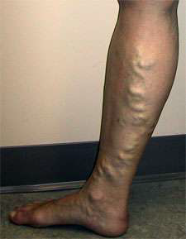
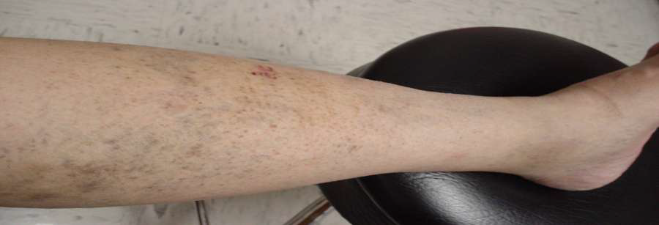
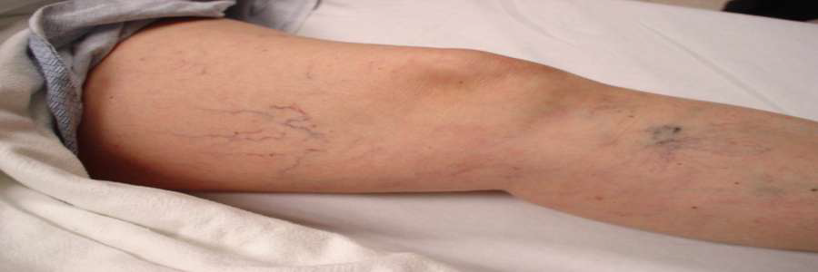
Subcutaneous Veins
When abnormal:
Varicose veins- dilated, palpable, subcutaneous veins > 4mm in diameter.
Reticular veins- dilated, nonpalpable, subdermal vein between1- 4 mm in diameter.
Telangiectasia (spider)- dilated intradermal venules < 1mm in diameter.

Slide 12
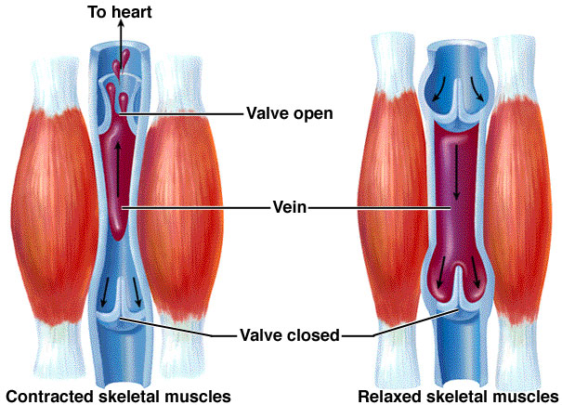
Muscle Pump
Contractions propel blood toward heart.
Relaxation draws blood from:
Superficial Veins
Lower Deep Veins

Slide 13
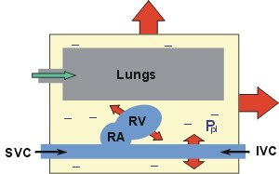
Thoracoabdominal Pump
Inspiration decreases intrathoracic pressure promoting venous return.
Expiration reverses the process.
Findings easily seen in US.

Slide 14
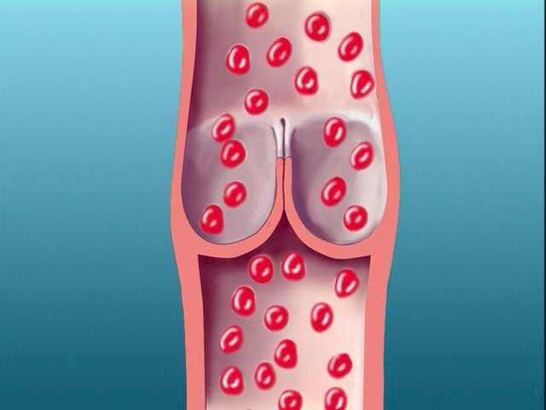
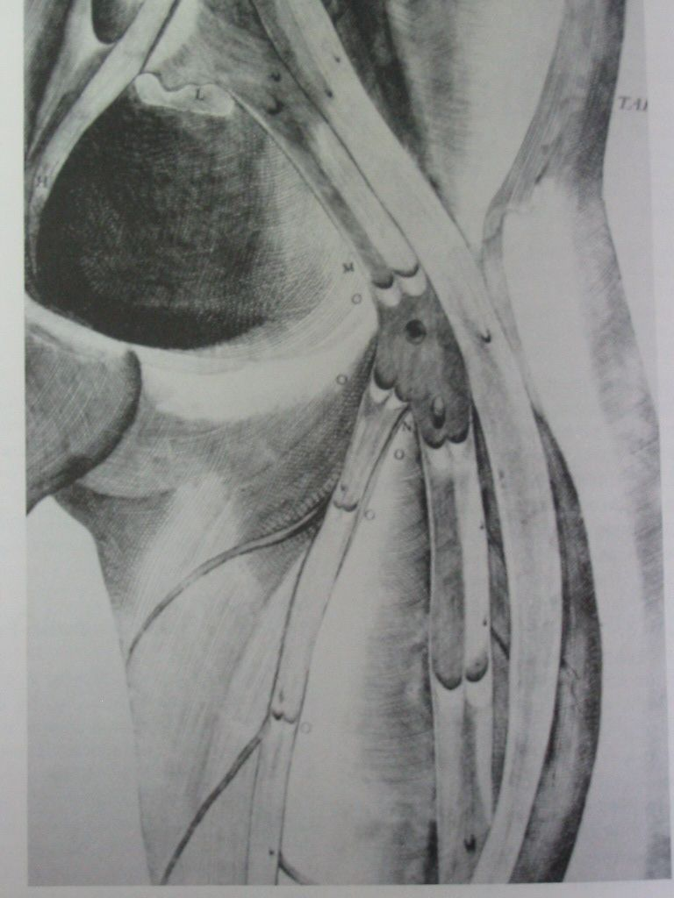
Valves
Maintain unidirectional flow
Extremity to heart
Superficial to deep
GSV and SSV with terminal and preterminal valves.
Terminal (sentinel or first) valve with firm thickened white cusps different from the rest of the valves.

Slide 15
Types of varicose vein
1. Primary trunk varicose vein-
- valvular insufficiency of superficial veins ,most commonly at SF junction
2. Secondary trunk varicose vein-
Mainly caused by deep vein thrombosis (DVT) that leads to chronic deep venous obstruction or valvular insufficiency.
Catheter-associated DVTs are also included.
Pregnancy-induced and progesterone-induced venous valve weakness Trauma.
3. Congenital-
This includes any venous malformations i.e. Klippel- Trenaunay variants, avalvulia etc.

Slide 16
Pathogenesis
Primary varicose vein are due to valvular failure,
2 theories-
Primary valve failure-primary degenerative changes in the valve annulus & leaflets.
Secondary valve failure-developmental weakness in the vein wall leads to secondary widening of the valve commissure & incompetence.
It is likely that both mechanism are involved, but to a variable extent in different pt.

Slide 17
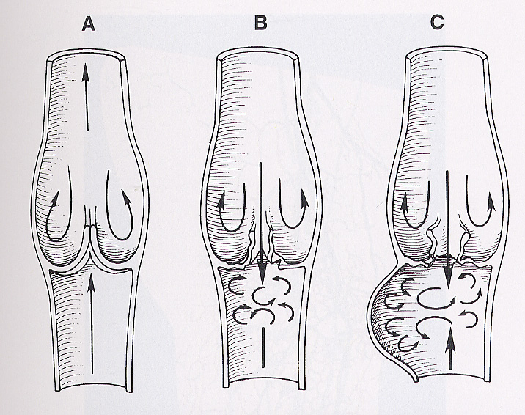
Incompetent Valve Progression

Slide 18
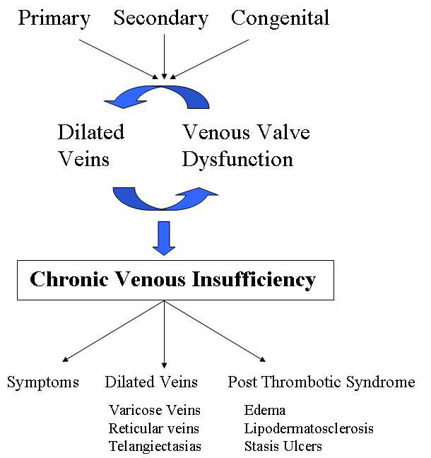

Slide 19
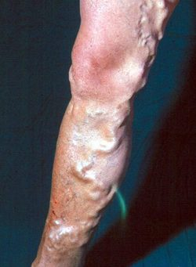
Etiology
Idiopathic
Prolonged standing
Pregnancy
Pelvic obstruction
Chronic straining
Prolonged standing

Slide 20
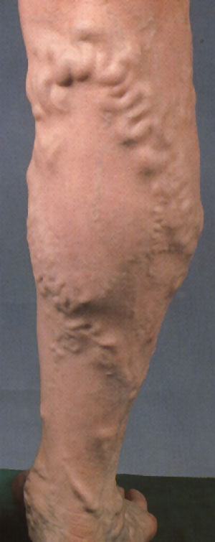
Etiology contd.
Wearing constricting clothing
Obesity
Hormones
Heredity risk?
Both parents = 80%
50/50 chance if one parent
20% chance if neither parent

Slide 21
Symptoms of Varicose Veins
Age : Any, Sex : F:M= 10:1
Occupation : Jobs demanding prolong standing person doing muscular work
Cosmetic (Elongated Tortous dilated visible vein)
Pain: aching, throbbing, tingling, sharp
Cramps, heaviness, tiredness of legs.
Ankle swelling usually at the end of day.
“Restless” legs at night.
Itching, dermatitis, hyperpigmentation, skin ulceration, bleeding, blood clots.
All increase with dependency, resolve with leg elevation or compression.

Slide 22
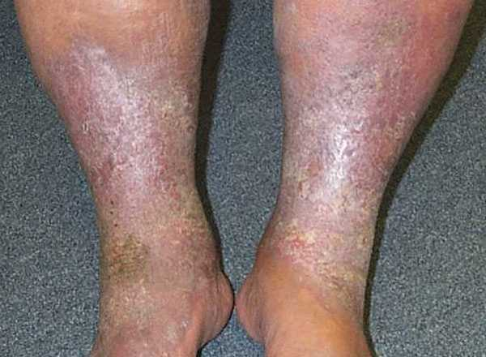
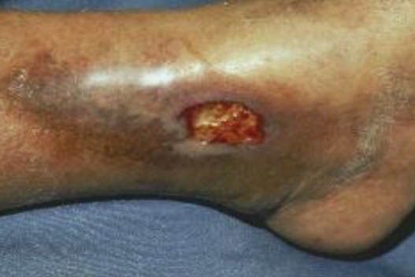
Abnormal skin
Eczema
Edema
Corona Phlebectatica
Lipodermatosclerosis
Ulceration

Slide 23
Examination (Properly exposed, standing and supine position, both in front and behind)
Inspection - Visible veins (site, size and extent, effect of elevation and dependency) Skin of the lower 3rd medial aspect of calf (swelling, redness, pigmentation, eczema and ulceration).
Palpation
Skin and subcutaneous tissue (texture, oedema, thickening and tenderness)
Course of the veins (defect)
SFJ and SPJ (cough impulse and thrill)
Special tests (to be demonstrated separately)
Percussion - For percussion impulse conducting up or down.
Auscultation
Bruit

Slide 24
SPECIAL TESTS:
Sapheno-Femoral incometence
1) Trendelenberg I
2) Modified Perthes test
Perforator incompetence
1) Tourniquet test
2) Pratt’s test
3) Fegan’s test
4) Trendelenberg II
Deep vein thrombosis
1) Perthes’test
2) Modified Perthes
3) Homan’s sign
4) Moses sign

Slide 25
Indications for Treatment
Often for cosmetic reasons.
Non-cosmetic indications varicosities (e.g. pain, fatigability, heaviness, recurrent superficial thrombophlebitis, bleeding).
For treatment of venous hypertension after skin or subcutaneous tissue changes, (lipodermatosclerosis, atrophie blanche, ulceration, or hyperpigmentation).

Slide 26
Contraindications for Treatment
Patients with venous outflow obstruction (DVT)because they are important bypass pathways that allow blood to flow around the obstruction.
Who cannot remain active enough to reduce risk of postoperative DVT.
Surgery during pregnancy because many varicose veins of pregnancy spontaneously regress after delivery.

Slide 27
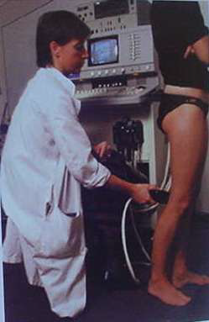
Investigations
1)Duplex Ultrasonography
Replaced plethysmography and venography
7-10MHz linear transducer
Exam sitting and standing
Superficial and deep systems evaluated
Physiologic reflux: < 0.5 sec
Pathologic reflux: > 0.5 sec
Duplex US with colour-flow imaging (sometimes called triplex ultrasound).
Special type of 2-dimensional ultrasound that uses Doppler-flow information to add colour for blood flow in the image. Vessels in blood are coloured red for flow in one direction and blue for flow in other, with a graduated colour scale to reflect the speed of flow.
Venous valvular reflux is defined as regurgitant flow with Valsalva that lasts great than 2 seconds.

Slide 28
2)Doppler USG
Doppler transducer is positioned along the axis of vein with probe at angle of 45 to skin When distal vein is compressed, audible forward flow exists.
If valves competent, no audible backward flow is heard with the release of compression.
If valves incompetent, an audible backflow exists.
These compression-decompression manoeuvres repeated while gradually ascending the limb to a level at which reflux can no longer be appreciated.
3)Venous refilling time (VRT)
Physiologic test, using plethysmography - VRT is time necessary for lower leg to become infused with blood after the calf-muscle pump has emptied the lower leg as thoroughly as possible,
In healthy subjects, venous refilling >120 seconds
In mild and asymptomatic venous insufficiency between 40 -120 seconds
In significant venous insufficiency 20-40 seconds. Such patients have nocturnal leg cramps, restless legs, leg soreness, burning leg pain, and premature leg fatigue,
If < 20 seconds markedly abnormal, and nearly always symptomatic
If < 10 seconds, venous ulcerations are likely

Slide 29
4)Direct Contrast Venogram
Intravenous catheter placed in dorsal vein of foot, and radiographic contrast material is infused into the vein.
X-rays used to obtain image of superficial venous anatomy.
If deep vein imaging is desired, superficial tourniquet is placed around leg to occlude superficial veins and contrast is forced into deep veins.
Assessment of reflux can be difficult because it requires passing a catheter from ankle to groin, with selective introduction of contrast material into each vein segment.
Labor-intensive and invasive venous imaging technique with a 15% chance of developing new venous thrombosis from the procedure itself.
Rarely used, and has been replaced by duplex ultrasound.
Reserved for difficult or confusing cases.

Slide 30
Classification of chronic lower extremity venous disease (CEAP Classification)
C | Clinical signs (grade 0-6), supplemented by (A) for asymptomatic and (S) for symptomatic presentation
E | Etiologic Classification (Congenital, Primary, Secondary)
A | Anatomic Distribution (Superficial, Deep, or Perforator, alone or in combination)
P | Pathophysiologic Dysfunction (Reflux or Obstruction, alone or in combination)

Slide 31
THE CEAP CLASSIFICATION: SUMMARY
Clinical-
C0: no visible or palpable signs of venous disease.
C1: telangiectasis or reticular veins.
C2: varicose veins.
C3: oedema.
C4a: pigmentation and eczema.
C4b: lipodermatosclerosis and atrophie blanche.
C5: healed venous ulcer.
C6: active venous ulcer.
S: symptoms including ache, pain, tightness, skin irritation, heaviness, muscle cramps, as well as other complaints attributable to venous dysfunction.
A: asymptomatic.

Slide 32
Etiologic Classification-
Ec: congenital.
Ep: primary.
Es: secondary (postthrombotic).
Anatomic Classification-
s: superficial veins.
p: perforator veins.
d: deep veins.
Pathophysiologic Classification-
Pr: reflux.
Po: obstruction.
Pr,o: reflux and obstruction.
Pn: no venous pathophysiology identifiable.

Slide 33
Advanced CEAP:
(SAME AS BASIC WITH THE ADDITION THAT ANY OF 18 NAMED VENOUS SEGMENTS CAN BEUTILIZED AS LOCATORS FOR VENOUS PATHOLOGY)
Superficial Veins:
1. telangiectasies/reticular veins.
2. GSV above knee.
3. GSV below knee.
4. LSV.
5. Nonsaphenous veins.
Deep Veins:
6. IVC.
7. Common iliac vein.
8. Internal iliac vein.
9. External iliac vein.
10. Pelvic: gonadal, broad ligament veins, other.
11. Common femoral vein.
12. Deep femoral vein.
13. Femoral vein.
14. Popliteal vein.
15. Crural: anterior tibial, posterior tibial, peroneal veins (all paired).
16. Muscular: gastrocnemial, soleal veins, other.
Perforating Veins:
17. Thigh
18. Calf.

Slide 34
Treatment
1) Conservative
For elderly unfit patients or with mild symptoms.
Elastic support, weight reduction, regular exercise, avoidance of constricting garments and prolonged standing.
Limb elevation above the level of heart while lying down.

Slide 35
Conservative Treatment
Indication
Contraindication
Refusal for surgery
Capillary veins, Telangiectases
Pregnant patients
Waiting for surgery
Early cases
Arterial Insufficiency

Slide 36
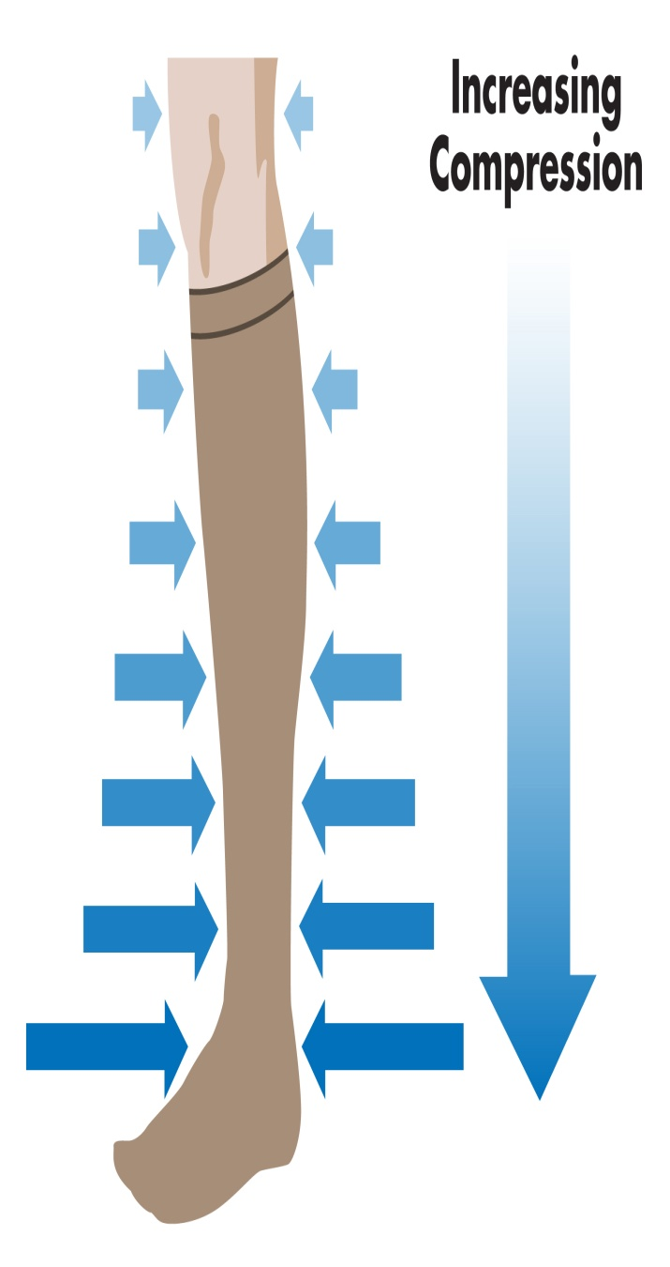
2) Compression Hosiery
Compression must be strong (20-30 mmhg at the ankle), graduated (maximal at ankle reducing at 75% at calf & 50% at thigh) & replaced regularly (every 6 month).

Slide 37
Medical Management
1) MICRONIZED PURIFIED FLAVONOID FRACTION (MPFF):
DAFLON 500MG oral phlebotropic drug consisting of 90% micronized diosmin and 10% flavonoids expressed as hesperidin.
Shown to improve venous tone and lymphatic drainage and reduce capillary hyperpermeability by protecting the microcirculation from inflammatory process.
2) CALCIUM DOBESILATE
3) PENTOXIFYLLINE: inhibits platelet aggregation hence reduce blood viscosity and improves microcirculation.
4) ASPIRIN

Slide 38
Sclerotherapy
Sclerosant fall into 3 category:
Detergent solution-sodium tetradecyl sulphate & polidocanal.
Osmotic solution-hypertonic saline.
Chemical irritants-chromated glycerin.
Complication of Sclerotherpy-
Anaphylaxis & allergic reaction.
Pigmentation & ulceration.
Superficial & deep thrombophlebitis.
Arterial injection & nerve damage.

Slide 39
Sclerotherapy
Indication
Varicosity confined below knee and caused by incompetent perforators
Recurrent/residual varicosities post-surgery
Large Venous telangiectasia dilated branch veins around the knee following early long saphenous incompetence.
Refusal for surgery.
Contraindication
Deep Venous thrombosis
Sapheno Femoral Incompetence
Veins in lower 1/3rd of leg
Veins on the foot
Veins in elderly
Veins in fat legs
Immobile patient
Post thrombotic syndrome
Dirty ulcer or extensive
Eczema.

Slide 40
Surgical Management
Indication
Contraindication
LSV /SSV incompetency .
Perforating vein incompetency.
DVT.
Pregnancy.
Thrombophlebitis.
Peripheral vascular disease.

Slide 41
Surgical Management
Indication
Saphenous vein ligation.
Saphenous vein stripping +/- ligation.
Flush Saphenofemoral junction ligation, stripping of GSV with excision of tributaries and stab phlebectomies of VV.
Stab avulsion technique (ambulatory phlebectomy).
Extrafascial ligation of perforators.
Subfascial ligation of perforators.

Slide 42
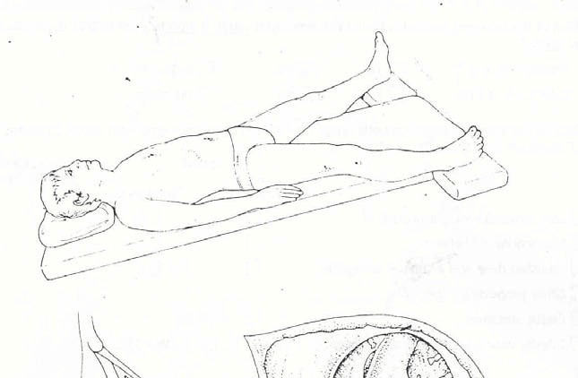
FLUSH SAPHENOFEMORAL JUNCTION LIGATION, STRIPPING OF GSV WITH EXCISION OF TRIBUTARIES AND STAB PHLEBECTOMIES OF VV
Steps
After anaesthesia proper position is given.
The whole table is tilted head down to an angle of about 10 degree (Trendelenburg position).

Slide 43
Steps continued..
Incisions:
1. Hockey stick incision
2. Oblique incision
Incision is kept at groin at Saphenous opening 3-4 cm below and lateral to pubic tubercle.

Slide 44
Steps continued..
After division of deep layer of fascia, saphenofemoral junction is exposed.

Slide 45
Steps continued..
Then flush saphenofemoral ligation (& tranfixation) done with ligation of all tributaries of GSV.

Slide 46
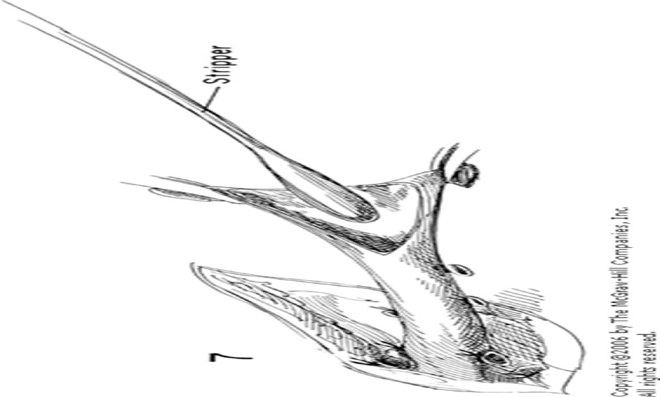
Steps continued..
Then stripper is passed down the saphenous vein and directed downward by finger.

Slide 47
Steps continued..
Stripper delivered through small incision over ankle on medial aspect.

Slide 48
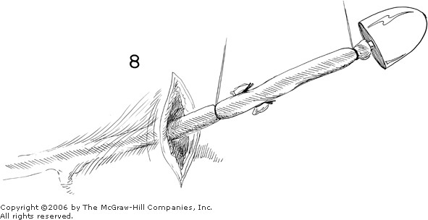

Slide 49
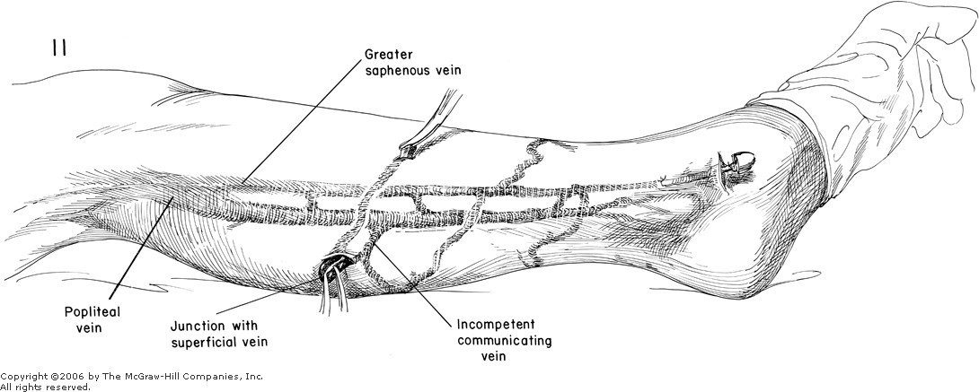

Slide 50
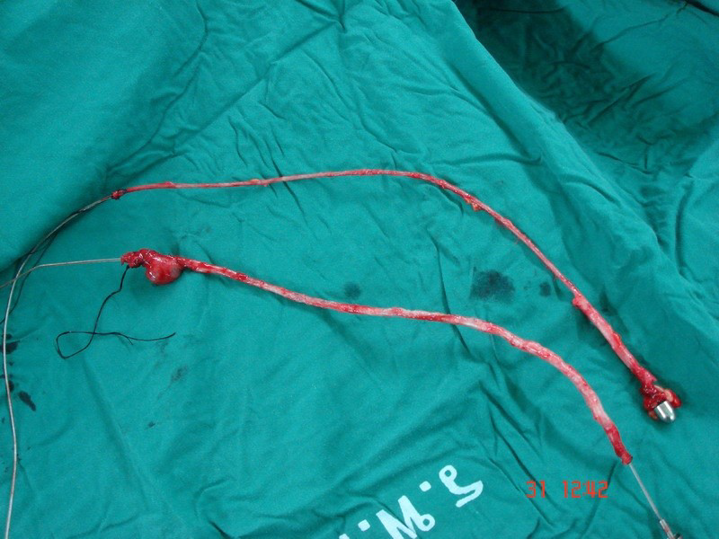
Vein is tied with stripper and then stripper is slowly and steadily pulled out through lower wound.
The ‘vein bolus’ is withdrawn slowly from the lower wound.
The residual veins are then ‘wormed out ‘ using multiple stab avulsions using vein hooks, from the preoperative marked sites.
Post operatively limb elevation and compression stockings are given.

Slide 51
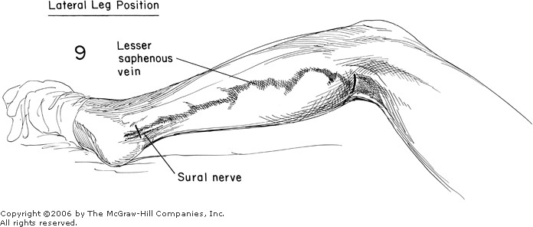
STEPS OF SURGERY FOR SSV
After anaesthesia proper position is given.
The patient must be face down and the knee is flexed a little, by placing sandbag under the ankle.
Lateral leg position.
The foot of the table is tilted up a little, so that legs are above the heart.

Slide 52
Incision is kept at least 5 cm long, transversely across the popliteal fossa, in one of the transverse line of skin about the level with knee joint.
The incision is deepened until the deep fascia and short saphenous vein lies deep to this.
The fascia is divided transversely in the line of incision.
The short saphenous vein is then seen or sought for between the two heads of gastrocnemius.
As soon as the SSV is identified, it is lifted up in a pair of artery forceps and the knee is flexed still further.
Then flush saphenopopliteal ligation (& trans fixation) done with ligation of all the side branches of SSV, right upto its junction with the popliteal vein.

Slide 53
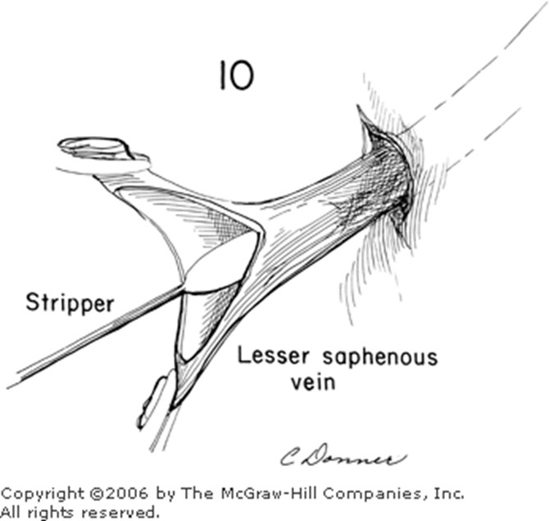
Then stripper is passed down distally, directed by finger.
And delivered to point below external malleous through a small transverse incision.

Slide 54
INTRA - OPERATIVE COMPLICATIONS OF THE SURGERY
Bleeding From A Torn Saphena Varix
Injury To Common Femoral Vein
Injury To common Femoral Artery
Injury To Saphaneous Nerve
Injury To Sural Nerve

Slide 55
IMMEDIATE POST-OP CARE
Three factors to be kept in mind in the first week:
1. Maintenance of firm elastic pressure over whole limb.
2. Regular movement and exercise of the legs
3. Elevation of the foot of the bed 6 to 9 inches so that the leg are just above the heart level when the patient is in bed.

Slide 56
Post operative complications
Haematoma and buising
Normally bruise absorbed within 3-4 wks
Small haematos get reabsorbed large haematomas
More than 4 cm evacuatedunder LA with sterile precautions
Lymphatoma
Generally occurs on 5-6 post op day
Get absorbed within 1-2 wks
Should not be interveined as may lead to lymphatic fistula formation
Wound sepsis
Post operative saphenous neuritis
Lymphoedema of leg
Induration of stripper tract
DVT and embolism

Slide 57
Extra fascial ligation of perforators (Cocketts procedure)
Not commonly employed.
Aim is to clear all the extra fascial veins.
More traumatic due to adherence of subcutaneous fat and connective tissue to the fascia.

Slide 58
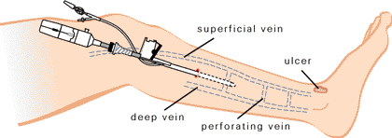
Subfascial Endoscopic Perforator
Surgery
People who suffer with leg ulcers due to incompetent venous perforators.
Indication:
Incompetent perforating veins in calf with no superficial venous reflux or no evidence of DVT on Doppler .
Patient with LSV / SSV varicosity with ulcer.

Slide 59
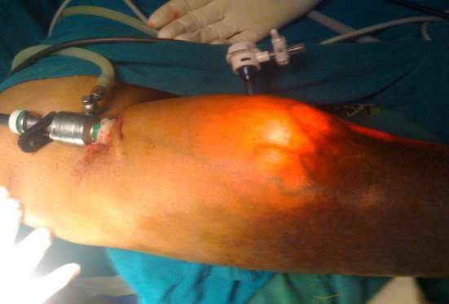
Insertion Of Ports for SEPS
A single 10 mm port for camera is inserted below the deep fascia at the medial end of upper part of tibia. Another 5mm port inserted at junction of upper 1/3rd and lower 2/3rd of the calf.

Slide 60
Endovenous Laser Treatment (EVLT)
Principal:
EVLT initiate a non-thrombotic occlusion by direct thermal injury to vein wall, causing endothelial denudation, collagen contraction and later fibrosis.

Slide 61
Indication
Contraindication
Long saphenous vein varicosity.
Short saphenous vein varicosity.
Superficial vein
Thrombophlebitis
DVT

Slide 62
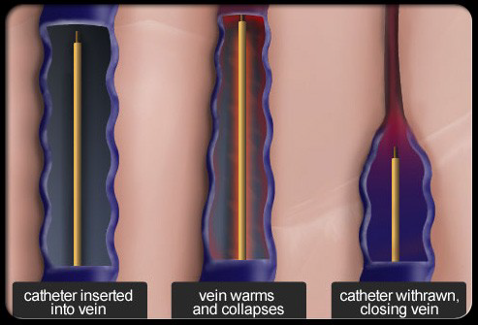

Slide 63
Advantage
Disadvantage
Minimal invasive procedure
No post op scar
Done with local anesthesia
Minimal post-op pain
Recurrence rate ( at 2 year f/u only 3%
Costly procedure
High technical skills req
Color Doppler and Radiologist is req
Skin burns
Thrombophebitis
Paresthesia

Slide 64
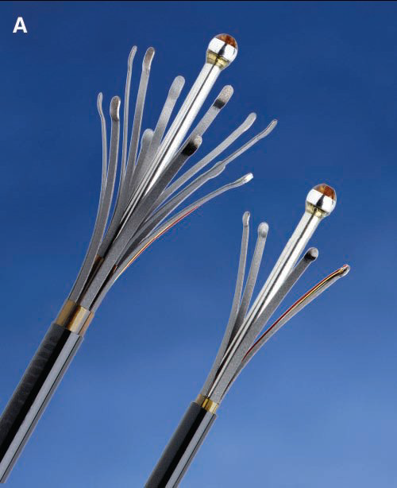
Radiofrequency Ablation
This technique based on same principal of EVLT
Here instead of laser fiber, special heater probe is inserted which work at 85-120c
Probe directly comes in contact with vein wall & causes tissue damage .
A 45 cm of vein segment takes only 3-5 min
Patient can directly go to home after procedure.

Slide 65
Thank You

