Slide 1
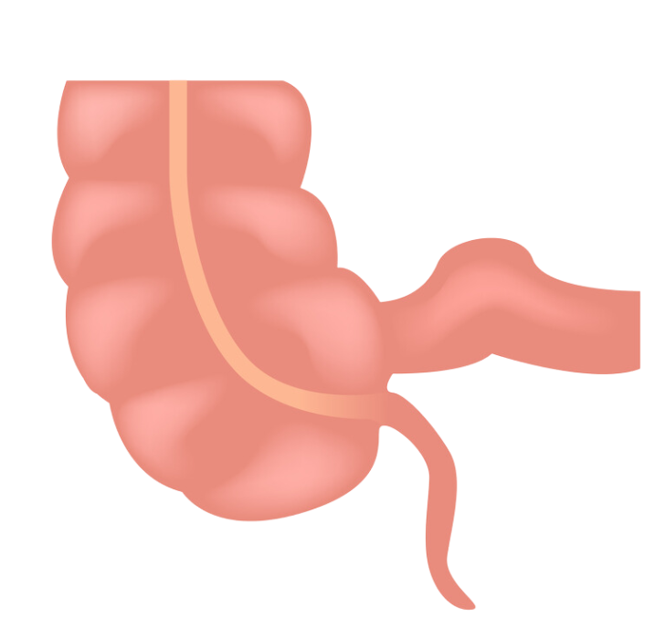
Vermiform appendix
BY MBBSPPT.COM

Slide 2
Vermiform appendix
  It is a blind intestinal diverticulum.
  It varies in length from 3 to 5 in. (8 to 13 cm).
  It contains masses of lymphoid tissue.
  It arises from the posteromedial aspect of the cecum inferior to the ileocecal junction.
  The appendix has a short triangular mesentery, the mesoappendix, which derives from the posterior side of the mesentery of the terminal ileum.
  The mesoappendix contains the appendicular vessels and nerves.

Slide 3
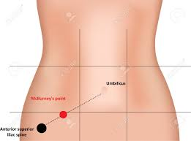
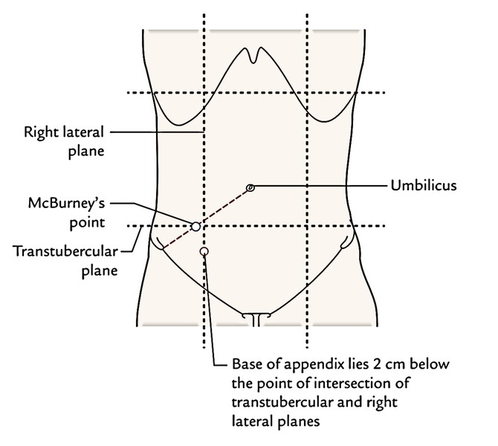
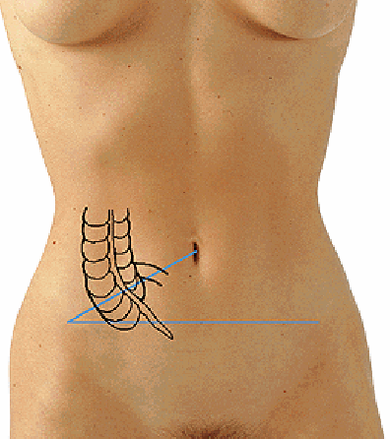

Slide 4
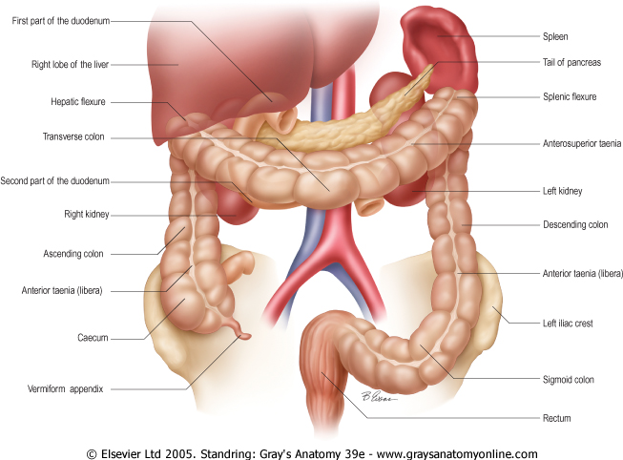

Slide 5
Location and Description
  The appendix lies in the right iliac fossa, and in relation to the anterior abdominal wall its base is situated one third of the way up the line joining the right anterior superior iliac spine to the umbilicus (McBurney's point).
  Inside the abdomen, the base of the appendix is easily found by identifying the teniae coli of the cecum and tracing them to the base of the appendix, where they converge to form a continuous longitudinal muscle coat.

Slide 6
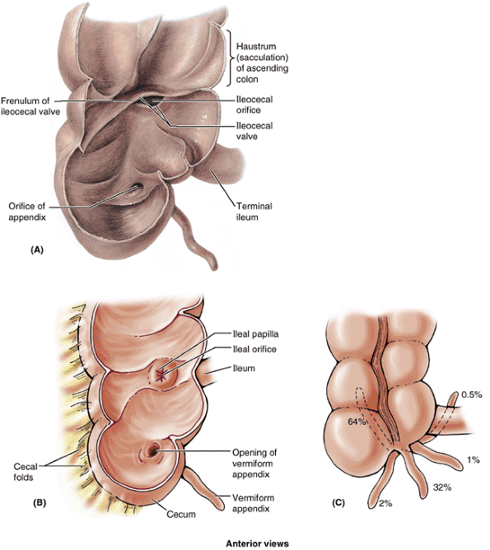
The lumen of the appendix is small and opens into the caecum by an orifice lying below and slightly posterior to the ileocaecal opening.

Slide 7
Positions
  These are the commonest positions seen in clinical practice. Thus, it may be:
    Retrocecal,
    Retrocolic (behind the caecum or lower ascending colon respectively).
    Pelvic or descending (when it hangs dependently over the pelvic brim, in close relation to the right uterine tube and ovary in females).
    Other positions are occasionally seen especially when there is a long appendix mesentery allowing greater mobility.
    These include subcaecal (below the caecum); preilial (anterior to the terminal ileum); postileal (behind the terminal ileum).

Slide 9
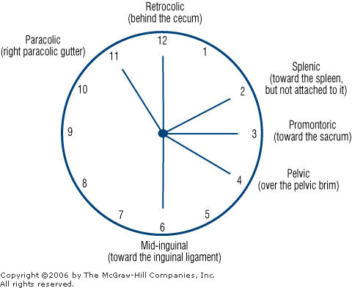

Slide 10
Appendiceal Wall
  The appendiceal wall is similar to the wall of the colon. It is formed by the serosa.
  A muscular layer composed of the longitudinal and circular layers. At the appendiceal base, the longitudinal muscle produces a thickening that is related to all cecal taeniae.
  The submucosa, which contains many lymphoid islands.
  The mucosa.

Slide 11
Histology
Though the thick appendiceal wall has the same four layers as the colon.
  Serosa or adventitia,
  Muscularis externa,
  Submucosa and
  Mucosa,
It differs by having the following characteristics:
  Its outer layer of longitudinal smooth muscle is complete, and
  The mucosa and submucosa have multiple lymph nodules.

Slide 12
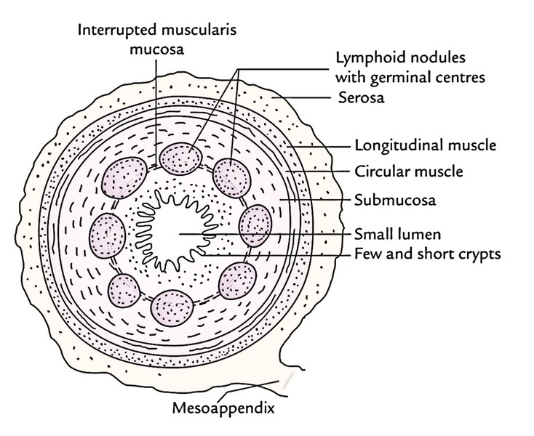

Slide 13
Anatomical basis of tests
  Right psoas muscle test: The forced extension of the right thigh produces increased pain in the RLQ of the abdomen when the inflamed appendix and its short mesentery rest on the peritoneum which covers the right major psoas muscle.
  Right obturator muscle test: Flexion and lateral rotation of the right thigh produces increased pain in the RLQ and right pelvic area when the inflamed appendix is closely related to the obturator internus muscle.

Slide 14
Each position of the appendix produces and mimics a different clinical picture
Retrocecal appendix:
RLQ or right flank pain with ureteric irritation.
Pelvic appendix:
Pelvic pain with urinary symptoms; rule out pelvic inflammatory disease.
Subhepatic appendix:
Due to cecal malrotation; presents gallbladder symptoms.
Upper or lower midline appendix:
Epigastric or hypogastric pain.
Situs inversus:
When present, pain is located at the LLQ.

Slide 15
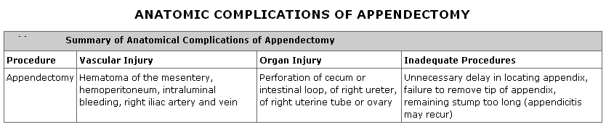
  The convergence of the taeniae coli at the appendiceal base will help the surgeon find a hidden appendix.
  The lumen may be widely patent in early childhood and is often partially or wholly obliterated in the later decades of life.
  The appendix usually contains numerous patches of lymphoid tissue although these tend to decrease in size from early adulthood.

Slide 16
Arteries
  The appendicular artery is a branch of the posterior cecal artery.
  The appendicular artery represents the entire vascular supply of the appendix. It runs first in the edge of the appendicular mesentery and then, distally, along the wall of the appendix.
  Acute infection of the appendix may result in thrombosis of this artery with rapid development of gangrene and subsequent perforation.

Slide 18
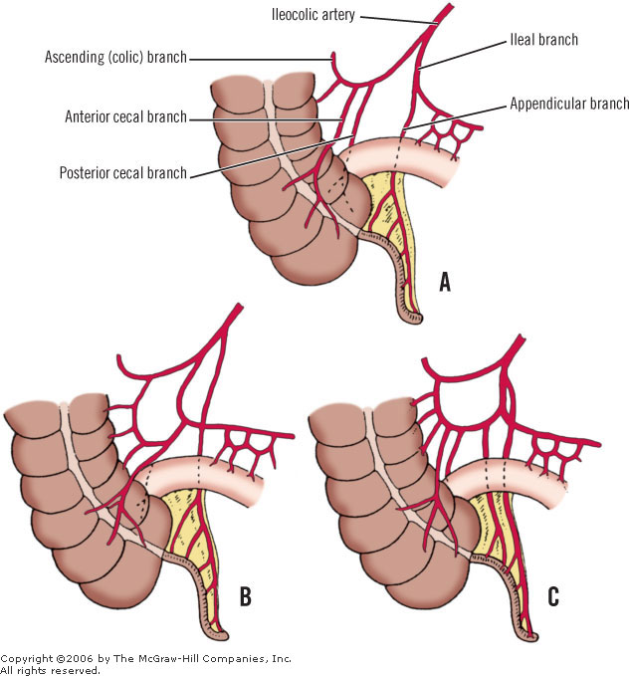

Slide 19
Veins
  The appendicular vein drains into the posterior cecal vein.

Slide 20
Lymphatic Drainage
  The lymph vessels drain into one or two nodes lying in the mesoappendix and then eventually into the superior mesenteric nodes.
  Lymphatic drainage from the ileocecal region is through a chain of nodes on the appendicular, ileocolic, and superior mesenteric arteries through which the lymph passes to reach the celiac lymph nodes and the cisterna chyli.
  A secondary drainage (which passes anterior to the pancreas) to subpyloric nodes.
  It should be remembered that lymph nodules in the wall of the appendix are not connected with the lymphatic drainage of the organ. The lymphocytes formed in the nodules pass into the lumen of the appendix.

Slide 21
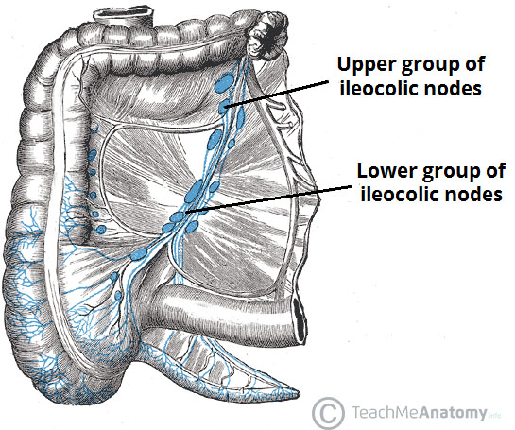
Lymphatic Drainage

Slide 22
Nerve Supply
  The appendix is supplied by the sympathetic and parasympathetic (vagus) nerves from the superior mesenteric plexus.
  Afferent nerve fibers concerned with the conduction of visceral pain from the appendix accompany the sympathetic nerves and enter the spinal cord at the level of the 10th thoracic segment.

Slide 23
Predisposition of the Appendix to Infection
The following factors contribute to the appendix's predilection to infection:
  It is a long, narrow, blind-ended tube, which encourages stasis of large-bowel contents.
  It has a large amount of lymphoid tissue in its wall.
  The lumen has a tendency to become obstructed by hardened intestinal contents (enteroliths), which leads to further stagnation of its contents.

Slide 24
Predisposition of the Appendix
to Perforation
The appendix is supplied by a long small artery that does not anastomose with other arteries.
The blind end of the appendix is supplied by the terminal branches of the appendicular artery. Inflammatory edema of the appendicular wall compresses the blood supply to the appendix and often leads to thrombosis of the appendicular artery.
These conditions commonly result in necrosis or gangrene of the appendicular wall, with perforation.
Perforation of the appendix or transmigration of bacteria through the inflamed appendicular wall results in infection of the peritoneum of the greater sac.
The greater omentum may play in arresting the spread of the peritoneal infection.

Slide 25
Appendicectomy
Appendicectomy is performed most commonly through a grid-iron muscle-splitting incision.
The appendix is first located by tracing the taeniae coli along the caecum—they fuse at the base of the appendix and then delivered into the wound.
The mesentery of the appendix is then divided and ligated.
The appendix is then tied at its base, excised and removed.
Most surgeons still opt to invaginate the appendix stump as a precautionary measure against slippage of the stump ligature.

Slide 26
Congenital Anomalies
Appendiceal variations are few, and are all rare
Absence of the Appendix.
Ectopic Appendix
Found an appendix in the thorax, in association with malrotation and diaphragmatic defect, in the lumbar area, can be located within the posterior cecal wall, and which did not have a serous coat.
Left-Sided Appendix
There are four conditions that can result in a left-sided appendix. In order of frequency, they are:
Situs Inversus Viscerum,
Nonrotation of The Intestines,
"Wandering" Cecum With a Long Mesentery, and
An Excessively Long Appendix Crossing the Midline.
Duplication of the Appendix

Slide 27
Thank You

